Slide 1

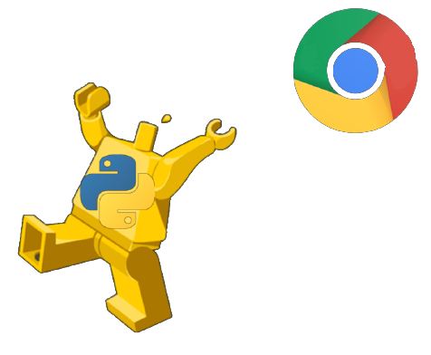

LithuaniaPy #3:
Headless browsing with Python

Slide 2
Headless Browsers
Web browsers without a GUI
Provide automated control via CLI or network
Used mainly for front-end testing and for scraping

Slide 3
Selenium
Unreliable
Resource heavy
Supports multiple languages
Splash
Runs as a service, controlled via network
Buggy and limited (e. g. Content Security Policy header)
Stability issues
Advanced features require Lua scripting knowledge

Slide 4
Pyppeteer
https://github.com/pyppeteer/pyppeteer
Python port of Puppeteer (https://github.com/puppeteer/puppeteer)
Supports headful and headless
Built on asyncio

Slide 5
Playwright for Python
https://github.com/microsoft/playwright-python
Python port of playwright (https://github.com/microsoft/playwright)
Very similar to Pyppeteer/Puppeteer, but for 3 drivers (Chromium, Firefox and WebKit)
Supports both sync and async

