Slide 1
STM-based concurrent heaps
Mateusz Machalica

Slide 2
Heap (a priority queue)
for simplicity: min-heap
operations on heap of size n
min() in O(1) time
push(e) in O(log(n)) time
pop() in O(log(n)) time, possibly amortized

Slide 3
Take 1: coarse-grained locking
take array-based heap implementation
replace array with TArray Int e
equivalently with MArray Int (TVar e)
replace size with TVar Int
put everything in a transaction

Slide 4
Take 1: correctness (trivial invariant)
“A heap has the heap property after each transaction.”
p
p <= min(l, r)
l
r

Slide 5
Take 1: problems
full contention on size required for push() and pop()
consecutive push() operations follow nearly the same path
despite inserted values
long operations shuffle many elements
STM creates data dependencies for elements on the path
two updates cannot “follow” each other

Slide 6
Take 1: concurrent push()
STM has no idea of our invariant
altered elements will force second trans- action to be rejected
full sequencing
O(log(k)) steps until full contention
for k processes

Slide 7
Problems to keep in mind
STM thinks that if element is touched then it necessarily breaks the transaction
very strong invariant
but not always true
and hard to weaken
arrays
cannot make things immutable
but a tree would be nicer for dynamic sized heaps
updating size cannot end up in a global transaction

Slide 8
Assumption
“Mutual exclusion between push() and pop() operations.”
In case we drop it:
what is the semantics?
how to avoid contention in the root?
hard to maintain any invariants
not necessary for most applications I can think about...

Slide 9
Take 2: fine-grained locking
implement heap as a tree
all operations go top-down
balancing achieved by maintaining size of a subtree rooted at each node
single transaction covers O(1) nodes
we need some fancy invariant
if the old one works, we can sort in O(n) time in comparison model #impossibru

Slide 10
Why it should work
updates can proceed one after another on the same path
we do not look back after the transaction
each update waits for preceding to leave the root
k updates take O(k) time if log(n)=O(k) and k=O(log(n))
or diverge as early as possible
each update descents in a different subtree
k updates take O(k) time if log(n)=O(k) and k=O(n)
in sequential case
k updates take O(k*log(n))

Slide 11
Why it should work

Slide 12
The push() operation
in transaction
choose a child node with smaller size field
update size
if the node is empty, insert our value and finish
swap element to be inserted e with the one in current node x if e < x
recurse into the chosen node
after committing the transaction

Slide 13
Correctness of push()
invariant of a transaction
the simple invariant works for the tree, but need to cover the extra element e
“The heap property holds for each tree node and the element to be inserted e is greater than all elements on the path from the current node to the root”
in absence of pop() operations
elements in each node are non-increasing
traversing a node = it will be at most as big as we have seen until the next deletion

Slide 14
The pop() operation
in transaction
replace root’s element with “a gap”
decrease size
in transaction
choose a child node with smaller element
decrease size
move element in the node to the parent, place gap here
recurse into the chosen node
after committing the transaction
only if it’s subtree is non-empty

Slide 15
The pop() operation - caveat
if a root has a gap retry
if any of the child nodes have gaps and size > 0, then retry
there is at least one node having gap-free children
no deadlock
are these necessary?
we don’t know which element will end up here
possibly the smallest among children of the node
0
1
5
2

Slide 16
Correctness of pop()
invariant of a transaction
the simple invariant no longer works!
“The heap property holds for each tree node, when one assigns each gap-node an element from it’s parent (recursively)”
for each gap we have a processor trying to push it down the tree
the conditions from previous slide ensure
that we know upper bound on each subtree before replacing root’s gap
we never steal the gap from someone else

Slide 17
Performance comparison
initially 50k elements in the heap
each (of W) writer inserts 50k / W
each (of R) reader removes 50k / R
different scenarios (parametrized by N)
W = max(1, N - 1), R = 1
W = N, R = 0
W = 0, R = N
W = 1, R = 1, sequentially, i.e. first all writes, then all removals
averaged over 5 random seeds

Slide 18
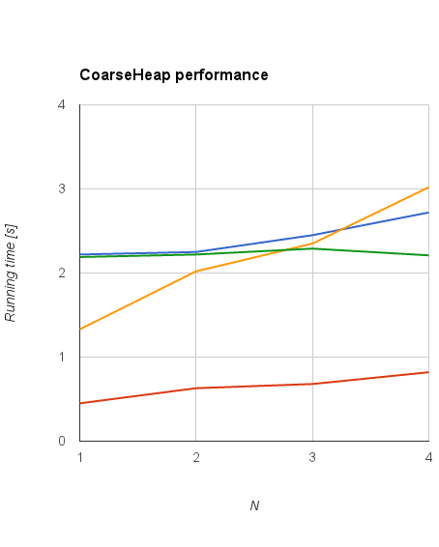
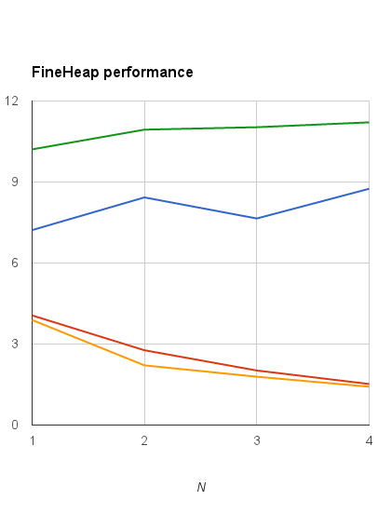
Performance comparison

Slide 19
Application: concurrent sorting
insert all elements into a heap
using N processors
each inserts around n/N elements
initialize n element TArray Int (Maybe e) with Nothing
assign threads to array cells in round-robin fashion
waits for previous cell to be filled
replaces heap’s root with a gap, places the element in the array
pushes the gap down the tree
proceeds to it’s next index

Slide 20
Performance: concurrent sorting
100k random elements
phase 1 (insertion)
each (of N) writer inserts 100k / N elements
phase 2 (removal)
each (of N) reader
waits for previous cell of output array to be written
takes element from the heap
writes to the output array into its cell
cells assigned to workers in round-robin fashion

Slide 21
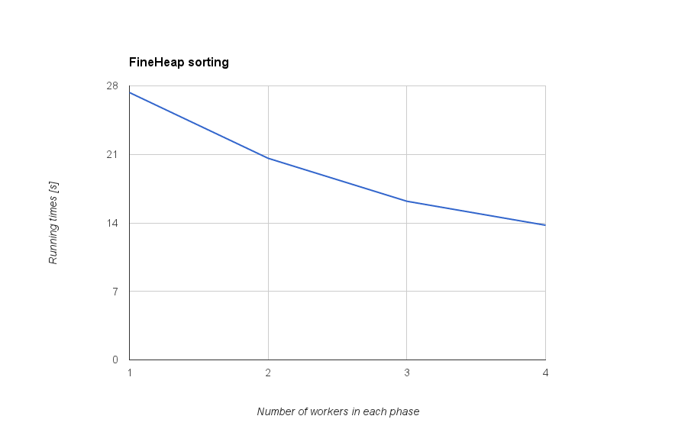
Performance: concurrent sorting

