Slide 1
RNN
Jovan Heng Ghim Hong
P2401418
DAAA/2B/22

Slide 2

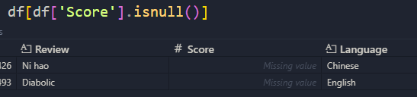
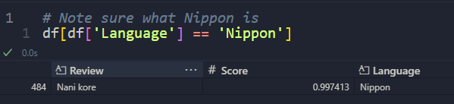
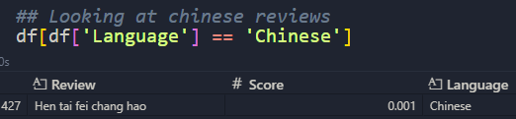
Basic Data Exploration
There are 4 different languages
Too little Chinese and Japanese reviews to work with
There are some null data

Slide 3
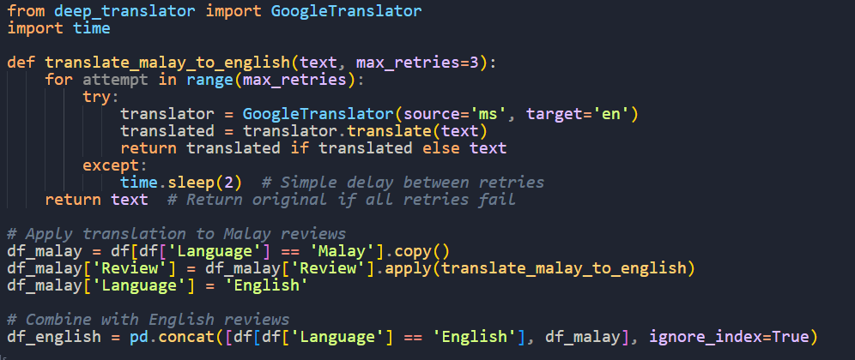
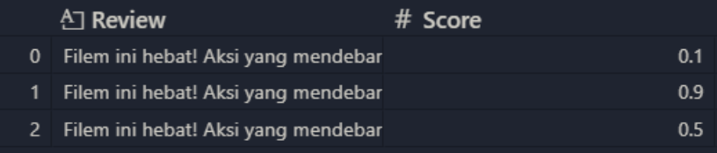
Data Manipulation
Decision:
Drop Chinese and Japanese
Drop Na values
Translate All Malays To English
Drop Duplicates
Why Not take mean of duplicated reviews?
Since there are multiple reviews with vastly different scores
This can create a ‘bad score’ overall even with good words
‘This movie is great! Thrilling action and a surprising plot’

Slide 4
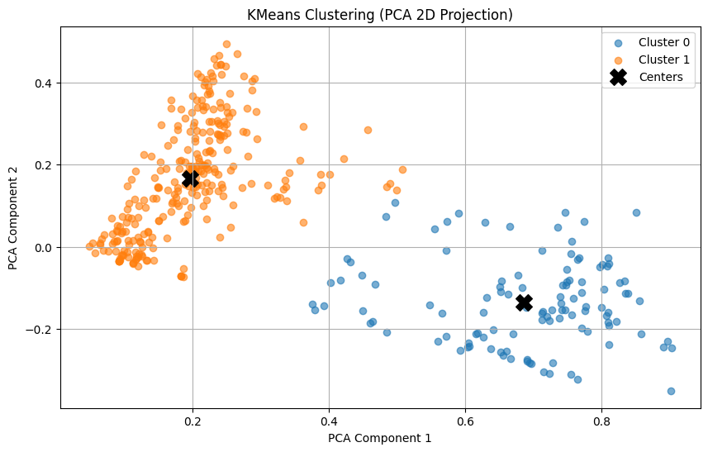
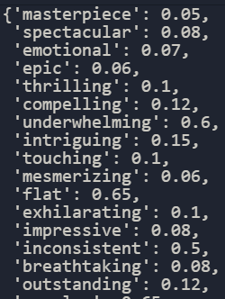

Further Data Exploration
Clustering of TF-IDF against scores
Shows that there are some anomalous points (circled)
Analyzing them: they are a dictionary of adjectives.
We can extract them and keep them for train data (below)
Part of adjective list

Slide 5
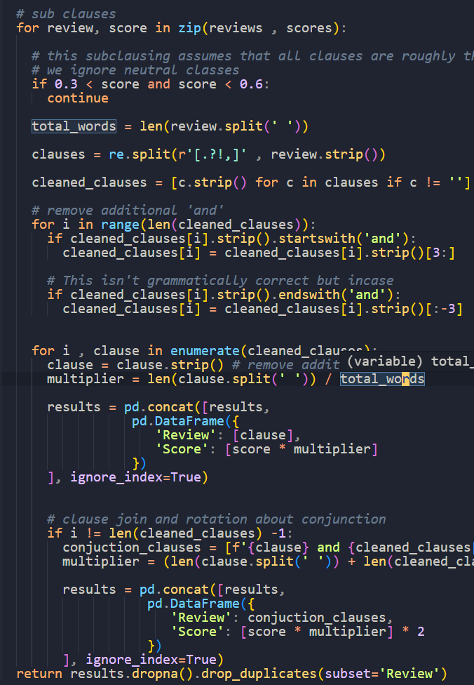
Data Engineering
part of function for steps 1 , 2
1.
Split Sentences in clauses
2.
Join Clauses with Conjunctions
3.
Shuffle Clauses around Conjuctions
4.
Create Artificial Reviews

Slide 6
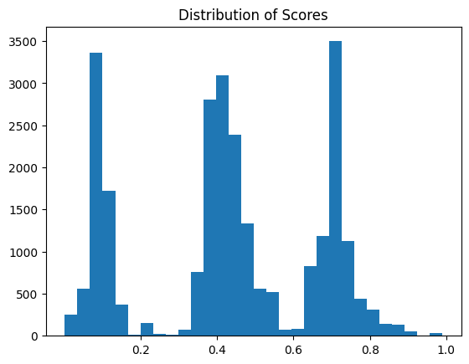
How much data to create?
My goal is to create as much as while balancing the weights
After few rounds of data augmentation

Slide 7
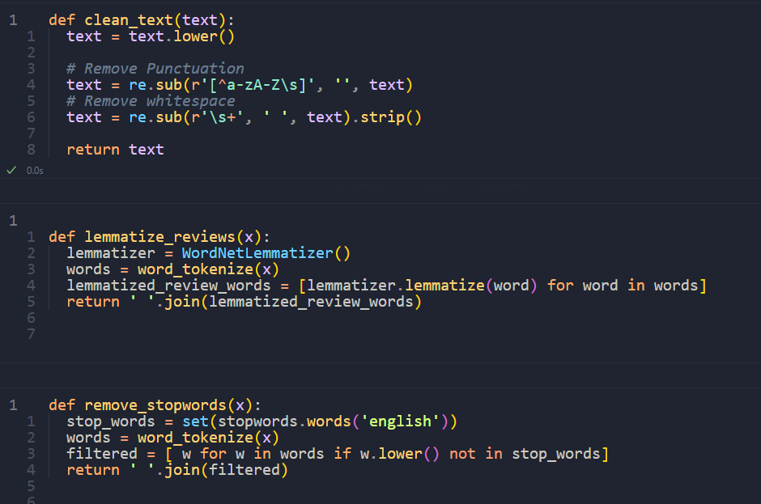
Data Preperation
clean (remove punctuation etc)
remove stopwords
lemmatize
tokenize
pad

Slide 8
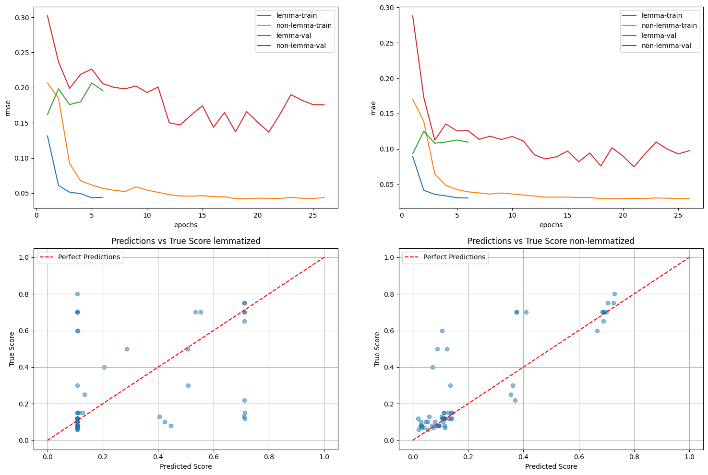
Base Model Evaluation
Lemmatization can negatively affect models sometimes, so I decided to evaluate it on a base model
Shows that overall non-lemmatized can generalize better for both positive and negative

Slide 9
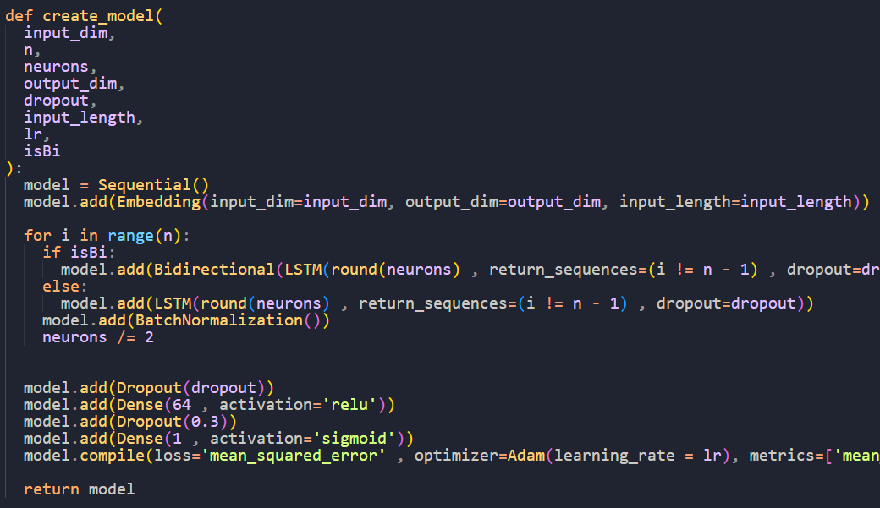
Model Architecture
Embedding
(Bi)-LSTM
Batch Norm
Dropout
Dense (connected layer)
Dense (output layer)
2 – 3 are repeated ‘n’ number of times

Slide 10
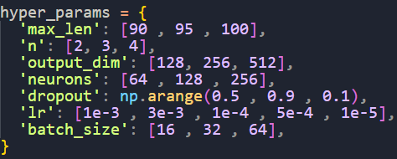
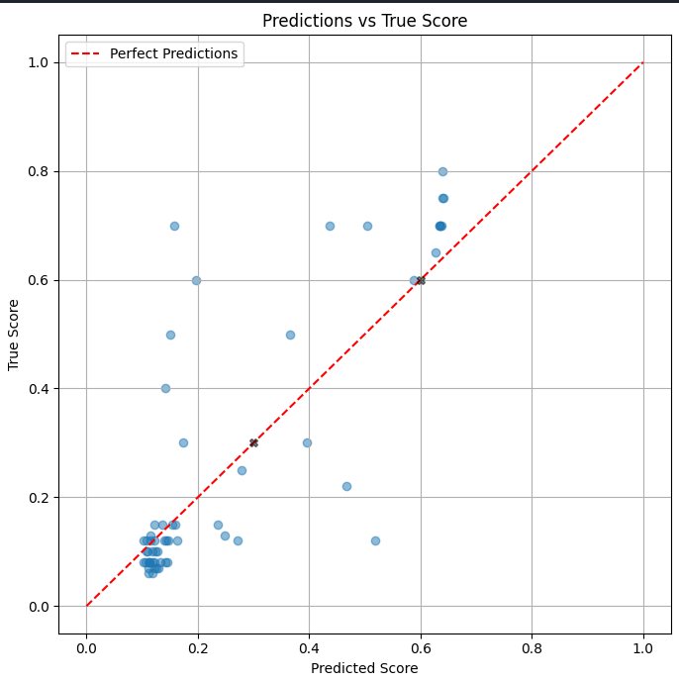
Hyper param tune
Graph shows that it seems to be predicting more positives even though they are negative
Did random search (params right)
Params | Value
isBi | False
Batch_size | 64
Dropout | 0.5
Lr | 0.0005
Max len | 100
N | 2
Neurons | 64
Output_dim | 256
Best params from tuning
< --

Slide 11
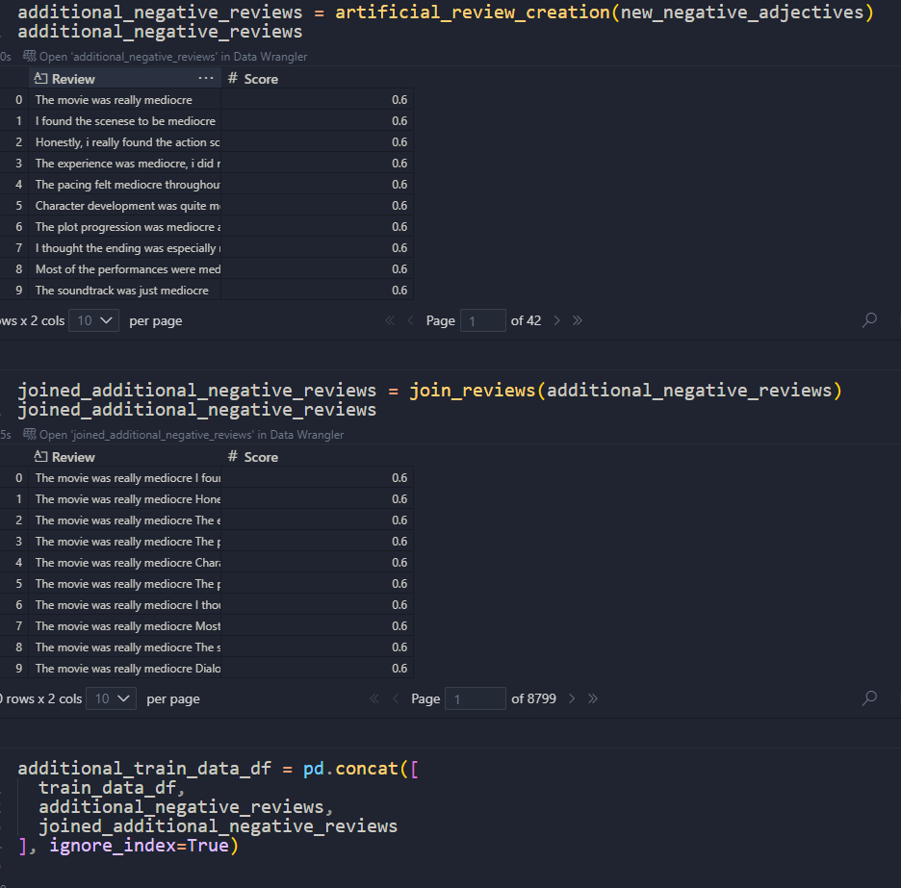
Model Improvement
Since it is bad at predicting negative, we can increase the amount of negative data

Slide 12
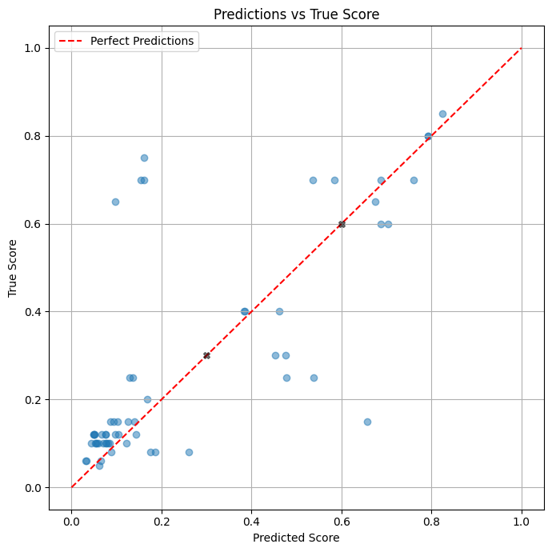
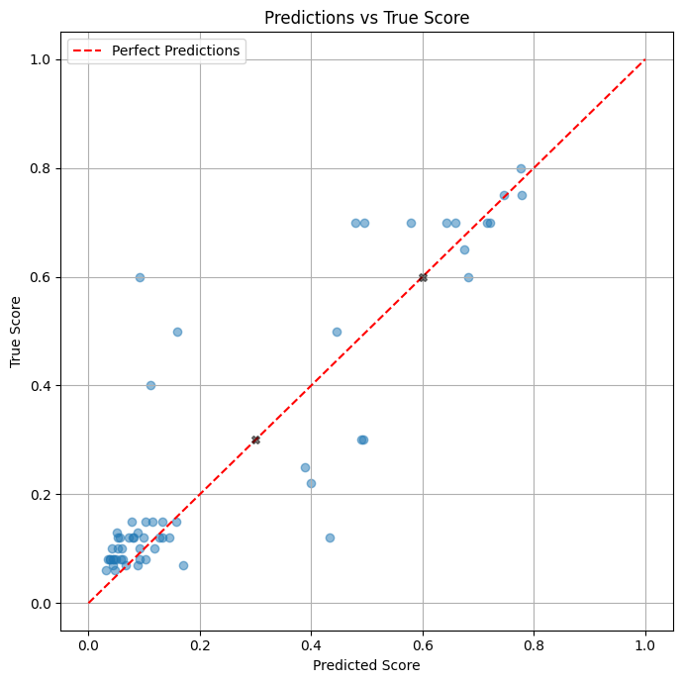
Final Results
The new data improved the val data performance (left)
The test data performance is on the right
Overall, both are able to predict negative significantly better

Slide 13
CNN

Slide 14
Manual Inspection & Cleaning
What I Found:
There are some duplicated images
Test Folders are mis-named (e.g. Pumpkin is named Tomatoes, etc)
Beans in Train data contains some carrots
What I did:
I dropped them with .drop_duplicates()
Rename folders to match Train and Val
Moved carrots to carrots folder

Slide 15
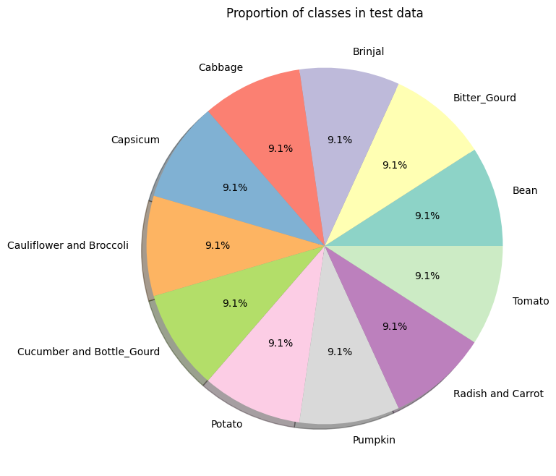
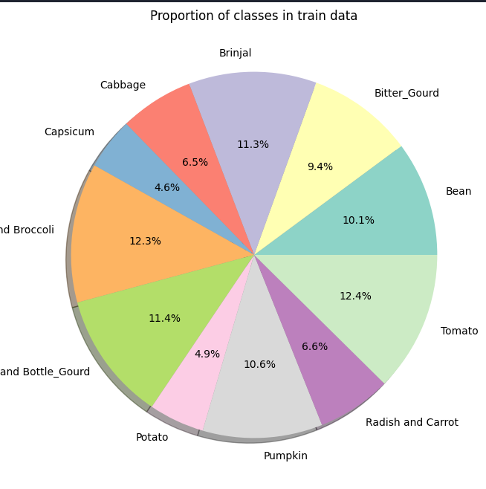
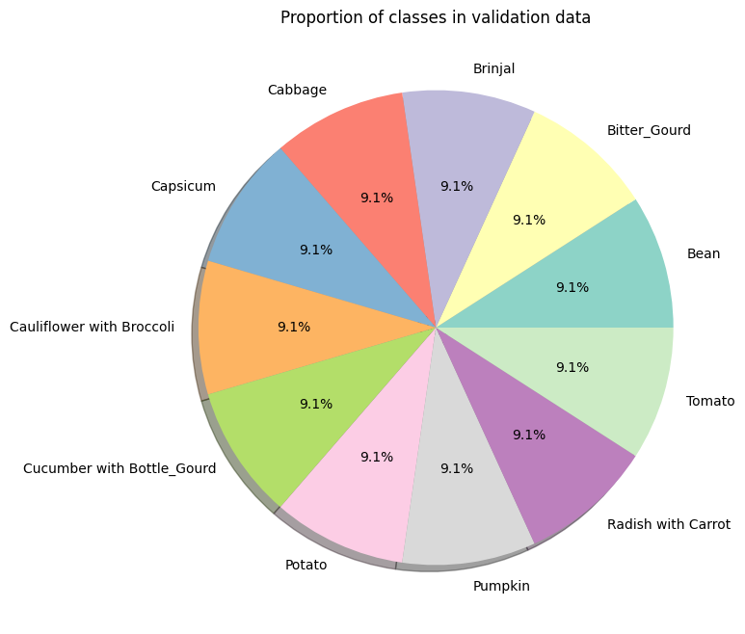
Data Exploration
Train data is imbalanced, test and validation are (furthest right)
I attempt to perform class weightages to ‘balance’ the imbalanced classes
Therefore, I choose f1-score as my metric as it is a good balance between precision and recall

Slide 16
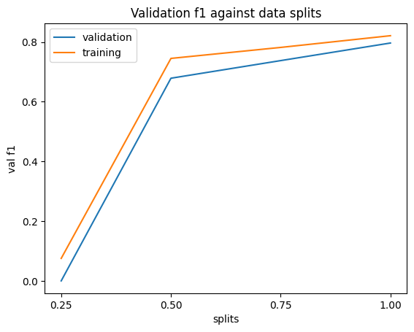
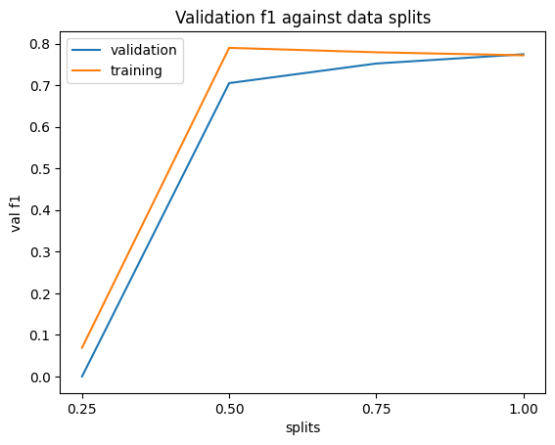
Is my data enough? (23)
Bottom left is before aug, f1 hasn’t plateaued.
Bottom right is after aug, f1 has flat-lined and performance has roughly plateaued
I plotted splits of data against f1 and gradually increased data

Slide 17
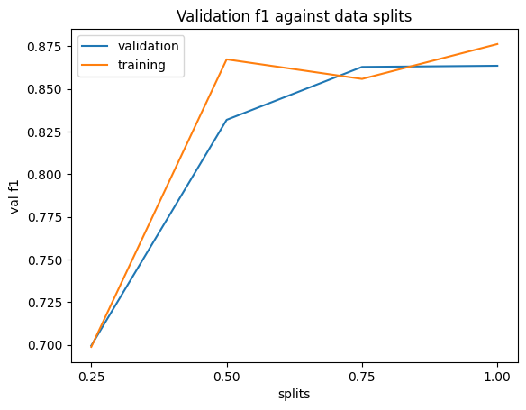
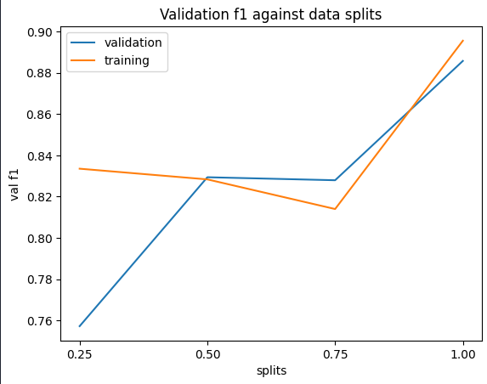
101
The model plateaus at around 75% of augmented data
Clearly shows that my model is still very data hungry

Slide 18
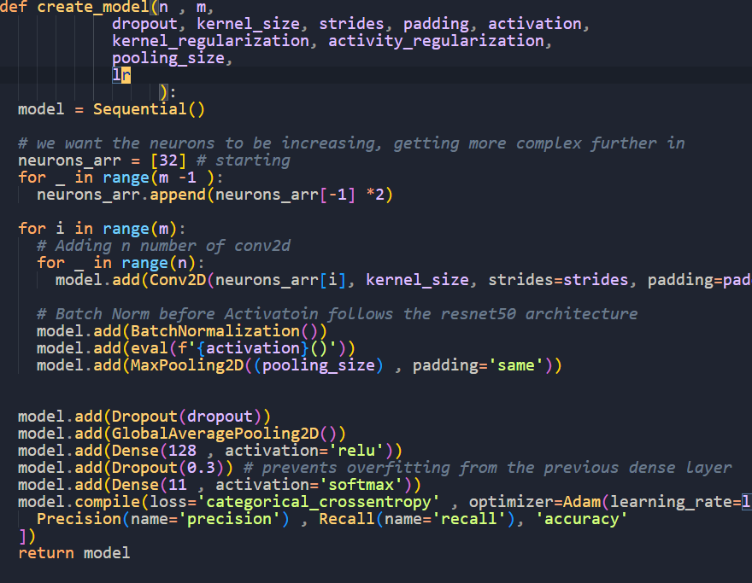
Model Architecture
1. Input Layer
2. Conv2d * n amounts
3. BatchNormalize
4. Activation Relu
5. Maxpooling/bottleneck layer
6. Flatten
7. Dense - softmax (we are doing multiclass-classification)
where layers 2-5 can be repeated m times.
Batchnorm before ReLU follows the ResNet50 Architecture

Slide 19
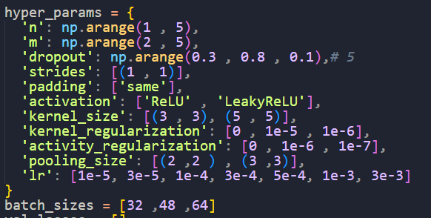
Hyper param tuning
I random Searched params (right)
Param (23) | Value
Lr | 0.003
M | 3
N | 2
Pooling_size | (2,2)
Batch_size | 32
Activation | Relu
Activity_regularization | 1e-06
Dropout | 0.3
Kernel_regularization | 1e-05
Kernel_size | (5,5)
Param (101 | Value
Lr | 3e-05
M | 4
N | 3
Pooling_size | (2,2)
Batch_size | 64
Activation | Relu
Activity_regularization | 1e-06
Dropout | 0.3
Kernel_regularization | 1e-06
Kernel_size | (3,3)

Slide 20
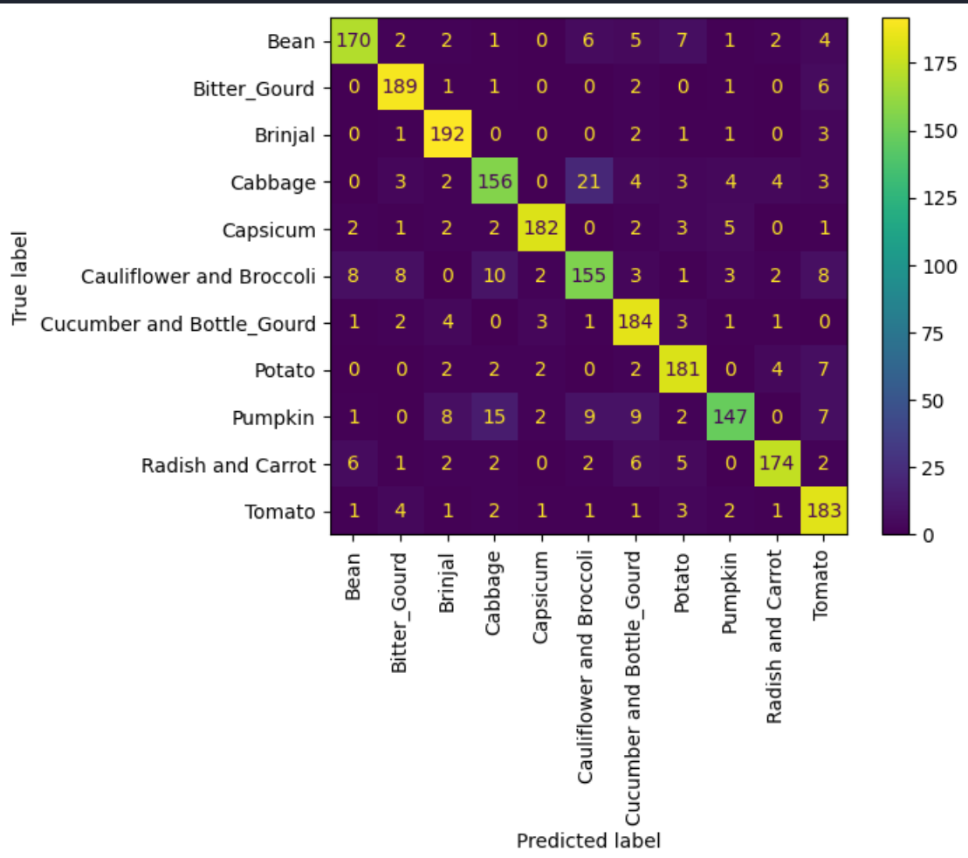
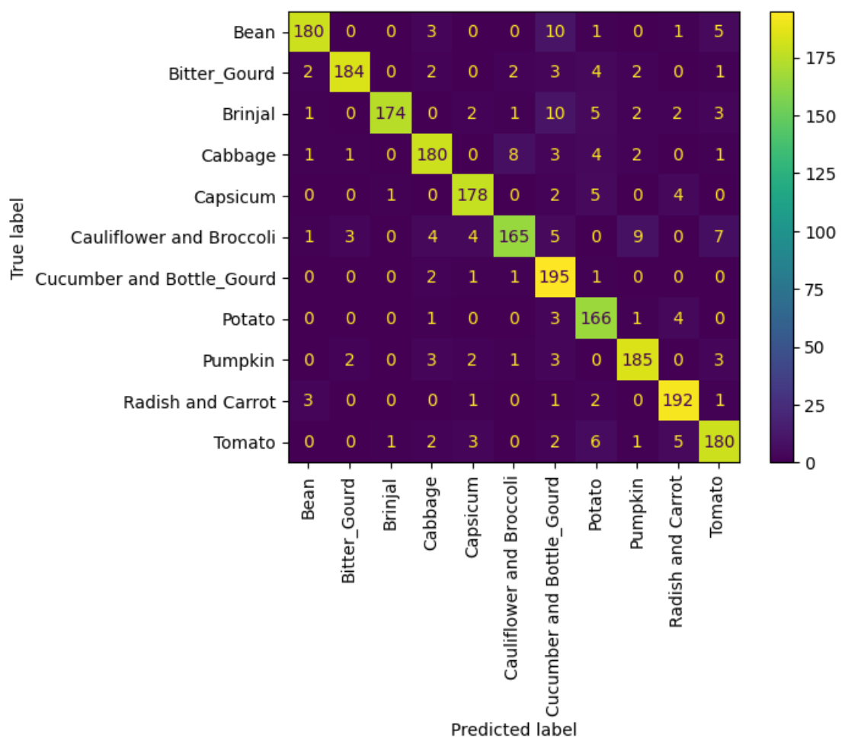
Hyper param tuning results
Left 23 right 101

Slide 21


Evaluate on Test
Left 23 right 101

Slide 22
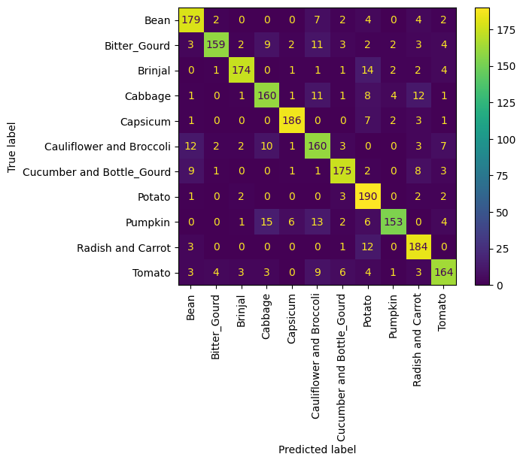
Model Improvement
There are some errors on 23x23 with Cauliflower, Bean and Bitter_Gourd, so tuned their weights
It is able to geralize quite well overall

Slide 23

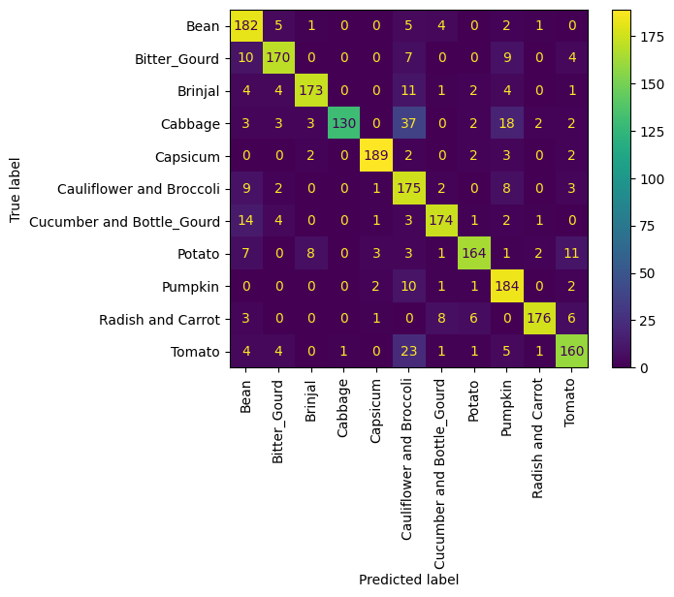
Final Predictions
Left 23 right 101

