Slide 1
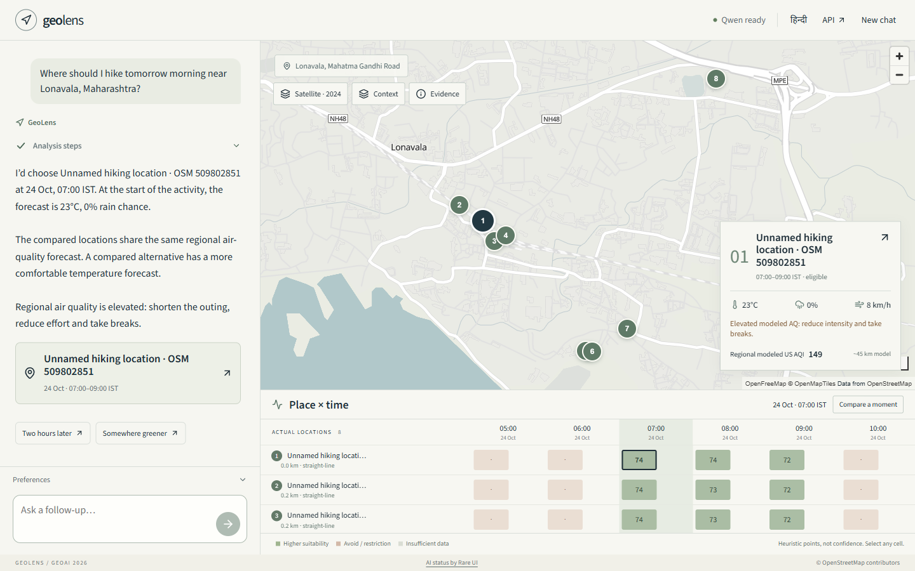
geolens
1 / 6
A place and an hour, backed by evidence
Compare actual outdoor locations across complete activity windows.
A synchronized map, venue × hour surface and inspectable scoring make the trade-offs visible.
Ten activities. English and Hindi. One local open-weights SLM.
Actual Lonavala query through the conversational interface.
LOCAL PROTOTYPE | 23 OCT 2026

Slide 2
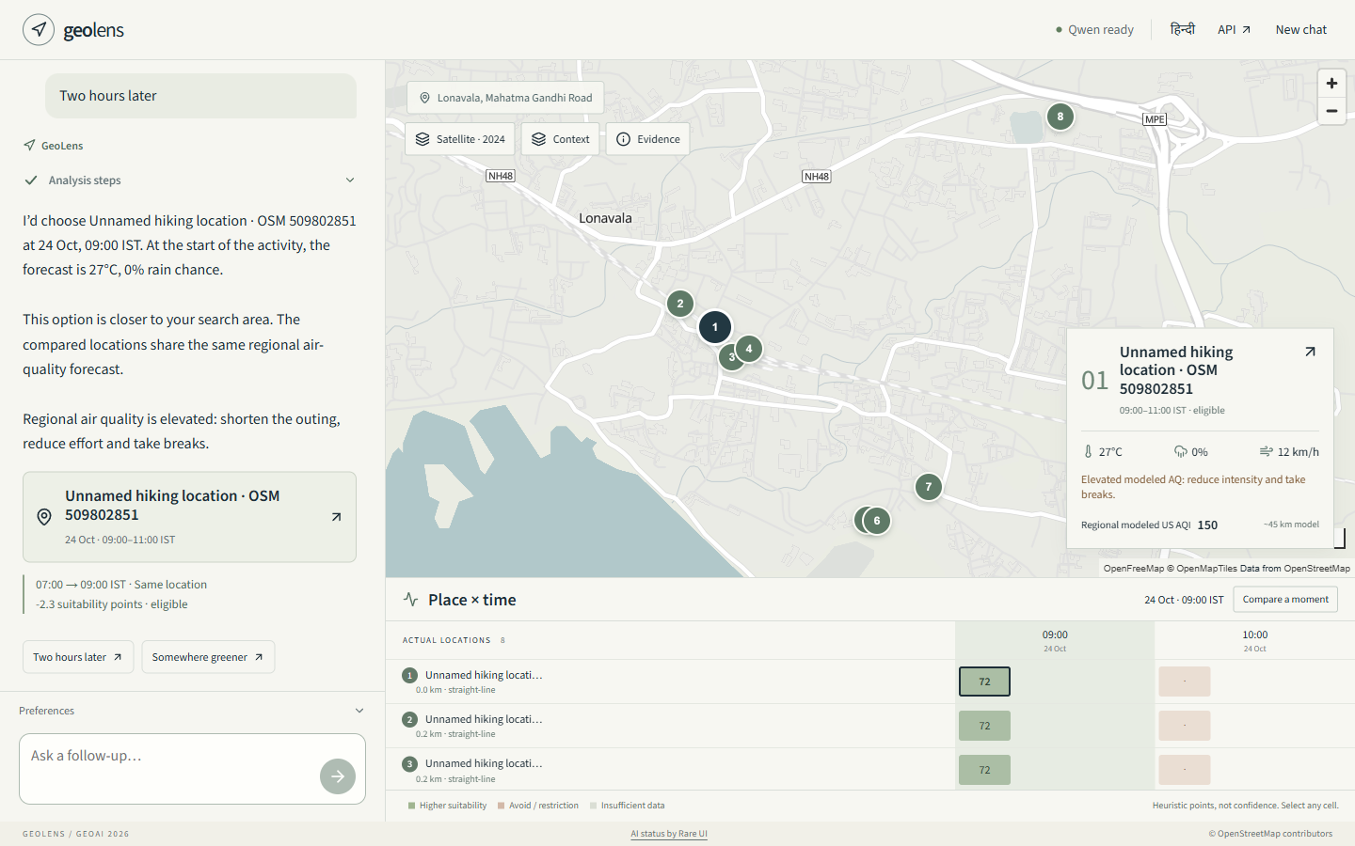
geolens
2 / 6
What changes when you leave later?
Lonavala follow-up
07:00 → 09:00
The typed conversation retains location and hiking activity while recomputing the requested time.
The inspector exposes actual conditions and contribution changes.
Forecasts and heuristic points, not measured exposure or confidence.
LOCAL PROTOTYPE | 23 OCT 2026
Notes:
Actual captured 23 October analysis for 24 October. OSM/OpenFreeMap attribution remains visible.

Slide 3
geolens
3 / 6
Live retrieval, grounded computation
Question → local SLM interpretation
Geocoding → OSM venues or attributed Geofabrik fallback
Hourly forecast + CAMS regional air quality
Geometry, full-window restrictions and suitability scoring
SLM option and evidence selection → predicate validation
Independent JSON API → synchronized website
LOCAL PROTOTYPE | 23 OCT 2026
Notes:
No stored recommendations. Extracts contain geography. Weather refreshes under source cache TTLs. Road and industry proximity are proxies; AQ is regional modeled US AQI.

Slide 4
geolens
4 / 6
One small model, two substantive tasks
Qwen3.5-2B | Apache-2.0
2,274,069,824 parameters in the full original release.
1. Interpret activity, place, time, constraints and follow-up patches.
2. Select eligible options and verifiable comparative evidence.
Pinned Q4_K_M runtime, 2 CPU threads, 2K context, thinking off.
Original-format weights, tokenizer, config and licence staged locally.
Public Hugging Face publication and clean public load remain release gates.
LOCAL PROTOTYPE | 23 OCT 2026

Slide 5
geolens
5 / 6
Measured on the local machine
71 correctness tests pass across all ten activity profiles.
Two concurrent requests: 8.2–9.2 seconds, both HTTP 200.
Five concurrent requests: 17.3–21.0 seconds, all HTTP 200.
Observed model working set: about 1.5–2.0 GiB in these runs.
Ryzen AI 9 HX 370, Windows, 2 inference threads. These small samples do not establish p95 or production capacity. Linux container limits require deployment verification.
LOCAL PROTOTYPE | 23 OCT 2026

Slide 6
geolens
6 / 6
Release gates and scientific limits
Ready locally: API, website, model inference, genuine data fallback, tests and reproducibility files.
Still required: chosen public GitHub/HF identities, successful public model load, authorized isolated deployment, externally verified API and judging-window uptime.
No live traffic, verified complete routes, guaranteed opening hours or medical clearance. Historical satellite imagery is context only.
AI coding disclosure: OpenAI Codex. No sub-agents. No paid/private runtime inference or data API.
LOCAL PROTOTYPE | 23 OCT 2026

