Slide 1


BRIDGE
ASL to text and speech, wherever you go.
Everyday moments like ordering coffee or asking for directions shouldn’t require an interpreter.
PRESENTED BY:
CEG 4913 | Group 4
Krisha, Gauthier, Stuti, William, Somona, Aidan
Notes:
Introduction
Aidan:
We are bridge, and we are making a wearable live ASL translating system using gloves the user wears.

Slide 2
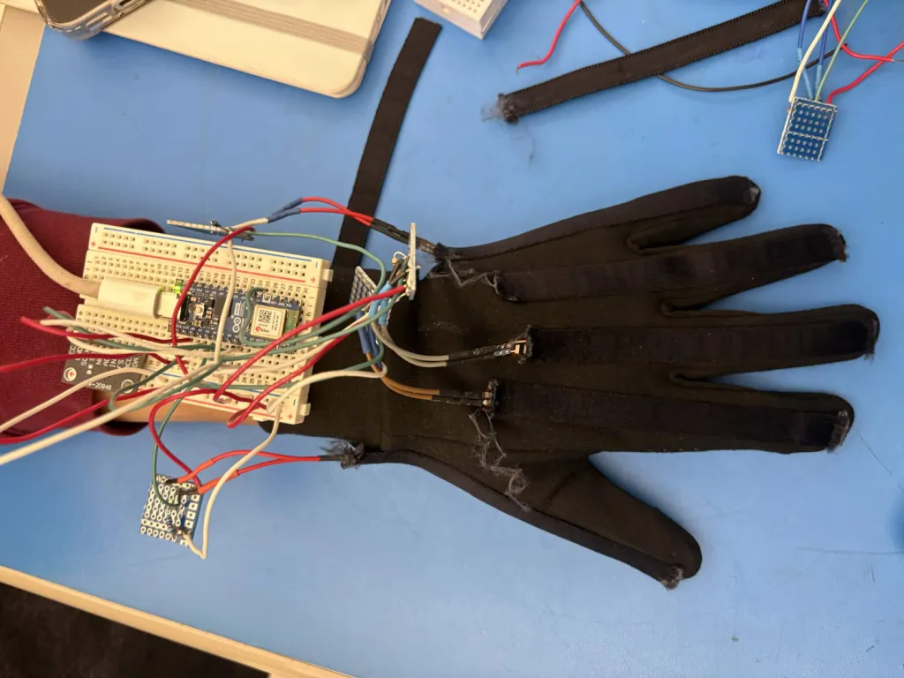
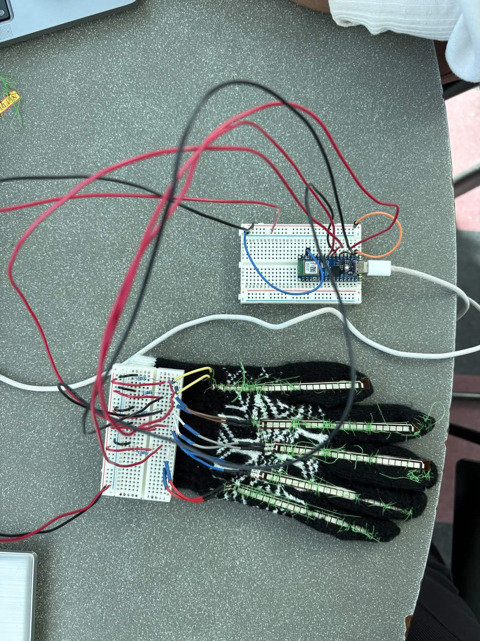
UPDATE: GLOVE FIRMWARE
9-axis motion sensor + 5 flex sensors at 50 Hz over Bluetooth
Notes:
Somana & Aidan
(0:00 to 0:50)
Since September, the glove firmware (and the glove itself) got a major upgrade. Most notably, we brought the 9-axis motion sensor back behind the wrist into the main firmware, as to not impede on any of the user’s hand motions.
The glove now streams five flex sensors plus accelerometer, gyroscope, and magnetometer in one 56-byte packet at 50 Hz, up from about 10 Hz before. We added fault tolerance: if the motion sensor disconnects, the flex sensors keep working and the firmware retries every five seconds. We also fixed noisy pinky readings by moving it off the second ADC, which reads noisy while Bluetooth is active. And we built debugging tools including a live visualizer in the browser.

Slide 3
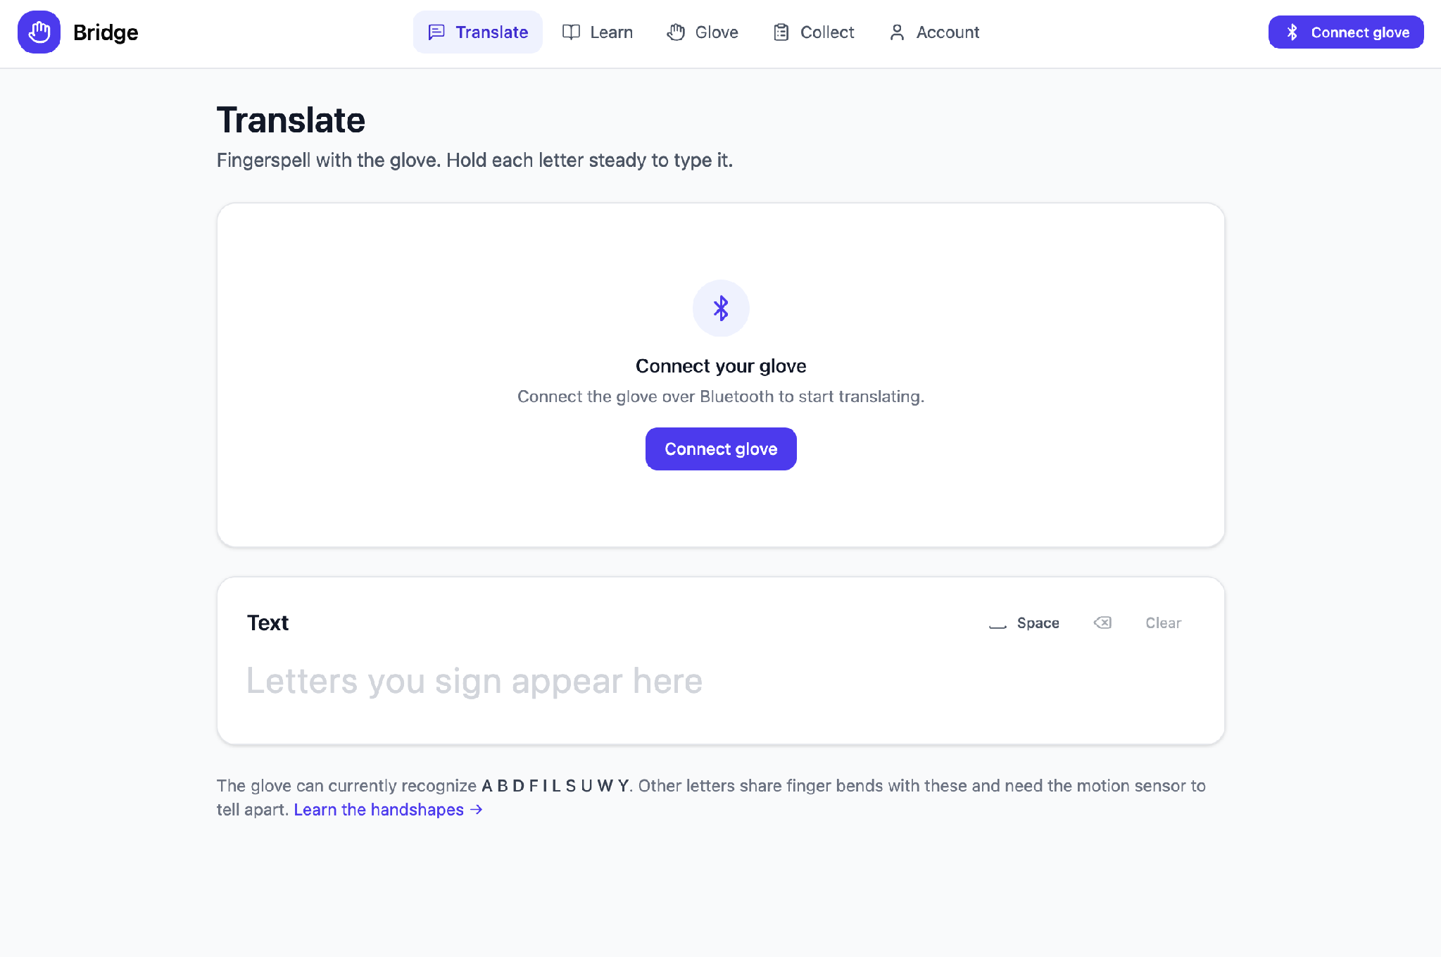
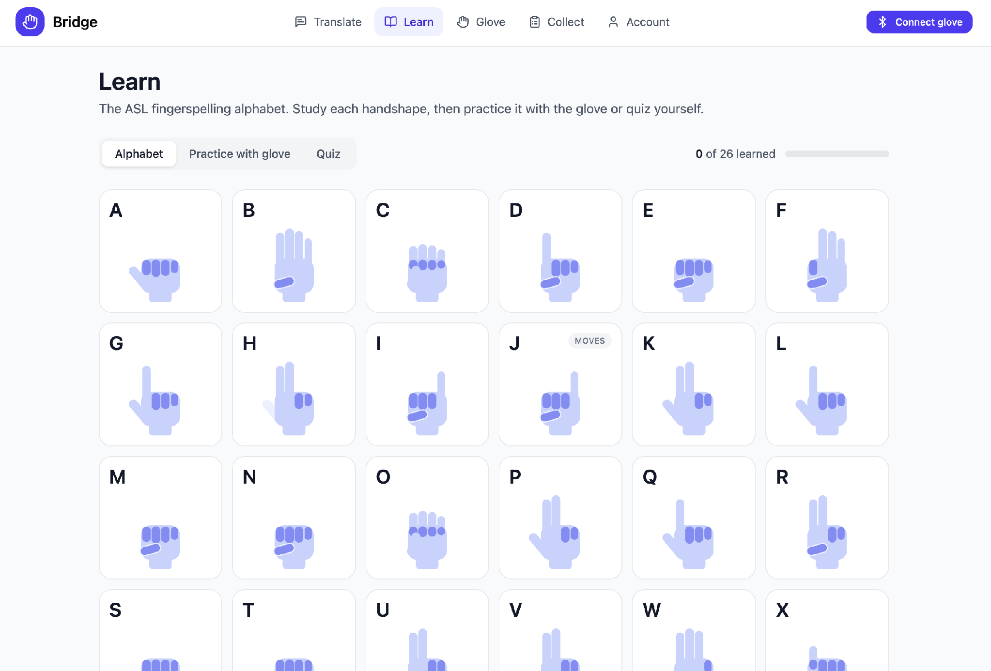
UPDATE: WEB APP REDESIGN
Translate
Learn
Translate, Learn, Glove, Collect, Account — 5 new pages
Notes:
Stuti and Krisha
(0:50 to 1:50)
We completely redesigned the web app. The old dashboard was replaced with five purpose-built pages. Translate is now the home page: hold a letter for 0.7 seconds and it types it out, with space, delete, and pause controls. Learn has all 26 ASL letters with handshape descriptions and three modes: alphabet reference, guided practice with the glove that tells you which finger to fix, and a quiz that works without the glove. The Glove page handles connection, calibration, and shows live sensor readings. Collect is for recording training data, which feeds into our machine learning pipeline. A key finding: flex sensors alone can only reliably recognize 11 of 26 letters. The rest share finger bends with other letters or involve movement, which is why we brought the motion sensor back.

Slide 4
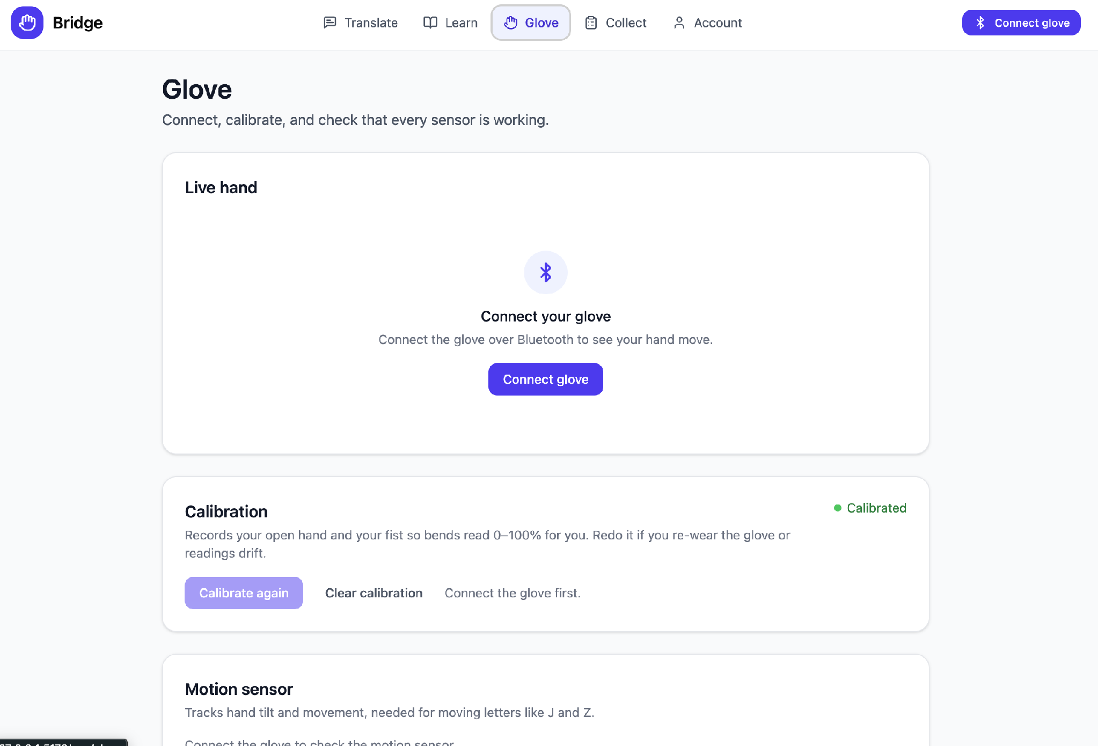
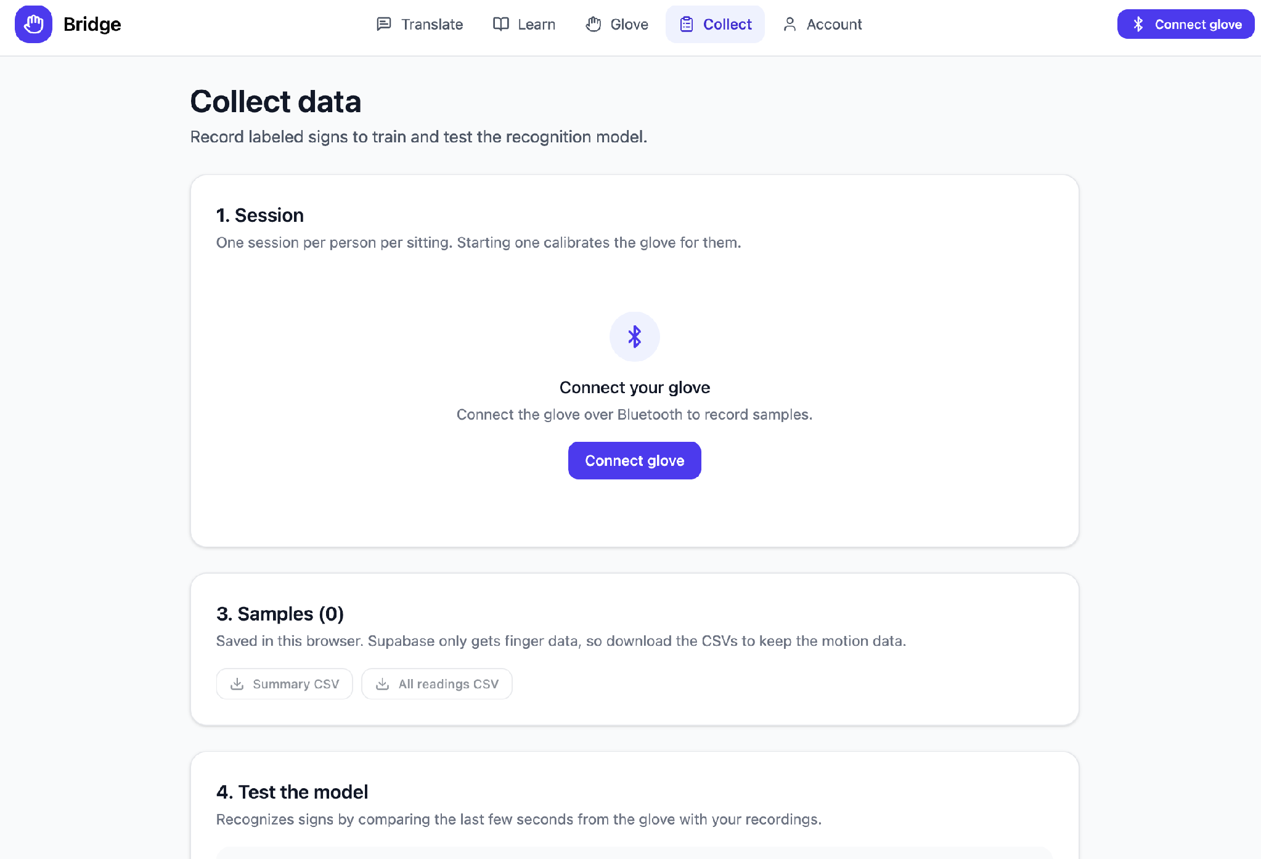
UPDATE: DATA COLLECTION & ML
Glove
Collect
Notes:
Krisha
(1:50 to 2:50)
To handle the letters that flex sensors can't distinguish, we built a data collection and machine learning pipeline. The Collect page lets you run sessions per participant, record samples by letter in static or movement modes, sync to our Supabase database, and export CSVs. On the ML side, we extract motion features: tilt, rotation speed, total rotation, and direction changes. We have hand-written rules that recognize still versus turn versus shake, plus J and Z movements. And a k-nearest-neighbors classifier trains on recorded data right in the browser. There is a Movement Lab that lets you compare flex-only accuracy against flex-plus-motion-sensor accuracy.

Slide 5
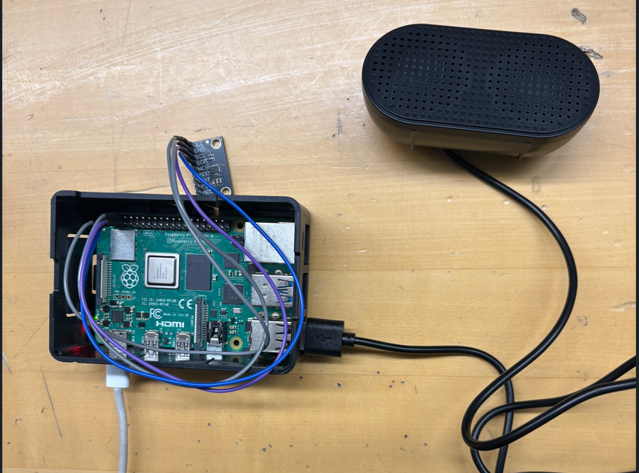
UPDATE: Raspberry Pi
Notes:
William and Gauthier
(1:50 to 2:50)
To handle the letters that flex sensors can't distinguish, we built a data collection and machine learning pipeline. The Collect page lets you run sessions per participant, record samples by letter in static or movement modes, sync to our Supabase database, and export CSVs. On the ML side, we extract motion features: tilt, rotation speed, total rotation, and direction changes. We have hand-written rules that recognize still versus turn versus shake, plus J and Z movements. And a k-nearest-neighbors classifier trains on recorded data right in the browser. There is a Movement Lab that lets you compare flex-only accuracy against flex-plus-motion-sensor accuracy.

Slide 6
WHAT’S LEFT
1
2
3
2 Gloves Synced Together
Training ML Model
Cover letters flex sensors miss (J, Z, E/M/N)
Full System Integration
Offline translation, runs locally and speaks out loud
DECEMBER GOAL: Sign a sentence. Hear it spoken.
Notes:
Aidan (2:50 to 3:30)
Looking ahead, we have a two-hand prototype already working with a motion sensor and ESP32 each. Eventually, the ML model will be expanded to interpret motion data to cover the letters that flex sensors alone can't distinguish (J, Z, and the E/M/N/S/T group). The Pi body unit will connect to the gloves and run everything offline, translating signs, and speaking them out loud. Our December goal stays the same, to sign a sentence and hear it spoken back.

Slide 7
Thank you!

