Slide 1
An Introduction to Leaflet
By Michael Moore
Flat Rock Geographics
flatrockgeo.com

Slide 2
Mini-Survey of Web Mapping
Google Maps
Bing Maps
MapQuest
Open Layers
Leaflet.js

Slide 3
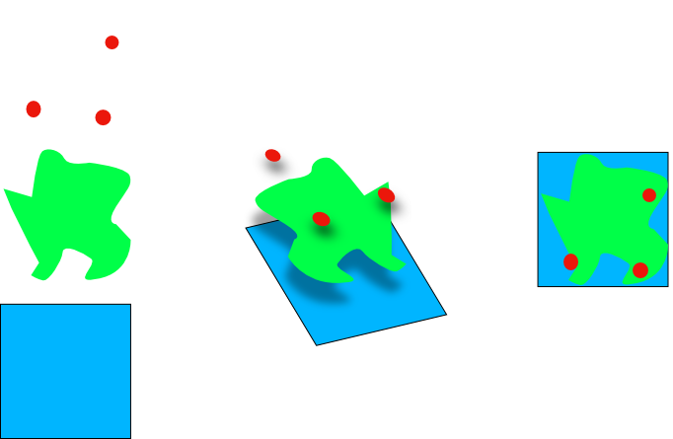
Basics of Web Mapping: Layers!

Slide 4
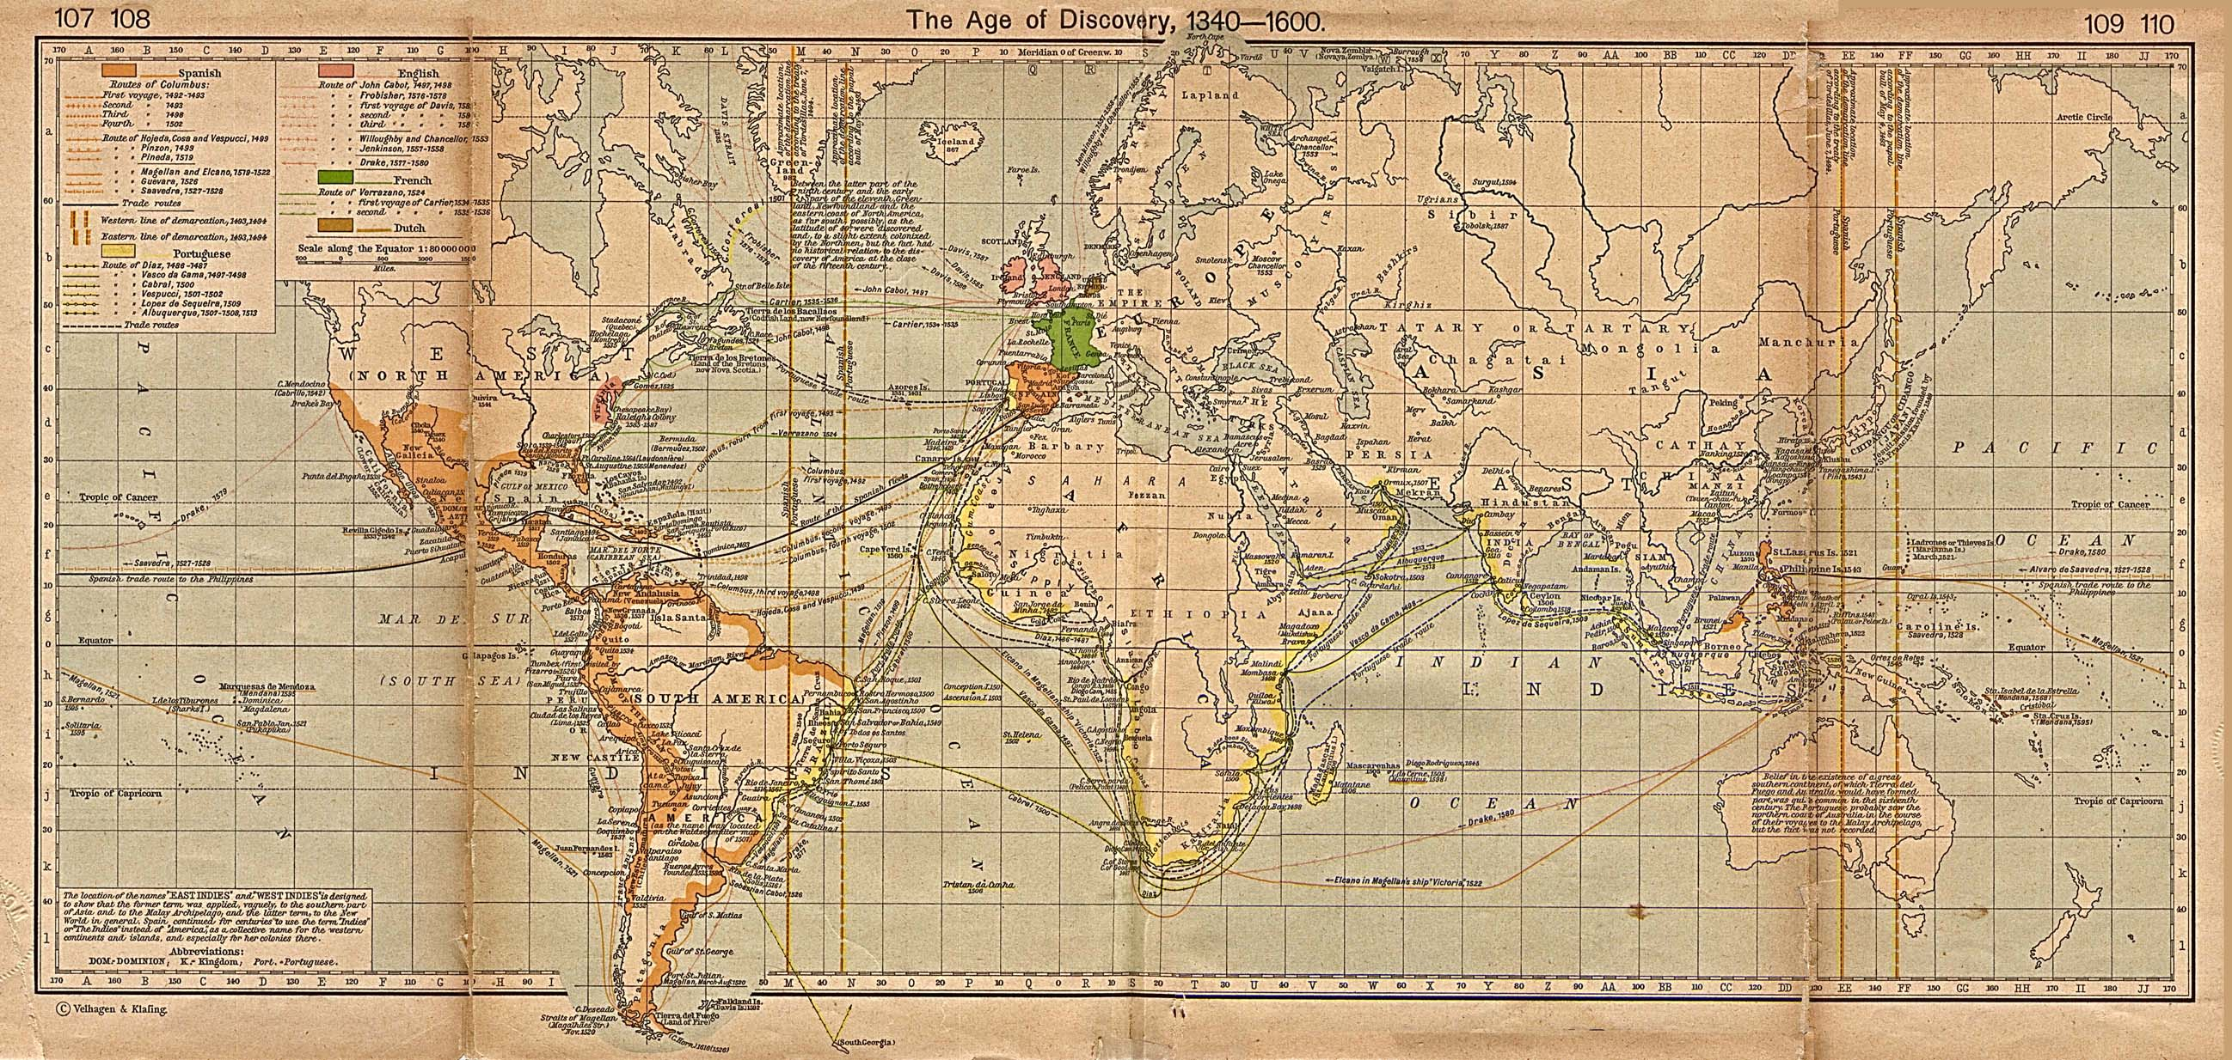
Basics of Web Mapping: Tiles!

Slide 5
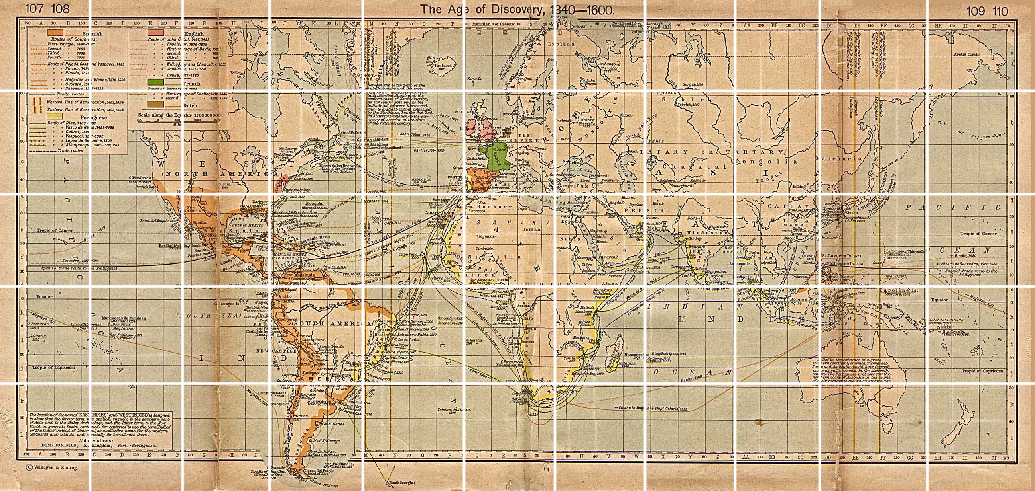
Basics of Web Mapping: Tiles!

Slide 6
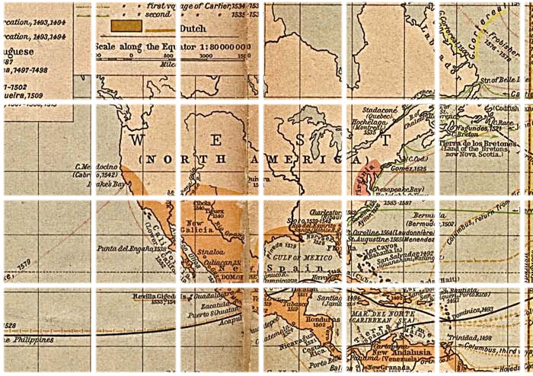
Basics of Web Mapping: Tiles!
Usually used for base layers
Zoom level 1: Whole world
Max zoom usually 17-21
Each level has 2x zoom
Tile Sources
Google Maps Tiles
Open Street Maps
MapQuest
Mapbox

Slide 7

Basics of Web Mapping: Vectors!
Shapes made from points and lines
Points, Lines and Polygons
AKA: Features, “Point Features”, etc.
Can be made Clickable, etc

Slide 8
Why Leaflet?
Lightweight
Free
Easy to use
Good documentation
Pretty good examples

Slide 9
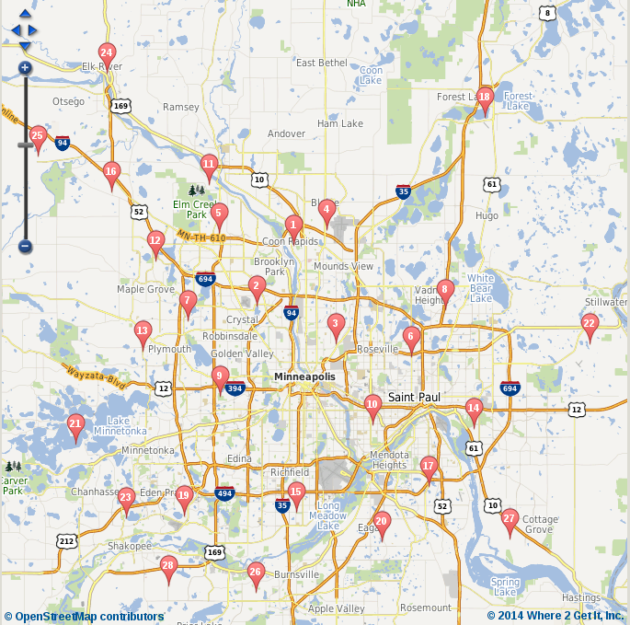
Demo Use Case
Business Locations Map
We'll need
  Basic Web page
  Leaflet Map
  Basemap
  Store locations

