Slide 1
Condition Monitoring of Structures, Machines and Processes
Tutorial

Slide 2
2
Matlab:
Data Processing

Slide 3
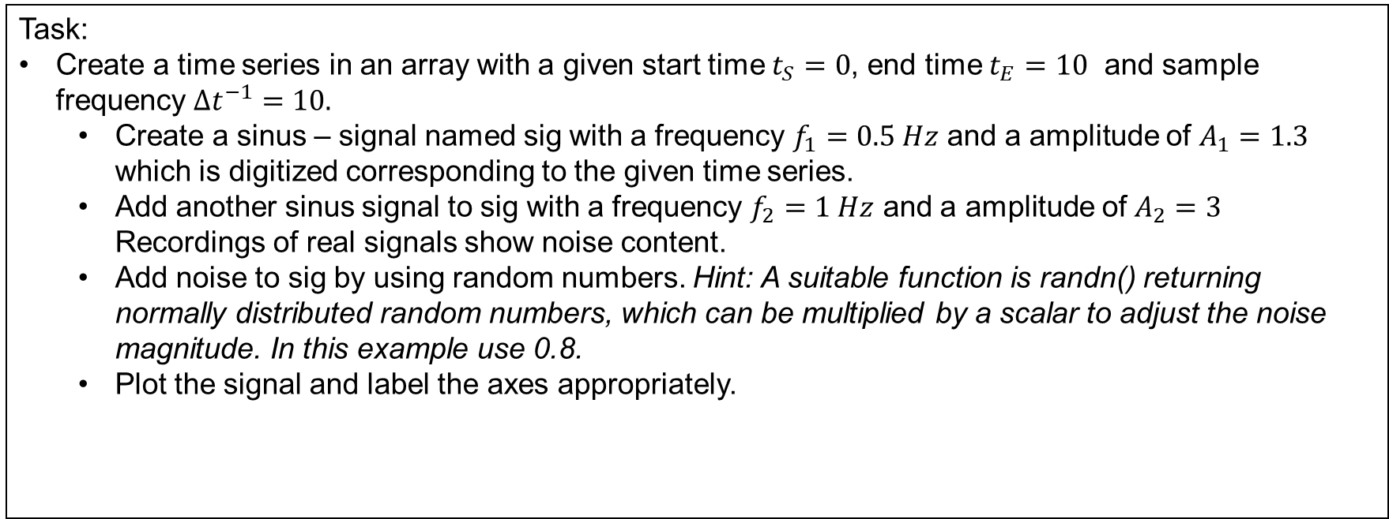
Exercice 12.1
Generating Test Signals
Task:
Create a time series in an array with a given start time $t_{S}=0$, end time $t_{E}=10$ and sample frequency$Δt^{−1}=10.$
Create a sinus – signal named sig with a frequency $f_{1}=0.5 Hz$ and a amplitude of $A_{1}=1.3$ which is digitized corresponding to the given time series.
Add another sinus signal to sig with a frequency $f_{2}=1 Hz$ and a amplitude of $A_{2}=3$ Recordings of real signals show noise content.
Add noise to sig by using random numbers. Hint: A suitable function is randn() returning normally distributed random numbers, which can be multiplied by a scalar to adjust the noise magnitude. In this example use 0.8.
Plot the signal and label the axes appropriately.

Slide 4
Exercice 12.2
Pre-processing Signals
Task:
Extract the maximum and the mean of sig.
At which time does the maximum occur?
Normalize the signal.
Replot the normalized signal.

Slide 5
Exercice 13 (advanced)
FFT: Fourier Transform
The Fourier Transform is a valuable method to analyse any kind of signals composed of oscillations.
MatLab offers a Y = fft(X) function computing the discrete Fourier transform Y of X.
Task:
Plot the power spectrum of the noisy signal generated in excercise 12. Hint: Proceed analog to the example of the fft() documentation on mathworks.com

