Slide 1
Condition Monitoring of Structures, Machines and Processes
Tutorial

Slide 2
2
Matlab:
Data Processing

Slide 3
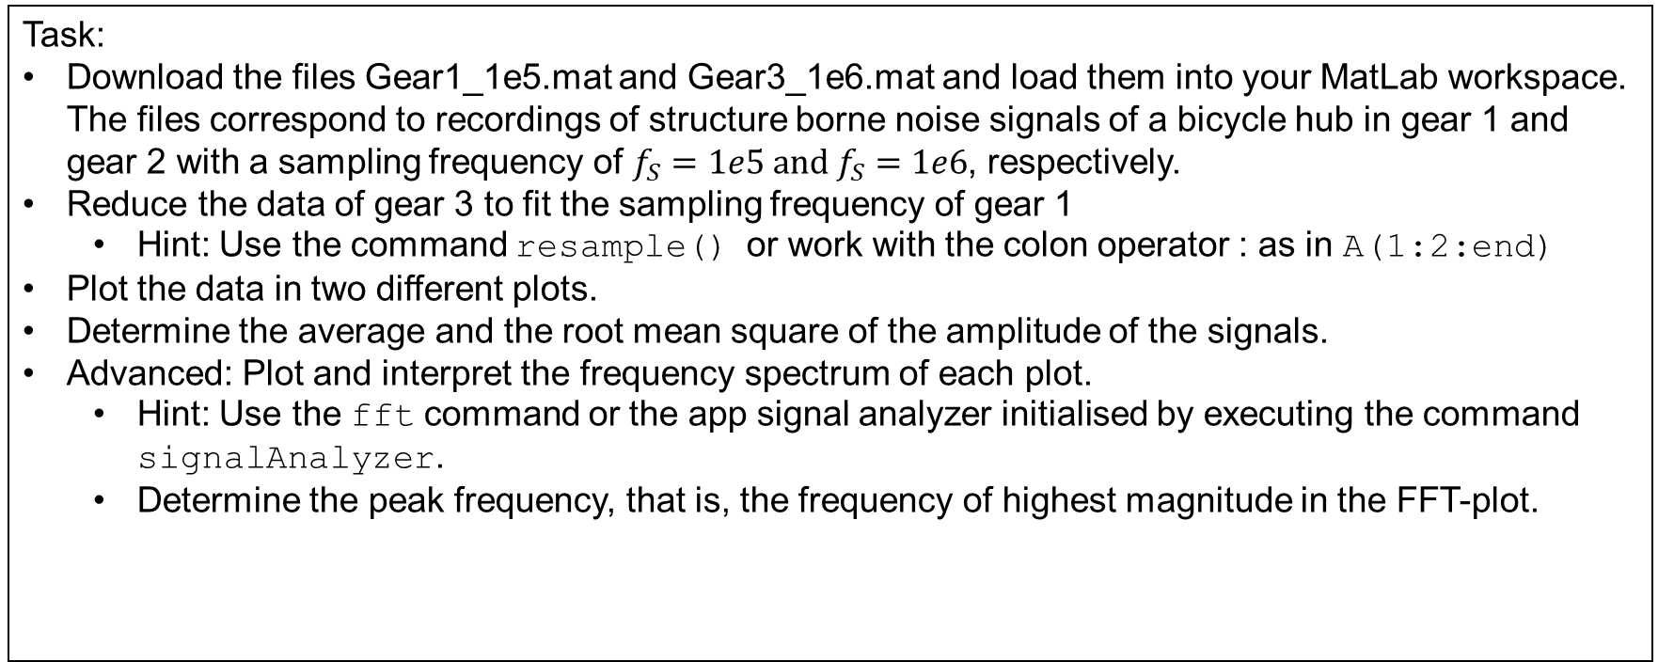
Exercice 14.1
Pre-processing Signals and Data Reduction
Task:
Download the files Gear1_1e5.mat and Gear3_1e6.mat and load them into your MatLab workspace. The files correspond to recordings of structure borne noise signals of a bicycle hub in gear 1 and gear 2 with a sampling frequency of ${f_{S}=1e5 and f}_{S}=1e6$, respectively.
Reduce the data of gear 3 to fit the sampling frequency of gear 1
Hint: Use the command resample() or work with the colon operator : as in A(1:2:end)
Plot the data in two different plots.
Determine the average and the root mean square of the amplitude of the signals.
Advanced: Plot and interpret the frequency spectrum of each plot.
Hint: Use the fft command or the app signal analyzer initialised by executing the command signalAnalyzer.
Determine the peak frequency, that is, the frequency of highest magnitude in the FFT-plot.

Slide 4
Exercice 14.2
Classification
Task:
The file GearX_1e5.mat is a recording of the bicycle hub in an unknown gear.
Based on the results of exercise 14.1 try to determine the gear.

