Slide 1


Scaling the Monolith
Single Page Applications with Django and React

Slide 2
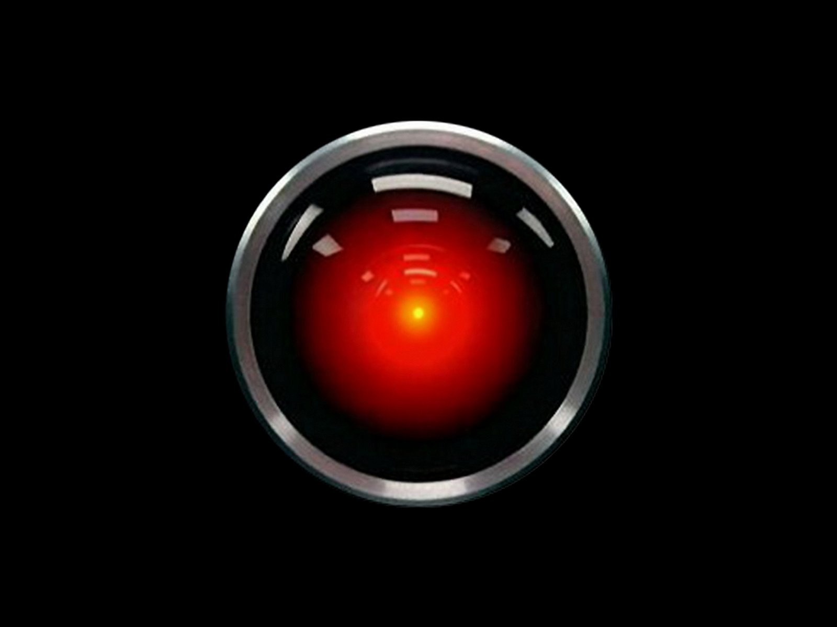
Introductions
“Affirmative Dave, I read you”

Slide 3
Senior IT Project Leader - The Wharton School University of Pennsylvania
LEHIGH UNIVERSITY GRADUATE Bachelors and Masters in Chemical Engineering
(MOSTLY) SELF-TAUGHT PROGRAMMER
Began programming in Fortran and Matlab After graduating, I moved on to PHP, then ruby, and most recently, python Javascript is my favorite language to code in
Some other stuff:
Husband, father to rambunctious 2 year old boy
Video game and movie nerd
30 years active training in the martial arts
Notes:
Python and javascript are languages of choice
Use Atom for IDE

Slide 4
Overview
Note: slides are fairly heavy on example code
Nothing too esoteric. Data and application flow should be fairly straightforward.
Basic Application Structure
Django
Django REST
React
Redux | React Router
Notes:
Django is the underlying server architecture with Django REST running as a plugin to Django
React eventually takes over as the template layer with state managed by Redux and client-side routes by react-router

Slide 5
Before we start getting into it…
A FEW NOTES ABOUT APPLICATION PACKAGING AND BUNDLING
Arguably the most difficult part of setting up your project. Will affect everything from your local environment to deployment.
1
Django plugins managed through pip and added to a requirements.txt file
2
Javascript dependencies managed through yarn with package.json file
3
Application javascript built through webpack (and maybe gulp)
Notes:
All packaging files should include all of the project’s dependencies (including versions)
Versioning is important to “pickle” dependencies to ensure compatibility

Slide 6
Python/Django PIP and requirements.txt
requirements.txt
Django==1.10.2 django-bootstrap3==7.1.0 django-compressor==2.1 djangorestframework==3.5.1
home:react_meetup sturoscy$ pip install django djangorestframework
home:react_meetup sturoscy$ pip freeze > requirements/base.txt
home:react_meetup sturoscy$ pip install -r requirements/dev.txt
home:react_meetup sturoscy$ ./manage.py collectstatic –-no-input
Notes:
Cannot automatically add requirements to .txt file through command line. Have to add manually or through a “pip freeze”.
Virtual environments should be used along with pip
Easy to manage multiple environments
Don’t have to install requirements globally
Acts as a container for your requirements

Slide 7
Node Package Manager Yarn!
package.json (truncated)
… "dependencies": { "immutable": "^3.8.1”, "moment": "^2.15.2”, "react": "^15.3.2”, "react-dom": "^15.3.2”, "react-redux": "^4.4.5”, "react-router": "^3.0.0”, "redux": "^3.6.0”, "redux-thunk": "^2.1.0” }, …
home:react_meetup sturoscy$ yarn add react
home:react_meetup sturoscy$ yarn add –-dev webpack
home:react_meetup sturoscy$ yarn install
Yarn benchmarks === very fast!
Notes:
Yarn
Facebook’s new package manager
No overhead to using it over NPM
Uses the same package.json file
Slightly different syntax to add modules (can still use NPM though)
Very fast, especially for cached plugins

Slide 8
Build and Package Your Modules Webpack
webpack.config.js (truncated)
entry: { ‘path/to/index.js’ }, output: { ‘path/to/dist/’ }, module: { loaders: [ { test: [/\.jsx?$/, /\.js$/], exclude: /(node_modules)/, loader: 'babel’, query: { presets: ['es2015', 'react', 'stage-2’] } }, { test: [/\.scss$/, /\.css$/], exclude: /(bower_components)/, loaders: ["style", "css", "sass”] } ] }
home:react_meetup sturoscy$ webpack
Notes:
Webpack
Lots of loaders/plugins to use
Can even import and compile css and sass!
Poor documentation
Check examples of webpack files for how to do things correctly

Slide 9
OK, lets get into it!
Basic Application Structure
Django
Django REST
React
Redux | React Router

Slide 10
Django… unchained (I’m sorry)
Basic Application Structure
Django
Django REST
React
Redux | React Router

Slide 11

Why Django?
Rock solid MVT architecture
Excellent ORM
Drivers for nearly any DB type
Built-in admin interface and user management system
Plugins everywhere
Pleasant and helpful community
Updated consistently
Python!
Also, Wharton uses it as the default framework (all new apps are to be on django)
Notes:
MVT
model/view/template
view == controller, template == view (in other frameworks)
Can have many apps feeding into a single project
Promotes maintainable code, much like react
Can be reusable
In a traditional MVT app, you would have multiple apps each with multiple templates and views that govern your application
React will take over that traditional architecture
Biggest reason for, “why django” is the Django REST Framework

Slide 12
Basic Structure for a Django Project
[projectname]/ ├── api/ ├── __init__.py ├── models.py ├── serializers.py ├── views.py └── urls.py ├── [projectname]/ ├── __init__.py ├── urls.py └── wsgi.py ├── node_modules/ ├── requirements/ ├── base.txt ├── dev.txt └── production.txt
(continued)
├── settings/ ├── base.py ├── dev.py └── production.py ├── static/ ├── static_dev/ ├── templates/ ├── manage.py ├── package.json └──webpack.config.json
Lets talk about static assets for a minute
Django is a framework, and as such, really likes to do things its own way
<app_name>/static/<app_name>/
for reusability
configure settings in settings.py file
modify static asset structure
build > dist (nodejs)
static_dev > static (django)
Notes:
Project-level folder contains individual apps routing in urls.py along with a wsgi file for apache server management
Lose reusability when moving to SPA architecture

Slide 13
One template to rule them all!
<body>
<div class="container">
<div class="row">
<div class="col-lg-12">
<div id="wrapper"></div>
</div>
</div>
</div>
</body>
[projectname]/ ├── templates/ └── index.html

Slide 14
Django Routing
One route to bootstrap your React application: from django.conf.urls import include, url
from django.views.generic import TemplateView
urlpatterns = [
url(r'^$', TemplateView.as_view(
template_name='index.html')),
] React will take over from here!
[projectname]/ ├── [projectname]/ └── urls.py
Notes:
Add root URL to urls.py in project sub-folder.
React will take over from here

Slide 15
Django REST Framework API Layer
Basic Application Structure
Django
Django REST
React
Redux | React Router

Slide 16




Django REST Framework
This is where most of the “magic” happens. DRF sits at an API layer in your project and can give read/write access to whatever data you expose.
Built on top of Django. Can use ORM or non-ORM data sources.
Full CRUD support with very little code
Browsable API with Swagger support - http://restframework.herokuapp.com/
Views return serialized JSON which makes AJAX calls and managing state much simpler.
Robust serializers enable accurate representation of data allowing for easier access in Javascript
Built in session and token based authentcation with granular permssions on a per view basis
Notes:
What’s a non-ORM data source?
Can use python requests module to make calls to another API (facebook, twitter, linkedIn)
Serialize the incoming data using a DRF serializer
Return formatted JSON data use in a React component
The browsable API is a usability win for developers, and possibly customers (depending on how you want to deliver data)
Great documentation and community support

Slide 17
Django Routing
from api.views import EventAPIView
from rest_framework import routers
router = routers.DefaultRouter()
router.register(r'events', EventAPIView, base_name='event_view')
[projectname]/ ├── api/ ├── __init__.py ├── models.py ├── serializers.py ├── views.py └── urls.py ├── [projectname]/ └── urls.py

Slide 18
Django Routing
from django.conf.urls import include, url
from django.views.generic import TemplateView
from api.urls import router
urlpatterns = [
url(r'^$', TemplateView.as_view(
template_name='index.html')),
# Include API views
url(r'^api/v1/', include(router.urls),
name='api-root'),
]
[projectname]/ ├── api/ ├── __init__.py ├── models.py ├── serializers.py ├── views.py └── urls.py ├── [projectname]/ └── urls.py
Notes:
API urls have a base of /api/v1/. Actual endpoints are added via the API urls.py file.
For this case we now have a route located at /api/v1/events. Lets see how to wire up the view.

Slide 19
The Model
from django.db import models class Event(models.Model):
name = models.CharField(max_length=100)
description = models.TextField()
location = models.CharField(max_length=100)
created = models.DateTimeField(auto_now_add=True)
updated = models.DateTimeField(auto_now=True)
[projectname]/ ├── api/ ├── __init__.py ├── models.py ├── serializers.py ├── views.py └── urls.py

Slide 20
The Serializer
from api.models import Event
from rest_framework import serializers class EventSerializer(serializers.ModelSerializer):
class Meta:
model = Event
fields = ‘__all__’
[projectname]/ ├── api/ ├── __init__.py ├── models.py ├── serializers.py ├── views.py └── urls.py

Slide 21
The View
from api.models import Event
from api.serializers import EventSerializer
from rest_framework import viewsets
class EventAPIView(viewset.ModelViewSet):
queryset = Event.objects.all()
serializer_class = EventSerializer
[projectname]/ ├── api/ ├── __init__.py ├── models.py ├── serializers.py ├── views.py └── urls.py

Slide 22
Voila!
We now have a full CRUD endpoint at /api/v1/events/
Notes:
Lets see how React fits in.

Slide 23

On to the fun part!
Django
Django REST
React
Redux | React Router
React, Redux, and Router (R³?)

Slide 24
Here’s what we’re going to do…
Configure an initial state for the client
Set up basic client-side routes
Connect components to the events API through AJAX calls via Redux
Redux allows for central management of your applications state via a central store
We will use redux-thunk middleware which allows action creators to return functions instead of an action. This is useful to delay the dispatch of an action or dispatch multiple actions.
Sounds fun, right? Right!

Slide 25
Configure Store
import { applyMiddleware, createStore } from 'redux'; import ReduxThunk from 'redux-thunk’; import rootReducer from './redux/reducers/index';
// Initial State let initialState = { events: { isLoading: false, meetupEvent: {}, results: [] } }; const configureStore = createStore( rootReducer, initialState, applyMiddleware(ReduxThunk) )
[projectname]/ ├── static_dev/ ├── components ├── redux ├── stylesheets └── index.js
Notes:
List of events will be an array/list from the API. We’ll store that in events.results. An individual event will get stored in meetupEvent (so as to not collide with an actual JS event).
isLoading will let the client know we are fetching events from the server and display a loading indicator.
Build initial state based on what is coming back from the API server.
Accurate initial state is important

Slide 26
Routing
import { Provider } from 'react-redux’; import { render } from 'react-dom’; import { Router, Route, hashHistory, IndexRoute } from 'react-router’; ... render(( <Provider store={configureStore}> <Router history={hashHistory}> <Route path='/' component={App}> <IndexRoute component={Home} /> <Route path='/events' component={Events}> <Route path='/events/:eventID’ component={Event} /> </Route> </Route> </Router> </Provider> ), document.getElementById('wrapper'))
[projectname]/ ├── static_dev/ ├── components ├── redux ├── stylesheets └── index.js
Component Lifecycle
Notes:
Components in Router are imported as well. I left them out for brevity.
Notice use of IndexRoute and nested Routes for Events > Event

Slide 27
Events Component
import { getEvents } from '../redux/actions/index'; componentDidMount() { let dispatch = this.props.dispatch; dispatch(getEvents()); } render() { if (this.props.events.isLoading) { return <h1>Loading Events...</h1> } ... return ( <div> <h1>Events</h1> <ul>{events}</ul> <div> {this.props.children} </div> </div> ) }
[projectname]/ ├── static_dev/ ├── components └── Events.jsx ├── redux ├── stylesheets └── index.js
Notes:
Missing from component: events object is built using a map on this.props.events.results and returning an array of JSX <li> objects
Dispatch the getEvents action on component mount
We set initial state at first load, so no need to set anything in the constructor (componentWillMount)
If events are loading, display a loading indicator
isLoading is updated from redux store

Slide 28
Events Actions
const url = 'http://localhost:8000/api’;
const requestEvents = () => { return { type: 'REQUEST_EVENTS' } }
const receiveEvents = (events=null) => { return { type: 'RECEIVE_EVENTS’, events: events } }
export const getEvents = () => { return (dispatch) => { dispatch(requestEvents()); $.get(`${url}/events/`) .done(events => { dispatch(receiveEvents(events)); }); } }
[projectname]/ ├── static_dev/ ├── components ├── redux ├── actions └── events.js └── reducers ├── stylesheets └── index.js
Notes:
Redux thunk allows us to dispatch two actions in getEvents
requestEvents sets isLoading to true
receiveEvents sets isLoading back to false and updates state of events from server

Slide 29
Events Reducer
import Immutable from 'immutable’;
function setState (state, newState={}) { return state.merge(newState); }
const events = (state, action) => { state = Immutable.fromJS(state) || Immutable.Map(); switch (action.type) { case 'REQUEST_EVENTS’: var newState = state.set('isLoading', true); state = setState(state, newState); return state.toJS(); case 'RECEIVE_EVENTS’: var events = Immutable.fromJS(action.events); var newState = state .set('isLoading', false) .set('results', events) state = setState(state, newState); return state.toJS(); default: return state.toJS(); } }
[projectname]/ ├── static_dev/ ├── components ├── redux ├── actions └── reducers └── events.js ├── stylesheets └── index.js
Notes:
Highly advise using Immutable to manage data in your reducer. Makes it safer and simpler to return new, updated state.

Slide 30



Where to go from here
This is only the start of a Single Page App
ADD MORE ROUTES
Rebuild & test locally
deploy
Add more client-side routes in index.js with any corresponding API DRF endpoints.
Add to initialState to account for any additional incoming data.
Dispatch additional actions related to the client and server routes.
After adding more routes, components, stylesheets, etc. re-run webpack and test.
Use an application plugin like zappa to deploy to AWS Lambda and API Gateway.
https://www.zappa.io/

Slide 31

Questions?

