Slide 1
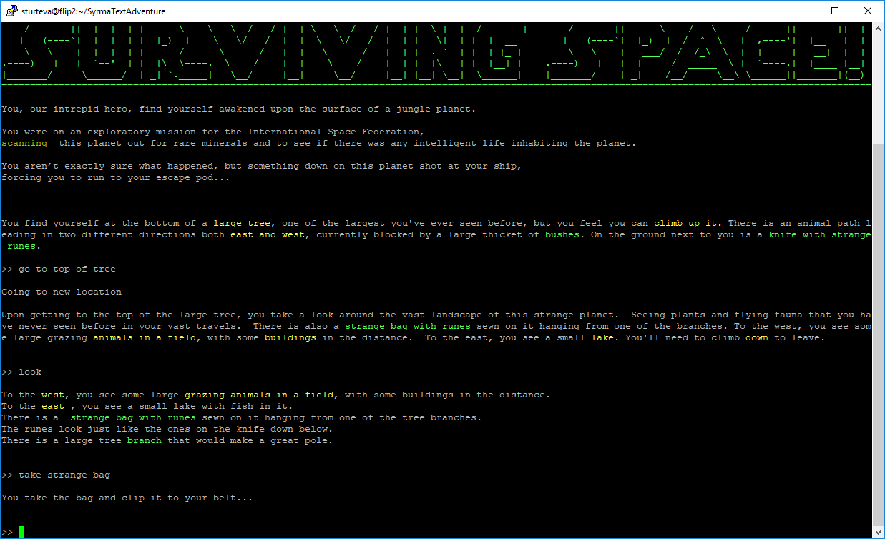
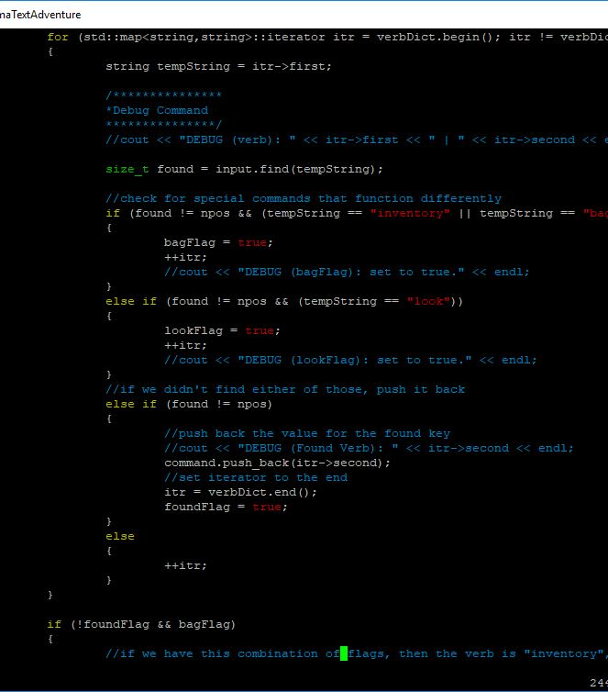
Surviving Space!
Lets Talk Gamestate
A Text based Adventure Game by:
Britany Hughes, William Taylor Mack, and Andrew Sturtevant
Using the Boost Library
The Gamestate has a separate function for each primary verb that can be used in our game. The command from the parser is then compared using the doCommand function implemented in game.cpp. Each verb is implemented in its own function that will alter the Gamestate depending on current player location, as well as rooms or items included in the command. 20 different verbs are able to be understood by the parser: help, save, go, inventory, look at, look, take, cut, move toward, sneak, put, drop, crush, combine, give, use, fix, eat, sleep and exit.
Towards the end of the project, Britany opted to implement the Boost library in order to take advantage of the additional functionality that the usage of Regular Expression could bring to the parser’s understanding of language. Although Regex technically compiled without incident, she noted that the compiled program did not handle Regex as it should due to the environment (Oregon State University’s FLIP servers) utilizing an older version of the compiler.
After a little digging, she discovered that the Boost library could be implemented with solely the files pertaining to Regex. By doing so, it was possible to implement the usage of Regular Expression into the parser while simultaneously not bloating the overall file size of the project. This was accomplished by identifying the key header files associated with Regex and then retrieving all of the files referenced by include statements in those files.
About Surviving Space!
Data Input/Output
At its core, Surviving Space! is a text-based adventure game similar to the legendary game Zork. We wanted to do this as an original story, so we first discussed the genre we wanted to operate our story within. We chose a sort of science-fantasy game where the player is a space explorer that gets trapped on a planet that is full of magic and mystery. That is how we got to the title Space Survival!. To build this project, we leveraged C++11 with the Boost library.
The basic gameplay of the game involves typing in commands in a fairly natural manner. Ultimately, the player is trying to get off of the mysterious planet they find themselves on, back onto their ship and then get their ship running again so that they escape! There are a few perils throughout the game that can end the game in failure, or even restart the game!
The first step was ensuring that all of our room data files had the same format from the very beginning.
We would then read in all of the room files (*.roomdat) and on each line of the files, read the particular tag.
After the tags were removed, depending on what the tag was, it would be properly processed as a characteristic of that given room.
Build a map of adjacent rooms, utilizing vectors with pointers to each adjacent room.
Ensuring on Save/Load that room characteristics were converted back into a formatted form in the room newly made room file.

