Slide 1
Adventure Works Sales Dashboard
Shailesh Kumar Maurya
Date: 05-02-2026

Slide 2
Business Problem
AdventureWorks is a sample business dataset provided by Microsoft. It represents a bicycle manufacturing and sales company. The dataset contains information about customers, products, sales transactions, returns, territories, and dates.
The main objective of this dataset is to perform
Sales Analysis
Regional/Territory Analysis
Category Analysis
Product Performance Analysis
Return Analysis

Slide 3
Business Objective
The objective of this project is to analyze sales, customers, products, returns, and profitability of Adventure Works company and provide business insights through interactive Power BI dashboards.

Slide 4
Data Overview
We have total 10 csv files to create Power Bi Dashboard.
Dataset | Rows | Columns | Dataset Description
AdventureWorks_Customers | 18148 | 13 | Stores customer information.
Product_Categories | 4 | 2 | Contains product categories
Product_Subcategories | 38 | 3 | Contains detailed product groups.
AdventureWorks_Products | 293 | 11 | Contains product information.
AdventureWorks_Calendar | 912 | 1 | Contains date-related information.
AdventureWorks_Returns | 1809 | 4 | Stores returned products.
AdventureWorks_Sales_2015 | 2630 | 8 | Contains sales transactions for 2015.
AdventureWorks_Sales_2016 | 23935 | 8 | Contains sales transactions for 2016.
AdventureWorks_Sales_2017 | 29481 | 8 | Contains sales transactions for 2017.
AdventureWorks_Territories | 10 | 4 | Stores regional sales information.

Slide 5
Data Import & ETL Process
I imported all Adventure Works tables into Power BI using Get Data option.
I imported all AdventureWorks CSV files into Power BI
transformed and cleaned the data in Power Query, appended the yearly sales files into a single Sales table, and then used Close & Apply to load the data. After that, I created a Star Schema data model by connecting fact and dimension tables.

Slide 6
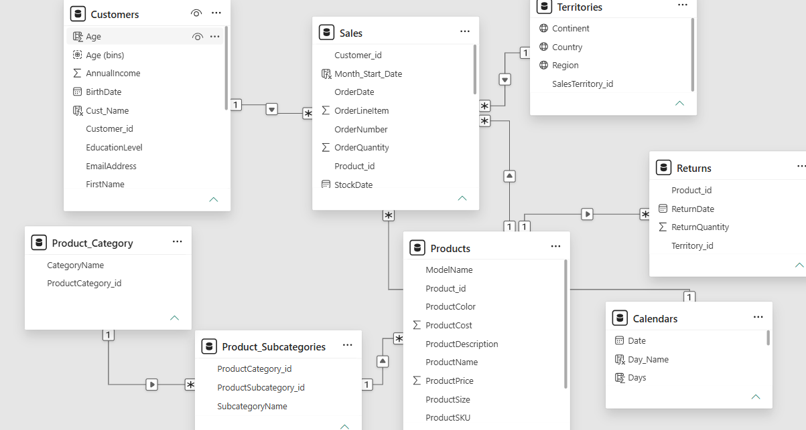
Data Model and Relationships

Slide 7
Dashboard Overview
KPI | Value
Revenue | 24.91M
Profit | 10.46M
Total Orders | 56K
Total Sold Qty | 84K
Return Qty | 1.83K
Return Amount | 765K
Total Cost | 14.46M
Business Insight:
Revenue generated is 24.91M.
Profit generated is 10.46M
Profit margin is approximately 42%.
The company is maintaining healthy profitability and controlling costs effectively.

Slide 8
Customer Analysis Insights
Customer Analysis Insights
• Customers aged 40–60 years contribute the highest number of orders, making them the most valuable customer segment.
• Jordan Turner is the top revenue-generating customer with approximately 15.57K revenue, highlighting the importance of customer retention strategies.
• Customers from the Management occupation generate the highest revenue, indicating stronger purchasing power among professionals.
• Order distribution is almost equal between Male (50.43%) and Female (49.57%) customers, showing a balanced customer base.
• Average-income customers contribute 67.35% of total orders, making them the primary target market for the business.
• The dashboard helps identify key customer segments for targeted marketing campaigns and improved customer engagement

Slide 9
Product Analysis Insights
Product Analysis Insights
• Water Bottle – 30 oz. is the most ordered product, indicating strong customer demand and popularity.
• Mountain-200 Black, 46 is the most profitable product and contributes significantly to overall business profit.
• Weekly profit trends show fluctuations throughout the year, with peak profits reaching approximately 313K during high-performing weeks.
• Product returns vary across weeks, suggesting seasonal patterns and customer purchasing behavior.
• Products such as Road-650 Red, 52 and Mountain-100 Silver, 44 have higher return rates and may require quality review.
• The analysis helps management optimize inventory levels, improve product quality, and focus on high-profit products.

Slide 10
Category Analysis Insights
Category Analysis Insights
• Bikes generate 23.64M revenue, making them the highest revenue-contributing category and the primary business growth driver.
• Accessories account for the highest order quantity (58K units), indicating strong demand despite lower revenue contribution.
• The Clothing category contributes the least revenue, presenting opportunities for future growth and promotional activities.
• Weekday orders (40K) are significantly higher than weekend orders (16K), indicating stronger customer purchasing activity during weekdays.
• Bikes have the highest average selling price (1.54K) and contribute the largest share of company profit.
• Category analysis helps stakeholders understand sales performance, customer preferences, and opportunities to improve category-level profitability.

Slide 11
Conclusion
The Adventure Works Sales Dashboard successfully transforms raw business data into meaningful insights, helping stakeholders improve sales performance, increase profitability, optimize inventory management, and better understand customer behavior. This project demonstrates my skills in Power BI, Power Query, DAX, Data Modeling, and Business Intelligence reporting.

Slide 12
THANK YOU!

