Slide 1
Simple Dependency Injection in Rust

Slide 2
What is DI?
When modules are provided needed resources or factories for the needed resources instead of generating themselves.
Also the source of a lot of the jokes about enterprise java.

Slide 3
Advantage of DI
Makes code much easier to test.
Removes external dependencies from unit tests.
Makes testing strange error states possible.
Encourages looser coupling in code and defines clear contracts between modules

Slide 4
Disadvantages of DI
ADDS. SO. MUCH. CODE.
The path to accomplish simple tasks can get frustratingly long.

Slide 5
What Should Be Injected?
Personal rule of thumb, anything external to the program that you will reach out to
  Databases
  Message Queues
  If there is complicated disk IO, then even file access.

Slide 6
State of DI in Rust
I’ve yet to see a good DI framework for Rust (and that’s okay)
DI doesn’t need to be complex and doesn’t need a special frameworks
Everything you need can easily be accomplished with just traits

Slide 7
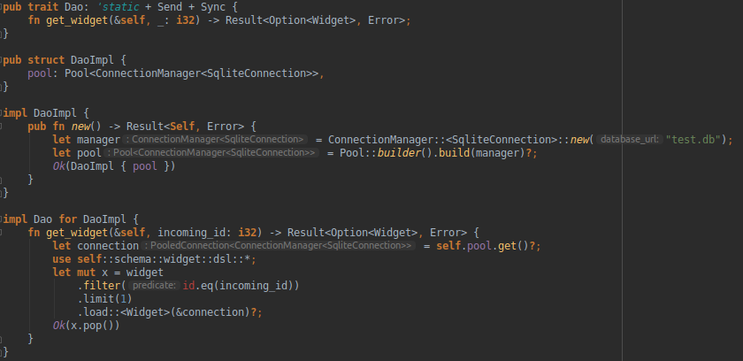
Create the Service

Slide 8
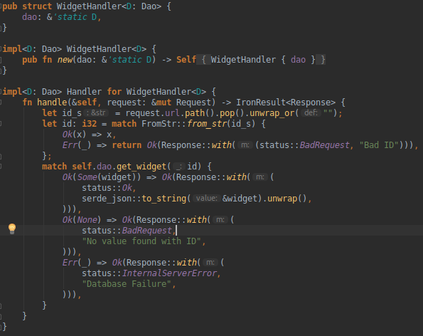
Consume Only the Trait

Slide 9
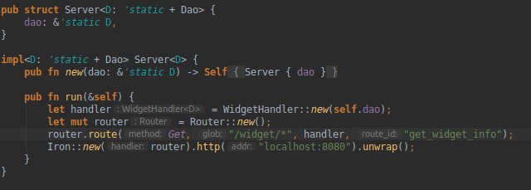
Wire It All together

Slide 10
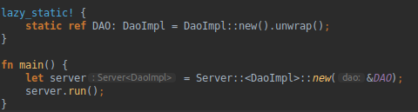
Inject the Concrete Impl

Slide 11
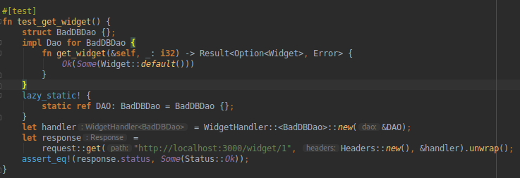
Test!

Slide 12
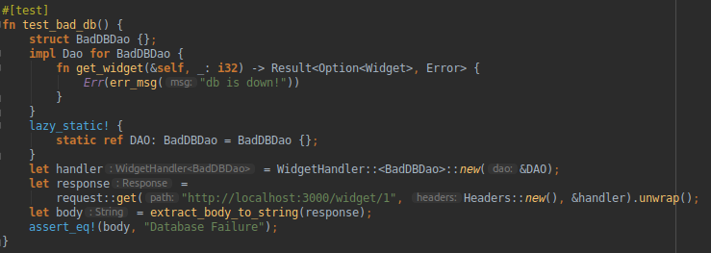
Test!

