Slide 1
Client Fingerprinting with TLS Session Resumption

Slide 2
Why?
Most IPv4 clients are behind a NAT
To be an effective firewall we need to differentiate between individual clients as much as possible to prevent blocking innocent users.
You can’t completely rely on any user reported information. Malicious users will change user agents, refuse to accept cookies, etc.

Slide 3

Fingerprinting Ideas...
One common method is providing a session cookie.
Easy to implement.
Malicious users will see this and not accept it.

Slide 4
Fingerprinting Ideas...
Another technique is javascript fingerprinting
A library is loaded that probes a long list of characteristics to build a signature
  Available fonts
  Webgl, audio and canvas properties
  Screen resolution
  Much, much more
https://github.com/Valve/fingerprintjs2

Slide 5
What We Want
Something that is easily overlooked by a malicious user
Relies on features that are common and makes users life difficult if disabled
The fingerprint doesn’t need to be perfect. It can be one of several factors that works into the larger decision

Slide 6
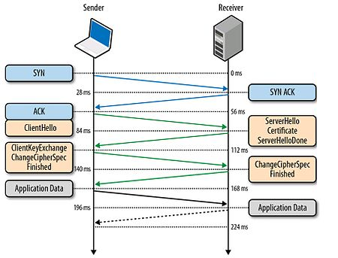
Quick HTTPS Primer

Slide 7
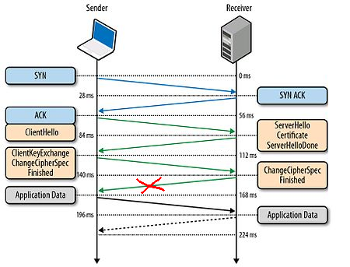
Quick HTTPS Primer

Slide 8
TLS Resumption
Extremely common feature in clients
  Wide support in modern browsers
  Used in many command line tools and bots
Provides dramatic reduction in CPU usage and cuts the time of the handshake by ~50%
Not all developers know/think about it

Slide 9
Why Rust?
Rust lends itself well to writing, safe, predictable, low level code.
Because of this, there is a growing list of well documented, easy to access crypto implementations in rust
OpenSSL internals aren’t easy to work in

Slide 10
Why Rust?
I was able to pick up rustls, walk through the documentation and get a simple POC HTTPS server.
Took an afternoon and about 50 lines of code

Slide 11
Demo

Slide 12
Why Release It Now?
We decided not to use it yet but might in the future
Another group independently released a great paper about the concept: https://svs.informatik.uni-hamburg.de/publications/2018/2018-12-06-Sy-ACSAC-Tracking_Users_across_the_Web_via_TLS_Session_Resumption.pdf

Slide 13
We Are Hiring!
Send us a resume: careers@threatx.com
Also if you want slides or code: @thestusmall

