Slide 1
Security management
Node js

Slide 2
Introduction
Node.js applications are often exposed to public networks, making them vulnerable to various attacks.
Asynchronous architecture and extensive use of third-party packages increase potential risks.
A security breach can compromise user data, system integrity, and business reputation.

Slide 3
Common Security Threats in Node.js
SQL Injection – Malicious queries injected into your database.
Cross-Site Scripting (XSS) – Attackers inject malicious scripts into your web app.
Cross-Site Request Forgery (CSRF) – Forcing users to perform unwanted actions.
Denial-of-Service (DoS) – Flooding the server with excessive requests.
Data Breaches – Exposing sensitive data due to weak security controls.

Slide 4
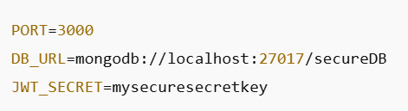
Secure Configuration Management
Storing sensitive data directly in your code can expose it to attackers.
Solution :Use .env Files
.env files store environment variables securely.
Best Practice : Never commit .env files to your repository.

Slide 5
Data Validation and Sanitization
Prevents injection attacks and ensures data integrity.
Best Practices:
Use strong validation libraries like express-validator.
Sanitize user inputs to remove malicious characters.
Define strong data rules (e.g., required fields , data types).

Slide 6
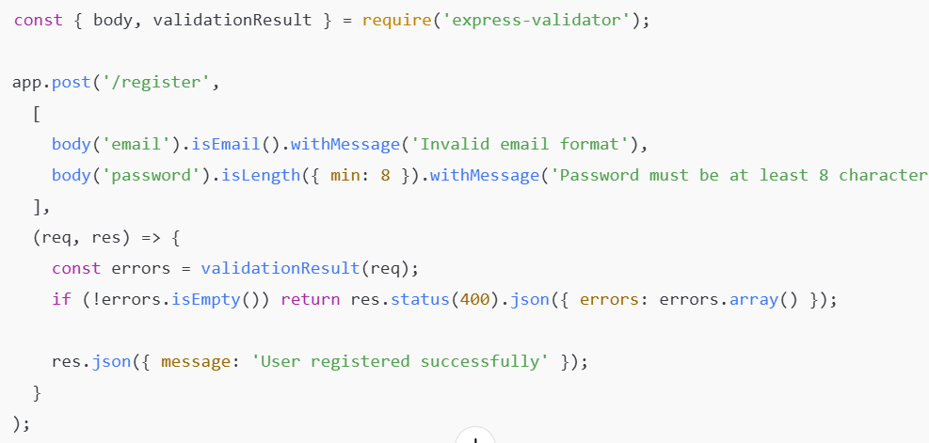
Data Validation and Sanitization

Slide 7

Using Helmet for HTTP Security
Helps secure your app by setting proper HTTP headers.
Key Features
Prevents XSS attacks.
Adds content Security Policy to limit allowed content sources .
Controls X-Frame-Options to avoid clickjacking .

Slide 8

Preventing Cross-Origin Attacks (CORS)
Restricts unauthorized domains from accessing your API.
Best Practices:
Use cors middleware to define safe origins .
Avoid using * as a wildcard in production .

Slide 9
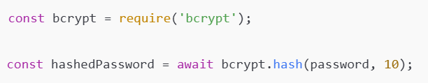
Password Hashing with Bcrypt
Storing plain text passwords can expose user data.
Best Practices:
Use strong hashing algorithms like bcrypt.
Add salting for improved security.
Never store original passwords.

Slide 10
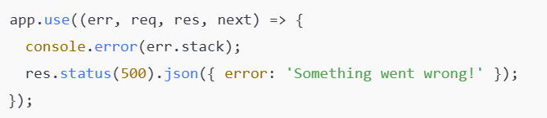
Error Handling for Security
Revealing stack traces or internal details can expose your system’s vulnerabilities.
Best Practices :-
Return user-friendly error messages.
Log detailed errors securely for internal use.

Slide 11
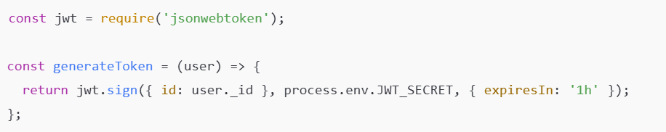
Authentication Using JWT (JSON Web Token)
JWT is a secure method for transmitting data
between parties.
Tokens are stateless, reducing server load .
Key Components :-
Header: Contains token type & algorithm.
Payload: Contains user data.
Signature: Ensures data integrity.

Slide 12
Session Management
Weak session handling can lead to session hijacking.
Best Practice :-
Use secure cookies with the httpOnly and secure flags.
Set session expiration times.
Regenerate session IDs after login to prevent fixation attacks.

Slide 13

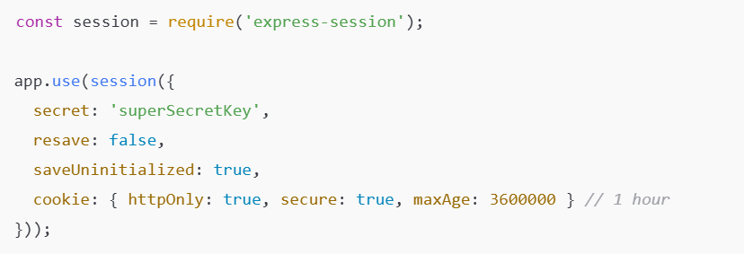
Market overview

Slide 14
Secure File Uploads
Attackers may upload malicious files to gain access to your system or overload
your server.
Best Practice :-
Use libraries like multer for safe file uploads.
Restrict file types to trusted formats (e.g., .jpg, .png, .pdf).
Limit file sizes to prevent denial-of-service (DoS) attacks

Slide 15
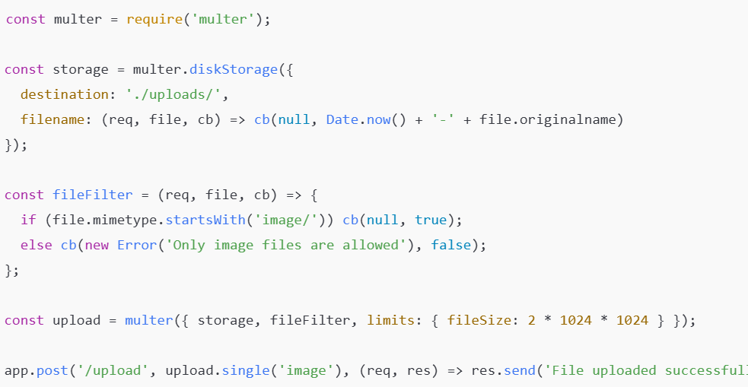
Market overview

Slide 16

Thank you
Stuti shah

