Slide 1
ROVER PROJECT
Acquired Startup Analysis
By Stuti Chugh

Slide 2
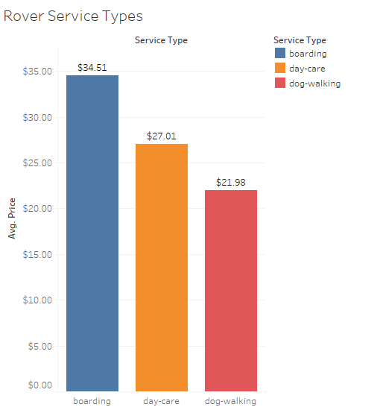
Conversations and Bookings
Possible Service and their Average Price
As the plot on the right shows there are three possible services- boarding, day-care, and dog-walking and the average prices for these services are $34.51, $27.01, and $21.98 respectively.

Slide 3
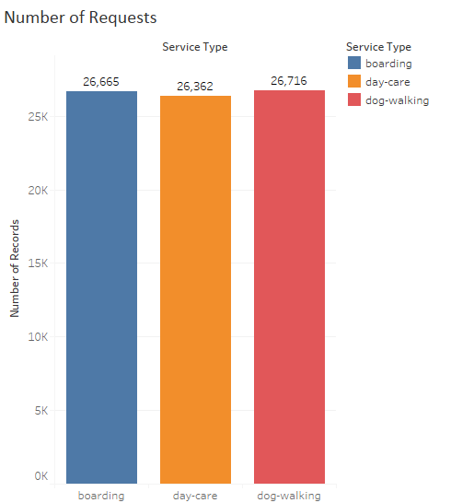
Conversations and Bookings
Number of Requests for each service
As the plot on the right shows there are three possible services- boarding, day-care, and dog-walking and the number of requests per service for each service are 26665, 26363, and 26716 respectively.

Slide 4
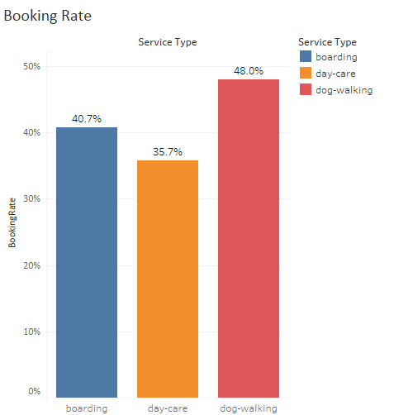
Conversations and Bookings
Booking Rate
The booking rate is calculated taking the ratio of count of number non-null elements in the ‘Booked at’ Column and count of number of records. The booking rate is highest for dog-walking, followed by boarding and then day-care.

Slide 5
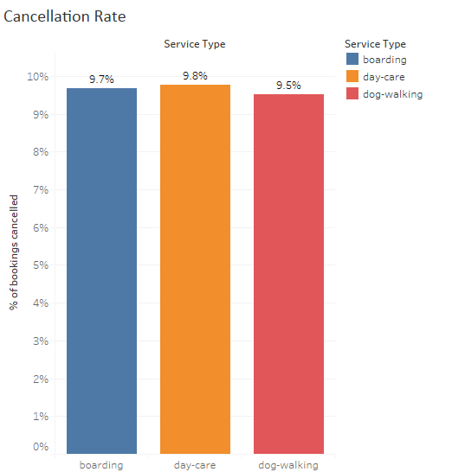
Conversations and Bookings
Cancellation Rate
The booking rate is calculated taking the ratio of count of number non-null elements in the ‘Booked at’ Column and count of number of records. The booking rate is highest for dog-walking, followed by boarding and then day-care.

Slide 6
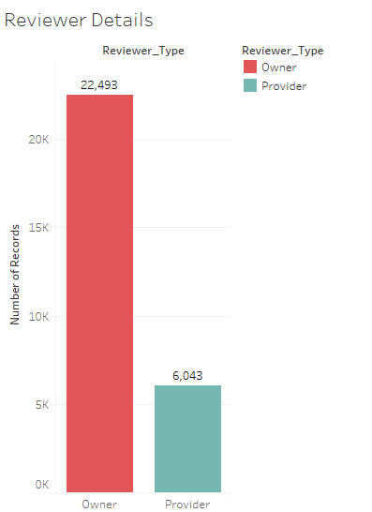
Conversations and Bookings
Owner/Provider Review Analysis
As the graph on the right shows owners are more likely to leave reviews than providers.

Slide 7
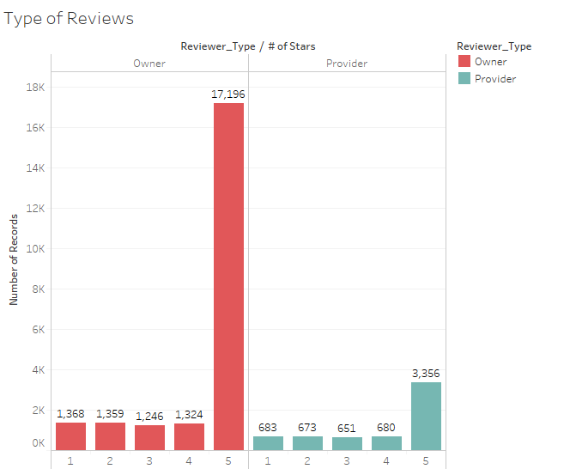
Conversations and Bookings
Owner/Provider Review Analysis
We can see that Owners tend to leave better reviews since they tend to leave more 5-star reviews than Providers.

Slide 8
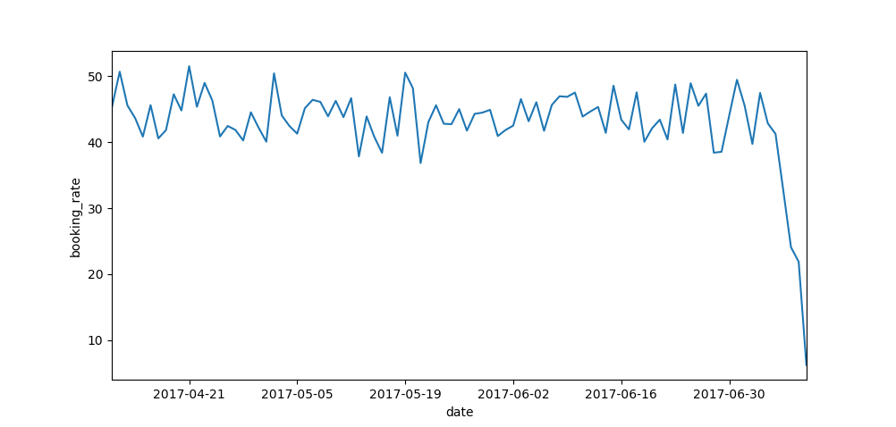
RECENT DAILY BOOKING RATE
Daily Booking Rate
Modelling the data of the last 90 days prior 2017-07-11 suggests that there is a downward trend; especially a steep drop in the last week. There might be a competitor in the area that might have influenced this downward trend or providers who have joined are not satisfying the needs of the new owners.

Slide 9
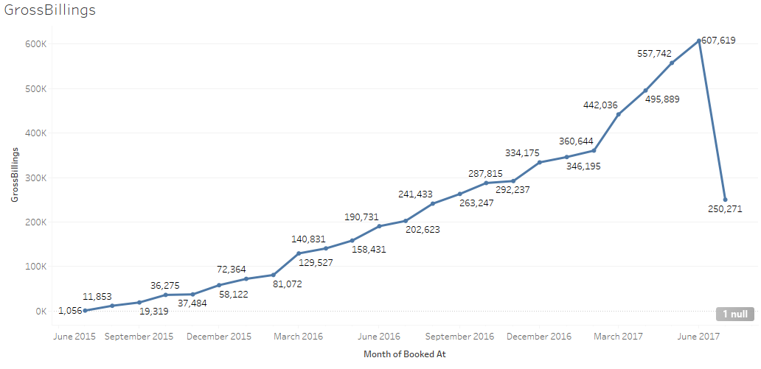
Analyzing TAKE RATE

Slide 10
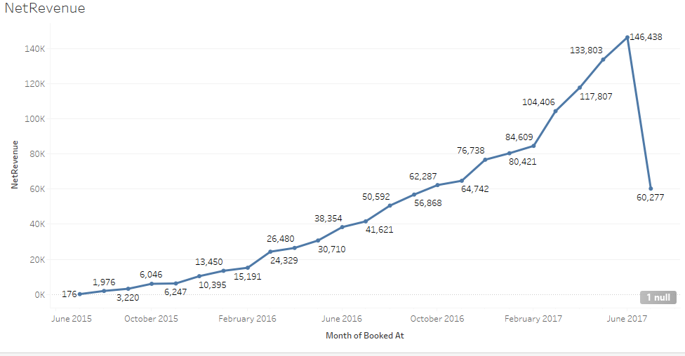
Analyzing TAKE RATE

Slide 11
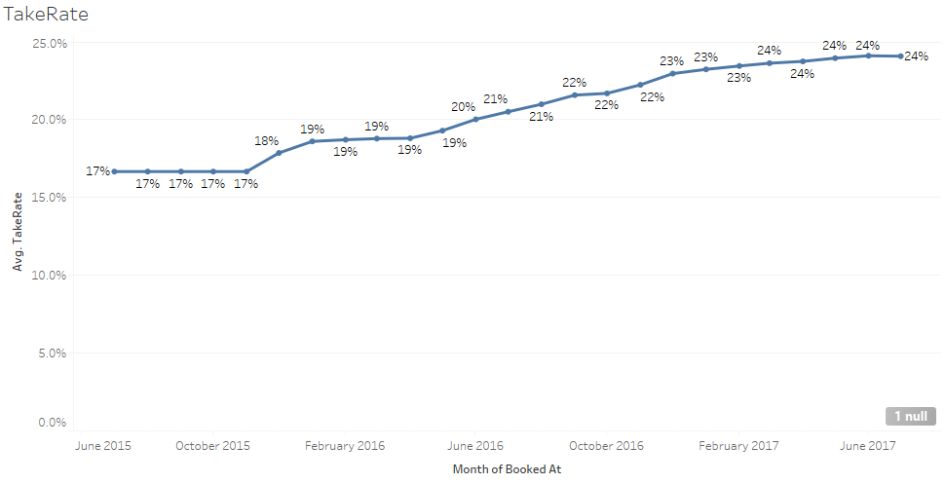
Analyzing TAKE RATE

Slide 12
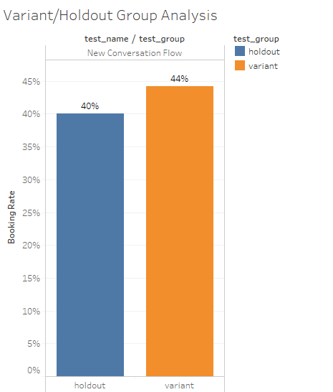
NEW CONVERSATION FLOW
Holdout v/s Variant Booking Rate
Viewers who see the new conversation flow have a booking rate of 44% whereas the ones who see the old conversation flow have a booking rate of 40%.

Slide 13
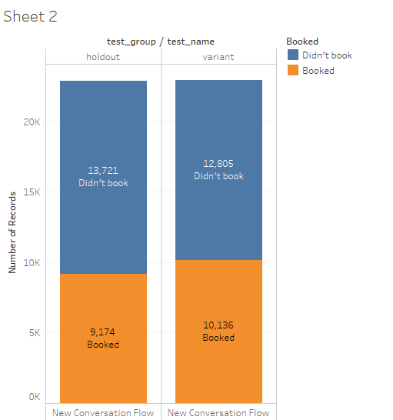
NEW CONVERSATION FLOW
Statistical Significance
A Chi-squared test is a good way to tell if the difference in the booking rates of two groups is a random coincidence or a statistically significant result. Upon running such a test with significance level set to 5% it can be concluded that the difference is indeed statistically significant.

Slide 14
NEW CONVERSATION FLOW
New Conversation flow might not be the only reason as to why the booking rate is high. There can be other factors effecting the booking rate. A way to dig deeper and see if the improved UI design actually improves the booking rate we can examine the past booking rate, reviews, and activities of the users of the people in holdout and variant group to check for any false negatives or false positives. We can also switch the people in variant group with people in holdout group to see if the booking rates switch as well. Running a linear or logistic regression model to measure how much each of these factors effect booking rate might be a good next step.

Slide 15
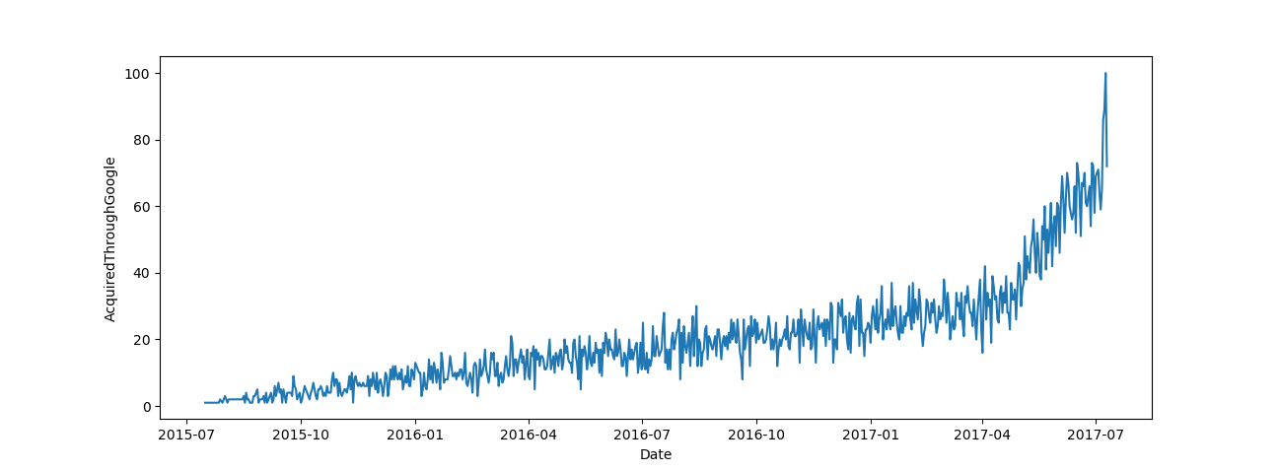
SEARCH ENGINE MARKETING
Graph using Python and MatplotLib

Slide 16
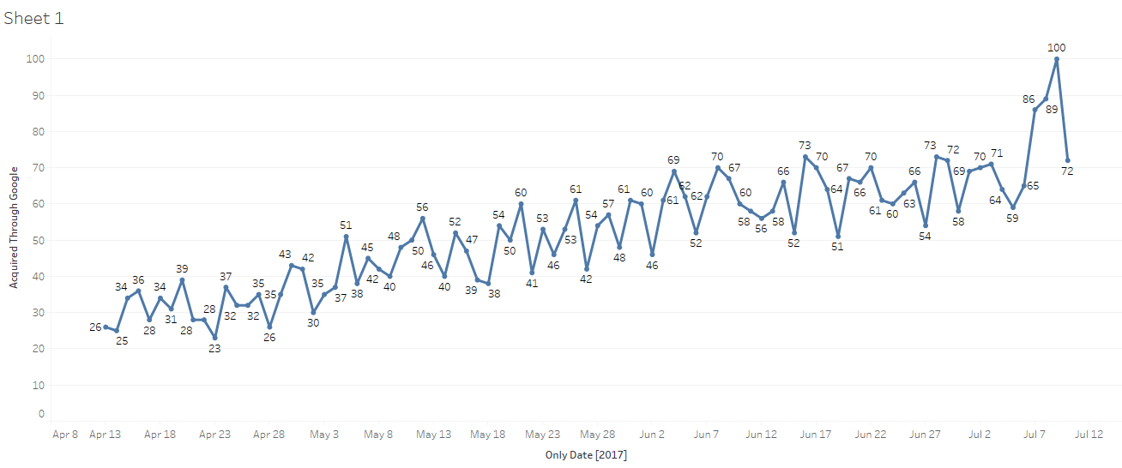
SEARCH ENGINE MARKETING

Slide 17
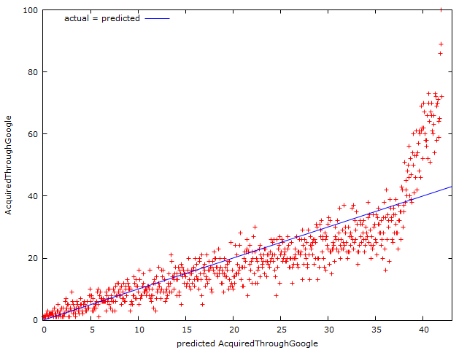
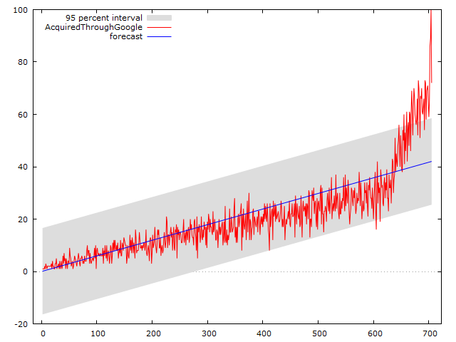
SEARCH ENGINE MARKETING

Slide 18
SEARCH ENGINE MARKETING
As both graphs and the data in the csv files suggest, the number of users acquired through google has increased with an inflection point near April 12, 2017. Upon taking the sum of all users acquired by google from this date until the end it is observed that 4673 users were acquired by Google since then. Dividing this number by the amount they spent since this date we get ($210285/4673)=$45 to be the average cost per account.
Furthermore, upon running a simple linear regression on this data we can plot an actual v/s fitted model and forecast how many customers would have been acquired had the company not changed it’s bidding strategy. In that case we would have approximately 3544 users acquired instead of 4673. If this were the case then company wouldn’t have increase their spending and it would have stayed at $30 per account. So the marketing spend would have been(30*3544)=$106,320. The additional account created would have been (4673-3544)=1129. The marginal cost per account would be $15 per account.

