Slide 1
Planning
Session-8
2nd June, 2026

Slide 2
What is planning?
Planning involves defining the organization's goals, establishing an overall strategy for achieving those goals, and developing a comprehensive set of plans to integrate and coordinate organizational work.
It's concerned with both ends (what's to be done) and means (how it's to be done).
Planning can either be formal or informal
In formal planning, specific goals covering a period of years are defined. These goals are written down and shared with organizational members. Finally, specific action programs exist for the achievement of these goals; that is, managers clearly define the path they want to take to get the organization and the various work units from where they are to where they want them to be.
In informal planning, nothing is written down, and there is little or no sharing of goals with others in the organization. This type of planning often is done in many small businesses where the owner-manager has a vision of where he or she wants the business to go and how to get there. Informal planning is general and lacks continuity

Slide 3
Purposes of Planning
Planning establishes coordinated effort. It gives direction to managers and nonmanagers alike. When employees know where the organization or work unit is going and what they must contribute to reach goals, they can coordinate their activities, cooperate with each other, and do what it takes to accomplish those goals.

Slide 4
Planning also reduces uncertainty by forcing managers to look ahead, anticipate change, consider the impact of change, and develop appropriate responses. It also clarifies the consequences of actions managers might take in response to change.

Slide 5
Planning reduces overlapping and wasteful activities. When work activities are coordinated around established plans, wasted time and resources and redundancy can be minimized

Slide 6
Planning establishes goals or standards that are used in controlling
In planning, we develop the goals and the plans. Then, through controlling, we compare actual performance against the goals, identify any significant deviations, and take any necessary corrective action

Slide 7
Planning and Performance
Formal planning is associated with higher profits, higher return on assets, and other positive financial results.
Second, the quality of the planning process and the appropriate implementation of the plans probably contribute more to high performance than does the extent of planning.
Governmental regulations, powerful labor unions, and other critical environmental forces constrain managers' options and reduce the impact of planning on an organization's performance.
Finally, the planning/performance relationship is influenced by the planning time frame

Slide 8
The Role of Goals and Plans in Planning
Goals are desired outcomes for individuals, groups, and entire organizations. Goals are objectives. They provide the direction for all management decisions and form the criterion against which actual work accomplishments can be measured. That's why they're often called the foundation of planning
Plans are documents that outline how goals are going to be met and that typically describe resource allocations, schedules, and other necessary actions to accomplish the goals

Slide 9
Types of Goals
Stated goals—official statements of what an organization says, and what it wants its various stakeholders to believe, its goals are. However, stated goals—which can be found in an organization's charter, annual report, public relations announcements, or in public statements made by managers—are often conflicting and excessively influenced by what society believes organizations should do
Organization's real goals—those goals that an organization actually pursues

Slide 10
Types of Plans
Strategic plans are plans that apply to the entire organization, establish the organization's overall goals, and seek to position the organization in terms of its environment
Plans that specify the details of how the overall goals are to be achieved are called operational plans.
Strategic plans tend to cover a longer time frame. They also cover a broader view of the organization. Strategic plans also include the formulation of goals whereas operational plans define ways to achieve the goals. Also, operational plans tend to cover short time periods—monthly, weekly, and day-to-day.

Slide 11
Long-term plans as those with a time frame beyond three years.
Short-term plans as those covering one year or less.
Intermediate term is any time period in between

Slide 12
Specific plans are clearly defined and leave no room for interpretation. They have specifically stated objectives. There's no ambiguity and no problem with misunderstandings
The drawbacks of specific plans are that they require clarity and a sense of predictability that often do not exist.
Directional plans are flexible plans that set out general guidelines. They provide focus but do not lock managers into specific goals or courses of action.

Slide 13
A single-use plan is a one-time plan specifically designed to meet the needs of a unique situation
In contrast, standing plans are ongoing plans that provide guidance for activities performed repeatedly. Standing plans include policies, rules, and procedures

Slide 14
Approaches to establishing goals
Traditional Objective Setting: goals are set at the top and then broken down into subgoals for each level of the organization
Integrated network of goals, or a means-ends chain: Higher-level goals, or ends, are linked to lower-level goals, which serve as the means for their accomplishment. Thus, the achievement of goals at a low level becomes the means to reach the goals at the next level (ends). And the accomplishment of goals at that level becomes the means to achieve the goals at the next level (ends).
Managament by Objectives (MBO): Management system specific performance goals are jointly determined by employees and their managers, progress toward accomplishing these goals is periodically reviewed, and rewards are allocated on the basis of this progress

Slide 15
Steps in a typical MBO program
The organization's overall objectives and strategies are formulated.
Major objectives are allocated among divisional and departmental units.
Unit managers collaboratively set specific objectives for their units with their managers.
Specific objectives are collaboratively set with all department members.
Action plans, defining how objectives are to be achieved, are specified and agreed upon by managers and employees.
The action plans are implemented.
Progress toward objectives is periodically reviewed, and feedback is provided.
Successful achievement of objectives is reinforced by performance-based rewards.

Slide 16
Characteristics of Well-Designed Goals
Written in terms of outcomes rather than actions
Measurable and quantifiable
Clear as to a time frame
Challenging yet attainable
Written down
Communicated to all necessary organizational members

Slide 17
Steps in Goal Setting
Review the organization's mission, which is the purpose of an organization
Evaluate available resources
Determine the goals individually or with input from others
Write down the goals and communicate them to all who need to know
Review results to see whether goals are being met

Slide 18
Developing Plans
Contingency Factors in Planning: Will strategic or operational plans be needed? How about specific or directional plans? In some situations, long-term plans make sense; in others they do not. What are these situations? Environmental uncertainty; Time frame of the plans

Slide 19
Approaches to Planning
In the traditional approach, planning was done entirely by top-level managers who were often assisted by a formal planning department, a group of planning specialists whose sole responsibility was helping to write the various organizational plans
Second option is to involve more organizational members in the process. In this approach, plans aren't handed down from one level to the next but instead are developed by organizational members at the various levels and in the various work units to meet their specific needs

Slide 20
Criticisms of Planning
Planning may create rigidity
Plans can't be developed for a dynamic environment
Formal plans can't replace intuition and creativity
Planning focuses managers' attention on today's competition not on tomorrow's survival
Formal planning reinforces success, which may lead to failure

Slide 21
Planning tools and techniques

Slide 22
Techniques For Assessing The Environment
Environmental Scanning: Competitor intelligence, Global scanning
Forecasting: Quantitative techniques applies a set of mathematical rules to a series of past data to predict outcomes. These techniques are preferred when managers have sufficient hard data that can be used. Qualitative forecasting, in contrast, uses the judgment and opinions of knowledgeable individuals to predict outcomes

Slide 23
Quantitative techniques | Description | Qualitative techniques | Description
Time series analysis | Fits a trend line to a mathematical equation and projects into the future by means of this equation | Jury of opinion | Combines and averages the opinions of experts
Regression models | Predicts one variable on the basis of known or assumed other variables | Salesforce composition | Combines estimates from field sales personnel of customers' expected purchases
Econometric models | Uses a set of regression equations to simulate segments of the economy | Customer evaluation | Combines estimates from established purchases
Economic indicators | Uses one or more economic indicators to predict a future state of the economy
Substitution effect | Uses a mathematical formula to predict how, when, and under what circumstances a new product or technology will replace an existing one

Slide 24
Benchmarking
This is the search for the best practices among competitors or noncompetitors that lead to their superior performance.
The basic idea behind benchmarking is that managers can improve quality by analyzing and then copying the methods of the leaders in various fields

Slide 25
Steps in Benchmarking Process
A benchmarking planning team is formed. The team's initial task is to identify what is to be benchmarked, identify comparative organizations, and determine data collection methods
The team collects data internally on its own work methods and externally from other organizations
The data are analyzed to identify performance gaps and the cause of differences
An action plan that will result in meeting or exceeding the standards of others is prepared and implemented

Slide 26
Suggestions for Improving Benchmarking Efforts
Link benchmarking efforts to strategic objectives.
Have the right-sized team—between six and eight people is most effective.
Involve those individuals who will be directly affected by benchmarking efforts.
Focus on specific, targeted issues rather than broad, general ones.
Set realistic timetables.
Choose benchmarking targets carefully.
Observe proper protocol when gathering benchmarking information by dealing with the appropriate individuals.
Don't collect excessive, unnecessary data.
Look at the processes behind the numbers, not just at the numbers themselves.
Identify benchmarking targets and then be sure to take action.

Slide 27
Techniques for allocating resources
Resources are the assets of the organization and include financial (debt, equity, retained earnings, and other financial holdings); physical (equipment, buildings, raw materials, or other tangible assets); human (experiences, skills, knowledge, and competencies of people); intangible (brand names, patents, reputation, trademarks, copyrights, registered designs, and databases); and structural/cultural (history, culture, work systems, working relationships, level of trust, policies, and structure).

Slide 28
Budgeting
A budget is a numerical plan for allocating resources to specific activities
Types of Budgets:
Cash budgets (Forecasts cash on hand and how much will be needed);
Revenue budget (Projects future sales);
Expense budget (Lists primary activities and allocates dollar amount to each);
Variable budget (Takes into account the costs that vary with volume);
Fixed budget (Assumes fixed level of sales or production);
Profit budget (Combines revenue and expense budgets of various units to determine each unit's profit contribution)

Slide 29
Scheduling
Gantt Charts: The Gantt chart was developed during the early 1900s by Henry Gantt
It's essentially a bar graph with time on the horizontal axis and the activities to be scheduled on the vertical axis.
The bars show output, both planned and actual, over a period of time.
The Gantt chart visually shows when tasks are supposed to be done and compares that with the actual progress on each

Slide 30
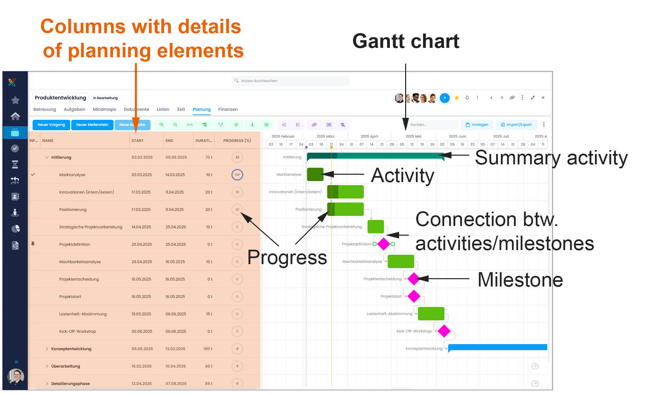

Slide 31
Load Charts
Load charts list either entire departments or specific resources.
This arrangement allows managers to plan and control capacity utilization.
Load charts schedule capacity by work areas

Slide 32
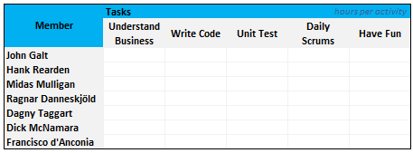
Load Chart

Slide 33
PERT (Program Evaluation and Review Technique) Network
It is a flowchartlike diagram that depicts the sequence of activities needed to complete a project and the time or costs associated with each activity.
With a PERT network, a manager must think through what has to be done, determine which events depend on one another, and identify potential trouble spots.
PERT also makes it easy to compare the effects alternative actions might have on scheduling and costs.
Thus, PERT allows managers to monitor a project's progress, identify possible bottlenecks, and shift resources as necessary to keep the project on schedule.

Slide 34
4 terms in PERT
Events are end points that represent the completion of major activities.
Activities represent the time or resources required to progress from one event to another.
Slack time is the amount of time an individual activity can be delayed without delaying the whole project.
The critical path is the longest or most time-consuming sequence of events and activities in a PERT network

Slide 35
Steps in Developing a PERT Network
Identify every significant activity that must be achieved for a project to be completed.
Determine the order in which these events must be completed.
Diagram the flow of activities from start to finish, identifying each activity and its relationship to all other activities.
Compute a time estimate for completing each activity.
Using the network diagram that contains time estimates for each activity, determine a schedule for the start and finish dates of each activity and for the entire project.

Slide 36
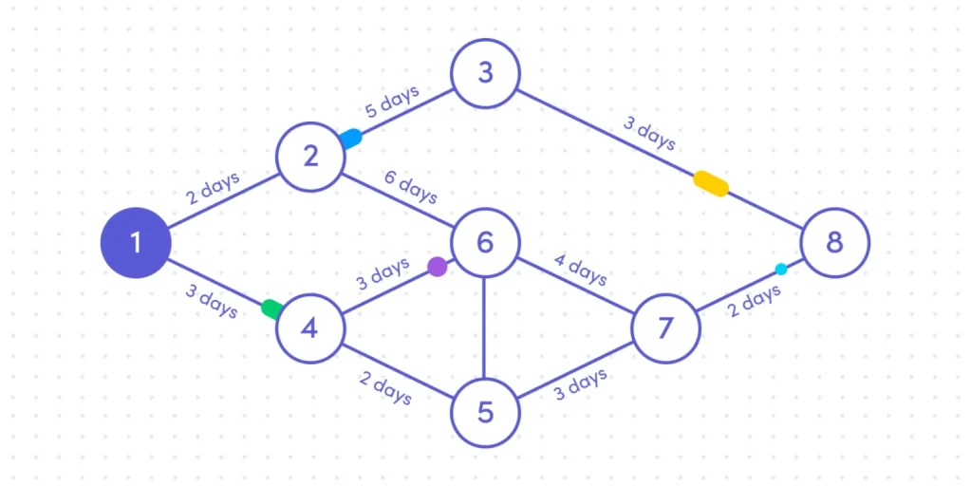
PERT Chart

Slide 37
Breakeven Analysis
Break even—that is, the point at which total revenue is just sufficient to cover total costs.
To compute breakeven point (BE), a manager needs to know the unit price of the product being sold (P), the variable cost per unit (VC), and total fixed costs (TFC).
An organization breaks even when its total revenue is just enough to equal its total costs.
But total cost has two parts: fixed and variable.
Fixed costs are expenses that do not change regardless of volume. Examples include insurance premiums, rent, and property taxes.
Variable costs change in proportion to output and include raw materials, labor costs, and energy costs.

Slide 38
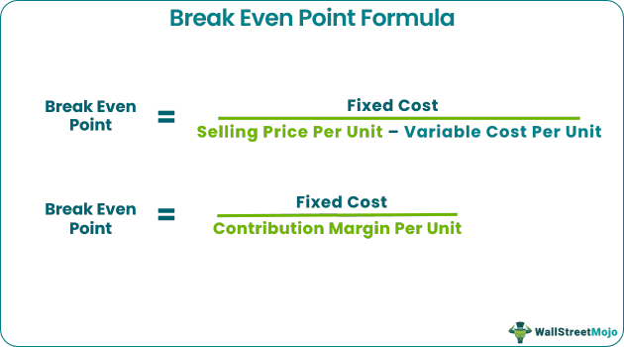
This formula tells us that
(1) total revenue will equal total costs when we sell enough units at a price that covers all variable unit costs and
(2) the difference between price and variable costs, when multiplied by the number of units sold, equals the fixed costs

Slide 39
Linear Programming
Linear programming (LP), or linear optimization, is a mathematical method for determining the best outcome—such as maximum profit or lowest cost—in a model where requirements are represented by linear relationships.
It optimizes a linear objective function subject to constraints (linear inequalities or equalities) and bound constraints

Slide 40
Applications of Linear Programming
Manufacturing: Optimizing production levels to maximize profit under resource constraints.
Logistics & Transportation: Determining the best routes or distribution, sometimes known as the transportation problem.
Finance: Portfolio optimization and cash flow matching.
Energy: Planning and optimization in energy sectors.

Slide 41
Contemporary Planning Techniques
Project Management: A project is a one-time-only set of activities that has a definite beginning and ending point in time
Project management is the task of getting a project's activities done on time, within budget, and according to specifications

Slide 42
Project Planning Process
Define objectives
Identify activities and resources
Establish sequences
Establish time for services
Determine project completion time
Compare objectives
Determine additional resource requirements

Slide 43
Scenario Planning
A scenario is a consistent view of what the future is likely to be.
Developing scenarios also can be described as contingency planning; that is, if this is what happens, then these are the actions we need to take.

Slide 44
Preparing for Unexpected Events
Identify potential unexpected events.
Determine if any of these events would have early indicators.
Set up an information-gathering system to identify early indicators.
Have appropriate responses (plans) in place if these unexpected events occur

