Slide 1
Leadership in Management
7th April, 2026

Slide 2
Managers vs Leaders
Managers | Leaders
Managers are appointed to their position. Their ability to influence is based on the formal authority inherent in that position. | Leaders may either be appointed or emerge from within a work group. Leaders are able to influence others to perform beyond the actions dictated by formal authority.
 | A leader is someone who can influence others and who has managerial authority
Leadership is the process of influencing a group toward the achievement of goals.

Slide 3
Leadership theories

Slide 4
Early Leadership Theories
Trait theory: Leadership research in the 1920s and 1930s focused basically on leader traits— physical stature, appearance, social class, emotional stability, fluency of speech, and sociability.
Later, Six traits associated with effective leadership included drive, the desire to lead, honesty and integrity, self-confidence, intelligence, and job-relevant knowledge.
However, these theories ignored the interactions of leaders and their group members as well as situational factors.

Slide 5
Behavioral Theories
Leadership research from the late 1940s to the mid-1960s concentrated on the preferred behavioral styles that leaders demonstrated-what effective leaders did
Four main leader behavior studies: University of Iowa; Ohio State University; University of Michigan; Managerial Grid

Slide 6
University of Iowa: Kurt Lewin, Ronald Lippitt, and Ralph K. White (1939)
Behavioral Dimension | Conclusion
Democratic style: involving subordinates, delegating authority, and encouraging participation | Democratic style of leadership was most effective, although later studies showed mixed results.
Autocratic style: dictating work methods, centralizing decision making, and limiting participation
Laissez-faire style: giving group freedom to make decisions and complete work

Slide 7
Ohio State University (Late 1940s)
Behavioral Dimension | Conclusion
Initiating structure: structuring work and work relationships to meet job goals | High-high leader (high in consideration and high in initiating structure) achieved high subordinate performance and satisfaction, but not in all situations.
Consideration: being considerate of followers' ideas and feelings

Slide 8
University of Michigan: Survey Research Center: Rensis Likert (1950s)
Behavioral Dimension | Conclusion
Employee oriented: emphasized interpersonal relationships and taking care of employees' needs | Employee-oriented leaders were associated with high group productivity and higher job satisfaction.
Production oriented: emphasized technical or task aspects of job

Slide 9
Managerial Grid: Robert R. Blake, Jane S. Mouton, Louis B. Barnes, and Larry E. Greiner (1964)
Behavioral Dimension | Conclusion
Concern for people: measured leader's concern for subordinates on a scale of 1 to 9 (low to high) | Impoverished management (1,1), Task management (9,1), Middle-of-the-road management (5,5), Country club management (1,9), and Team management (9,9). Leaders performed best with a 9,9 style (high concern for production and high concern for people).
Concern for production: measured leader's concern for getting job done on a scale of 1 to 9 (low to high)

Slide 10
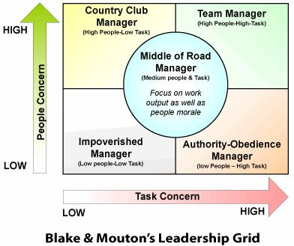

Slide 11
Contingency theories of leadership
Fiedler contingency theory,
Hersey-Blanchard leadership theory,
Leader participation theory, and,
Path-goal model
These theories define leadership style and the situation and attempt to answer the if-then contingencies (i.e., if this is my situation, then this is the best leadership style for me to use)

Slide 12
Fred Fiedler’s contingency model of leadership (1964)
Effective group performance depended on the proper match between the leader's style of interacting with his or her followers and the degree to which the situation allowed the leader to control and influence
A person's style was one of two types: task oriented or relationship oriented.
To measure a leader's style, Fiedler developed the least-preferred co-worker (LPC) questionnaire. This questionnaire contained 16 pairs of contrasting adjectives—for example, pleasant-unpleasant, cold-warm, boring-interesting, and friendly-unfriendly. Respondents were asked to think of all the co-workers they had ever had and to describe that one person they least enjoyed working with by rating him or her on a scale of 1 to 8 (the 8 always described the positive adjective out of the pair and the 1 always described the negative adjective out of the pair) for each of the 16 sets of adjectives. Fiedler believed that you could determine a person's basic leadership style on the basis of the responses to the LPC questionnaire.

Slide 13
Fred Fiedler’s contingency model of leadership (1964)
If the leader described the least preferred co-worker in relatively positive terms (in other words, a "high" LPC score), then the respondent was primarily interested in good personal relations with co-workers. That is, if you described the person that you least liked to work with in favorable terms, your style would be described as relationship oriented. In contrast, if you saw the least preferred co-worker in relatively unfavorable terms (a low LPC score), you were primarily interested in productivity and getting the job done; thus, your style would be labeled as task oriented.
Fiedler assumed that a person's leadership style was always the same (fixed) regardless of the situation. In other words, if you were a relationship-oriented leader, you'd always be one, and the same if you were task oriented.

Slide 14
Fred Fiedler’s contingency model of leadership (1964)
Fiedler's research concluded three contingency dimensions that defined the key situational factors for determining leader effectiveness:
Leader-member relations: the degree of confidence, trust, and respect employees had for their leader; rated as either good or poor
Task structure: the degree to which job assignments were formalized and procedurized; rated as either high or low
Position power: the degree of influence a leader had over power-based activities such as hiring, firing, discipline, promotions, and salary increases; rated as either strong or weak

Slide 15
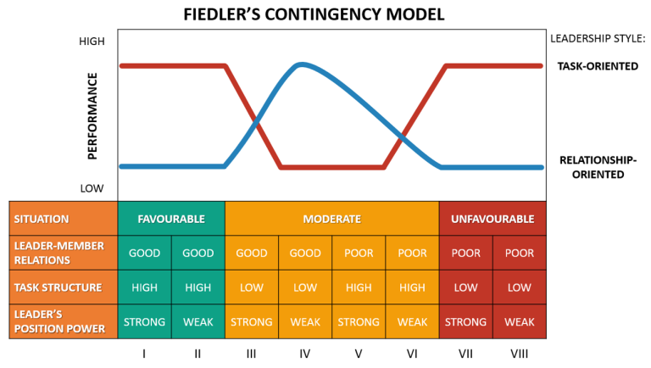
Fred Fiedler’s contingency model of leadership (1964)
Task-oriented leaders tended to perform better in situations that were very favorable to them and in situations that were very unfavorable.
Relationship-oriented leaders seemed to perform better in moderately favorable situations.

Slide 16
Drawbacks of Fiedler’s contingency theory
There were problems with the LPC, and the practicality of it needed to be addressed.
It's probably unrealistic to assume that a person can't change his or her leadership style to fit the situation. Effective leaders can, and do, change their styles to meet the needs of a particular situation.
Finally, the contingency variables were complex and difficult for practitioners to assess.

Slide 17
Hersey and Blanchard's Situational Leadership Theory (1969)
This model called situational leadership theory (SLT) is a contingency theory that focuses on followers' readiness. Hersey and Blanchard argue that successful leadership is achieved by selecting the right leadership style, which is contingent on the level of the followers' readiness
it is the followers who accept or reject the leader. Regardless of what the leader does, effectiveness depends on the actions of his or her followers
Readiness refers to the extent to which people have the ability and willingness to accomplish a specific task

Slide 18
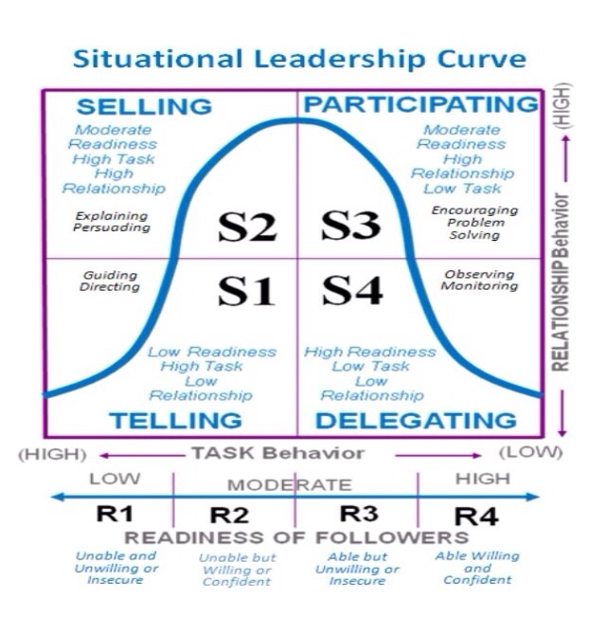

Slide 19
Hersey and Blanchard's Situational Leadership Theory (1969)
Telling (high task–low relationship): The leader defines roles and tells people what, how, when, and where to do various tasks.
Selling (high task–high relationship): The leader provides both directive and supportive behavior.
Participating (low task–high relationship): The leader and follower share in decision making; the main role of the leader is facilitating and communicating.
Delegating (low task–low relationship): The leader provides little direction or support.

Slide 20
Four stages of follower readiness:
R1: People are both unable and unwilling to take responsibility for doing something. They're neither competent nor confident.
R2: People are unable but willing to do the necessary job tasks. They're motivated but currently lack the appropriate skills.
R3: People are able but unwilling to do what the leader wants.
R4: People are both able and willing to do what is asked of them.

Slide 21
Summing up the theory:
If followers are unable and unwilling to do a task, the leader needs to give clear and specific directions (telling);
If followers are unable and willing, the leader needs to display high task orientation to compensate for the followers' lack of ability and high relationship orientation to get followers to "buy into" the leader's desires (selling);
If followers are able and unwilling, the leader needs to use a supportive and participative style (participating); and
If employees are both able and willing, the leader doesn't need to do much (delegating)

Slide 22
Leader participation model (Victor Vroom and Philip Yetton (1973, later revised with Arthur Jago in 1988)
Contingencies—
Decision significance,
Importance of commitment,
Leader expertise,
Likelihood of commitment,
Group support,
Group expertise, and
Team competence
—are either present in the situation (H for high) or absent (L for low)

Slide 23
Leader participation model (Victor Vroom and Philip Yetton (1973, later revised with Arthur Jago in 1988)
Leadership Styles in the Vroom Leader Participation Model
Autocratic Type I (Decide) | Leader makes the decision alone and either announces or sells it to group.
Autocratic Type II (Consult individually) | Leader presents the problem to group members individually, gets their suggestions, and then makes the decision.
Consultative Type I (Consult group) | Leader presents the problem to group members in a meeting, gets their suggestions, and then makes the decision
Consultative Type II (Facilitate) | Leader presents the problem to the group in a meeting and, acting as facilitator, defines the problem and the boundaries within which a decision must be made.
Group-Based Type II (Delegate) | Leader permits the group to make the decision within prescribed limits.

Slide 24
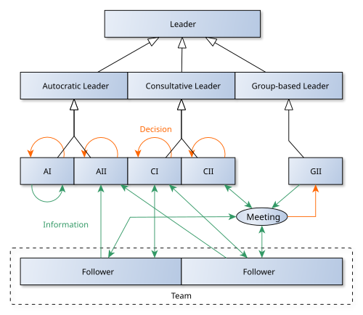

Slide 25
Robert House’s Path-Goal Theory (1971, 1996)
It's the leader's job to assist his or her followers in attaining their goals and to provide the direction or support needed to ensure that their goals are compatible with the overall objectives of the group or organization
The term path-goal is derived from the belief that effective leaders clarify the path to help their followers get from where they are to the achievement of their work goals and make the journey along the path easier by reducing roadblocks and pitfalls.
House assumes that leaders are flexible. In other words, path-goal theory assumes that the same leader can display any or all of these leadership styles depending on the situation.

Slide 26
Robert House’s Path-Goal Theory (1971, 1996)
Directive leader: The leader lets subordinates know what's expected of them, schedules work to be done, and gives specific guidance on how to accomplish tasks
Supportive leader: The leader is friendly and shows concern for the needs of followers
Participative leader: The leader consults with group members and uses their suggestions before making a decision
Achievement-oriented leader: The leader sets challenging goals and expects followers to perform at their highest level

Slide 27
Cutting-edge theories of leadership
Transformational-transactional leadership
Charismatic-visionary leadership
Team leadership

Slide 28
Transactional-Transformational Leadership
Transactional leadership | Transformational leadership
Leaders who guide or motivate their followers in the direction of established goals by clarifying role and task requirements | Leaders who inspire followers to transcend their own self-interests for the good of the organization and are capable of having a profound and extraordinary effect on their followers
 | Transformational leadership is more than charisma since the transformational leader attempts to instill in followers the ability to question not only established views but those views held by the leader

Slide 29
Charismatic-Visionary Leadership
Charismatic leader | Visionary leader
An enthusiastic, self-confident leader whose personality and actions influence people to behave in certain ways | Leader has the ability to create and articulate a realistic, credible, and attractive vision of the future that improves on the present situation
Charismatic leaders have a vision, are able to articulate that vision, are willing to take risks to achieve that vision, are sensitive to both environmental constraints and follower needs, and exhibit behaviors that are out of the ordinary | A vision should offer clear and compelling imagery that taps into people's emotions and inspires enthusiasm and energy to pursue the organization's goals. It should be able to generate possibilities that are inspirational and unique and that offer a new way of doing things and will lead to organizational distinction
 | Leader should have: ability to explain the vision to others; ability to express the vision not just verbally but through behavior; ability to extend or apply the vision to different leadership contexts

Slide 30
Team leadership
Coaching,
Facilitating,
Handling disciplinary problems,
Reviewing team and individual performance,
Training, and
Communication

Slide 31
Team leadership
Team leaders are liaisons with external constituencies (upper management, other organizational work teams, customers, or suppliers)
Team leaders are troubleshooters (solve problems)
Team leaders are conflict managers
Team leaders are coaches

Slide 32
Contemporary issues in leadership
POWER
Legitimate power (the power a leader has as a result of his or her position in the organization)
Coercive power (leader's ability to punish or control)
Reward power (power to give positive benefits or rewards)
Expert power (based on expertise, special skills, or knowledge)
Referent power (leader has desirable resources or personal traits)

Slide 33
TRUST
Integrity: honesty and truthfulness
Competence: technical and interpersonal knowledge and skills
Consistency: reliability, predictability, and good judgment in handling situations
Loyalty: willingness to protect a person, physically and emotionally
Openness: willingness to share ideas and information freely

Slide 34
Empowerment
Providing followers with decision-making opportunities
Delegation
Participation

Slide 35
Gender and Culture
Are females better than males in terms of leadership?
Are there cultural differences in leadership?

Slide 36
Thank you

