Slide 1
LangAlarmApp
Tassadit Sanaa
&
Stuti Misra

Slide 2
Team Work:
Brainstorm
Chose Idea
Divided Responsibilities
Debug Together
Research
Our first app and our first hackathon

Slide 3

What about the app?
Have you ever had trouble waking up early?
Have you ever been late for your work/classes because you slept in?
Do you like learning new languages?
LangAlarm is Here!
Image Source: http://activerain.trulia.com/image_store/uploads/8/7/5/9/1/ar134428392019578.png

Slide 4
What about the app?
LangAlarm is inspired from the idea of MathAlarm.
It helps users learn a language while their alarm is snoozing to wake them up.
The alarm would not stop until the user finishes answering 5 questions correctly!
It helps us to both learn and wake up on time!

Slide 5
Software & OS:
Windows/MAC OS
Android Studio/Eclipse
Language: Java

Slide 6
Challenges We Faced
Merging the Alarm and Quiz together
Making sure the alarm ran smoothly
The run time of the app

Slide 7
Future Developments
A more intensive Spanish course!
Find our language questions too easy? Three different levels coming up-Easy, Medium and Hard
More Languages- Languages like French, Arabic, and Hindi
The option to save your alarm

Slide 8
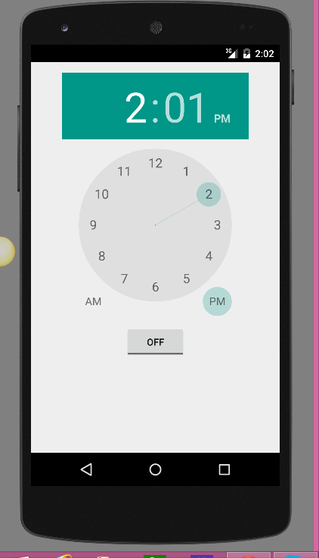
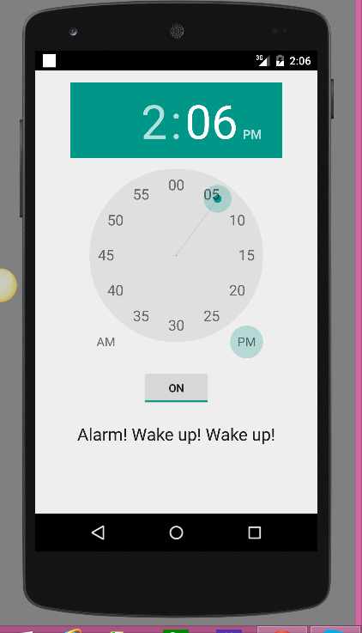
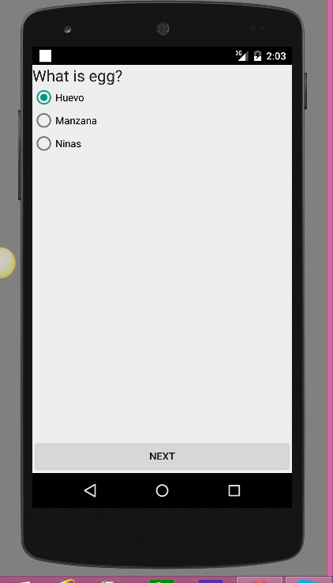
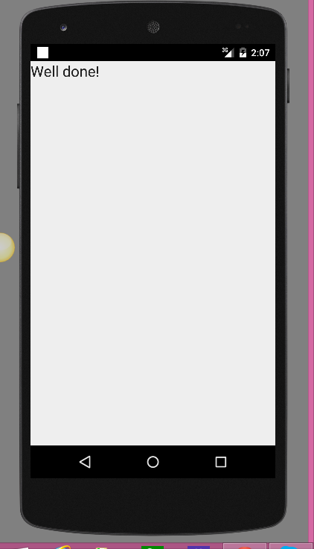
Demo:

Slide 9
Source Code:
https://github.com/stutim95/LangApp

Slide 10

References:
Image Source: http://inspire.org.mt/wp-content/uploads/2015/02/Thank-you-.png

