Slide 1

SkillHire: Gig Worker Marketplace
By STUTI SAXENA

Slide 2

Index
Problem Statement
Your solution
Working (Method/Mind map)
Conclusion.
Note: Slides (excluding Thank-you and Introduction slide) should not be more than 4.

Slide 3
Problem Statement
Gig Worker Marketplace Website
The objective of this project is to design and develop a fully responsive multi-page website for a gig worker marketplace.
The platform should allow users to:
Browse short-term hourly job services
Filter workers by service category and location
View worker availability and hourly rates
Book service slots easily
The website must include:
Structured UI design
Responsive layout for mobile devices
CSS animations and UI effects
Functional JavaScript features for booking and filtering

Slide 4
Your Solution
To solve this problem, we developed a responsive gig worker marketplace website using modern front-end technologies.
Technologies Used
HTML for website structure
CSS for layout, responsiveness, and animations
JavaScript for interactive functionality
Key Features
Service category grid
Worker profile cards with availability tags
Booking slot selection system
Location-based filtering
Total booking cost calculation
The website provides an easy and efficient way to connect users with gig workers.

Slide 5
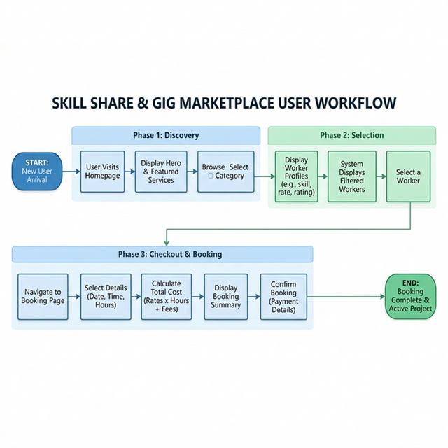
Working(Method/MindMap)

Slide 6
Conclusion
The Gig Worker Marketplace website demonstrates how modern web technologies can be used to build an interactive service platform.
Key Outcomes
Responsive multi-page website design
Organized service and worker profiles
Dynamic booking slot system
User-friendly interface with animations and filtering
This project shows how HTML, CSS, and JavaScript can be combined to create a functional front-end application. The system can be further expanded with databases, authentication, and backend integration.

Slide 7
Thank You

