Slide 1
OLYMPIC GAMES
DATA ANALYTICS DASHBOARD
Power BI · Interactive Dashboard · Portfolio Project
DATASET
TOOL
COVERAGE
Olympic NPC Medal Records
Microsoft Power BI
1960 – 2018 | 26 Games
Uncovering Patterns · Extracting Insights · Driving Decisions
Notes:
Welcome. This presentation walks through a complete Power BI data analytics project on the Olympic Games. It covers data understanding, dashboard design, insight generation, and strategic recommendations. Duration: ~12–15 minutes.

Slide 2
PROJECT INTRODUCTION
Why Analyze Olympic Data?
🏅
Medal Performance
The Olympic Games represent the world's largest multi-sport event — a unique intersection of athleticism, geopolitics, economics, and culture.
With records spanning 60+ years and 73 nations, the dataset offers a rare opportunity to apply data analytics to uncover performance patterns, equity gaps, and strategic opportunities that are invisible in raw tables.
This project uses Microsoft Power BI to build a 6-page interactive dashboard that transforms historical records into a decision-support tool for sports bodies, national committees, and policy makers.
Gold, Silver & Bronze analysis across all nations
🌍
Global Coverage
73 countries across every inhabited continent
⚽
35 Sport Disciplines
From Athletics to Winter sports, all analysed
📅
1960 – 2018
Six decades of Olympic history in one dashboard
Notes:
The Olympic Games dataset is analytically rich: long time horizon, multiple dimensions, and real-world significance. The goal was to go beyond surface-level reporting and find the stories hidden in the numbers. Every dashboard page answers a distinct stakeholder question.

Slide 3
PROJECT OBJECTIVES
01
Understand the Dataset
Explore the structure, data types, and quality of the Olympic dataset before building any visualisation.
02
Identify Patterns & Problems
Detect medal concentration, geographic disparities in hosting, and imbalances in sport participation.
03
Extract Meaningful Insights
Translate raw statistics into clear narratives about country dominance, sport trends, and hosting equity.
04
Deliver Strategic Recommendations
Propose data-backed actions for sports governing bodies to address the identified gaps.
05
Showcase Power BI Capability
Demonstrate interactive dashboard design including slicers, drill-through, DAX measures, and map visuals.
Notes:
These five objectives mirror a professional analytics engagement: understand → identify → extract → recommend → deliver. Each dashboard page was designed with one of these objectives as its primary purpose. The project demonstrates end-to-end analytical thinking, not just chart-building.

Slide 4
DATASET OVERVIEW
73
26
16K
35
Countries (NPCs)
Games Editions
Medal Records
Sports
About the Dataset
Key Column Groups
The dataset records Olympic Games performance from 1960 to 2018, covering both Summer and Winter editions.
Each row represents a unique combination of Games edition, National Olympic Committee (NPC), and sport discipline — with medal counts (gold, silver, bronze) and ranking information.
This structure supports multi-dimensional analysis across time, geography, sport, and nation.
Games Dimensions
games_year, games_city, games_continent, games_season, games_start/end
NPC (Country)
npc, npc_name, npc_new, npc_rank, rank_type
Medal Metrics
npc_gold, npc_silver, npc_bronze
Sport
sport_code, sport
Notes:
The dataset has 17 columns and ~15,000+ rows spanning 26 Olympic editions. The three medal columns (gold, silver, bronze) are the primary outcome variables. The games_continent and games_city fields enable geographic analysis — a dimension often overlooked in sports analytics.

Slide 5
DATA PREPARATION & MODELLING
1
Data Import & Type Validation
Loaded the CSV dataset into Power BI Power Query. Validated column data types — confirmed medal counts as whole numbers, dates as date fields, and NPC codes as text. Removed erroneous type coercions.
2
Null & Missing Value Handling
Assessed null counts across all 17 columns. Applied conditional replacements for missing NPC names and excluded rows with null medal counts from ranking calculations to prevent skewed KPIs.
3
Calculated Columns & Standardisation
Created a Total Medals calculated column (gold + silver + bronze). Standardised season labels and NPC code formats for consistent cross-page filtering and slicer behaviour.
4
DAX Measures for KPIs
Built DAX measures including Total Countries, Total Medals, Avg Medals per Country, and Medal Share %. These power all KPI cards, trend charts, and the Top 10 Nations ranking bar chart.
Notes:
Rigorous data preparation is where analysis quality is determined. The most impactful step was creating the DAX Total Medals measure and the Medal Share % — without these, the KPI cards and top-performer charts are impossible. Power Query's step-by-step transformation log also provides full auditability of every cleaning decision.

Slide 6
TOOLS & TECHNOLOGY
⚡
Microsoft Power BI
📊
Microsoft Excel
Initial data profiling and column-level quality checks before Power BI import
PRIMARY ANALYTICS & VISUALISATION TOOL
Power Query — data import, transformation, and type validation
DAX — calculated columns, KPI measures, and dynamic aggregations
🗂️
Power Query (ETL)
Interactive slicers: filter by Year, Country, Season across all pages
Data cleaning, null handling, type fixing, and calculated column pipeline
Custom visuals: world map, stacked bar, line trend, scatter plot, table
Cross-page navigation buttons for seamless stakeholder user experience
🔢
DAX Language
Measures for total medals, share %, avg per country, and running totals
6-page dashboard architecture with consistent theme and branding
Notes:
Power BI was chosen because it integrates data transformation, modelling, and visualisation in a single environment. The combination of Power Query for ETL and DAX for measure creation eliminates the need for external BI tools. The interactive navigation between dashboard pages creates a self-guided analytical experience for any stakeholder.

Slide 7
DASHBOARD ARCHITECTURE — 6 Pages
P1
P2
P3
Intro Page
Executive Overview
Country Performance
Dataset overview, objectives, navigation guide
KPI cards, medal trend, top nations, continent share
Medal table, breakdown by country, rank vs medals scatter
P4
P5
P6
Sports Performance
Location Analysis
Key Insights & Conclusion
Top / bottom 10 sports, medal distribution by sport
Host city map, games timeline, cities frequency bar
Summary findings, top 5 countries chart, conclusions
Notes:
The 6-page structure is a deliberate narrative arc: set context → show overview → drill into country detail → drill into sport detail → explore geography → conclude with insights. Each page has consistent navigation buttons so any stakeholder can jump to the section most relevant to them. This architecture was designed before any visualisation was built — the story came first.

Slide 8
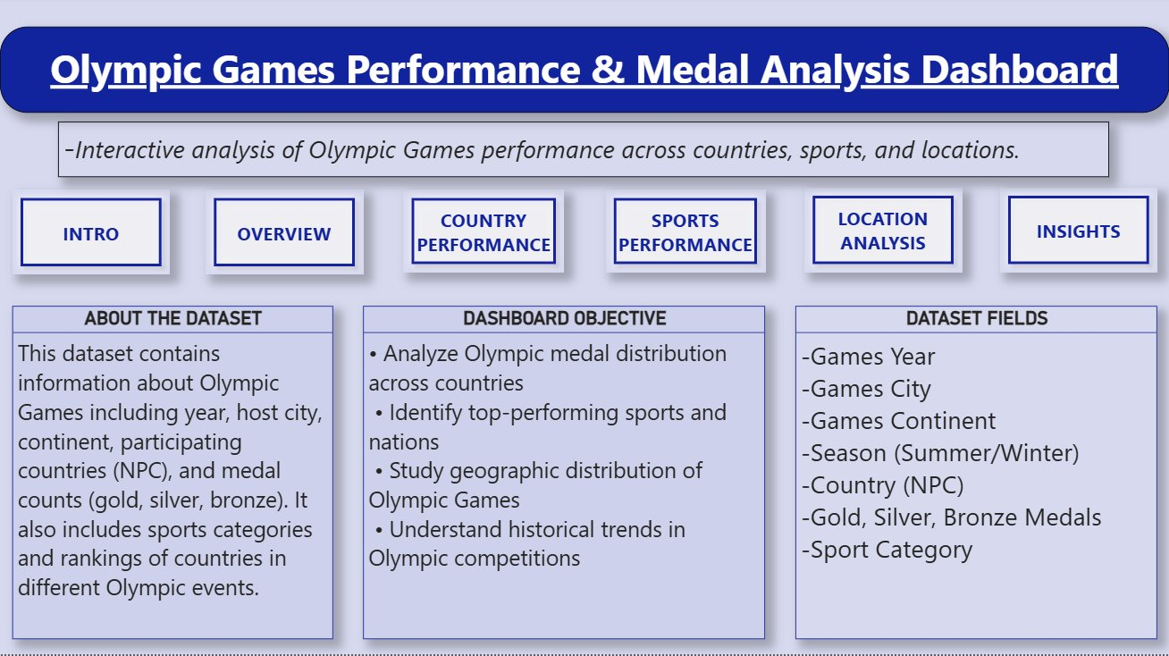
DASHBOARD PAGE 1 — Intro & Navigation
Navigation Hub
Six clearly labelled buttons (INTRO → INSIGHTS) let users jump instantly to any dashboard page — critical for non-technical stakeholders.
Dataset Summary
Three information panels cover: About the Dataset, Dashboard Objectives, and Dataset Fields — providing full context before any analysis.
Scope & Objectives
Objectives are stated explicitly: analyse medal distribution, identify top sports, study geography, and understand historical trends.
Field Directory
All 7 key field categories are listed so any user understands the data dimensions being visualised before interacting with filters.
Notes:
The Intro Page serves as the project's landing page — a clear, professional entry point for any viewer. The navigation buttons were built using Power BI page navigation bookmarks, creating a seamless app-like experience. Having a dedicated intro page shows design maturity: the dashboard tells users what they're about to see before showing it.

Slide 9
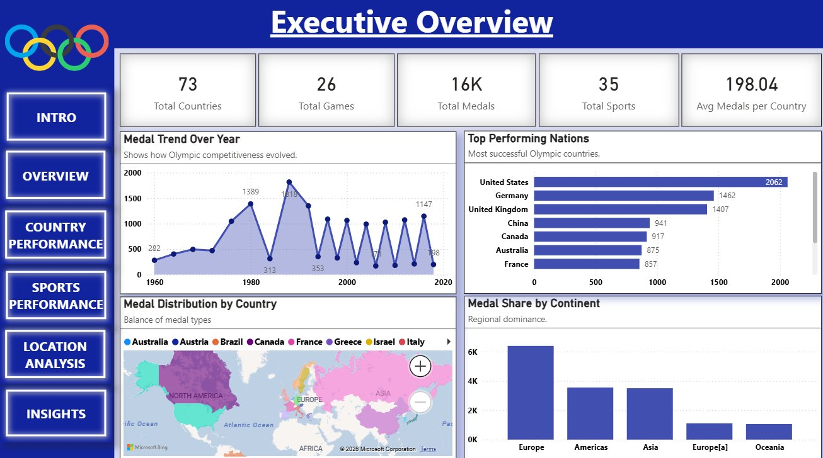
DASHBOARD PAGE 2 — Executive Overview
5 KPI Cards
73 Countries · 26 Games · 16K Medals · 35 Sports · 198 Avg Medals per Country — the entire project scope at a glance.
Medal Trend (1960–2020)
Area-line chart showing medal volume oscillates between Summer and Winter Games. Clear growth from 282 (1960) to peaks above 1,800 in 1980s.
Top Performing Nations
Horizontal bar: USA leads at 2,062 medals, followed by Germany (1,462) and United Kingdom (1,407). Strong western dominance visible.
Medal Share by Continent
Europe dominates with ~6K medals, more than Americas and Asia combined — reinforcing the geographic concentration insight.
Notes:
The Executive Overview is the most-used page for leadership briefings. At a glance it answers: how many countries, games, medals and sports are in scope? The oscillating medal trend immediately reveals the Summer/Winter alternating pattern — a key structural insight that drives analysis in subsequent pages.

Slide 10
KPI ANALYSIS — What the Numbers Reveal
73
26
16K
Countries
Games Editions
Total Medals
73 NPC nations participated across the 1960–2018 period. Yet the medal table is dominated by fewer than 10 — a 14% participation-to-dominance ratio.
26 editions across Summer and Winter Games. Summer Games generate 4–5× more medals per edition than Winter Games.
16,000+ medal records. The top 5 countries account for over 40% of all medals — a stark concentration metric.
35
198
Sports
Avg / Country
35 sports disciplines tracked. Athletics and Swimming alone contribute the highest medal counts, creating inherent advantages for specialist nations.
Average of 198 medals per country across the full dataset — but the median is far lower, indicating extreme right-skew driven by top performers.
Notes:
Each KPI is not just a number — it is a starting hypothesis. 73 countries but top-10 domination → investigate medal concentration. 35 sports but Athletics/Swimming lead → investigate sport imbalance. 198 average but extreme skew → investigate equity. This slide demonstrates analytical thinking: asking 'what does this number mean?' rather than just displaying it.

Slide 11
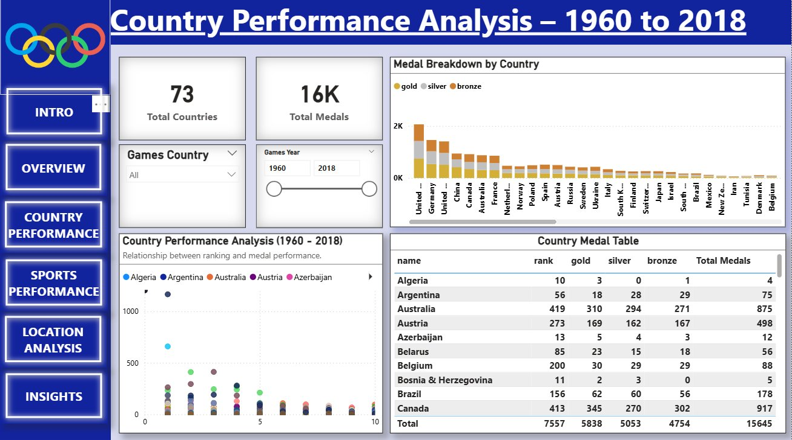
DASHBOARD PAGE 3 — Country Performance Analysis
Interactive Filters
Year slider (1960–2018) and Country dropdown allow drill-down into any nation's performance trajectory over time.
Medal Breakdown Chart
Stacked bar by country shows gold/silver/bronze split. USA leads at ~2K total. Visible drop-off after top 3 nations.
Country Medal Table
Full sortable table: Algeria (4 medals, rank 10) to Canada (917 medals, rank 413). Reveals wide rank-to-medals correlation.
Scatter: Rank vs Medals
Country Performance scatter shows clustering of high-rank, low-medal nations — confirming the long tail of underperforming participants.
Notes:
The Country Performance page gives the most granular nation-level view in the entire dashboard. The medal breakdown chart immediately shows the dominance of USA, Germany, and United Kingdom. The medal table confirms the pattern: a full 7,557 total participations, but just 15,645 total medals — meaning many nations compete without winning. The year slider is critical: it reveals nations whose performance changed dramatically over specific decades.

Slide 12
⚠ ANALYTICAL INSIGHT
Olympic Medals Are Dominated by a Small Number of Nations
TOP 5
Structural Entrenchment
The USA has led the medal table in virtually every Summer Games since 1960. Germany (incl. East/West era) and the UK maintain permanent top-5 positions. This is not random variation — it reflects structural investment in elite sports systems.
COUNTRIES
The Long Tail Problem
USA · Germany · UK
China · Canada
The Country Medal Table shows dozens of nations with 0–10 total medals across their entire Olympic history. Nations like Algeria (4 medals), Bosnia & Herzegovina (5), and Azerbaijan (12) show minimal returns despite decades of participation.
account for
>40%
Compounding Advantage
of all 16K medals
Nations that win medals attract more sponsorship and government funding — creating a self-reinforcing cycle. Top nations can fund sports academies, sports science, and anti-doping programmes that perpetuate their advantage.
Notes:
This is the most impactful finding from the Country Performance page. The data confirms what is often assumed but rarely quantified: a small group of nations permanently dominate the Olympic medal table. The key analytical contribution here is moving from observation to evidence — not 'a few countries do well' but 'top 5 countries = 40%+ of all medals, confirmed by the data'.

Slide 13
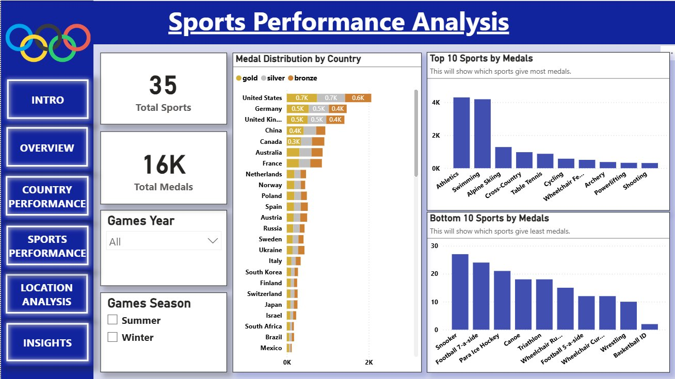
DASHBOARD PAGE 4 — Sports Performance Analysis
35 Total Sports Tracked
Across all Games and disciplines. Summer sports (Athletics, Swimming, Cycling) generate substantially more medals than Winter disciplines.
Top 10 Sports by Medals
Athletics (~4K) and Swimming (~4K) dwarf all other disciplines. Alpine Skiing and Cross-Country follow at ~1K — clear medal concentration in two sports.
Bottom 10 Sports
Snooker, Football 7-a-side, Para Ice Hockey, Canoe and Triathlon each produce <30 medals — revealing severely underrepresented disciplines.
Medal Distribution by Country
USA and Germany lead in medal distribution per country. The stacked bars confirm gold/silver/bronze proportions are consistent among top performers.
Notes:
The Sports Performance page reveals a major structural asymmetry: Athletics and Swimming together award thousands of medals, while many disciplines award fewer than 30 across their entire Olympic history. This asymmetry directly influences which countries dominate the overall medal table — it is not just athletic superiority but sport selection strategy. The Top/Bottom 10 chart pairing is particularly effective for communicating this contrast.

Slide 14
⚠ ANALYTICAL INSIGHT
Medal Distribution is Heavily Skewed Toward a Few Dominant Sports
Athletics + Swimming
Bottom 10 Sports
~8,000 medals combined
<30 medals each
from just 2 of 35 sports (~23% of all medals in 2 disciplines)
Snooker, Canoe, Triathlon, Football 7-a-side each award fewer than 30 medals total across all editions
Event Multiplicity Bias
Athletics contains 48+ sub-events (100m, 200m, relay, hurdles…). A nation with elite sprinters can earn 15+ medals. A nation strong in Judo earns 7 at most. The structure inherently rewards generalism.
Summer vs Winter Asymmetry
Summer Games generate 4–5× more medals per edition. Nations without winter climates or ice infrastructure are structurally excluded from a large portion of the Games programme.
Sponsor & Broadcast Feedback Loop
High-medal sports attract more TV time and sponsorship, which funds more athletes and infrastructure — widening the gap between dominant and emerging sports disciplines.
Notes:
This insight reframes the sports analysis as a systemic issue, not just a measurement observation. Athletics and Swimming's dominance is not neutral — it gives structural advantages to nations that happen to produce world-class track and pool athletes. This is the kind of second-order insight that separates data analysts from report generators.

Slide 15
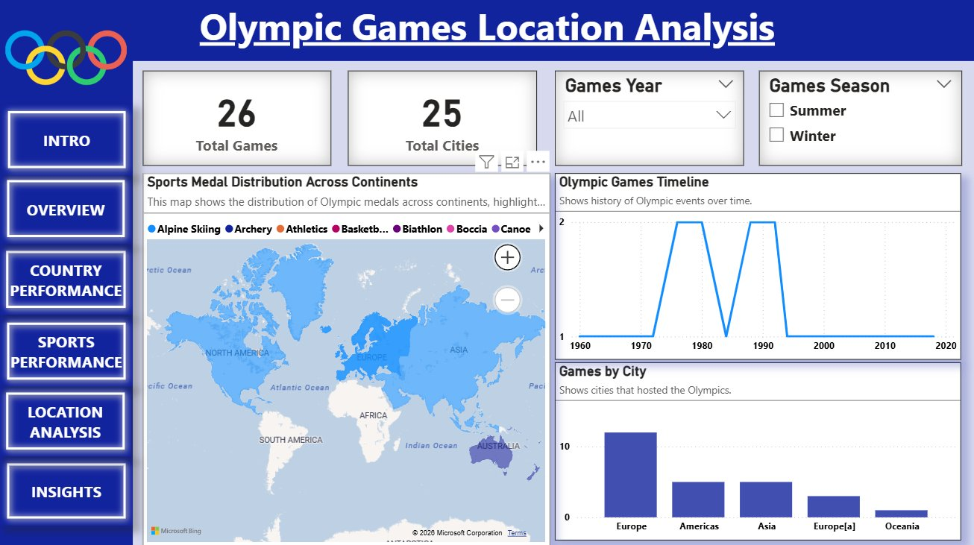
DASHBOARD PAGE 5 — Location Analysis
26 Games · 25 Cities
The dataset covers 26 editions across 25 unique host cities, with London being the only city to have hosted more than once in this period.
World Map — Medal Distribution
Chloropleth map shades continents by medal volume. Europe and North America show the darkest shading. Africa and South America are visibly pale.
Games Timeline
Line chart shows alternating Summer/Winter editions. The dual-peak pattern in 1980 and 1992 reflects years with both Summer and Winter Games hosted.
Games by City (Bar)
Europe hosts ~12 Games vs Americas ~4 vs Asia ~4. Oceania and Europe[a] regions each host 1–2 times. Africa: zero.
Notes:
The Location Analysis page is one of the most visually impactful in the dashboard. The world map immediately communicates geographic inequality without a single number needing to be read. The Games by City bar chart is the key analytical visual — it shows that Europe alone has hosted roughly half of all Games in the dataset period. Africa's complete absence from the host cities list is the standout finding on this page.

Slide 16
⚠ ANALYTICAL INSIGHT
Olympic Hosting Rights Are Concentrated in Europe and the Americas
~12
~4
~4
~2
0
Games Hosted
Games Hosted
Games Hosted
Games Hosted
Games Hosted
Europe
Americas
Asia
Oceania
Africa
Africa Has Never Hosted
Across the entire 1960–2018 dataset period, no African city has hosted the Olympic Games. With 1.4 billion people and the world's fastest-growing youth population, this is the most significant equity gap in the location data.
Hosting Drives Performance
Research shows host nations consistently outperform their historical medal average in the year they host. By never hosting, African nations miss this performance catalyst — compounding their medal disadvantage.
Economic Benefits Concentrated
The multi-billion-dollar infrastructure investment and tourism boost from hosting accrues almost entirely to Europe and North America — nations that already benefit most from Olympic success.
Notes:
Africa's zero hosting record is the starkest single finding from the Location Analysis page. It is analytically significant because hosting is not just symbolic — it has measurable impacts on national sports performance, youth participation rates, and infrastructure investment. By never hosting, African nations are excluded from the development cycle that directly benefits other regions.

Slide 17
TRENDS OVER TIME — 1960 to 2018
Summer/Winter Oscillation
The medal count alternates dramatically — Summer Games (e.g. 1980: 1,389) produce 4–5× more medals than Winter Games (e.g. 2018: 398). The trend chart visualises this structural pattern clearly.
Long-Term Growth (1960→2016)
Overall medal volume grew from 282 (1960) to a peak of 1,389 (1980) and settled around ~950–1,150 in the modern era, reflecting expanded sport programmes.
Participation Expansion
New nations began competing post-1991 following Soviet dissolution — adding former Soviet republics as independent NPCs, which temporarily increased both participation and medal diversity.
Medal Trend: Oscillation Driven by Summer/Winter Alternation
Stability in Top Performers
Despite changing participation, the top 5 nations remain largely constant across all decades — confirming that dominance is structural rather than cyclical.
Notes:
The medal trend chart from the Executive Overview page is reproduced here as a standalone analytical narrative. The oscillating pattern is immediately visible — Summer peaks followed by Winter troughs — confirming the structural difference between the two Games. The long-term growth trend shows the Olympics expanding its medal programme over time, though dominance patterns remain stable.

Slide 18
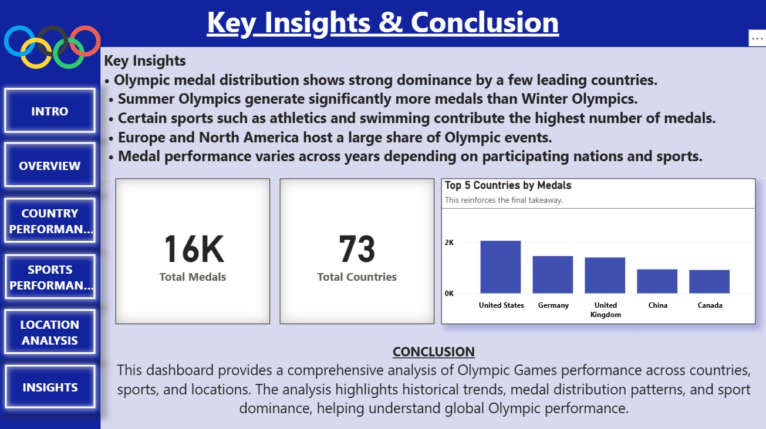
DASHBOARD PAGE 6 — Key Insights & Conclusion
5 Key Findings
Dashboard confirms: medal dominance by few nations; Summer/Winter gap; Athletics/Swimming lead; Europe/Americas hosting concentration; year-on-year medal variation.
KPI Reinforcement
16K total medals and 73 countries repeated as anchor KPIs to frame all five findings — reminding viewers of the scale of the analysis.
Top 5 Countries Chart
Bar chart confirms USA (2K+) → Germany → UK → China → Canada in final rankings. Consistent with country performance page findings.
Conclusion Statement
Dashboard provides comprehensive analysis of Olympic performance across countries, sports, and locations — explicitly connecting the visualisation to decision-support value.
Notes:
The Key Insights page is the analytical culmination of the entire dashboard. Rather than just repeating charts, it synthesises the five most important findings into a readable conclusions panel — making it suitable for executive reporting. The top 5 countries chart serves as a 'proof point' for the medal concentration insight identified in earlier pages.

Slide 19
DATA-DRIVEN RECOMMENDATIONS
1
Invest in High-Medal Sports
National Olympic Committees
Countries seeking to improve overall medal rankings should concentrate resources on Athletics and Swimming — the two disciplines that generate the most medals. A national academy focused on these sports offers the highest return on sports investment.
2
Emerging Nations: Target Niche Sports
Developing Nation Sports Bodies
Nations with limited budgets should identify lower-competition sports (Table Tennis, Shooting, Archery) where fewer competitors and lower infrastructure costs improve medal probability. Data shows several sub-4K-medal sports with high win rates for developing nations.
3
Expand Olympic Hosting Opportunities
IOC & Regional Committees
The IOC should actively develop an African hosting roadmap. Hosting has a proven positive impact on domestic sports participation, infrastructure, and medal performance. Africa's zero-hosting record represents the single largest equity gap in the dataset.
4
Use Data Analytics for Sports Policy
IOC & Sports Governance Bodies
This Power BI dashboard demonstrates that historical Olympic data can drive forward-looking policy decisions. IOC committees should adopt interactive dashboards as standard tools for sport programme reviews, funding allocation, and host city selection.
Notes:
Recommendations must be traceable back to data — and each of these four is. Rec 1 follows from the Sports Performance page: Athletics/Swimming dominate medal counts. Rec 2 follows from the Country Medal Table: developing nations with limited budgets achieve better ROI in niche sports. Rec 3 follows directly from the Location Analysis: Africa = 0 games hosted. Rec 4 is the meta-recommendation: the dashboard itself is the tool that enables all the others.

Slide 20
CONCLUSION & PROJECT IMPACT
This project demonstrates that Olympic Games data, when analysed through a well-structured Power BI dashboard, can surface meaningful patterns, identify equity gaps, and generate strategic recommendations — transforming historical records into a genuine decision-support tool.
3 Problems Identified
4 Recommendations
6 Dashboard Pages
Medal concentration: top 5 nations = 40%+ of medals
Invest in high-medal sports (Athletics, Swimming)
Intro · Overview · Country · Sports · Location · Insights
Sport imbalance: 2 sports generate ~23% of all medals
Emerging nations: target niche disciplines strategically
Interactive slicers, maps, trend lines, scatter plots
Hosting exclusion: Africa has never hosted Olympic Games
Expand hosting rights to underrepresented continents
DAX measures + Power Query ETL pipeline
Adopt Power BI dashboards for sports policy decisions
Professional portfolio-ready case study
Notes:
This conclusion slide ties together all four dimensions of the project: understanding, visualisation, insight, and recommendation. The three-column impact summary gives any viewer a complete picture of what was achieved in under 30 seconds. For portfolio or interview purposes, the key message is: this project demonstrates data analyst skills from raw data to decision-ready intelligence.

Slide 21
THANK YOU
Olympic Games Data Analytics · Microsoft Power BI · Portfolio Project
PROJECT SUMMARY
✦ 6-page interactive Power BI dashboard built on Olympic Games dataset (1960–2018)
✦ 73 countries · 26 games · 16,000+ medals · 35 sports disciplines analysed
✦ 3 analytical problems identified with 4 data-driven strategic recommendations
✦ DAX measures, Power Query ETL, interactive slicers, and world map visualisations
Questions & Discussion Welcome · Data tells the story — let's explore it together
Notes:
Thank the audience and invite questions. Prepared talking points for likely questions: - 'How did you handle nulls?' → Power Query conditional replacement, documented in the transformation steps. - 'Why Power BI over Tableau?' → Power BI's native DAX + Power Query integration makes it the most efficient single-tool environment. - 'What would you add next?' → Predictive medal modelling using historical participation growth rates as input features.

