Slide 1
PHARMACIA:
A COMPREHENSIVE PHARMACY MANAGEMENT SYSTEM

Slide 2

Introduction to Pharmacy Management
In today's fast-paced healthcare environment, a comprehensive pharmacy management system is essential for improving operational efﬁciency. This project will explore key components, beneﬁts, and implementation strategies that enhance pharmacy operations and patient care.

Slide 3

KEY COMPONENTS OF THE SYSTEM
A successful pharmacy management system includes inventory management, prescription processing, and patient record integration. These components work together to streamline workﬂows, reduce errors, and ensure compliance with regulatory standards, ultimately enhancing service quality.

Slide 4

BENEFITS OF IMPLEMENTATION
Implementing a pharmacy management system leads to signiﬁcant cost savings, improved patient safety, and enhanced workﬂow efﬁciency. By automating routine tasks, pharmacists can focus more on patient care and medication management, resulting in better health outcomes.

Slide 5

CHALLENGES IN ADOPTION
Despite the beneﬁts, challenges such as staff training, system integration, and resistance to change may arise during implementation. Addressing these challenges proactively is crucial for a smooth transition and maximizing the system's potential.

Slide 6

CASE STUDIES OF SUCCESS
Several pharmacies have successfully adopted comprehensive management systems, reporting increased efﬁciency and reduced errors. These case studies highlight the importance of tailored solutions and ongoing support to achieve desired outcomes and patient satisfaction.

Slide 7
KEY FEATURES
Inventory Management: Tracks stock levels, expiry dates, and alerts for low stock
Sales Management: Records transactions, generates bills, and maintains sales history
Customer Management: Stores customer details, medical history, and prescription records
Reporting: Generates reports on inventory, sales, and other key metrics
User Authentication: Secure login system for admins and staff

Slide 8
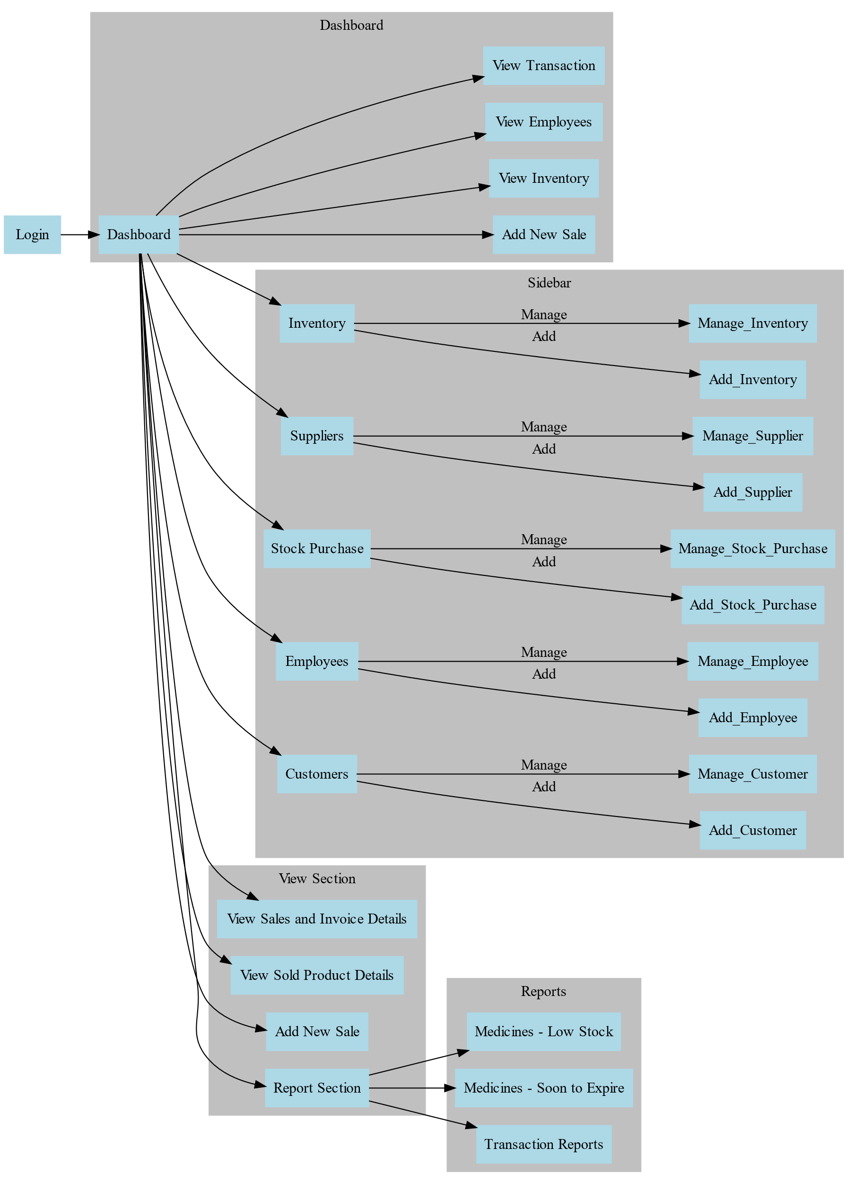
WORKFLOW

Slide 9
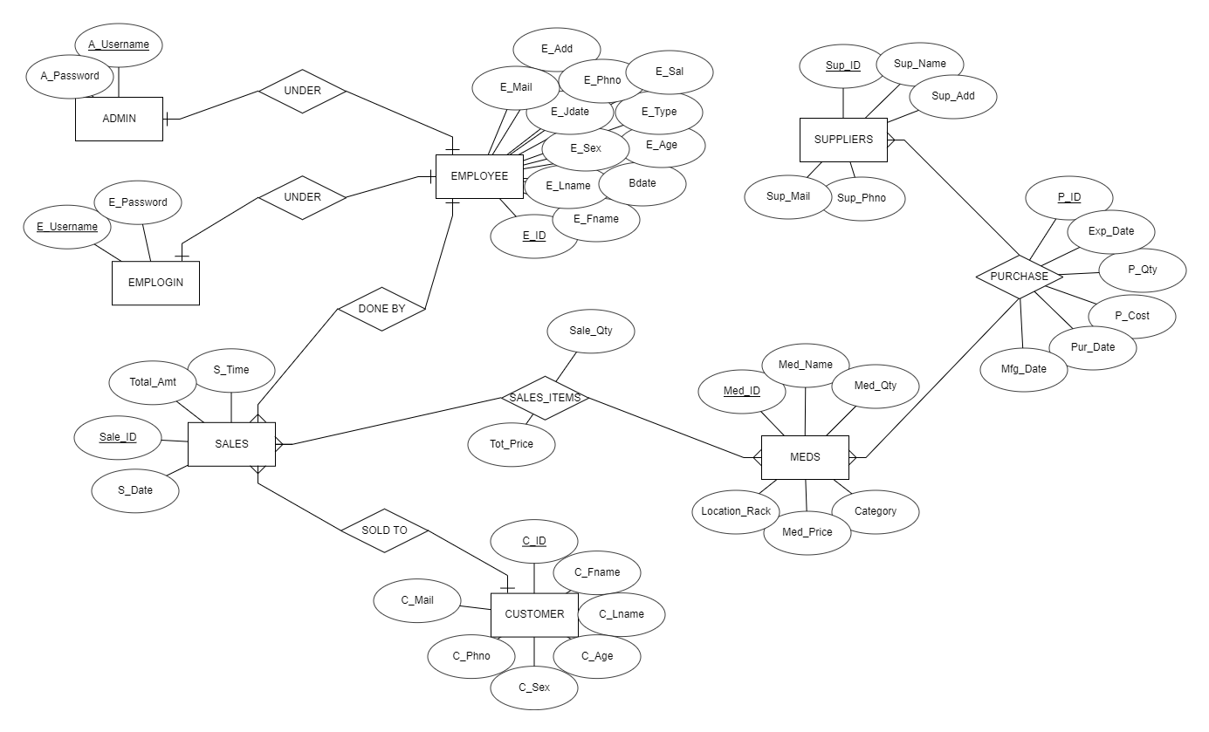
ER DIAGRAM

Slide 10
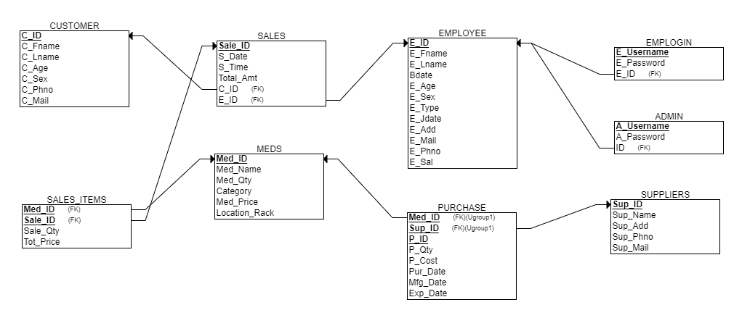
REALATIONAL MODEL

Slide 11
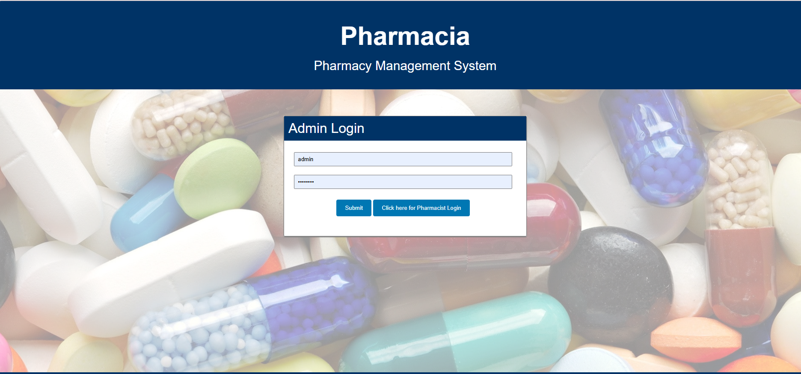
IMPLEMENTATION
LOGIN PAGE

Slide 12
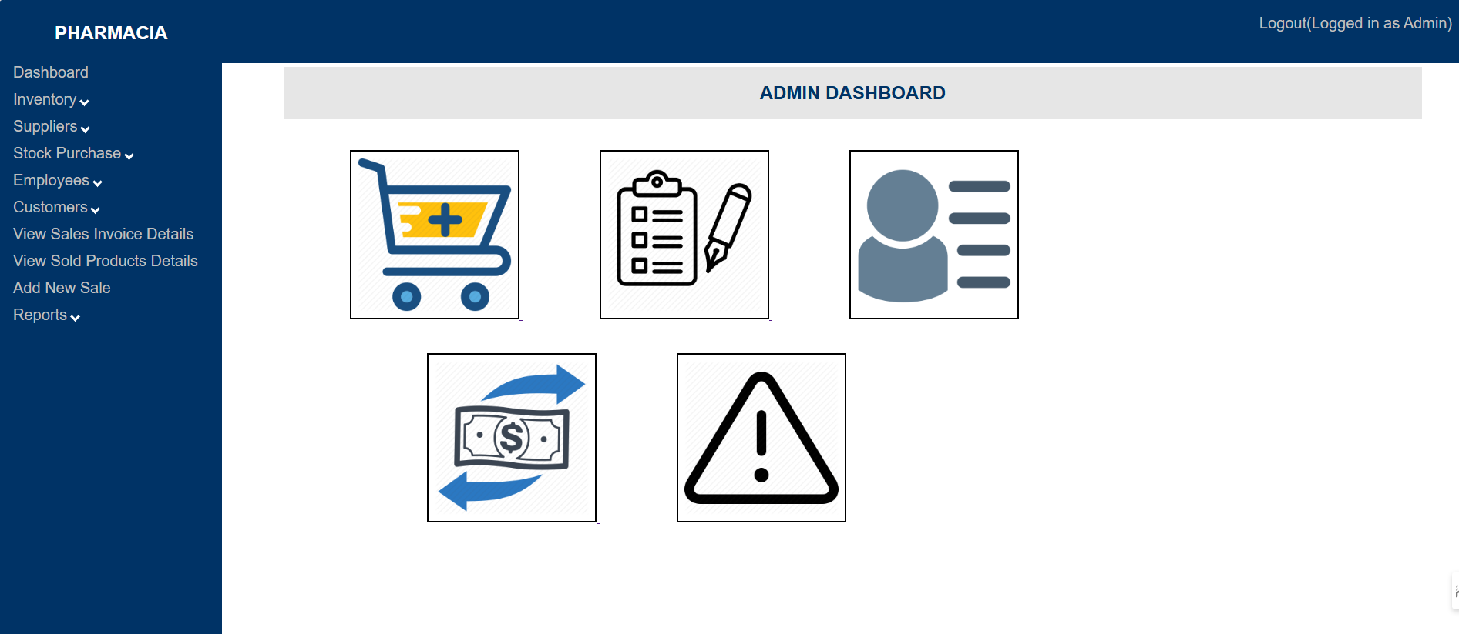
IMPLEMENTATION
DASHBOARD

Slide 13
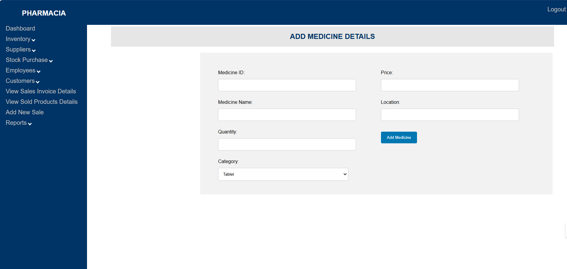
IMPLEMENTATION
INVENTORY MANAGEMENT

Slide 14
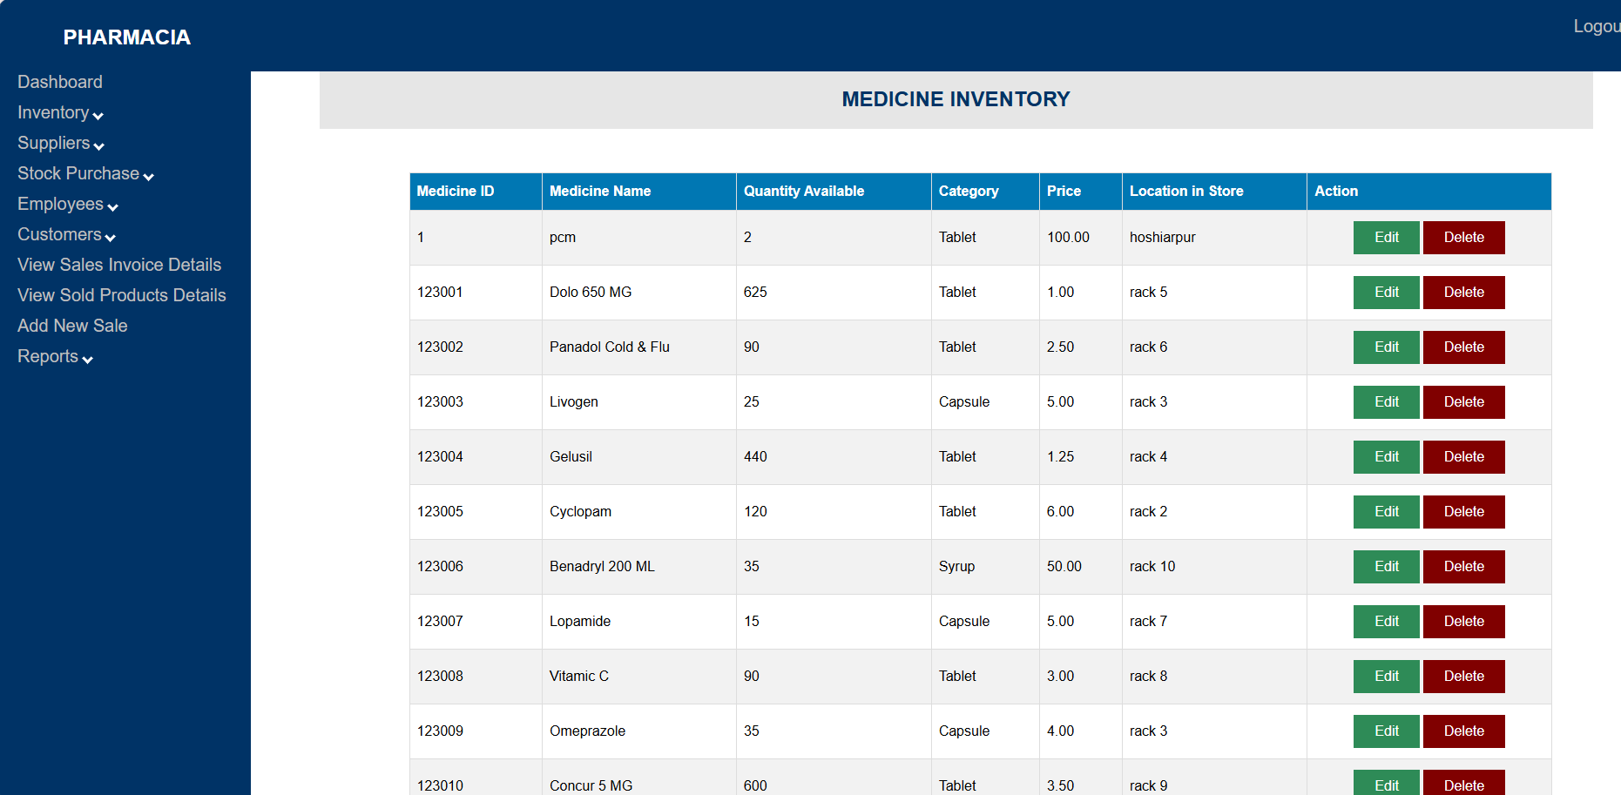
IMPLEMENTATION
VIEW REPORTS

Slide 15
CONCLUSION AND FUTURE OUTLOOK
In conclusion, a comprehensive pharmacy management system is vital for enhancing operational efﬁciency. As technology continues to evolve, pharmacies must embrace these systems to stay competitive, improve care delivery, and adapt to future healthcare challenges.

Slide 16

Thanks!

