Slide 1
Coup Traps
How failed coup attempts can make additional coup attemps more likely.

Slide 2
Inspired by Andrew T. Little (2017) “Coordination, Learning, and Coups.”
Journal of Conflict Resolution 61(1): 204-234.

Slide 3
think of a military officer who would like to participate in a coup attempt IF it would be successful.

Slide 4
think of a military officer who would like to participate in a coup attempt IF it would be successful.
If a coup starts, some of her fellow officers will join the cause...

Slide 5
think of a military officer who would like to participate in a coup attempt IF it would be successful.
But others will stay loyal to the government.

Slide 6
think of a military officer who would like to participate in a coup attempt IF it would be successful.
Of course, the coup is more likely to succeed if more officers will contribute.

Slide 7

think of a military officer who would like to participate in a coup attempt IF it would be successful.
So an officer’s willingness to participate in a coup attempt may depend on her beliefs about how many of her fellow officers would also participate.

Slide 8
Imagine a military officer who has beliefs like this

Slide 9
Imagine a military officer who has uncertainty like this
if there is an attempted coup, how many other officers will participate?
Will a coup be attempted and if so will it succeed?

Slide 10


Imagine a military officer who has uncertainty like this
if there is an attempted coup, how many other officers will participate?
few
many
$$1−μ$$
$$μ$$
Will a coup be attempted and if so will it succeed?

Slide 11
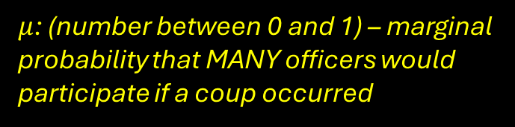
Imagine a military officer who has uncertainty like this
if there is an attempted coup, how many other officers will participate?
few
many
$$1−μ$$
$$μ$$
$μ$: (number between 0 and 1) – marginal probability that MANY officers would participate if a coup occurred
Will a coup be attempted and if so will it succeed?

Slide 12



Imagine a military officer who has uncertainty like this
if there is an attempted coup, how many other officers will participate?
few
many
$$1−μ$$
$$μ$$
$μ$: (number between 0 and 1) – marginal probability that MANY officers would participate if a coup occurred
no attempt
$$\frac{1}{2}$$
Will a coup be attempted and if so will it succeed?
$$\frac{1}{4}$$
attempt and failure
$$\frac{1}{4}$$
attempt and success

Slide 13


Imagine a military officer who has uncertainty like this
if there is an attempted coup, how many other officers will participate?
few
many
$$1−μ$$
$$μ$$
$μ$: (number between 0 and 1) – marginal probability that MANY officers would participate if a coup occurred
no attempt
$$\frac{1}{2}$$
$$P\left(\text{attempt} | \text{many}\right)= \frac{1}{2}$$
$$P\left(\text{success}│\text{attempt}\text{ \& }\text{many}\right)= \frac{1}{2}$$
Will a coup be attempted and if so will it succeed?
$$\frac{1}{4}$$
attempt and failure
$$\frac{1}{4}$$
attempt and success

Slide 14
Imagine a military officer who has uncertainty like this
if there is an attempted coup, how many other officers will participate?
few
many
$$1−μ$$
$$μ$$
$μ$: (number between 0 and 1) – marginal probability that MANY officers would participate if a coup occurred
no attempt
$$\frac{1}{2}$$
$$P\left(\text{attempt} | \text{many}\right)= \frac{1}{2}$$
$$P\left(\text{success}│\text{attempt}\text{ \& }\text{many}\right)= \frac{1}{2}$$
Will a coup be attempted and if so will it succeed?
$$\frac{1}{4}$$
attempt and failure
THEREFORE:
P(no attempt | many) =
1 – P(attempt | many) = 1/2
$$\frac{1}{4}$$
attempt and success

Slide 15
Imagine a military officer who has uncertainty like this
if there is an attempted coup, how many other officers will participate?
few
many
$$1−μ$$
$$μ$$
$μ$: (number between 0 and 1) – marginal probability that MANY officers would participate if a coup occurred
no attempt
$$\frac{1}{2}$$
$$P\left(\text{attempt} | \text{many}\right)= \frac{1}{2}$$
$$P\left(\text{success}│\text{attempt}\text{ \& }\text{many}\right)= \frac{1}{2}$$
Will a coup be attempted and if so will it succeed?
$$\frac{1}{4}$$
attempt and failure
THEREFORE:
P(attempt & failure | many) =
P(attempt | many) X P(failure | attempt & many) =
1/4
$$\frac{1}{4}$$
attempt and success

Slide 16
Imagine a military officer who has uncertainty like this
if there is an attempted coup, how many other officers will participate?
few
many
$$1−μ$$
$$μ$$
$μ$: (number between 0 and 1) – marginal probability that MANY officers would participate if a coup occurred
no attempt
$$\frac{1}{2}$$
Will a coup be attempted and if so will it succeed?
$$\frac{1}{4}$$
attempt and failure
$$\frac{1}{4}$$
attempt and success

Slide 17

Imagine a military officer who has uncertainty like this
if there is an attempted coup, how many other officers will participate?
few
many
$$1−μ$$
$$μ$$
$μ$: (number between 0 and 1) – marginal probability that MANY officers would participate if a coup occurred
no attempt
no attempt
$$1−α\frac{1}{2}$$
$$\frac{1}{2}$$
Will a coup be attempted and if so will it succeed?
$$\frac{1}{4}$$
attempt and failure
$$\frac{1}{4}$$
attempt and success

Slide 18
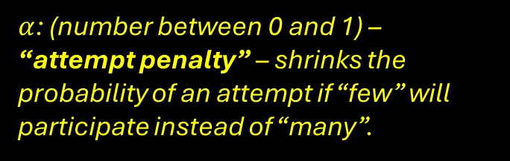
Imagine a military officer who has uncertainty like this
if there is an attempted coup, how many other officers will participate?
few
many
$$1−μ$$
$$μ$$
$μ$: (number between 0 and 1) – marginal probability that MANY officers would participate if a coup occurred
no attempt
no attempt
$$1−α\frac{1}{2}$$
$α$: (number between 0 and 1) – “attempt penalty” – shrinks the probability of an attempt if “few” will participate instead of “many”.
$$\frac{1}{2}$$
Will a coup be attempted and if so will it succeed?
$$\frac{1}{4}$$
attempt and failure
$$\frac{1}{4}$$
attempt and success

Slide 19

Imagine a military officer who has uncertainty like this
if there is an attempted coup, how many other officers will participate?
few
many
$$1−μ$$
$$μ$$
$μ$: (number between 0 and 1) – marginal probability that MANY officers would participate if a coup occurred
no attempt
no attempt
$$1−α\frac{1}{2}$$
$α$: (number between 0 and 1) – “attempt penalty” – shrinks the probability of an attempt if “few” will participate instead of “many”.
$$\frac{1}{2}$$
Will a coup be attempted and if so will it succeed?
$$\frac{1}{4}$$
attempt and failure
$$\frac{1}{4}$$
attempt and success
$$σα\frac{1}{4}$$
attempt and success

Slide 20
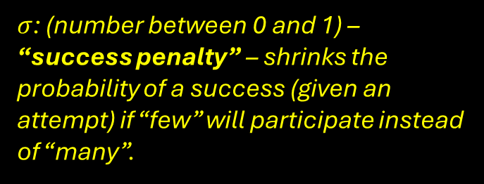
Imagine a military officer who has uncertainty like this
if there is an attempted coup, how many other officers will participate?
few
many
$$1−μ$$
$$μ$$
$μ$: (number between 0 and 1) – marginal probability that MANY officers would participate if a coup occurred
no attempt
no attempt
$$1−α\frac{1}{2}$$
$α$: (number between 0 and 1) – “attempt penalty” – shrinks the probability of an attempt if “few” will participate instead of “many”.
$$\frac{1}{2}$$
Will a coup be attempted and if so will it succeed?
$σ$: (number between 0 and 1) – “success penalty” – shrinks the probability of a success (given an attempt) if “few” will participate instead of “many”.
$$\frac{1}{4}$$
attempt and failure
$$\frac{1}{4}$$
attempt and success
$$σα\frac{1}{4}$$
attempt and success

Slide 21

Imagine a military officer who has uncertainty like this
if there is an attempted coup, how many other officers will participate?
few
many
$$1−μ$$
$$μ$$
$μ$: (number between 0 and 1) – marginal probability that MANY officers would participate if a coup occurred
no attempt
no attempt
$$1−α\frac{1}{2}$$
$α$: (number between 0 and 1) – “attempt penalty” – shrinks the probability of an attempt if “few” will participate instead of “many”.
$$\frac{1}{2}$$
Will a coup be attempted and if so will it succeed?
attempt and failure
$σ$: (number between 0 and 1) – “success penalty” – shrinks the probability of a success (given an attempt) if “few” will participate instead of “many”.
$$\frac{1}{4}$$
attempt and failure
$$α\frac{1}{2}(1−σ\frac{1}{2})$$
$$\frac{1}{4}$$
attempt and success
$$σα\frac{1}{4}$$
attempt and success

Slide 22
Imagine a military officer who has uncertainty like this
if there is an attempted coup, how many other officers will participate?
few
Suppose an officer with these beliefs observes a failed attempt, but does not observe whether few or many other officers participated in the failed attempt.
many
$$1−μ$$
$$μ$$
no attempt
no attempt
Suppose the officer observes a FAILED ATTEMPT, but does not observe whether few or many officers participated.
$$1−α\frac{1}{2}$$
$$\frac{1}{2}$$
Will a coup be attempted and if so will it succeed?
attempt and failure
$$\frac{1}{4}$$
attempt and failure
$$α\frac{1}{2}(1−σ\frac{1}{2})$$
$$\frac{1}{4}$$
attempt and success
$$σα\frac{1}{4}$$
attempt and success

Slide 23

Imagine a military officer who has uncertainty like this
if there is an attempted coup, how many other officers will participate?
few
Suppose an officer with these beliefs observes a failed attempt, but does not observe whether few or many other officers participated in the failed attempt.
many
$$1−μ$$
$$μ$$
no attempt
no attempt
Suppose the officer observes a FAILED ATTEMPT, but does not observe whether few or many officers participated.
$$1−α\frac{1}{2}$$
Write the expression for the officer’s updated beliefs about whether few or many officers would participate in a coup attempt – i.e.
$$P(\text{many}|\text{attempt}\text{ \& }\text{failure})$$
$$\frac{1}{2}$$
Will a coup be attempted and if so will it succeed?
attempt and failure
$$\frac{1}{4}$$
attempt and failure
$$α\frac{1}{2}(1−σ\frac{1}{2})$$
$$\frac{1}{4}$$
attempt and success
$$σα\frac{1}{4}$$
attempt and success

Slide 24
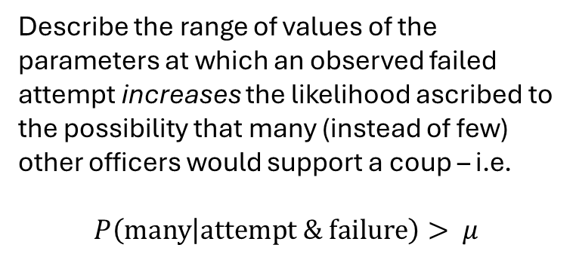
Imagine a military officer who has uncertainty like this
if there is an attempted coup, how many other officers will participate?
few
Suppose an officer with these beliefs observes a failed attempt, but does not observe whether few or many other officers participated in the failed attempt.
many
$$1−μ$$
$$μ$$
no attempt
no attempt
Suppose the officer observes a FAILED ATTEMPT, but does not observe whether few or many officers participated.
$$1−α\frac{1}{2}$$
Write the expression for the officer’s updated beliefs about whether few or many officers would participate in a coup attempt – i.e.
$$P(\text{many}|\text{attempt}\text{ \& }\text{failure})$$
$$\frac{1}{2}$$
Will a coup be attempted and if so will it succeed?
attempt and failure
$$\frac{1}{4}$$
attempt and failure
$$α\frac{1}{2}(1−σ\frac{1}{2})$$
Describe the range of values of the parameters at which an observed failed attempt increases the likelihood ascribed to the possibility that many (instead of few) other officers would support a coup – i.e.
$$P\left(\text{many} | \text{attempt}\text{ \& }\text{failure}\right)> μ$$
$$\frac{1}{4}$$
attempt and success
$$σα\frac{1}{4}$$
attempt and success

