Slide 1
In-Out Games

Slide 2
Your List This Week
Work through Lesson 8
Problem solving sessions this Thursday and Friday

Slide 3
In-Out Games How To
Definition of In-Out Games
An example – “I Need a Buddy”
Steps to Identifying Nash Equilibria in In-Out Games
Practicing/Demonstrating the Steps – Substitutes vs. Complements

Slide 4
IN-OUT GAMES -- DEFINITION

Slide 5
IN-OUT GAMES -- DEFINITION
N persons, where N is an integer greater than or equal to 3.
Each person has two available actions: in and out.
Each person’s preferences over her available actions depend on the number of persons other than herself who do in.

Slide 6
IN-OUT GAMES -- APPLICATIONS

Slide 7
IN-OUT GAMES -- APPLICATIONS
Persons in a population each choosing whether to participate in a protest.
Wealthy individuals each choosing whether to make a donation to a political candidate or party.
Persons each choosing whether to enter an electoral race as candidates.
Persons in an organization each choosing whether to put work into a shared project.
Military officers each choosing whether to participate in a conspiracy to overthrow a civilian government

Slide 8

In-Out Games How To
Definition of In-Out Games
An example – “I Need a Buddy”
Steps to Identifying Nash Equilibria in In-Out Games
Practicing/Demonstrating the Steps – Substitutes vs. Complements

Slide 9
IN-OUT GAMES – EXAMPLE: “I NEED A BUDDY”

Slide 10
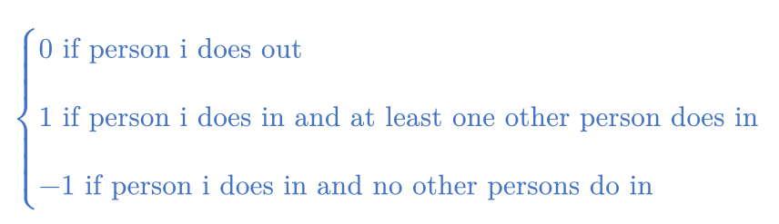
IN-OUT GAMES – EXAMPLE: “I NEED A BUDDY”
10 Persons
Each person chooses in or out
Each person i’s utility level is given by:

Slide 11
IN-OUT GAMES – EXAMPLE: “I NEED A BUDDY”
any given person, “i”

Slide 12
IN-OUT GAMES – EXAMPLE: “I NEED A BUDDY”
any given person, “i”
the other 9 persons

Slide 13
IN-OUT GAMES – EXAMPLE: “I NEED A BUDDY”
any given person, “i”
the other 9 persons
one does in the others do out...
...i’s utility from out is 0 and from in is 1.

Slide 14
IN-OUT GAMES – EXAMPLE: “I NEED A BUDDY”
any given person, “i”
the other 9 persons
all do out...
...i’s utility from out is 0 and from in is -1.
one does in the others do out...
...i’s utility from out is 0 and from in is 1.

Slide 15
IN-OUT GAMES – EXAMPLE: “I NEED A BUDDY”
any given person, “i”
the other 9 persons
all do out...
...i’s utility from out is 0 and from in is -1.
one does in the others do out...
...i’s utility from out is 0 and from in is 1.
two do in the others do out...
...i’s utility from out is 0 and from in is 1.

Slide 16
IN-OUT GAMES – EXAMPLE: “I NEED A BUDDY”
any given person, “i”
the other 9 persons
all do out...
...i’s utility from out is 0 and from in is -1.
one does in the others do out...
...i’s utility from out is 0 and from in is 1.
two do in the others do out...
...i’s utility from out is 0 and from in is 1.
three do in the others do out...
...i’s utility from out is 0 and from in is 1.

Slide 17
IN-OUT GAMES – EXAMPLE: “I NEED A BUDDY”
any given person, “i”
the other 9 persons
all do out...
...i’s utility from out is 0 and from in is -1.
one does in the others do out...
...i’s utility from out is 0 and from in is 1.
two do in the others do out...
...i’s utility from out is 0 and from in is 1.
three do in the others do out...
...i’s utility from out is 0 and from in is 1.
etc, etc, etc.

Slide 18
IN-OUT GAMES – NASH EQUILIBRIUM IN “I NEED A BUDDY”

Slide 19
IN-OUT GAMES – NASH EQUILIBRIUM IN “I NEED A BUDDY”
Step 1: Best Responses
Step 2: Nash Equilibrium

Slide 20
IN-OUT GAMES – NASH EQUILIBRIUM IN “I NEED A BUDDY”
Step 1: Best Responses
Take any given person “i”...
To which expectations about what the other 9 persons will do is in a best response for person i?
To which expectations about what the other 9 persons will do is out a best response for person i?
Step 2: Nash Equilibrium

Slide 21
IN-OUT GAMES – NASH EQUILIBRIUM IN “I NEED A BUDDY”
Step 1: Best Responses
Take any given person “i”...
To which expectations about what the other 9 persons will do is in a best response for person i?
To which expectations about what the other 9 persons will do is out a best response for person i?
Step 2: Nash Equilibrium

Slide 22
IN-OUT GAMES – NASH EQUILIBRIUM IN “I NEED A BUDDY”
Step 1: Best Responses
Take any given person “i”...
To which expectations about what the other 9 persons will do is in a best response for person i?
To which expectations about what the other 9 persons will do is out a best response for person i?
----> ANY EXPECTATION IN WHICH AT LEAST ONE OTHER PERSON DOES IN
Step 2: Nash Equilibrium

Slide 23
IN-OUT GAMES – NASH EQUILIBRIUM IN “I NEED A BUDDY”
Step 1: Best Responses
Take any given person “i”...
To which expectations about what the other 9 persons will do is in a best response for person i?
To which expectations about what the other 9 persons will do is out a best response for person i?
----> ANY EXPECTATION IN WHICH AT LEAST ONE OTHER PERSON DOES IN
----> THE EXPECTATION IN WHICH ALL OTHER PERSONS DO OUT
Step 2: Nash Equilibrium

Slide 24
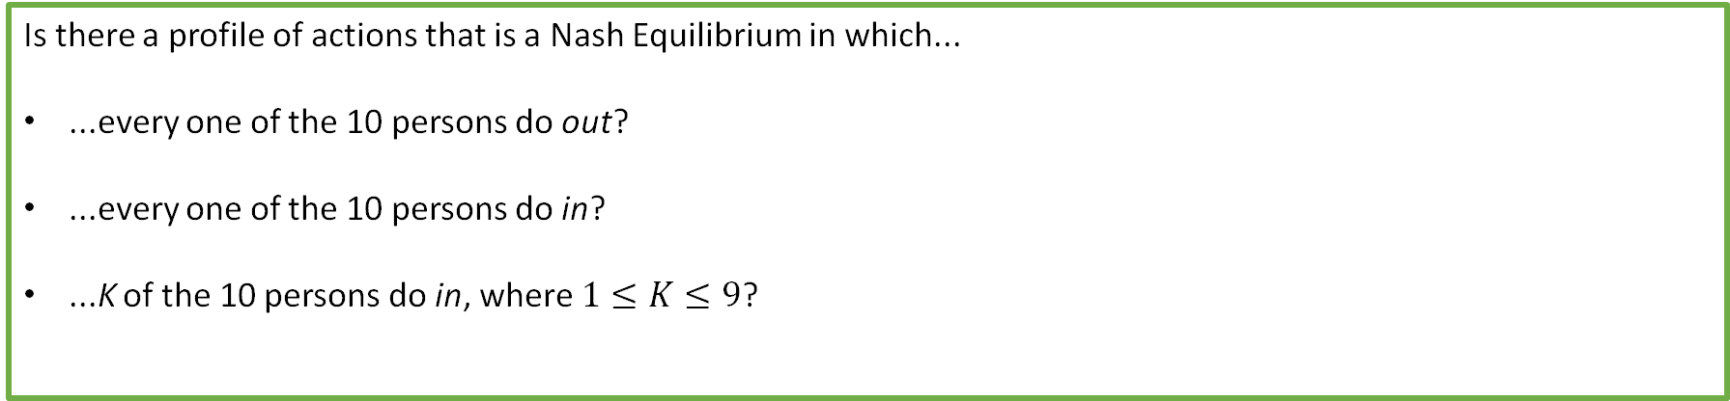
IN-OUT GAMES – NASH EQUILIBRIUM IN “I NEED A BUDDY”
Step 1: Best Responses
Take any given person “i”...
To which expectations about what the other 9 persons will do is in a best response for person i?
To which expectations about what the other 9 persons will do is out a best response for person i?
----> ANY EXPECTATION IN WHICH AT LEAST ONE OTHER PERSON DOES IN
----> THE EXPECTATION IN WHICH ALL OTHER PERSONS DO OUT
Step 2: Nash Equilibrium
Is there a profile of actions that is a Nash Equilibrium in which...
...every one of the 10 persons do out?
...every one of the 10 persons do in?
...K of the 10 persons do in, where $1≤K≤9$?

Slide 25
IN-OUT GAMES – NASH EQUILIBRIUM IN “I NEED A BUDDY”
Step 1: Best Responses
Take any given person “i”...
To which expectations about what the other 9 persons will do is in a best response for person i?
To which expectations about what the other 9 persons will do is out a best response for person i?
----> ANY EXPECTATION IN WHICH AT LEAST ONE OTHER PERSON DOES IN
----> THE EXPECTATION IN WHICH ALL OTHER PERSONS DO OUT
Step 2: Nash Equilibrium
Is there a profile of actions that is a Nash Equilibrium in which...
...every one of the 10 persons do out?
...every one of the 10 persons do in?
...K of the 10 persons do in, where $1≤K≤9$?
these cover all the profiles, so we can solve this by checking each one!

Slide 26
IN-OUT GAMES – NASH EQUILIBRIUM IN “I NEED A BUDDY”
Is the profile in which every one of the 10 persons do out a Nash Equilibrium?

Slide 27
IN-OUT GAMES – NASH EQUILIBRIUM IN “I NEED A BUDDY”
Is the profile in which every one of the 10 persons do out a Nash Equilibrium?
all 10 do out

Slide 28
IN-OUT GAMES – NASH EQUILIBRIUM IN “I NEED A BUDDY”
Is the profile in which every one of the 10 persons do out a Nash Equilibrium?
If this is an NE, then for any one of the 10, doing out must be a best response to the expectation that the other 9 to out.

Slide 29
IN-OUT GAMES – NASH EQUILIBRIUM IN “I NEED A BUDDY”
Is the profile in which every one of the 10 persons do out a Nash Equilibrium?
utility from in is -1
utility from out is 0
If this is an NE, then for any one of the 10, doing out must be a best response to the expectation that the other 9 to out.

Slide 30
IN-OUT GAMES – NASH EQUILIBRIUM IN “I NEED A BUDDY”
Is the profile in which every one of the 10 persons do out a Nash Equilibrium?
utility from in is -1
out is a best response!
utility from out is 0
If this is an NE, then for any one of the 10, doing out must be a best response to the expectation that the other 9 to out.

Slide 31
IN-OUT GAMES – NASH EQUILIBRIUM IN “I NEED A BUDDY”
Is the profile in which every one of the 10 persons do out a Nash Equilibrium?
utility from in is -1
out is a best response!
utility from out is 0
If this is an NE, then for any one of the 10, doing out must be a best response to the expectation that the other 9 to out.
SO, this profile IS a Nash Equilibrium!

Slide 32
IN-OUT GAMES – NASH EQUILIBRIUM IN “I NEED A BUDDY”
Step 1: Best Responses
Take any given person “i”...
To which expectations about what the other 9 persons will do is in a best response for person i?
To which expectations about what the other 9 persons will do is out a best response for person i?
----> ANY EXPECTATION IN WHICH AT LEAST ONE OTHER PERSON DOES IN
----> THE EXPECTATION IN WHICH ALL OTHER PERSONS DO OUT
Step 2: Nash Equilibrium
Is there a profile of actions that is a Nash Equilibrium in which...
...every one of the 10 persons do out?
...every one of the 10 persons do in?
...K of the 10 persons do in, where $1≤K≤9$?
YES

Slide 33
IN-OUT GAMES – NASH EQUILIBRIUM IN “I NEED A BUDDY”
Is the profile in which every one of the 10 persons do in a Nash Equilibrium?

Slide 34
IN-OUT GAMES – NASH EQUILIBRIUM IN “I NEED A BUDDY”
Is the profile in which every one of the 10 persons do in a Nash Equilibrium?
all 10 do in

Slide 35
IN-OUT GAMES – NASH EQUILIBRIUM IN “I NEED A BUDDY”
Is the profile in which every one of the 10 persons do in a Nash Equilibrium?
If this is an NE, then for any one of the 10, doing in must be a best response to the expectation that the other 9 to in.

Slide 36
IN-OUT GAMES – NASH EQUILIBRIUM IN “I NEED A BUDDY”
Is the profile in which every one of the 10 persons do in a Nash Equilibrium?
utility from in is 1
utility from out is 0
If this is an NE, then for any one of the 10, doing in must be a best response to the expectation that the other 9 to in.

Slide 37
IN-OUT GAMES – NASH EQUILIBRIUM IN “I NEED A BUDDY”
Is the profile in which every one of the 10 persons do in a Nash Equilibrium?
utility from in is 1
in is a best response!
utility from out is 0
If this is an NE, then for any one of the 10, doing in must be a best response to the expectation that the other 9 to in.

Slide 38
IN-OUT GAMES – NASH EQUILIBRIUM IN “I NEED A BUDDY”
Is the profile in which every one of the 10 persons do in a Nash Equilibrium?
utility from in is 1
in is a best response!
utility from out is 0
If this is an NE, then for any one of the 10, doing in must be a best response to the expectation that the other 9 to in.
...SO in is a BR for each person to the expectation that all 9 others do in. SO, all 10 doing in is a Nash Equilibrium!

Slide 39
IN-OUT GAMES – NASH EQUILIBRIUM IN “I NEED A BUDDY”
Step 1: Best Responses
Take any given person “i”...
To which expectations about what the other 9 persons will do is in a best response for person i?
To which expectations about what the other 9 persons will do is out a best response for person i?
----> ANY EXPECTATION IN WHICH AT LEAST ONE OTHER PERSON DOES IN
----> THE EXPECTATION IN WHICH ALL OTHER PERSONS DO OUT
Step 2: Nash Equilibrium
Is there a profile of actions that is a Nash Equilibrium in which...
...every one of the 10 persons do out?
...every one of the 10 persons do in?
...K of the 10 persons do in, where $1≤K≤9$?
YES
YES

Slide 40
IN-OUT GAMES – NASH EQUILIBRIUM IN “I NEED A BUDDY”
Is any profile in which $K$ do in with $1≤K<9$ a Nash Equilibrium?

Slide 41


IN-OUT GAMES – NASH EQUILIBRIUM IN “I NEED A BUDDY”
Is any profile in which $K$ do in with $1≤K<9$ a Nash Equilibrium?
$K$ do in
$10−K$ do out

Slide 42
IN-OUT GAMES – NASH EQUILIBRIUM IN “I NEED A BUDDY”
Is any profile in which $K$ do in with $1≤K<9$ a Nash Equilibrium?
$K$ do in
$10−K$ do out
If this profile is a Nash Equilibrium then it must be that...

Slide 43
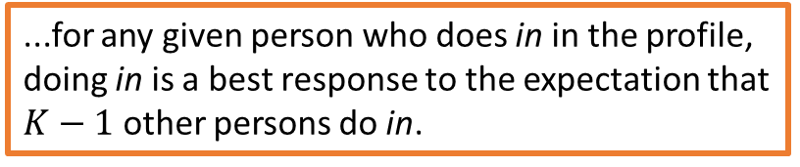
IN-OUT GAMES – NASH EQUILIBRIUM IN “I NEED A BUDDY”
Is any profile in which $K$ do in with $1≤K<9$ a Nash Equilibrium?
$K$ do in
$10−K$ do out
If this profile is a Nash Equilibrium then it must be that...
...for any given person who does in in the profile, doing in is a best response to the expectation that $K−1$ other persons do in.

Slide 44
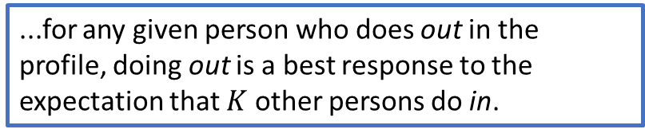
IN-OUT GAMES – NASH EQUILIBRIUM IN “I NEED A BUDDY”
Is any profile in which $K$ do in with $1≤K<9$ a Nash Equilibrium?
$K$ do in
$10−K$ do out
If this profile is a Nash Equilibrium then it must be that...
...for any given person who does in in the profile, doing in is a best response to the expectation that $K−1$ other persons do in.
...AND...
...for any given person who does out in the profile, doing out is a best response to the expectation that $K$ other persons do in.

Slide 45
IN-OUT GAMES – NASH EQUILIBRIUM IN “I NEED A BUDDY”
Is any profile in which $K$ do in with $1≤K<9$ a Nash Equilibrium?
$K$ do in
$10−K$ do out
utility from in is 1
utility from out is 0
out is NOT a best response!!!
If this profile is a Nash Equilibrium then it must be that...
...for any given person who does in in the profile, doing in is a best response to the expectation that $K−1$ other persons do in.
...AND...
...for any given person who does out in the profile, doing out is a best response to the expectation that $K$ other persons do in.

Slide 46
IN-OUT GAMES – NASH EQUILIBRIUM IN “I NEED A BUDDY”
Is any profile in which $K$ do in with $1≤K<9$ a Nash Equilibrium?
$K$ do in
$10−K$ do out
so no such profile can be a Nash Equilibrium!
utility from in is 1
utility from out is 0
out is NOT a best response!!!
If this profile is a Nash Equilibrium then it must be that...
...for any given person who does in in the profile, doing in is a best response to the expectation that $K−1$ other persons do in.
...AND...
...for any given person who does out in the profile, doing out is a best response to the expectation that $K$ other persons do in.

Slide 47

IN-OUT GAMES – NASH EQUILIBRIUM IN “I NEED A BUDDY”
Step 1: Best Responses
Take any given person “i”...
To which expectations about what the other 9 persons will do is in a best response for person i?
To which expectations about what the other 9 persons will do is out a best response for person i?
----> ANY EXPECTATION IN WHICH AT LEAST ONE OTHER PERSON DOES IN
----> THE EXPECTATION IN WHICH ALL OTHER PERSONS DO OUT
Step 2: Nash Equilibrium
Is there a profile of actions that is a Nash Equilibrium in which...
...every one of the 10 persons do out?
...every one of the 10 persons do in?
...K of the 10 persons do in, where $1≤K≤9$?
YES
YES
NO

Slide 48
IN-OUT GAMES – NASH EQUILIBRIUM IN “I NEED A BUDDY”
Step 1: Best Responses
Take any given person “i”...
To which expectations about what the other 9 persons will do is in a best response for person i?
To which expectations about what the other 9 persons will do is out a best response for person i?
----> ANY EXPECTATION IN WHICH AT LEAST ONE OTHER PERSON DOES IN
----> THE EXPECTATION IN WHICH ALL OTHER PERSONS DO OUT
Step 2: Nash Equilibrium
So equilibria in this game have a weird on-off quality...
Either everybody does in or everybody does out.
Is there a profile of actions that is a Nash Equilibrium in which...
...every one of the 10 persons do out?
...every one of the 10 persons do in?
...K of the 10 persons do in, where $1≤K≤9$?
YES
YES
NO

Slide 49
In-Out Games How To
Definition of In-Out Games
An example – “I Need a Buddy”
Steps to Identifying Nash Equilibria in In-Out Games
Practicing/Demonstrating the Steps – Substitutes vs. Complements

Slide 50
Steps in Identifying Nash Equilibria in In-Out Games
STEP 1: Create a list of ALL POSSIBLE profiles of actions in the game.
STEP 2: Break up the list into mutually exclusive groups, with each group a candidate for NE.
STEP 3: Check each group of profiles (Checking process – what has to be true for each behavior in the profile to be a best response?)

Slide 51
In-Out Games How To
Definition of In-Out Games
An example – “I Need a Buddy”
Steps to Identifying Nash Equilibria in In-Out Games
Practicing/Demonstrating the Steps – Substitutes vs. Complements

Slide 52
Application of in-out games:
Strategic Complements vs. Strategic Substitutes

Slide 53
Strategic Complement
An action X is a strategic complement to another action Y if a person’s incentive to do Y increases in the number of other persons she expects will do X.
Strategic Substitute
An action X is a strategic substitute to another action Y if a person’s incentive to do Y decreases in the number of other persons she expects will do X.

Slide 54
EXAMPLE
Strategic Complement
“I was thinking about going to the permit hearing to express my opposition to that new apartment building. But then I thought about how many flyers I saw posted all over the neighborhood opposing the apartment building, and I guessed a lot of people were going to show up and tell the city not to give the developer a permit. So I figured my voice wouldn’t make much difference, given that there would be so many people who were going to show up and say what I was going to say. So I decided to stay home and watch The Great British Baking Show.”
An action X is a strategic complement to another action Y if a person’s incentive to do Y increases in the number of other persons she expects will do X.
Strategic Substitute
An action X is a strategic substitute to another action Y if a person’s incentive to do Y decreases in the number of other persons she expects will do X.
From this person’s point of view, is attendance at the hearing by other people who oppose the permit a strategic complement to or a strategic substitute for her own attendance?

Slide 55
EXAMPLE
Strategic Complement
“I was thinking about going to the protest. But then I thought about how tiny our movement is and how few people we’ve persuaded to get involved. That got me thinking about how few people were going to show up at the protest. And then I thought how humiliating it would be to stand out there and yell slogans with just a handful of other people. If I’m going to show up for a protest, I want to be there with a LOT of people making a BIG noise. So I stayed home and watched Real Housewives”
An action X is a strategic complement to another action Y if a person’s incentive to do Y increases in the number of other persons she expects will do X.
Strategic Substitute
An action X is a strategic substitute to another action Y if a person’s incentive to do Y decreases in the number of other persons she expects will do X.
From this person’s point of view, is attendance at the hearing by other people who oppose the permit a strategic complement to or a strategic substitute for her own attendance?

Slide 56
An in-out game in which
in substitutes for in
An in-out game in which
in complements in

Slide 57
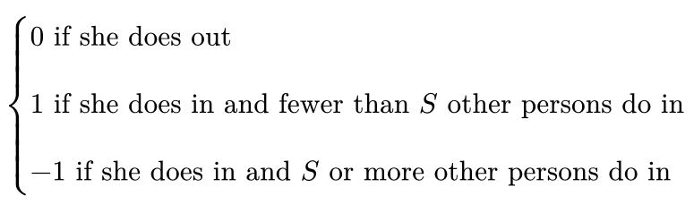
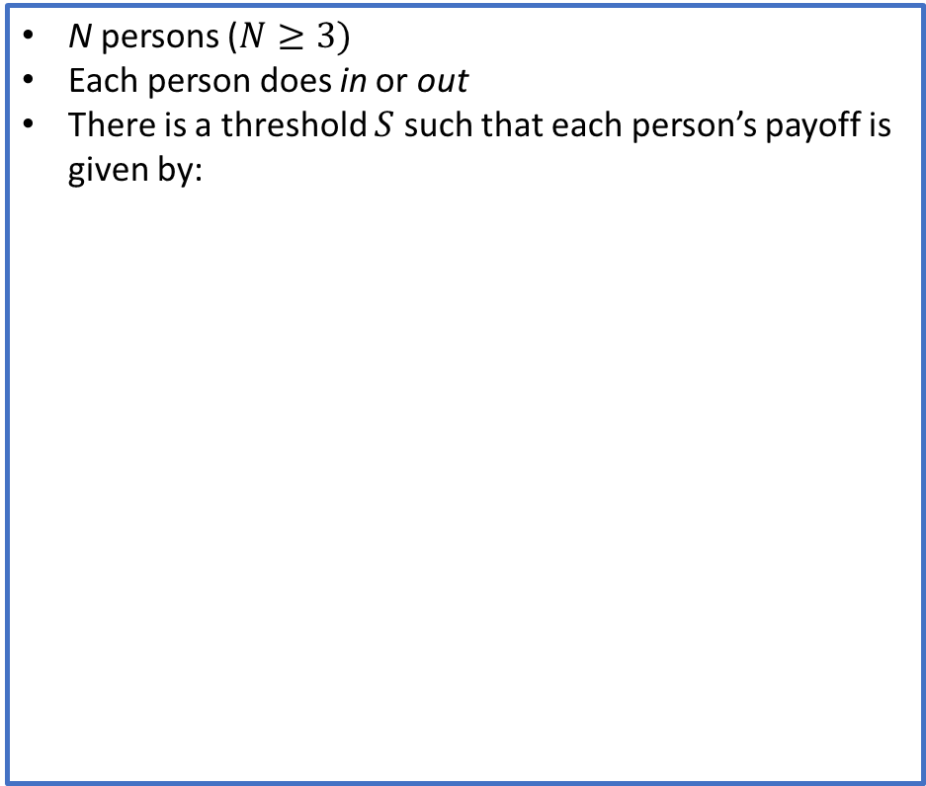
An in-out game in which
in substitutes for in
An in-out game in which
in complements in
N persons ($N≥3)$
Each person does in or out
There is a threshold $S$ such that each person’s payoff is given by:

Slide 58
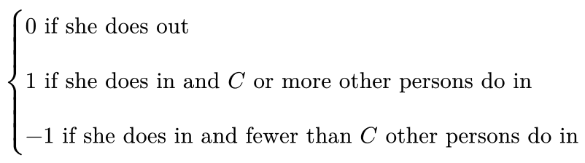

An in-out game in which
in substitutes for in
An in-out game in which
in complements in
N persons ($N≥3)$
Each person does in or out
There is a threshold $S$ such that each person’s payoff is given by:
N persons ($N≥3)$
Each person does in or out
There is a threshold $C$ such that each person’s payoff is given by:

Slide 59
An in-out game in which
in substitutes for in
An in-out game in which
in complements in
N persons ($N≥3)$
Each person does in or out
There is a threshold $S$ such that each person’s payoff is given by:
N persons ($N≥3)$
Each person does in or out
There is a threshold $C$ such that each person’s payoff is given by:
Which profiles are Nash Equilibria in this game?
Which profiles are Nash Equilibria in this game?

Slide 60
Steps in Identifying NE
List all profiles.
Break them up into groups.
Check each group

Slide 61
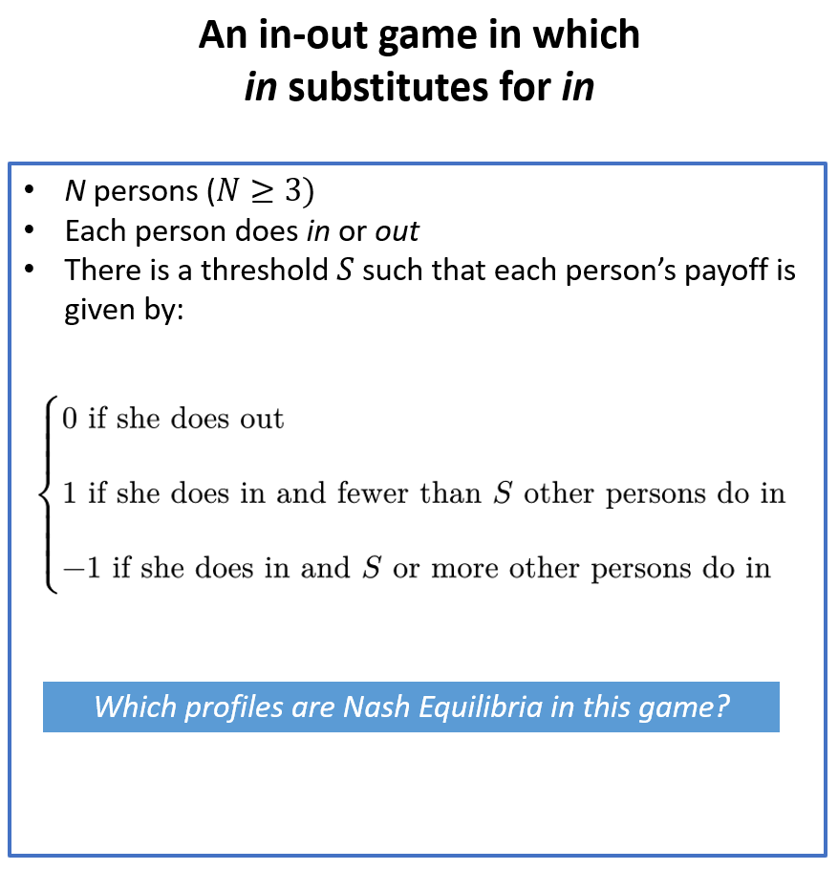
Steps in Identifying NE
List all profiles.
Break them up into groups.
Check each group

Slide 62
Steps in Identifying NE
List all profiles.
Break them up into groups.
Check each group
STEP 1: LIST ALL PROFILES

Slide 63

Steps in Identifying NE
List all profiles.
Break them up into groups.
Check each group
STEP 1: LIST ALL PROFILES
$N$ do out

Slide 64

Steps in Identifying NE
List all profiles.
Break them up into groups.
Check each group
STEP 1: LIST ALL PROFILES
$N$ do out
$1$ does in

Slide 65

Steps in Identifying NE
List all profiles.
Break them up into groups.
Check each group
STEP 1: LIST ALL PROFILES
$N$ do out
$1$ does in
$2$ do in

Slide 66
Steps in Identifying NE
List all profiles.
Break them up into groups.
Check each group
STEP 1: LIST ALL PROFILES
$N$ do out
$1$ does in
$2$ do in

Slide 67





Steps in Identifying NE
List all profiles.
Break them up into groups.
Check each group
STEP 1: LIST ALL PROFILES
$N$ do out
$1$ does in
$2$ do in
$S−2$ do in
$S−1$ do in
$S$ do in
$S+1$ do in
$S+2$ do in

Slide 68



Steps in Identifying NE
List all profiles.
Break them up into groups.
Check each group
STEP 1: LIST ALL PROFILES
$N$ do out
$1$ does in
$2$ do in
$S−2$ do in
$S−1$ do in
$S$ do in
$S+1$ do in
$S+2$ do in
$N−1$ do in
$N$ do in

Slide 69
Steps in Identifying NE
List all profiles.
Break them up into groups.
Check each group
STEP 2: BREAK PROFILES INTO GROUPS
$N$ do out
$1$ does in
$2$ do in
$S−2$ do in
$S−1$ do in
$S$ do in
$S+1$ do in
$S+2$ do in
$N−1$ do in
$N$ do in

Slide 70



Steps in Identifying NE
List all profiles.
Break them up into groups.
Check each group
STEP 2: BREAK PROFILES INTO GROUPS
$N$ do out
$1$ does in
$2$ do in
fewer than $S$ do in
$S−2$ do in
$S−1$ do in
exactly $S$ do in
$S$ do in
$S+1$ do in
$S+2$ do in
more than $S$ do in
$N−1$ do in
$N$ do in

Slide 71
Steps in Identifying NE
List all profiles.
Break them up into groups.
Check each group
STEP 2: BREAK PROFILES INTO GROUPS
fewer than $S$ do in
exactly $S$ do in
more than $S$ do in

Slide 72
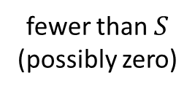
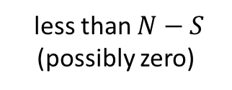





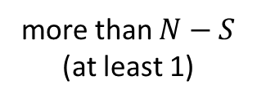
Steps in Identifying NE
List all profiles.
Break them up into groups.
Check each group
STEP 2: BREAK PROFILES INTO GROUPS
fewer than $S$ do in
fewer than $S$ (possibly zero)
more than $N−S$ (at least 1)
exactly $S$ do in
exactly $S$
exactly $N−S$
more than $S$ do in
more than $S$
less than $N−S$ (possibly zero)

Slide 73
Steps in Identifying NE
List all profiles.
Break them up into groups.
Check each group
STEP 3: CHECK EACH GROUP
fewer than $S$ do in
fewer than $S$ (possibly zero)
more than $N−S$ (at least 1)
exactly $S$ do in
exactly $S$
exactly $N−S$
more than $S$ do in
more than $S$
less than $N−S$ (possibly zero)

Slide 74

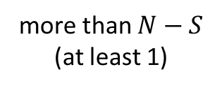
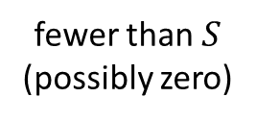
Steps in Identifying NE
List all profiles.
Break them up into groups.
Check each group
STEP 3: CHECK EACH GROUP
fewer than $S$ do in
fewer than $S$ do in
fewer than $S$ (possibly zero)
more than $N−S$ (at least 1)
fewer than $S$ (possibly zero)
more than $N−S$ (at least 1)
exactly $S$ do in
exactly $S$
exactly $N−S$
more than $S$ do in
more than $S$
less than $N−S$ (possibly zero)

Slide 75
Steps in Identifying NE
List all profiles.
Break them up into groups.
Check each group
STEP 3: CHECK EACH GROUP
fewer than $S$ do in
fewer than $S$ do in
fewer than $S$ (possibly zero)
more than $N−S$ (at least 1)
fewer than $S$ (possibly zero)
more than $N−S$ (at least 1)
If any profile in this group is a Nash Equilibrium, it must be that for any one person that does out...
exactly $S$ do in
exactly $S$
exactly $N−S$
more than $S$ do in
more than $S$
less than $N−S$ (possibly zero)

Slide 76
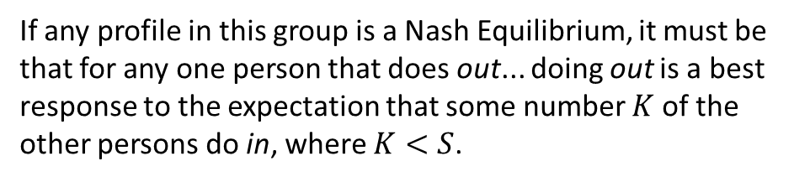
Steps in Identifying NE
List all profiles.
Break them up into groups.
Check each group
STEP 3: CHECK EACH GROUP
fewer than $S$ do in
fewer than $S$ do in
fewer than $S$ (possibly zero)
more than $N−S$ (at least 1)
fewer than $S$ (possibly zero)
more than $N−S$ (at least 1)
If any profile in this group is a Nash Equilibrium, it must be that for any one person that does out... doing out is a best response to the expectation that some number $K$ of the other persons do in, where $K<S$.
exactly $S$ do in
exactly $S$
exactly $N−S$
more than $S$ do in
more than $S$
less than $N−S$ (possibly zero)

Slide 77

Steps in Identifying NE
List all profiles.
Break them up into groups.
Check each group
STEP 3: CHECK EACH GROUP
fewer than $S$ do in
fewer than $S$ do in
fewer than $S$ (possibly zero)
more than $N−S$ (at least 1)
fewer than $S$ (possibly zero)
more than $N−S$ (at least 1)
If any profile in this group is a Nash Equilibrium, it must be that for any one person that does out... doing out is a best response to the expectation that some number $K$ of the other persons do in, where $K<S$.
Since $K<S$, her utility level from doing in is 1. Thus, since her utility level from doing out is 0, doing out is NOT a best response to the expectation that $K$ of the other persons do in.
exactly $S$ do in
exactly $S$
exactly $N−S$
more than $S$ do in
more than $S$
less than $N−S$ (possibly zero)

Slide 78

Steps in Identifying NE
List all profiles.
Break them up into groups.
Check each group
STEP 3: CHECK EACH GROUP
fewer than $S$ do in
fewer than $S$ do in
fewer than $S$ (possibly zero)
more than $N−S$ (at least 1)
fewer than $S$ (possibly zero)
more than $N−S$ (at least 1)
If any profile in this group is a Nash Equilibrium, it must be that for any one person that does out... doing out is a best response to the expectation that some number $K$ of the other persons do in, where $K<S$.
Since $K<S$, her utility level from doing in is 1. Thus, since her utility level from doing out is 0, doing out is NOT a best response to the expectation that $K$ of the other persons do in.
So no profile in this group is a Nash Equilibrium!
exactly $S$ do in
exactly $S$
exactly $N−S$
more than $S$ do in
more than $S$
less than $N−S$ (possibly zero)

Slide 79
Steps in Identifying NE
List all profiles.
Break them up into groups.
Check each group
STEP 3: CHECK EACH GROUP
fewer than $S$ do in
fewer than $S$ (possibly zero)
more than $N−S$ (at least 1)
exactly $S$ do in
exactly $S$
exactly $N−S$
more than $S$ do in
more than $S$
less than $N−S$ (possibly zero)

Slide 80



Steps in Identifying NE
List all profiles.
Break them up into groups.
Check each group
STEP 3: CHECK EACH GROUP
exactly $S$ do in
fewer than $S$ do in
fewer than $S$ (possibly zero)
more than $N−S$ (at least 1)
exactly $S$
exactly $N−S$
exactly $S$ do in
exactly $S$
exactly $N−S$
more than $S$ do in
more than $S$
less than $N−S$ (possibly zero)

Slide 81
Steps in Identifying NE
List all profiles.
Break them up into groups.
Check each group
STEP 3: CHECK EACH GROUP
exactly $S$ do in
fewer than $S$ do in
fewer than $S$ (possibly zero)
more than $N−S$ (at least 1)
exactly $S$
exactly $N−S$
If any such profile is a Nash Equilibrium it must be that...
exactly $S$ do in
exactly $S$
exactly $N−S$
more than $S$ do in
more than $S$
less than $N−S$ (possibly zero)

Slide 82
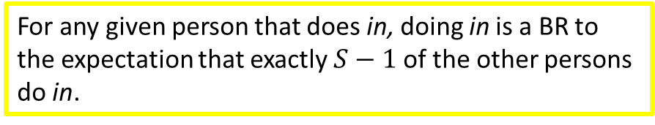
Steps in Identifying NE
List all profiles.
Break them up into groups.
Check each group
STEP 3: CHECK EACH GROUP
exactly $S$ do in
fewer than $S$ do in
fewer than $S$ (possibly zero)
more than $N−S$ (at least 1)
exactly $S$
exactly $N−S$
If any such profile is a Nash Equilibrium it must be that...
exactly $S$ do in
For any given person that does in, doing in is a BR to the expectation that exactly $S−1$ of the other persons do in.
exactly $S$
exactly $N−S$
more than $S$ do in
more than $S$
less than $N−S$ (possibly zero)

Slide 83
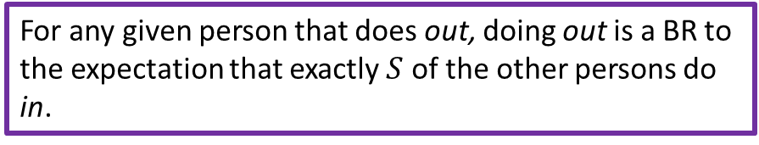
Steps in Identifying NE
List all profiles.
Break them up into groups.
Check each group
STEP 3: CHECK EACH GROUP
exactly $S$ do in
fewer than $S$ do in
fewer than $S$ (possibly zero)
more than $N−S$ (at least 1)
exactly $S$
exactly $N−S$
If any such profile is a Nash Equilibrium it must be that...
exactly $S$ do in
For any given person that does in, doing in is a BR to the expectation that exactly $S−1$ of the other persons do in.
exactly $S$
exactly $N−S$
AND
more than $S$ do in
For any given person that does out, doing out is a BR to the expectation that exactly $S$ of the other persons do in.
more than $S$
less than $N−S$ (possibly zero)

Slide 84
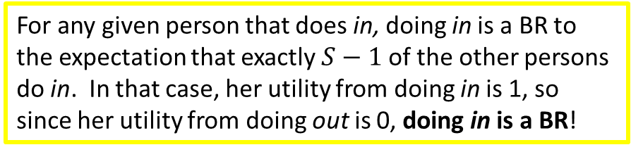
Steps in Identifying NE
List all profiles.
Break them up into groups.
Check each group
STEP 3: CHECK EACH GROUP
exactly $S$ do in
fewer than $S$ do in
fewer than $S$ (possibly zero)
more than $N−S$ (at least 1)
exactly $S$
exactly $N−S$
If any such profile is a Nash Equilibrium it must be that...
exactly $S$ do in
For any given person that does in, doing in is a BR to the expectation that exactly $S−1$ of the other persons do in. In that case, her utility from doing in is 1, so since her utility from doing out is 0, doing in is a BR!
exactly $S$
exactly $N−S$
AND
more than $S$ do in
For any given person that does out, doing out is a BR to the expectation that exactly $S$ of the other persons do in.
more than $S$
less than $N−S$ (possibly zero)

Slide 85
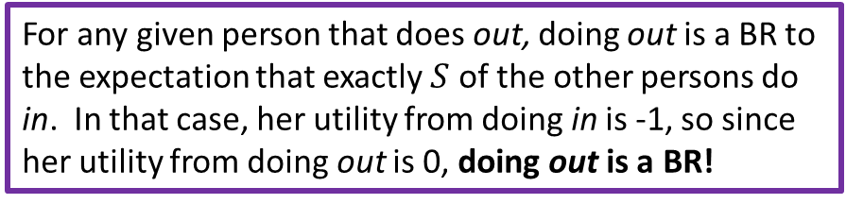
Steps in Identifying NE
List all profiles.
Break them up into groups.
Check each group
STEP 3: CHECK EACH GROUP
exactly $S$ do in
fewer than $S$ do in
fewer than $S$ (possibly zero)
more than $N−S$ (at least 1)
exactly $S$
exactly $N−S$
If any such profile is a Nash Equilibrium it must be that...
exactly $S$ do in
For any given person that does in, doing in is a BR to the expectation that exactly $S−1$ of the other persons do in. In that case, her utility from doing in is 1, so since her utility from doing out is 0, doing in is a BR!
exactly $S$
exactly $N−S$
AND
more than $S$ do in
For any given person that does out, doing out is a BR to the expectation that exactly $S$ of the other persons do in. In that case, her utility from doing in is -1, so since her utility from doing out is 0, doing out is a BR!
more than $S$
less than $N−S$ (possibly zero)

Slide 86
Steps in Identifying NE
List all profiles.
Break them up into groups.
Check each group
STEP 3: CHECK EACH GROUP
exactly $S$ do in
fewer than $S$ do in
fewer than $S$ (possibly zero)
more than $N−S$ (at least 1)
exactly $S$
exactly $N−S$
If any such profile is a Nash Equilibrium it must be that...
exactly $S$ do in
For any given person that does in, doing in is a BR to the expectation that exactly $S−1$ of the other persons do in. In that case, her utility from doing in is 1, so since her utility from doing out is 0, doing in is a BR!
exactly $S$
exactly $N−S$
AND
more than $S$ do in
For any given person that does out, doing out is a BR to the expectation that exactly $S$ of the other persons do in. In that case, her utility from doing in is -1, so since her utility from doing out is 0, doing out is a BR!
more than $S$
less than $N−S$ (possibly zero)

Slide 87
Steps in Identifying NE
List all profiles.
Break them up into groups.
Check each group
STEP 3: CHECK EACH GROUP
fewer than $S$ do in
fewer than $S$ (possibly zero)
more than $N−S$ (at least 1)
exactly $S$ do in
exactly $S$
exactly $N−S$
more than $S$ do in
more than $S$
less than $N−S$ (possibly zero)

Slide 88

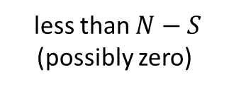

Steps in Identifying NE
List all profiles.
Break them up into groups.
Check each group
STEP 3: CHECK EACH GROUP
more than $S$ do in
fewer than $S$ do in
fewer than $S$ (possibly zero)
more than $N−S$ (at least 1)
more than $S$
less than $N−S$ (possibly zero)
exactly $S$ do in
exactly $S$
exactly $N−S$
more than $S$ do in
more than $S$
less than $N−S$ (possibly zero)

Slide 89
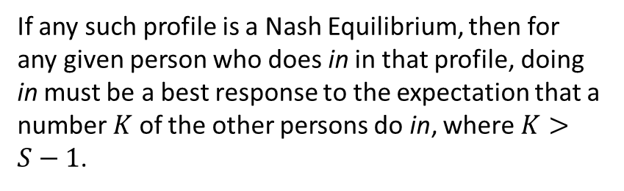
Steps in Identifying NE
List all profiles.
Break them up into groups.
Check each group
STEP 3: CHECK EACH GROUP
more than $S$ do in
fewer than $S$ do in
fewer than $S$ (possibly zero)
more than $N−S$ (at least 1)
more than $S$
less than $N−S$ (possibly zero)
If any such profile is a Nash Equilibrium, then for any given person who does in in that profile, doing in must be a best response to the expectation that a number $K$ of the other persons do in, where $K>S−1$.
exactly $S$ do in
exactly $S$
exactly $N−S$
more than $S$ do in
more than $S$
less than $N−S$ (possibly zero)

Slide 90

Steps in Identifying NE
List all profiles.
Break them up into groups.
Check each group
STEP 3: CHECK EACH GROUP
more than $S$ do in
fewer than $S$ do in
fewer than $S$ (possibly zero)
more than $N−S$ (at least 1)
more than $S$
less than $N−S$ (possibly zero)
If any such profile is a Nash Equilibrium, then for any given person who does in in that profile, doing in must be a best response to the expectation that a number $K$ of the other persons do in, where $K>S−1$.
Since $K>S−1$, $K$ is not less than $S$. Thus, given this expectation, this person’s utility from in is -1. So, since her utility from out is 0, in is NOT a BR to this expectation!
exactly $S$ do in
exactly $S$
exactly $N−S$
more than $S$ do in
more than $S$
less than $N−S$ (possibly zero)

Slide 91
Steps in Identifying NE
List all profiles.
Break them up into groups.
Check each group
STEP 3: CHECK EACH GROUP
fewer than $S$ do in
fewer than $S$ (possibly zero)
more than $N−S$ (at least 1)
exactly $S$ do in
exactly $S$
exactly $N−S$
more than $S$ do in
more than $S$
less than $N−S$ (possibly zero)

Slide 92
An in-out game in which
in substitutes for in
An in-out game in which
in complements in
N persons ($N≥3)$
Each person does in or out
There is a threshold $S$ such that each person’s payoff is given by:
N persons ($N≥3)$
Each person does in or out
There is a threshold $C$ such that each person’s payoff is given by:
Which profiles are Nash Equilibria in this game?
Which profiles are Nash Equilibria in this game?

Slide 93


An in-out game in which
in substitutes for in
An in-out game in which
in complements in
N persons ($N≥3)$
Each person does in or out
There is a threshold $S$ such that each person’s payoff is given by:
N persons ($N≥3)$
Each person does in or out
There is a threshold $C$ such that each person’s payoff is given by:
Which profiles are Nash Equilibria in this game?
Every profile like this:
Which profiles are Nash Equilibria in this game?
Exactly $S$ do in
Exactly $N−S$ do out

Slide 94


An in-out game in which
in substitutes for in
An in-out game in which
in complements in
N persons ($N≥3)$
Each person does in or out
There is a threshold $S$ such that each person’s payoff is given by:
N persons ($N≥3)$
Each person does in or out
There is a threshold $C$ such that each person’s payoff is given by:
Which profiles are Nash Equilibria in this game?
Which profiles are Nash Equilibria in this game?
Every profile like this:
Every profile like this:
Exactly $S$ do in
Exactly $N−S$ do out
Everyone does in
And every profile like this:
Everyone does out

Slide 95
An in-out game in which
in substitutes for in
An in-out game in which
in complements in
N persons ($N≥3)$
Each person does in or out
There is a threshold $S$ such that each person’s payoff is given by:
N persons ($N≥3)$
Each person does in or out
There is a threshold $C$ such that each person’s payoff is given by:
SO WHAT???
Which profiles are Nash Equilibria in this game?
Which profiles are Nash Equilibria in this game?
Every profile like this:
Every profile like this:
Exactly $S$ do in
Exactly $N−S$ do out
Everyone does in
And every profile like this:
Everyone does out

Slide 96
This suggests that whether participation is a substitute for or complement to participation determines the sort of problems the group has to solve to act effectively as a collective.

Slide 97
This suggests that whether participation is a substitute for or complement to participation determines the sort of problems the group has to solve to act effectively as a collective.
A group in which in is a substitute for in
A group in which in is a complement to in

Slide 98
This suggests that whether participation is a substitute for or complement to participation determines the sort of problems the group has to solve to act effectively as a collective.
A group in which in is a substitute for in
A group in which in is a complement to in
Think of a Nash Equilibrium as an “self-reinforcing” plan of action for the group. In that plan, everyone has a role. And each person WANTS to play their assigned role, if they EXPECT everyone else to go along with the plan.

Slide 99
This suggests that whether participation is a substitute for or complement to participation determines the sort of problems the group has to solve to act effectively as a collective.
A group in which in is a substitute for in
A group in which in is a complement to in
Think of a Nash Equilibrium as an “self-reinforcing” plan of action for the group. In that plan, everyone has a role. And each person WANTS to play their assigned role, if they EXPECT everyone else to go along with the plan.
In this view, the real problem groups face is to decide WHICH of many Nash Equilibrium profiles to play.

Slide 100
This suggests that whether participation is a substitute for or complement to participation determines the sort of problems the group has to solve to act effectively as a collective.
OK people, we need 2 main dishes, 2 side dishes, and 2 deserts for the pot luck. That means we only need 6 people to make a dish. Which 6 of us are going to do bring a dish this time?
A group in which in is a substitute for in
A group in which in is a complement to in

Slide 101
This suggests that whether participation is a substitute for or complement to participation determines the sort of problems the group has to solve to act effectively as a collective.
OK people, we need 2 main dishes, 2 side dishes, and 2 deserts for the pot luck. That means we only need 6 people to make a dish. Which 6 of us are going to do bring a dish this time?
A group in which in is a substitute for in
A group in which in is a complement to in
When participation substitutes for participation, the problem the group must solve is how to distribute the burden. Which persons in the group will put in the work, just up to the point where no more work is needed?

Slide 102
This suggests that whether participation is a substitute for or complement to participation determines the sort of problems the group has to solve to act effectively as a collective.
A group in which in is a substitute for in
A group in which in is a complement to in
When participation substitutes for participation, the problem the group must solve is how to distribute the burden. Which persons in the group will put in the work, just up to the point where no more work is needed?

Slide 103
This suggests that whether participation is a substitute for or complement to participation determines the sort of problems the group has to solve to act effectively as a collective.
OK people, are we having a dance party tonight or aren’t we? We all know that if there IS a party, we all want to be there. And if there’s NOT a party, no one wants to be the only one showing up. So CAN WE PLEASE JUST MAKE A F***ING DECISION???
A group in which in is a substitute for in
A group in which in is a complement to in
When participation substitutes for participation, the problem the group must solve is how to distribute the burden. Which persons in the group will put in the work, just up to the point where no more work is needed?

Slide 104
This suggests that whether participation is a substitute for or complement to participation determines the sort of problems the group has to solve to act effectively as a collective.
OK people, are we having a dance party tonight or aren’t we? We all know that if there IS a party, we all want to be there. And if there’s NOT a party, no one wants to be the only one showing up. So CAN WE PLEASE JUST MAKE A F***ING DECISION???
A group in which in is a substitute for in
A group in which in is a complement to in
When participation complements participation, the problem the group must solve is coordination. Are we doing this thing or not??? Cause if we’re doing it, we ALL want in! And if we’re not doing it, NO ONE wants in!
When participation substitutes for participation, the problem the group must solve is how to distribute the burden. Which persons in the group will put in the work, just up to the point where no more work is needed?

Slide 105
This suggests that whether participation is a substitute for or complement to participation determines the sort of problems the group has to solve to act effectively as a collective.
A group in which in is a substitute for in
A group in which in is a complement to in
When participation complements participation, the problem the group must solve is coordination. Are we doing this thing or not??? Cause if we’re doing it, we ALL want in! And if we’re not doing it, NO ONE wants in!
When participation substitutes for participation, the problem the group must solve is how to distribute the burden. Which persons in the group will put in the work, just up to the point where no more work is needed?

