Slide 1
Your List For This Week
Work your way through Lesson 7 and all Lesson 7 COUs
Problem solving sessions meet this week

Slide 2
Key Concepts & Tools for Lesson 7
The Actual Thing in Actual Politics
Tools for Modeling the Actual Thing
Game Theoretic Models
Strategic Interdependence
Simultaneous Move Game
Profiles of Actions
Payoff Function
2-by-2 Game
Matrix Form

Slide 3
Strategic Interdependence

Slide 4
Some actual politics
Attacking Jim Crow in Greenwood, MS, 1962

Slide 5


Slide 6
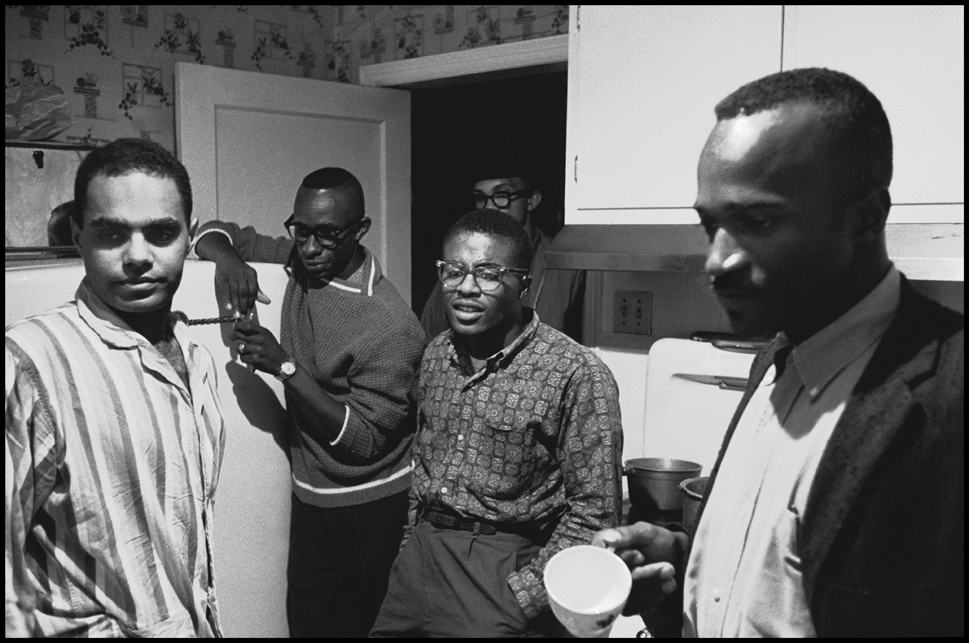
Left half of photo: Bob Moses, Sam Block, Willie Peacock, 1962
(Man on the right may be Amzie Moore)
Photo by Danny Lyon
Retrieved from https://snccdigital.org/people/sam-block/

Slide 7
Jim Crow

Slide 8
Jim Crow
A set of widely shared expectations about:
How black persons would interact with white persons.
Which public accommodations and institutions black persons would and would not take part in.
What would occur when a black person violated these expectations.

Slide 9
The first Greenwood protest lead by Sam Block, August 1962
Block and 3-4 black residents of Greenwood show up at the county courthouse.
Ask the clerk on duty to be registered to vote.

Slide 10
The first Greenwood protest lead by Sam Block, August 1962
Block and 3-4 black residents of Greenwood show up at the county courthouse.
Ask the clerk on duty to be registered to vote.
There were no laws on the books that prohibited black persons being registered to vote.
Several black residents of Greenwood were registered to vote, and several black residents voted regularly in elections.
So what made this a “protest”??? And what was being “protested”???

Slide 11
Jim Crow
A set of widely shared expectations about:
How black persons would interact with white persons.
Which public accommodations and institutions black persons would and would not take part in.
What would occur when a black person violated these expectations.

Slide 12
AUTHORITARIAN REGIMES IN GENERAL
Demand certain behaviors in the populations they rule.
Use spectacular public violence to try to enforce those demands.
Can collapse in one of two ways, depending on how they use violence to repress mass resistance – (a) loss of credibility, (b) loss of support from “liberal” elites

Slide 13
Two Contrasting Outcomes

Slide 14
Two Contrasting Outcomes
1961, McComb Mississippi: SNCC organizers begin voter registration trainings in July. Local resident Herbert Lee begins to assist organizers in August. Lee shot and killed by white supremist in retaliation for his collaboration with SNCC organizers in September. Many black residents plead with SNCC organizers to stop the campaign and leave town, which they do.

Slide 15
Two Contrasting Outcomes
1961, McComb Mississippi: SNCC organizers begin voter registration trainings in July. Local resident Herbert Lee begins to assist organizers in August. Lee shot and killed by white supremist in retaliation for his collaboration with SNCC organizers in September. Many black residents plead with SNCC organizers to stop the campaign and leave town, which they do.
1962, Greenwood Mississippi: SNCC organizers being voter registration trainings in July. Sam Block begins leading small groups of voters to attempt to register at courthouse in July. Local terrorists target Block for beating and lynching, but do not attack local residents directly. Partipication in voter registration actions steadily grows to hundreds at a time by January of 1963. Campaign attracts national media attention, leading local white elites to ousting white supremists hardliners from local government positions, and collapse of regime resistance to mass black voter registration in spring of 1963.

Slide 16
The McComb Campaign was Counterproductive

Slide 17
The McComb Campaign was Counterproductive
Murder of a local resident almost immediately after first tiny protests terrified population, convince many that any resistance would punished brutally.

Slide 18
The McComb Campaign was Counterproductive
Murder of a local resident almost immediately after first tiny protests terrified population, convince many that any resistance would punished brutally.
Independent protests by highschool students convinced many that SNCC would put children in danger, inspired them to resist further organizing by SNCC.

Slide 19
Strategic Interdependence

Slide 20
Strategic Interdependence
Depending on the responses of locals, police and white terrorists to SNCC’s activities...
...SNCC’s activities could be productive or counterproductive.

Slide 21
Strategic Interdependence
Imagine a SNCC organizer trying to decide whether to start organizing resistance in another town, and thinking about the results in McComb...

Slide 22
Strategic Interdependence
Imagine the organizer anticipates...
What SNCC does | What local Highschoolers do | Effect on ruling regime
organizes protests | Start their own protest campaign | strengthened
refrains from organizing |  | weakened
organizes protests | Do not start a protest campaign | weakened
refrains from organizing protests |  | neither strengthened nor weakened

Slide 23
Strategic Interdependence
Imagine the organizer anticipates...
What SNCC does | What local Highschoolers do | Effect on ruling regime
organizes protests | Start their own protest campaign | strengthened
refrains from organizing |  | weakened
organizes protests | Do not start a protest campaign | weakened
refrains from organizing protests |  | neither strengthened nor weakened

Slide 24
Strategic Interdependence
Imagine the organizer anticipates...
What SNCC does | What local Highschoolers do | Effect on ruling regime
organizes protests | Start their own protest campaign | strengthened
refrains from organizing |  | weakened
organizes protests | Do not start a protest campaign | weakened
refrains from organizing protests |  | neither strengthened nor weakened

Slide 25
Strategic Interdependence
Imagine the organizer anticipates...
What SNCC does | What local Highschoolers do | Effect on ruling regime
organizes protests | Start their own protest campaign | strengthened
refrains from organizing |  | weakened
organizes protests | Do not start a protest campaign | weakened
refrains from organizing protests |  | neither strengthened nor weakened
NOTICE: The organizer’s preferences over her available actions DEPEND on what she EXPECTS the highschoolers to do!!!
If she expects highschoolers to protest, she prefers to not organize instead of organize.
If she expects highschoolers to not protest, she prefers to organize instead of not organize.

Slide 26
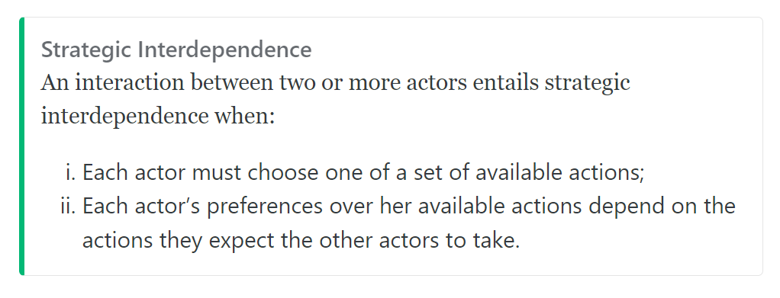
Strategic Interdependence

Slide 27
Strategic Interdependence
TRY IT:
Organizer’s expectation about what highschoolers will do | Organizer’s preferences over his actions

Slide 28
Strategic Interdependence
TRY IT:
Organizer’s expectation about what highschoolers will do | Organizer’s preferences over his actions
Start their own protest campaign
Not start their own protest campaign

Slide 29
Strategic Interdependence
TRY IT:
Organizer’s expectation about what highschoolers will do | Organizer’s preferences over his actions
Start their own protest campaign | Prefers to not organize resistance instead of to organize resistance.
Not start their own protest campaign | Prefers to organize resistance instead of to not organize resistance.

Slide 30
Strategic Interdependence
FOR EXAMPLE:
Organizer’s Expectation about What Highschoolers will Do | Organizer’s preferences over his actions
Protest | Prefers to not organize resistance instead of to organize resistance.
Not protest | Prefers to organize resistance instead of to not organize resistance.
NOTICE THAT THE ORGANIZER’S PREFERENCE ORDERING OVER HIS ACTIONS SWITCHES WHEN HER EXPECTATIONS ABOUT WHAT HIGHSCHOOLERS WILL DO CHANGES!!!!

Slide 31
Strategic Interdependence
ANOTHER EXAMPLE:
Organizer’s Expectation about How Local Terrorists will Respond to Organizing | Organizer’s preferences over his actions

Slide 32
Strategic Interdependence
ANOTHER EXAMPLE:
Organizer’s Expectation about How Local Terrorists will Respond to Organizing | Organizer’s preferences over his actions
Murder a local
Beat the organizer

Slide 33
Strategic Interdependence
ANOTHER EXAMPLE:
Organizer’s Expectation about How Local Terrorists will Respond to Organizing | Organizer’s preferences over his actions
Murder a local | prefers to not organize resistance instead of organizing resistance
Beat the organizer | prefers to organize resistance instead of not organizing resistance

Slide 34
Strategic Interdependence

Slide 35
Strategic Interdependence
NOTICE: Strategic interdependence is a mutual condition between multiple persons. Each person’s preferences over her actions depend on what actions she expects the other persons to take!

Slide 36
Strategic Interdependence is a mutual condition between multiple persons

Slide 37
Organizer’s Expectation about How Local Terrorists will Respond to Organizing | Organizer’s preferences over his actions
Murder a local | Prefers to not organize protests instead of organizing protests
Beat the organizer | Prefers to organize protests instead of not organizing protest

Slide 38
NOTICE: The organizer’s preferences over her available actions DEPEND on what he EXPECTS the local terroists to do if she organizes protests!
Organizer’s Expectation about How Local Terrorists will Respond to Organizing | Organizer’s preferences over his actions
Murder a local | Prefers to not organize protests instead of organizing protests
Beat the organizer | Prefers to organize protests instead of not organizing protest

Slide 39
NOTICE: The organizer’s preferences over her available actions DEPEND on what he EXPECTS the local terroists to do if she organizes protests!
Organizer’s Expectation about How Local Terrorists will Respond to Organizing | Organizer’s preferences over his actions
Murder a local | Prefers to not organize protests instead of organizing protests
Beat the organizer | Prefers to organize protests instead of not organizing protest
BUT...this isn’t really strategic interdependence unless the local terrorists’ preferences over how to respond to any organizing similarly depend on whether the organizer organizes protests!

Slide 40
Strategic Considerations in the Use of Repressive Violence:

Slide 41
Strategic Considerations in the Use of Repressive Violence:
Leaders of repressive regimes typically rely on support from both “hardliner” and “liberal” factions of elites.

Slide 42
Strategic Considerations in the Use of Repressive Violence:
Leaders of repressive regimes typically rely on support from both “hardliner” and “liberal” factions of elites.
“Hardliners” typically want the leaders to be unrestrained and brutal in their use of violence against dissidents.

Slide 43
Strategic Considerations in the Use of Repressive Violence:
Leaders of repressive regimes typically rely on support from both “hardliner” and “liberal” factions of elites.
“Hardliners” typically want the leaders to be unrestrained and brutal in their use of violence against dissidents.
“Liberals” typically want the leaders to use minimal or no violence to repress the subordinated population.

Slide 44
Strategic Considerations in the Use of Repressive Violence:
Leaders of repressive regimes typically rely on support from both “hardliner” and “liberal” factions of elites.
“Hardliners” typically want the leaders to be unrestrained and brutal in their use of violence against dissidents.
“Liberals” typically want the leaders to use minimal or no violence to repress the subordinated population.
When leaders expect little or no protest, they benefit from an official policy in which any protest is met with unrestrained violence. This makes the hardliners happy and doesn’t offend the liberals, because little or no protest occurs and thus little or no unrestrained violence occurs;

Slide 45
Strategic Considerations in the Use of Repressive Violence:
Leaders of repressive regimes typically rely on support from both “hardliner” and “liberal” factions of elites.
“Hardliners” typically want the leaders to be unrestrained and brutal in their use of violence against dissidents.
“Liberals” typically want the leaders to use minimal or no violence to repress the subordinated population.
When leaders expect little or no protest, they benefit from an official policy in which any protest is met with unrestrained violence. This makes the hardliners happy and doesn’t offend the liberals, because little or no protest occurs and thus little or no unrestrained violence occurs;
But when leaders expect frequent or large protests, a policy of restrained violence is often better for them. If protests are frequent and large, overwhelming violence will end up in the media and can cause liberal elites to withdraw their support for the regime.

Slide 46
Organizer’s Expectation about How Local Regine will Respond to Protests | Organizer’s preferences over his actions
Overwhelming violence | Prefers to not organize protests instead of organizing protests
Limited violence | Prefers to organize protests instead of not organizing protest

Slide 47
Organizer’s Expectation about How Local Regine will Respond to Protests | Organizer’s preferences over his actions
Overwhelming violence | Prefers to not organize protests instead of organizing protests
Limited violence | Prefers to organize protests instead of not organizing protest
Regime Leader’s Expectation about Whether protests will occur | Organizer’s preferences over his actions
Protests will occur | Prefers to order limited violence instead of overwhelming violence in response to any protests
No protests will occur | Prefers to order overwhelming violence instead of limited violence in response to any protest

Slide 48
THIS is strategic interdependence because it is a mutual condition between an organizer and a regime leader in which each person’s preferences over her available actions depend on her expectations about what the other person will do!
Organizer’s Expectation about How Local Regine will Respond to Protests | Organizer’s preferences over his actions
Overwhelming violence | Prefers to not organize protests instead of organizing protests
Limited violence | Prefers to organize protests instead of not organizing protest
Regime Leader’s Expectation about Whether protests will occur | Organizer’s preferences over his actions
Protests will occur | Prefers to order limited violence instead of overwhelming violence in response to any protests
No protests will occur | Prefers to order overwhelming violence instead of limited violence in response to any protest

Slide 49
A much simpler (and much less interesting) example

Slide 50
A much simpler (and much less interesting) example
On which side of the road do I prefer to drive?

Slide 51
A much simpler (and much less interesting) example
On which side of the road do I prefer to drive?
My expectation about the side of the road on which others will drive | My preferences over the side of the road on which I drive

Slide 52
A much simpler (and much less interesting) example
On which side of the road do I prefer to drive?
My expectation about the side of the road on which others will drive | My preferences over the side of the road on which I drive
Others will drive on the right-hand side | I prefer to drive on the right-hand instead of the left-hand side.

Slide 53
A much simpler (and much less interesting) example
On which side of the road do I prefer to drive?
My expectation about the side of the road on which others will drive | My preferences over the side of the road on which I drive
Others will drive on the right-hand side | I prefer to drive on the right-hand instead of the left-hand side.
Others will drive on the left-hand side | I prefer to drive on the left-hand instead of the right-hand side.

Slide 54
A much simpler (and much less interesting) example
On which side of the road do I prefer to drive?
My expectation about the side of the road on which others will drive | My preferences over the side of the road on which I drive
Others will drive on the right-hand side | I prefer to drive on the right-hand instead of the left-hand side.
Others will drive on the left-hand side | I prefer to drive on the left-hand instead of the right-hand side.
EACH driver’s preferences over which side to drive on similarly depend on her expectations about what every other drive will do!
Thus this is a mutual condition!
Thus this is strategic interdependence!

Slide 55

Key Concepts & Tools for Lesson 5
The Actual Thing in Actual Politics
Tools for Modeling the Actual Thing
Game Theoretic Models
Strategic Interdependence
Simultaneous Move Game
Profiles of Actions
Payoff Function
2-by-2 Game
Matrix Form

Slide 56
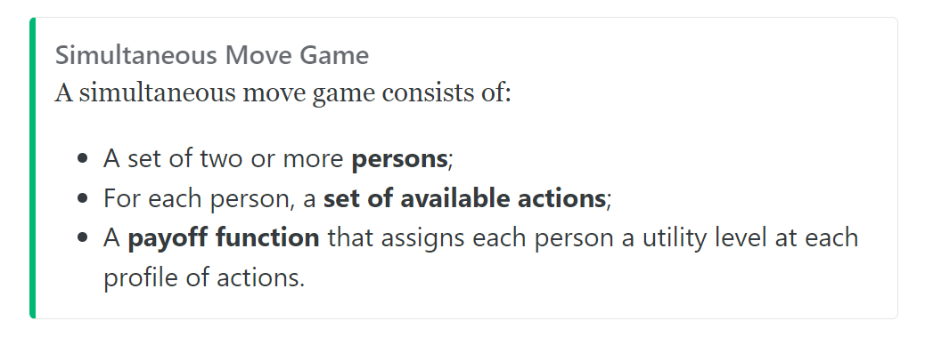

Slide 57
Example: “Power in Numbers”
The outcome of a street protest against a repressive regime can depend on the number of persons who participate.
If a large number participate, only a fraction of them will be imprisoned, beaten or killed and the population’s fear of the regime may be diminished.
If a small number participate, all will be imprisoned, beaten or killed and the population’s fear of the regime may increase.
Thus potential participants in a street protest are strategically interdependent: Each prefers to participate if she expects many others to participate. Each prefers to not participate if she expects few others to participate

Slide 58
Simultaneous Move Game Depicting “Power in Numbers”
Persons:
Sets of Available Actions:
Payoff Function:

Slide 59
Simultaneous Move Game Depicting “Power in Numbers”
Persons:
Person 1, Person 2, Person 3, Person 4
Sets of Available Actions:
Payoff Function:

Slide 60
Simultaneous Move Game Depicting “Power in Numbers”
Persons:
Person 1, Person 2, Person 3, Person 4
Sets of Available Actions:
For each person, {P,D} (P=“Participate”, D = “Do Not Participate”)
Payoff Function:

Slide 61
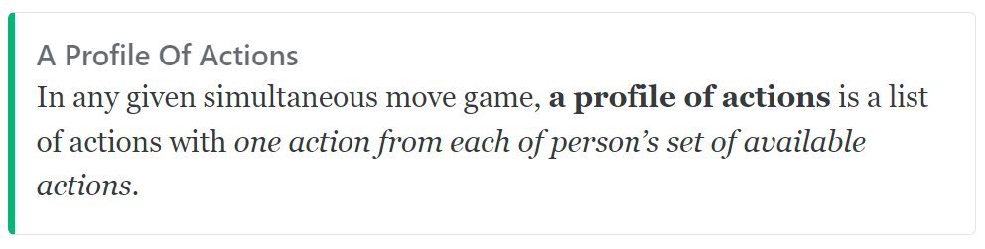
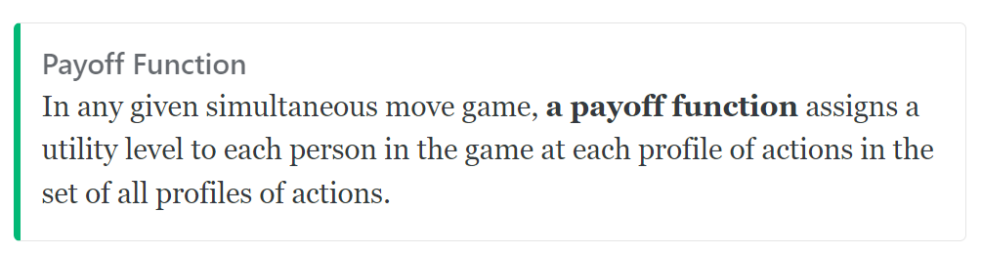
Simultaneous Move Game Depicting “Power in Numbers”
Persons:
Person 1, Person 2, Person 3, Person 4
Sets of Available Actions:
For each person, {P,D} (P=“Participate”, D = “Do Not Participate”)
Payoff Function:

Slide 62
Profile of Actions |  |  |  | Utility Levels
Person 1 | Person 2 | Person 3 | Person 4 | Person 1 | Person 2 | Person 3 | Person 4

Slide 63
Profile of Actions |  |  |  | Utility Levels
Person 1 | Person 2 | Person 3 | Person 4 | Person 1 | Person 2 | Person 3 | Person 4
We’ll depict the following strategic interdependence between the four persons in the game:
Person’s expectation about what the other three persons will do | Person’s preferences over her actions
less than two of other three will participate | Prefers to not participate instead of participate
two or more of other three will participate | Prefers to participate instead of not participate

Slide 64
Profile of Actions |  |  |  | Utility Levels
Person 1 | Person 2 | Person 3 | Person 4 | Person 1 | Person 2 | Person 3 | Person 4
P | D | P | D

Slide 65
Profile of Actions |  |  |  | Utility Levels
Person 1 | Person 2 | Person 3 | Person 4 | Person 1 | Person 2 | Person 3 | Person 4
P | D | P | D
This is ONE profile of actions....it specificies an action (“P” or “D”) for each of the four persons.

Slide 66
Profile of Actions |  |  |  | Utility Levels
Person 1 | Person 2 | Person 3 | Person 4 | Person 1 | Person 2 | Person 3 | Person 4

Slide 67
Profile of Actions |  |  |  | Utility Levels
Person 1 | Person 2 | Person 3 | Person 4 | Person 1 | Person 2 | Person 3 | Person 4
Write the profiles in which ZERO of the four participate here

Slide 68
Profile of Actions |  |  |  | Utility Levels
Person 1 | Person 2 | Person 3 | Person 4 | Person 1 | Person 2 | Person 3 | Person 4
Write the profiles in which ZERO of the four participate here
Write the profiles in which ONE of the four participate here

Slide 69
Profile of Actions |  |  |  | Utility Levels
Person 1 | Person 2 | Person 3 | Person 4 | Person 1 | Person 2 | Person 3 | Person 4
Write the profiles in which ZERO of the four participate here
Write the profiles in which ONE of the four participate here
Write the profiles in which TWO of the four participate here

Slide 70
Profile of Actions |  |  |  | Utility Levels
Person 1 | Person 2 | Person 3 | Person 4 | Person 1 | Person 2 | Person 3 | Person 4
Write the profiles in which ZERO of the four participate here
Write the profiles in which ONE of the four participate here
Write the profiles in which TWO of the four participate here
Write the profiles in which THREE of the four participate here

Slide 71
Profile of Actions |  |  |  | Utility Levels
Person 1 | Person 2 | Person 3 | Person 4 | Person 1 | Person 2 | Person 3 | Person 4
Write the profiles in which ZERO of the four participate here
Write the profiles in which ONE of the four participate here
Write the profiles in which TWO of the four participate here
Write the profiles in which THREE of the four participate here
Write the profiles in which FOUR of the four participate here

Slide 72
Profile of Actions |  |  |  | Utility Levels
Person 1 | Person 2 | Person 3 | Person 4 | Person 1 | Person 2 | Person 3 | Person 4
D | D | D | D
Write the profiles in which ZERO of the four participate here
Write the profiles in which ONE of the four participate here
Write the profiles in which TWO of the four participate here
Write the profiles in which THREE of the four participate here
Write the profiles in which FOUR of the four participate here

Slide 73
Profile of Actions |  |  |  | Utility Levels
Person 1 | Person 2 | Person 3 | Person 4 | Person 1 | Person 2 | Person 3 | Person 4
D | D | D | D
P | D | D | D
D | P | D | D
D | D | P | D
D | D | D | P
Write the profiles in which ZERO of the four participate here
Write the profiles in which ONE of the four participate here
Write the profiles in which TWO of the four participate here
Write the profiles in which THREE of the four participate here
Write the profiles in which FOUR of the four participate here

Slide 74
Profile of Actions |  |  |  | Utility Levels
Person 1 | Person 2 | Person 3 | Person 4 | Person 1 | Person 2 | Person 3 | Person 4
D | D | D | D
P | D | D | D
D | P | D | D
D | D | P | D
D | D | D | P
P | P | D | D
P | D | P | D
P | D | D | P
D | P | P | D
D | P | D | P
D | D | P | P
Write the profiles in which ZERO of the four participate here
Write the profiles in which ONE of the four participate here
Write the profiles in which TWO of the four participate here
Write the profiles in which THREE of the four participate here
Write the profiles in which FOUR of the four participate here

Slide 75
Profile of Actions |  |  |  | Utility Levels
Person 1 | Person 2 | Person 3 | Person 4 | Person 1 | Person 2 | Person 3 | Person 4
D | D | D | D
P | D | D | D
D | P | D | D
D | D | P | D
D | D | D | P
P | P | D | D
P | D | P | D
P | D | D | P
D | P | P | D
D | P | D | P
D | D | P | P
P | P | P | P
Write the profiles in which ZERO of the four participate here
Write the profiles in which ONE of the four participate here
Write the profiles in which TWO of the four participate here
Write the profiles in which THREE of the four participate here
Write the profiles in which FOUR of the four participate here

Slide 76
Profile of Actions |  |  |  | Utility Levels
Person 1 | Person 2 | Person 3 | Person 4 | Person 1 | Person 2 | Person 3 | Person 4
D | D | D | D
P | D | D | D
D | P | D | D
D | D | P | D
D | D | D | P
P | P | D | D
P | D | P | D
P | D | D | P
D | P | P | D
D | P | D | P
D | D | P | P
P | P | P | D
P | P | D | P
P | D | P | P
D | P | P | P
P | P | P | P
Write the profiles in which ZERO of the four participate here
Write the profiles in which ONE of the four participate here
Write the profiles in which TWO of the four participate here
Write the profiles in which THREE of the four participate here
Write the profiles in which FOUR of the four participate here

Slide 77
Profile of Actions |  |  |  | Utility Levels
Person 1 | Person 2 | Person 3 | Person 4 | Person 1 | Person 2 | Person 3 | Person 4
D | D | D | D
P | D | D | D
D | P | D | D
D | D | P | D
D | D | D | P
P | P | D | D
P | D | P | D
P | D | D | P
D | P | P | D
D | P | D | P
D | D | P | P
P | P | P | D
P | P | D | P
P | D | P | P
D | P | P | P
P | P | P | P
ZERO
ONE
TWO
THREE
FOUR

Slide 78
Profile of Actions |  |  |  | Utility Levels
Person 1 | Person 2 | Person 3 | Person 4 | Person 1 | Person 2 | Person 3 | Person 4
D | D | D | D
P | D | D | D
D | P | D | D
D | D | P | D
D | D | D | P
P | P | D | D
P | D | P | D
P | D | D | P
D | P | P | D
D | P | D | P
D | D | P | P
P | P | P | D
P | P | D | P
P | D | P | P
D | P | P | P
P | P | P | P
ZERO
ONE
We’ll depict the following strategic interdependence between the four persons in the game:
TWO
Person’s expectation about what the other three persons will do | Person’s preferences over her actions
less than two of other three will participate | Prefers to not participate instead of participate
two or more of other three will participate | Prefers to participate instead of not participate
THREE
FOUR

Slide 79
Profile of Actions |  |  |  | Utility Levels
Person 1 | Person 2 | Person 3 | Person 4 | Person 1 | Person 2 | Person 3 | Person 4
D | D | D | D
P | D | D | D
D | P | D | D
D | D | P | D
D | D | D | P
P | P | D | D
P | D | P | D
P | D | D | P
D | P | P | D
D | P | D | P
D | D | P | P
P | P | P | D
P | P | D | P
P | D | P | P
D | P | P | P
P | P | P | P
ZERO
ONE
TWO
THREE
FOUR

Slide 80
Profile of Actions |  |  |  | Utility Levels
Person 1 | Person 2 | Person 3 | Person 4 | Person 1 | Person 2 | Person 3 | Person 4
D | D | D | D
P | D | D | D
D | P | D | D
D | D | P | D
D | D | D | P
P | P | D | D
P | D | P | D
P | D | D | P
D | P | P | D
D | P | D | P
D | D | P | P
P | P | P | D
P | P | D | P
P | D | P | P
D | P | P | P
P | P | P | P
ZERO
ONE
In which profiles do less than two of the three persons OTHER than person 1 participate?
TWO
THREE
FOUR

Slide 81
Profile of Actions |  |  |  | Utility Levels
Person 1 | Person 2 | Person 3 | Person 4 | Person 1 | Person 2 | Person 3 | Person 4
D | D | D | D
P | D | D | D
D | P | D | D
D | D | P | D
D | D | D | P
P | P | D | D
P | D | P | D
P | D | D | P
D | P | P | D
D | P | D | P
D | D | P | P
P | P | P | D
P | P | D | P
P | D | P | P
D | P | P | P
P | P | P | P
ZERO
ONE
In which profiles do less than two of the three persons OTHER than person 1 participate?
TWO
THREE
FOUR

Slide 82
Profile of Actions |  |  |  | Utility Levels
Person 1 | Person 2 | Person 3 | Person 4 | Person 1 | Person 2 | Person 3 | Person 4
D | D | D | D
P | D | D | D
D | P | D | D
D | D | P | D
D | D | D | P
P | P | D | D
P | D | P | D
P | D | D | P
D | P | P | D
D | P | D | P
D | D | P | P
P | P | P | D
P | P | D | P
P | D | P | P
D | P | P | P
P | P | P | P
ZERO
ONE
In which profiles do less than two of the three persons OTHER than person 1 participate?
TWO
THREE
FOUR

Slide 83
Profile of Actions |  |  |  | Utility Levels
Person 1 | Person 2 | Person 3 | Person 4 | Person 1 | Person 2 | Person 3 | Person 4
D | D | D | D
P | D | D | D
D | P | D | D
D | D | P | D
D | D | D | P
P | P | D | D
P | D | P | D
P | D | D | P
D | P | P | D
D | P | D | P
D | D | P | P
P | P | P | D
P | P | D | P
P | D | P | P
D | P | P | P
P | P | P | P
ZERO
ONE
In which profiles do less than two of the three persons OTHER than person 1 participate?
TWO
THREE
FOUR

Slide 84
Profile of Actions |  |  |  | Utility Levels
Person 1 | Person 2 | Person 3 | Person 4 | Person 1 | Person 2 | Person 3 | Person 4
D | D | D | D
P | D | D | D
D | P | D | D
D | D | P | D
D | D | D | P
P | P | D | D
P | D | P | D
P | D | D | P
D | P | P | D
D | P | D | P
D | D | P | P
P | P | P | D
P | P | D | P
P | D | P | P
D | P | P | P
P | P | P | P
ZERO
ONE
In which profiles do less than two of the three persons OTHER than person 1 participate?
TWO
THREE
FOUR

Slide 85
Profile of Actions |  |  |  | Utility Levels
Person 1 | Person 2 | Person 3 | Person 4 | Person 1 | Person 2 | Person 3 | Person 4
D | D | D | D
P | D | D | D
D | P | D | D
D | D | P | D
D | D | D | P
P | P | D | D
P | D | P | D
P | D | D | P
D | P | P | D
D | P | D | P
D | D | P | P
P | P | P | D
P | P | D | P
P | D | P | P
D | P | P | P
P | P | P | P
ZERO
ONE
In which profiles do less than two of the three persons OTHER than person 1 participate?
TWO
THREE
FOUR

Slide 86
Profile of Actions |  |  |  | Utility Levels
Person 1 | Person 2 | Person 3 | Person 4 | Person 1 | Person 2 | Person 3 | Person 4
D | D | D | D
P | D | D | D
D | P | D | D
D | D | P | D
D | D | D | P
P | P | D | D
P | D | P | D
P | D | D | P
D | P | P | D
D | P | D | P
D | D | P | P
P | P | P | D
P | P | D | P
P | D | P | P
D | P | P | P
P | P | P | P
ZERO
ONE
In which profiles do less than two of the three persons OTHER than person 1 participate?
TWO
THREE
FOUR

Slide 87
Profile of Actions |  |  |  | Utility Levels
Person 1 | Person 2 | Person 3 | Person 4 | Person 1 | Person 2 | Person 3 | Person 4
D | D | D | D
P | D | D | D
D | P | D | D
D | D | P | D
D | D | D | P
P | P | D | D
P | D | P | D
P | D | D | P
D | P | P | D
D | P | D | P
D | D | P | P
P | P | P | D
P | P | D | P
P | D | P | P
D | P | P | P
P | P | P | P
ZERO
ONE
TWO
In which profiles do less than two of the three persons OTHER than person 1 participate?
THREE
FOUR

Slide 88
Profile of Actions |  |  |  | Utility Levels
Person 1 | Person 2 | Person 3 | Person 4 | Person 1 | Person 2 | Person 3 | Person 4
D | D | D | D
P | D | D | D
D | P | D | D
D | D | P | D
D | D | D | P
P | P | D | D
P | D | P | D
P | D | D | P
D | P | P | D
D | P | D | P
D | D | P | P
P | P | P | D
P | P | D | P
P | D | P | P
D | P | P | P
P | P | P | P
ZERO
In which profiles do two or more of the three persons OTHER than person 1 participate?
ONE
TWO
THREE
FOUR

Slide 89
Profile of Actions |  |  |  | Utility Levels
Person 1 | Person 2 | Person 3 | Person 4 | Person 1 | Person 2 | Person 3 | Person 4
D | D | D | D
P | D | D | D
D | P | D | D
D | D | P | D
D | D | D | P
P | P | D | D
P | D | P | D
P | D | D | P
D | P | P | D
D | P | D | P
D | D | P | P
P | P | P | D
P | P | D | P
P | D | P | P
D | P | P | P
P | P | P | P
ZERO
In which profiles do two or more of the three persons OTHER than person 1 participate?
ONE
TWO
THREE
FOUR

Slide 90
Profile of Actions |  |  |  | Utility Levels
Person 1 | Person 2 | Person 3 | Person 4 | Person 1 | Person 2 | Person 3 | Person 4
D | D | D | D
P | D | D | D
D | P | D | D
D | D | P | D
D | D | D | P
P | P | D | D
P | D | P | D
P | D | D | P
D | P | P | D
D | P | D | P
D | D | P | P
P | P | P | D
P | P | D | P
P | D | P | P
D | P | P | P
P | P | P | P
ZERO
In which profiles do two or more of the three persons OTHER than person 1 participate?
ONE
We’ll depict the following strategic interdependence between the four persons in the game:
TWO
Person’s expectation about what the other three persons will do | Person’s preferences over her actions
less than two of other three will participate | Prefers to not participate instead of participate
two or more of other three will participate | Prefers to participate instead of not participate
THREE
FOUR

Slide 91
Profile of Actions |  |  |  | Utility Levels
Person 1 | Person 2 | Person 3 | Person 4 | Person 1 | Person 2 | Person 3 | Person 4
D | D | D | D
P | D | D | D
D | P | D | D
D | D | P | D
D | D | D | P
P | P | D | D
P | D | P | D
P | D | D | P
D | P | P | D
D | P | D | P
D | D | P | P
P | P | P | D
P | P | D | P
P | D | P | P
D | P | P | P
P | P | P | P
ZERO
ONE
TWO
THREE
FOUR

Slide 92
Profile of Actions |  |  |  | Utility Levels
Person 1 | Person 2 | Person 3 | Person 4 | Person 1 | Person 2 | Person 3 | Person 4
D | D | D | D
P | D | D | D
D | P | D | D
D | D | P | D
D | D | D | P
P | P | D | D
P | D | P | D
P | D | D | P
D | P | P | D
D | P | D | P
D | D | P | P
P | P | P | D
P | P | D | P
P | D | P | P
D | P | P | P
P | P | P | P
ZERO
ONE
Person’s expectation about what the other three persons will do | Person’s preferences over her actions
less than two of other three will participate | Prefers to not participate instead of participate
two or more of other three will participate | Prefers to participate instead of not participate
TWO
THREE
FOUR

Slide 93
Profile of Actions |  |  |  | Utility Levels
Person 1 | Person 2 | Person 3 | Person 4 | Person 1 | Person 2 | Person 3 | Person 4
D | D | D | D | 1
P | D | D | D | -1
D | P | D | D
D | D | P | D
D | D | D | P
P | P | D | D
P | D | P | D
P | D | D | P
D | P | P | D
D | P | D | P
D | D | P | P
P | P | P | D
P | P | D | P
P | D | P | P
D | P | P | P
P | P | P | P
ZERO
ONE
Person’s expectation about what the other three persons will do | Person’s preferences over her actions
less than two of other three will participate | Prefers to not participate instead of participate
two or more of other three will participate | Prefers to participate instead of not participate
TWO
THREE
FOUR

Slide 94
Profile of Actions |  |  |  | Utility Levels
Person 1 | Person 2 | Person 3 | Person 4 | Person 1 | Person 2 | Person 3 | Person 4
D | D | D | D | 1
P | D | D | D | -1
D | P | D | D
D | D | P | D
D | D | D | P
P | P | D | D
P | D | P | D
P | D | D | P
D | P | P | D
D | P | D | P
D | D | P | P
P | P | P | D
P | P | D | P
P | D | P | P
D | P | P | P
P | P | P | P
ZERO
Fill out the remaining green-shaded rows!
ONE
TWO
Person’s expectation about what the other three persons will do | Person’s preferences over her actions
less than two of other three will participate | Prefers to not participate instead of participate
two or more of other three will participate | Prefers to participate instead of not participate
THREE
FOUR

Slide 95
Profile of Actions |  |  |  | Utility Levels
Person 1 | Person 2 | Person 3 | Person 4 | Person 1 | Person 2 | Person 3 | Person 4
D | D | D | D | 1
P | D | D | D | -1
D | P | D | D | 1
D | D | P | D | 1
D | D | D | P | 1
P | P | D | D | -1
P | D | P | D | -1
P | D | D | P | -1
D | P | P | D
D | P | D | P
D | D | P | P
P | P | P | D
P | P | D | P
P | D | P | P
D | P | P | P
P | P | P | P
ZERO
Fill out the remaining green-shaded rows!
ONE
TWO
Person’s expectation about what the other three persons will do | Person’s preferences over her actions
less than two of other three will participate | Prefers to not participate instead of participate
two or more of other three will participate | Prefers to participate instead of not participate
THREE
FOUR

Slide 96
Profile of Actions |  |  |  | Utility Levels
Person 1 | Person 2 | Person 3 | Person 4 | Person 1 | Person 2 | Person 3 | Person 4
D | D | D | D | 1
P | D | D | D | -1
D | P | D | D | 1
D | D | P | D | 1
D | D | D | P | 1
P | P | D | D | -1
P | D | P | D | -1
P | D | D | P | -1
D | P | P | D
D | P | D | P
D | D | P | P
P | P | P | D
P | P | D | P
P | D | P | P
D | P | P | P
P | P | P | P
ZERO
Fill out the yellow-shaded rows. Remember: We want to depict the idea that Person 1 prefers to participate instead of not participate if she expects two or more of the three other persons to participate!
ONE
TWO
THREE
FOUR

Slide 97
Profile of Actions |  |  |  | Utility Levels
Person 1 | Person 2 | Person 3 | Person 4 | Person 1 | Person 2 | Person 3 | Person 4
D | D | D | D | 1
P | D | D | D | -1
D | P | D | D | 1
D | D | P | D | 1
D | D | D | P | 1
P | P | D | D | -1
P | D | P | D | -1
P | D | D | P | -1
D | P | P | D | -1
D | P | D | P
D | D | P | P
P | P | P | D | 1
P | P | D | P
P | D | P | P
D | P | P | P
P | P | P | P
ZERO
Fill out the yellow-shaded rows. Remember: We want to depict the idea that Person 1 prefers to participate instead of not participate if she expects two or more of the three other persons to participate!
ONE
TWO
THREE
FOUR

Slide 98
Profile of Actions |  |  |  | Utility Levels
Person 1 | Person 2 | Person 3 | Person 4 | Person 1 | Person 2 | Person 3 | Person 4
D | D | D | D | 1
P | D | D | D | -1
D | P | D | D | 1
D | D | P | D | 1
D | D | D | P | 1
P | P | D | D | -1
P | D | P | D | -1
P | D | D | P | -1
D | P | P | D | -1
D | P | D | P | -1
D | D | P | P | -1
P | P | P | D | 1
P | P | D | P | 1
P | D | P | P | 1
D | P | P | P | -1
P | P | P | P | 1
ZERO
Fill out the yellow-shaded rows. Remember: We want to depict the idea that Person 1 prefers to participate instead of not participate if she expects two or more of the three other persons to participate!
ONE
TWO
THREE
FOUR

Slide 99
Profile of Actions |  |  |  | Utility Levels
Person 1 | Person 2 | Person 3 | Person 4 | Person 1 | Person 2 | Person 3 | Person 4
D | D | D | D | 1
P | D | D | D | -1
D | P | D | D | 1
D | D | P | D | 1
D | D | D | P | 1
P | P | D | D | -1
P | D | P | D | -1
P | D | D | P | -1
D | P | P | D | -1
D | P | D | P | -1
D | D | P | P | -1
P | P | P | D | 1
P | P | D | P | 1
P | D | P | P | 1
D | P | P | P | -1
P | P | P | P | 1
ZERO
ONE
TWO
THREE
FOUR

Slide 100
Profile of Actions |  |  |  | Utility Levels
Person 1 | Person 2 | Person 3 | Person 4 | Person 1 | Person 2 | Person 3 | Person 4
D | D | D | D | 1
P | D | D | D | -1
D | P | D | D | 1
D | D | P | D | 1
D | D | D | P | 1
P | P | D | D | -1
P | D | P | D | -1
P | D | D | P | -1
D | P | P | D | -1
D | P | D | P | -1
D | D | P | P | -1
P | P | P | D | 1
P | P | D | P | 1
P | D | P | P | 1
D | P | P | P | -1
P | P | P | P | 1
ZERO
ONE
We’ll depict the following strategic interdependence between the four persons in the game:
Person’s expectation about what the other three persons will do | Person’s preferences over her actions
less than two of other three will participate | Prefers to not participate instead of participate
two or more of other three will participate | Prefers to participate instead of not participate
TWO
THREE
FOUR

Slide 101
Profile of Actions |  |  |  | Utility Levels
Person 1 | Person 2 | Person 3 | Person 4 | Person 1 | Person 2 | Person 3 | Person 4
D | D | D | D | 1
P | D | D | D | -1
D | P | D | D | 1
D | D | P | D | 1
D | D | D | P | 1
P | P | D | D | -1
P | D | P | D | -1
P | D | D | P | -1
D | P | P | D | -1
D | P | D | P | -1
D | D | P | P | -1
P | P | P | D | 1
P | P | D | P | 1
P | D | P | P | 1
D | P | P | P | -1
P | P | P | P | 1
ZERO
Identify the profiles in which less than two of the three persons other than person 2 participate
ONE
TWO
THREE
FOUR

Slide 102
Profile of Actions |  |  |  | Utility Levels
Person 1 | Person 2 | Person 3 | Person 4 | Person 1 | Person 2 | Person 3 | Person 4
D | D | D | D | 1
P | D | D | D | -1
D | P | D | D | 1
D | D | P | D | 1
D | D | D | P | 1
P | P | D | D | -1
P | D | P | D | -1
P | D | D | P | -1
D | P | P | D | -1
D | P | D | P | -1
D | D | P | P | -1
P | P | P | D | 1
P | P | D | P | 1
P | D | P | P | 1
D | P | P | P | -1
P | P | P | P | 1
ZERO
Identify the profiles in which less than two of the three persons other than person 2 participate
ONE
TWO
THREE
FOUR

Slide 103
Profile of Actions |  |  |  | Utility Levels
Person 1 | Person 2 | Person 3 | Person 4 | Person 1 | Person 2 | Person 3 | Person 4
D | D | D | D | 1
P | D | D | D | -1
D | P | D | D | 1
D | D | P | D | 1
D | D | D | P | 1
P | P | D | D | -1
P | D | P | D | -1
P | D | D | P | -1
D | P | P | D | -1
D | P | D | P | -1
D | D | P | P | -1
P | P | P | D | 1
P | P | D | P | 1
P | D | P | P | 1
D | P | P | P | -1
P | P | P | P | 1
ZERO
Identify the profiles in which less than two of the three persons other than person 2 participate
ONE
We’ll depict the following strategic interdependence between the four persons in the game:
Person’s expectation about what the other three persons will do | Person’s preferences over her actions
less than two of other three will participate | Prefers to not participate instead of participate
two or more of other three will participate | Prefers to participate instead of not participate
TWO
THREE
FOUR

Slide 104
Profile of Actions |  |  |  | Utility Levels
Person 1 | Person 2 | Person 3 | Person 4 | Person 1 | Person 2 | Person 3 | Person 4
D | D | D | D | 1
P | D | D | D | -1
D | P | D | D | 1
D | D | P | D | 1
D | D | D | P | 1
P | P | D | D | -1
P | D | P | D | -1
P | D | D | P | -1
D | P | P | D | -1
D | P | D | P | -1
D | D | P | P | -1
P | P | P | D | 1
P | P | D | P | 1
P | D | P | P | 1
D | P | P | P | -1
P | P | P | P | 1
ZERO
Assign utility levels to Person 2 at those profiles in a way that depicts the idea that Person 2 prefers to not participate instead of participate when he expects less than two of the three others to participate.
ONE
TWO
THREE
FOUR

Slide 105
Profile of Actions |  |  |  | Utility Levels
Person 1 | Person 2 | Person 3 | Person 4 | Person 1 | Person 2 | Person 3 | Person 4
D | D | D | D | 1 | 1
P | D | D | D | -1 | -1
D | P | D | D | 1
D | D | P | D | 1
D | D | D | P | 1
P | P | D | D | -1
P | D | P | D | -1
P | D | D | P | -1
D | P | P | D | -1
D | P | D | P | -1
D | D | P | P | -1
P | P | P | D | 1
P | P | D | P | 1
P | D | P | P | 1
D | P | P | P | -1
P | P | P | P | 1
ZERO
Assign utility levels to Person 2 at those profiles in a way that depicts the idea that Person 2 prefers to not participate instead of participate when he expects less than two of the three others to participate.
ONE
TWO
THREE
FOUR

Slide 106
Profile of Actions |  |  |  | Utility Levels
Person 1 | Person 2 | Person 3 | Person 4 | Person 1 | Person 2 | Person 3 | Person 4
D | D | D | D | 1 | 1
P | D | D | D | -1 | -1
D | P | D | D | 1 | 1
D | D | P | D | 1 | 1
D | D | D | P | 1 | 1
P | P | D | D | -1 | -1
P | D | P | D | -1
P | D | D | P | -1
D | P | P | D | -1 | 1
D | P | D | P | -1 | 1
D | D | P | P | -1
P | P | P | D | 1
P | P | D | P | 1
P | D | P | P | 1
D | P | P | P | -1
P | P | P | P | 1
ZERO
Assign utility levels to Person 2 at those profiles in a way that depicts the idea that Person 2 prefers to not participate instead of participate when he expects less than two of the three others to participate.
ONE
TWO
THREE
FOUR

Slide 107
Profile of Actions |  |  |  | Utility Levels
Person 1 | Person 2 | Person 3 | Person 4 | Person 1 | Person 2 | Person 3 | Person 4
D | D | D | D | 1 | 1
P | D | D | D | -1 | -1
D | P | D | D | 1 | 1
D | D | P | D | 1 | 1
D | D | D | P | 1 | 1
P | P | D | D | -1 | -1
P | D | P | D | -1
P | D | D | P | -1
D | P | P | D | -1 | 1
D | P | D | P | -1 | 1
D | D | P | P | -1
P | P | P | D | 1
P | P | D | P | 1
P | D | P | P | 1
D | P | P | P | -1
P | P | P | P | 1
ZERO
Assign utility levels to Person 2 at those profiles in a way that depicts the idea that Person 2 prefers to not participate instead of participate when he expects less than two of the three others to participate.
ONE
We’ll depict the following strategic interdependence between the four persons in the game:
Person’s expectation about what the other three persons will do | Person’s preferences over her actions
less than two of other three will participate | Prefers to not participate instead of participate
two or more of other three will participate | Prefers to participate instead of not participate
TWO
THREE
FOUR

Slide 108
Profile of Actions |  |  |  | Utility Levels
Person 1 | Person 2 | Person 3 | Person 4 | Person 1 | Person 2 | Person 3 | Person 4
D | D | D | D | 1 | 1
P | D | D | D | -1 | -1
D | P | D | D | 1 | 1
D | D | P | D | 1 | 1
D | D | D | P | 1 | 1
P | P | D | D | -1 | -1
P | D | P | D | -1
P | D | D | P | -1
D | P | P | D | -1 | 1
D | P | D | P | -1 | 1
D | D | P | P | -1
P | P | P | D | 1
P | P | D | P | 1
P | D | P | P | 1
D | P | P | P | -1
P | P | P | P | 1
ZERO
Identify the profiles in which two or more of the three persons other than Person 2 participate.
ONE
TWO
THREE
FOUR

Slide 109
Profile of Actions |  |  |  | Utility Levels
Person 1 | Person 2 | Person 3 | Person 4 | Person 1 | Person 2 | Person 3 | Person 4
D | D | D | D | 1 | 1
P | D | D | D | -1 | -1
D | P | D | D | 1 | 1
D | D | P | D | 1 | 1
D | D | D | P | 1 | 1
P | P | D | D | -1 | -1
P | D | P | D | -1
P | D | D | P | -1
D | P | P | D | -1 | 1
D | P | D | P | -1 | 1
D | D | P | P | -1
P | P | P | D | 1
P | P | D | P | 1
P | D | P | P | 1
D | P | P | P | -1
P | P | P | P | 1
ZERO
Identify the profiles in which two or more of the three persons other than Person 2 participate.
ONE
TWO
THREE
FOUR

Slide 110
Profile of Actions |  |  |  | Utility Levels
Person 1 | Person 2 | Person 3 | Person 4 | Person 1 | Person 2 | Person 3 | Person 4
D | D | D | D | 1 | 1
P | D | D | D | -1 | -1
D | P | D | D | 1 | 1
D | D | P | D | 1 | 1
D | D | D | P | 1 | 1
P | P | D | D | -1 | -1
P | D | P | D | -1
P | D | D | P | -1
D | P | P | D | -1 | 1
D | P | D | P | -1 | 1
D | D | P | P | -1
P | P | P | D | 1
P | P | D | P | 1
P | D | P | P | 1
D | P | P | P | -1
P | P | P | P | 1
ZERO
Identify the profiles in which two or more of the three persons other than Person 2 participate.
ONE
We’ll depict the following strategic interdependence between the four persons in the game:
Person’s expectation about what the other three persons will do | Person’s preferences over her actions
less than two of other three will participate | Prefers to not participate instead of participate
two or more of other three will participate | Prefers to participate instead of not participate
TWO
THREE
FOUR

Slide 111
Profile of Actions |  |  |  | Utility Levels
Person 1 | Person 2 | Person 3 | Person 4 | Person 1 | Person 2 | Person 3 | Person 4
D | D | D | D | 1 | 1
P | D | D | D | -1 | -1
D | P | D | D | 1 | 1
D | D | P | D | 1 | 1
D | D | D | P | 1 | 1
P | P | D | D | -1 | -1
P | D | P | D | -1
P | D | D | P | -1
D | P | P | D | -1 | 1
D | P | D | P | -1 | 1
D | D | P | P | -1
P | P | P | D | 1
P | P | D | P | 1
P | D | P | P | 1
D | P | P | P | -1
P | P | P | P | 1
ZERO
Assign utility levels to those profiles in a way that depicts the idea that Person 2 prefers to participate instead of not participate when she expects two or more of the three other persons to participate.
ONE
TWO
THREE
FOUR

Slide 112
Profile of Actions |  |  |  | Utility Levels
Person 1 | Person 2 | Person 3 | Person 4 | Person 1 | Person 2 | Person 3 | Person 4
D | D | D | D | 1 | 1
P | D | D | D | -1 | -1
D | P | D | D | 1 | 1
D | D | P | D | 1 | 1
D | D | D | P | 1 | 1
P | P | D | D | -1 | -1
P | D | P | D | -1 | 1
P | D | D | P | -1
D | P | P | D | -1 | 1
D | P | D | P | -1 | 1
D | D | P | P | -1 | -1
P | P | P | D | 1
P | P | D | P | 1
P | D | P | P | 1
D | P | P | P | -1
P | P | P | P | 1
ZERO
Assign utility levels to those profiles in a way that depicts the idea that Person 2 prefers to participate instead of not participate when she expects two or more of the three other persons to participate.
ONE
TWO
THREE
FOUR

Slide 113
Profile of Actions |  |  |  | Utility Levels
Person 1 | Person 2 | Person 3 | Person 4 | Person 1 | Person 2 | Person 3 | Person 4
D | D | D | D | 1 | 1
P | D | D | D | -1 | -1
D | P | D | D | 1 | 1
D | D | P | D | 1 | 1
D | D | D | P | 1 | 1
P | P | D | D | -1 | -1
P | D | P | D | -1 | 1
P | D | D | P | -1 | 1
D | P | P | D | -1 | 1
D | P | D | P | -1 | 1
D | D | P | P | -1 | -1
P | P | P | D | 1 | 1
P | P | D | P | 1 | 1
P | D | P | P | 1 | 1
D | P | P | P | -1 | -1
P | P | P | P | 1 | 1
ZERO
Assign utility levels to those profiles in a way that depicts the idea that Person 2 prefers to participate instead of not participate when she expects two or more of the three other persons to participate.
ONE
TWO
THREE
FOUR

Slide 114
Profile of Actions |  |  |  | Utility Levels
Person 1 | Person 2 | Person 3 | Person 4 | Person 1 | Person 2 | Person 3 | Person 4
D | D | D | D | 1 | 1
P | D | D | D | -1 | -1
D | P | D | D | 1 | 1
D | D | P | D | 1 | 1
D | D | D | P | 1 | 1
P | P | D | D | -1 | -1
P | D | P | D | -1 | 1
P | D | D | P | -1 | 1
D | P | P | D | -1 | 1
D | P | D | P | -1 | 1
D | D | P | P | -1 | -1
P | P | P | D | 1 | 1
P | P | D | P | 1 | 1
P | D | P | P | 1 | 1
D | P | P | P | -1 | -1
P | P | P | P | 1 | 1
ZERO
ONE
On your own...finish this for Persons 3 and 4!!!!
TWO
THREE
FOUR

