Slide 1
Expected Utility: Parameterized Models

Slide 2
What’s Coming Up
This week: Module 2 practice exams
This week: Problem solving sessions
In class, next Tuesday 3/31: Module 2 Exam. Please get here early.
No class next Thursday, nothing due next Friday. Forget about PSCI 107 for a few days.

Slide 3
warm up
Build an expected utility model of a person, “Faith”, choosing whether to run for office in an upcoming election. Depict the idea that Faith does not know how many other candidates will run in the election, and whether those candidates will be “high quality” (professional, well-funded, and thus likely to win), or “low quality” (amateur, lacking funding, and thus not likely to win). Assume Faith would find running personally costly, and values the prospect of winning public office.

Slide 4
warm up
Available actions
Build an expected utility model of a person, “Faith”, choosing whether to run for office in an upcoming election. Depict the idea that Faith does not know how many other candidates will run in the election, and whether those candidates will be “high quality” (professional, well-funded, and thus likely to win), or “low quality” (amateur, lacking funding, and thus not likely to win). Assume Faith would find running personally costly, and values the prospect of winning public office.
Possible outcomes
Preferences over outcomes
Probability distributions

Slide 5

warm up
Available actions
run, do not run
Build an expected utility model of a person, “Faith”, choosing whether to run for office in an upcoming election. Depict the idea that Faith does not know how many other candidates will run in the election, and whether those candidates will be “high quality” (professional, well-funded, and thus likely to win), or “low quality” (amateur, lacking funding, and thus not likely to win). Assume Faith would find running personally costly, and values the prospect of winning public office.
Possible outcomes
Faith runs and wins, runs and loses, or doesn’t run
Preferences over outcomes
$$U=\left\{\begin{matrix}−1 & \text{if} \text{Faith} \text{runs} \text{and} \text{loses} \\ 0 & \text{if} \text{Faith} \text{does} \text{not} \text{run} \\ 1 & \text{if} \text{Faith} \text{runs} \text{and} \text{wins}\end{matrix}\right\}$$
Probability distributions

Slide 6
warm up
Available actions
run, do not run
Build an expected utility model of a person, “Faith”, choosing whether to run for office in an upcoming election. Depict the idea that Faith does not know how many other candidates will run in the election, and whether those candidates will be “high quality” (professional, well-funded, and thus likely to win), or “low quality” (amateur, lacking funding, and thus not likely to win). Assume Faith would find running personally costly, and values the prospect of winning public office.
Possible outcomes
Faith runs and win, runs and loses, or doesn’t run
Preferences over outcomes
$$U=\left\{\begin{matrix}−1 & \text{if} \text{Faith} \text{runs} \text{and} \text{loses} \\ 0 & \text{if} \text{Faith} \text{does} \text{not} \text{run} \\ 1 & \text{if} \text{Faith} \text{runs} \text{and} \text{wins}\end{matrix}\right\}$$
Probability distributions
Idea: There will be either 1 or 2 other persons running. Each will be either “high quality” (H) or “low quality” (L)

Slide 7
warm up
Available actions
run, do not run
Build an expected utility model of a person, “Faith”, choosing whether to run for office in an upcoming election. Depict the idea that Faith does not know how many other candidates will run in the election, and whether those candidates will be “high quality” (professional, well-funded, and thus likely to win), or “low quality” (amateur, lacking funding, and thus not likely to win). Assume Faith would find running personally costly, and values the prospect of winning public office.
Possible outcomes
Faith runs and win, runs and loses, or doesn’t run
Preferences over outcomes
$$U=\left\{\begin{matrix}−1 & \text{if} \text{Faith} \text{runs} \text{and} \text{loses} \\ 0 & \text{if} \text{Faith} \text{does} \text{not} \text{run} \\ 1 & \text{if} \text{Faith} \text{runs} \text{and} \text{wins}\end{matrix}\right\}$$
Probability distributions
Idea: There will be either 1 or 2 other persons running. Each will be either “high quality” (H) or “low quality” (L)
number & quality of other persons running
win/lose

Slide 8
warm up
Available actions
run, do not run
Build an expected utility model of a person, “Faith”, choosing whether to run for office in an upcoming election. Depict the idea that Faith does not know how many other candidates will run in the election, and whether those candidates will be “high quality” (professional, well-funded, and thus likely to win), or “low quality” (amateur, lacking funding, and thus not likely to win). Assume Faith would find running personally costly, and values the prospect of winning public office.
Possible outcomes
Faith runs and win, runs and loses, or doesn’t run
Preferences over outcomes
$$U=\left\{\begin{matrix}−1 & \text{if} \text{Faith} \text{runs} \text{and} \text{loses} \\ 0 & \text{if} \text{Faith} \text{does} \text{not} \text{run} \\ 1 & \text{if} \text{Faith} \text{runs} \text{and} \text{wins}\end{matrix}\right\}$$
Probability distributions
Idea: There will be either 1 or 2 other persons running. Each will be either “high quality” (H) or “low quality” (L)
number & quality of other persons running
win/lose
Working with someone nearby you, build the rest of this model

Slide 9
warm up
Available actions
run, do not run
Build an expected utility model of a person, “Faith”, choosing whether to run for office in an upcoming election. Depict the idea that Faith does not know how many other candidates will run in the election, and whether those candidates will be “high quality” (professional, well-funded, and thus likely to win), or “low quality” (amateur, lacking funding, and thus not likely to win). Assume Faith would find running personally costly, and values the prospect of winning public office.
Possible outcomes
Faith runs and win, runs and loses, or doesn’t run
Preferences over outcomes
$$U=\left\{\begin{matrix}−1 & \text{if} \text{Faith} \text{runs} \text{and} \text{loses} \\ 0 & \text{if} \text{Faith} \text{does} \text{not} \text{run} \\ 1 & \text{if} \text{Faith} \text{runs} \text{and} \text{wins}\end{matrix}\right\}$$
Probability distributions
Idea: There will be either 1 or 2 other persons running. Each will be either “high quality” (H) or “low quality” (L)
number & quality of other persons running
2L
1L
1 H, 1L
1 H
2 H
win/lose

Slide 10

warm up
Available actions
run, do not run
Build an expected utility model of a person, “Faith”, choosing whether to run for office in an upcoming election. Depict the idea that Faith does not know how many other candidates will run in the election, and whether those candidates will be “high quality” (professional, well-funded, and thus likely to win), or “low quality” (amateur, lacking funding, and thus not likely to win). Assume Faith would find running personally costly, and values the prospect of winning public office.
Possible outcomes
Faith runs and win, runs and loses, or doesn’t run
Preferences over outcomes
$$U=\left\{\begin{matrix}−1 & \text{if} \text{Faith} \text{runs} \text{and} \text{loses} \\ 0 & \text{if} \text{Faith} \text{does} \text{not} \text{run} \\ 1 & \text{if} \text{Faith} \text{runs} \text{and} \text{wins}\end{matrix}\right\}$$
Probability distributions
Idea: There will be either 1 or 2 other persons running. Each will be either “high quality” (H) or “low quality” (L)
number & quality of other persons running
2L
1L
1 H, 1L
1 H
2 H
$$1$$
$$1$$
win/lose
win
lose

Slide 11






warm up
Available actions
run, do not run
Build an expected utility model of a person, “Faith”, choosing whether to run for office in an upcoming election. Depict the idea that Faith does not know how many other candidates will run in the election, and whether those candidates will be “high quality” (professional, well-funded, and thus likely to win), or “low quality” (amateur, lacking funding, and thus not likely to win). Assume Faith would find running personally costly, and values the prospect of winning public office.
Possible outcomes
Faith runs and win, runs and loses, or doesn’t run
Preferences over outcomes
$$U=\left\{\begin{matrix}−1 & \text{if} \text{Faith} \text{runs} \text{and} \text{loses} \\ 0 & \text{if} \text{Faith} \text{does} \text{not} \text{run} \\ 1 & \text{if} \text{Faith} \text{runs} \text{and} \text{wins}\end{matrix}\right\}$$
Probability distributions
Idea: There will be either 1 or 2 other persons running. Each will be either “high quality” (H) or “low quality” (L)
number & quality of other persons running
2L
1L
1 H, 1L
1 H
2 H
$$\frac{1}{4}$$
$$\frac{3}{4}$$
$$\frac{1}{2}$$
win
$$1$$
$$1$$
win
win
win/lose
win
lose
$$\frac{3}{4}$$
lose
$$\frac{1}{4}$$
$$\frac{1}{2}$$
lose
lose

Slide 12





warm up
Available actions
run, do not run
Build an expected utility model of a person, “Faith”, choosing whether to run for office in an upcoming election. Depict the idea that Faith does not know how many other candidates will run in the election, and whether those candidates will be “high quality” (professional, well-funded, and thus likely to win), or “low quality” (amateur, lacking funding, and thus not likely to win). Assume Faith would find running personally costly, and values the prospect of winning public office.
Possible outcomes
Faith runs and win, runs and loses, or doesn’t run
Preferences over outcomes
$$U=\left\{\begin{matrix}−1 & \text{if} \text{Faith} \text{runs} \text{and} \text{loses} \\ 0 & \text{if} \text{Faith} \text{does} \text{not} \text{run} \\ 1 & \text{if} \text{Faith} \text{runs} \text{and} \text{wins}\end{matrix}\right\}$$
Probability distributions
Idea: There will be either 1 or 2 other persons running. Each will be either “high quality” (H) or “low quality” (L)
number & quality of other persons running
2L
1L
1 H, 1L
1 H
2 H
$$\frac{1}{10}$$
$$\frac{2}{10}$$
$$\frac{4}{10}$$
$$\frac{2}{10}$$
$$\frac{1}{10}$$
$$\frac{1}{4}$$
$$\frac{3}{4}$$
$$\frac{1}{2}$$
win
$$1$$
$$1$$
win
win
win/lose
win
lose
$$\frac{3}{4}$$
lose
$$\frac{1}{4}$$
$$\frac{1}{2}$$
lose
lose

Slide 13






warm up
Available actions
run, do not run
Build an expected utility model of a person, “Faith”, choosing whether to run for office in an upcoming election. Depict the idea that Faith does not know how many other candidates will run in the election, and whether those candidates will be “high quality” (professional, well-funded, and thus likely to win), or “low quality” (amateur, lacking funding, and thus not likely to win). Assume Faith would find running personally costly, and values the prospect of winning public office.
Possible outcomes
Faith runs and win, runs and loses, or doesn’t run
Preferences over outcomes
$$U=\left\{\begin{matrix}−1 & \text{if} \text{Faith} \text{runs} \text{and} \text{loses} \\ 0 & \text{if} \text{Faith} \text{does} \text{not} \text{run} \\ 1 & \text{if} \text{Faith} \text{runs} \text{and} \text{wins}\end{matrix}\right\}$$
Probability distributions
Idea: There will be either 1 or 2 other persons running. Each will be either “high quality” (H) or “low quality” (L)
number & quality of other persons running
2L
1L
1 H, 1L
1 H
2 H
$$\frac{1}{10}$$
$$\frac{2}{10}$$
$$\frac{4}{10}$$
$$\frac{2}{10}$$
$$\frac{1}{10}$$
$$\frac{1}{4}$$
$$\frac{3}{4}$$
$$\frac{1}{2}$$
win
$$1$$
win
win
$$1$$
win/lose
win
lose
$$\frac{3}{4}$$
lose
$$\frac{1}{4}$$
$$\frac{1}{2}$$
lose
lose

Slide 14
warm up
Available actions
run, do not run
Build an expected utility model of a person, “Faith”, choosing whether to run for office in an upcoming election. Depict the idea that Faith does not know how many other candidates will run in the election, and whether those candidates will be “high quality” (professional, well-funded, and thus likely to win), or “low quality” (amateur, lacking funding, and thus not likely to win). Assume Faith would find running personally costly, and values the prospect of winning public office.
Possible outcomes
Faith runs and win, runs and loses, or doesn’t run
Preferences over outcomes
$$U=\left\{\begin{matrix}−1 & \text{if} \text{Faith} \text{runs} \text{and} \text{loses} \\ 0 & \text{if} \text{Faith} \text{does} \text{not} \text{run} \\ 1 & \text{if} \text{Faith} \text{runs} \text{and} \text{wins}\end{matrix}\right\}$$
Probability distributions
Idea: There will be either 1 or 2 other persons running. Each will be either “high quality” (H) or “low quality” (L)
number & quality of other persons running
2L
1L
1 H, 1L
1 H
2 H
calculate the marginal probability that Faith wins if she runs.
$$\frac{1}{10}$$
$$\frac{2}{10}$$
$$\frac{4}{10}$$
$$\frac{2}{10}$$
$$\frac{1}{10}$$
$$\frac{1}{4}$$
$$\frac{3}{4}$$
$$\frac{1}{2}$$
win
$$1$$
win
win
$$1$$
win/lose
win
and the marginal probability that Faith loses if she runs.
lose
$$\frac{3}{4}$$
lose
$$\frac{1}{4}$$
$$\frac{1}{2}$$
lose
lose

Slide 15


warm up
Available actions
run, do not run
Build an expected utility model of a person, “Faith”, choosing whether to run for office in an upcoming election. Depict the idea that Faith does not know how many other candidates will run in the election, and whether those candidates will be “high quality” (professional, well-funded, and thus likely to win), or “low quality” (amateur, lacking funding, and thus not likely to win). Assume Faith would find running personally costly, and values the prospect of winning public office.
Possible outcomes
Faith runs and win, runs and loses, or doesn’t run
Preferences over outcomes
$$U=\left\{\begin{matrix}−1 & \text{if} \text{Faith} \text{runs} \text{and} \text{loses} \\ 0 & \text{if} \text{Faith} \text{does} \text{not} \text{run} \\ 1 & \text{if} \text{Faith} \text{runs} \text{and} \text{wins}\end{matrix}\right\}$$
Probability distributions
Idea: There will be either 1 or 2 other persons running. Each will be either “high quality” (H) or “low quality” (L)
number & quality of other persons running
2L
1L
1 H, 1L
1 H
2 H
calculate the marginal probability that Faith wins if she runs.
$$\frac{1}{10}$$
$$\frac{2}{10}$$
$$\frac{4}{10}$$
$$\frac{2}{10}$$
$$\frac{1}{10}$$
$$\frac{1}{10}×\frac{4}{4}+\frac{2}{10}×\frac{3}{4}+\frac{4}{10}×\frac{2}{4}+\frac{2}{10}×\frac{1}{4}=\frac{20}{40}=\frac{1}{2}$$
$$\frac{1}{4}$$
$$\frac{3}{4}$$
$$\frac{1}{2}$$
win
$$1$$
win
win
$$1$$
win/lose
win
and the marginal probability that Faith loses if she runs.
lose
$$\frac{2}{10}×\frac{1}{4}+\frac{4}{10}×\frac{2}{4}+\frac{2}{10}×\frac{3}{4}+\frac{1}{10}×\frac{4}{4}=\frac{20}{40}=\frac{1}{2}$$
$$\frac{3}{4}$$
lose
$$\frac{1}{4}$$
$$\frac{1}{2}$$
lose
lose

Slide 16
warm up
Available actions
run, do not run
Build an expected utility model of a person, “Faith”, choosing whether to run for office in an upcoming election. Depict the idea that Faith does not know how many other candidates will run in the election, and whether those candidates will be “high quality” (professional, well-funded, and thus likely to win), or “low quality” (amateur, lacking funding, and thus not likely to win). Assume Faith would find running personally costly, and values the prospect of winning public office.
Possible outcomes
Faith runs and win, runs and loses, or doesn’t run
Preferences over outcomes
$$U=\left\{\begin{matrix}−1 & \text{if} \text{Faith} \text{runs} \text{and} \text{loses} \\ 0 & \text{if} \text{Faith} \text{does} \text{not} \text{run} \\ 1 & \text{if} \text{Faith} \text{runs} \text{and} \text{wins}\end{matrix}\right\}$$
Probability distributions
Idea: There will be either 1 or 2 other persons running. Each will be either “high quality” (H) or “low quality” (L)
Calculate Faith’s expected utility from each of her available actions (remembering that if she runs, she wins with probability $\frac{1}{2}$ and loses with probability $\frac{1}{2}$).

Slide 17
warm up
Available actions
run, do not run
Build an expected utility model of a person, “Faith”, choosing whether to run for office in an upcoming election. Depict the idea that Faith does not know how many other candidates will run in the election, and whether those candidates will be “high quality” (professional, well-funded, and thus likely to win), or “low quality” (amateur, lacking funding, and thus not likely to win). Assume Faith would find running personally costly, and values the prospect of winning public office.
Possible outcomes
Faith runs and win, runs and loses, or doesn’t run
Preferences over outcomes
$$U=\left\{\begin{matrix}−1 & \text{if} \text{Faith} \text{runs} \text{and} \text{loses} \\ 0 & \text{if} \text{Faith} \text{does} \text{not} \text{run} \\ 1 & \text{if} \text{Faith} \text{runs} \text{and} \text{wins}\end{matrix}\right\}$$
Probability distributions
Idea: There will be either 1 or 2 other persons running. Each will be either “high quality” (H) or “low quality” (L)
Calculate Faith’s expected utility from each of her available actions (remembering that if she runs, she wins with probability $\frac{1}{2}$ and loses with probability $\frac{1}{2}$).
Action | Outcome | Probability | Utility
run | win
 | lose
don’t run | NA

Slide 18
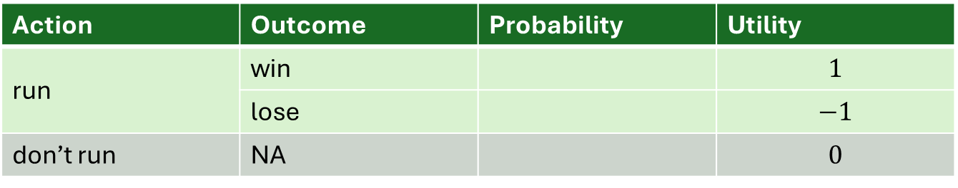
warm up
Available actions
run, do not run
Build an expected utility model of a person, “Faith”, choosing whether to run for office in an upcoming election. Depict the idea that Faith does not know how many other candidates will run in the election, and whether those candidates will be “high quality” (professional, well-funded, and thus likely to win), or “low quality” (amateur, lacking funding, and thus not likely to win). Assume Faith would find running personally costly, and values the prospect of winning public office.
Possible outcomes
Faith runs and win, runs and loses, or doesn’t run
Preferences over outcomes
$$U=\left\{\begin{matrix}−1 & \text{if} \text{Faith} \text{runs} \text{and} \text{loses} \\ 0 & \text{if} \text{Faith} \text{does} \text{not} \text{run} \\ 1 & \text{if} \text{Faith} \text{runs} \text{and} \text{wins}\end{matrix}\right\}$$
Probability distributions
Idea: There will be either 1 or 2 other persons running. Each will be either “high quality” (H) or “low quality” (L)
Calculate Faith’s expected utility from each of her available actions (remembering that if she runs, she wins with probability $\frac{1}{2}$ and loses with probability $\frac{1}{2}$).
Action | Outcome | Probability | Utility
run | win |  | $$1$$
 | lose |  | $$−1$$
don’t run | NA |  | $$0$$

Slide 19
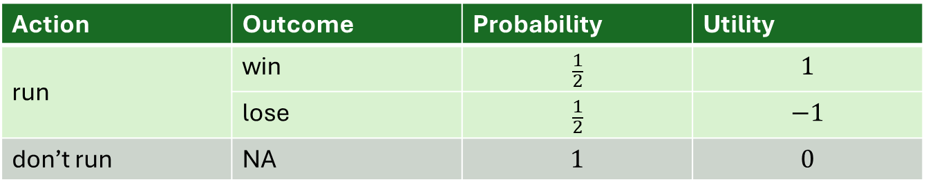
warm up
Available actions
run, do not run
Build an expected utility model of a person, “Faith”, choosing whether to run for office in an upcoming election. Depict the idea that Faith does not know how many other candidates will run in the election, and whether those candidates will be “high quality” (professional, well-funded, and thus likely to win), or “low quality” (amateur, lacking funding, and thus not likely to win). Assume Faith would find running personally costly, and values the prospect of winning public office.
Possible outcomes
Faith runs and win, runs and loses, or doesn’t run
Preferences over outcomes
$$U=\left\{\begin{matrix}−1 & \text{if} \text{Faith} \text{runs} \text{and} \text{loses} \\ 0 & \text{if} \text{Faith} \text{does} \text{not} \text{run} \\ 1 & \text{if} \text{Faith} \text{runs} \text{and} \text{wins}\end{matrix}\right\}$$
Probability distributions
Idea: There will be either 1 or 2 other persons running. Each will be either “high quality” (H) or “low quality” (L)
Calculate Faith’s expected utility from each of her available actions (remembering that if she runs, she wins with probability $\frac{1}{2}$ and loses with probability $\frac{1}{2}$).
Action | Outcome | Probability | Utility
run | win | $$\frac{1}{2}$$ | $$1$$
 | lose | $$\frac{1}{2}$$ | $$−1$$
don’t run | NA | $$1$$ | $$0$$

Slide 20

warm up
Available actions
run, do not run
Build an expected utility model of a person, “Faith”, choosing whether to run for office in an upcoming election. Depict the idea that Faith does not know how many other candidates will run in the election, and whether those candidates will be “high quality” (professional, well-funded, and thus likely to win), or “low quality” (amateur, lacking funding, and thus not likely to win). Assume Faith would find running personally costly, and values the prospect of winning public office.
Possible outcomes
Faith runs and win, runs and loses, or doesn’t run
Preferences over outcomes
$$U=\left\{\begin{matrix}−1 & \text{if} \text{Faith} \text{runs} \text{and} \text{loses} \\ 0 & \text{if} \text{Faith} \text{does} \text{not} \text{run} \\ 1 & \text{if} \text{Faith} \text{runs} \text{and} \text{wins}\end{matrix}\right\}$$
Probability distributions
Idea: There will be either 1 or 2 other persons running. Each will be either “high quality” (H) or “low quality” (L)
Calculate Faith’s expected utility from each of her available actions (remembering that if she runs, she wins with probability $\frac{1}{2}$ and loses with probability $\frac{1}{2}$).
Action | Outcome | Probability | Utility
run | win | $$\frac{1}{2}$$ | $$1$$
 | lose | $$\frac{1}{2}$$ | $$−1$$
don’t run | NA | $$1$$ | $$0$$
EU formula: $p_{1}×u_{1}+p_{2}×u_{2}+⋯+p_{N}×u_N$

Slide 21
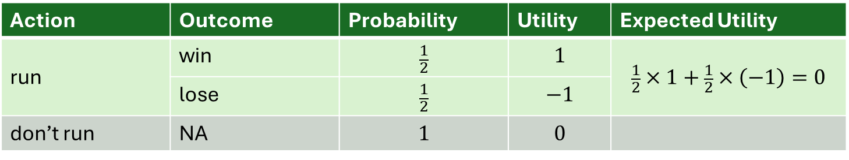
warm up
Available actions
run, do not run
Build an expected utility model of a person, “Faith”, choosing whether to run for office in an upcoming election. Depict the idea that Faith does not know how many other candidates will run in the election, and whether those candidates will be “high quality” (professional, well-funded, and thus likely to win), or “low quality” (amateur, lacking funding, and thus not likely to win). Assume Faith would find running personally costly, and values the prospect of winning public office.
Possible outcomes
Faith runs and win, runs and loses, or doesn’t run
Preferences over outcomes
$$U=\left\{\begin{matrix}−1 & \text{if} \text{Faith} \text{runs} \text{and} \text{loses} \\ 0 & \text{if} \text{Faith} \text{does} \text{not} \text{run} \\ 1 & \text{if} \text{Faith} \text{runs} \text{and} \text{wins}\end{matrix}\right\}$$
Probability distributions
Idea: There will be either 1 or 2 other persons running. Each will be either “high quality” (H) or “low quality” (L)
Calculate Faith’s expected utility from each of her available actions (remembering that if she runs, she wins with probability $\frac{1}{2}$ and loses with probability $\frac{1}{2}$).
Action | Outcome | Probability | Utility | Expected Utility
run | win | $$\frac{1}{2}$$ | $$1$$ | $$\frac{1}{2}×1+\frac{1}{2}×\left(−1\right)=0$$
 | lose | $$\frac{1}{2}$$ | $$−1$$
don’t run | NA | $$1$$ | $$0$$
EU formula: $p_{1}×u_{1}+p_{2}×u_{2}+⋯+p_{N}×u_N$

Slide 22
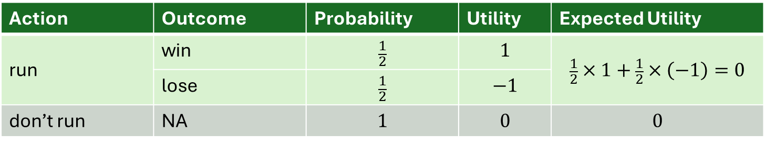
warm up
Available actions
run, do not run
Build an expected utility model of a person, “Faith”, choosing whether to run for office in an upcoming election. Depict the idea that Faith does not know how many other candidates will run in the election, and whether those candidates will be “high quality” (professional, well-funded, and thus likely to win), or “low quality” (amateur, lacking funding, and thus not likely to win). Assume Faith would find running personally costly, and values the prospect of winning public office.
Possible outcomes
Faith runs and win, runs and loses, or doesn’t run
Preferences over outcomes
$$U=\left\{\begin{matrix}−1 & \text{if} \text{Faith} \text{runs} \text{and} \text{loses} \\ 0 & \text{if} \text{Faith} \text{does} \text{not} \text{run} \\ 1 & \text{if} \text{Faith} \text{runs} \text{and} \text{wins}\end{matrix}\right\}$$
Probability distributions
Idea: There will be either 1 or 2 other persons running. Each will be either “high quality” (H) or “low quality” (L)
Calculate Faith’s expected utility from each of her available actions (remembering that if she runs, she wins with probability $\frac{1}{2}$ and loses with probability $\frac{1}{2}$).
Action | Outcome | Probability | Utility | Expected Utility
run | win | $$\frac{1}{2}$$ | $$1$$ | $$\frac{1}{2}×1+\frac{1}{2}×\left(−1\right)=0$$
 | lose | $$\frac{1}{2}$$ | $$−1$$
don’t run | NA | $$1$$ | $$0$$ | $$0$$
EU formula: $p_{1}×u_{1}+p_{2}×u_{2}+⋯+p_{N}×u_N$

Slide 23
A Puzzle About Women’s Representation in U.S. Legislatures

Slide 24
A Puzzle About Women’s Representation in U.S. Legislatures
The proportion of U.S. federal and state legislators who are women is WAY below the proportion of women among eligible persons (50%).
Yet multiple studies have shown two things:
Candidates for legislative office who are women win at about the same rate as candidates who are men.
Legislators who are women sponsor more bills and bring home more funding to their districts on average than legislators who are men.

Slide 25
A Puzzle About Women’s Representation in U.S. Legislatures
The proportion of U.S. federal and state legislators who are women is WAY below the proportion of women among eligible persons (50%).
Yet multiple studies have shown two things:
Candidates for legislative office who are women win at about the same rate as candidates who are men.
Legislators who are women sponsor more bills and bring home more funding to their districts on average than legislators who are men.
So women candidates win just as much as men candidates...and when they win, they perform better than men in office.
How, then, do women end up underrepresented in office?

Slide 26
Inspired by a model by Ashworth, Berry, and Bueno de Mesquita

Slide 27
Suppose that each person who considers running for office has two characteristics:
Gender (woman, man)
Political talent (high, low)
Suppose that each characteristics has different effects...
A substantial portion of voters are biased against women candidates. So, women candidates are less likely (all else equal) than men candidates to win their races.
Persons with high political talent are more effective as candidates, so they are more likely than persons with low political talent to win their races.

Slide 28
Suppose that each person who considers running for office has two characteristics:
Gender (woman, man)
Political talent (high, low)
Suppose that each characteristics has different effects...
A substantial portion of voters are biased against women candidates. So, women candidates are less likely (all else equal) than men candidates to win their races.
Persons with high political talent are more effective as candidates, so they are more likely than persons with low political talent to win their races.

Slide 29
Suppose that each person who considers running for office has two characteristics:
Gender (woman, man)
Political talent (high, low)
Suppose that each characteristics has different effects...
A substantial portion of voters are biased against women candidates. So, women candidates are less likely (all else equal) than men candidates to win their races.
Persons with high political talent are more effective as candidates, so they are more likely than persons with low political talent to win their races.

Slide 30
Suppose that each person who considers running for office has two characteristics:
Gender (woman, man)
Political talent (high, low)
Suppose that each characteristics has different effects...
A substantial portion of voters are biased against women candidates. So, women candidates are less likely (all else equal) than men candidates to win their races.
Persons with high political talent are more effective as candidates, so they are more likely than persons with low political talent to win their races.

Slide 31
Suppose that each person who considers running for office has two characteristics:
Gender (woman, man)
Political talent (high, low)
Suppose that each characteristics has different effects...
A substantial portion of voters are biased against women candidates. So, women candidates are less likely (all else equal) than men candidates to win their races.
Persons with high political talent are more effective as candidates, so they are more likely than persons with low political talent to win their races.
Persons with high political talent are more effective as elected representatives, so they are more productive if/when they gain office.

Slide 32
Imagine a person choosing whether to run for office who has a gender (man or woman) and a level of political talent (high or low)...

Slide 33
Imagine a person choosing whether to run for office who has a gender (man or woman) and a level of political talent (high or low)...
Gender | Level of Talent | Action
man | low | don’t run
 |  | run
man | high | don’t run
 |  | run
woman | low | don’t run
 |  | run
woman | high | don’t run
 |  | run

Slide 34
If the person doesn’t run, they don’t win office for sure. But if they run, they an either win or lose office.
Gender | Level of Talent | Action | Outcome | Probability
man | low | don’t run | lose | 1
 |  | run | win
 |  |  | lose
man | high | don’t run | lose | 1
 |  | run | win
 |  |  | lose
woman | low | don’t run | lose | 1
 |  | run | win
 |  |  | lose
woman | high | don’t run | lose | 1
 |  | run | win
 |  |  | lose

Slide 35
If they don’t run, they get utility 0. If they run and win they get utility B-C. If they run and lose they get utility –C.
Gender | Level of Talent | Action | Outcome | Probability | Utility
man | low | don’t run | lose | 1 | 0
 |  | run | win |  | B-C
 |  |  | lose |  | -C
man | high | don’t run | lose | 1 | 0
 |  | run | win |  | B-C
 |  |  | lose |  | -C
woman | low | don’t run | lose | 1 | 0
 |  | run | win |  | B-C
 |  |  | lose |  | -C
woman | high | don’t run | lose | 1 | 0
 |  | run | win |  | B-C
 |  |  | lose |  | -C

Slide 36

If they don’t run, they get utility 0. If they run and win they get utility B-C. If they run and lose they get utility –C.
$B$ is a number greater than 0 depicting the benefit of winning office.
$C$ is a number greater than 0 depicting the personal costs of running for office.
Assume $B>C$, so that a person would always prefer to run if they were guaranteed to win.
Gender | Level of Talent | Action | Outcome | Probability | Utility
man | low | don’t run | lose | 1 | 0
 |  | run | win |  | B-C
 |  |  | lose |  | -C
man | high | don’t run | lose | 1 | 0
 |  | run | win |  | B-C
 |  |  | lose |  | -C
woman | low | don’t run | lose | 1 | 0
 |  | run | win |  | B-C
 |  |  | lose |  | -C
woman | high | don’t run | lose | 1 | 0
 |  | run | win |  | B-C
 |  |  | lose |  | -C

Slide 37
Note...Each of these is ONE expected utility model, depicting the choice to run or not run by a person with different gender and level of talent.
Gender | Level of Talent | Action | Outcome | Probability | Utility
man | low | don’t run | lose | 1 | 0
 |  | run | win |  | B-C
 |  |  | lose |  | -C
man | high | don’t run | lose | 1 | 0
 |  | run | win |  | B-C
 |  |  | lose |  | -C
woman | low | don’t run | lose | 1 | 0
 |  | run | win |  | B-C
 |  |  | lose |  | -C
woman | high | don’t run | lose | 1 | 0
 |  | run | win |  | B-C
 |  |  | lose |  | -C

Slide 38
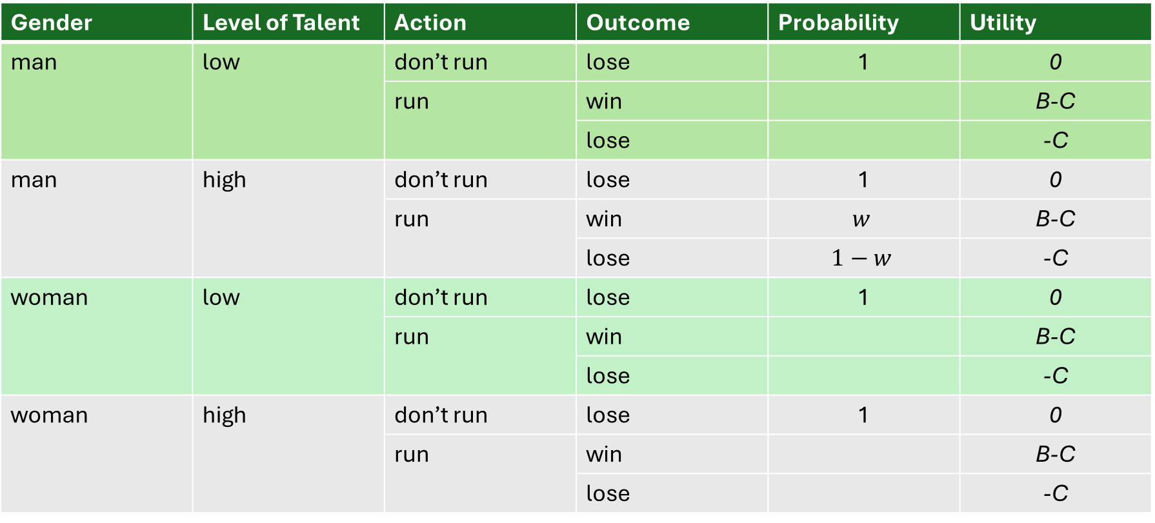
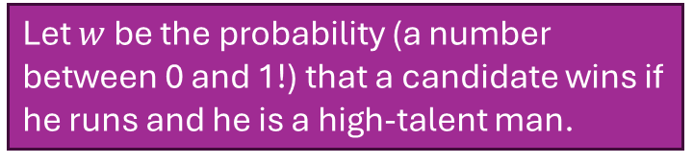
Let $w$ be the probability (a number between 0 and 1!) that a candidate wins if he runs and he is a high-talent man.
Gender | Level of Talent | Action | Outcome | Probability | Utility
man | low | don’t run | lose | 1 | 0
 |  | run | win |  | B-C
 |  |  | lose |  | -C
man | high | don’t run | lose | 1 | 0
 |  | run | win | $$w$$ | B-C
 |  |  | lose | $$1−w$$ | -C
woman | low | don’t run | lose | 1 | 0
 |  | run | win |  | B-C
 |  |  | lose |  | -C
woman | high | don’t run | lose | 1 | 0
 |  | run | win |  | B-C
 |  |  | lose |  | -C

Slide 39
Let $w$ be the probability (a number between 0 and 1!) that a candidate wins if he runs and he is a high-talent man.
Gender | Level of Talent | Action | Outcome | Probability | Utility
man | low | don’t run | lose | 1 | 0
 |  | run | win |  | B-C
 |  |  | lose |  | -C
man | high | don’t run | lose | 1 | 0
 |  | run | win | $$w$$ | B-C
 |  |  | lose | $$1−w$$ | -C
woman | low | don’t run | lose | 1 | 0
 |  | run | win |  | B-C
 |  |  | lose |  | -C
woman | high | don’t run | lose | 1 | 0
 |  | run | win |  | B-C
 |  |  | lose |  | -C
Check your understanding: Write the expression for the expected utility of running for a person who is a high-talent man.

Slide 40
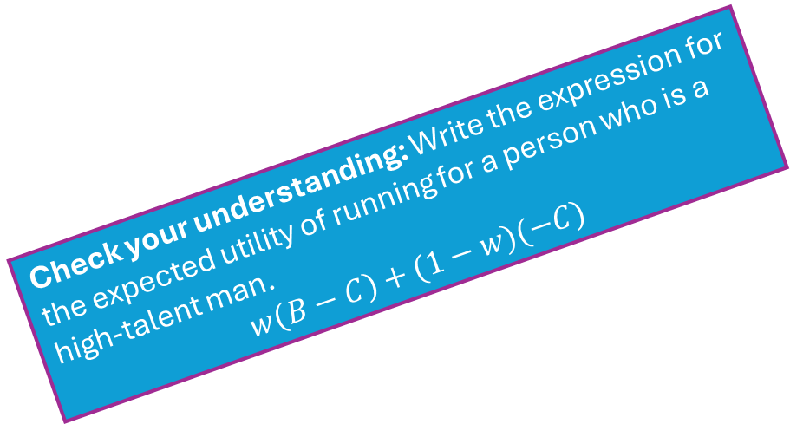
Let $w$ be the probability (a number between 0 and 1!) that a candidate wins if he runs and he is a high-talent man.
Gender | Level of Talent | Action | Outcome | Probability | Utility
man | low | don’t run | lose | 1 | 0
 |  | run | win |  | B-C
 |  |  | lose |  | -C
man | high | don’t run | lose | 1 | 0
 |  | run | win | $$w$$ | B-C
 |  |  | lose | $$1−w$$ | -C
woman | low | don’t run | lose | 1 | 0
 |  | run | win |  | B-C
 |  |  | lose |  | -C
woman | high | don’t run | lose | 1 | 0
 |  | run | win |  | B-C
 |  |  | lose |  | -C
Check your understanding: Write the expression for the expected utility of running for a person who is a high-talent man. $$w\left(B−C\right)+(1−w)(−C)$$

Slide 41
Gender | Level of Talent | Action | Outcome | Probability | Utility
man | low | don’t run | lose | 1 | 0
 |  | run | win |  | B-C
 |  |  | lose |  | -C
man | high | don’t run | lose | 1 | 0
 |  | run | win | $$w$$ | B-C
 |  |  | lose | $$1−w$$ | -C
woman | low | don’t run | lose | 1 | 0
 |  | run | win |  | B-C
 |  |  | lose |  | -C
woman | high | don’t run | lose | 1 | 0
 |  | run | win |  | B-C
 |  |  | lose |  | -C

Slide 42
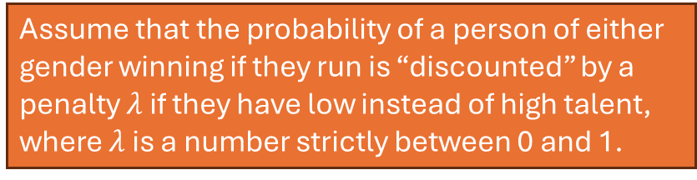
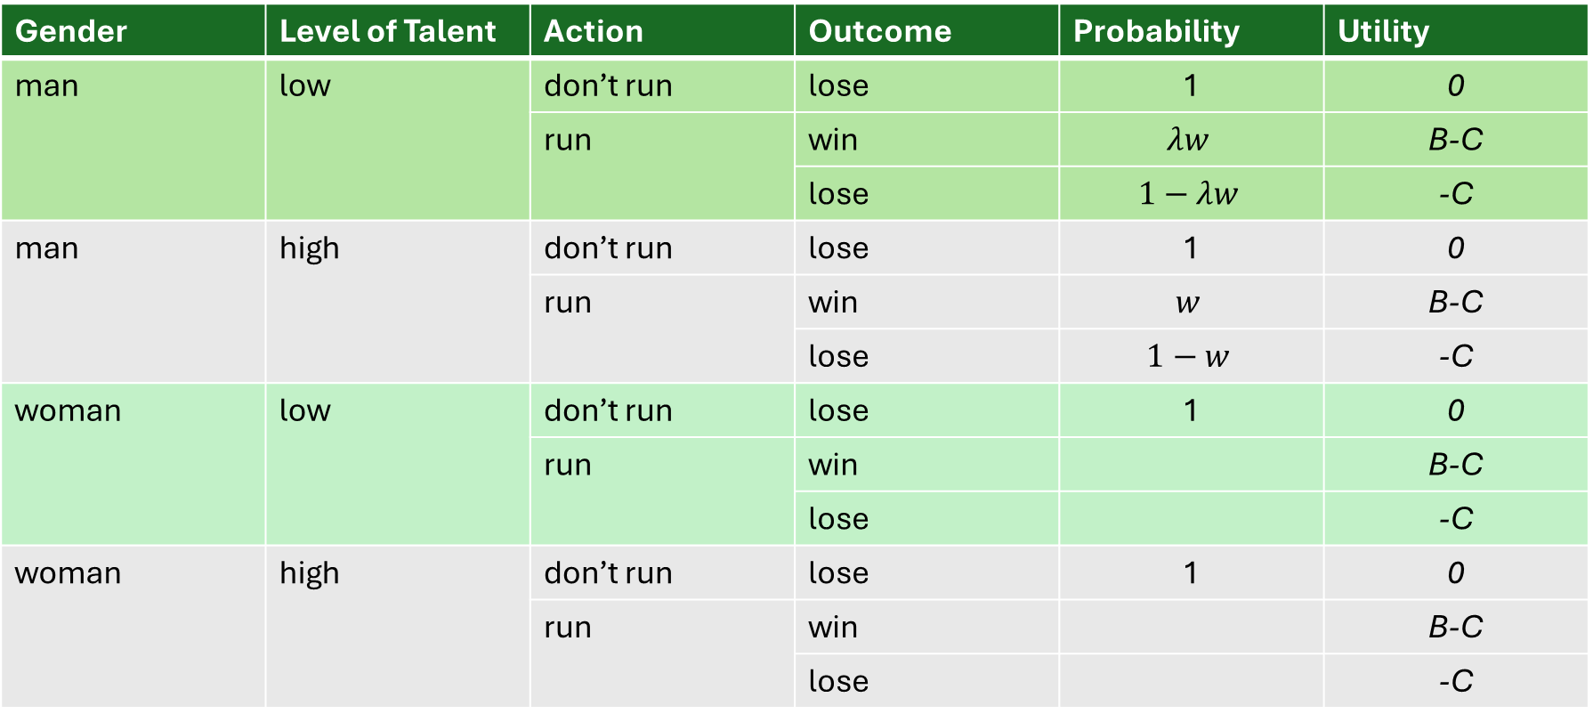
Assume that the probability of a person of either gender winning if they run is “discounted” by a penalty $λ$ if they have low instead of high talent, where $λ$ is a number strictly between 0 and 1.
Gender | Level of Talent | Action | Outcome | Probability | Utility
man | low | don’t run | lose | 1 | 0
 |  | run | win | $$λw$$ | B-C
 |  |  | lose | $$1−λw$$ | -C
man | high | don’t run | lose | 1 | 0
 |  | run | win | $$w$$ | B-C
 |  |  | lose | $$1−w$$ | -C
woman | low | don’t run | lose | 1 | 0
 |  | run | win |  | B-C
 |  |  | lose |  | -C
woman | high | don’t run | lose | 1 | 0
 |  | run | win |  | B-C
 |  |  | lose |  | -C

Slide 43
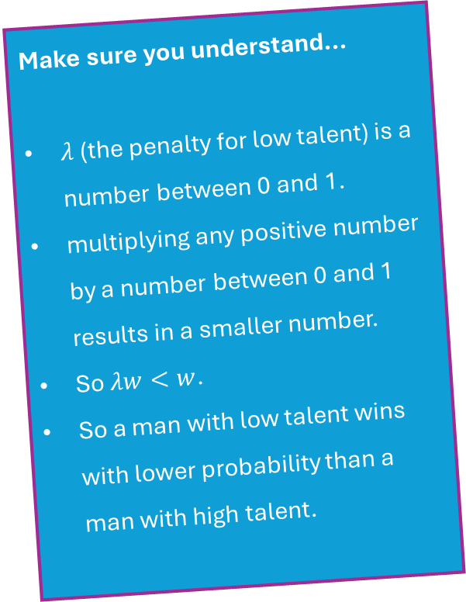
Assume that the probability of a person of either gender winning if they run is “discounted” by a penalty $λ$ if they have low instead of high talent, where $λ$ is a number strictly between 0 and 1.
Gender | Level of Talent | Action | Outcome | Probability | Utility
man | low | don’t run | lose | 1 | 0
 |  | run | win | $$λw$$ | B-C
 |  |  | lose | $$1−λw$$ | -C
man | high | don’t run | lose | 1 | 0
 |  | run | win | $$w$$ | B-C
 |  |  | lose | $$1−w$$ | -C
woman | low | don’t run | lose | 1 | 0
 |  | run | win |  | B-C
 |  |  | lose |  | -C
woman | high | don’t run | lose | 1 | 0
 |  | run | win |  | B-C
 |  |  | lose |  | -C
lower
Make sure you understand...
$λ$ (the penalty for low talent) is a number between 0 and 1.
multiplying any positive number by a number between 0 and 1 results in a smaller number.
So $λw<w$.
So a man with low talent wins with lower probability than a man with high talent.
higher

Slide 44
Gender | Level of Talent | Action | Outcome | Probability | Utility
man | low | don’t run | lose | 1 | 0
 |  | run | win | $$λw$$ | B-C
 |  |  | lose | $$1−λw$$ | -C
man | high | don’t run | lose | 1 | 0
 |  | run | win | $$w$$ | B-C
 |  |  | lose | $$1−w$$ | -C
woman | low | don’t run | lose | 1 | 0
 |  | run | win |  | B-C
 |  |  | lose |  | -C
woman | high | don’t run | lose | 1 | 0
 |  | run | win |  | B-C
 |  |  | lose |  | -C

Slide 45
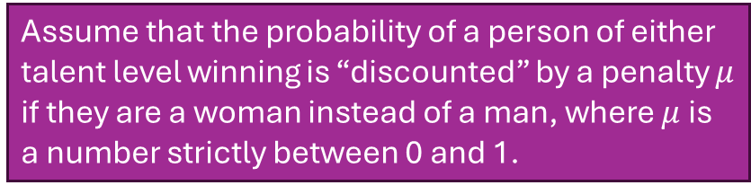
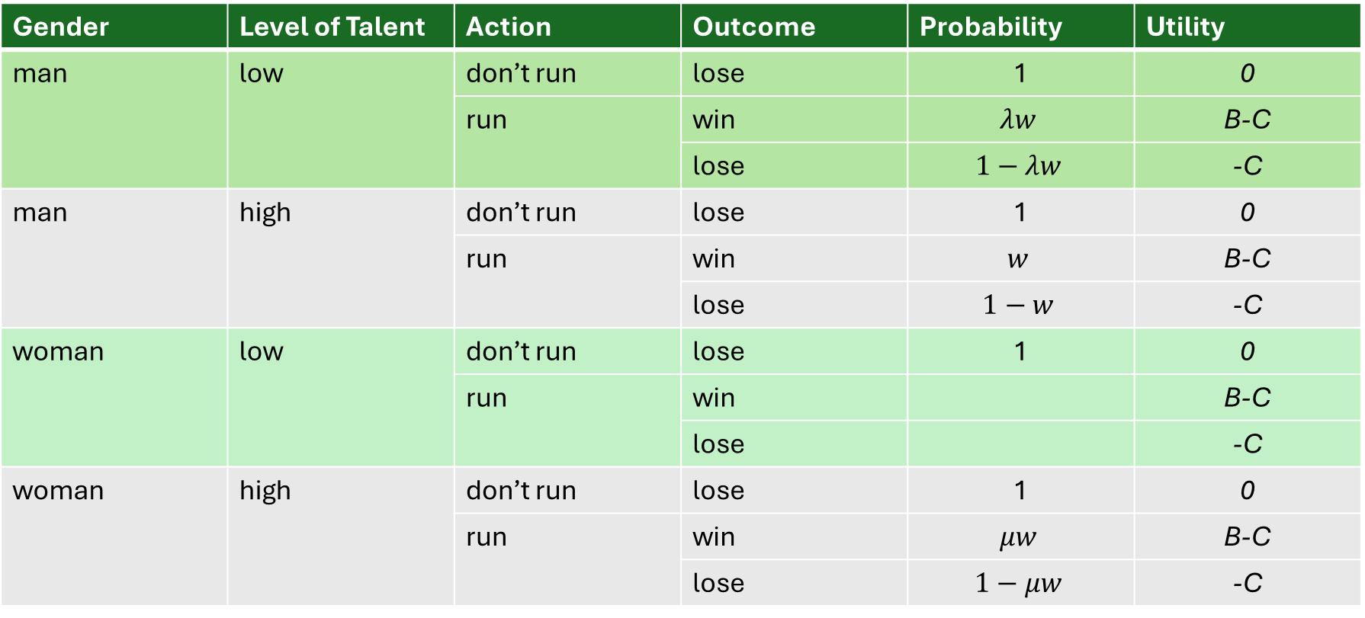
Assume that the probability of a person of either talent level winning is “discounted” by a penalty $μ$ if they are a woman instead of a man, where $μ$ is a number strictly between 0 and 1.
Gender | Level of Talent | Action | Outcome | Probability | Utility
man | low | don’t run | lose | 1 | 0
 |  | run | win | $$λw$$ | B-C
 |  |  | lose | $$1−λw$$ | -C
man | high | don’t run | lose | 1 | 0
 |  | run | win | $$w$$ | B-C
 |  |  | lose | $$1−w$$ | -C
woman | low | don’t run | lose | 1 | 0
 |  | run | win |  | B-C
 |  |  | lose |  | -C
woman | high | don’t run | lose | 1 | 0
 |  | run | win | $$μw$$ | B-C
 |  |  | lose | $$1−μw$$ | -C

Slide 46

Assume that the probability of a person of either talent level winning is “discounted” by a penalty $μ$ if they are a woman instead of a man, where $μ$ is a number strictly between 0 and 1.
Gender | Level of Talent | Action | Outcome | Probability | Utility
man | low | don’t run | lose | 1 | 0
 |  | run | win | $$λw$$ | B-C
 |  |  | lose | $$1−λw$$ | -C
man | high | don’t run | lose | 1 | 0
 |  | run | win | $$w$$ | B-C
 |  |  | lose | $$1−w$$ | -C
woman | low | don’t run | lose | 1 | 0
 |  | run | win |  | B-C
 |  |  | lose |  | -C
woman | high | don’t run | lose | 1 | 0
 |  | run | win | $$μw$$ | B-C
 |  |  | lose | $$1−μw$$ | -C
Make sure your understand...
$μ$ (the misogyny penalty) is a number between 0 and 1.
multiplying any positive number by a number between 0 and 1 results in a smaller number.
So $μw<w$.
So a woman with high talent wins with lower probability than a man with high talent.
higher
lower

Slide 47
Gender | Level of Talent | Action | Outcome | Probability | Utility
man | low | don’t run | lose | 1 | 0
 |  | run | win | $$λw$$ | B-C
 |  |  | lose | $$1−λw$$ | -C
man | high | don’t run | lose | 1 | 0
 |  | run | win | $$w$$ | B-C
 |  |  | lose | $$1−w$$ | -C
woman | low | don’t run | lose | 1 | 0
 |  | run | win |  | B-C
 |  |  | lose |  | -C
woman | high | don’t run | lose | 1 | 0
 |  | run | win | $$μw$$ | B-C
 |  |  | lose | $$1−μw$$ | -C

Slide 48
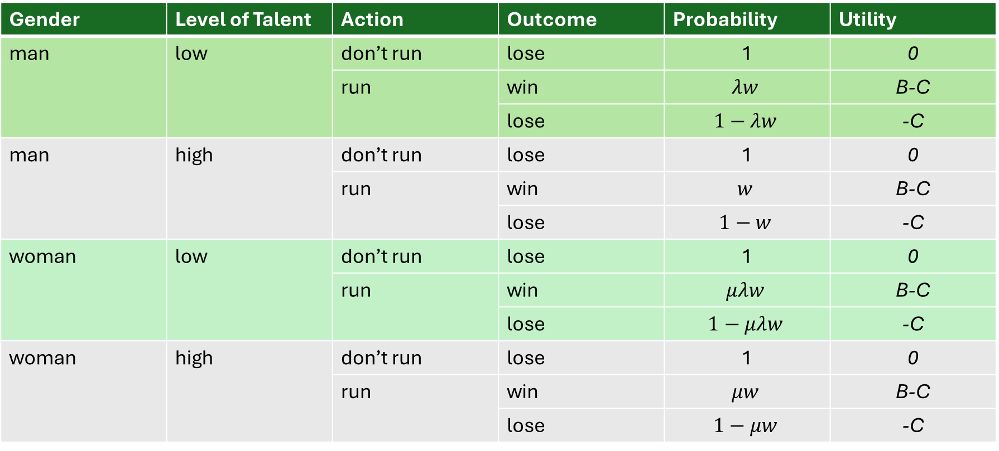
So a person who is low-talent and is a woman has a “double penalty”.
Gender | Level of Talent | Action | Outcome | Probability | Utility
man | low | don’t run | lose | 1 | 0
 |  | run | win | $$λw$$ | B-C
 |  |  | lose | $$1−λw$$ | -C
man | high | don’t run | lose | 1 | 0
 |  | run | win | $$w$$ | B-C
 |  |  | lose | $$1−w$$ | -C
woman | low | don’t run | lose | 1 | 0
 |  | run | win | $$μλw$$ | B-C
 |  |  | lose | $$1−μλw$$ | -C
woman | high | don’t run | lose | 1 | 0
 |  | run | win | $$μw$$ | B-C
 |  |  | lose | $$1−μw$$ | -C

Slide 49
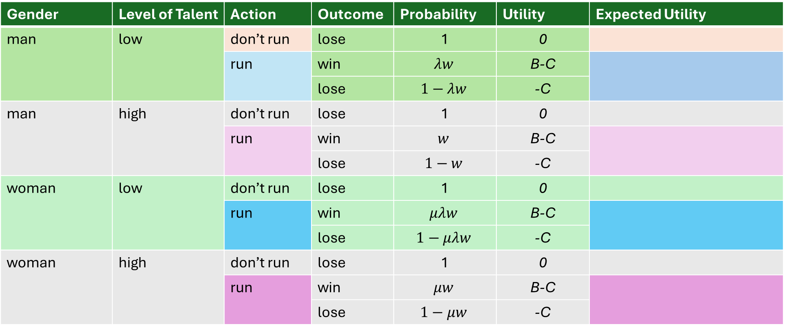
Gender | Level of Talent | Action | Outcome | Probability | Utility | Expected Utility
man | low | don’t run | lose | 1 | 0
 |  | run | win | $$λw$$ | B-C
 |  |  | lose | $$1−λw$$ | -C
man | high | don’t run | lose | 1 | 0
 |  | run | win | $$w$$ | B-C
 |  |  | lose | $$1−w$$ | -C
woman | low | don’t run | lose | 1 | 0
 |  | run | win | $$μλw$$ | B-C
 |  |  | lose | $$1−μλw$$ | -C
woman | high | don’t run | lose | 1 | 0
 |  | run | win | $$μw$$ | B-C
 |  |  | lose | $$1−μw$$ | -C

Slide 50
Check your understanding: Apply the expected utility formula to write the expressions for the expected utility from running and not running for each type of candidate
Gender | Level of Talent | Action | Outcome | Probability | Utility | Expected Utility
man | low | don’t run | lose | 1 | 0
 |  | run | win | $$λw$$ | B-C
 |  |  | lose | $$1−λw$$ | -C
man | high | don’t run | lose | 1 | 0
 |  | run | win | $$w$$ | B-C
 |  |  | lose | $$1−w$$ | -C
woman | low | don’t run | lose | 1 | 0
 |  | run | win | $$μλw$$ | B-C
 |  |  | lose | $$1−μλw$$ | -C
woman | high | don’t run | lose | 1 | 0
 |  | run | win | $$μw$$ | B-C
 |  |  | lose | $$1−μw$$ | -C

Slide 51
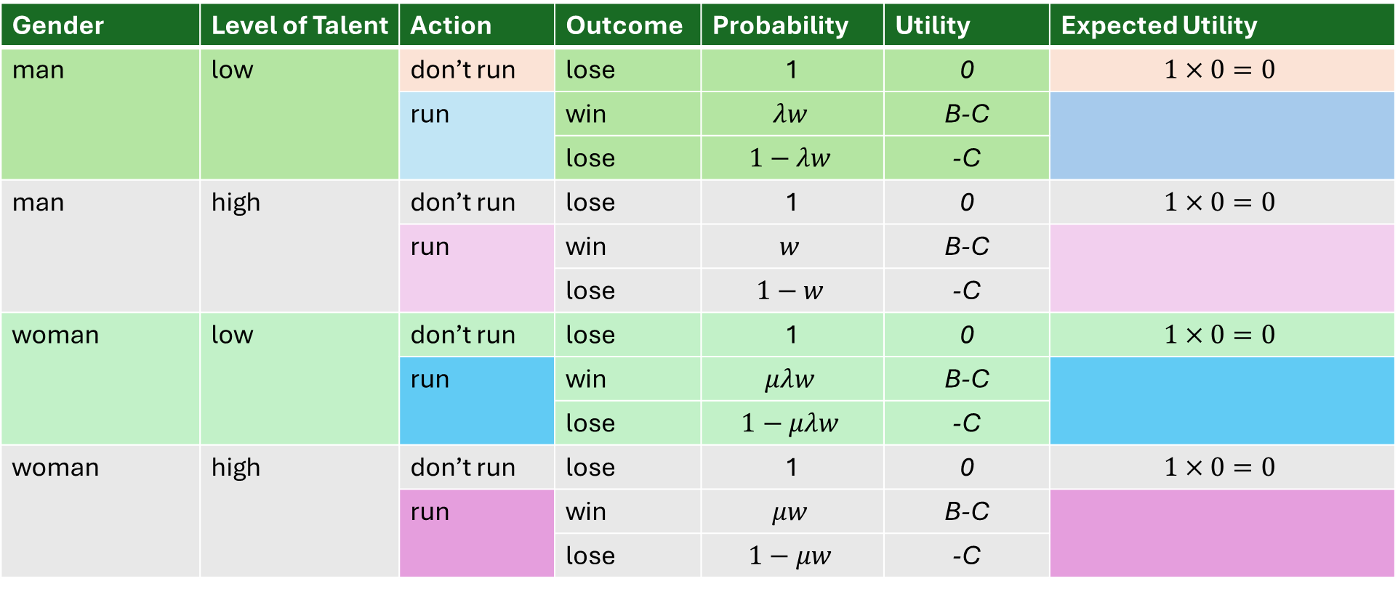
Check your understanding: Apply the expected utility formula to write the expressions for the expected utility from running and not running for each type of candidate
Gender | Level of Talent | Action | Outcome | Probability | Utility | Expected Utility
man | low | don’t run | lose | 1 | 0 | $$1×0=0$$
 |  | run | win | $$λw$$ | B-C
 |  |  | lose | $$1−λw$$ | -C
man | high | don’t run | lose | 1 | 0 | $$1×0=0$$
 |  | run | win | $$w$$ | B-C
 |  |  | lose | $$1−w$$ | -C
woman | low | don’t run | lose | 1 | 0 | $$1×0=0$$
 |  | run | win | $$μλw$$ | B-C
 |  |  | lose | $$1−μλw$$ | -C
woman | high | don’t run | lose | 1 | 0 | $$1×0=0$$
 |  | run | win | $$μw$$ | B-C
 |  |  | lose | $$1−μw$$ | -C

Slide 52

Check your understanding: Apply the expected utility formula to write the expressions for the expected utility from running and not running for each type of candidate
Gender | Level of Talent | Action | Outcome | Probability | Utility | Expected Utility
man | low | don’t run | lose | 1 | 0 | $$0$$
 |  | run | win | $$λw$$ | B-C
 |  |  | lose | $$1−λw$$ | -C
man | high | don’t run | lose | 1 | 0 | $$0$$
 |  | run | win | $$w$$ | B-C
 |  |  | lose | $$1−w$$ | -C
woman | low | don’t run | lose | 1 | 0 | $$0$$
 |  | run | win | $$μλw$$ | B-C
 |  |  | lose | $$1−μλw$$ | -C
woman | high | don’t run | lose | 1 | 0 | $$0$$
 |  | run | win | $$μw$$ | B-C
 |  |  | lose | $$1−μw$$ | -C

Slide 53
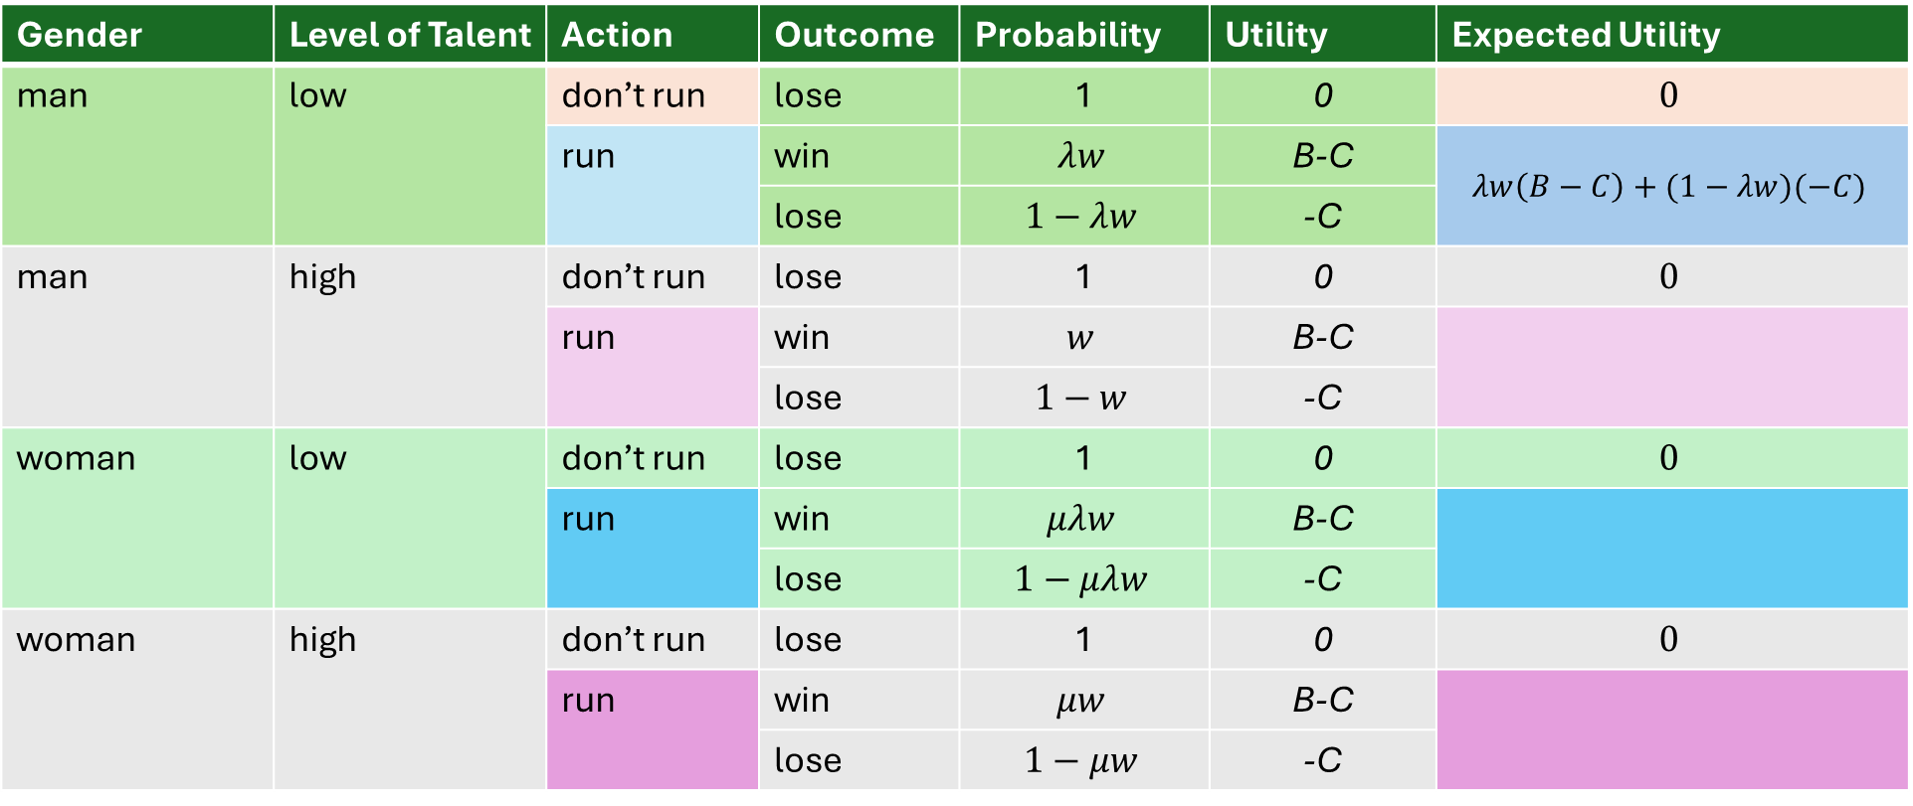
Check your understanding: Apply the expected utility formula to write the expressions for the expected utility from running and not running for each type of candidate
Gender | Level of Talent | Action | Outcome | Probability | Utility | Expected Utility
man | low | don’t run | lose | 1 | 0 | $$0$$
 |  | run | win | $$λw$$ | B-C | $$λw\left(B−C\right)+(1−λw)(−C)$$
 |  |  | lose | $$1−λw$$ | -C
man | high | don’t run | lose | 1 | 0 | $$0$$
 |  | run | win | $$w$$ | B-C
 |  |  | lose | $$1−w$$ | -C
woman | low | don’t run | lose | 1 | 0 | $$0$$
 |  | run | win | $$μλw$$ | B-C
 |  |  | lose | $$1−μλw$$ | -C
woman | high | don’t run | lose | 1 | 0 | $$0$$
 |  | run | win | $$μw$$ | B-C
 |  |  | lose | $$1−μw$$ | -C

Slide 54
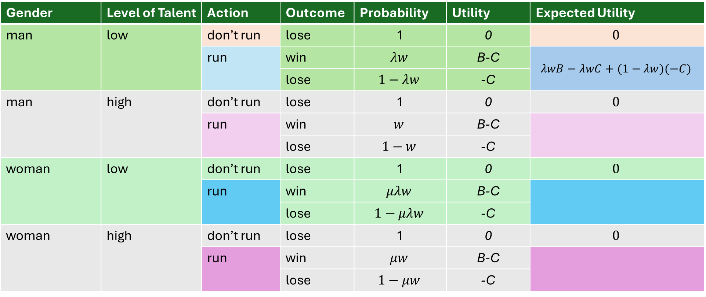
Check your understanding: Apply the expected utility formula to write the expressions for the expected utility from running and not running for each type of candidate
Gender | Level of Talent | Action | Outcome | Probability | Utility | Expected Utility
man | low | don’t run | lose | 1 | 0 | $$0$$
 |  | run | win | $$λw$$ | B-C | $$λwB−λwC+(1−λw)(−C)$$
 |  |  | lose | $$1−λw$$ | -C
man | high | don’t run | lose | 1 | 0 | $$0$$
 |  | run | win | $$w$$ | B-C
 |  |  | lose | $$1−w$$ | -C
woman | low | don’t run | lose | 1 | 0 | $$0$$
 |  | run | win | $$μλw$$ | B-C
 |  |  | lose | $$1−μλw$$ | -C
woman | high | don’t run | lose | 1 | 0 | $$0$$
 |  | run | win | $$μw$$ | B-C
 |  |  | lose | $$1−μw$$ | -C

Slide 55

Check your understanding: Apply the expected utility formula to write the expressions for the expected utility from running and not running for each type of candidate
Gender | Level of Talent | Action | Outcome | Probability | Utility | Expected Utility
man | low | don’t run | lose | 1 | 0 | $$0$$
 |  | run | win | $$λw$$ | B-C | $$λwB+(−C)(λw+1−λw)$$
 |  |  | lose | $$1−λw$$ | -C
man | high | don’t run | lose | 1 | 0 | $$0$$
 |  | run | win | $$w$$ | B-C
 |  |  | lose | $$1−w$$ | -C
woman | low | don’t run | lose | 1 | 0 | $$0$$
 |  | run | win | $$μλw$$ | B-C
 |  |  | lose | $$1−μλw$$ | -C
woman | high | don’t run | lose | 1 | 0 | $$0$$
 |  | run | win | $$μw$$ | B-C
 |  |  | lose | $$1−μw$$ | -C

Slide 56

Check your understanding: Apply the expected utility formula to write the expressions for the expected utility from running and not running for each type of candidate
Gender | Level of Talent | Action | Outcome | Probability | Utility | Expected Utility
man | low | don’t run | lose | 1 | 0 | $$0$$
 |  | run | win | $$λw$$ | B-C | $$λwB−C$$
 |  |  | lose | $$1−λw$$ | -C
man | high | don’t run | lose | 1 | 0 | $$0$$
 |  | run | win | $$w$$ | B-C
 |  |  | lose | $$1−w$$ | -C
woman | low | don’t run | lose | 1 | 0 | $$0$$
 |  | run | win | $$μλw$$ | B-C
 |  |  | lose | $$1−μλw$$ | -C
woman | high | don’t run | lose | 1 | 0 | $$0$$
 |  | run | win | $$μw$$ | B-C
 |  |  | lose | $$1−μw$$ | -C

Slide 57
Check your understanding: Apply the expected utility formula to write the expressions for the expected utility from running and not running for each type of candidate
Gender | Level of Talent | Action | Outcome | Probability | Utility | Expected Utility
man | low | don’t run | lose | 1 | 0 | $$0$$
 |  | run | win | $$λw$$ | B-C | $$λwB−C$$
 |  |  | lose | $$1−λw$$ | -C
man | high | don’t run | lose | 1 | 0 | $$0$$
 |  | run | win | $$w$$ | B-C
 |  |  | lose | $$1−w$$ | -C
woman | low | don’t run | lose | 1 | 0 | $$0$$
 |  | run | win | $$μλw$$ | B-C
 |  |  | lose | $$1−μλw$$ | -C
woman | high | don’t run | lose | 1 | 0 | $$0$$
 |  | run | win | $$μw$$ | B-C
 |  |  | lose | $$1−μw$$ | -C

Slide 58
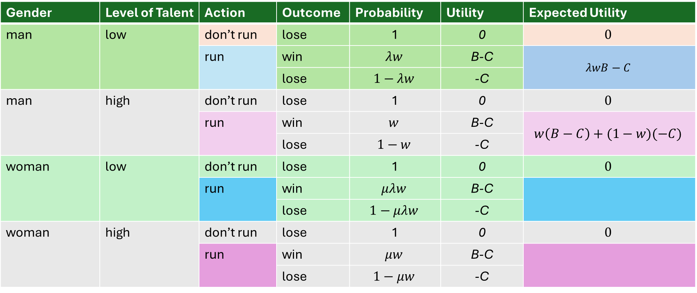
Check your understanding: Apply the expected utility formula to write the expressions for the expected utility from running and not running for each type of candidate
Gender | Level of Talent | Action | Outcome | Probability | Utility | Expected Utility
man | low | don’t run | lose | 1 | 0 | $$0$$
 |  | run | win | $$λw$$ | B-C | $$λwB−C$$
 |  |  | lose | $$1−λw$$ | -C
man | high | don’t run | lose | 1 | 0 | $$0$$
 |  | run | win | $$w$$ | B-C | $$w\left(B−C\right)+(1−w)(−C)$$
 |  |  | lose | $$1−w$$ | -C
woman | low | don’t run | lose | 1 | 0 | $$0$$
 |  | run | win | $$μλw$$ | B-C
 |  |  | lose | $$1−μλw$$ | -C
woman | high | don’t run | lose | 1 | 0 | $$0$$
 |  | run | win | $$μw$$ | B-C
 |  |  | lose | $$1−μw$$ | -C

Slide 59
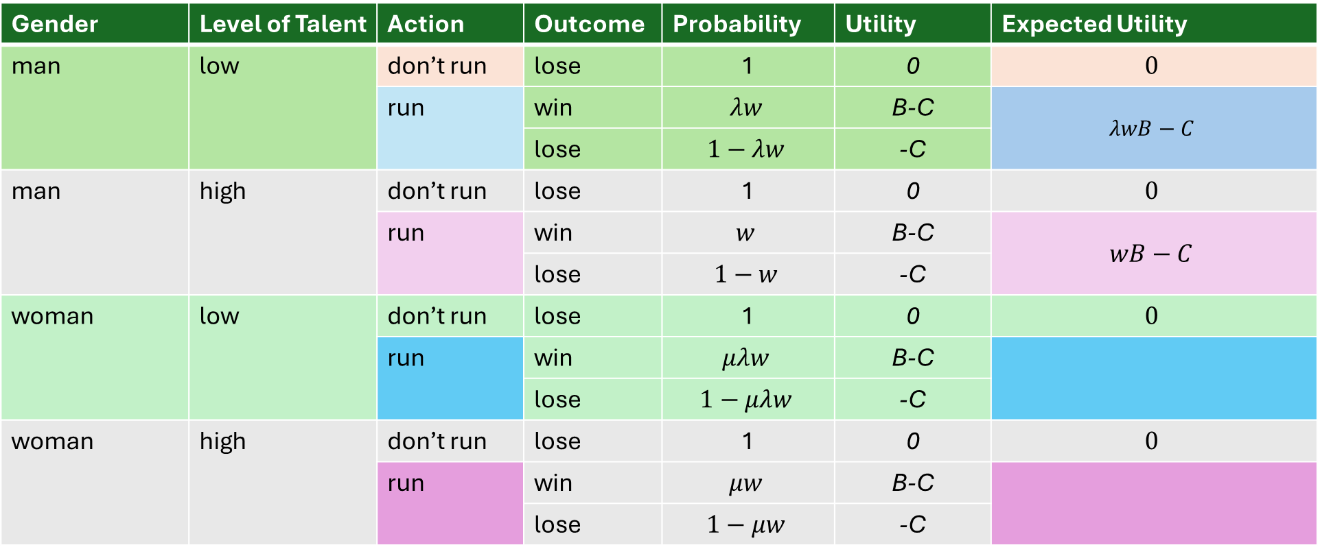
Check your understanding: Apply the expected utility formula to write the expressions for the expected utility from running and not running for each type of candidate
Gender | Level of Talent | Action | Outcome | Probability | Utility | Expected Utility
man | low | don’t run | lose | 1 | 0 | $$0$$
 |  | run | win | $$λw$$ | B-C | $$λwB−C$$
 |  |  | lose | $$1−λw$$ | -C
man | high | don’t run | lose | 1 | 0 | $$0$$
 |  | run | win | $$w$$ | B-C | $$wB−C$$
 |  |  | lose | $$1−w$$ | -C
woman | low | don’t run | lose | 1 | 0 | $$0$$
 |  | run | win | $$μλw$$ | B-C
 |  |  | lose | $$1−μλw$$ | -C
woman | high | don’t run | lose | 1 | 0 | $$0$$
 |  | run | win | $$μw$$ | B-C
 |  |  | lose | $$1−μw$$ | -C

Slide 60

Check your understanding: Apply the expected utility formula to write the expressions for the expected utility from running and not running for each type of candidate
Gender | Level of Talent | Action | Outcome | Probability | Utility | Expected Utility
man | low | don’t run | lose | 1 | 0 | $$0$$
 |  | run | win | $$λw$$ | B-C | $$λwB−C$$
 |  |  | lose | $$1−λw$$ | -C
man | high | don’t run | lose | 1 | 0 | $$0$$
 |  | run | win | $$w$$ | B-C | $$wB−C$$
 |  |  | lose | $$1−w$$ | -C
woman | low | don’t run | lose | 1 | 0 | $$0$$
 |  | run | win | $$μλw$$ | B-C
 |  |  | lose | $$1−μλw$$ | 0
woman | high | don’t run | lose | 1 | 0 | $$0$$
 |  | run | win | $$μw$$ | B-C
 |  |  | lose | $$1−μw$$ | -C

Slide 61
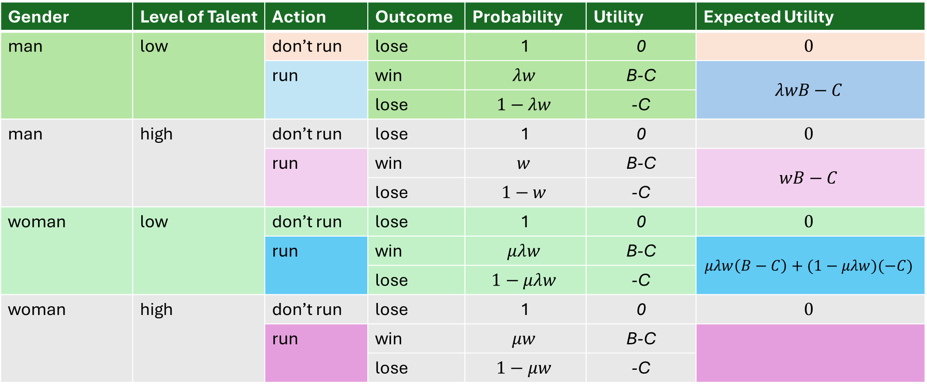
Check your understanding: Apply the expected utility formula to write the expressions for the expected utility from running and not running for each type of candidate
Gender | Level of Talent | Action | Outcome | Probability | Utility | Expected Utility
man | low | don’t run | lose | 1 | 0 | $$0$$
 |  | run | win | $$λw$$ | B-C | $$λwB−C$$
 |  |  | lose | $$1−λw$$ | -C
man | high | don’t run | lose | 1 | 0 | $$0$$
 |  | run | win | $$w$$ | B-C | $$wB−C$$
 |  |  | lose | $$1−w$$ | -C
woman | low | don’t run | lose | 1 | 0 | $$0$$
 |  | run | win | $$μλw$$ | B-C | $$μλw\left(B−C\right)+(1−μλw)(−C)$$
 |  |  | lose | $$1−μλw$$ | -C
woman | high | don’t run | lose | 1 | 0 | $$0$$
 |  | run | win | $$μw$$ | B-C
 |  |  | lose | $$1−μw$$ | -C

Slide 62
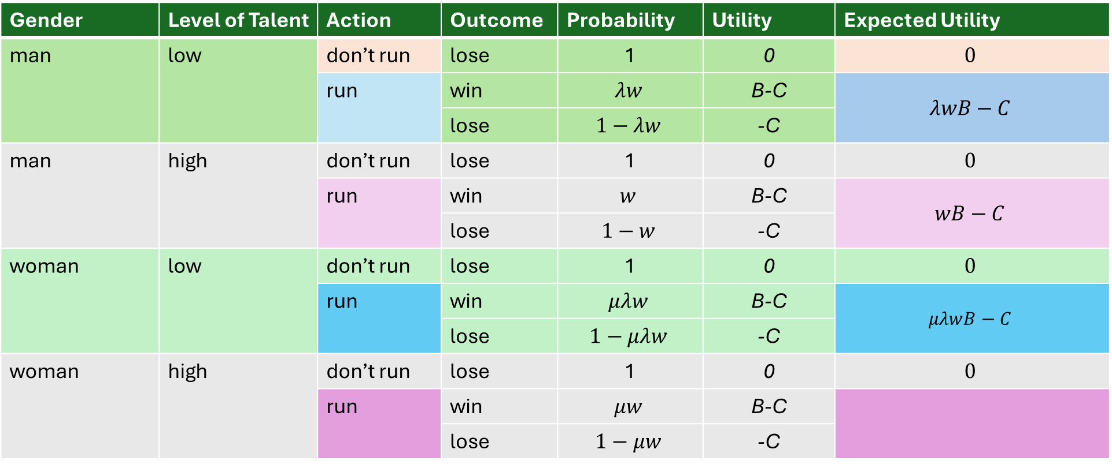
Check your understanding: Apply the expected utility formula to write the expressions for the expected utility from running and not running for each type of candidate
Gender | Level of Talent | Action | Outcome | Probability | Utility | Expected Utility
man | low | don’t run | lose | 1 | 0 | $$0$$
 |  | run | win | $$λw$$ | B-C | $$λwB−C$$
 |  |  | lose | $$1−λw$$ | -C
man | high | don’t run | lose | 1 | 0 | $$0$$
 |  | run | win | $$w$$ | B-C | $$wB−C$$
 |  |  | lose | $$1−w$$ | -C
woman | low | don’t run | lose | 1 | 0 | $$0$$
 |  | run | win | $$μλw$$ | B-C | $$μλwB−C$$
 |  |  | lose | $$1−μλw$$ | -C
woman | high | don’t run | lose | 1 | 0 | $$0$$
 |  | run | win | $$μw$$ | B-C
 |  |  | lose | $$1−μw$$ | -C

Slide 63
Check your understanding: Apply the expected utility formula to write the expressions for the expected utility from running and not running for each type of candidate
Gender | Level of Talent | Action | Outcome | Probability | Utility | Expected Utility
man | low | don’t run | lose | 1 | 0 | $$0$$
 |  | run | win | $$λw$$ | B-C | $$λwB−C$$
 |  |  | lose | $$1−λw$$ | -C
man | high | don’t run | lose | 1 | 0 | $$0$$
 |  | run | win | $$w$$ | B-C | $$wB−C$$
 |  |  | lose | $$1−w$$ | -C
woman | low | don’t run | lose | 1 | 0 | $$0$$
 |  | run | win | $$μλw$$ | B-C | $$μλwB−C$$
 |  |  | lose | $$1−μλw$$ | -C
woman | high | don’t run | lose | 1 | 0 | $$0$$
 |  | run | win | $$μw$$ | B-C
 |  |  | lose | $$1−μw$$ | -C

Slide 64
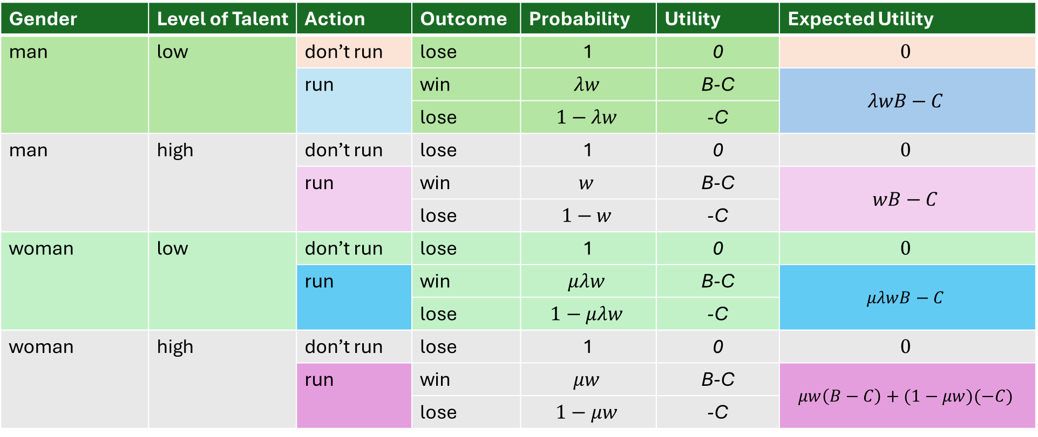
Check your understanding: Apply the expected utility formula to write the expressions for the expected utility from running and not running for each type of candidate
Gender | Level of Talent | Action | Outcome | Probability | Utility | Expected Utility
man | low | don’t run | lose | 1 | 0 | $$0$$
 |  | run | win | $$λw$$ | B-C | $$λwB−C$$
 |  |  | lose | $$1−λw$$ | -C
man | high | don’t run | lose | 1 | 0 | $$0$$
 |  | run | win | $$w$$ | B-C | $$wB−C$$
 |  |  | lose | $$1−w$$ | -C
woman | low | don’t run | lose | 1 | 0 | $$0$$
 |  | run | win | $$μλw$$ | B-C | $$μλwB−C$$
 |  |  | lose | $$1−μλw$$ | -C
woman | high | don’t run | lose | 1 | 0 | $$0$$
 |  | run | win | $$μw$$ | B-C | $$μw\left(B−C\right)+(1−μw)(−C)$$
 |  |  | lose | $$1−μw$$ | -C

Slide 65

Check your understanding: Apply the expected utility formula to write the expressions for the expected utility from running and not running for each type of candidate
Gender | Level of Talent | Action | Outcome | Probability | Utility | Expected Utility
man | low | don’t run | lose | 1 | 0 | $$0$$
 |  | run | win | $$λw$$ | B-C | $$λwB−C$$
 |  |  | lose | $$1−λw$$ | -C
man | high | don’t run | lose | 1 | 0 | $$0$$
 |  | run | win | $$w$$ | B-C | $$wB−C$$
 |  |  | lose | $$1−w$$ | -C
woman | low | don’t run | lose | 1 | 0 | $$0$$
 |  | run | win | $$μλw$$ | B-C | $$μλwB−C$$
 |  |  | lose | $$1−μλw$$ | -C
woman | high | don’t run | lose | 1 | 0 | $$0$$
 |  | run | win | $$μw$$ | B-C | $$μwB−C$$
 |  |  | lose | $$1−μw$$ | -C

Slide 66
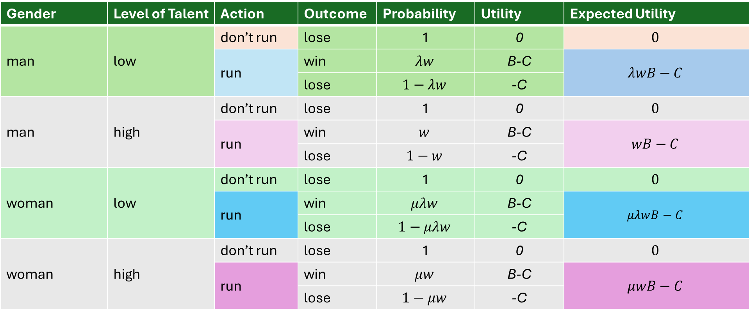
Gender | Level of Talent | Action | Outcome | Probability | Utility | Expected Utility
man | low | don’t run | lose | 1 | 0 | $$0$$
 |  | run | win | $$λw$$ | B-C | $$λwB−C$$
 |  |  | lose | $$1−λw$$ | -C
man | high | don’t run | lose | 1 | 0 | $$0$$
 |  | run | win | $$w$$ | B-C | $$wB−C$$
 |  |  | lose | $$1−w$$ | -C
woman | low | don’t run | lose | 1 | 0 | $$0$$
 |  | run | win | $$μλw$$ | B-C | $$μλwB−C$$
 |  |  | lose | $$1−μλw$$ | -C
woman | high | don’t run | lose | 1 | 0 | $$0$$
 |  | run | win | $$μw$$ | B-C | $$μwB−C$$
 |  |  | lose | $$1−μw$$ | -C

Slide 67

Gender | Level of Talent | Action | Outcome | Probability | Utility | Expected Utility
man | low | don’t run | lose | 1 | 0 | $$0$$
 |  | run | win | $$λw$$ | B-C | $$λwB−C$$
 |  |  | lose | $$1−λw$$ | -C
man | high | don’t run | lose | 1 | 0 | $$0$$
 |  | run | win | $$w$$ | B-C | $$wB−C$$
 |  |  | lose | $$1−w$$ | -C
woman | low | don’t run | lose | 1 | 0 | $$0$$
 |  | run | win | $$μλw$$ | B-C | $$μλwB−C$$
 |  |  | lose | $$1−μλw$$ | -C
woman | high | don’t run | lose | 1 | 0 | $$0$$
 |  | run | win | $$μw$$ | B-C | $$μwB−C$$
 |  |  | lose | $$1−μw$$ | -C
Check your understanding:
Write the expression describing the condition under which a low-talent man prefers to run instead of not run.
Then re-arrange the expression so that the low-talent penalty ($λ)$ is by itself on one side of the inequality and all the other parameters are on the other side.

Slide 68
Gender | Level of Talent | Action | Outcome | Probability | Utility | Expected Utility
man | low | don’t run | lose | 1 | 0 | $$0$$
 |  | run | win | $$λw$$ | B-C | $$λwB−C$$
 |  |  | lose | $$1−λw$$ | -C
man | high | don’t run | lose | 1 | 0 | $$0$$
 |  | run | win | $$w$$ | B-C | $$wB−C$$
 |  |  | lose | $$1−w$$ | -C
woman | low | don’t run | lose | 1 | 0 | $$0$$
 |  | run | win | $$μλw$$ | B-C | $$μλwB−C$$
 |  |  | lose | $$1−μλw$$ | -C
woman | high | don’t run | lose | 1 | 0 | $$0$$
 |  | run | win | $$μw$$ | B-C | $$μwB−C$$
 |  |  | lose | $$1−μw$$ | -C
Check your understanding:
Write the expression describing the condition under which a low-talent man prefers to run instead of not run.
Then re-arrange the expression so that the low-talent penalty ($λ)$ is by itself on one side of the inequality and all the other parameters are on the other side.
$$EU\left(\text{run}\right)≥EU(\text{don}\text{′}\text{t} \text{run})$$

Slide 69

Gender | Level of Talent | Action | Outcome | Probability | Utility | Expected Utility
man | low | don’t run | lose | 1 | 0 | $$0$$
 |  | run | win | $$λw$$ | B-C | $$λwB−C$$
 |  |  | lose | $$1−λw$$ | -C
man | high | don’t run | lose | 1 | 0 | $$0$$
 |  | run | win | $$w$$ | B-C | $$wB−C$$
 |  |  | lose | $$1−w$$ | -C
woman | low | don’t run | lose | 1 | 0 | $$0$$
 |  | run | win | $$μλw$$ | B-C | $$μλwB−C$$
 |  |  | lose | $$1−μλw$$ | -C
woman | high | don’t run | lose | 1 | 0 | $$0$$
 |  | run | win | $$μw$$ | B-C | $$μwB−C$$
 |  |  | lose | $$1−μw$$ | -C
Check your understanding:
Write the expression describing the condition under which a low-talent man prefers to run instead of not run.
Then re-arrange the expression so that the low-talent penalty ($λ)$ is by itself on one side of the inequality and all the other parameters are on the other side.
$$EU\left(\text{run}\right)≥EU\left(\text{don}\text{′}\text{t} \text{run}\right) \\ λwB−C≥0$$

Slide 70

Gender | Level of Talent | Action | Outcome | Probability | Utility | Expected Utility
man | low | don’t run | lose | 1 | 0 | $$0$$
 |  | run | win | $$λw$$ | B-C | $$λwB−C$$
 |  |  | lose | $$1−λw$$ | -C
man | high | don’t run | lose | 1 | 0 | $$0$$
 |  | run | win | $$w$$ | B-C | $$wB−C$$
 |  |  | lose | $$1−w$$ | -C
woman | low | don’t run | lose | 1 | 0 | $$0$$
 |  | run | win | $$μλw$$ | B-C | $$μλwB−C$$
 |  |  | lose | $$1−μλw$$ | -C
woman | high | don’t run | lose | 1 | 0 | $$0$$
 |  | run | win | $$μw$$ | B-C | $$μwB−C$$
 |  |  | lose | $$1−μw$$ | -C
Check your understanding:
Write the expression describing the condition under which a low-talent man prefers to run instead of not run.
Then re-arrange the expression so that the low-talent penalty ($λ)$ is by itself on one side of the inequality and all the other parameters are on the other side.
$$EU\left(\text{run}\right)≥EU\left(\text{don}\text{′}\text{t} \text{run}\right) \\ λwB−C≥0 \\ λwB≥C$$

Slide 71

Gender | Level of Talent | Action | Outcome | Probability | Utility | Expected Utility
man | low | don’t run | lose | 1 | 0 | $$0$$
 |  | run | win | $$λw$$ | B-C | $$λwB−C$$
 |  |  | lose | $$1−λw$$ | -C
man | high | don’t run | lose | 1 | 0 | $$0$$
 |  | run | win | $$w$$ | B-C | $$wB−C$$
 |  |  | lose | $$1−w$$ | -C
woman | low | don’t run | lose | 1 | 0 | $$0$$
 |  | run | win | $$μλw$$ | B-C | $$μλwB−C$$
 |  |  | lose | $$1−μλw$$ | -C
woman | high | don’t run | lose | 1 | 0 | $$0$$
 |  | run | win | $$μw$$ | B-C | $$μwB−C$$
 |  |  | lose | $$1−μw$$ | -C
Check your understanding:
Write the expression describing the condition under which a low-talent man prefers to run instead of not run.
Then re-arrange the expression so that the low-talent penalty ($λ)$ is by itself on one side of the inequality and all the other parameters are on the other side.
$$EU\left(\text{run}\right)≥EU\left(\text{don}\text{′}\text{t} \text{run}\right) \\ λwB−C≥0 \\ λwB≥C \\ λ≥\frac{C}{wB}$$

Slide 72
Gender | Level of Talent | Action | Outcome | Probability | Utility | Expected Utility
man | low | don’t run | lose | 1 | 0 | $$0$$
 |  | run | win | $$λw$$ | B-C | $$λwB−C$$
 |  |  | lose | $$1−λw$$ | -C
man | high | don’t run | lose | 1 | 0 | $$0$$
 |  | run | win | $$w$$ | B-C | $$wB−C$$
 |  |  | lose | $$1−w$$ | -C
woman | low | don’t run | lose | 1 | 0 | $$0$$
 |  | run | win | $$μλw$$ | B-C | $$μλwB−C$$
 |  |  | lose | $$1−μλw$$ | -C
woman | high | don’t run | lose | 1 | 0 | $$0$$
 |  | run | win | $$μw$$ | B-C | $$μwB−C$$
 |  |  | lose | $$1−μw$$ | -C
Check your understanding:
Write the expression that describes the conditions under which high-talent men prefer to run instead of not run, while low-talent men prefer to not run instead of run.

Slide 73
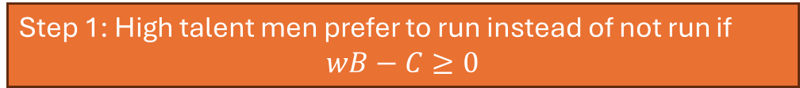
Gender | Level of Talent | Action | Outcome | Probability | Utility | Expected Utility
man | low | don’t run | lose | 1 | 0 | $$0$$
 |  | run | win | $$λw$$ | B-C | $$λwB−C$$
 |  |  | lose | $$1−λw$$ | -C
man | high | don’t run | lose | 1 | 0 | $$0$$
 |  | run | win | $$w$$ | B-C | $$wB−C$$
 |  |  | lose | $$1−w$$ | -C
woman | low | don’t run | lose | 1 | 0 | $$0$$
 |  | run | win | $$μλw$$ | B-C | $$μλwB−C$$
 |  |  | lose | $$1−μλw$$ | -C
woman | high | don’t run | lose | 1 | 0 | $$0$$
 |  | run | win | $$μw$$ | B-C | $$μwB−C$$
 |  |  | lose | $$1−μw$$ | -C
Check your understanding:
Write the expression that describes the conditions under which high-talent men prefer to run instead of not run, while low-talent men prefer to not run instead of run.
Step 1: High talent men prefer to run instead of not run if
$$wB−C≥0$$

Slide 74
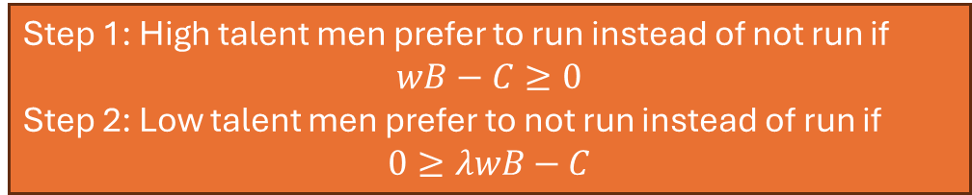
Gender | Level of Talent | Action | Outcome | Probability | Utility | Expected Utility
man | low | don’t run | lose | 1 | 0 | $$0$$
 |  | run | win | $$λw$$ | B-C | $$λwB−C$$
 |  |  | lose | $$1−λw$$ | -C
man | high | don’t run | lose | 1 | 0 | $$0$$
 |  | run | win | $$w$$ | B-C | $$wB−C$$
 |  |  | lose | $$1−w$$ | -C
woman | low | don’t run | lose | 1 | 0 | $$0$$
 |  | run | win | $$μλw$$ | B-C | $$μλwB−C$$
 |  |  | lose | $$1−μλw$$ | -C
woman | high | don’t run | lose | 1 | 0 | $$0$$
 |  | run | win | $$μw$$ | B-C | $$μwB−C$$
 |  |  | lose | $$1−μw$$ | -C
Check your understanding:
Write the expression that describes the conditions under which high-talent men prefer to run instead of not run, while low-talent men prefer to not run instead of run.
Step 1: High talent men prefer to run instead of not run if
$$wB−C≥0$$
Step 2: Low talent men prefer to not run instead of run if
$$0≥λwB−C$$

Slide 75

Gender | Level of Talent | Action | Outcome | Probability | Utility | Expected Utility
man | low | don’t run | lose | 1 | 0 | $$0$$
 |  | run | win | $$λw$$ | B-C | $$λwB−C$$
 |  |  | lose | $$1−λw$$ | -C
man | high | don’t run | lose | 1 | 0 | $$0$$
 |  | run | win | $$w$$ | B-C | $$wB−C$$
 |  |  | lose | $$1−w$$ | -C
woman | low | don’t run | lose | 1 | 0 | $$0$$
 |  | run | win | $$μλw$$ | B-C | $$μλwB−C$$
 |  |  | lose | $$1−μλw$$ | -C
woman | high | don’t run | lose | 1 | 0 | $$0$$
 |  | run | win | $$μw$$ | B-C | $$μwB−C$$
 |  |  | lose | $$1−μw$$ | -C
Check your understanding:
Write the expression that describes the conditions under which high-talent men prefer to run instead of not run, while low-talent men prefer to not run instead of run.
Step 1: High talent men prefer to run instead of not run if
$$wB−C≥0$$
Step 2: Low talent men prefer to not run instead of run if
$$0≥λwB−C$$
Step 3: Putting these together, we must have
$$w≥\frac{C}{B} and \frac{C}{wB}≥λ$$

Slide 76






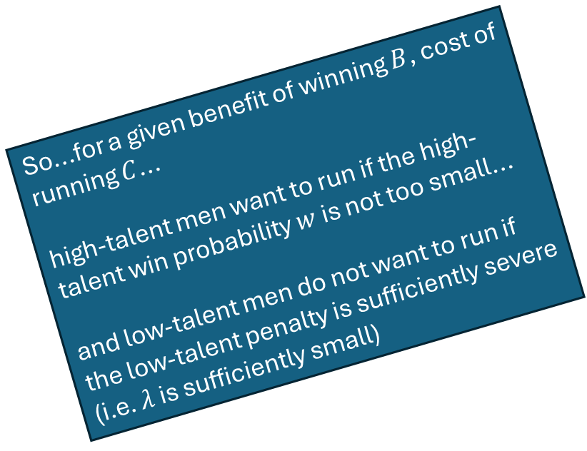

$$λ$$
(low-talent penalty)
Gender | Level of Talent | Action | Outcome | Probability | Utility | Expected Utility
man | low | don’t run | lose | 1 | 0 | $$0$$
 |  | run | win | $$λw$$ | B-C | $$λwB−C$$
 |  |  | lose | $$1−λw$$ | -C
man | high | don’t run | lose | 1 | 0 | $$0$$
 |  | run | win | $$w$$ | B-C | $$wB−C$$
 |  |  | lose | $$1−w$$ | -C
woman | low | don’t run | lose | 1 | 0 | $$0$$
 |  | run | win | $$μλw$$ | B-C | $$μλwB−C$$
 |  |  | lose | $$1−μλw$$ | -C
woman | high | don’t run | lose | 1 | 0 | $$0$$
 |  | run | win | $$μw$$ | B-C | $$μwB−C$$
 |  |  | lose | $$1−μw$$ | -C
So...for a given benefit of winning $B$, cost of running $C$...
high-talent men want to run if the high-talent win probability $w$ is not too small...
and low-talent men do not want to run if the low-talent penalty is sufficiently severe (i.e. $λ$ is sufficiently small)
$$1$$
Check your understanding:
Write the expression that describes the conditions under which high-talent men prefer to run instead of not run, while low-talent men prefer to not run instead of run.
Step 1: High talent men prefer to run instead of not run if
$$wB−C≥0$$
Step 2: Low talent men prefer to not run instead of run if
$$0≥λwB−C$$
Step 3: Putting these together, we must have
$$wB≥C and C≥λwB$$
or, equivalently:
$$λwB≤C≤wB$$
$w$ (win probability for
high-talent men)
$$0$$
$$0$$
$$1$$

Slide 77
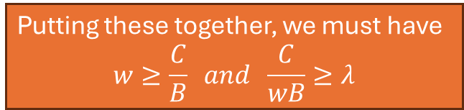
Putting these together, we must have
$$w≥\frac{C}{B} and \frac{C}{wB}≥λ$$
$$λ$$
(low-talent penalty)
Gender | Level of Talent | Action | Outcome | Probability | Utility | Expected Utility
man | low | don’t run | lose | 1 | 0 | $$0$$
 |  | run | win | $$λw$$ | B-C | $$λwB−C$$
 |  |  | lose | $$1−λw$$ | -C
man | high | don’t run | lose | 1 | 0 | $$0$$
 |  | run | win | $$w$$ | B-C | $$wB−C$$
 |  |  | lose | $$1−w$$ | -C
woman | low | don’t run | lose | 1 | 0 | $$0$$
 |  | run | win | $$μλw$$ | B-C | $$μλwB−C$$
 |  |  | lose | $$1−μλw$$ | -C
woman | high | don’t run | lose | 1 | 0 | $$0$$
 |  | run | win | $$μw$$ | B-C | $$μwB−C$$
 |  |  | lose | $$1−μw$$ | -C
So...for a given benefit of winning $B$, cost of running $C$...
high-talent men want to run if the high-talent win probability $w$ is not too small...
and low-talent men do not want to run if the low-talent penalty is sufficiently severe (i.e. $λ$ is sufficiently small)
$$1$$
Check your understanding:
Write the expression that describes the conditions under which high-talent men prefer to run instead of not run, while low-talent men prefer to not run instead of run.
Step 1: High talent men prefer to run instead of not run if
$$wB−C≥0$$
Step 2: Low talent men prefer to not run instead of run if
$$0≥λwB−C$$
Step 3: Putting these together, we must have
$$wB≥C and C≥λwB$$
or, equivalently:
$$λwB≤C≤wB$$
$w$ (win probability for
high-talent men)
$$0$$
$$0$$
$$1$$

Slide 78

Putting these together, we must have
$$w≥\frac{C}{B} and \frac{C}{wB}≥λ$$
$$λ$$
(low-talent penalty)
Gender | Level of Talent | Action | Outcome | Probability | Utility | Expected Utility
man | low | don’t run | lose | 1 | 0 | $$0$$
 |  | run | win | $$λw$$ | B-C | $$λwB−C$$
 |  |  | lose | $$1−λw$$ | -C
man | high | don’t run | lose | 1 | 0 | $$0$$
 |  | run | win | $$w$$ | B-C | $$wB−C$$
 |  |  | lose | $$1−w$$ | -C
woman | low | don’t run | lose | 1 | 0 | $$0$$
 |  | run | win | $$μλw$$ | B-C | $$μλwB−C$$
 |  |  | lose | $$1−μλw$$ | -C
woman | high | don’t run | lose | 1 | 0 | $$0$$
 |  | run | win | $$μw$$ | B-C | $$μwB−C$$
 |  |  | lose | $$1−μw$$ | -C
So...for a given benefit of winning $B$, cost of running $C$...
high-talent men want to run if the high-talent win probability $w$ is not too small...
and low-talent men do not want to run if the low-talent penalty is sufficiently severe (i.e. $λ$ is sufficiently small)
$$1$$
high talent men don’t want to run
high talent men want to run
Check your understanding:
Write the expression that describes the conditions under which high-talent men prefer to run instead of not run, while low-talent men prefer to not run instead of run.
Step 1: High talent men prefer to run instead of not run if
$$wB−C≥0$$
Step 2: Low talent men prefer to not run instead of run if
$$0≥λwB−C$$
Step 3: Putting these together, we must have
$$wB≥C and C≥λwB$$
or, equivalently:
$$λwB≤C≤wB$$
$w$ (win probability for
high-talent men)
$$0$$
$$0$$
$$\frac{C}{B}$$
$$1$$

Slide 79

Putting these together, we must have
$$w≥\frac{C}{B} and \frac{C}{wB}≥λ$$
$$λ$$
(low-talent penalty)
Gender | Level of Talent | Action | Outcome | Probability | Utility | Expected Utility
man | low | don’t run | lose | 1 | 0 | $$0$$
 |  | run | win | $$λw$$ | B-C | $$λwB−C$$
 |  |  | lose | $$1−λw$$ | -C
man | high | don’t run | lose | 1 | 0 | $$0$$
 |  | run | win | $$w$$ | B-C | $$wB−C$$
 |  |  | lose | $$1−w$$ | -C
woman | low | don’t run | lose | 1 | 0 | $$0$$
 |  | run | win | $$μλw$$ | B-C | $$μλwB−C$$
 |  |  | lose | $$1−μλw$$ | -C
woman | high | don’t run | lose | 1 | 0 | $$0$$
 |  | run | win | $$μw$$ | B-C | $$μwB−C$$
 |  |  | lose | $$1−μw$$ | -C
So...for a given benefit of winning $B$, cost of running $C$...
high-talent men want to run if the high-talent win probability $w$ is not too small...
and low-talent men do not want to run if the low-talent penalty is sufficiently severe (i.e. $λ$ is sufficiently small)
$$1$$
high talent men don’t want to run
high talent men want to run
Check your understanding:
Write the expression that describes the conditions under which high-talent men prefer to run instead of not run, while low-talent men prefer to not run instead of run.
Step 1: High talent men prefer to run instead of not run if
$$wB−C≥0$$
Step 2: Low talent men prefer to not run instead of run if
$$0≥λwB−C$$
Step 3: Putting these together, we must have
$$wB≥C and C≥λwB$$
or, equivalently:
$$λwB≤C≤wB$$
$$\frac{C}{B}$$
$w$ (win probability for
high-talent men)
$$0$$
$$0$$
$$\frac{C}{B}$$
$$1$$

Slide 80

Putting these together, we must have
$$w≥\frac{C}{B} and \frac{C}{wB}≥λ$$
$$λ$$
(low-talent penalty)
Gender | Level of Talent | Action | Outcome | Probability | Utility | Expected Utility
man | low | don’t run | lose | 1 | 0 | $$0$$
 |  | run | win | $$λw$$ | B-C | $$λwB−C$$
 |  |  | lose | $$1−λw$$ | -C
man | high | don’t run | lose | 1 | 0 | $$0$$
 |  | run | win | $$w$$ | B-C | $$wB−C$$
 |  |  | lose | $$1−w$$ | -C
woman | low | don’t run | lose | 1 | 0 | $$0$$
 |  | run | win | $$μλw$$ | B-C | $$μλwB−C$$
 |  |  | lose | $$1−μλw$$ | -C
woman | high | don’t run | lose | 1 | 0 | $$0$$
 |  | run | win | $$μw$$ | B-C | $$μwB−C$$
 |  |  | lose | $$1−μw$$ | -C
So...for a given benefit of winning $B$, cost of running $C$...
high-talent men want to run if the high-talent win probability $w$ is not too small...
and low-talent men do not want to run if the low-talent penalty is sufficiently severe (i.e. $λ$ is sufficiently small)
$$1$$
high talent men don’t want to run
high talent men want to run
Check your understanding:
Write the expression that describes the conditions under which high-talent men prefer to run instead of not run, while low-talent men prefer to not run instead of run.
Step 1: High talent men prefer to run instead of not run if
$$wB−C≥0$$
Step 2: Low talent men prefer to not run instead of run if
$$0≥λwB−C$$
Step 3: Putting these together, we must have
$$wB≥C and C≥λwB$$
or, equivalently:
$$λwB≤C≤wB$$
$$\frac{C}{B}$$
$$\frac{C}{wB}$$
$w$ (win probability for
high-talent men)
$$0$$
$$0$$
$$\frac{C}{B}$$
$$1$$

Slide 81
Putting these together, we must have
$$w≥\frac{C}{B} and \frac{C}{wB}≥λ$$
$$λ$$
(low-talent penalty)
Gender | Level of Talent | Action | Outcome | Probability | Utility | Expected Utility
man | low | don’t run | lose | 1 | 0 | $$0$$
 |  | run | win | $$λw$$ | B-C | $$λwB−C$$
 |  |  | lose | $$1−λw$$ | -C
man | high | don’t run | lose | 1 | 0 | $$0$$
 |  | run | win | $$w$$ | B-C | $$wB−C$$
 |  |  | lose | $$1−w$$ | -C
woman | low | don’t run | lose | 1 | 0 | $$0$$
 |  | run | win | $$μλw$$ | B-C | $$μλwB−C$$
 |  |  | lose | $$1−μλw$$ | -C
woman | high | don’t run | lose | 1 | 0 | $$0$$
 |  | run | win | $$μw$$ | B-C | $$μwB−C$$
 |  |  | lose | $$1−μw$$ | -C
So...for a given benefit of winning $B$, cost of running $C$...
high-talent men want to run if the high-talent win probability $w$ is not too small...
and low-talent men do not want to run if the low-talent penalty is sufficiently severe (i.e. $λ$ is sufficiently small)
$$1$$
high talent men don’t want to run
high talent men want to run
low talent men want to run
Check your understanding:
Write the expression that describes the conditions under which high-talent men prefer to run instead of not run, while low-talent men prefer to not run instead of run.
Step 1: High talent men prefer to run instead of not run if
$$wB−C≥0$$
Step 2: Low talent men prefer to not run instead of run if
$$0≥λwB−C$$
Step 3: Putting these together, we must have
$$wB≥C and C≥λwB$$
or, equivalently:
$$λwB≤C≤wB$$
low talent men don’t want to run
$$\frac{C}{B}$$
$$\frac{C}{wB}$$
$w$ (win probability for
high-talent men)
$$0$$
$$0$$
$$\frac{C}{B}$$
$$1$$

Slide 82


Putting these together, we must have
$$w≥\frac{C}{B} and \frac{C}{wB}≥λ$$
$$λ$$
(low-talent penalty)
Gender | Level of Talent | Action | Outcome | Probability | Utility | Expected Utility
man | low | don’t run | lose | 1 | 0 | $$0$$
 |  | run | win | $$λw$$ | B-C | $$λwB−C$$
 |  |  | lose | $$1−λw$$ | -C
man | high | don’t run | lose | 1 | 0 | $$0$$
 |  | run | win | $$w$$ | B-C | $$wB−C$$
 |  |  | lose | $$1−w$$ | -C
woman | low | don’t run | lose | 1 | 0 | $$0$$
 |  | run | win | $$μλw$$ | B-C | $$μλwB−C$$
 |  |  | lose | $$1−μλw$$ | -C
woman | high | don’t run | lose | 1 | 0 | $$0$$
 |  | run | win | $$μw$$ | B-C | $$μwB−C$$
 |  |  | lose | $$1−μw$$ | -C
So...for a given benefit of winning $B$, cost of running $C$...
high-talent men want to run if the high-talent win probability $w$ is not too small...
and low-talent men do not want to run if the low-talent penalty is sufficiently severe (i.e. $λ$ is sufficiently small)
$$1$$
high talent men don’t want to run
So for any given $B$ and $C$, high talent men’s win probability must be sufficiently high and the low-talent penalty must be sufficiently severe.
high talent men want to run
low talent men want to run
Check your understanding:
Write the expression that describes the conditions under which high-talent men prefer to run instead of not run, while low-talent men prefer to not run instead of run.
Step 1: High talent men prefer to run instead of not run if
$$wB−C≥0$$
Step 2: Low talent men prefer to not run instead of run if
$$0≥λwB−C$$
Step 3: Putting these together, we must have
$$wB≥C and C≥λwB$$
or, equivalently:
$$λwB≤C≤wB$$
low talent men don’t want to run
$$\frac{C}{B}$$
$$\frac{C}{wB}$$
$w$ and $λ$ must be in this region
$w$ (win probability for
high-talent men)
$$0$$
$$0$$
$$\frac{C}{B}$$
$$1$$

Slide 83
Gender | Level of Talent | Action | Outcome | Probability | Utility | Expected Utility
man | low | don’t run | lose | 1 | 0 | $$0$$
 |  | run | win | $$λw$$ | B-C | $$λwB−C$$
 |  |  | lose | $$1−λw$$ | -C
man | high | don’t run | lose | 1 | 0 | $$0$$
 |  | run | win | $$w$$ | B-C | $$wB−C$$
 |  |  | lose | $$1−w$$ | -C
woman | low | don’t run | lose | 1 | 0 | $$0$$
 |  | run | win | $$μλw$$ | B-C | $$μλwB−C$$
 |  |  | lose | $$1−μλw$$ | -C
woman | high | don’t run | lose | 1 | 0 | $$0$$
 |  | run | win | $$μw$$ | B-C | $$μwB−C$$
 |  |  | lose | $$1−μw$$ | -C

Slide 84
Back to the data...
When they run, women candidates win at the same rate as men candidates.
Women run at a lower rate than men.
(Thus) women are under-represented in legislatures.
When in office, women legislators are more productive (more legislation, more funding brought to the district) than men legislators.

Slide 85
Back to the data...
When they run, women candidates win at the same rate as men candidates.
Women run at a lower rate than men.
(Thus) women are under-represented in legislatures.
When in office, women legislators are more productive (more legislation, more funding brought to the district) than men legislators.
How can our model generate behavior consist with these patterns?

Slide 86
Back to the data...
When they run, women candidates win at the same rate as men candidates.
Women run at a lower rate than men.
(Thus) women are under-represented in legislatures.
When in office, women legislators are more productive (more legislation, more funding brought to the district) than men legislators.
How can our model generate behavior consist with these patterns?
Remember...
Win probabilities in the model depend on candidate talent and candidate gender.
Productivity once in office in the model depends only on candidate talent.
Running is costly in the model, so persons only want to become candidates when their win probabilities are high enough.

Slide 87
Back to the data...
When they run, women candidates win at the same rate as men candidates.
Women run at a lower rate than men.
(Thus) women are under-represented in legislatures.
When in office, women legislators are more productive (more legislation, more funding brought to the district) than men legislators.
How can our model generate behavior consist with these patterns?
In the model, win probabilities can be ordered in one of two ways (depending on the values of $λ$ and $μ$):
lowest probability of winning
highest probability of winning

Slide 88
Back to the data...
When they run, women candidates win at the same rate as men candidates.
Women run at a lower rate than men.
(Thus) women are under-represented in legislatures.
When in office, women legislators are more productive (more legislation, more funding brought to the district) than men legislators.
How can our model generate behavior consist with these patterns?
In the model, win probabilities can be ordered in one of two ways (depending on the values of $λ$ and $μ$):
one way:
low talent women
low talent men
high talent women
high talent men
lowest probability of winning
highest probability of winning

Slide 89
Back to the data...
When they run, women candidates win at the same rate as men candidates.
Women run at a lower rate than men.
(Thus) women are under-represented in legislatures.
When in office, women legislators are more productive (more legislation, more funding brought to the district) than men legislators.
How can our model generate behavior consist with these patterns?
In the model, win probabilities can be ordered in one of two ways (depending on the values of $λ$ and $μ$):
one way:
low talent women
low talent men
high talent women
high talent men
lowest probability of winning
highest probability of winning
other way:
low talent women
high talent women
low talent men
high talent men

Slide 90
Back to the data...
When they run, women candidates win at the same rate as men candidates.
Women run at a lower rate than men.
(Thus) women are under-represented in legislatures.
When in office, women legislators are more productive (more legislation, more funding brought to the district) than men legislators.
How can our model generate behavior consist with these patterns?
In the model, win probabilities can be ordered in one of two ways (depending on the values of $λ$ and $μ$):
(which order just depends on the relative sizes of the misogyny penalty and the low-talent penalty)
one way:
low talent women
low talent men
high talent women
high talent men
lowest probability of winning
highest probability of winning
other way:
low talent women
high talent women
low talent men
high talent men

Slide 91
Back to the data...
When they run, women candidates win at the same rate as men candidates.
Women run at a lower rate than men.
(Thus) women are under-represented in legislatures.
When in office, women legislators are more productive (more legislation, more funding brought to the district) than men legislators.
How can our model generate behavior consist with these patterns?
In the model, running is costly, so people only run if they are sufficiently likely to win.
one way:
low talent women
low talent men
high talent women
high talent men
lowest probability of winning
highest probability of winning
other way:
low talent women
high talent women
low talent men
high talent men

Slide 92
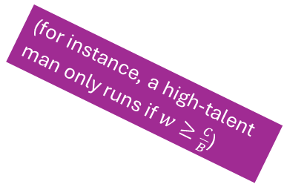
Back to the data...
When they run, women candidates win at the same rate as men candidates.
Women run at a lower rate than men.
(Thus) women are under-represented in legislatures.
When in office, women legislators are more productive (more legislation, more funding brought to the district) than men legislators.
How can our model generate behavior consist with these patterns?
(for instance, a high-talent man only runs if $w≥\frac{C}{B}$)
In the model, running is costly, so people only run if they are sufficiently likely to win.
one way:
low talent women
low talent men
high talent women
high talent men
lowest probability of winning
highest probability of winning
other way:
low talent women
high talent women
low talent men
high talent men

Slide 93
Back to the data...
When they run, women candidates win at the same rate as men candidates.
Women run at a lower rate than men.
(Thus) women are under-represented in legislatures.
When in office, women legislators are more productive (more legislation, more funding brought to the district) than men legislators.
How can our model generate behavior consist with these patterns?
So there will be a cutoff on the probability of winning, with persons above running and groups below not running.
one way:
low talent women
low talent men
high talent women
high talent men
lowest probability of winning
highest probability of winning
other way:
low talent women
high talent women
low talent men
high talent men

Slide 94
Back to the data...
When they run, women candidates win at the same rate as men candidates.
Women run at a lower rate than men.
(Thus) women are under-represented in legislatures.
When in office, women legislators are more productive (more legislation, more funding brought to the district) than men legislators.
How can our model generate behavior consist with these patterns?
example cutoff
So there will be a cutoff on the probability of winning, with groups above running and groups below not running.
these types don’t run
these types run
one way:
low talent women
low talent men
high talent women
high talent men
lowest probability of winning
highest probability of winning
other way:
low talent women
high talent women
low talent men
high talent men

Slide 95
With all that in mind, consider two possibilities
possibility A
possibility B

Slide 96
With all that in mind, consider two possibilities
(low-talent penalty is bigger than misogyny penalty)
possibility A
low talent women
low talent men
high talent women
high talent men
lowest probability of winning
highest probability of winning
possibility B

Slide 97
With all that in mind, consider two possibilities
(low-talent penalty is bigger than misogyny penalty)
cutoff here
possibility A
low talent women
low talent men
high talent women
high talent men
lowest probability of winning
highest probability of winning
Imagine 1,000 people consider running every year.
Of those persons...
250 are low-talent women
250 are low-talent men
250 are high-talent women
250 are high-talent men
Given the above cutoff, everyone but the low-talent women will run.
possibility B

Slide 98
With all that in mind, consider two possibilities
(low-talent penalty is bigger than misogyny penalty)
cutoff here
possibility A
low talent women
low talent men
high talent women
high talent men
lowest probability of winning
highest probability of winning
So...
Women are under-represented among candidates (250 candidates are women, 500 are men)
Women candidates are disproportionately high talent. (100% of women candidates are high talent, 50% of men candidates are high talent)
100% of women who win are high talent. Some portion of men who win are low talent. Thus average talent among women who win office is higher than average talent among men who win office.
Imagine 1,000 people consider running every year.
Of those persons...
250 are low-talent women
250 are low-talent men
250 are high-talent women
250 are high-talent men
Given the above cutoff, everyone but the low-talent women will run.
possibility B

Slide 99
With all that in mind, consider two possibilities
(low-talent penalty is bigger than misogyny penalty)
cutoff here
possibility A
low talent women
low talent men
high talent women
high talent men
lowest probability of winning
highest probability of winning
So...
Women are under-represented among candidates (250 candidates are women, 500 are men)
Women candidates are disproportionately high talent. (100% of women candidates are high talent, 50% of men candidates are high talent)
100% of women who win are high talent. Some portion of men who win are low talent. Thus average talent among women who win office is higher than average talent among men who win office.
Imagine 1,000 people consider running every year.
Of those persons...
250 are low-talent women
250 are low-talent men
250 are high-talent women
250 are high-talent men
Given the above cutoff, everyone but the low-talent women will run.
possibility B

Slide 100
With all that in mind, consider two possibilities
(low-talent penalty is bigger than misogyny penalty)
cutoff here
possibility A
low talent women
low talent men
high talent women
high talent men
lowest probability of winning
highest probability of winning
So...
Women are under-represented among candidates (250 candidates are women, 500 are men)
Women candidates are disproportionately high talent. (100% of women candidates are high talent, 50% of men candidates are high talent)
100% of women who win are high talent. Some portion of men who win are low talent. Thus average talent among women who win office is higher than average talent among men who win office.
Imagine 1,000 people consider running every year.
Of those persons...
250 are low-talent women
250 are low-talent men
250 are high-talent women
250 are high-talent men
Given the above cutoff, everyone but the low-talent women will run.
possibility B

Slide 101
With all that in mind, consider two possibilities
(low-talent penalty is bigger than misogyny penalty)
cutoff here
possibility A
low talent women
low talent men
high talent women
high talent men
lowest probability of winning
highest probability of winning
So...
Women are under-represented among candidates (250 candidates are women, 500 are men)
Women candidates are disproportionately high talent. (100% of women candidates are high talent, 50% of men candidates are high talent)
100% of women who win are high talent. Some portion of men who win are low talent. Thus average talent among women who win office is higher than average talent among men who win office.
Imagine 1,000 people consider running every year.
Of those persons...
250 are low-talent women
250 are low-talent men
250 are high-talent women
250 are high-talent men
Given the above cutoff, everyone but the low-talent women will run.
possibility B

Slide 102
With all that in mind, consider two possibilities
(low-talent penalty is bigger than misogyny penalty)
cutoff here
possibility A
low talent women
low talent men
high talent women
high talent men
lowest probability of winning
highest probability of winning
possibility B
(low-talent penalty is smaller than misogyny penalty)
cutoff here
low talent women
high talent women
low talent men
high talent men
lowest probability of winning
highest probability of winning

Slide 103
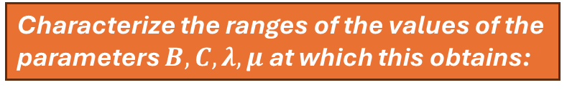
Characterize the ranges of the values of the parameters $B, C, λ, μ$ at which this obtains:
(low-talent penalty is bigger than misogyny penalty)
cutoff here
possibility A
low talent women
low talent men
high talent women
high talent men
lowest probability of winning
highest probability of winning

Slide 104
Gender | Level of Talent | Action | Outcome | Probability | Utility | Expected Utility
man | low | don’t run | lose | 1 | 0 | $$0$$
 |  | run | win | $$λw$$ | B-C | $$λwB−C$$
 |  |  | lose | $$1−λw$$ | -C
man | high | don’t run | lose | 1 | 0 | $$0$$
 |  | run | win | $$w$$ | B-C | $$wB−C$$
 |  |  | lose | $$1−w$$ | -C
woman | low | don’t run | lose | 1 | 0 | $$0$$
 |  | run | win | $$μλw$$ | B-C | $$μλwB−C$$
 |  |  | lose | $$1−μλw$$ | -C
woman | high | don’t run | lose | 1 | 0 | $$0$$
 |  | run | win | $$μw$$ | B-C | $$μwB−C$$
 |  |  | lose | $$1−μw$$ | -C

Slide 105
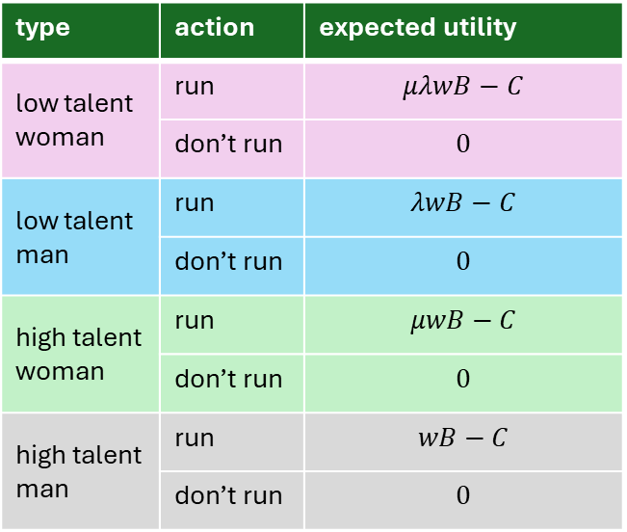
Characterize the ranges of the values of the parameters $B, C, λ, μ$ at which this obtains:
(low-talent penalty is bigger than misogyny penalty)
cutoff here
possibility A
low talent women
low talent men
high talent women
high talent men
lowest probability of winning
highest probability of winning
type | action | expected utility
low talent woman | run | $$μλwB−C$$
 | don’t run | $$0$$
low talent man | run | $$λwB−C$$
 | don’t run | $$0$$
high talent woman | run | $$μwB−C$$
 | don’t run | $$0$$
high talent man | run | $$wB−C$$
 | don’t run | $$0$$

Slide 106
Characterize the ranges of the values of the parameters $B, C, λ, μ$ at which this obtains:
(low-talent penalty is bigger than misogyny penalty)
cutoff here
possibility A
low talent women
low talent men
high talent women
high talent men
lowest probability of winning
highest probability of winning
Step 1: What has to be true for this to be the ordering?
type | action | expected utility
low talent woman | run | $$μλwB−C$$
 | don’t run | $$0$$
low talent man | run | $$λwB−C$$
 | don’t run | $$0$$
high talent woman | run | $$μwB−C$$
 | don’t run | $$0$$
high talent man | run | $$wB−C$$
 | don’t run | $$0$$

Slide 107

Characterize the ranges of the values of the parameters $B, C, λ, μ$ at which this obtains:
(low-talent penalty is bigger than misogyny penalty)
cutoff here
possibility A
low talent women
low talent men
high talent women
high talent men
lowest probability of winning
highest probability of winning
Step 1: What has to be true for this to be the ordering?
$$λ<μ$$
type | action | expected utility
low talent woman | run | $$μλwB−C$$
 | don’t run | $$0$$
low talent man | run | $$λwB−C$$
 | don’t run | $$0$$
high talent woman | run | $$μwB−C$$
 | don’t run | $$0$$
high talent man | run | $$wB−C$$
 | don’t run | $$0$$

Slide 108
Characterize the ranges of the values of the parameters $B, C, λ, μ$ at which this obtains:
(low-talent penalty is bigger than misogyny penalty)
cutoff here
possibility A
low talent women
low talent men
high talent women
high talent men
lowest probability of winning
highest probability of winning
Step 1: What has to be true for this to be the ordering?
$$λ<μ$$
type | action | expected utility
low talent woman | run | $$μλwB−C$$
 | don’t run | $$0$$
low talent man | run | $$λwB−C$$
 | don’t run | $$0$$
high talent woman | run | $$μwB−C$$
 | don’t run | $$0$$
high talent man | run | $$wB−C$$
 | don’t run | $$0$$
Step 2: What has to be true for the cutoff to be here?

Slide 109
Characterize the ranges of the values of the parameters $B, C, λ, μ$ at which this obtains:
(low-talent penalty is bigger than misogyny penalty)
cutoff here
possibility A
low talent women
low talent men
high talent women
high talent men
lowest probability of winning
highest probability of winning
Step 1: What has to be true for this to be the ordering?
$$λ<μ$$
type | action | expected utility
low talent woman | run | $$μλwB−C$$
 | don’t run | $$0$$
low talent man | run | $$λwB−C$$
 | don’t run | $$0$$
high talent woman | run | $$μwB−C$$
 | don’t run | $$0$$
high talent man | run | $$wB−C$$
 | don’t run | $$0$$
Step 2: What has to be true for the cutoff to be here?
(low talent women prefer not to run, while low talent men prefer to run.)

Slide 110
Characterize the ranges of the values of the parameters $B, C, λ, μ$ at which this obtains:
(low-talent penalty is bigger than misogyny penalty)
cutoff here
possibility A
low talent women
low talent men
high talent women
high talent men
lowest probability of winning
highest probability of winning
Step 1: What has to be true for this to be the ordering?
$$λ<μ$$
type | action | expected utility
low talent woman | run | $$μλwB−C$$
 | don’t run | $$0$$
low talent man | run | $$λwB−C$$
 | don’t run | $$0$$
high talent woman | run | $$μwB−C$$
 | don’t run | $$0$$
high talent man | run | $$wB−C$$
 | don’t run | $$0$$
Step 2: What has to be true for the cutoff to be here?
(low talent women prefer not to run, while low talent men prefer to run.)
$$μλwB−C≤0$$

Slide 111
Characterize the ranges of the values of the parameters $B, C, λ, μ$ at which this obtains:
(low-talent penalty is bigger than misogyny penalty)
cutoff here
possibility A
low talent women
low talent men
high talent women
high talent men
lowest probability of winning
highest probability of winning
Step 1: What has to be true for this to be the ordering?
$$λ<μ$$
type | action | expected utility
low talent woman | run | $$μλwB−C$$
 | don’t run | $$0$$
low talent man | run | $$λwB−C$$
 | don’t run | $$0$$
high talent woman | run | $$μwB−C$$
 | don’t run | $$0$$
high talent man | run | $$wB−C$$
 | don’t run | $$0$$
Step 2: What has to be true for the cutoff to be here?
(low talent women prefer not to run, while low talent men prefer to run.)
$$μλwB−C≤0$$
$$λwB−C≥0$$

Slide 112

Characterize the ranges of the values of the parameters $B, C, λ, μ$ at which this obtains:
(low-talent penalty is bigger than misogyny penalty)
cutoff here
possibility A
low talent women
low talent men
high talent women
high talent men
lowest probability of winning
highest probability of winning
Step 1: What has to be true for this to be the ordering?
$$λ<μ$$
type | action | expected utility
low talent woman | run | $$μλwB−C$$
 | don’t run | $$0$$
low talent man | run | $$λwB−C$$
 | don’t run | $$0$$
high talent woman | run | $$μwB−C$$
 | don’t run | $$0$$
high talent man | run | $$wB−C$$
 | don’t run | $$0$$
Step 2: What has to be true for the cutoff to be here?
(low talent women prefer not to run, while low talent men prefer to run.)
$$μλwB−C≤0$$
$$λ≥\frac{C}{wB}$$

Slide 113

Characterize the ranges of the values of the parameters $B, C, λ, μ$ at which this obtains:
(low-talent penalty is bigger than misogyny penalty)
cutoff here
possibility A
low talent women
low talent men
high talent women
high talent men
lowest probability of winning
highest probability of winning
Step 1: What has to be true for this to be the ordering?
$$λ<μ$$
type | action | expected utility
low talent woman | run | $$μλwB−C$$
 | don’t run | $$0$$
low talent man | run | $$λwB−C$$
 | don’t run | $$0$$
high talent woman | run | $$μwB−C$$
 | don’t run | $$0$$
high talent man | run | $$wB−C$$
 | don’t run | $$0$$
Step 2: What has to be true for the cutoff to be here?
(low talent women prefer not to run, while low talent men prefer to run.)
$$μ≤\frac{1}{λ}\frac{C}{wB}$$
$$λ≥\frac{C}{wB}$$

Slide 114






Characterize the ranges of the values of the parameters $B, C, λ, μ$ at which this obtains:
$λ<μ$ (low talent penalty more severe than misogyny penalty
$μ≤\frac{1}{λ}\frac{C}{wB}$ (low-talent women do not want to run)
$μ$ (misogyny penalty)
$λ≥\frac{C}{wB}$ (low-talent men want to run)
(low-talent penalty is bigger than misogyny penalty)
cutoff here
possibility A
$$1$$
low talent women
low talent men
high talent women
high talent men
lowest probability of winning
highest probability of winning
Step 1: What has to be true for this to be the ordering?
$$λ<μ$$
type | action | expected utility
low talent woman | run | $$μλwB−C$$
 | don’t run | $$0$$
low talent man | run | $$λwB−C$$
 | don’t run | $$0$$
high talent woman | run | $$μwB−C$$
 | don’t run | $$0$$
high talent man | run | $$wB−C$$
 | don’t run | $$0$$
Step 2: What has to be true for the cutoff to be here?
(low talent women prefer not to run, while low talent men prefer to run.)
$$λ$$
(low-talent penalty)
$$0$$
$$μ≤\frac{1}{λ}\frac{C}{wB}$$
$$0$$
$$1$$
$$λ≥\frac{C}{wB}$$

Slide 115
Characterize the ranges of the values of the parameters $B, C, λ, μ$ at which this obtains:
$λ<μ$ (low talent penalty more severe than misogyny penalty
$μ≤\frac{1}{λ}\frac{C}{wB}$ (low-talent women do not want to run)
$μ$ (misogyny penalty)
$λ≥\frac{C}{wB}$ (low-talent men want to run)
(low-talent penalty is bigger than misogyny penalty)
cutoff here
possibility A
$$1$$
low talent women
low talent men
high talent women
high talent men
lowest probability of winning
highest probability of winning
Step 1: What has to be true for this to be the ordering?
$$λ<μ$$
type | action | expected utility
low talent woman | run | $$μλwB−C$$
 | don’t run | $$0$$
low talent man | run | $$λwB−C$$
 | don’t run | $$0$$
high talent woman | run | $$μwB−C$$
 | don’t run | $$0$$
high talent man | run | $$wB−C$$
 | don’t run | $$0$$
Step 2: What has to be true for the cutoff to be here?
(low talent women prefer not to run, while low talent men prefer to run.)
$$λ$$
(low-talent penalty)
$$0$$
$$μ≤\frac{1}{λ}\frac{C}{wB}$$
$$0$$
$$1$$
$$λ≥\frac{C}{wB}$$

Slide 116

Characterize the ranges of the values of the parameters $B, C, λ, μ$ at which this obtains:
$λ<μ$ (low talent penalty more severe than misogyny penalty
$μ≤\frac{1}{λ}\frac{C}{wB}$ (low-talent women do not want to run)
$μ$ (misogyny penalty)
$λ≥\frac{C}{wB}$ (low-talent men want to run)
(low-talent penalty is bigger than misogyny penalty)
cutoff here
possibility A
$$1$$
low talent women
low talent men
high talent women
high talent men
lowest probability of winning
highest probability of winning
Step 1: What has to be true for this to be the ordering?
$$λ<μ$$
type | action | expected utility
low talent woman | run | $$μλwB−C$$
 | don’t run | $$0$$
low talent man | run | $$λwB−C$$
 | don’t run | $$0$$
high talent woman | run | $$μwB−C$$
 | don’t run | $$0$$
high talent man | run | $$wB−C$$
 | don’t run | $$0$$
Step 2: What has to be true for the cutoff to be here?
(low talent women prefer not to run, while low talent men prefer to run.)
$$λ$$
(low-talent penalty)
$$0$$
$$μ≤\frac{1}{λ}\frac{C}{wB}$$
$$0$$
$$\frac{C}{wB}$$
$$1$$
$$λ≥\frac{C}{wB}$$

Slide 117


Characterize the ranges of the values of the parameters $B, C, λ, μ$ at which this obtains:
$λ<μ$ (low talent penalty more severe than misogyny penalty
$μ≤\frac{1}{λ}\frac{C}{wB}$ (low-talent women do not want to run)
$μ$ (misogyny penalty)
$λ≥\frac{C}{wB}$ (low-talent men want to run)
(low-talent penalty is bigger than misogyny penalty)
cutoff here
possibility A
$$1$$
low talent women
low talent men
high talent women
high talent men
lowest probability of winning
highest probability of winning
Step 1: What has to be true for this to be the ordering?
$$λ<μ$$
type | action | expected utility
low talent woman | run | $$μλwB−C$$
 | don’t run | $$0$$
low talent man | run | $$λwB−C$$
 | don’t run | $$0$$
high talent woman | run | $$μwB−C$$
 | don’t run | $$0$$
high talent man | run | $$wB−C$$
 | don’t run | $$0$$
$$\frac{C}{wB}$$
(low talent women prefer not to run, while low talent men prefer to run.)
Step 2: What has to be true for the cutoff to be here?
$$λ$$
(low-talent penalty)
$$0$$
$$μ≤\frac{1}{λ}\frac{C}{wB}$$
$$0$$
$$\frac{C}{wB}$$
$$1$$
$$λ≥\frac{C}{wB}$$

Slide 118


Characterize the ranges of the values of the parameters $B, C, λ, μ$ at which this obtains
$λ<μ$ (low talent penalty more severe than misogyny penalty
$μ≤\frac{1}{λ}\frac{C}{wB}$ (low-talent women do not want to run)
$μ$ (misogyny penalty)
$λ≥\frac{C}{wB}$ (low-talent men want to run)
(low-talent penalty is bigger than misogyny penalty)
cutoff here
possibility A
$$1$$
low talent women
low talent men
high talent women
high talent men
lowest probability of winning
highest probability of winning
Step 1: What has to be true for this to be the ordering?
$$λ<μ$$
type | action | expected utility
low talent woman | run | $$μλwB−C$$
 | don’t run | $$0$$
low talent man | run | $$λwB−C$$
 | don’t run | $$0$$
high talent woman | run | $$μwB−C$$
 | don’t run | $$0$$
high talent man | run | $$wB−C$$
 | don’t run | $$0$$
$$\frac{C}{wB}$$
(low talent women prefer not to run, while low talent men prefer to run.)
Step 2: What has to be true for the cutoff to be here?
$$λ$$
(low-talent penalty)
$$0$$
$$μ≤\frac{1}{λ}\frac{C}{wB}$$
$$0$$
$$\frac{C}{wB}$$
$$1$$
$$λ≥\frac{C}{wB}$$

Slide 119



What patterns of gender disparity does this model generate in all these different regions?
$μ$ (misogyny penalty)
$$λ=\frac{C}{wB}$$
(low-talent penalty is bigger than misogyny penalty)
cutoff here
possibility A
$$μ=λ$$
$$1$$
low talent women
low talent men
high talent women
high talent men
lowest probability of winning
highest probability of winning
Step 1: What has to be true for this to be the ordering?
$$λ<μ$$
type | action | expected utility
low talent woman | run | $$μλwB−C$$
 | don’t run | $$0$$
low talent man | run | $$λwB−C$$
 | don’t run | $$0$$
high talent woman | run | $$μwB−C$$
 | don’t run | $$0$$
high talent man | run | $$wB−C$$
 | don’t run | $$0$$
$$\frac{C}{wB}$$
(low talent women prefer not to run, while low talent men prefer to run.)
$$μ=\frac{1}{λ}\frac{C}{wB}$$
Step 2: What has to be true for the cutoff to be here?
$$λ$$
(low-talent penalty)
$$0$$
$$μ≤\frac{1}{λ}\frac{C}{wB}$$
$$0$$
$$\frac{C}{wB}$$
$$1$$
$$λ≥\frac{C}{wB}$$

Slide 120
What patterns of gender disparity does this model generate in all these different regions?
For instance, in this region:
Women are underrepresented among candidates
Average talent among women candidates is higher than average talent among men candidates
$μ$ (misogyny penalty)
$$λ=\frac{C}{wB}$$
(low-talent penalty is bigger than misogyny penalty)
cutoff here
possibility A
$$μ=λ$$
$$1$$
low talent women
low talent men
high talent women
high talent men
lowest probability of winning
highest probability of winning
Step 1: What has to be true for this to be the ordering?
$$λ<μ$$
type | action | expected utility
low talent woman | run | $$μλwB−C$$
 | don’t run | $$0$$
low talent man | run | $$λwB−C$$
 | don’t run | $$0$$
high talent woman | run | $$μwB−C$$
 | don’t run | $$0$$
high talent man | run | $$wB−C$$
 | don’t run | $$0$$
$$\frac{C}{wB}$$
(low talent women prefer not to run, while low talent men prefer to run.)
$$μ=\frac{1}{λ}\frac{C}{wB}$$
Step 2: What has to be true for the cutoff to be here?
$$λ$$
(low-talent penalty)
$$0$$
$$μ≤\frac{1}{λ}\frac{C}{wB}$$
$$0$$
$$\frac{C}{wB}$$
$$1$$
$$λ≥\frac{C}{wB}$$

Slide 121
What patterns of gender disparity does this model generate in all these different regions?
$μ$ (misogyny penalty)
$$λ=\frac{C}{wB}$$
(low-talent penalty is bigger than misogyny penalty)
cutoff here
possibility A
$$μ=λ$$
$$1$$
low talent women
low talent men
high talent women
high talent men
What happens in this region?
lowest probability of winning
highest probability of winning
Step 1: What has to be true for this to be the ordering?
$$λ<μ$$
type | action | expected utility
low talent woman | run | $$μλwB−C$$
 | don’t run | $$0$$
low talent man | run | $$λwB−C$$
 | don’t run | $$0$$
high talent woman | run | $$μwB−C$$
 | don’t run | $$0$$
high talent man | run | $$wB−C$$
 | don’t run | $$0$$
$$\frac{C}{wB}$$
(low talent women prefer not to run, while low talent men prefer to run.)
$$μ=\frac{1}{λ}\frac{C}{wB}$$
Step 2: What has to be true for the cutoff to be here?
$$λ$$
(low-talent penalty)
$$0$$
$$μ≤\frac{1}{λ}\frac{C}{wB}$$
$$0$$
$$\frac{C}{wB}$$
$$1$$
$$λ≥\frac{C}{wB}$$

Slide 122

What patterns of gender disparity does this model generate in all these different regions?
$μ$ (misogyny penalty)
$$λ=\frac{C}{wB}$$
(low-talent penalty is bigger than misogyny penalty)
cutoff here
possibility A
$$μ=λ$$
$$1$$
low talent women
low talent men
high talent women
high talent men
What happens in this region?
lowest probability of winning
highest probability of winning
Step 1: What has to be true for this to be the ordering?
$$λ<μ$$
type | action | expected utility
low talent woman | run | $$μλwB−C$$
 | don’t run | $$0$$
low talent man | run | $$λwB−C$$
 | don’t run | $$0$$
high talent woman | run | $$μwB−C$$
 | don’t run | $$0$$
high talent man | run | $$wB−C$$
 | don’t run | $$0$$
$μ≥λ$ – i.e. the low-talent penalty is more severe than the misogyny penalty.
So the ordering of win-probabilities is like this:
$$\frac{C}{wB}$$
(low talent women prefer not to run, while low talent men prefer to run.)
$$μ=\frac{1}{λ}\frac{C}{wB}$$
Step 2: What has to be true for the cutoff to be here?
$$λ$$
(low-talent penalty)
$$0$$
low talent women
low talent men
high talent women
high talent men
$$μ≤\frac{1}{λ}\frac{C}{wB}$$
$$0$$
$$\frac{C}{wB}$$
$$1$$
$$λ≥\frac{C}{wB}$$

Slide 123
What patterns of gender disparity does this model generate in all these different regions?
$μ$ (misogyny penalty)
$$λ=\frac{C}{wB}$$
(low-talent penalty is bigger than misogyny penalty)
cutoff here
possibility A
$$μ=λ$$
$$1$$
low talent women
low talent men
high talent women
high talent men
What happens in this region?
lowest probability of winning
highest probability of winning
low talent women
low talent men
high talent women
high talent men
Step 1: What has to be true for this to be the ordering?
$$λ<μ$$
type | action | expected utility
low talent woman | run | $$μλwB−C$$
 | don’t run | $$0$$
low talent man | run | $$λwB−C$$
 | don’t run | $$0$$
high talent woman | run | $$μwB−C$$
 | don’t run | $$0$$
high talent man | run | $$wB−C$$
 | don’t run | $$0$$
$$\frac{C}{wB}$$
(low talent women prefer not to run, while low talent men prefer to run.)
$$μ=\frac{1}{λ}\frac{C}{wB}$$
Step 2: What has to be true for the cutoff to be here?
$$λ$$
(low-talent penalty)
$$0$$
$$μ≤\frac{1}{λ}\frac{C}{wB}$$
$$0$$
$$\frac{C}{wB}$$
$$1$$
$$λ≥\frac{C}{wB}$$

Slide 124
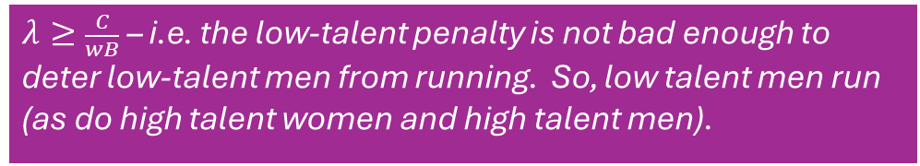
What patterns of gender disparity does this model generate in all these different regions?
$μ$ (misogyny penalty)
$$λ=\frac{C}{wB}$$
(low-talent penalty is bigger than misogyny penalty)
cutoff here
possibility A
$$μ=λ$$
$$1$$
low talent women
low talent men
high talent women
high talent men
What happens in this region?
lowest probability of winning
they run!
highest probability of winning
low talent women
low talent men
high talent women
high talent men
Step 1: What has to be true for this to be the ordering?
$$λ<μ$$
type | action | expected utility
low talent woman | run | $$μλwB−C$$
 | don’t run | $$0$$
low talent man | run | $$λwB−C$$
 | don’t run | $$0$$
high talent woman | run | $$μwB−C$$
 | don’t run | $$0$$
high talent man | run | $$wB−C$$
 | don’t run | $$0$$
$λ≥\frac{C}{wB}$ – i.e. the low-talent penalty is not bad enough to deter low-talent men from running. So, low talent men run (as do high talent women and high talent men).
$$\frac{C}{wB}$$
(low talent women prefer not to run, while low talent men prefer to run.)
$$μ=\frac{1}{λ}\frac{C}{wB}$$
Step 2: What has to be true for the cutoff to be here?
$$λ$$
(low-talent penalty)
$$0$$
$$μ≤\frac{1}{λ}\frac{C}{wB}$$
$$0$$
$$\frac{C}{wB}$$
$$1$$
$$λ≥\frac{C}{wB}$$

Slide 125
What patterns of gender disparity does this model generate in all these different regions?
$μ$ (misogyny penalty)
$$λ=\frac{C}{wB}$$
(low-talent penalty is bigger than misogyny penalty)
cutoff here
possibility A
$$μ=λ$$
$$1$$
low talent women
low talent men
high talent women
high talent men
What happens in this region?
lowest probability of winning
they run!
highest probability of winning
low talent women
low talent men
high talent women
high talent men
Step 1: What has to be true for this to be the ordering?
$$λ<μ$$
type | action | expected utility
low talent woman | run | $$μλwB−C$$
 | don’t run | $$0$$
low talent man | run | $$λwB−C$$
 | don’t run | $$0$$
high talent woman | run | $$μwB−C$$
 | don’t run | $$0$$
high talent man | run | $$wB−C$$
 | don’t run | $$0$$
$$\frac{C}{wB}$$
(low talent women prefer not to run, while low talent men prefer to run.)
$$μ=\frac{1}{λ}\frac{C}{wB}$$
Step 2: What has to be true for the cutoff to be here?
$$λ$$
(low-talent penalty)
$$0$$
$$μ≤\frac{1}{λ}\frac{C}{wB}$$
$$0$$
$$\frac{C}{wB}$$
$$1$$
$$λ≥\frac{C}{wB}$$

Slide 126
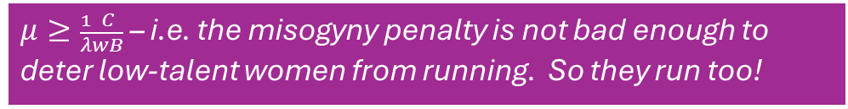
What patterns of gender disparity does this model generate in all these different regions?
$μ$ (misogyny penalty)
$$λ=\frac{C}{wB}$$
(low-talent penalty is bigger than misogyny penalty)
cutoff here
possibility A
$$μ=λ$$
$$1$$
low talent women
low talent men
high talent women
high talent men
What happens in this region?
they run!
lowest probability of winning
they run!
highest probability of winning
low talent women
low talent men
high talent women
high talent men
Step 1: What has to be true for this to be the ordering?
$$λ<μ$$
type | action | expected utility
low talent woman | run | $$μλwB−C$$
 | don’t run | $$0$$
low talent man | run | $$λwB−C$$
 | don’t run | $$0$$
high talent woman | run | $$μwB−C$$
 | don’t run | $$0$$
high talent man | run | $$wB−C$$
 | don’t run | $$0$$
$μ≥\frac{1}{λ}\frac{C}{wB}$ – i.e. the misogyny penalty is not bad enough to deter low-talent women from running. So they run too!
$$μ=\frac{1}{λ}\frac{C}{wB}$$
$$\frac{C}{wB}$$
(low talent women prefer not to run, while low talent men prefer to run.)
Step 2: What has to be true for the cutoff to be here?
$$λ$$
(low-talent penalty)
$$0$$
$$μ≤\frac{1}{λ}\frac{C}{wB}$$
$$0$$
$$\frac{C}{wB}$$
$$1$$
$$λ≥\frac{C}{wB}$$

Slide 127
What patterns of gender disparity does this model generate in all these different regions?
$μ$ (misogyny penalty)
$$λ=\frac{C}{wB}$$
(low-talent penalty is bigger than misogyny penalty)
cutoff here
possibility A
$$μ=λ$$
$$1$$
low talent women
low talent men
high talent women
high talent men
What happens in this region?
they run!
lowest probability of winning
they run!
highest probability of winning
low talent women
low talent men
high talent women
high talent men
Step 1: What has to be true for this to be the ordering?
$$λ<μ$$
type | action | expected utility
low talent woman | run | $$μλwB−C$$
 | don’t run | $$0$$
low talent man | run | $$λwB−C$$
 | don’t run | $$0$$
high talent woman | run | $$μwB−C$$
 | don’t run | $$0$$
high talent man | run | $$wB−C$$
 | don’t run | $$0$$
$$\frac{C}{wB}$$
(low talent women prefer not to run, while low talent men prefer to run.)
$$μ=\frac{1}{λ}\frac{C}{wB}$$
Step 2: What has to be true for the cutoff to be here?
$$λ$$
(low-talent penalty)
$$0$$
$$μ≤\frac{1}{λ}\frac{C}{wB}$$
$$0$$
$$\frac{C}{wB}$$
$$1$$
$$λ≥\frac{C}{wB}$$

Slide 128
What patterns of gender disparity does this model generate in all these different regions?
$μ$ (misogyny penalty)
$$λ=\frac{C}{wB}$$
(low-talent penalty is bigger than misogyny penalty)
cutoff here
possibility A
$$μ=λ$$
$$1$$
low talent women
low talent men
high talent women
high talent men
What happens in this region?
they run!
lowest probability of winning
they run!
highest probability of winning
low talent women
low talent men
high talent women
high talent men
Step 1: What has to be true for this to be the ordering?
$$λ<μ$$
type | action | expected utility
low talent woman | run | $$μλwB−C$$
 | don’t run | $$0$$
low talent man | run | $$λwB−C$$
 | don’t run | $$0$$
high talent woman | run | $$μwB−C$$
 | don’t run | $$0$$
high talent man | run | $$wB−C$$
 | don’t run | $$0$$
No disparities!
Women and men are equally represented among candidates
Average talent among women candidates is equal to average talent among men candidates.
$$\frac{C}{wB}$$
(low talent women prefer not to run, while low talent men prefer to run.)
$$μ=\frac{1}{λ}\frac{C}{wB}$$
Step 2: What has to be true for the cutoff to be here?
$$λ$$
(low-talent penalty)
$$0$$
$$μ≤\frac{1}{λ}\frac{C}{wB}$$
$$0$$
$$\frac{C}{wB}$$
$$1$$
$$λ≥\frac{C}{wB}$$

Slide 129
What patterns of gender disparity does this model generate in all these different regions?
$μ$ (misogyny penalty)
$$λ=\frac{C}{wB}$$
(low-talent penalty is bigger than misogyny penalty)
cutoff here
possibility A
$$μ=λ$$
$$1$$
low talent women
low talent men
high talent women
high talent men
lowest probability of winning
highest probability of winning
Step 1: What has to be true for this to be the ordering?
$$λ<μ$$
type | action | expected utility
low talent woman | run | $$μλwB−C$$
 | don’t run | $$0$$
low talent man | run | $$λwB−C$$
 | don’t run | $$0$$
high talent woman | run | $$μwB−C$$
 | don’t run | $$0$$
high talent man | run | $$wB−C$$
 | don’t run | $$0$$
$$\frac{C}{wB}$$
(low talent women prefer not to run, while low talent men prefer to run.)
$$μ=\frac{1}{λ}\frac{C}{wB}$$
Step 2: What has to be true for the cutoff to be here?
What happens in this region?
$$λ$$
(low-talent penalty)
$$0$$
$$μ≤\frac{1}{λ}\frac{C}{wB}$$
$$0$$
$$\frac{C}{wB}$$
$$1$$
$$λ≥\frac{C}{wB}$$

Slide 130
What patterns of gender disparity does this model generate in all these different regions?
$μ$ (misogyny penalty)
$$λ=\frac{C}{wB}$$
(low-talent penalty is bigger than misogyny penalty)
cutoff here
possibility A
$$μ=λ$$
$$1$$
low talent women
low talent men
high talent women
step 1: how are win probabilities ordered across the 4 types?
step 2: does the low-talent penalty deter low-talent men from running?
step 3: does the misogyny penalty deter low-talent women from running?
high talent men
lowest probability of winning
highest probability of winning
Step 1: What has to be true for this to be the ordering?
$$λ<μ$$
type | action | expected utility
low talent woman | run | $$μλwB−C$$
 | don’t run | $$0$$
low talent man | run | $$λwB−C$$
 | don’t run | $$0$$
high talent woman | run | $$μwB−C$$
 | don’t run | $$0$$
high talent man | run | $$wB−C$$
 | don’t run | $$0$$
$$\frac{C}{wB}$$
(low talent women prefer not to run, while low talent men prefer to run.)
$$μ=\frac{1}{λ}\frac{C}{wB}$$
Step 2: What has to be true for the cutoff to be here?
What happens in this region?
$$λ$$
(low-talent penalty)
$$0$$
$$μ≤\frac{1}{λ}\frac{C}{wB}$$
$$0$$
$$\frac{C}{wB}$$
$$1$$
$$λ≥\frac{C}{wB}$$

Slide 131
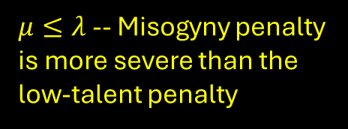
What patterns of gender disparity does this model generate in all these different regions?
low talent women
high talent women
low talent men
high talent men
$μ$ (misogyny penalty)
$$λ=\frac{C}{wB}$$
(low-talent penalty is bigger than misogyny penalty)
cutoff here
possibility A
$$μ=λ$$
$$1$$
$μ≤λ$ -- Misogyny penalty is more severe than the low-talent penalty
step 1: how are win probabilities ordered across the 4 types?
step 2: does the low-talent penalty deter low-talent men from running?
step 3: does the misogyny penalty deter low-talent women from running?
low talent women
low talent men
high talent women
high talent men
lowest probability of winning
highest probability of winning
Step 1: What has to be true for this to be the ordering?
$$λ<μ$$
type | action | expected utility
low talent woman | run | $$μλwB−C$$
 | don’t run | $$0$$
low talent man | run | $$λwB−C$$
 | don’t run | $$0$$
high talent woman | run | $$μwB−C$$
 | don’t run | $$0$$
high talent man | run | $$wB−C$$
 | don’t run | $$0$$
$$\frac{C}{wB}$$
(low talent women prefer not to run, while low talent men prefer to run.)
$$μ=\frac{1}{λ}\frac{C}{wB}$$
Step 2: What has to be true for the cutoff to be here?
What happens in this region?
$$λ$$
(low-talent penalty)
$$0$$
$$μ≤\frac{1}{λ}\frac{C}{wB}$$
$$0$$
$$\frac{C}{wB}$$
$$1$$
$$λ≥\frac{C}{wB}$$

Slide 132
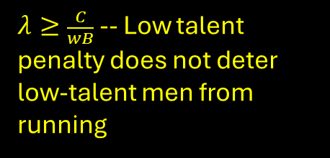
What patterns of gender disparity does this model generate in all these different regions?
they run!
low talent women
high talent women
low talent men
high talent men
$μ$ (misogyny penalty)
$$λ=\frac{C}{wB}$$
(low-talent penalty is bigger than misogyny penalty)
cutoff here
possibility A
$$μ=λ$$
$$1$$
$λ≥\frac{C}{wB}$ -- Low talent penalty does not deter low-talent men from running
step 1: how are win probabilities ordered across the 4 types?
step 2: does the low-talent penalty deter low-talent men from running?
step 3: does the misogyny penalty deter low-talent women from running?
low talent women
low talent men
high talent women
high talent men
lowest probability of winning
highest probability of winning
Step 1: What has to be true for this to be the ordering?
$$λ<μ$$
type | action | expected utility
low talent woman | run | $$μλwB−C$$
 | don’t run | $$0$$
low talent man | run | $$λwB−C$$
 | don’t run | $$0$$
high talent woman | run | $$μwB−C$$
 | don’t run | $$0$$
high talent man | run | $$wB−C$$
 | don’t run | $$0$$
$$\frac{C}{wB}$$
(low talent women prefer not to run, while low talent men prefer to run.)
$$μ=\frac{1}{λ}\frac{C}{wB}$$
Step 2: What has to be true for the cutoff to be here?
What happens in this region?
$$λ$$
(low-talent penalty)
$$0$$
$$μ≤\frac{1}{λ}\frac{C}{wB}$$
$$0$$
$$\frac{C}{wB}$$
$$1$$
$$λ≥\frac{C}{wB}$$

Slide 133
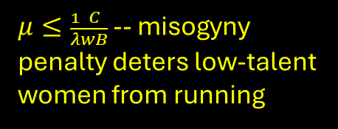
What patterns of gender disparity does this model generate in all these different regions?
they don’t run!
they run!
low talent women
high talent women
low talent men
high talent men
$μ$ (misogyny penalty)
$$λ=\frac{C}{wB}$$
(low-talent penalty is bigger than misogyny penalty)
cutoff here
possibility A
$$μ=λ$$
$$1$$
$μ≤\frac{1}{λ}\frac{C}{wB}$ -- misogyny penalty deters low-talent women from running
step 1: how are win probabilities ordered across the 4 types?
step 2: does the low-talent penalty deter low-talent men from running?
step 3: does the misogyny penalty deter low-talent women from running?
low talent women
low talent men
high talent women
high talent men
lowest probability of winning
highest probability of winning
Step 1: What has to be true for this to be the ordering?
$$λ<μ$$
type | action | expected utility
low talent woman | run | $$μλwB−C$$
 | don’t run | $$0$$
low talent man | run | $$λwB−C$$
 | don’t run | $$0$$
high talent woman | run | $$μwB−C$$
 | don’t run | $$0$$
high talent man | run | $$wB−C$$
 | don’t run | $$0$$
$$\frac{C}{wB}$$
(low talent women prefer not to run, while low talent men prefer to run.)
$$μ=\frac{1}{λ}\frac{C}{wB}$$
Step 2: What has to be true for the cutoff to be here?
What happens in this region?
$$λ$$
(low-talent penalty)
$$0$$
$$μ≤\frac{1}{λ}\frac{C}{wB}$$
$$0$$
$$\frac{C}{wB}$$
$$1$$
$$λ≥\frac{C}{wB}$$

Slide 134
What patterns of gender disparity does this model generate in all these different regions?
they don’t run!
they run!
low talent women
high talent women
low talent men
high talent men
$μ$ (misogyny penalty)
$$λ=\frac{C}{wB}$$
(low-talent penalty is bigger than misogyny penalty)
cutoff here
possibility A
$$μ=λ$$
$$1$$
low talent women
low talent men
high talent women
high talent men
lowest probability of winning
highest probability of winning
Step 1: What has to be true for this to be the ordering?
$$λ<μ$$
type | action | expected utility
low talent woman | run | $$μλwB−C$$
 | don’t run | $$0$$
low talent man | run | $$λwB−C$$
 | don’t run | $$0$$
high talent woman | run | $$μwB−C$$
 | don’t run | $$0$$
high talent man | run | $$wB−C$$
 | don’t run | $$0$$
$$\frac{C}{wB}$$
(low talent women prefer not to run, while low talent men prefer to run.)
$$μ=\frac{1}{λ}\frac{C}{wB}$$
Step 2: What has to be true for the cutoff to be here?
What happens in this region?
$$λ$$
(low-talent penalty)
$$0$$
$$μ≤\frac{1}{λ}\frac{C}{wB}$$
$$0$$
$$\frac{C}{wB}$$
$$1$$
$$λ≥\frac{C}{wB}$$

Slide 135
What patterns of gender disparity does this model generate in all these different regions?
they don’t run!
they run!
low talent women
high talent women
low talent men
high talent men
$μ$ (misogyny penalty)
$$λ=\frac{C}{wB}$$
(low-talent penalty is bigger than misogyny penalty)
cutoff here
possibility A
$$μ=λ$$
$$1$$
but wait..we’re not done!!!
What do high-talent women do???
low talent women
low talent men
high talent women
high talent men
lowest probability of winning
highest probability of winning
Step 1: What has to be true for this to be the ordering?
$$λ<μ$$
type | action | expected utility
low talent woman | run | $$μλwB−C$$
 | don’t run | $$0$$
low talent man | run | $$λwB−C$$
 | don’t run | $$0$$
high talent woman | run | $$μwB−C$$
 | don’t run | $$0$$
high talent man | run | $$wB−C$$
 | don’t run | $$0$$
$$\frac{C}{wB}$$
(low talent women prefer not to run, while low talent men prefer to run.)
$$μ=\frac{1}{λ}\frac{C}{wB}$$
Step 2: What has to be true for the cutoff to be here?
What happens in this region?
$$λ$$
(low-talent penalty)
$$0$$
$$μ≤\frac{1}{λ}\frac{C}{wB}$$
$$0$$
$$\frac{C}{wB}$$
$$1$$
$$λ≥\frac{C}{wB}$$

Slide 136

What patterns of gender disparity does this model generate in all these different regions?
they don’t run!
they run!
low talent women
high talent women
low talent men
high talent men
$μ$ (misogyny penalty)
$$λ=\frac{C}{wB}$$
(low-talent penalty is bigger than misogyny penalty)
cutoff here
possibility A
$$μ=λ$$
$$1$$
but wait..we’re not done!!!
What do high-talent women do???
low talent women
low talent men
high talent women
A high-talent women prefers to run instead of not run if
$$μwB−C≥0$$
or equivalently if
$$μ≥\frac{C}{wB}$$
high talent men
lowest probability of winning
highest probability of winning
Step 1: What has to be true for this to be the ordering?
$$λ<μ$$
type | action | expected utility
low talent woman | run | $$μλwB−C$$
 | don’t run | $$0$$
low talent man | run | $$λwB−C$$
 | don’t run | $$0$$
high talent woman | run | $$μwB−C$$
 | don’t run | $$0$$
high talent man | run | $$wB−C$$
 | don’t run | $$0$$
$$\frac{C}{wB}$$
(low talent women prefer not to run, while low talent men prefer to run.)
$$μ=\frac{1}{λ}\frac{C}{wB}$$
Step 2: What has to be true for the cutoff to be here?
What happens in this region?
$$λ$$
(low-talent penalty)
$$0$$
$$μ≤\frac{1}{λ}\frac{C}{wB}$$
$$0$$
$$\frac{C}{wB}$$
$$1$$
$$λ≥\frac{C}{wB}$$

Slide 137



What patterns of gender disparity does this model generate in all these different regions?
they don’t run!
they run!
low talent women
high talent women
low talent men
high talent men
$μ$ (misogyny penalty)
$$λ=\frac{C}{wB}$$
(low-talent penalty is bigger than misogyny penalty)
cutoff here
possibility A
$$μ=λ$$
$$1$$
but wait..we’re not done!!!
What do high-talent women do???
low talent women
low talent men
high talent women
A high-talent women prefers to run instead of not run if
$$μwB−C≥0$$
or equivalently if
$$μ≥\frac{C}{wB}$$
high talent men
lowest probability of winning
highest probability of winning
$$μ=\frac{1}{λ}\frac{C}{wB}$$
Step 1: What has to be true for this to be the ordering?
$$λ<μ$$
type | action | expected utility
low talent woman | run | $$μλwB−C$$
 | don’t run | $$0$$
low talent man | run | $$λwB−C$$
 | don’t run | $$0$$
high talent woman | run | $$μwB−C$$
 | don’t run | $$0$$
high talent man | run | $$wB−C$$
 | don’t run | $$0$$
$$\frac{C}{wB}$$
high-talent women run
$$μ=\frac{C}{wB}$$
Step 2: What has to be true for the cutoff to be here?
(low talent women prefer not to run, while low talent men prefer to run.)
high-talent women don’t run
What happens in this region?
$$λ$$
(low-talent penalty)
$$0$$
$$μ≤\frac{1}{λ}\frac{C}{wB}$$
$$0$$
$$\frac{C}{wB}$$
$$1$$
$$λ≥\frac{C}{wB}$$

Slide 138
What patterns of gender disparity does this model generate in all these different regions?
So actually we have two regions here.
$μ$ (misogyny penalty)
$$λ=\frac{C}{wB}$$
(low-talent penalty is bigger than misogyny penalty)
cutoff here
possibility A
$$μ=λ$$
$$1$$
low talent women
low talent men
high talent women
high talent men
lowest probability of winning
highest probability of winning
$$μ=\frac{1}{λ}\frac{C}{wB}$$
Step 1: What has to be true for this to be the ordering?
$$λ<μ$$
type | action | expected utility
low talent woman | run | $$μλwB−C$$
 | don’t run | $$0$$
low talent man | run | $$λwB−C$$
 | don’t run | $$0$$
high talent woman | run | $$μwB−C$$
 | don’t run | $$0$$
high talent man | run | $$wB−C$$
 | don’t run | $$0$$
$$\frac{C}{wB}$$
(low talent women prefer not to run, while low talent men prefer to run.)
$$μ=\frac{C}{wB}$$
Step 2: What has to be true for the cutoff to be here?
$$λ$$
(low-talent penalty)
$$0$$
$$μ≤\frac{1}{λ}\frac{C}{wB}$$
$$0$$
$$\frac{C}{wB}$$
$$1$$
$$λ≥\frac{C}{wB}$$

Slide 139
What patterns of gender disparity does this model generate in all these different regions?
So actually we have two regions here.
$μ$ (misogyny penalty)
don’t run
run
$$λ=\frac{C}{wB}$$
(low-talent penalty is bigger than misogyny penalty)
cutoff here
possibility A
$$μ=λ$$
$$1$$
low talent women
high talent women
low talent men
high talent men
low talent women
low talent men
high talent women
high talent men
lowest probability of winning
highest probability of winning
In this region, high talent women run. So:
women are underrepresented among candidates
average talent is higher among women candidates than men candidates
(This is the pattern we see in the “real world”)
$$μ=\frac{1}{λ}\frac{C}{wB}$$
Step 1: What has to be true for this to be the ordering?
$$λ<μ$$
type | action | expected utility
low talent woman | run | $$μλwB−C$$
 | don’t run | $$0$$
low talent man | run | $$λwB−C$$
 | don’t run | $$0$$
high talent woman | run | $$μwB−C$$
 | don’t run | $$0$$
high talent man | run | $$wB−C$$
 | don’t run | $$0$$
$$\frac{C}{wB}$$
(low talent women prefer not to run, while low talent men prefer to run.)
$$μ=\frac{C}{wB}$$
Step 2: What has to be true for the cutoff to be here?
$$λ$$
(low-talent penalty)
$$0$$
$$μ≤\frac{1}{λ}\frac{C}{wB}$$
$$0$$
$$\frac{C}{wB}$$
$$1$$
$$λ≥\frac{C}{wB}$$

Slide 140
What patterns of gender disparity does this model generate in all these different regions?
So actually we have two regions here.
$μ$ (misogyny penalty)
don’t run
run
$$λ=\frac{C}{wB}$$
(low-talent penalty is bigger than misogyny penalty)
cutoff here
possibility A
$$μ=λ$$
$$1$$
low talent women
high talent women
low talent men
high talent men
low talent women
low talent men
high talent women
high talent men
lowest probability of winning
highest probability of winning
In this region, high talent women don’t run. So 100% of candidates are men (and thus there is no talent disparity between men and women candidates to speak of).
$$μ=\frac{1}{λ}\frac{C}{wB}$$
Step 1: What has to be true for this to be the ordering?
$$λ<μ$$
type | action | expected utility
low talent woman | run | $$μλwB−C$$
 | don’t run | $$0$$
low talent man | run | $$λwB−C$$
 | don’t run | $$0$$
high talent woman | run | $$μwB−C$$
 | don’t run | $$0$$
high talent man | run | $$wB−C$$
 | don’t run | $$0$$
$$\frac{C}{wB}$$
(low talent women prefer not to run, while low talent men prefer to run.)
$$μ=\frac{C}{wB}$$
Step 2: What has to be true for the cutoff to be here?
$$λ$$
(low-talent penalty)
$$0$$
$$μ≤\frac{1}{λ}\frac{C}{wB}$$
$$0$$
$$\frac{C}{wB}$$
$$1$$
$$λ≥\frac{C}{wB}$$

Slide 141
Exercise: Do the analysis for all 8 regions!
$μ$ (misogyny penalty)
$$λ=\frac{C}{wB}$$
(low-talent penalty is bigger than misogyny penalty)
cutoff here
possibility A
$$μ=λ$$
$$1$$
low talent women
low talent men
high talent women
high talent men
lowest probability of winning
highest probability of winning
$$μ=\frac{1}{λ}\frac{C}{wB}$$
Step 1: What has to be true for this to be the ordering?
$$λ<μ$$
type | action | expected utility
low talent woman | run | $$μλwB−C$$
 | don’t run | $$0$$
low talent man | run | $$λwB−C$$
 | don’t run | $$0$$
high talent woman | run | $$μwB−C$$
 | don’t run | $$0$$
high talent man | run | $$wB−C$$
 | don’t run | $$0$$
$$\frac{C}{wB}$$
(low talent women prefer not to run, while low talent men prefer to run.)
$$μ=\frac{C}{wB}$$
Step 2: What has to be true for the cutoff to be here?
$$λ$$
(low-talent penalty)
$$0$$
$$μ≤\frac{1}{λ}\frac{C}{wB}$$
$$0$$
$$\frac{C}{wB}$$
$$1$$
$$λ≥\frac{C}{wB}$$

