Slide 1
Marginal-Conditional Diagrams

Slide 2
Review: the Marginal-Conditional Method
Marginal-Conditional Diagrams: How to Draw One
Marginal-Conditional Diagrams: How to Compute with One

Slide 3
Review: The Marginal-Conditional Method
two uncertainties:
If the military attempts a coup, will it succeed?
In a conflict with an opposing military force, how well will the military perform?

Slide 4
Review: The Marginal-Conditional Method
Build a model of these two uncertainties in which a military that would succeed when attempting a coup is more likely to perform well against an opposing force than a military that would fail when attempting a coup.
two uncertainties:
If the military attempts a coup, will it succeed?
In a conflict with an opposing military force, how well will the military perform?

Slide 5
Review: The Marginal-Conditional Method
Build a model of these two uncertainties in which a military that would succeed when attempting a coup is more likely to perform well against an opposing force than a military that would fail when attempting a coup.
two uncertainties:
If the military attempts a coup, will it succeed?
In a conflict with an opposing military force, how well will the military perform?
Brute Force Approach – JUST SAY NO!!!

Slide 6
Review: The Marginal-Conditional Method
Build a model of these two uncertainties in which a military that would succeed when attempting a coup is more likely to perform well against an opposing force than a military that would fail when attempting a coup.
two uncertainties:
If the military attempts a coup, will it succeed?
In a conflict with an opposing military force, how well will the military perform?
Brute Force Approach – JUST SAY NO!!!
Step 1: Model the joint probabilities with a grid

Slide 7
Review: The Marginal-Conditional Method
Build a model of these two uncertainties in which a military that would succeed when attempting a coup is more likely to perform well against an opposing force than a military that would fail when attempting a coup.
two uncertainties:
If the military attempts a coup, will it succeed?
In a conflict with an opposing military force, how well will the military perform?
Brute Force Approach – JUST SAY NO!!!
how well against an opposing military?
Step 1: Model the joint probabilities with a grid
outcome of a coup attempt?

Slide 8
Review: The Marginal-Conditional Method
Build a model of these two uncertainties in which a military that would succeed when attempting a coup is more likely to perform well against an opposing force than a military that would fail when attempting a coup.
two uncertainties:
If the military attempts a coup, will it succeed?
In a conflict with an opposing military force, how well will the military perform?
Brute Force Approach – JUST SAY NO!!!
how well against an opposing military?
Step 1: Model the joint probabilities with a grid
barely acceptable
abysmal
adequate
spectacular
outcome of a coup attempt?

Slide 9
Review: The Marginal-Conditional Method
Build a model of these two uncertainties in which a military that would succeed when attempting a coup is more likely to perform well against an opposing force than a military that would fail when attempting a coup.
two uncertainties:
If the military attempts a coup, will it succeed?
In a conflict with an opposing military force, how well will the military perform?
Brute Force Approach – JUST SAY NO!!!
how well against an opposing military?
Step 1: Model the joint probabilities with a grid
barely acceptable
abysmal
adequate
spectacular
success
outcome of a coup attempt?
failure

Slide 10
Review: The Marginal-Conditional Method
Build a model of these two uncertainties in which a military that would succeed when attempting a coup is more likely to perform well against an opposing force than a military that would fail when attempting a coup.
two uncertainties:
If the military attempts a coup, will it succeed?
In a conflict with an opposing military force, how well will the military perform?
Brute Force Approach – JUST SAY NO!!!
how well against an opposing military?
Step 2: Assign joint probabilities
barely acceptable
abysmal
adequate
spectacular
success
outcome of a coup attempt?
failure

Slide 11







Review: The Marginal-Conditional Method
Build a model of these two uncertainties in which a military that would succeed when attempting a coup is more likely to perform well against an opposing force than a military that would fail when attempting a coup.
two uncertainties:
If the military attempts a coup, will it succeed?
In a conflict with an opposing military force, how well will the military perform?
Brute Force Approach – JUST SAY NO!!!
how well against an opposing military?
Step 2: Assign joint probabilities
barely acceptable
abysmal
adequate
spectacular
success
$$\frac{1}{20}$$
$$\frac{2}{20}$$
$$\frac{3}{20}$$
$$\frac{4}{20}$$
outcome of a coup attempt?
failure
$$\frac{4}{20}$$
$$\frac{3}{20}$$
$$\frac{2}{20}$$
$$\frac{1}{20}$$

Slide 12
Review: The Marginal-Conditional Method
Build a model of these two uncertainties in which a military that would succeed when attempting a coup is more likely to perform well against an opposing force than a military that would fail when attempting a coup.
two uncertainties:
If the military attempts a coup, will it succeed?
In a conflict with an opposing military force, how well will the military perform?
Marginal-Conditional Method– JUST SAY YES!!!

Slide 13
Review: The Marginal-Conditional Method
Build a model of these two uncertainties in which a military that would succeed when attempting a coup is more likely to perform well against an opposing force than a military that would fail when attempting a coup.
two uncertainties:
If the military attempts a coup, will it succeed?
In a conflict with an opposing military force, how well will the military perform?
Marginal-Conditional Method– JUST SAY YES!!!
Step 1: Assign marginal probabilities of success/failure in attempted coup

Slide 14


Review: The Marginal-Conditional Method
Build a model of these two uncertainties in which a military that would succeed when attempting a coup is more likely to perform well against an opposing force than a military that would fail when attempting a coup.
two uncertainties:
If the military attempts a coup, will it succeed?
In a conflict with an opposing military force, how well will the military perform?
Marginal-Conditional Method– JUST SAY YES!!!
Step 1: Assign marginal probabilities of success/failure in attempted coup
$$\frac{1}{8}$$
attempted coup would succeed
$$\frac{7}{8}$$
attempted coup would fail

Slide 15
Review: The Marginal-Conditional Method
Build a model of these two uncertainties in which a military that would succeed when attempting a coup is more likely to perform well against an opposing force than a military that would fail when attempting a coup.
two uncertainties:
If the military attempts a coup, will it succeed?
In a conflict with an opposing military force, how well will the military perform?
Marginal-Conditional Method– JUST SAY YES!!!
Step 2: Model uncertainty about success against opposing miiltaries, conditional on knowledge of outcome of a coup attempt.
$$\frac{1}{8}$$
attempted coup would succeed
$$\frac{7}{8}$$
attempted coup would fail

Slide 16
Review: The Marginal-Conditional Method
Build a model of these two uncertainties in which a military that would succeed when attempting a coup is more likely to perform well against an opposing force than a military that would fail when attempting a coup.
two uncertainties:
If the military attempts a coup, will it succeed?
In a conflict with an opposing military force, how well will the military perform?
Marginal-Conditional Method– JUST SAY YES!!!
how well against an opposing military?
Step 2: Model uncertainty about success against opposing miiltaries, conditional on knowledge of outcome of a coup attempt.
abysmal
barely acceptable
adequate
spectacular
succeed
$$\frac{1}{8}$$
a coup attempt would...?
fail
attempted coup would succeed
how well against an opposing military?
abysmal
barely acceptable
adequate
spectacular
$$\frac{7}{8}$$
attempted coup would fail
succeed
a coup attempt would...?
fail

Slide 17
Review: The Marginal-Conditional Method
Build a model of these two uncertainties in which a military that would succeed when attempting a coup is more likely to perform well against an opposing force than a military that would fail when attempting a coup.
two uncertainties:
If the military attempts a coup, will it succeed?
In a conflict with an opposing military force, how well will the military perform?
Marginal-Conditional Method– JUST SAY YES!!!
how well against an opposing military?
Step 2: Model uncertainty about success against opposing miiltaries, conditional on knowledge of outcome of a coup attempt.
abysmal
barely acceptable
adequate
spectacular
succeed
$$\frac{1}{8}$$
a coup attempt would...?
fail
attempted coup would succeed
how well against an opposing military?
abysmal
barely acceptable
adequate
spectacular
$$\frac{7}{8}$$
attempted coup would fail
succeed
a coup attempt would...?
fail

Slide 18
Review: The Marginal-Conditional Method
Build a model of these two uncertainties in which a military that would succeed when attempting a coup is more likely to perform well against an opposing force than a military that would fail when attempting a coup.
two uncertainties:
how well against an opposing military?
abysmal
barely acceptable
adequate
spectacular
If the military attempts a coup, will it succeed?
In a conflict with an opposing military force, how well will the military perform?
succeed
Marginal-Conditional Method– JUST SAY YES!!!
a coup attempt would...?
how well against an opposing military?
fail
barely acceptable
adequate
spectacular
Step 2: Model uncertainty about success against opposing miiltaries, conditional on knowledge of outcome of a coup attempt.
abysmal
succeed
how well against an opposing military?
$$\frac{1}{8}$$
a coup attempt would...?
abysmal
barely acceptable
adequate
spectacular
fail
succeed
attempted coup would succeed
a coup attempt would...?
fail
how well against an opposing military?
abysmal
barely acceptable
adequate
spectacular
$$\frac{7}{8}$$
attempted coup would fail
succeed
a coup attempt would...?
fail

Slide 19
Review: The Marginal-Conditional Method
Build a model of these two uncertainties in which a military that would succeed when attempting a coup is more likely to perform well against an opposing force than a military that would fail when attempting a coup.
two uncertainties:
how well against an opposing military?
abysmal
barely acceptable
adequate
spectacular
If the military attempts a coup, will it succeed?
In a conflict with an opposing military force, how well will the military perform?
succeed
Marginal-Conditional Method– JUST SAY YES!!!
“More likely to be more successful”
a coup attempt would...?
how well against an opposing military?
fail
barely acceptable
adequate
spectacular
Step 2: Model uncertainty about success against opposing miiltaries, conditional on knowledge of outcome of a coup attempt.
abysmal
succeed
how well against an opposing military?
$$\frac{1}{8}$$
a coup attempt would...?
abysmal
barely acceptable
adequate
spectacular
fail
succeed
attempted coup would succeed
“Less likely to be more successful”
a coup attempt would...?
fail
how well against an opposing military?
abysmal
barely acceptable
adequate
spectacular
$$\frac{7}{8}$$
attempted coup would fail
succeed
a coup attempt would...?
fail

Slide 20
Review: The Marginal-Conditional Method
How do we assign probabilities to model this?
Build a model of these two uncertainties in which a military that would succeed when attempting a coup is more likely to perform well against an opposing force than a military that would fail when attempting a coup.
two uncertainties:
how well against an opposing military?
abysmal
barely acceptable
adequate
spectacular
If the military attempts a coup, will it succeed?
In a conflict with an opposing military force, how well will the military perform?
succeed
Marginal-Conditional Method– JUST SAY YES!!!
“More likely to be more successful”
a coup attempt would...?
how well against an opposing military?
fail
barely acceptable
adequate
spectacular
Step 2: Model uncertainty about success against opposing miiltaries, conditional on knowledge of outcome of a coup attempt.
abysmal
succeed
how well against an opposing military?
$$\frac{1}{8}$$
a coup attempt would...?
abysmal
barely acceptable
adequate
spectacular
fail
succeed
attempted coup would succeed
“Less likely to be more successful”
a coup attempt would...?
fail
how well against an opposing military?
abysmal
barely acceptable
adequate
spectacular
$$\frac{7}{8}$$
attempted coup would fail
succeed
a coup attempt would...?
fail

Slide 21
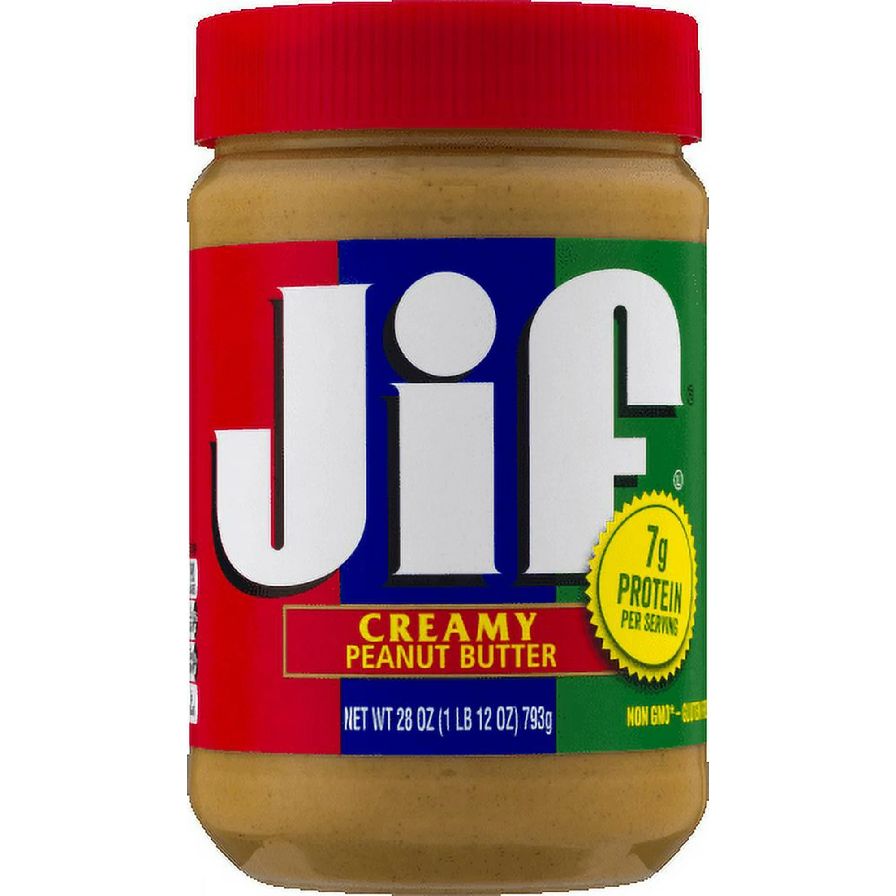
Review: The Marginal-Conditional Method
How do we assign probabilities to model this?
Build a model of these two uncertainties in which a military that would succeed when attempting a coup is more likely to perform well against an opposing force than a military that would fail when attempting a coup.
two uncertainties:
how well against an opposing military?
abysmal
barely acceptable
adequate
spectacular
If the military attempts a coup, will it succeed?
In a conflict with an opposing military force, how well will the military perform?
succeed
Marginal-Conditional Method– JUST SAY YES!!!
“More likely to be more successful”
a coup attempt would...?
how well against an opposing military?
fail
barely acceptable
adequate
spectacular
Step 2: Model uncertainty about success against opposing miiltaries, conditional on knowledge of outcome of a coup attempt.
abysmal
succeed
how well against an opposing military?
$$\frac{1}{8}$$
a coup attempt would...?
abysmal
barely acceptable
adequate
spectacular
fail
succeed
attempted coup would succeed
“Less likely to be more successful”
a coup attempt would...?
fail
how well against an opposing military?
abysmal
barely acceptable
adequate
spectacular
$$\frac{7}{8}$$
attempted coup would fail
succeed
a coup attempt would...?
fail

Slide 22
Review: The Marginal-Conditional Method
How do we assign probabilities to model this?
Build a model of these two uncertainties in which a military that would succeed when attempting a coup is more likely to perform well against an opposing force than a military that would fail when attempting a coup.
two uncertainties:
how well against an opposing military?
abysmal
barely acceptable
adequate
spectacular
If the military attempts a coup, will it succeed?
In a conflict with an opposing military force, how well will the military perform?
less
succeed
Marginal-Conditional Method– JUST SAY YES!!!
“More likely to be more successful”
a coup attempt would...?
how well against an opposing military?
fail
barely acceptable
adequate
spectacular
Step 2: Model uncertainty about success against opposing miiltaries, conditional on knowledge of outcome of a coup attempt.
abysmal
succeed
how well against an opposing military?
$$\frac{1}{8}$$
a coup attempt would...?
abysmal
barely acceptable
adequate
spectacular
fail
succeed
attempted coup would succeed
“Less likely to be more successful”
a coup attempt would...?
more
fail
how well against an opposing military?
abysmal
barely acceptable
adequate
spectacular
$$\frac{7}{8}$$
attempted coup would fail
succeed
a coup attempt would...?
fail

Slide 23
Review: The Marginal-Conditional Method
How do we assign probabilities to model this?
Build a model of these two uncertainties in which a military that would succeed when attempting a coup is more likely to perform well against an opposing force than a military that would fail when attempting a coup.
two uncertainties:
how well against an opposing military?
abysmal
barely acceptable
less
adequate
spectacular
If the military attempts a coup, will it succeed?
In a conflict with an opposing military force, how well will the military perform?
less
succeed
Marginal-Conditional Method– JUST SAY YES!!!
“More likely to be more successful”
a coup attempt would...?
how well against an opposing military?
fail
barely acceptable
adequate
spectacular
Step 2: Model uncertainty about success against opposing miiltaries, conditional on knowledge of outcome of a coup attempt.
abysmal
succeed
how well against an opposing military?
$$\frac{1}{8}$$
a coup attempt would...?
abysmal
barely acceptable
adequate
spectacular
fail
succeed
attempted coup would succeed
“Less likely to be more successful”
a coup attempt would...?
more
fail
how well against an opposing military?
more
abysmal
barely acceptable
adequate
spectacular
$$\frac{7}{8}$$
attempted coup would fail
succeed
a coup attempt would...?
fail

Slide 24
Review: The Marginal-Conditional Method
How do we assign probabilities to model this?
Build a model of these two uncertainties in which a military that would succeed when attempting a coup is more likely to perform well against an opposing force than a military that would fail when attempting a coup.
two uncertainties:
how well against an opposing military?
abysmal
barely acceptable
less
adequate
spectacular
If the military attempts a coup, will it succeed?
In a conflict with an opposing military force, how well will the military perform?
less
less
succeed
Marginal-Conditional Method– JUST SAY YES!!!
“More likely to be more successful”
a coup attempt would...?
how well against an opposing military?
fail
barely acceptable
adequate
spectacular
Step 2: Model uncertainty about success against opposing miiltaries, conditional on knowledge of outcome of a coup attempt.
abysmal
succeed
how well against an opposing military?
$$\frac{1}{8}$$
a coup attempt would...?
abysmal
barely acceptable
adequate
spectacular
fail
succeed
attempted coup would succeed
“Less likely to be more successful”
a coup attempt would...?
more
fail
how well against an opposing military?
more
more
abysmal
barely acceptable
adequate
spectacular
$$\frac{7}{8}$$
attempted coup would fail
succeed
a coup attempt would...?
fail

Slide 25




Review: The Marginal-Conditional Method
How do we assign probabilities to model this?
Build a model of these two uncertainties in which a military that would succeed when attempting a coup is more likely to perform well against an opposing force than a military that would fail when attempting a coup.
two uncertainties:
how well against an opposing military?
abysmal
barely acceptable
less
adequate
spectacular
If the military attempts a coup, will it succeed?
In a conflict with an opposing military force, how well will the military perform?
less
less
Marginal-Conditional Method– JUST SAY YES!!!
succeed
$$\frac{1}{12}$$
$$\frac{4}{12}$$
$$\frac{6}{12}$$
$$\frac{1}{12}$$
“More likely to be more successful”
a coup attempt would...?
how well against an opposing military?
fail
barely acceptable
adequate
spectacular
Step 2: Model uncertainty about success against opposing miiltaries, conditional on knowledge of outcome of a coup attempt.
abysmal
succeed
how well against an opposing military?
$$\frac{1}{8}$$
a coup attempt would...?
abysmal
barely acceptable
adequate
spectacular
fail
succeed
attempted coup would succeed
“Less likely to be more successful”
a coup attempt would...?
more
fail
how well against an opposing military?
more
more
abysmal
barely acceptable
adequate
spectacular
$$\frac{7}{8}$$
attempted coup would fail
succeed
a coup attempt would...?
fail

Slide 26

Review: The Marginal-Conditional Method
How do we assign probabilities to model this?
Build a model of these two uncertainties in which a military that would succeed when attempting a coup is more likely to perform well against an opposing force than a military that would fail when attempting a coup.
two uncertainties:
how well against an opposing military?
abysmal
barely acceptable
less
adequate
spectacular
If the military attempts a coup, will it succeed?
In a conflict with an opposing military force, how well will the military perform?
less
less
Marginal-Conditional Method– JUST SAY YES!!!
succeed
$$\frac{1}{12}$$
$$\frac{4}{12}$$
$$\frac{6}{12}$$
$$\frac{1}{12}$$
“More likely to be more successful”
a coup attempt would...?
how well against an opposing military?
fail
barely acceptable
adequate
spectacular
Step 2: Model uncertainty about success against opposing miiltaries, conditional on knowledge of outcome of a coup attempt.
abysmal
succeed
how well against an opposing military?
$$\frac{1}{8}$$
a coup attempt would...?
abysmal
barely acceptable
adequate
spectacular
fail
succeed
attempted coup would succeed
“Less likely to be more successful”
a coup attempt would...?
more
fail
$$\frac{1}{12}$$
how well against an opposing military?
more
more
abysmal
barely acceptable
adequate
spectacular
$$\frac{7}{8}$$
attempted coup would fail
succeed
a coup attempt would...?
fail

Slide 27

Review: The Marginal-Conditional Method
How do we assign probabilities to model this?
Build a model of these two uncertainties in which a military that would succeed when attempting a coup is more likely to perform well against an opposing force than a military that would fail when attempting a coup.
two uncertainties:
how well against an opposing military?
abysmal
barely acceptable
less
adequate
spectacular
If the military attempts a coup, will it succeed?
In a conflict with an opposing military force, how well will the military perform?
less
less
Marginal-Conditional Method– JUST SAY YES!!!
succeed
$$\frac{1}{12}$$
$$\frac{4}{12}$$
$$\frac{6}{12}$$
$$\frac{1}{12}$$
“More likely to be more successful”
a coup attempt would...?
how well against an opposing military?
fail
barely acceptable
adequate
spectacular
Step 2: Model uncertainty about success against opposing miiltaries, conditional on knowledge of outcome of a coup attempt.
abysmal
succeed
how well against an opposing military?
$$\frac{1}{8}$$
a coup attempt would...?
abysmal
barely acceptable
adequate
spectacular
fail
succeed
attempted coup would succeed
“Less likely to be more successful”
a coup attempt would...?
more
fail
$$\frac{1}{12}$$
$$\frac{5}{12}$$
how well against an opposing military?
more
more
abysmal
barely acceptable
adequate
spectacular
$$\frac{7}{8}$$
attempted coup would fail
succeed
a coup attempt would...?
fail

Slide 28

Review: The Marginal-Conditional Method
How do we assign probabilities to model this?
Build a model of these two uncertainties in which a military that would succeed when attempting a coup is more likely to perform well against an opposing force than a military that would fail when attempting a coup.
two uncertainties:
how well against an opposing military?
abysmal
barely acceptable
less
adequate
spectacular
If the military attempts a coup, will it succeed?
In a conflict with an opposing military force, how well will the military perform?
less
less
Marginal-Conditional Method– JUST SAY YES!!!
succeed
$$\frac{1}{12}$$
$$\frac{4}{12}$$
$$\frac{6}{12}$$
$$\frac{1}{12}$$
“More likely to be more successful”
a coup attempt would...?
how well against an opposing military?
fail
barely acceptable
adequate
spectacular
Step 2: Model uncertainty about success against opposing miiltaries, conditional on knowledge of outcome of a coup attempt.
abysmal
succeed
how well against an opposing military?
$$\frac{1}{8}$$
a coup attempt would...?
abysmal
barely acceptable
adequate
spectacular
fail
succeed
attempted coup would succeed
“Less likely to be more successful”
a coup attempt would...?
more
fail
$$\frac{1}{12}$$
$$\frac{5}{12}$$
$$\frac{5}{12}$$
how well against an opposing military?
more
more
abysmal
barely acceptable
adequate
spectacular
$$\frac{7}{8}$$
attempted coup would fail
succeed
a coup attempt would...?
fail

Slide 29
Review: The Marginal-Conditional Method
How do we assign probabilities to model this?
Build a model of these two uncertainties in which a military that would succeed when attempting a coup is more likely to perform well against an opposing force than a military that would fail when attempting a coup.
two uncertainties:
how well against an opposing military?
abysmal
barely acceptable
less
adequate
spectacular
If the military attempts a coup, will it succeed?
In a conflict with an opposing military force, how well will the military perform?
less
less
Marginal-Conditional Method– JUST SAY YES!!!
succeed
$$\frac{1}{12}$$
$$\frac{4}{12}$$
$$\frac{6}{12}$$
$$\frac{1}{12}$$
“More likely to be more successful”
a coup attempt would...?
how well against an opposing military?
fail
barely acceptable
adequate
spectacular
Step 2: Model uncertainty about success against opposing miiltaries, conditional on knowledge of outcome of a coup attempt.
abysmal
succeed
how well against an opposing military?
$$\frac{1}{8}$$
a coup attempt would...?
abysmal
barely acceptable
adequate
spectacular
fail
succeed
attempted coup would succeed
“Less likely to be more successful”
a coup attempt would...?
more
fail
$$\frac{1}{12}$$
$$\frac{5}{12}$$
$$\frac{5}{12}$$
$$\frac{1}{12}$$
how well against an opposing military?
more
more
abysmal
barely acceptable
adequate
spectacular
$$\frac{7}{8}$$
attempted coup would fail
succeed
a coup attempt would...?
fail

Slide 30
Review: The Marginal-Conditional Method
How do we assign probabilities to model this?
Build a model of these two uncertainties in which a military that would succeed when attempting a coup is more likely to perform well against an opposing force than a military that would fail when attempting a coup.
two uncertainties:
how well against an opposing military?
abysmal
barely acceptable
less
adequate
spectacular
If the military attempts a coup, will it succeed?
In a conflict with an opposing military force, how well will the military perform?
less
less
Marginal-Conditional Method– JUST SAY YES!!!
succeed
$$\frac{1}{12}$$
$$\frac{4}{12}$$
$$\frac{6}{12}$$
$$\frac{1}{12}$$
“More likely to be more successful”
a coup attempt would...?
how well against an opposing military?
fail
barely acceptable
adequate
spectacular
Step 2: Model uncertainty about success against opposing miiltaries, conditional on knowledge of outcome of a coup attempt.
abysmal
succeed
Here we’ve modeled the difference as VERY SLIGHT
how well against an opposing military?
$$\frac{1}{8}$$
a coup attempt would...?
abysmal
barely acceptable
adequate
spectacular
fail
succeed
attempted coup would succeed
“Less likely to be more successful”
a coup attempt would...?
more
fail
$$\frac{1}{12}$$
$$\frac{5}{12}$$
$$\frac{5}{12}$$
$$\frac{1}{12}$$
how well against an opposing military?
more
more
abysmal
barely acceptable
adequate
spectacular
$$\frac{7}{8}$$
attempted coup would fail
succeed
a coup attempt would...?
fail

Slide 31
Review: The Marginal-Conditional Method
How do we assign probabilities to model this?
Build a model of these two uncertainties in which a military that would succeed when attempting a coup is more likely to perform well against an opposing force than a military that would fail when attempting a coup.
two uncertainties:
how well against an opposing military?
abysmal
barely acceptable
less
adequate
spectacular
If the military attempts a coup, will it succeed?
In a conflict with an opposing military force, how well will the military perform?
less
less
Marginal-Conditional Method– JUST SAY YES!!!
succeed
$$\frac{1}{12}$$
$$\frac{4}{12}$$
$$\frac{6}{12}$$
$$\frac{1}{12}$$
“More likely to be more successful”
a coup attempt would...?
how well against an opposing military?
fail
barely acceptable
adequate
spectacular
Step 2: Model uncertainty about success against opposing miiltaries, conditional on knowledge of outcome of a coup attempt.
abysmal
succeed
What if we want to make the difference very severe?
how well against an opposing military?
$$\frac{1}{8}$$
a coup attempt would...?
abysmal
barely acceptable
adequate
spectacular
fail
succeed
attempted coup would succeed
“Less likely to be more successful”
a coup attempt would...?
more
fail
$$\frac{1}{12}$$
$$\frac{5}{12}$$
$$\frac{5}{12}$$
$$\frac{1}{12}$$
how well against an opposing military?
more
more
abysmal
barely acceptable
adequate
spectacular
$$\frac{7}{8}$$
attempted coup would fail
succeed
a coup attempt would...?
fail

Slide 32








Review: The Marginal-Conditional Method
How do we assign probabilities to model this?
Build a model of these two uncertainties in which a military that would succeed when attempting a coup is more likely to perform well against an opposing force than a military that would fail when attempting a coup.
two uncertainties:
how well against an opposing military?
abysmal
barely acceptable
less
adequate
spectacular
If the military attempts a coup, will it succeed?
In a conflict with an opposing military force, how well will the military perform?
less
less
Marginal-Conditional Method– JUST SAY YES!!!
succeed
$$0$$
$$0$$
$$0$$
$$1$$
“More likely to be more successful”
a coup attempt would...?
how well against an opposing military?
fail
barely acceptable
adequate
spectacular
Step 2: Model uncertainty about success against opposing miiltaries, conditional on knowledge of outcome of a coup attempt.
abysmal
succeed
What if we want to make the difference very severe?
how well against an opposing military?
$$\frac{1}{8}$$
a coup attempt would...?
abysmal
barely acceptable
adequate
spectacular
fail
succeed
attempted coup would succeed
“Less likely to be more successful”
a coup attempt would...?
more
fail
$$1$$
$$0$$
$$0$$
$$0$$
how well against an opposing military?
more
more
abysmal
barely acceptable
adequate
spectacular
$$\frac{7}{8}$$
attempted coup would fail
succeed
a coup attempt would...?
fail

Slide 33







Review: The Marginal-Conditional Method
Build a model of these two uncertainties in which a military that would succeed when attempting a coup is more likely to perform well against an opposing force than a military that would fail when attempting a coup.
two uncertainties:
If the military attempts a coup, will it succeed?
In a conflict with an opposing military force, how well will the military perform?
Marginal-Conditional Method– JUST SAY YES!!!
how well against an opposing military?
Step 2: Model uncertainty about success against opposing miiltaries, conditional on knowledge of outcome of a coup attempt.
abysmal
barely acceptable
adequate
spectacular
succeed
$$\frac{10}{20}$$
$$\frac{8}{20}$$
$$\frac{1}{20}$$
$$\frac{1}{20}$$
$$\frac{1}{8}$$
a coup attempt would...?
fail
attempted coup would succeed
how well against an opposing military?
abysmal
barely acceptable
adequate
spectacular
$$\frac{7}{8}$$
attempted coup would fail
succeed
a coup attempt would...?
fail
$$\frac{12}{20}$$
$$\frac{7}{20}$$
$$\frac{1}{20}$$
$$0$$

Slide 34
Review: The Marginal-Conditional Method
try it

Slide 35
Review: The Marginal-Conditional Method
try it
two uncertainties:
How much independent political power will the Commissioner of Sanitation amass?
How satisfied will residents be with the cleanliness of city streets and sidewalks?

Slide 36
Review: The Marginal-Conditional Method
try it
two uncertainties:
How much independent political power will the Commissioner of Sanitation amass?
How satisfied will residents be with the cleanliness of city streets and sidewalks?
Use the marginal-conditional method to build a model of these two uncertainties in which a the more satisfied residents are, the more likely the Commissioner is to amass more power

Slide 37
Review: The Marginal-Conditional Method
try it
two uncertainties:
How much independent political power will the Commissioner of Sanitation amass?
How satisfied will residents be with the cleanliness of city streets and sidewalks?
Use the marginal-conditional method to build a model of these two uncertainties in which a the more satisfied residents are, the more likely the Commissioner is to amass more power

Slide 38


Review: The Marginal-Conditional Method
try it
two uncertainties:
How much independent political power will the Commissioner of Sanitation amass?
How satisfied will residents be with the cleanliness of city streets and sidewalks?
Use the marginal-conditional method to build a model of these two uncertainties in which a the more satisfied residents are, the more likely the Commissioner is to amass more power
satisfaction low
$$\frac{1}{12}$$
$$\frac{8}{12}$$
satisfaction medium
$$\frac{3}{12}$$
satisfaction high

Slide 39
Review: The Marginal-Conditional Method
try it
two uncertainties:
How much independent political power will the Commissioner of Sanitation amass?
How satisfied will residents be with the cleanliness of city streets and sidewalks?
Use the marginal-conditional method to build a model of these two uncertainties in which a the more satisfied residents are, the more likely the Commissioner is to amass more power
how satisfied?
low
medium
high
satisfaction low
$$\frac{1}{12}$$
very
how powerful?
not much
$$\frac{8}{12}$$
satisfaction medium
$$\frac{3}{12}$$
satisfaction high

Slide 40
Review: The Marginal-Conditional Method
try it
two uncertainties:
How much independent political power will the Commissioner of Sanitation amass?
How satisfied will residents be with the cleanliness of city streets and sidewalks?
Use the marginal-conditional method to build a model of these two uncertainties in which a the more satisfied residents are, the more likely the Commissioner is to amass more power
how satisfied?
low
medium
high
very
satisfaction low
$$\frac{1}{12}$$
how powerful?
not much
how satisfied?
low
medium
high
$$\frac{8}{12}$$
very
satisfaction medium
how powerful?
not much
how satisfied?
low
medium
high
$$\frac{3}{12}$$
very
satisfaction high
how powerful?
not much

Slide 41
Review: The Marginal-Conditional Method
try it
two uncertainties:
How much independent political power will the Commissioner of Sanitation amass?
How satisfied will residents be with the cleanliness of city streets and sidewalks?
Use the marginal-conditional method to build a model of these two uncertainties in which a the more satisfied residents are, the more likely the Commissioner is to amass more power
how satisfied?
low
medium
high
very
satisfaction low
$$\frac{1}{12}$$
how powerful?
not much
how satisfied?
low
medium
high
$$\frac{8}{12}$$
very
satisfaction medium
how powerful?
not much
how satisfied?
low
medium
high
$$\frac{3}{12}$$
very
satisfaction high
how powerful?
not much

Slide 42






Review: The Marginal-Conditional Method
try it
two uncertainties:
How much independent political power will the Commissioner of Sanitation amass?
How satisfied will residents be with the cleanliness of city streets and sidewalks?
Use the marginal-conditional method to build a model of these two uncertainties in which a the more satisfied residents are, the more likely the Commissioner is to amass more power
how satisfied?
low
medium
high
very
$$0$$
satisfaction low
$$\frac{1}{12}$$
how powerful?
not much
$$1$$
how satisfied?
low
medium
high
$$\frac{8}{12}$$
very
$$\frac{1}{2}$$
satisfaction medium
how powerful?
not much
$$\frac{1}{2}$$
how satisfied?
low
medium
high
$$\frac{3}{12}$$
very
$$1$$
satisfaction high
how powerful?
not much
$$0$$

Slide 43

Review: the Marginal-Conditional Method
Marginal-Conditional Diagrams: How to Draw One
Marginal-Conditional Diagrams: How to Compute with One

Slide 44
how to draw a marginal-Conditional Diagram

Slide 45









how to draw a marginal-Conditional Diagram
how well against an opposing military?
barely acceptable
spectacular
$$\frac{1}{8}$$
abysmal
adequate
$$\frac{10}{20}$$
$$\frac{8}{20}$$
$$\frac{1}{20}$$
$$\frac{1}{20}$$
succeed
a coup attempt would...?
fail
attempted coup would succeed
how well against an opposing military?
barely acceptable
spectacular
abysmal
adequate
attempted coup would fail
succeed
$$\frac{7}{8}$$
$$\frac{1}{20}$$
a coup attempt would...?
$$\frac{12}{20}$$
$$\frac{7}{20}$$
$$0$$
fail

Slide 46
how to draw a marginal-Conditional Diagram
how well against an opposing military?
barely acceptable
spectacular
Step 1: Draw a rectangle
$$\frac{1}{8}$$
abysmal
adequate
$$\frac{10}{20}$$
$$\frac{8}{20}$$
$$\frac{1}{20}$$
$$\frac{1}{20}$$
succeed
a coup attempt would...?
fail
attempted coup would succeed
how well against an opposing military?
barely acceptable
spectacular
abysmal
adequate
attempted coup would fail
succeed
$$\frac{7}{8}$$
$$\frac{1}{20}$$
a coup attempt would...?
$$\frac{12}{20}$$
$$\frac{7}{20}$$
$$0$$
fail

Slide 47
how to draw a marginal-Conditional Diagram
how well against an opposing military?
barely acceptable
spectacular
Step 1: Draw a rectangle
$$\frac{1}{8}$$
abysmal
adequate
$$\frac{10}{20}$$
$$\frac{8}{20}$$
$$\frac{1}{20}$$
$$\frac{1}{20}$$
succeed
a coup attempt would...?
fail
attempted coup would succeed
how well against an opposing military?
barely acceptable
spectacular
abysmal
adequate
attempted coup would fail
succeed
$$\frac{7}{8}$$
$$\frac{1}{20}$$
a coup attempt would...?
$$\frac{12}{20}$$
$$\frac{7}{20}$$
$$0$$
fail

Slide 48
how to draw a marginal-Conditional Diagram
how well against an opposing military?
Step 2: Label and divide the horizontal axis to show marginal uncertainty
barely acceptable
spectacular
$$\frac{1}{8}$$
abysmal
adequate
$$\frac{10}{20}$$
$$\frac{8}{20}$$
$$\frac{1}{20}$$
$$\frac{1}{20}$$
succeed
a coup attempt would...?
fail
attempted coup would succeed
how well against an opposing military?
barely acceptable
spectacular
abysmal
adequate
attempted coup would fail
succeed
$$\frac{7}{8}$$
$$\frac{1}{20}$$
a coup attempt would...?
$$\frac{12}{20}$$
$$\frac{7}{20}$$
$$0$$
fail

Slide 49
how to draw a marginal-Conditional Diagram
how well against an opposing military?
Step 2: Label and divide the horizontal axis to show marginal uncertainty
barely acceptable
spectacular
$$\frac{1}{8}$$
abysmal
adequate
$$\frac{10}{20}$$
$$\frac{8}{20}$$
$$\frac{1}{20}$$
$$\frac{1}{20}$$
succeed
a coup attempt would...?
fail
attempted coup would succeed
how well against an opposing military?
barely acceptable
spectacular
abysmal
adequate
attempted coup would fail
succeed
$$\frac{7}{8}$$
$$\frac{1}{20}$$
a coup attempt would...?
$$\frac{12}{20}$$
$$\frac{7}{20}$$
$$0$$
fail

Slide 50
how to draw a marginal-Conditional Diagram
how well against an opposing military?
Step 2: Label and divide the horizontal axis to show marginal uncertainty
barely acceptable
spectacular
$$\frac{1}{8}$$
abysmal
adequate
$$\frac{10}{20}$$
$$\frac{8}{20}$$
$$\frac{1}{20}$$
$$\frac{1}{20}$$
succeed
a coup attempt would...?
fail
attempted coup would succeed
how well against an opposing military?
barely acceptable
spectacular
abysmal
adequate
attempted coup would fail
succeed
$$\frac{7}{8}$$
$$\frac{1}{20}$$
a coup attempt would...?
$$\frac{12}{20}$$
$$\frac{7}{20}$$
$$0$$
fail

Slide 51
how to draw a marginal-Conditional Diagram
how well against an opposing military?
Step 2: Label and divide the horizontal axis to show marginal uncertainty
barely acceptable
spectacular
$$\frac{1}{8}$$
abysmal
adequate
$$\frac{10}{20}$$
$$\frac{8}{20}$$
$$\frac{1}{20}$$
$$\frac{1}{20}$$
a coup attempt would...?
succeed
a coup attempt would...?
fail
attempted coup would succeed
how well against an opposing military?
barely acceptable
spectacular
abysmal
adequate
attempted coup would fail
succeed
$$\frac{7}{8}$$
$$\frac{1}{20}$$
a coup attempt would...?
$$\frac{12}{20}$$
$$\frac{7}{20}$$
$$0$$
fail

Slide 52
how to draw a marginal-Conditional Diagram
how well against an opposing military?
Step 2: Label and divide the horizontal axis to show marginal uncertainty
barely acceptable
spectacular
$$\frac{1}{8}$$
abysmal
adequate
$$\frac{10}{20}$$
$$\frac{8}{20}$$
$$\frac{1}{20}$$
$$\frac{1}{20}$$
a coup attempt would...?
succeed
a coup attempt would...?
fail
succeed
fail
attempted coup would succeed
how well against an opposing military?
barely acceptable
spectacular
abysmal
adequate
attempted coup would fail
succeed
$$\frac{7}{8}$$
$$\frac{1}{20}$$
a coup attempt would...?
$$\frac{12}{20}$$
$$\frac{7}{20}$$
$$0$$
fail

Slide 53
how to draw a marginal-Conditional Diagram
how well against an opposing military?
Step 2: Label and divide the horizontal axis to show marginal uncertainty
barely acceptable
spectacular
$$\frac{1}{8}$$
abysmal
adequate
$$\frac{10}{20}$$
$$\frac{8}{20}$$
$$\frac{1}{20}$$
$$\frac{1}{20}$$
a coup attempt would...?
succeed
a coup attempt would...?
fail
succeed
fail
attempted coup would succeed
probabilities are proportions!!!!
how well against an opposing military?
barely acceptable
spectacular
abysmal
adequate
attempted coup would fail
succeed
$$\frac{7}{8}$$
$$\frac{1}{20}$$
a coup attempt would...?
$$\frac{12}{20}$$
$$\frac{7}{20}$$
$$0$$
fail

Slide 54
how to draw a marginal-Conditional Diagram
how well against an opposing military?
Step 2: Label and divide the horizontal axis to show marginal uncertainty
barely acceptable
spectacular
$$\frac{1}{8}$$
abysmal
adequate
$$\frac{10}{20}$$
$$\frac{8}{20}$$
$$\frac{1}{20}$$
$$\frac{1}{20}$$
a coup attempt would...?
succeed
a coup attempt would...?
fail
succeed
fail
attempted coup would succeed
probabilities are proportions!!!!
how well against an opposing military?
barely acceptable
spectacular
abysmal
adequate
attempted coup would fail
succeed
$$\frac{7}{8}$$
$$\frac{1}{20}$$
a coup attempt would...?
$$\frac{12}{20}$$
$$\frac{7}{20}$$
$$0$$
fail

Slide 55
how to draw a marginal-Conditional Diagram
how well against an opposing military?
Step 2: Label and divide the horizontal axis to show marginal uncertainty
barely acceptable
spectacular
$$\frac{1}{8}$$
abysmal
adequate
$$\frac{10}{20}$$
$$\frac{8}{20}$$
$$\frac{1}{20}$$
$$\frac{1}{20}$$
a coup attempt would...?
succeed
fail
succeed
a coup attempt would...?
$$\frac{7}{8}$$
$$\frac{1}{8}$$
fail
attempted coup would succeed
probabilities are proportions!!!!
how well against an opposing military?
barely acceptable
spectacular
abysmal
adequate
attempted coup would fail
succeed
$$\frac{7}{8}$$
$$\frac{1}{20}$$
a coup attempt would...?
$$\frac{12}{20}$$
$$\frac{7}{20}$$
$$0$$
fail

Slide 56
how to draw a marginal-Conditional Diagram
how well against an opposing military?
Step 3: Label and divide up the vertical sections to show the conditional uncertainties
barely acceptable
spectacular
$$\frac{1}{8}$$
abysmal
adequate
$$\frac{10}{20}$$
$$\frac{8}{20}$$
$$\frac{1}{20}$$
$$\frac{1}{20}$$
a coup attempt would...?
succeed
fail
succeed
a coup attempt would...?
$$\frac{7}{8}$$
$$\frac{1}{8}$$
fail
attempted coup would succeed
how well against an opposing military?
barely acceptable
spectacular
abysmal
adequate
attempted coup would fail
succeed
$$\frac{7}{8}$$
$$\frac{1}{20}$$
a coup attempt would...?
$$\frac{12}{20}$$
$$\frac{7}{20}$$
$$0$$
fail

Slide 57
how to draw a marginal-Conditional Diagram
how well against an opposing military?
Step 3: Label and divide up the vertical sections to show the conditional uncertainties
barely acceptable
spectacular
$$\frac{1}{8}$$
abysmal
adequate
$$\frac{10}{20}$$
$$\frac{8}{20}$$
$$\frac{1}{20}$$
$$\frac{1}{20}$$
a coup attempt would...?
succeed
fail
succeed
a coup attempt would...?
$$\frac{7}{8}$$
$$\frac{1}{8}$$
fail
attempted coup would succeed
how well against an opposing military?
how well against an opposing military?
barely acceptable
spectacular
abysmal
adequate
attempted coup would fail
succeed
$$\frac{7}{8}$$
$$\frac{1}{20}$$
a coup attempt would...?
$$\frac{12}{20}$$
$$\frac{7}{20}$$
$$0$$
fail

Slide 58
how to draw a marginal-Conditional Diagram
how well against an opposing military?
Step 3: Label and divide up the vertical sections to show the conditional uncertainties
barely acceptable
spectacular
$$\frac{1}{8}$$
abysmal
adequate
$$\frac{10}{20}$$
$$\frac{8}{20}$$
$$\frac{1}{20}$$
$$\frac{1}{20}$$
a coup attempt would...?
succeed
fail
succeed
a coup attempt would...?
$$\frac{7}{8}$$
$$\frac{1}{8}$$
fail
attempted coup would succeed
how well against an opposing military?
how well against an opposing military?
barely acceptable
spectacular
abysmal
adequate
attempted coup would fail
succeed
$$\frac{7}{8}$$
$$\frac{1}{20}$$
a coup attempt would...?
$$\frac{12}{20}$$
$$\frac{7}{20}$$
$$0$$
fail

Slide 59
how to draw a marginal-Conditional Diagram
how well against an opposing military?
Step 3: Label and divide up the vertical sections to show the conditional uncertainties
barely acceptable
spectacular
$$\frac{1}{8}$$
abysmal
adequate
$$\frac{10}{20}$$
$$\frac{8}{20}$$
$$\frac{1}{20}$$
$$\frac{1}{20}$$
a coup attempt would...?
succeed
fail
succeed
a coup attempt would...?
$$\frac{7}{8}$$
$$\frac{1}{8}$$
fail
attempted coup would succeed
abysmal
barely acceptable
how well against an opposing military?
adequate
how well against an opposing military?
barely acceptable
spectacular
abysmal
adequate
attempted coup would fail
spectacular
succeed
$$\frac{7}{8}$$
$$\frac{1}{20}$$
a coup attempt would...?
$$\frac{12}{20}$$
$$\frac{7}{20}$$
$$0$$
fail

Slide 60
how to draw a marginal-Conditional Diagram
how well against an opposing military?
Step 3: Label and divide up the vertical sections to show the conditional uncertainties
barely acceptable
spectacular
$$\frac{1}{8}$$
abysmal
adequate
$$\frac{10}{20}$$
$$\frac{8}{20}$$
$$\frac{1}{20}$$
$$\frac{1}{20}$$
a coup attempt would...?
succeed
fail
succeed
a coup attempt would...?
$$\frac{7}{8}$$
$$\frac{1}{8}$$
fail
attempted coup would succeed
abysmal
probabilities are proportions!!!!
barely acceptable
how well against an opposing military?
adequate
how well against an opposing military?
barely acceptable
spectacular
abysmal
adequate
attempted coup would fail
spectacular
succeed
$$\frac{7}{8}$$
$$\frac{1}{20}$$
a coup attempt would...?
$$\frac{12}{20}$$
$$\frac{7}{20}$$
$$0$$
fail

Slide 61


how to draw a marginal-Conditional Diagram
how well against an opposing military?
Step 3: Label and divide up the vertical sections to show the conditional uncertainties
barely acceptable
spectacular
$$\frac{1}{8}$$
abysmal
adequate
$$\frac{10}{20}$$
$$\frac{8}{20}$$
$$\frac{1}{20}$$
$$\frac{1}{20}$$
a coup attempt would...?
succeed
fail
succeed
a coup attempt would...?
$$\frac{7}{8}$$
$$\frac{1}{8}$$
fail
attempted coup would succeed
abysmal
probabilities are proportions!!!!
$$\frac{10}{20}$$
how well against an opposing military?
$$\frac{8}{20}$$
how well against an opposing military?
barely acceptable
barely acceptable
spectacular
abysmal
adequate
attempted coup would fail
succeed
$$\frac{1}{20}$$
adequate
$$\frac{7}{8}$$
$$\frac{1}{20}$$
a coup attempt would...?
$$\frac{12}{20}$$
$$\frac{7}{20}$$
$$0$$
fail
$$\frac{1}{20}$$
spectacular

Slide 62

how to draw a marginal-Conditional Diagram
how well against an opposing military?
Step 3: Label and divide up the vertical sections to show the conditional uncertainties
barely acceptable
spectacular
$$\frac{1}{8}$$
abysmal
adequate
$$\frac{10}{20}$$
$$\frac{8}{20}$$
$$\frac{1}{20}$$
$$\frac{1}{20}$$
a coup attempt would...?
succeed
fail
succeed
a coup attempt would...?
$$\frac{7}{8}$$
$$\frac{1}{8}$$
fail
attempted coup would succeed
abysmal
abysmal
$$\frac{12}{20}$$
$$\frac{10}{20}$$
how well against an opposing military?
barely acceptable
$$\frac{8}{20}$$
$$\frac{7}{20}$$
how well against an opposing military?
barely acceptable
barely acceptable
spectacular
abysmal
adequate
attempted coup would fail
succeed
$$\frac{1}{20}$$
adequate
$$\frac{7}{8}$$
a coup attempt would...?
$$\frac{1}{20}$$
adequate
$$\frac{12}{20}$$
$$\frac{7}{20}$$
$$\frac{1}{20}$$
$$0$$
fail
$$\frac{1}{20}$$
spectacular

Slide 63
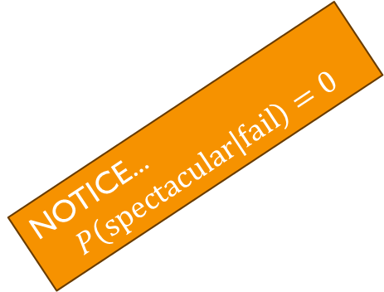
how to draw a marginal-Conditional Diagram
how well against an opposing military?
Step 3: Label and divide up the vertical sections to show the conditional uncertainties
barely acceptable
spectacular
$$\frac{1}{8}$$
abysmal
adequate
$$\frac{10}{20}$$
$$\frac{8}{20}$$
$$\frac{1}{20}$$
$$\frac{1}{20}$$
a coup attempt would...?
succeed
fail
succeed
a coup attempt would...?
$$\frac{7}{8}$$
$$\frac{1}{8}$$
fail
attempted coup would succeed
abysmal
abysmal
$$\frac{12}{20}$$
$$\frac{10}{20}$$
NOTICE...
$$P\left(\text{spectacular} | \text{fail}\right)=0$$
how well against an opposing military?
barely acceptable
$$\frac{8}{20}$$
$$\frac{7}{20}$$
how well against an opposing military?
barely acceptable
barely acceptable
spectacular
abysmal
adequate
attempted coup would fail
succeed
$$\frac{1}{20}$$
adequate
$$\frac{7}{8}$$
a coup attempt would...?
$$\frac{1}{20}$$
adequate
$$\frac{12}{20}$$
$$\frac{7}{20}$$
$$\frac{1}{20}$$
$$0$$
fail
$$\frac{1}{20}$$
spectacular

Slide 64
how to draw a marginal-Conditional Diagram
try it
two uncertainties:
Build a marginal-conditional diagram to model these two uncertainties. Design the model so that the more satisfied are residents, the more likely the commissioner is to be more powerful.
How much independent political power will the Commissioner of Sanitation amass?
How satisfied will residents be with the cleanliness of city streets and sidewalks?

Slide 65
how to draw a marginal-Conditional Diagram
try it
two uncertainties:
Build a marginal-conditional diagram to model these two uncertainties. Design the model so that the more satisfied are residents, the more likely the commissioner is to be more powerful.
How much independent political power will the Commissioner of Sanitation amass?
How satisfied will residents be with the cleanliness of city streets and sidewalks?

Slide 66
how to draw a marginal-Conditional Diagram
try it
Step 1: Draw a rectangle
two uncertainties:
Build a marginal-conditional diagram to model these two uncertainties. Design the model so that the more satisfied are residents, the more likely the commissioner is to be more powerful.
How much independent political power will the Commissioner of Sanitation amass?
How satisfied will residents be with the cleanliness of city streets and sidewalks?

Slide 67
how to draw a marginal-Conditional Diagram
try it
Step 2: Label and divide the horizontal axis to show marginal uncertainty
two uncertainties:
Build a marginal-conditional diagram to model these two uncertainties. Design the model so that the more satisfied are residents, the more likely the commissioner is to be more powerful.
How much independent political power will the Commissioner of Sanitation amass?
How satisfied will residents be with the cleanliness of city streets and sidewalks?

Slide 68









Review: The Marginal-Conditional Method
try it
two uncertainties:
How much independent political power will the Commissioner of Sanitation amass?
How satisfied will residents be with the cleanliness of city streets and sidewalks?
Use the marginal-conditional method to build a model of these two uncertainties in which a the more satisfied residents are, the more likely the Commissioner is to amass more power
how satisfied?
low
medium
high
very
$$0$$
satisfaction low
$$\frac{1}{12}$$
how powerful?
not much
$$1$$
how satisfied?
low
medium
high
$$\frac{8}{12}$$
very
$$\frac{1}{2}$$
satisfaction medium
how powerful?
not much
$$\frac{1}{2}$$
how satisfied?
low
medium
high
$$\frac{3}{12}$$
very
$$1$$
satisfaction high
how powerful?
not much
$$0$$

Slide 69
Review: The Marginal-Conditional Method
try it
two uncertainties:
I’m going to do this in the opposite order
(To show you that either order is ok!!!)
How much independent political power will the Commissioner of Sanitation amass?
How satisfied will residents be with the cleanliness of city streets and sidewalks?
Use the marginal-conditional method to build a model of these two uncertainties in which a the more satisfied residents are, the more likely the Commissioner is to amass more power
how satisfied?
low
medium
high
very
$$0$$
satisfaction low
$$\frac{1}{12}$$
how powerful?
not much
$$1$$
how satisfied?
low
medium
high
$$\frac{8}{12}$$
very
$$\frac{1}{2}$$
satisfaction medium
how powerful?
not much
$$\frac{1}{2}$$
how satisfied?
low
medium
high
$$\frac{3}{12}$$
very
$$1$$
satisfaction high
how powerful?
not much
$$0$$

Slide 70
how to draw a marginal-Conditional Diagram
try it
Step 2: Label and divide the horizontal axis to show marginal uncertainty
two uncertainties:
Build a marginal-conditional diagram to model these two uncertainties. Design the model so that the more satisfied are residents, the more likely the commissioner is to be more powerful.
How much independent political power will the Commissioner of Sanitation amass?
How satisfied will residents be with the cleanliness of city streets and sidewalks?
how much power?

Slide 71
how to draw a marginal-Conditional Diagram
try it
Step 2: Label and divide the horizontal axis to show marginal uncertainty
two uncertainties:
Build a marginal-conditional diagram to model these two uncertainties. Design the model so that the more satisfied are residents, the more likely the commissioner is to be more powerful.
How much independent political power will the Commissioner of Sanitation amass?
How satisfied will residents be with the cleanliness of city streets and sidewalks?
how much power?
Winnie the pooh
wicked witch of the west
godzilla

Slide 72



how to draw a marginal-Conditional Diagram
try it
Step 2: Label and divide the horizontal axis to show marginal uncertainty
two uncertainties:
Build a marginal-conditional diagram to model these two uncertainties. Design the model so that the more satisfied are residents, the more likely the commissioner is to be more powerful.
How much independent political power will the Commissioner of Sanitation amass?
How satisfied will residents be with the cleanliness of city streets and sidewalks?
how much power?
Winnie the pooh
$$\frac{1}{8}$$
wicked witch of the west
$$\frac{5}{8}$$
$$\frac{2}{8}$$
godzilla

Slide 73


how to draw a marginal-Conditional Diagram
try it
Step 2: Label and divide the horizontal axis to show marginal uncertainty
two uncertainties:
Build a marginal-conditional diagram to model these two uncertainties. Design the model so that the more satisfied are residents, the more likely the commissioner is to be more powerful.
How much independent political power will the Commissioner of Sanitation amass?
How satisfied will residents be with the cleanliness of city streets and sidewalks?
how much power?
Winnie the pooh
godzilla
$$\frac{1}{8}$$
wicked witch of the west
$$\frac{5}{8}$$
$$\frac{2}{8}$$
probabilities are proportions!!!!

Slide 74
how to draw a marginal-Conditional Diagram
try it
two uncertainties:
Step 3: Label and divide up the vertical sections to show the conditional uncertainties
Build a marginal-conditional diagram to model these two uncertainties. Design the model so that the more satisfied are residents, the more likely the commissioner is to be more powerful.
How much independent political power will the Commissioner of Sanitation amass?
How satisfied will residents be with the cleanliness of city streets and sidewalks?
how much power?
Winnie the pooh
godzilla
$$\frac{1}{8}$$
wicked witch of the west
$$\frac{5}{8}$$
$$\frac{2}{8}$$

Slide 75
how to draw a marginal-Conditional Diagram
try it
two uncertainties:
Step 3: Label and divide up the vertical sections to show the conditional uncertainties
Build a marginal-conditional diagram to model these two uncertainties. Design the model so that the more satisfied are residents, the more likely the commissioner is to be more powerful.
How much independent political power will the Commissioner of Sanitation amass?
How satisfied will residents be with the cleanliness of city streets and sidewalks?
how much power?
Winnie the pooh
godzilla
$$\frac{1}{8}$$
wicked witch of the west
$$\frac{5}{8}$$
$$\frac{2}{8}$$
how satisfied?

Slide 76

how to draw a marginal-Conditional Diagram
try it
two uncertainties:
Step 3: Label and divide up the vertical sections to show the conditional uncertainties
Build a marginal-conditional diagram to model these two uncertainties. Design the model so that the more satisfied are residents, the more likely the commissioner is to be more powerful.
How much independent political power will the Commissioner of Sanitation amass?
How satisfied will residents be with the cleanliness of city streets and sidewalks?
how much power?
Winnie the pooh
godzilla
wicked witch of the west
$$\frac{1}{8}$$
$$\frac{5}{8}$$
$$\frac{2}{8}$$
thrilled
how satisfied?
moderately
underwhelmed

Slide 77


how to draw a marginal-Conditional Diagram
try it
two uncertainties:
Step 3: Label and divide up the vertical sections to show the conditional uncertainties
Build a marginal-conditional diagram to model these two uncertainties. Design the model so that the more satisfied are residents, the more likely the commissioner is to be more powerful.
How much independent political power will the Commissioner of Sanitation amass?
How satisfied will residents be with the cleanliness of city streets and sidewalks?
how much power?
Winnie the pooh
godzilla
wicked witch of the west
$$\frac{1}{8}$$
$$\frac{5}{8}$$
$$\frac{2}{8}$$
$$\frac{1}{8}$$
thrilled
probabilities are proportions!!!!
moderately
$$\frac{2}{8}$$
how satisfied?
$$\frac{5}{8}$$
underwhelmed

Slide 78




how to draw a marginal-Conditional Diagram
try it
two uncertainties:
Step 3: Label and divide up the vertical sections to show the conditional uncertainties
Build a marginal-conditional diagram to model these two uncertainties. Design the model so that the more satisfied are residents, the more likely the commissioner is to be more powerful.
How much independent political power will the Commissioner of Sanitation amass?
How satisfied will residents be with the cleanliness of city streets and sidewalks?
how much power?
Winnie the pooh
godzilla
wicked witch of the west
$$\frac{1}{8}$$
$$\frac{5}{8}$$
$$\frac{2}{8}$$
$$\frac{1}{8}$$
thrilled
$$\frac{5}{16}$$
thrilled
$$\frac{2}{8}$$
$$\frac{3}{16}$$
moderately
moderately
how satisfied?
$$\frac{5}{8}$$
$$\frac{8}{16}$$
underwhelmed
underwhelmed

Slide 79




how to draw a marginal-Conditional Diagram
try it
two uncertainties:
Step 3: Label and divide up the vertical sections to show the conditional uncertainties
Build a marginal-conditional diagram to model these two uncertainties. Design the model so that the more satisfied are residents, the more likely the commissioner is to be more powerful.
How much independent political power will the Commissioner of Sanitation amass?
How satisfied will residents be with the cleanliness of city streets and sidewalks?
how much power?
Winnie the pooh
godzilla
wicked witch of the west
$$\frac{1}{8}$$
$$\frac{5}{8}$$
$$\frac{2}{8}$$
$$\frac{1}{8}$$
thrilled
$$\frac{5}{16}$$
thrilled
thrilled
$$\frac{11}{20}$$
$$\frac{2}{8}$$
$$\frac{3}{16}$$
moderately
moderately
how satisfied?
moderately
$$\frac{2}{20}$$
$$\frac{5}{8}$$
$$\frac{8}{16}$$
$$\frac{7}{20}$$
underwhelmed
underwhelmed
underwhelmed

Slide 80
how to draw a marginal-Conditional Diagram
try it
two uncertainties:
Build a marginal-conditional diagram to model these two uncertainties. Design the model so that the more satisfied are residents, the more likely the commissioner is to be more powerful.
How much independent political power will the Commissioner of Sanitation amass?
How satisfied will residents be with the cleanliness of city streets and sidewalks?
how much power?
Winnie the pooh
godzilla
wicked witch of the west
$$\frac{1}{8}$$
$$\frac{5}{8}$$
$$\frac{2}{8}$$
$$\frac{1}{8}$$
thrilled
$$\frac{5}{16}$$
thrilled
thrilled
$$\frac{11}{20}$$
$$\frac{2}{8}$$
$$\frac{3}{16}$$
moderately
moderately
how satisfied?
moderately
$$\frac{2}{20}$$
$$\frac{5}{8}$$
$$\frac{8}{16}$$
$$\frac{7}{20}$$
underwhelmed
underwhelmed
underwhelmed

Slide 81
Review: the Marginal-Conditional Method
Marginal-Conditional Diagrams: How to Draw One
Marginal-Conditional Diagrams: How to Compute with One

Slide 82
how to Compute With A marginal-Conditional Diagram

Slide 83
how to Compute With A marginal-Conditional Diagram
Compute what?

Slide 84
how to Compute With A marginal-Conditional Diagram
Compute what?
Is the defendant actually guilty?
guilty
innocent
convicted
Will the defendant be acquitted?
acquitted

Slide 85
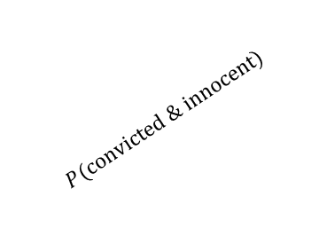
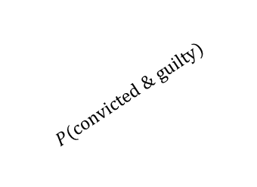
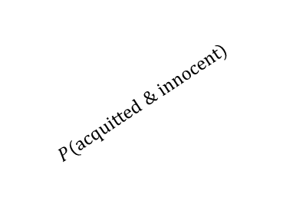
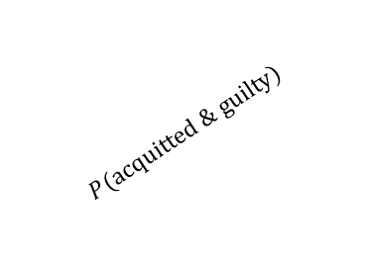
how to Compute With A marginal-Conditional Diagram
Compute what?
Is the defendant actually guilty?
guilty
innocent
convicted
$$P(\text{convicted}\text{ \& }\text{guilty}\text{)}$$
$$P(\text{convicted}\text{ \& }\text{innocent}\text{)}$$
Will the defendant be acquitted?
acquitted
$$P(\text{acquitted}\text{ \& }\text{guilty}\text{)}$$
$$P(\text{acquitted}\text{ \& }\text{innocent}\text{)}$$

Slide 86


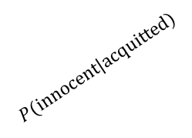
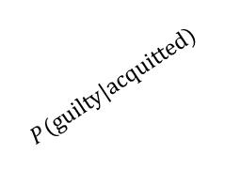
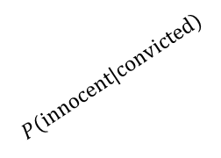
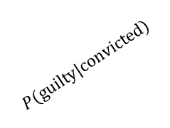
how to Compute With A marginal-Conditional Diagram
Compute what?
guilty
innocent
Is the defendant actually guilty?
convicted
$$P(\text{convicted}\text{)}$$
convicted
$$P(\text{guilty}\text{|}\text{convicted}\text{)}$$
$$P(\text{innocent}\text{|}\text{convicted}\text{)}$$
guilty
innocent
convicted
$$P(\text{convicted}\text{ \& }\text{guilty}\text{)}$$
$$P(\text{convicted}\text{ \& }\text{innocent}\text{)}$$
acquitted
$$P(\text{aquitted}\text{)}$$
guilty
innocent
Will the defendant be acquitted?
acquitted
convicted
$$P(\text{acquitted}\text{ \& }\text{guilty}\text{)}$$
$$P(\text{acquitted}\text{ \& }\text{innocent}\text{)}$$
acquitted
$$P(\text{guilty}\text{|}\text{acquitted}\text{)}$$
$$P(\text{innocent}\text{|}\text{acquitted}\text{)}$$

Slide 87



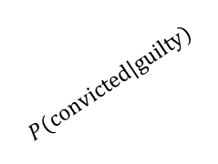
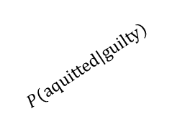

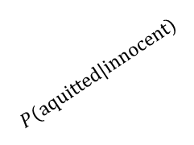
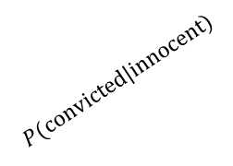
how to Compute With A marginal-Conditional Diagram
Compute what?
guilty
innocent
Is the defendant actually guilty?
convicted
$$P(\text{convicted}\text{)}$$
convicted
$$P(\text{guilty}\text{|}\text{convicted}\text{)}$$
$$P(\text{innocent}\text{|}\text{convicted}\text{)}$$
guilty
innocent
acquitted
convicted
$$P(\text{convicted}\text{ \& }\text{guilty}\text{)}$$
$$P(\text{convicted}\text{ \& }\text{innocent}\text{)}$$
acquitted
$$P(\text{aquitted}\text{)}$$
guilty
innocent
Will the defendant be acquitted?
acquitted
convicted
$$P(\text{acquitted}\text{ \& }\text{guilty}\text{)}$$
$$P(\text{acquitted}\text{ \& }\text{innocent}\text{)}$$
innocent
$$P(\text{innocent}\text{)}$$
acquitted
$$P(\text{guilty}\text{|}\text{acquitted}\text{)}$$
$$P(\text{innocent}\text{|}\text{acquitted}\text{)}$$
guilty
innocent
guilty
innocent
convicted
guilty
$$P(\text{guilty}\text{)}$$
convicted
$$P(\text{convicted}\text{|}\text{innocent}\text{)}$$
$$P(\text{convicted}\text{|}\text{guilty}\text{)}$$
acquitted
$$P(\text{aquitted}\text{|}\text{guilty}\text{)}$$
acquitted
$$P(\text{aquitted}\text{|}\text{innocent}\text{)}$$

Slide 88


how to Compute With A marginal-Conditional Diagram
All of these probabilities are related to one another
Compute what?
guilty
innocent
Is the defendant actually guilty?
convicted
$$P(\text{convicted}\text{)}$$
convicted
$$P(\text{guilty}\text{|}\text{convicted}\text{)}$$
$$P(\text{innocent}\text{|}\text{convicted}\text{)}$$
guilty
innocent
Joint Probability
Marginal Probability
acquitted
convicted
$$P(\text{convicted}\text{ \& }\text{guilty}\text{)}$$
$$P(\text{convicted}\text{ \& }\text{innocent}\text{)}$$
acquitted
$$P(\text{aquitted}\text{)}$$
guilty
innocent
Will the defendant be acquitted?
acquitted
Marginal Probability
convicted
$$P(\text{acquitted}\text{ \& }\text{guilty}\text{)}$$
$$P(\text{acquitted}\text{ \& }\text{innocent}\text{)}$$
Joint Probability
Conditional Probability
innocent
$$P(\text{innocent}\text{)}$$
acquitted
$$P(\text{guilty}\text{|}\text{acquitted}\text{)}$$
$$P(\text{innocent}\text{|}\text{acquitted}\text{)}$$
guilty
innocent
guilty
innocent
convicted
guilty
$$P(\text{guilty}\text{)}$$
convicted
$$P(\text{convicted}\text{|}\text{innocent}\text{)}$$
$$P(\text{convicted}\text{|}\text{guilty}\text{)}$$
acquitted
$$P(\text{aquitted}\text{|}\text{guilty}\text{)}$$
acquitted
$$P(\text{aquitted}\text{|}\text{innocent}\text{)}$$

Slide 89
how to Compute With A marginal-Conditional Diagram
All of these probabilities are related to one another
Compute what?
guilty
innocent
Is the defendant actually guilty?
convicted
$$P(\text{convicted}\text{)}$$
convicted
$$P(\text{guilty}\text{|}\text{convicted}\text{)}$$
$$P(\text{innocent}\text{|}\text{convicted}\text{)}$$
guilty
innocent
Joint Probability
Marginal Probability
acquitted
convicted
$$P(\text{convicted}\text{ \& }\text{innocent}\text{)}$$
$$P(\text{convicted}\text{ \& }\text{guilty}\text{)}$$
$$P\left(X\&Y_{1}\right)+P\left(X\&Y_{2}\right)+⋯+P\left(X\&Y_{N}\right)=P(X)$$
acquitted
$$P(\text{aquitted}\text{)}$$
guilty
innocent
Will the defendant be acquitted?
acquitted
Marginal Probability
convicted
$$P(\text{acquitted}\text{ \& }\text{guilty}\text{)}$$
$$P(\text{acquitted}\text{ \& }\text{innocent}\text{)}$$
Joint Probability
Conditional Probability
innocent
$$P(\text{innocent}\text{)}$$
acquitted
$$P(\text{guilty}\text{|}\text{acquitted}\text{)}$$
$$P(\text{innocent}\text{|}\text{acquitted}\text{)}$$
guilty
innocent
guilty
innocent
convicted
guilty
$$P(\text{guilty}\text{)}$$
convicted
$$P(\text{convicted}\text{|}\text{innocent}\text{)}$$
$$P(\text{convicted}\text{|}\text{guilty}\text{)}$$
acquitted
$$P(\text{aquitted}\text{|}\text{guilty}\text{)}$$
acquitted
$$P(\text{aquitted}\text{|}\text{innocent}\text{)}$$

Slide 90
how to Compute With A marginal-Conditional Diagram
All of these probabilities are related to one another
Compute what?
guilty
innocent
Is the defendant actually guilty?
convicted
$$P(\text{convicted}\text{)}$$
convicted
$$P(\text{guilty}\text{|}\text{convicted}\text{)}$$
$$P(\text{innocent}\text{|}\text{convicted}\text{)}$$
guilty
innocent
Joint Probability
Marginal Probability
acquitted
convicted
$$P(\text{convicted}\text{ \& }\text{innocent}\text{)}$$
$$P(\text{convicted}\text{ \& }\text{guilty}\text{)}$$
$$P\left(X\&Y_{1}\right)+P\left(X\&Y_{2}\right)+⋯+P\left(X\&Y_{N}\right)=P(X)$$
acquitted
$$P(\text{aquitted}\text{)}$$
guilty
innocent
Will the defendant be acquitted?
acquitted
Marginal Probability
convicted
$$P(\text{acquitted}\text{ \& }\text{guilty}\text{)}$$
$$P(\text{acquitted}\text{ \& }\text{innocent}\text{)}$$
Joint Probability
Conditional Probability
innocent
$$P(\text{innocent}\text{)}$$
acquitted
$$P(\text{guilty}\text{|}\text{acquitted}\text{)}$$
$$P(\text{innocent}\text{|}\text{acquitted}\text{)}$$
$$P\left(X\&Y\right)=P\left(X\right)P\left(X | Y\right)=P\left(Y\right)P(Y|X)$$
guilty
innocent
guilty
innocent
convicted
guilty
$$P(\text{guilty}\text{)}$$
convicted
$$P(\text{convicted}\text{|}\text{innocent}\text{)}$$
$$P(\text{convicted}\text{|}\text{guilty}\text{)}$$
acquitted
$$P(\text{aquitted}\text{|}\text{guilty}\text{)}$$
acquitted
$$P(\text{aquitted}\text{|}\text{innocent}\text{)}$$

Slide 91
how to Compute With A marginal-Conditional Diagram
All of these probabilities are related to one another
Compute what?
guilty
innocent
Is the defendant actually guilty?
convicted
$$P(\text{convicted}\text{)}$$
convicted
$$P(\text{guilty}\text{|}\text{convicted}\text{)}$$
$$P(\text{innocent}\text{|}\text{convicted}\text{)}$$
guilty
innocent
Joint Probability
Marginal Probability
acquitted
convicted
$$P(\text{convicted}\text{ \& }\text{innocent}\text{)}$$
$$P(\text{convicted}\text{ \& }\text{guilty}\text{)}$$
$$P\left(X\&Y_{1}\right)+P\left(X\&Y_{2}\right)+⋯+P\left(X\&Y_{N}\right)=P(X)$$
acquitted
$$P(\text{aquitted}\text{)}$$
For instance: $P(\text{guilty}\text{ \& }\text{acquitted}\text{)}+P(\text{guilty}\text{ \& }\text{convicted}\text{)}=P(\text{guilty}\text{)}$
guilty
innocent
Will the defendant be acquitted?
acquitted
Marginal Probability
convicted
$$P(\text{acquitted}\text{ \& }\text{guilty}\text{)}$$
$$P(\text{acquitted}\text{ \& }\text{innocent}\text{)}$$
Joint Probability
Conditional Probability
innocent
$$P(\text{innocent}\text{)}$$
acquitted
$$P(\text{guilty}\text{|}\text{acquitted}\text{)}$$
$$P(\text{innocent}\text{|}\text{acquitted}\text{)}$$
$$P\left(X\&Y\right)=P\left(X\right)P\left(X | Y\right)=P\left(Y\right)P(Y|X)$$
guilty
innocent
guilty
innocent
For instance: $P\left(\text{guilty}\text{ \& }\text{acquitted}\right)=P(\text{guilty}\text{)}P(\text{acquitted}\text{|}\text{guilty})$
convicted
guilty
$$P(\text{guilty}\text{)}$$
convicted
$$P(\text{convicted}\text{|}\text{innocent}\text{)}$$
$$P(\text{convicted}\text{|}\text{guilty}\text{)}$$
acquitted
$$P(\text{aquitted}\text{|}\text{guilty}\text{)}$$
acquitted
$$P(\text{aquitted}\text{|}\text{innocent}\text{)}$$

Slide 92
how to Compute With A marginal-Conditional Diagram
For instance: Suppose we use the marginal conditional method to build this model, like this:
Compute what?
guilty
innocent
Is the defendant actually guilty?
convicted
$$P(\text{convicted}\text{)}$$
convicted
$$P(\text{guilty}\text{|}\text{convicted}\text{)}$$
$$P(\text{innocent}\text{|}\text{convicted}\text{)}$$
guilty
innocent
acquitted
convicted
$$P(\text{convicted}\text{ \& }\text{guilty}\text{)}$$
$$P(\text{convicted}\text{ \& }\text{innocent}\text{)}$$
acquitted
$$P(\text{aquitted}\text{)}$$
guilty
innocent
Will the defendant be acquitted?
acquitted
convicted
$$P(\text{acquitted}\text{ \& }\text{guilty}\text{)}$$
$$P(\text{acquitted}\text{ \& }\text{innocent}\text{)}$$
innocent
$$P(\text{innocent}\text{)}$$
acquitted
$$P(\text{guilty}\text{|}\text{acquitted}\text{)}$$
$$P(\text{innocent}\text{|}\text{acquitted}\text{)}$$
guilty
innocent
guilty
innocent
convicted
guilty
$$P(\text{guilty}\text{)}$$
convicted
$$P(\text{convicted}\text{|}\text{innocent}\text{)}$$
$$P(\text{convicted}\text{|}\text{guilty}\text{)}$$
acquitted
$$P(\text{aquitted}\text{|}\text{guilty}\text{)}$$
acquitted
$$P(\text{aquitted}\text{|}\text{innocent}\text{)}$$

Slide 93


how to Compute With A marginal-Conditional Diagram
For instance: Suppose we use the marginal conditional method to build this model, like this:
Compute what?
guilty
innocent
Is the defendant actually guilty?
convicted
$$P(\text{guilty}\text{|}\text{convicted}\text{)}$$
$$P(\text{innocent}\text{|}\text{convicted}\text{)}$$
guilty
innocent
convicted
$$\frac{1}{4}$$
acquitted
convicted
$$P(\text{convicted}\text{ \& }\text{guilty}\text{)}$$
$$P(\text{convicted}\text{ \& }\text{innocent}\text{)}$$
acquitted
$$\frac{3}{4}$$
guilty
innocent
Will the defendant be acquitted?
acquitted
convicted
$$P(\text{acquitted}\text{ \& }\text{guilty}\text{)}$$
$$P(\text{acquitted}\text{ \& }\text{innocent}\text{)}$$
innocent
$$P(\text{innocent}\text{)}$$
acquitted
$$P(\text{guilty}\text{|}\text{acquitted}\text{)}$$
$$P(\text{innocent}\text{|}\text{acquitted}\text{)}$$
guilty
innocent
guilty
innocent
convicted
guilty
$$P(\text{guilty}\text{)}$$
convicted
$$P(\text{convicted}\text{|}\text{innocent}\text{)}$$
$$P(\text{convicted}\text{|}\text{guilty}\text{)}$$
acquitted
$$P(\text{aquitted}\text{|}\text{guilty}\text{)}$$
acquitted
$$P(\text{aquitted}\text{|}\text{innocent}\text{)}$$

Slide 94


how to Compute With A marginal-Conditional Diagram
For instance: Suppose we use the marginal conditional method to build this model, like this:
Compute what?
guilty
innocent
Is the defendant actually guilty?
convicted
$$\frac{9}{16}$$
$$\frac{7}{16}$$
guilty
innocent
convicted
$$\frac{1}{4}$$
acquitted
convicted
$$P(\text{convicted}\text{ \& }\text{guilty}\text{)}$$
$$P(\text{convicted}\text{ \& }\text{innocent}\text{)}$$
acquitted
$$\frac{3}{4}$$
guilty
innocent
Will the defendant be acquitted?
acquitted
convicted
$$P(\text{acquitted}\text{ \& }\text{guilty}\text{)}$$
$$P(\text{acquitted}\text{ \& }\text{innocent}\text{)}$$
innocent
$$P(\text{innocent}\text{)}$$
acquitted
$$P(\text{guilty}\text{|}\text{acquitted}\text{)}$$
$$P(\text{innocent}\text{|}\text{acquitted}\text{)}$$
guilty
innocent
guilty
innocent
convicted
guilty
$$P(\text{guilty}\text{)}$$
convicted
$$P(\text{convicted}\text{|}\text{innocent}\text{)}$$
$$P(\text{convicted}\text{|}\text{guilty}\text{)}$$
acquitted
$$P(\text{aquitted}\text{|}\text{guilty}\text{)}$$
acquitted
$$P(\text{aquitted}\text{|}\text{innocent}\text{)}$$

Slide 95


how to Compute With A marginal-Conditional Diagram
For instance: Suppose we use the marginal conditional method to build this model, like this:
Compute what?
guilty
innocent
Is the defendant actually guilty?
convicted
$$\frac{9}{16}$$
$$\frac{7}{16}$$
guilty
innocent
convicted
$$\frac{1}{4}$$
acquitted
convicted
$$P(\text{convicted}\text{ \& }\text{guilty}\text{)}$$
$$P(\text{convicted}\text{ \& }\text{innocent}\text{)}$$
acquitted
$$\frac{3}{4}$$
guilty
innocent
Will the defendant be acquitted?
acquitted
convicted
$$P(\text{acquitted}\text{ \& }\text{guilty}\text{)}$$
$$P(\text{acquitted}\text{ \& }\text{innocent}\text{)}$$
innocent
$$P(\text{innocent}\text{)}$$
acquitted
$$\frac{2}{10}$$
$$\frac{8}{10}$$
guilty
innocent
guilty
innocent
convicted
guilty
$$P(\text{guilty}\text{)}$$
convicted
$$P(\text{convicted}\text{|}\text{innocent}\text{)}$$
$$P(\text{convicted}\text{|}\text{guilty}\text{)}$$
acquitted
$$P(\text{aquitted}\text{|}\text{guilty}\text{)}$$
acquitted
$$P(\text{aquitted}\text{|}\text{innocent}\text{)}$$

Slide 96
how to Compute With A marginal-Conditional Diagram
For instance: Suppose we use the marginal conditional method to build this model, like this:
Compute what?
guilty
innocent
Is the defendant actually guilty?
convicted
$$\frac{9}{16}$$
$$\frac{7}{16}$$
guilty
innocent
convicted
$$\frac{1}{4}$$
acquitted
convicted
$$P(\text{convicted}\text{ \& }\text{guilty}\text{)}$$
$$P(\text{convicted}\text{ \& }\text{innocent}\text{)}$$
acquitted
$$\frac{3}{4}$$
guilty
innocent
Will the defendant be acquitted?
acquitted
convicted
$$P(\text{acquitted}\text{ \& }\text{guilty}\text{)}$$
$$P(\text{acquitted}\text{ \& }\text{innocent}\text{)}$$
innocent
$$P(\text{innocent}\text{)}$$
acquitted
$$\frac{2}{10}$$
$$\frac{8}{10}$$
guilty
innocent
guilty
innocent
With those probabilities specified, we can compute all of these!
convicted
guilty
$$P(\text{guilty}\text{)}$$
convicted
$$P(\text{convicted}\text{|}\text{innocent}\text{)}$$
$$P(\text{convicted}\text{|}\text{guilty}\text{)}$$
acquitted
$$P(\text{aquitted}\text{|}\text{guilty}\text{)}$$
acquitted
$$P(\text{aquitted}\text{|}\text{innocent}\text{)}$$

Slide 97
how to Compute With A marginal-Conditional Diagram
Remember: Probabilities are Proportions!

Slide 98
how to Compute With A marginal-Conditional Diagram
Remember: Probabilities are Proportions!

Slide 99
how to Compute With A marginal-Conditional Diagram
Remember: Probabilities are Proportions!
what will be the outcome of the trial?

Slide 100
how to Compute With A marginal-Conditional Diagram
Remember: Probabilities are Proportions!
what will be the outcome of the trial?
(fixed space!)

Slide 101
how to Compute With A marginal-Conditional Diagram
Remember: Probabilities are Proportions!
what will be the outcome of the trial?
(fixed space!)
acquittal
hung jury
conviction

Slide 102



how to Compute With A marginal-Conditional Diagram
Remember: Probabilities are Proportions!
what will be the outcome of the trial?
acquittal
hung jury
conviction
$$\frac{6}{16}$$
$$\frac{7}{16}$$
$$\frac{3}{16}$$

Slide 103
how to Compute With A marginal-Conditional Diagram
Remember: Probabilities are Proportions!
what will be the outcome of the trial?
acquittal
hung jury
conviction
$$\frac{6}{16}$$
$$\frac{7}{16}$$
$$\frac{3}{16}$$
is the defendant actually guilty?

Slide 104
how to Compute With A marginal-Conditional Diagram
Remember: Probabilities are Proportions!
what will be the outcome of the trial?
acquittal
hung jury
conviction
$$\frac{6}{16}$$
$$\frac{7}{16}$$
$$\frac{3}{16}$$
(fixed space!)
is the defendant actually guilty?

Slide 105


how to Compute With A marginal-Conditional Diagram
Remember: Probabilities are Proportions!
what will be the outcome of the trial?
acquittal
hung jury
conviction
$$\frac{6}{16}$$
$$\frac{7}{16}$$
$$\frac{3}{16}$$
$$\frac{2}{10}$$
guilty
(fixed space!)
is the defendant actually guilty?
$$\frac{8}{10}$$
innocent

Slide 106
how to Compute With A marginal-Conditional Diagram
Remember: Probabilities are Proportions!
what will be the outcome of the trial?
acquittal
hung jury
conviction
$$\frac{6}{16}$$
$$\frac{7}{16}$$
$$\frac{3}{16}$$
$$\frac{2}{10}$$
guilty
(fixed space!)
is the defendant actually guilty?
$$\frac{8}{10}$$
innocent

Slide 107


how to Compute With A marginal-Conditional Diagram
Remember: Probabilities are Proportions!
what will be the outcome of the trial?
acquittal
hung jury
conviction
$$\frac{6}{16}$$
$$\frac{7}{16}$$
$$\frac{3}{16}$$
$$\frac{2}{10}$$
guilty
$$\frac{1}{2}$$
guilty
(fixed space!)
is the defendant actually guilty?
$$\frac{8}{10}$$
innocent
$$\frac{1}{2}$$
innocent

Slide 108
how to Compute With A marginal-Conditional Diagram
Remember: Probabilities are Proportions!
what will be the outcome of the trial?
acquittal
hung jury
conviction
$$\frac{6}{16}$$
$$\frac{7}{16}$$
$$\frac{3}{16}$$
$$\frac{2}{10}$$
guilty
$$\frac{1}{2}$$
guilty
(fixed space!)
is the defendant actually guilty?
$$\frac{8}{10}$$
innocent
$$\frac{1}{2}$$
innocent

Slide 109


how to Compute With A marginal-Conditional Diagram
Remember: Probabilities are Proportions!
what will be the outcome of the trial?
acquittal
hung jury
conviction
$$\frac{6}{16}$$
$$\frac{7}{16}$$
$$\frac{3}{16}$$
$$\frac{2}{10}$$
guilty
guilty
$$\frac{1}{2}$$
guilty
$$\frac{7}{11}$$
(fixed space!)
is the defendant actually guilty?
$$\frac{8}{10}$$
innocent
$$\frac{1}{2}$$
innocent
$$\frac{5}{11}$$
innocent

Slide 110
how to Compute With A marginal-Conditional Diagram
Remember: Probabilities are Proportions!
what will be the outcome of the trial?
acquittal
hung jury
conviction
Remember...
$$\frac{6}{16}$$
$$\frac{7}{16}$$
$$\frac{3}{16}$$
$$\frac{2}{10}$$
guilty
guilty
$$\frac{1}{2}$$
guilty
$$\frac{7}{11}$$
is the defendant actually guilty?
$$\frac{8}{10}$$
innocent
$$\frac{1}{2}$$
innocent
$$\frac{5}{11}$$
innocent

Slide 111
how to Compute With A marginal-Conditional Diagram
Remember: Probabilities are Proportions!
what will be the outcome of the trial?
acquittal
hung jury
conviction
Remember...
$$\frac{6}{16}$$
$$\frac{7}{16}$$
$$\frac{3}{16}$$
$$\frac{2}{10}$$
these are MARGINAL probabilities
guilty
guilty
$$\frac{1}{2}$$
guilty
$$\frac{7}{11}$$
these are CONDITIONAL probabilities
is the defendant actually guilty?
$$\frac{8}{10}$$
innocent
$$\frac{1}{2}$$
innocent
$$\frac{5}{11}$$
innocent

Slide 112
how to Compute With A marginal-Conditional Diagram
Remember: Probabilities are Proportions!
what will be the outcome of the trial?
acquittal
hung jury
conviction
Remember...
$$\frac{6}{16}$$
$$\frac{7}{16}$$
$$\frac{3}{16}$$
$$\frac{2}{10}$$
these are MARGINAL probabilities
guilty
guilty
$$\frac{1}{2}$$
guilty
$$\frac{7}{11}$$
these are CONDITIONAL probabilities
is the defendant actually guilty?
$$\frac{8}{10}$$
innocent
$$\frac{1}{2}$$
innocent
$$\frac{5}{11}$$
innocent

Slide 113
how to Compute With A marginal-Conditional Diagram
Remember: Probabilities are Proportions!
what will be the outcome of the trial?
things to compute
acquittal
hung jury
conviction
joint probabilities
marginal probabilities
conditional probabilities
$$\frac{6}{16}$$
$$\frac{7}{16}$$
$$\frac{3}{16}$$
$$\frac{2}{10}$$
guilty
guilty
$$\frac{1}{2}$$
guilty
$$\frac{7}{11}$$
is the defendant actually guilty?
$$\frac{8}{10}$$
innocent
$$\frac{1}{2}$$
innocent
$$\frac{5}{11}$$
innocent

Slide 114

how to Compute With A marginal-Conditional Diagram
Remember: Probabilities are Proportions!
what will be the outcome of the trial?
things to compute
acquittal
hung jury
conviction
joint probabilities
marginal probabilities
conditional probabilities
$$\frac{6}{16}$$
$$\frac{7}{16}$$
$$\frac{3}{16}$$
$$\frac{2}{10}$$
guilty
Example: $P(\text{innocent}\text{ \& }\text{conviction}\text{)}$
guilty
$$\frac{1}{2}$$
guilty
$$\frac{7}{11}$$
is the defendant actually guilty?
$$\frac{8}{10}$$
innocent
$$\frac{1}{2}$$
innocent
$$\frac{5}{11}$$
innocent

Slide 115
how to Compute With A marginal-Conditional Diagram
Remember: Probabilities are Proportions!
what will be the outcome of the trial?
things to compute
acquittal
hung jury
conviction
joint probabilities
marginal probabilities
conditional probabilities
$$\frac{6}{16}$$
$$\frac{7}{16}$$
$$\frac{3}{16}$$
$$\frac{2}{10}$$
guilty
Example: $P(\text{innocent}\text{ \& }\text{conviction}\text{)}$
guilty
$$\frac{1}{2}$$
guilty
$$\frac{7}{11}$$
Notice that each subsection of the rectangle corresponds to exactly one joint event, and together they cover the exhaustive list of joint events!
is the defendant actually guilty?
$$\frac{8}{10}$$
innocent
$$\frac{1}{2}$$
innocent
$$\frac{5}{11}$$
innocent

Slide 116
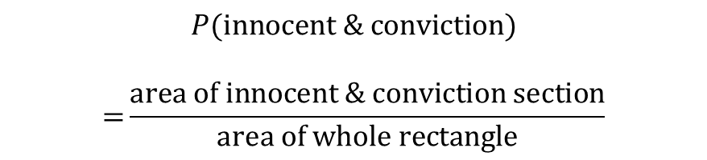
how to Compute With A marginal-Conditional Diagram
Remember: Probabilities are Proportions!
what will be the outcome of the trial?
things to compute
acquittal
hung jury
conviction
joint probabilities
marginal probabilities
conditional probabilities
$$\frac{6}{16}$$
$$\frac{7}{16}$$
$$\frac{3}{16}$$
$$\frac{2}{10}$$
guilty
Example: $P(\text{innocent}\text{ \& }\text{conviction}\text{)}$
guilty
$$\frac{1}{2}$$
guilty
$$\frac{7}{11}$$
$$P(\text{innocent}\text{ \& }\text{conviction}\text{)}$$ $$\text{=}\frac{\text{area} \text{of} \text{innocent}\text{ \& }\text{conviction} \text{section}}{\text{area} \text{of} \text{whole} \text{rectangle}}$$
is the defendant actually guilty?
$$\frac{8}{10}$$
innocent
$$\frac{1}{2}$$
innocent
$$\frac{5}{11}$$
innocent

Slide 117
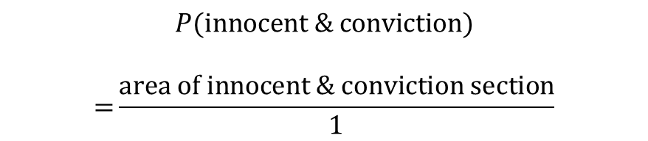
how to Compute With A marginal-Conditional Diagram
Remember: Probabilities are Proportions!
what will be the outcome of the trial?
things to compute
acquittal
hung jury
conviction
joint probabilities
marginal probabilities
conditional probabilities
$$\frac{6}{16}$$
$$\frac{7}{16}$$
$$\frac{3}{16}$$
$$\frac{2}{10}$$
guilty
Example: $P(\text{innocent}\text{ \& }\text{conviction}\text{)}$
guilty
$$\frac{1}{2}$$
guilty
$$\frac{7}{11}$$
$$P(\text{innocent}\text{ \& }\text{conviction}\text{)}$$ $$\text{=}\frac{\text{area} \text{of} \text{innocent}\text{ \& }\text{conviction} \text{section}}{\text{1}}$$
is the defendant actually guilty?
$$\frac{8}{10}$$
innocent
$$\frac{1}{2}$$
innocent
$$\frac{5}{11}$$
innocent

Slide 118

how to Compute With A marginal-Conditional Diagram
Remember: Probabilities are Proportions!
what will be the outcome of the trial?
things to compute
acquittal
hung jury
conviction
joint probabilities
marginal probabilities
conditional probabilities
$$\frac{6}{16}$$
$$\frac{7}{16}$$
$$\frac{3}{16}$$
$$\frac{2}{10}$$
guilty
Example: $P(\text{innocent}\text{ \& }\text{conviction}\text{)}$
guilty
$$\frac{1}{2}$$
guilty
$$\frac{7}{11}$$
$$P(\text{innocent}\text{ \& }\text{conviction}\text{)}$$ $$\text{=}\frac{\frac{3}{16}×\frac{5}{11}}{\text{1}}$$
is the defendant actually guilty?
$$\frac{8}{10}$$
innocent
$$\frac{1}{2}$$
innocent
$$\frac{5}{11}$$
innocent

Slide 119










how to Compute With A marginal-Conditional Diagram
Remember: Probabilities are Proportions!
what will be the outcome of the trial?
things to compute
acquittal
hung jury
conviction
joint probabilities
marginal probabilities
conditional probabilities
$$\frac{6}{16}$$
$$\frac{7}{16}$$
$$\frac{3}{16}$$
$$\frac{2}{10}$$
guilty
TRY IT: $P(\text{guilty}\text{ \& }\text{hung} \text{jury}\text{)}$
guilty
$$\frac{1}{2}$$
guilty
$$\frac{7}{11}$$
is the defendant actually guilty?
$$\frac{8}{10}$$
innocent
$$\frac{1}{2}$$
innocent
$$\frac{5}{11}$$
innocent

Slide 120
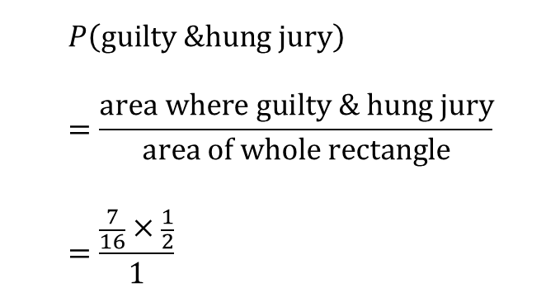
how to Compute With A marginal-Conditional Diagram
Remember: Probabilities are Proportions!
what will be the outcome of the trial?
things to compute
acquittal
hung jury
conviction
joint probabilities
marginal probabilities
conditional probabilities
$$\frac{6}{16}$$
$$\frac{7}{16}$$
$$\frac{3}{16}$$
$$\frac{2}{10}$$
guilty
TRY IT: $P(\text{guilty}\text{ \& }\text{hung} \text{jury}\text{)}$
guilty
$$\frac{1}{2}$$
guilty
$$\frac{7}{11}$$
$$P\left(\text{guilty}\text{ \&}\text{hung} \text{jury}\right)=\frac{\text{area} \text{where} \text{guilty}\text{ \& }\text{hung} \text{jury}}{\text{area} \text{of} \text{whole} \text{rectangle}} \\ =\frac{\frac{7}{16}×\frac{1}{2}}{1}$$
is the defendant actually guilty?
$$\frac{8}{10}$$
innocent
$$\frac{1}{2}$$
innocent
$$\frac{5}{11}$$
innocent

Slide 121
how to Compute With A marginal-Conditional Diagram
Remember: Probabilities are Proportions!
what will be the outcome of the trial?
things to compute
acquittal
hung jury
conviction
joint probabilities
marginal probabilities
conditional probabilities
$$\frac{6}{16}$$
$$\frac{7}{16}$$
$$\frac{3}{16}$$
$$\frac{2}{10}$$
guilty
guilty
$$\frac{1}{2}$$
guilty
$$\frac{7}{11}$$
is the defendant actually guilty?
$$\frac{8}{10}$$
innocent
$$\frac{1}{2}$$
innocent
$$\frac{5}{11}$$
innocent

Slide 122

how to Compute With A marginal-Conditional Diagram
Remember: Probabilities are Proportions!
what will be the outcome of the trial?
things to compute
acquittal
hung jury
conviction
joint probabilities
marginal probabilities
conditional probabilities
$$\frac{6}{16}$$
$$\frac{7}{16}$$
$$\frac{3}{16}$$
$$\frac{2}{10}$$
guilty
Example: $P(\text{innocent}\text{)}$
guilty
$$\frac{1}{2}$$
guilty
$$\frac{7}{11}$$
is the defendant actually guilty?
$$\frac{8}{10}$$
innocent
$$\frac{1}{2}$$
innocent
$$\frac{5}{11}$$
innocent

Slide 123
how to Compute With A marginal-Conditional Diagram
Remember: Probabilities are Proportions!
what will be the outcome of the trial?
things to compute
acquittal
hung jury
conviction
joint probabilities
marginal probabilities
conditional probabilities
$$\frac{6}{16}$$
$$\frac{7}{16}$$
$$\frac{3}{16}$$
$$\frac{2}{10}$$
guilty
Example: $P(\text{innocent}\text{)}$
guilty
$$\frac{1}{2}$$
guilty
$$\frac{7}{11}$$
Notice that we can divide the rectangle into two pieces – one covering the events in which the defendant is innocent, one covering the events in which the defendant is guilty.
is the defendant actually guilty?
$$\frac{8}{10}$$
innocent
$$\frac{1}{2}$$
innocent
$$\frac{5}{11}$$
innocent

Slide 124
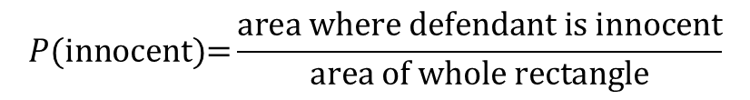
how to Compute With A marginal-Conditional Diagram
Remember: Probabilities are Proportions!
what will be the outcome of the trial?
things to compute
acquittal
hung jury
conviction
joint probabilities
marginal probabilities
conditional probabilities
$$\frac{6}{16}$$
$$\frac{7}{16}$$
$$\frac{3}{16}$$
$$\frac{2}{10}$$
guilty
Example: $P(\text{innocent}\text{)}$
guilty
$$\frac{1}{2}$$
guilty
$$\frac{7}{11}$$
$$P(\text{innocent}\text{)=}\frac{\text{area} \text{where} \text{defendant} \text{is} \text{innocent}}{\text{area} \text{of} \text{whole} \text{rectangle}}$$
is the defendant actually guilty?
$$\frac{8}{10}$$
innocent
$$\frac{1}{2}$$
innocent
$$\frac{5}{11}$$
innocent

Slide 125
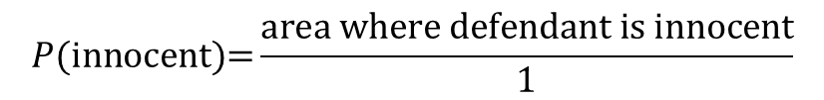
how to Compute With A marginal-Conditional Diagram
Remember: Probabilities are Proportions!
what will be the outcome of the trial?
things to compute
acquittal
hung jury
conviction
joint probabilities
marginal probabilities
conditional probabilities
$$\frac{6}{16}$$
$$\frac{7}{16}$$
$$\frac{3}{16}$$
$$\frac{2}{10}$$
guilty
Example: $P(\text{innocent}\text{)}$
guilty
$$\frac{1}{2}$$
guilty
$$\frac{7}{11}$$
$$P(\text{innocent}\text{)=}\frac{\text{area} \text{where} \text{defendant} \text{is} \text{innocent}}{1}$$
is the defendant actually guilty?
$$\frac{8}{10}$$
innocent
$$\frac{1}{2}$$
innocent
$$\frac{5}{11}$$
innocent

Slide 126

how to Compute With A marginal-Conditional Diagram
Remember: Probabilities are Proportions!
what will be the outcome of the trial?
things to compute
acquittal
hung jury
conviction
joint probabilities
marginal probabilities
conditional probabilities
$$\frac{6}{16}$$
$$\frac{7}{16}$$
$$\frac{3}{16}$$
$$\frac{2}{10}$$
guilty
Example: $P(\text{innocent}\text{)}$
guilty
$$\frac{1}{2}$$
guilty
$$\frac{7}{11}$$
$$P(\text{innocent}\text{)=}\frac{\frac{6}{16}×\frac{8}{10}+\frac{7}{16}×\frac{1}{2}+\frac{3}{16}×\frac{5}{11}}{1}$$
is the defendant actually guilty?
$$\frac{8}{10}$$
innocent
$$\frac{1}{2}$$
innocent
$$\frac{5}{11}$$
innocent

Slide 127


how to Compute With A marginal-Conditional Diagram
Remember: Probabilities are Proportions!
what will be the outcome of the trial?
things to compute
acquittal
hung jury
conviction
joint probabilities
marginal probabilities
conditional probabilities
$$\frac{6}{16}$$
$$\frac{7}{16}$$
$$\frac{3}{16}$$
$$\frac{2}{10}$$
guilty
Example: $P(\text{innocent}\text{)}$
guilty
$$\frac{1}{2}$$
guilty
$$\frac{7}{11}$$
$$P(\text{innocent}\text{)=}\frac{\frac{6}{16}×\frac{8}{10}+\frac{7}{16}×\frac{1}{2}+\frac{3}{16}×\frac{5}{11}}{1}$$
is the defendant actually guilty?
$$\frac{8}{10}$$
innocent
$$\frac{1}{2}$$
innocent
$$\frac{5}{11}$$
innocent

Slide 128
how to Compute With A marginal-Conditional Diagram
Remember: Probabilities are Proportions!
what will be the outcome of the trial?
things to compute
acquittal
hung jury
conviction
joint probabilities
marginal probabilities
conditional probabilities
$$\frac{6}{16}$$
$$\frac{7}{16}$$
$$\frac{3}{16}$$
$$\frac{2}{10}$$
guilty
Example: $P(\text{innocent}\text{)}$
guilty
$$\frac{1}{2}$$
guilty
$$\frac{7}{11}$$
$$P(\text{innocent}\text{)=}\frac{\frac{6}{16}×\frac{8}{10}+\frac{7}{16}×\frac{1}{2}+\frac{3}{16}×\frac{5}{11}}{1}$$
is the defendant actually guilty?
$$\frac{8}{10}$$
innocent
$$\frac{1}{2}$$
innocent
$$\frac{5}{11}$$
innocent

Slide 129
how to Compute With A marginal-Conditional Diagram
Remember: Probabilities are Proportions!
what will be the outcome of the trial?
things to compute
acquittal
hung jury
conviction
joint probabilities
marginal probabilities
conditional probabilities
$$\frac{6}{16}$$
$$\frac{7}{16}$$
$$\frac{3}{16}$$
$$\frac{2}{10}$$
guilty
Example: $P(\text{innocent}\text{)}$
guilty
$$\frac{1}{2}$$
guilty
$$\frac{7}{11}$$
$$P(\text{innocent}\text{)=}\frac{\frac{6}{16}×\frac{8}{10}+\frac{7}{16}×\frac{1}{2}+\frac{3}{16}×\frac{5}{11}}{1}$$
is the defendant actually guilty?
$$\frac{8}{10}$$
innocent
$$\frac{1}{2}$$
innocent
$$\frac{5}{11}$$
innocent

Slide 130

how to Compute With A marginal-Conditional Diagram
Remember: Probabilities are Proportions!
what will be the outcome of the trial?
things to compute
acquittal
hung jury
conviction
joint probabilities
marginal probabilities
conditional probabilities
$$\frac{6}{16}$$
$$\frac{7}{16}$$
$$\frac{3}{16}$$
$$\frac{2}{10}$$
guilty
TRY IT: $P(\text{guilty}\text{)}$
guilty
$$\frac{1}{2}$$
guilty
$$\frac{7}{11}$$
is the defendant actually guilty?
$$\frac{8}{10}$$
innocent
$$\frac{1}{2}$$
innocent
$$\frac{5}{11}$$
innocent

Slide 131
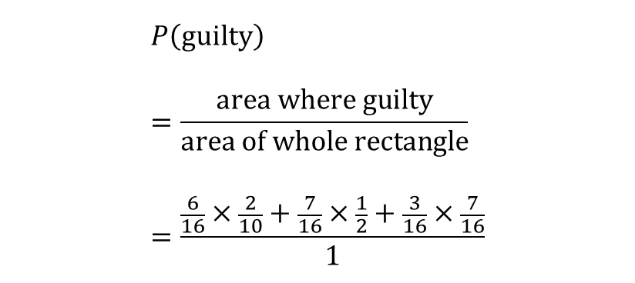
how to Compute With A marginal-Conditional Diagram
Remember: Probabilities are Proportions!
what will be the outcome of the trial?
things to compute
acquittal
hung jury
conviction
joint probabilities
marginal probabilities
conditional probabilities
$$\frac{6}{16}$$
$$\frac{7}{16}$$
$$\frac{3}{16}$$
$$\frac{2}{10}$$
guilty
TRY IT: $P(\text{guilty}\text{)}$
guilty
$$\frac{1}{2}$$
guilty
$$\frac{7}{11}$$
$$P\left(\text{guilty}\right) \\ =\frac{\text{area} \text{where} \text{guilty}}{\text{area} \text{of} \text{whole} \text{rectangle}} \\ =\frac{\frac{6}{16}×\frac{2}{10}+\frac{7}{16}×\frac{1}{2}+\frac{3}{16}×\frac{7}{16}}{1}$$
is the defendant actually guilty?
$$\frac{8}{10}$$
innocent
$$\frac{1}{2}$$
innocent
$$\frac{5}{11}$$
innocent

Slide 132
how to Compute With A marginal-Conditional Diagram
Remember: Probabilities are Proportions!
what will be the outcome of the trial?
things to compute
acquittal
hung jury
conviction
joint probabilities
marginal probabilities
conditional probabilities
$$\frac{6}{16}$$
$$\frac{7}{16}$$
$$\frac{3}{16}$$
$$\frac{2}{10}$$
guilty
guilty
$$\frac{1}{2}$$
guilty
$$\frac{7}{11}$$
is the defendant actually guilty?
$$\frac{8}{10}$$
innocent
$$\frac{1}{2}$$
innocent
$$\frac{5}{11}$$
innocent

Slide 133

how to Compute With A marginal-Conditional Diagram
Remember: Probabilities are Proportions!
what will be the outcome of the trial?
things to compute
acquittal
hung jury
conviction
joint probabilities
marginal probabilities
conditional probabilities
$$\frac{6}{16}$$
$$\frac{7}{16}$$
$$\frac{3}{16}$$
$$\frac{2}{10}$$
guilty
Example: $P(\text{acquittal}\text{|}\text{innocent}\text{)}$
guilty
$$\frac{1}{2}$$
guilty
$$\frac{7}{11}$$
is the defendant actually guilty?
$$\frac{8}{10}$$
innocent
$$\frac{1}{2}$$
innocent
$$\frac{5}{11}$$
innocent

Slide 134
how to Compute With A marginal-Conditional Diagram
Remember: Probabilities are Proportions!
what will be the outcome of the trial?
things to compute
acquittal
hung jury
conviction
joint probabilities
marginal probabilities
conditional probabilities
$$\frac{6}{16}$$
$$\frac{7}{16}$$
$$\frac{3}{16}$$
$$\frac{2}{10}$$
guilty
Example: $P(\text{acquittal}\text{|}\text{innocent}\text{)}$
guilty
$$\frac{1}{2}$$
guilty
$$\frac{7}{11}$$
Suppose we know that the defendant is innocent.
is the defendant actually guilty?
$$\frac{8}{10}$$
innocent
$$\frac{1}{2}$$
innocent
$$\frac{5}{11}$$
innocent

Slide 135
how to Compute With A marginal-Conditional Diagram
Remember: Probabilities are Proportions!
what will be the outcome of the trial?
things to compute
acquittal
hung jury
conviction
joint probabilities
marginal probabilities
conditional probabilities
$$\frac{6}{16}$$
$$\frac{7}{16}$$
$$\frac{3}{16}$$
$$\frac{2}{10}$$
guilty
Example: $P(\text{acquittal}\text{|}\text{innocent}\text{)}$
guilty
$$\frac{1}{2}$$
guilty
$$\frac{7}{11}$$
Suppose we know that the defendant is innocent. Then we know that these portions of the rectangle are ruled out.
is the defendant actually guilty?
$$\frac{8}{10}$$
innocent
$$\frac{1}{2}$$
innocent
$$\frac{5}{11}$$
innocent

Slide 136
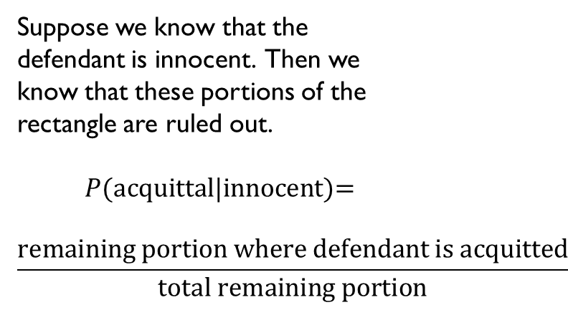
how to Compute With A marginal-Conditional Diagram
Remember: Probabilities are Proportions!
what will be the outcome of the trial?
things to compute
acquittal
hung jury
conviction
joint probabilities
marginal probabilities
conditional probabilities
$$\frac{6}{16}$$
$$\frac{7}{16}$$
$$\frac{3}{16}$$
$$\frac{2}{10}$$
guilty
Example: $P(\text{acquittal}\text{|}\text{innocent}\text{)}$
guilty
$$\frac{1}{2}$$
guilty
$$\frac{7}{11}$$
Suppose we know that the defendant is innocent. Then we know that these portions of the rectangle are ruled out.
$$P(\text{acquittal}\text{|}\text{innocent}\text{)=}$$ $$\frac{\text{remaining} \text{portion} \text{where} \text{defendant} \text{is} \text{acquitted}}{\text{total} \text{remaining} \text{portion}}$$
is the defendant actually guilty?
$$\frac{8}{10}$$
innocent
$$\frac{1}{2}$$
innocent
$$\frac{5}{11}$$
innocent

Slide 137
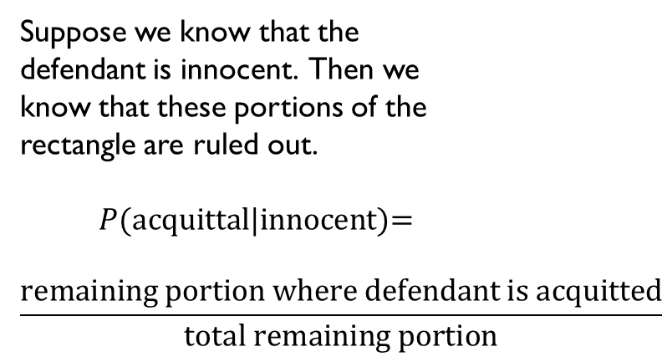

how to Compute With A marginal-Conditional Diagram
Remember: Probabilities are Proportions!
what will be the outcome of the trial?
things to compute
acquittal
hung jury
conviction
joint probabilities
marginal probabilities
conditional probabilities
$$\frac{6}{16}$$
$$\frac{7}{16}$$
$$\frac{3}{16}$$
$$\frac{2}{10}$$
guilty
Example: $P(\text{acquittal}\text{|}\text{innocent}\text{)}$
guilty
$$\frac{1}{2}$$
guilty
$$\frac{7}{11}$$
Suppose we know that the defendant is innocent. Then we know that these portions of the rectangle are ruled out.
$$P(\text{acquittal}\text{|}\text{innocent}\text{)=}$$ $$\frac{\text{remaining} \text{portion} \text{where} \text{defendant} \text{is} \text{acquitted}}{\text{total} \text{remaining} \text{portion}}$$
is the defendant actually guilty?
$$\frac{8}{10}$$
innocent
$$\frac{1}{2}$$
innocent
$$\frac{5}{11}$$
innocent

Slide 138
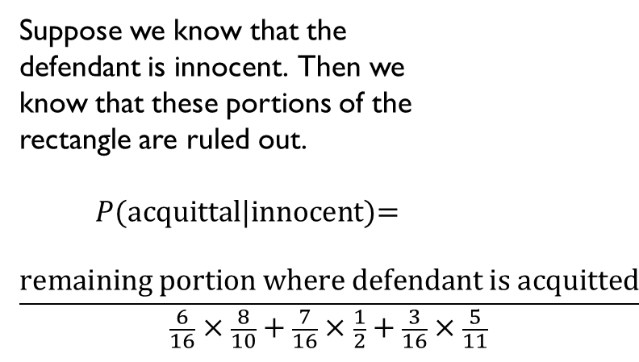
how to Compute With A marginal-Conditional Diagram
Remember: Probabilities are Proportions!
what will be the outcome of the trial?
things to compute
acquittal
hung jury
conviction
joint probabilities
marginal probabilities
conditional probabilities
$$\frac{6}{16}$$
$$\frac{7}{16}$$
$$\frac{3}{16}$$
$$\frac{2}{10}$$
guilty
Example: $P(\text{acquittal}\text{|}\text{innocent}\text{)}$
guilty
$$\frac{1}{2}$$
guilty
$$\frac{7}{11}$$
Suppose we know that the defendant is innocent. Then we know that these portions of the rectangle are ruled out.
$$P(\text{acquittal}\text{|}\text{innocent}\text{)=}$$ $$\frac{\text{remaining} \text{portion} \text{where} \text{defendant} \text{is} \text{acquitted}}{\frac{6}{16}×\frac{8}{10}+\frac{7}{16}×\frac{1}{2}+\frac{3}{16}×\frac{5}{11}}$$
is the defendant actually guilty?
$$\frac{8}{10}$$
innocent
$$\frac{1}{2}$$
innocent
$$\frac{5}{11}$$
innocent

Slide 139
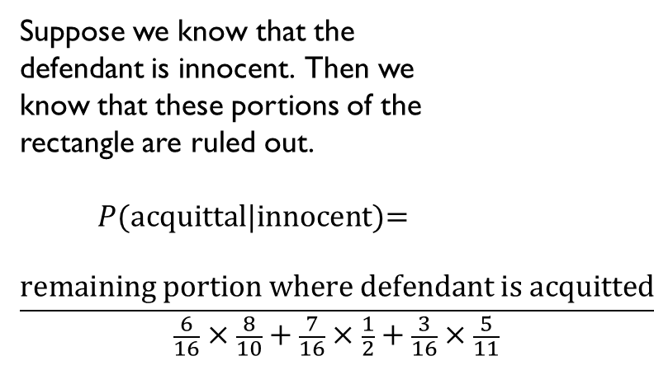
how to Compute With A marginal-Conditional Diagram
Remember: Probabilities are Proportions!
what will be the outcome of the trial?
things to compute
acquittal
hung jury
conviction
joint probabilities
marginal probabilities
conditional probabilities
$$\frac{6}{16}$$
$$\frac{7}{16}$$
$$\frac{3}{16}$$
$$\frac{2}{10}$$
guilty
Example: $P(\text{acquittal}\text{|}\text{innocent}\text{)}$
guilty
$$\frac{1}{2}$$
guilty
$$\frac{7}{11}$$
Suppose we know that the defendant is innocent. Then we know that these portions of the rectangle are ruled out.
$$P(\text{acquittal}\text{|}\text{innocent}\text{)=}$$ $$\frac{\text{remaining} \text{portion} \text{where} \text{defendant} \text{is} \text{acquitted}}{\frac{6}{16}×\frac{8}{10}+\frac{7}{16}×\frac{1}{2}+\frac{3}{16}×\frac{5}{11}}$$
is the defendant actually guilty?
$$\frac{8}{10}$$
innocent
$$\frac{1}{2}$$
innocent
$$\frac{5}{11}$$
innocent

Slide 140
how to Compute With A marginal-Conditional Diagram
Remember: Probabilities are Proportions!
what will be the outcome of the trial?
things to compute
acquittal
hung jury
conviction
joint probabilities
marginal probabilities
conditional probabilities
$$\frac{6}{16}$$
$$\frac{7}{16}$$
$$\frac{3}{16}$$
$$\frac{2}{10}$$
guilty
Example: $P(\text{acquittal}\text{|}\text{innocent}\text{)}$
guilty
$$\frac{1}{2}$$
guilty
$$\frac{7}{11}$$
Suppose we know that the defendant is innocent. Then we know that these portions of the rectangle are ruled out.
$$P(\text{acquittal}\text{|}\text{innocent}\text{)=}$$ $$\frac{\text{remaining} \text{portion} \text{where} \text{defendant} \text{is} \text{acquitted}}{\frac{6}{16}×\frac{8}{10}+\frac{7}{16}×\frac{1}{2}+\frac{3}{16}×\frac{5}{11}}$$
is the defendant actually guilty?
$$\frac{8}{10}$$
innocent
$$\frac{1}{2}$$
innocent
$$\frac{5}{11}$$
innocent

Slide 141
how to Compute With A marginal-Conditional Diagram
Remember: Probabilities are Proportions!
what will be the outcome of the trial?
things to compute
acquittal
hung jury
conviction
joint probabilities
marginal probabilities
conditional probabilities
$$\frac{6}{16}$$
$$\frac{7}{16}$$
$$\frac{3}{16}$$
$$\frac{2}{10}$$
guilty
Example: $P(\text{acquittal}\text{|}\text{innocent}\text{)}$
guilty
$$\frac{1}{2}$$
guilty
$$\frac{7}{11}$$
Suppose we know that the defendant is innocent. Then we know that these portions of the rectangle are ruled out.
$$P(\text{acquittal}\text{|}\text{innocent}\text{)=}$$ $$\frac{\text{remaining} \text{portion} \text{where} \text{defendant} \text{is} \text{acquitted}}{\frac{6}{16}×\frac{8}{10}+\frac{7}{16}×\frac{1}{2}+\frac{3}{16}×\frac{5}{11}}$$
is the defendant actually guilty?
$$\frac{8}{10}$$
innocent
$$\frac{1}{2}$$
innocent
$$\frac{5}{11}$$
innocent

Slide 142
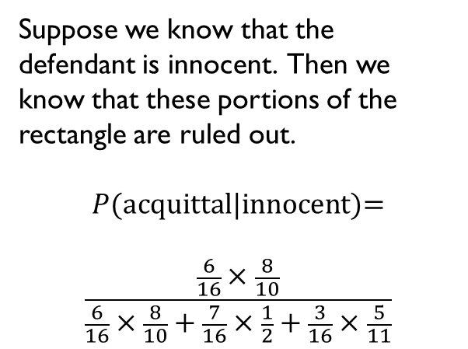
how to Compute With A marginal-Conditional Diagram
Remember: Probabilities are Proportions!
what will be the outcome of the trial?
things to compute
acquittal
hung jury
conviction
joint probabilities
marginal probabilities
conditional probabilities
$$\frac{6}{16}$$
$$\frac{7}{16}$$
$$\frac{3}{16}$$
$$\frac{2}{10}$$
guilty
Example: $P(\text{acquittal}\text{|}\text{innocent}\text{)}$
guilty
$$\frac{1}{2}$$
guilty
$$\frac{7}{11}$$
Suppose we know that the defendant is innocent. Then we know that these portions of the rectangle are ruled out.
$$P(\text{acquittal}\text{|}\text{innocent}\text{)=}$$ $$\frac{\frac{6}{16}×\frac{8}{10}}{\frac{6}{16}×\frac{8}{10}+\frac{7}{16}×\frac{1}{2}+\frac{3}{16}×\frac{5}{11}}$$
is the defendant actually guilty?
$$\frac{8}{10}$$
innocent
$$\frac{1}{2}$$
innocent
$$\frac{5}{11}$$
innocent

Slide 143

how to Compute With A marginal-Conditional Diagram
Remember: Probabilities are Proportions!
what will be the outcome of the trial?
things to compute
acquittal
hung jury
conviction
joint probabilities
marginal probabilities
conditional probabilities
$$\frac{6}{16}$$
$$\frac{7}{16}$$
$$\frac{3}{16}$$
$$\frac{2}{10}$$
guilty
TRY IT: $P(\text{hung} \text{jury}\text{|}\text{guilty}\text{)}$
guilty
$$\frac{1}{2}$$
guilty
$$\frac{7}{11}$$
is the defendant actually guilty?
$$\frac{8}{10}$$
innocent
$$\frac{1}{2}$$
innocent
$$\frac{5}{11}$$
innocent

Slide 144
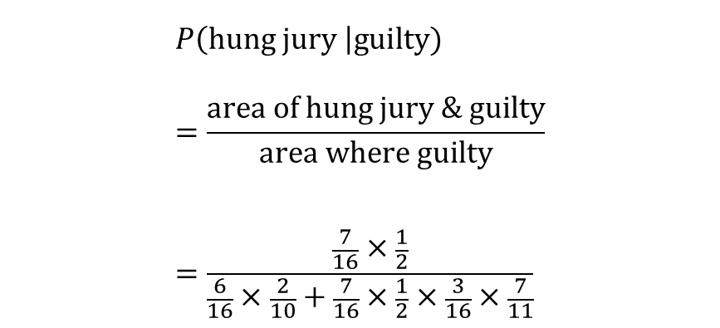
how to Compute With A marginal-Conditional Diagram
Remember: Probabilities are Proportions!
what will be the outcome of the trial?
things to compute
acquittal
hung jury
conviction
joint probabilities
marginal probabilities
conditional probabilities
$$\frac{6}{16}$$
$$\frac{7}{16}$$
$$\frac{3}{16}$$
$$\frac{2}{10}$$
guilty
TRY IT: $P(\text{hung} \text{jury}\text{|}\text{guilty}\text{)}$
guilty
$$\frac{1}{2}$$
guilty
$$\frac{7}{11}$$
$$P\left(\text{hung} \text{jury} \right|\text{guilty}) \\ =\frac{\text{area} \text{of} \text{hung} \text{jury}\text{ \& }\text{guilty}}{\text{area} \text{where} \text{guilty}} \\ =\frac{\frac{7}{16}×\frac{1}{2}}{\frac{6}{16}×\frac{2}{10}+\frac{7}{16}×\frac{1}{2}×\frac{3}{16}×\frac{7}{11}}$$
is the defendant actually guilty?
$$\frac{8}{10}$$
innocent
$$\frac{1}{2}$$
innocent
$$\frac{5}{11}$$
innocent

Slide 145
how to Compute With A marginal-Conditional Diagram
Remember: Probabilities are Proportions!
what will be the outcome of the trial?
things to compute
acquittal
hung jury
conviction
joint probabilities
marginal probabilities
conditional probabilities
$$\frac{6}{16}$$
$$\frac{7}{16}$$
$$\frac{3}{16}$$
$$\frac{2}{10}$$
guilty
TRY IT: $P(\text{hung} \text{jury}\text{|}\text{guilty}\text{)}$
guilty
$$\frac{1}{2}$$
guilty
$$\frac{7}{11}$$
$$P\left(\text{hung} \text{jury} \right|\text{guilty}) \\ =\frac{\text{area} \text{of} \text{hung} \text{jury}\text{ \& }\text{guilty}}{\text{area} \text{where} \text{guilty}} \\ =\frac{\frac{7}{16}×\frac{1}{2}}{\frac{6}{16}×\frac{2}{10}+\frac{7}{16}×\frac{1}{2}×\frac{3}{16}×\frac{7}{11}}$$
is the defendant actually guilty?
$$\frac{8}{10}$$
innocent
$$\frac{1}{2}$$
innocent
$$\frac{5}{11}$$
innocent

Slide 146
how to Compute With A marginal-Conditional Diagram
Remember: Probabilities are Proportions!
what will be the outcome of the trial?
things to compute
acquittal
hung jury
conviction
joint probabilities
marginal probabilities
conditional probabilities
$$\frac{6}{16}$$
$$\frac{7}{16}$$
$$\frac{3}{16}$$
$$\frac{2}{10}$$
guilty
TRY IT: $P(\text{hung} \text{jury}\text{|}\text{guilty}\text{)}$
guilty
$$\frac{1}{2}$$
guilty
$$\frac{7}{11}$$
$$P\left(\text{hung} \text{jury} \right|\text{guilty}) \\ =\frac{\text{area} \text{of} \text{hung} \text{jury}\text{ \& }\text{guilty}}{\text{area} \text{where} \text{guilty}} \\ =\frac{\frac{7}{16}×\frac{1}{2}}{\frac{6}{16}×\frac{2}{10}+\frac{7}{16}×\frac{1}{2}×\frac{3}{16}×\frac{7}{11}}$$
is the defendant actually guilty?
$$\frac{8}{10}$$
innocent
$$\frac{1}{2}$$
innocent
$$\frac{5}{11}$$
innocent

Slide 147
how to Compute With A marginal-Conditional Diagram
Remember: Probabilities are Proportions!
what will be the outcome of the trial?
things to compute
acquittal
hung jury
conviction
joint probabilities
marginal probabilities
conditional probabilities
$$\frac{6}{16}$$
$$\frac{7}{16}$$
$$\frac{3}{16}$$
$$\frac{2}{10}$$
guilty
TRY IT: $P(\text{hung} \text{jury}\text{|}\text{guilty}\text{)}$
guilty
$$\frac{1}{2}$$
guilty
$$\frac{7}{11}$$
$$P\left(\text{hung} \text{jury} \right|\text{guilty}) \\ =\frac{\text{area} \text{of} \text{hung} \text{jury}\text{ \& }\text{guilty}}{\text{area} \text{where} \text{guilty}} \\ =\frac{\frac{7}{16}×\frac{1}{2}}{\frac{6}{16}×\frac{2}{10}+\frac{7}{16}×\frac{1}{2}×\frac{3}{16}×\frac{7}{11}}$$
is the defendant actually guilty?
$$\frac{8}{10}$$
innocent
$$\frac{1}{2}$$
innocent
$$\frac{5}{11}$$
innocent

Slide 148
how to Compute With A marginal-Conditional Diagram
Remember: Probabilities are Proportions!
what will be the outcome of the trial?
things to compute
acquittal
hung jury
conviction
joint probabilities
marginal probabilities
conditional probabilities
$$\frac{6}{16}$$
$$\frac{7}{16}$$
$$\frac{3}{16}$$
$$\frac{2}{10}$$
guilty
TRY IT: $P(\text{hung} \text{jury}\text{|}\text{guilty}\text{)}$
guilty
$$\frac{1}{2}$$
guilty
$$\frac{7}{11}$$
$$P\left(\text{hung} \text{jury} \right|\text{guilty}) \\ =\frac{\text{area} \text{of} \text{hung} \text{jury}\text{ \& }\text{guilty}}{\text{area} \text{where} \text{guilty}} \\ =\frac{\frac{7}{16}×\frac{1}{2}}{\frac{6}{16}×\frac{2}{10}+\frac{7}{16}×\frac{1}{2}×\frac{3}{16}×\frac{7}{11}}$$
is the defendant actually guilty?
$$\frac{8}{10}$$
innocent
$$\frac{1}{2}$$
innocent
$$\frac{5}{11}$$
innocent

