Slide 1

让我们开始吧
DAMEN PPT.vol 1

Slide 2

Contants
01
02
03
title
title
title
Copyight @2014 wechat damen_ppp lnc
All Rights Reserved

Slide 3

PART ONE
Copyight @2014 wechat damen_ppp lnc
All Rights Reserved

Slide 4

ADD TITLE
ADD SUBTITLE
PICTURE
AND OTHER
It was the best of times, it was the worst of times; it was the age of wisdom, it was the age of foolishness.

Slide 5



ADD TITLE
ADD SUBTITLE
It was the best of times, it was the worst of times; it was the age of wisdom, it was the age of foolishness.
It was the best of times, it was the worst of times; it was the age of wisdom, it was the age of foolishness.
It was the best of times, it was the worst of times; it was the age of wisdom, it was the age of foolishness.

Slide 6
ADD TITLE
ADD SUBTITLE
NEIMENGGU
It was the best of times, it was the worst of times; it was the age of wisdom, it was the age of foolishness.
It was the best of times, it was the worst of times; it was the age of wisdom, it was the age of foolishness.

Slide 7

PART
TWO
Copyight @2014 wechat damen_ppp lnc
All Rights Reserved

Slide 8
ADD TITLE
ADD SUBTITLE
It was the best of times, it was the worst of times; it was the age of wisdom, it was the age of foolishness.

Slide 9
ADD TITLE
ADD SUBTITLE
It was the best of times, it was the worst of times; it was the age of wisdom, it was the age of foolishness.
56%
45%
40%
It was the best of times, it was the worst of times; it was the age of wisdom, it was the age of foolishness.
30%
It was the best of times, it was the worst of times; it was the age of wisdom, it was the age of foolishness.
It was the best of times, it was the worst of times; it was the age of wisdom, it was the age of foolishness.
A
B
C
D
TEXT

Slide 10
ADD TITLE
ADD SUBTITLE
A
It was the best of times, it was the worst of times; it was the age of wisdom, it was the age of foolishness.
B
It was the best of times, it was the worst of times; it was the age of wisdom, it was the age of foolishness.

Slide 11
ADD TITLE
ADD SUBTITLE
It was the best of times, it was the worst of times; it was the age of wisdom, it was the age of foolishness; it was the epoch of belief, it was the epoch of incredulity; it was the season of light, it was the season of darkness.
It was the best of times, it was the worst of times; it was the age of wisdom, it was the age of foolishness; it was the epoch of belief, it was the epoch of incredulity; it was the season of light, it was the season of darkness.
TEXT

Slide 12
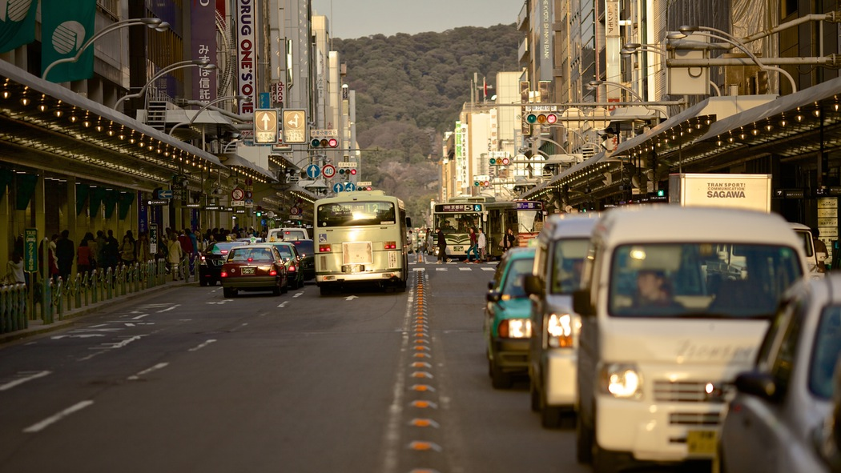
PART THREE
Copyight @2014 wechat damen_ppp lnc
All Rights Reserved

Slide 13
TEXT
It was the best of times, it was the worst of times; it was the age of wisdom, it was the age of foolishness.
It was the best of times, it was the worst of times; it was the age of wisdom, it was the age of foolishness.

Slide 14
ADD TITLE
ADD SUBTITLE
TEXT
TEXT
It was the best of times, it was the worst of times; it was the age of wisdom, it was the age of foolishness.
TEXT
It was the best of times, it was the worst of times; it was the age of wisdom, it was the age of foolishness.
It was the best of times, it was the worst of times; it was the age of wisdom, it was the age of foolishness.

Slide 15
ADD TITLE
ADD SUBTITLE
It was the best of times, it was the worst of times; it was the age of wisdom, it was the age of foolishness.
1
2
It was the best of times, it was the worst of times; it was the age of wisdom, it was the age of foolishness.
It was the best of times, it was the worst of times; it was the age of wisdom, it was the age of foolishness.
3
4
It was the best of times, it was the worst of times; it was the age of wisdom, it was the age of foolishness.

Slide 16

Thanks.
Copyight @2014 wechat damen_ppp lnc
All Rights Reserved

