Slide 1










Slide 2
Wishing you a song in your heart at Christmas
Christmas time is for thinking of others.
part1
part3
Much joy to you in the upcoming year.
Wishing you and your family a very merry Christmas
part2
part4

Slide 3


part1
December 25th is the day of celebration and of fun and frolic. As the long awaited winter holidays arrive, Christmas spirit builds up.

Slide 4
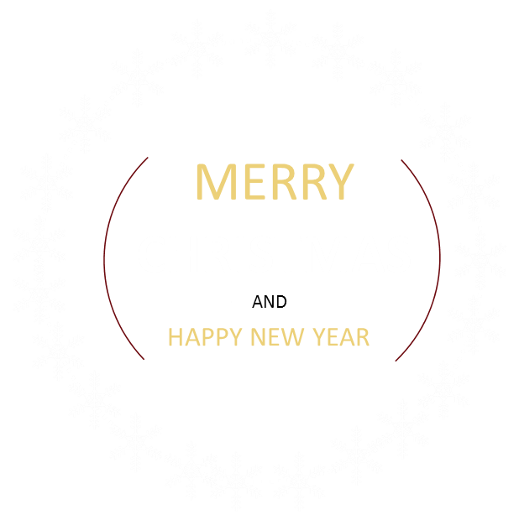

part2
The lovely snowflakes,
our dear Santa, decorated homes complete with whole range of
Christmas star, mistletoe, the good-luck plant, ivy, laurels and not the least the beautifully decorated
and illuminated Christmas tree are some of the inseparable parts of the picture.

Slide 5


part3
The soft music of the Christmas carols and children eager to open their gifts certainly lend unique warmth to the coldest day of the year.

Slide 6


part4
People visit their families and arrange some of the most lavish parties. The most awaited festival, the Christmas signifies love and kindness, joy and happiness. The holiday spirit of the season in one word is - infectious!

Slide 7


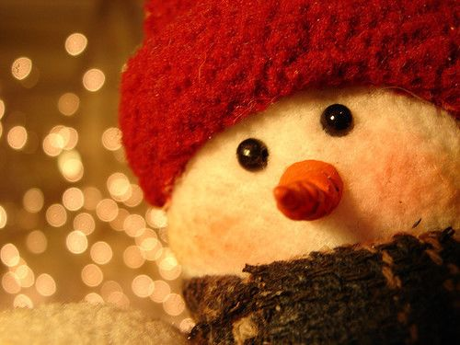
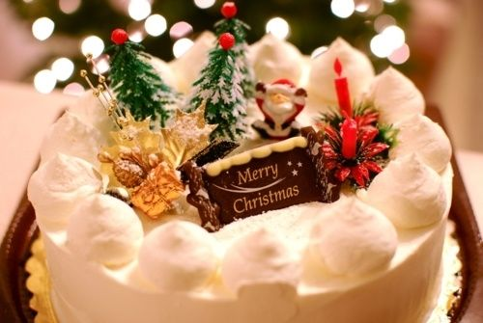
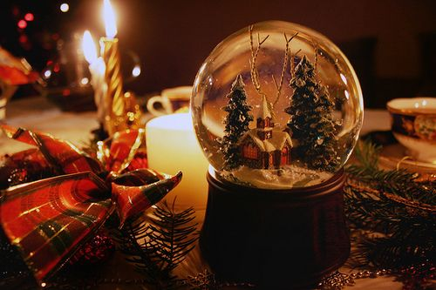
I love you
MERRY
CHRISTMAS

Slide 8






