Slide 1
BIOCHEMISTRY
Basic Chemistry

Slide 2
I. Chemistry:
Definition: the branch of science that deals with the study of matter, energy, and their interaction.
a) Matter: defined as anything that has mass and occupies volume.
Mass – is the measurement of the amount of matter in an object OR is the quantity of matter an object has.
The fundamental unit for mass is the gram (g).
The instrument used in chemistry to measure the mass of an object is the triple beam balance or the digital scale.

Slide 3
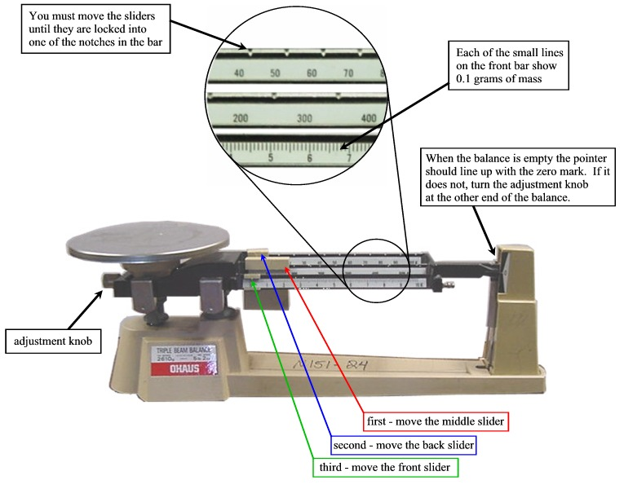
Figure 1: Triple Beam Balance
From: http://www.kirkwood.k12.mo.us/parent_student/khs/BartinJ/sci%20skills%20book/using_a_3beam_bal.jpg

Slide 4
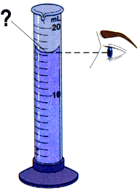
Volume: defined as the amount of space an object occupies.
The fundamental unit for volume is the liter (l). Other units used to measure the volume of substances include the cubic centimeter (cm³) or the (cc).
The instrument used in chemistry to measure the volume of a substance is the graduated cylinder.
Fig 2: Graduated Cylinder showing the meniscus
From: http://www.electrickiva.com/quiz/exam03/meniscus.gif

Slide 5
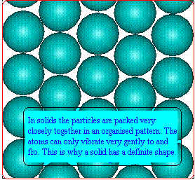
b) The States of Matter:
Gases, liquids and solids are all made up of microscopic particles, but the behaviors of these particles differ in the three phases.
1. Solid: state of matter that has both a definite volume and a definite shape.
Particles in a solid:
Vibrate in position
Have a high degree of bonds
Are tightly compacted
Fig 3: Arrangement of Particles in a Solid
From: http://www.ul.ie/~walshem/fyp/solid.gif

Slide 6
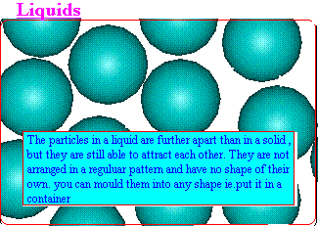
2. Liquid – state of matter that has definite volume but no definite shape. A key property of a liquid is that they flow and can be poured.
Fig. 4: Arrangement of Particles in a Liquid
From: http://www.ul.ie/~walshem/fyp/states%20of%20matter.htm#liquid

Slide 7
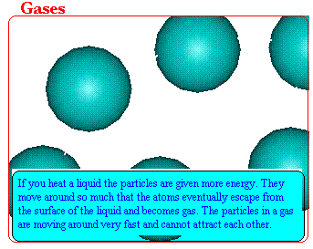
3. Gas – state of matter that has no definite volume and no definite shape.
A gas always takes both the volume and the shape of the container into which it is placed. If a gas is not in a container, it will spread out as far as it can.
Fig. 5: Arrangement of Particles in a Gas
From :http://www.ul.ie/~walshem/fyp/gas.gif

Slide 8
II. Energy:
a) Definition: The capacity for doing work.
b) Energy has several forms including:
  potential energy - the energy stored in the chemical bonds that exist between particles of matter.
  kinetic energy – the energy of motion. Temperature is a direct measure of the average kinetic energy of particles.
c) Law of Conservation of Mass and Energy:
This scientific law states that neither mass nor energy can be created or destroyed. They can only be converted from one form into another.
Units: Joule (J) or Kilojoules (KJ), calorie (c) or Kilocalorie (KJ).

Slide 9
d) Types of Energy
Light Energy: the energy associated with light waves and other forms of electromagnetic radiation.
Electrical Energy: the energy associated with electrical current (flow of electrons).
Chemical energy: the energy associated with chemical changes (the breaking and reformation of chemical bonds).
Heat Energy: the energy associated with the temperature of substances. Heat energy is the least useful form of energy.
Mechanical Energy: the energy associated with doing work.
Atomic and Nuclear Energy: the energy associated with changes in the mass of atoms and the energy that binds atoms together.

Slide 10
e) Energy and Chemical Change
All chemical reactions require energy to occur.
Chemical bonds are forces of attraction that hold atoms, elements, compounds, and molecules together.
Chemical bonds store energy.
For a reaction to occur, a chemical must absorb enough energy to break the bonds that hold it’s atoms together.
The amount of energy that must be absorbed by a chemical to begin a reaction is called the Activation Energy (E_{a}).

Slide 11
III. The Classification of Matter
a) Substances: Elements and Compounds
1. Elements are pure substances that cannot be broken down chemically into simpler kinds of matter.
More than 100 elements have been identified, though fewer than 30 are important in living things. (The Periodic Table of Elements)
All of the elements are arranged on a chart known as THE PERIODIC TABLE.
Among the information provided in the Periodic Table are the atomic number, the atomic mass (mass number), and the chemical symbol for each element.

Slide 12
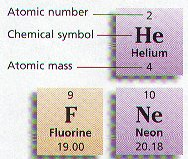
More than 90 percent of the mass of living things is composed of just four elements: Oxygen (O), Carbon (C), Hydrogen (H), and Nitrogen (N).
Each element has different Chemical Symbol which consist of one or two letters.

Slide 13
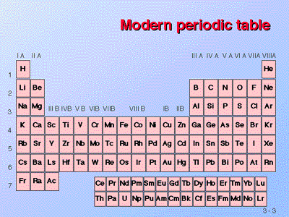

Slide 14
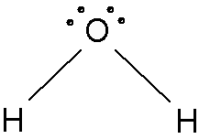
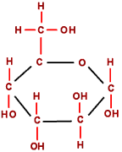
2) Compounds: Substances that consist of two or more elements that are combined chemically by bonds.
The elements in a compound cannot be separated easily.
Compounds include water (H₂O), carbon dioxide (CO₂), glucose (C₆H₁₂O₆), etc.
water
carbon dioxide
glucose

Slide 15
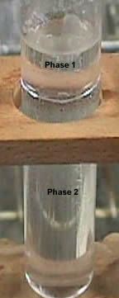
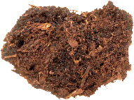
b) Mixtures
Two or more substances that are combined physically; the components can be easily separated.
In homogeneous mixtures, the substances are completely mixed. This means that you cannot see the individual components. The mixture appears to be only one substance.
In heterogeneous mixtures, the substances are not completely mixed. This means that you can see the individual components. The mixture appears to be only two different substances in the same container.
Heterogeneous Mixture: SOIL
Homogeneous Mixture: Salt Water

Slide 16
IV. Atoms
The simplest particle of an element is an ATOM.
Atoms are so small that their structure cannot be seen.
An Atom consists of three kinds of particles: protons, neutrons, and electrons.
The center of an atom is called the NUCLEUS which consists of two kinds of particles:
PROTONS and NEUTRONS
Electrons revolve around an atom’s nucleus in energy levels.

Slide 17
Subatomic Particles
a) Nucleons: subatomic particles that are located in an atom’s nucleus; includes protons and neutrons.
Proton: positively charged; has a mass of 1 amu.
Neutron: no charge; has a mass of 1 amu.
b) Electrons: small, negatively charged subatomic particles that revolve around the atom’s nucleus at extremely high velocities.
Electrons are located in energy levels around the nucleus.
Electrons have a mass of 1/1836 amu.
Note: Atomic Mass Unit = amu or μ

Slide 18
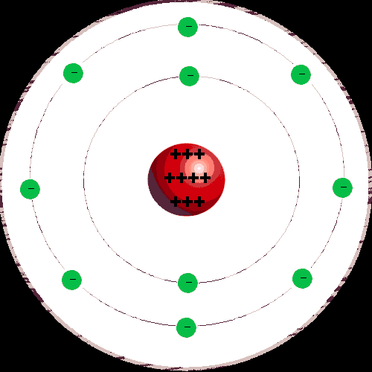
MODEL OF AN ATOM

Slide 19
c) Atomic Mass and Atomic Number
Atomic Mass: indicates the number of protons plus neutrons in an atom’s nucleus.
Ex: 12C 24Mg 23Na Larger Number
6 12 11 is the Atomic Mass.
p=6 p=12 p=11
n=6 n=12 n=12 Smaller Number
e=6 e=12 e=11 is the Atomic Number.
2. Atomic Number: indicates the number of protons found in an atom’s nucleus (It also tells you the number of electrons revolving around the nucleus of the atom).

Slide 20
d) Electron Arrangement Around the Nucleus:
1. Electrons are arranged around an atom’s nucleus in energy levels.
2. Each energy level can hold a certain amount of electrons.
energy level # of electrons
1 2
2 8
3 8
Note: For atoms to be stable they must have the maximum number of electrons in each of their energy level.

Slide 21
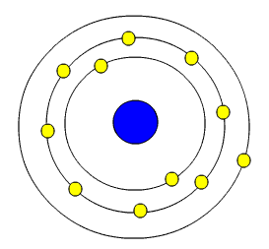
Ex #1: 23Na Element: Sodium
11
p=11 2-8-1
n=12
e=11
First Energy Level
2 electrons
11p
12n
Second Energy Level
8 electrons
Third Energy Level
1 electron
THE THIRD ENERGY LEVEL ONLY HAS ONE ELECTRON!!

Slide 22
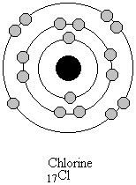
Ex #2: 35Cl Element: Chlorine
17
p=17 2-8-7
n=18
e=17
First Energy Level
2 electrons
17p
18n
Second Energy Level
8 electrons
THE THIRD ENERGY LEVEL HAS SEVEN ELECTRONS!!
Third Energy Level
7 electrons

Slide 23


Question: Why do atoms of sodium and chlorine form bonds?
Sodium Chlorine
Sodium gives an electron to chlorine and a bond is formed that connects the two atoms.

Slide 24
e) Bonds
1. Chemical Bonds are attractive forces that hold atoms and/or compounds together.
2. Chemical Bonds form when atoms lose, gain, (ionic) or share (covalent) electrons.
3. Types of Bonds:
Ionic Bonds: bonds that form between atoms when a metal loses an electron(s) to a nonmetal forming a positively charged ion (cation) and a negatively charged ion (anion).
Ionic bonds form when electrons are transferred between atoms.
Ionic bonds are considered very strong.

Slide 25
Covalent Bonds:
Are bonds between nonmetals.
Involve the equal and unequal sharing of electrons.
Are considered to be relatively weak bonds.
are found within organic molecules such as carbohydrates, lipids, proteins, and nucleic acids.

Slide 26
V. The Chemistry of Water
a) Structure of Water
1. Water is a universal solvent; it has the ability to dissolve most substances.
2. Water is a polar molecule. It has polar covalent bonds (unequal sharing of electrons) that results in the unequal distribution of electrons within the molecule. As a result, the oxygen and hydrogen atoms in a water molecule have a negative and positive charge respectively.
3. Water has a geometric shape that is referred to as “bent”.

Slide 27
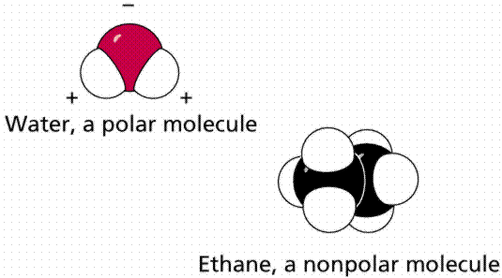
OXYGEN
HYDROGEN
Figure 1: Polar versus Nonpolar molecules.
From: http://www.emc.maricopa.edu/faculty/farabee/BIOBK/BioBookCHEM2.html

Slide 28
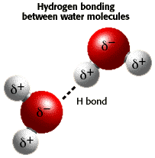
b) Physical and Chemical Properties of Water
1. Due to its polarity, hydrogen bonds (intermolecular forces) form between water molecules. Theses forces account for water’s relatively high boiling point and its cohesiveness.
Figure 2: Hydrogen Bonds between water molecules
From: http://www.biology.arizona.edu/biochemistry/tutorials/chemistry/page3.html

Slide 29
2. Water is adhesive to other substances that are polar. This phenomenon explain several processes in living systems such as capillary action and evapotranspiration.
Conversely, water does not interact well with nonpolar molecules such as lipids (fats, oils, waxes, steroids, and some vitamins).

Slide 30
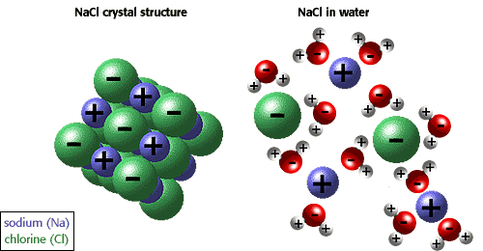
3. The ability of ions and other molecules to dissolve in water is due to polarity. For example, in the illustration below sodium chloride is shown in its crystalline form and dissolved in water.
Figure 3: Water as a solvent for polar substances.
From: http://www.biology.arizona.edu/biochemistry/tutorials/chemistry/page3.html

Slide 31
4. Water, Acids, and Bases
Water tends to disassociate into H+ and OH- ions.
Pure water has the same number (or concentration) of H+ as OH- ions.
Acidic solutions have more H+ ions than OH- ions.
Basic solutions have more OH- ions than H+ ions.
An acid causes an increase in the numbers of H+ ions and a base causes an increase in the numbers of OH- ions.

Slide 32
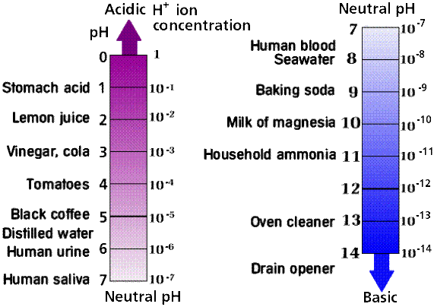
Figure 4: pH of some common items.
Image from Purves et al., Life: The Science of Biology, 4th Edition, by Sinauer Associates (www.sinauer.com) and WH Freeman (www.whfreeman.com), used with permission.

Slide 33
VI. Biochemistry: The Chemistry of Life
Organic molecules - contain carbon and hydrogen, most also contain oxygen, nitrogen, sulfur and phosphorus.
Organic compounds are bounded by covalent bonds which form when two atoms (nonmetals) share electrons. .
1. Carbohydrates - contain C, H and O in the proportion 1:2:1 (C₁H₂O₁).
Virtually all carbohydrates come from plants which use the sun's energy to make glucose.
Purpose: Used as an primary energy source for living things.
Categories:
Monosaccharides – one unit sugars. Examples include glucose, fructose, galactose, etc.
Disaccharides – two unit sugars. Examples include lactose, maltose, sucrose, etc.
Polysaccharides – complex carbohydrates that consist of long chains of monosaccharides. Examples include starch, cellulose, glycogen, etc.

Slide 34
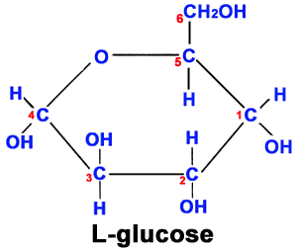
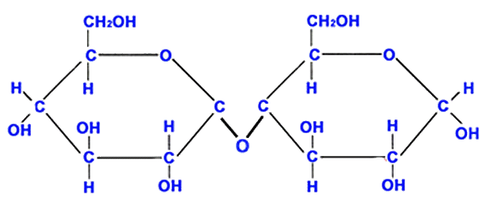
Common carbohydrates
(Note the six sided shape of the chemicals)
Maltose

Slide 35
2. Lipids – contain the elements C, H, and O.
Purpose: Secondary energy sources and structural compounds.
Examples: fats, oils, wax, and some vitamins and steroids.
Characteristics:
Store large amounts of energy due to the fact they contain many bonds.
Insoluble in water (do not mix with water).
Important structural compounds because they form cell (plasma) membranes which controls what enters and exits cells.
Components: Made from 3 Fatty acids and a Glycerol Molecule.

Slide 36
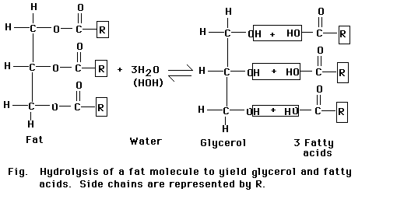
Typical Lipid
(Note the number of bonds; many bonds mean that it contain much stored energy)

Slide 37
3. Proteins – large molecules that contain the elements
C, H, O, N, and S.
Characteristics:
Proteins have a variety of functions due to their great diversity in structure.
This is due to the multitude of ways 20 different amino acids can be arranged to make a protein.
Purpose:
Structural compounds including muscles, connective tissue (cartilage, tendons, ligaments), hair, nails, collagen, elastin.
Enzymes – the chemicals that control the speed of the eight life functions (metabolism) are made of proteins.
Regulator and transport molecules such as insulin, hemoglobin, some neurotransmitters, integral and peripheral transport channels (cell membrane).
Components: Made of polymers of molecules called amino acids (peptides).

Slide 38
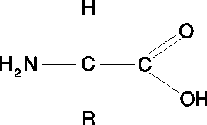
Categories:
Peptide (amino acid)
Amine Group
(Basic Group)
Carboxyl Group
(Acid Group)
(R-NH₂)
(R-COOH)
Variable Group
In humans, there are 20 different amino acids due to the existence of 20 different variable groups.

Slide 39
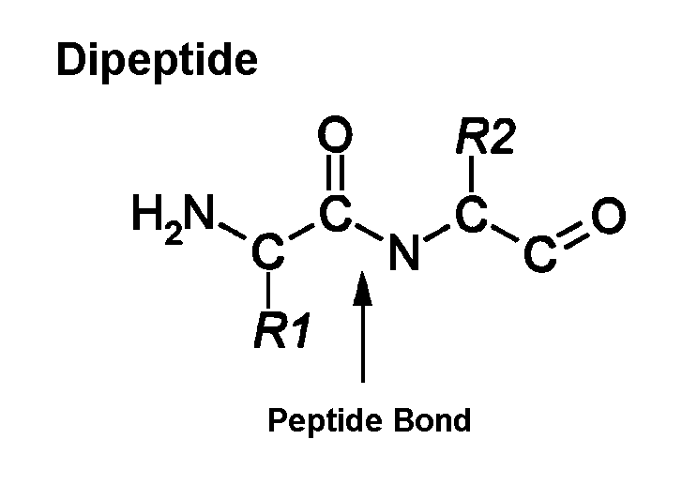
Dipeptide Molecule: Formed from the dehydration synthesis of two peptides (amino acids).
A dipeptide is two amino acids connected by a peptide bond.

Slide 40
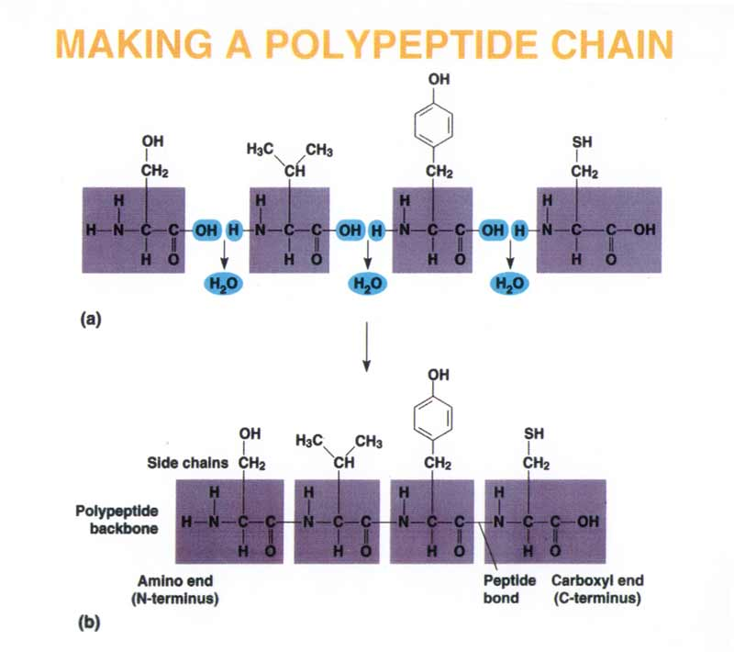
A polypeptide is a long chain of amino acids connected by many peptide bonds.

Slide 41
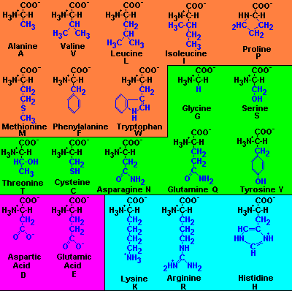
nonpolar and hydrophobic
Polar and hydrophilic
acidic
basic
Common Amino Acids in Humans
From: http://www.people.virginia.edu/~rjh9u/gif/aminacid.gif

Slide 42
4. Nucleic Acids – contain the elements C, H, O, N, and P.
(NOTE: No Sulfur (S) ).
Characteristics: stores the genetic information and determines the characteristics of living things.
Examples: DNA (deoxyribonucleic acid) and RNA (ribonucleic acid)
Components: Nucleic acids are made of nucleotides.
Nucleotides consist of a phosphate group, a pentose (five) carbon sugar, and a nitrogen-containing base.

Slide 43
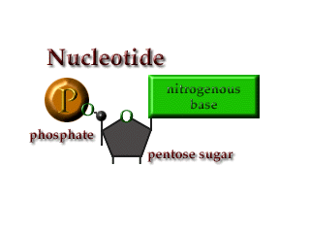
Nucleotide: A basic building block for nucleic acids such as DNA and RNA.

Slide 44
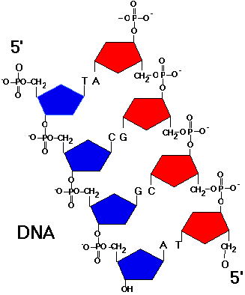

Slide 45
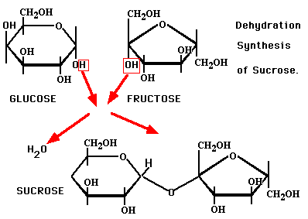
b) Basic Chemical Reactions of Biochemicals
Dehydration Synthesis- making large compounds from smaller ones by removing water.

Slide 46
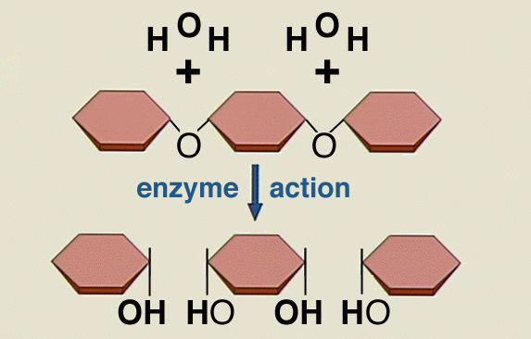
2. Hydrolysis - breaking apart large compounds into smaller, more simple ones by adding water.

Slide 47
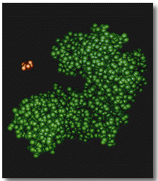
ENZYMES
Active Site
Substrate
Enzyme

Slide 48
VII. The Unique Properties of Proteins:
A polypeptide is a polymer of amino acids connected in a specific sequence
A protein’s function depends on its specific conformation
The primary structure of a protein is its unique sequence of amino acids linked by peptide bonds.
Protein shape is ultimately determined by its primary structure
Secondary structure is the folding or coiling of the polypeptide into repeating configurations, such as the alpha helix and the pleated sheet, which result from hydrogen bonding between parts of the polypeptide backbone
The structure and function of a protein are sensitive to physical and chemical conditions

Slide 49
Tertiary structure describes the packing of alpha-helices, beta-sheets and random coils with respect to each other on the level of one whole polypeptide chain. This occurs when the polypeptide chain folds upon itself.
The tertiary structure of proteins is maintained by hydrophobic/hydrophilic interactions, disulfide bridges, and hydrogen bonds.
Quaternary structure only exists, if there is more than one polypeptide chain present in a complex protein. Then quaternary structure describes the spatial organization of the chains.
This level of structure is maintained by Hydrogen bonds.

Slide 50
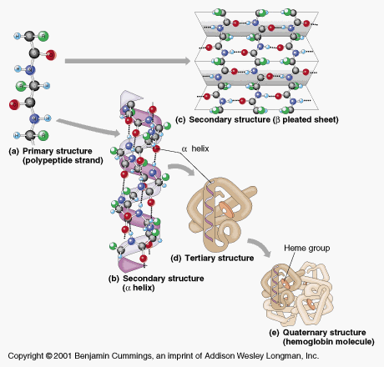
Primary and Secondary Structure of Proteins
From: http://www.mdx.ac.uk/www/lifesciences/alex/images/0321_1.gif

Slide 51
  Characteristics:
1. Enzymes are biochemical catalysts. They control the rate of chemical reactions by lowering the amount of energy needed to initiate the chemical reaction.
2. An important characteristic of catalysts is that they are NOT USED UP or changed when catalyzing a chemical reaction, thus they are available to repeat the catalysis repeatedly.

Slide 52
ACTIVATION ENERGY
Figure 1. Activation energy. The substrate contains a certain amount of trapped, or potential, energy. To release that energy, activation energy has to be added. The amount of energy needed to initiate the reaction can be lessened if an enzyme is present.

Slide 53
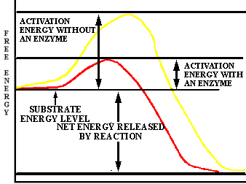
Potential energy diagram of an exothermic reaction

Slide 54
3. Enzymes are made of protein. Due to this fact, they display quite a complex, three-dimensional shape that is specific for particular substrate molecules.
Substrate molecules are chemicals that enzymes “work on”.
4. The area of an enzyme that is responsible for interacting with a substrate is the active site.
5. The active site of an enzyme is complementary to the substrate molecule.

Slide 55
6. The substrate will temporarily bind to the enzyme at the active site.
7. The enzyme will cause steric strain on the substrate causing it to become chemically unstable.
8. The instability of the substrate molecule will cause it to react with less energy than previously needed.

Slide 56
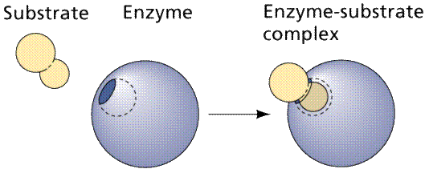
9. Catalysts cannot cause energetically unfavorable reactions to occur. They are only effective in catalyzing reactions that are already spontaneous.
10. The model that describes the interaction between enzyme and substrate is called the Lock and Key Model.

Slide 57
11. The active site of enzymes can be changed slightly to allow substrate molecules to bind.
This change in the enzyme’s active site is caused by the presence of the substrate.
This model of enzyme-substrate action is called the induced fit hypothesis. D:\ICIB.exe

Slide 58
12. The active site dictates whether the enzyme has the ability to catalyze a chemical reaction.
There are many factors that can affect the active site.
This is the key to understanding the regulation of enzyme activity.

Slide 59
b) Factors Affecting Enzyme Activity
KEY IDEA:
Enzymes have evolved to function optimally at a particular pH, temperature, and salt concentration.
Changes in any/all of these variables will result in enzyme denaturation.
This effectively changes the enzyme’s ability to catalyze reactions.

Slide 60
pH vs. Enzyme Activity
pH indicates the acidity/alkalinity of a solution by measuring the concentration of hydrogen ions.
Most enzymes function best at a pH range between 6-8.
Exceptions include the enzyme pepsin which functions to hydrolyze protein in the acidic fluids of the stomach. The higher levels of acidity in the stomach causes a conformational change in the enzyme’s active site.
This results in the change of the inactive pepsin to the active pepsinogen.

Slide 61
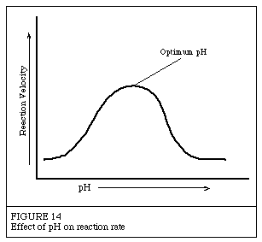

Slide 62
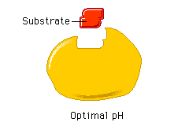

Slide 63
Table II pH for Optimum Activity
Enzyme | pH Optimum
Lipase (pancreas) | 8.0
Lipase (stomach) | 4.0 - 5.0
Lipase (castor oil) | 4.7
Pepsin | 1.5 - 1.6
Trypsin | 7.8 - 8.7
Urease | 7.0
Invertase | 4.5
Maltase | 6.1 - 6.8
Amylase (pancreas) | 6.7 - 7.0
Amylase (malt) | 4.6 - 5.2
Catalase | 7.0

Slide 64
2. Temperature vs. Enzyme Activity
Temperature is a measure of the average kinetic energy of matter.
Increases in temperature increases the KE and thus increases the velocity of the particles of matter.
By increasing temperature, the probability of effective collisions between reactants and between enzyme and reactants increases, thus increasing the reaction rate.

Slide 65
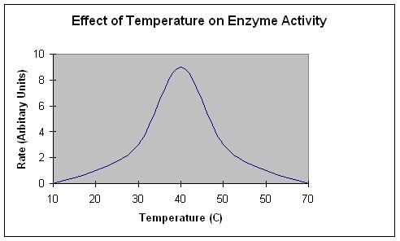
Denaturation

Slide 66
However, when the temperature of a system exceeds the level to which the enzyme is adapted to functioning, the enzyme denatures and the reaction rate decreases.
OVERVIEW: By changing the pH, temperature, and salinity of a system in which enzymes are functioning, a destabilization of the tertiary structure of the enzyme ensues. This causes a change in the enzyme’s active site resulting in denaturation.

Slide 67
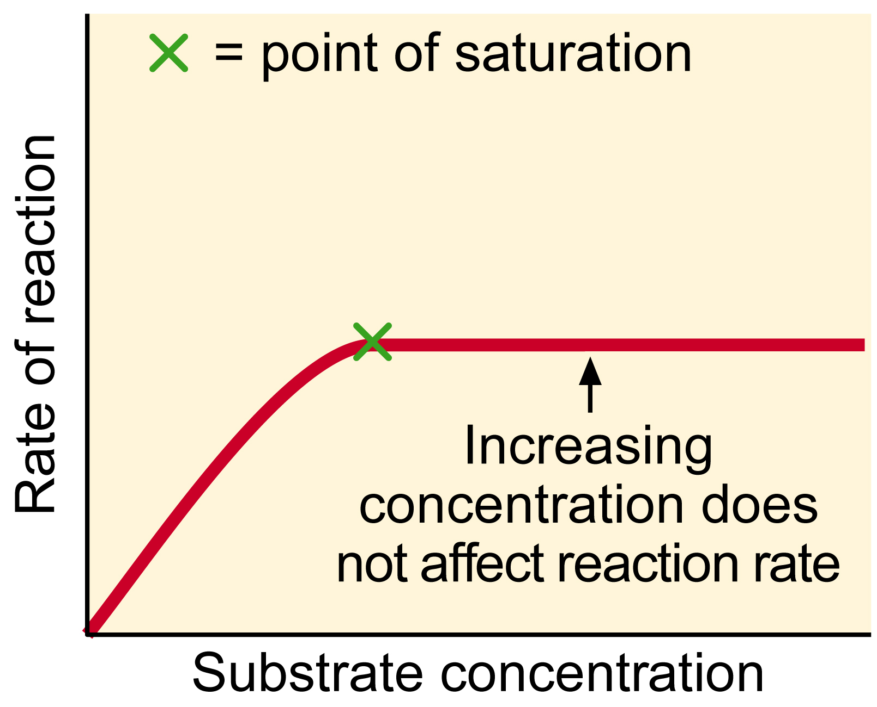
3. Substrate Concentration and Enzyme Activity
An increase in substrate concentration will cause a greater probability of a reaction with enzymes.
This will cause an increase in enzyme activity until all of the enzymes are functioning at which point the activity remains constant.

Slide 68
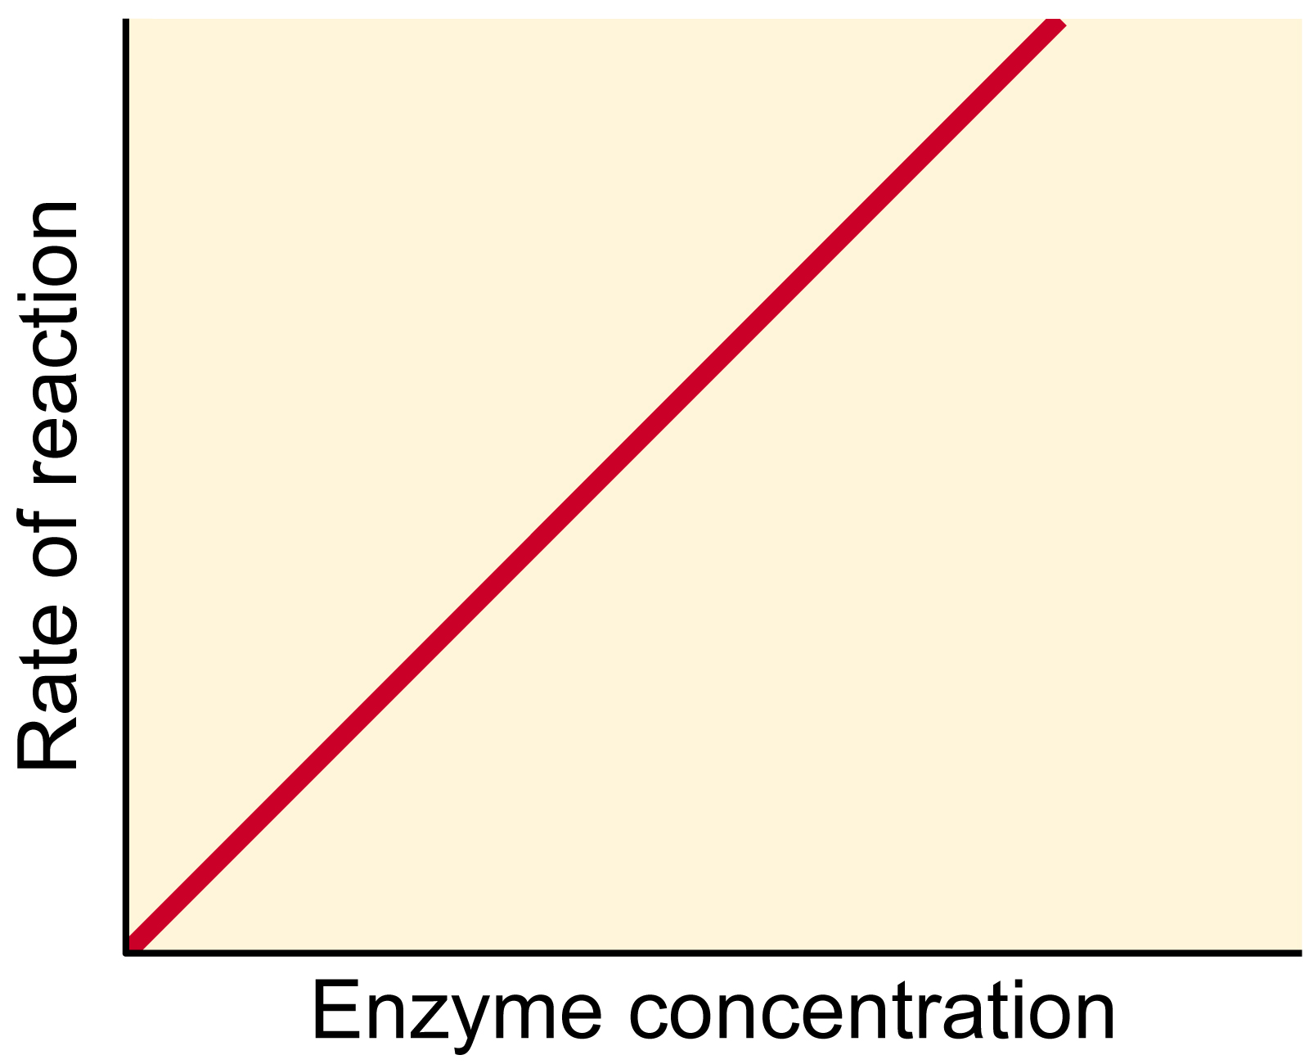
4. Enzyme Concentration vs. Enzyme Activity
An increase in enzyme concentration with an abundance of substrate will cause the reaction rate to increase.
Enzyme Concentration vs. Enzyme Activity

Slide 69
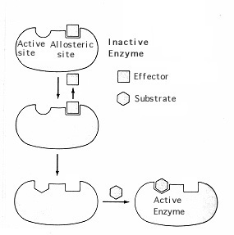
c) Metabolism Regulation Via Controlling Enzyme Activity
Allosteric Regulation: Certain molecules bind to a binding site, distinct from the active site. These molecules can act as activators or inhibitors by changing the active site configuration.

Slide 70
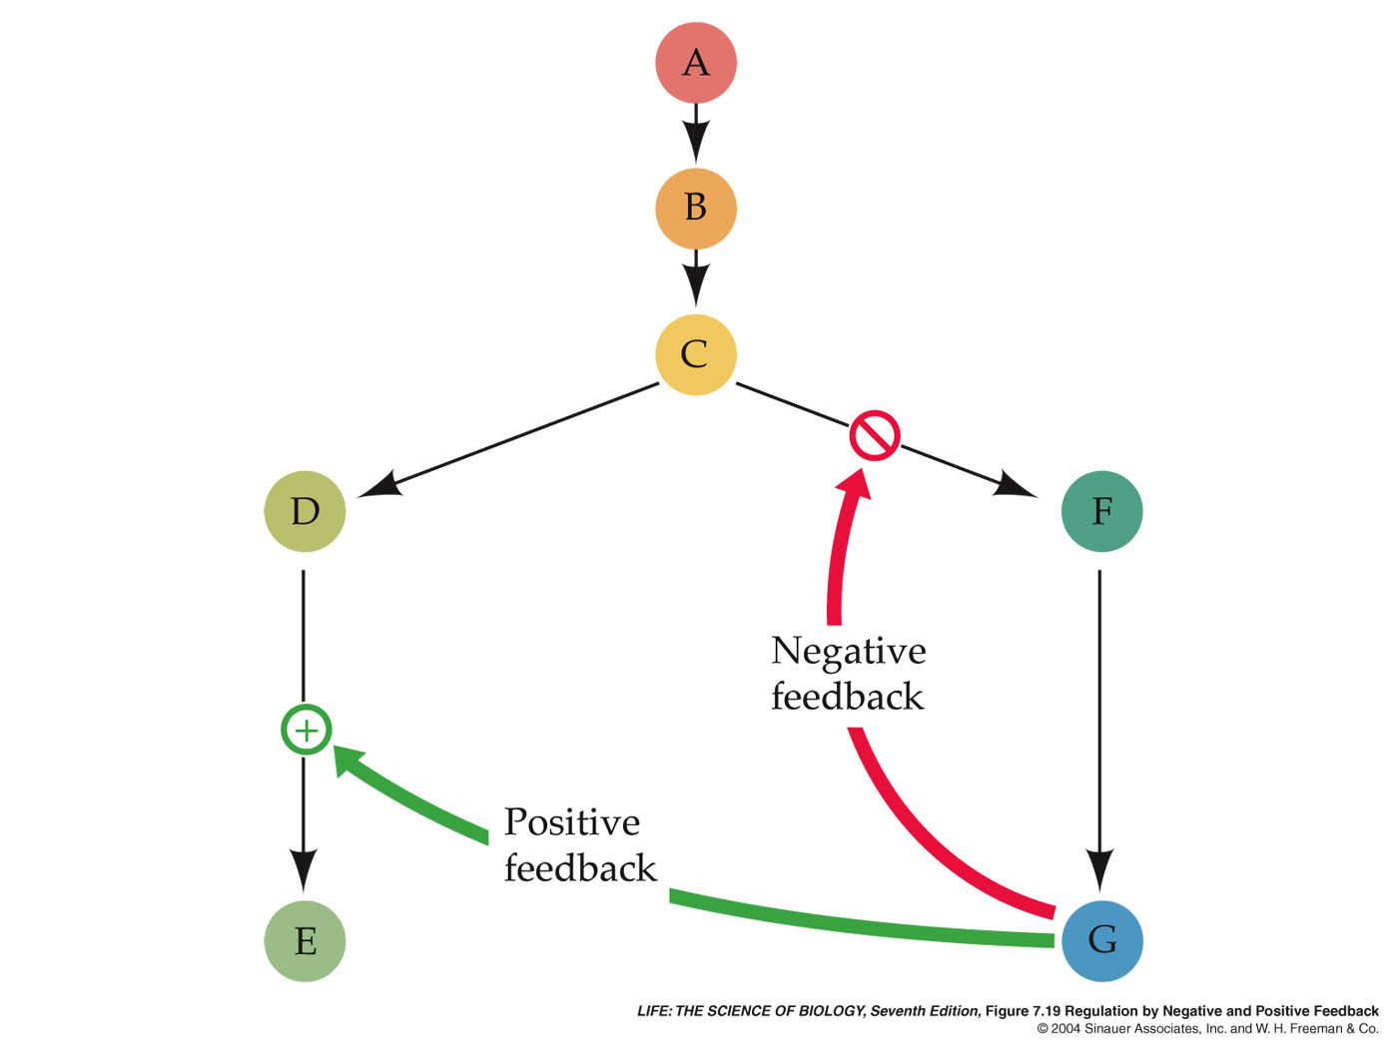
Feedback Inhibition: a method of metabolic control in which the end-product of a metabolic pathway acts as an inhibitor of an enzyme within that pathway. D:\ICIB.exe

Slide 71
1. Types of Inhibition
Competitive Inhibition: the process in which a molecule similar in shape to the substrate binds to the active site, effectively blocking the substrate molecule.
Ex: Alcohol metabolism
Noncompetitive Inhibition: the process in which a molecule binds to a site different from the active site on the enzyme. This interaction changes the shape of the active site blocking the substrate molecule.

Slide 72
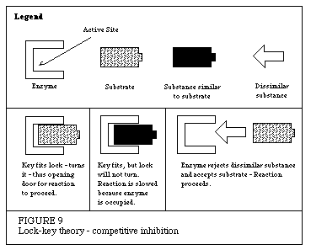

Slide 73
