Slide 1
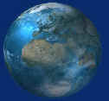
Ecology
Humans and the Environment:
The Impacts That Humans Have Upon the Environment

Slide 2
I .Human Impacts on the Environment
Environmental change, for better or worse, has not been impacted so greatly if not for the human species.
a) Population Growth and Industrialization
By-products of industrialization
1. Industrialization is driven by energy consumption from coal, petroleum, and natural gas.
a. Fossil fuels were formed by decomposition and pressure on remains of plants and animals millions of years ago
b. Oil is the fuel most widely used, both as starting material for making gasoline and for other products

Slide 3
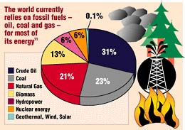

Slide 4
2. Pollution is any environmental change that adversely affects the lives and health of living things
a. Burning fossil fuels results in hydrocarbons, carbon dioxide, nitrogen dioxide, and sulfur oxide particulates.
b. Automobiles consume one-third of the world's production of oil and are the chief source of air pollution.
c. Some estimate there will be four times more automobiles in the world in 2025.
d. These sources are considered nonrenewable since they are in limited supply.

Slide 5
3. Nonpolluting sources of energy do exist.
a. Solar energy does not add additional heat to the atmosphere; solar panels absorb and move rooftop heat.
b. Photovoltaic (solar) cells produce energy directly from sunlight.
c. Falling water is used to produce electricity in hydroelectric dams.
d. Geothermal energy derived from heat in the earth's core heats water to heat buildings, generate electricity.
e. Wind power can pump water or generate electricity.
f. These sources are all considered renewable since they are replenished by physical means.

Slide 6
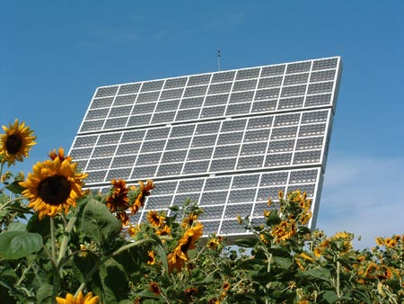
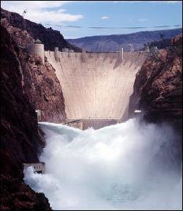
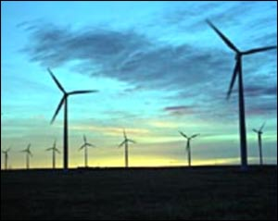
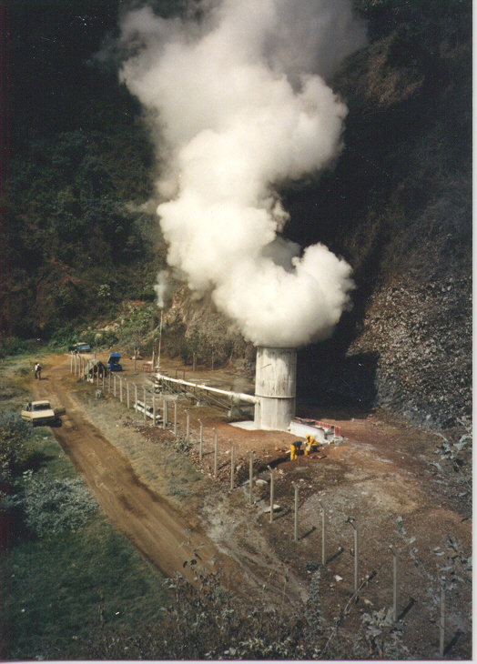
Hydroelectric Power
From: http://www.ecology.com/feature-stories/nuclear-energy-challenge/images/03.jpg
Solar Panels
From: http://www.csupomona.edu/~crs/gallery/images/Solar%20Energy%20Concentrator.jpg
Geothermal Energy
From: http://www.geothermex.com/images/zunil.jpg
Wind Power
From: http://www.ecology.com/feature-stories/nuclear-energy-challenge/

Slide 7
b) Global climate change: Climate Fluctuation
1. Earth's climate fluctuates; we are currently between ice ages, and today's climate was last seen 130,000 years ago.
2. Some scientists are concerned that global climate will warm at a rate ten times faster than in the past.
a. In 1850, atmospheric CO₂ was about 280 parts per million (ppm); today, it is about 350 ppm.
b. This increase is due largely to burning of fossil fuels and clearing of forests
c. Oceans currently absorb half of the CO₂ emitted or else the atmospheric level would be higher.

Slide 8
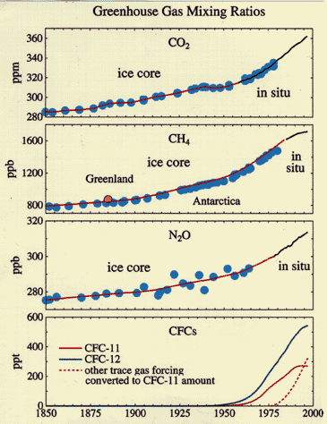
Changes in Greenhouse Gas Emissions from 1850 to present
From: http://www.agu.org/eos_elec/99148efig1.gif

Slide 9
d. Methane given off by oil and gas wells, rice paddies, cows, etc. is increasing by one percent a year.
e. Greenhouse effect - warming of lower atmosphere caused by accumulation of certain greenhouse gases that allow rays of the sun to pass through, but then reflect or reradiate heat to the earth.
f. Greenhouse gases:
1) carbon dioxide (CO₂), produced by fossil fuel and wood burning.
2) nitrous oxide (NO₂), produced by fertilizer use and released from decomposition of animals wastes.
3) methane (CH₄), produced by bacteria (especially in animal guts), in sediments, and in flooded rice paddies
4) chlorofluorocarbons (CFCs), in particular Freon (a refrigerant).

Slide 10
III. Acid precipitation (rain)
a) Rainfall pH
1. Pure water has a pH of 7.
2. Atmospheric CO₂ combines with water to produce a weak carbonic acid.
3. Rain normally has a pH of 5.6 rather than 7.0
4. However, near urban areas, rainfall pH is nearer 4.0 and some fog clouds drop to as acidic as 1.7.
5. Living vegetation and building limestone rapidly deteriorate under such "acid rains“.

Slide 11
b) Sources
1. Coal and oil routinely burned by power plants emit sulfur dioxide (SO₂) into the air.
2. Kuwait oil has high sulfur content; the oil well fires released much sulfur dioxide (SO₂) into the atmosphere.
3. Automobile exhaust contributes nitrogen oxides to the air.
4. Both sulfur dioxide and nitrogen oxides are converted to acids when they combine with water vapor in the air.
5. Sulfur and nitrogen oxides are emitted in one locale; deposition occurs in another location across boundaries due to wind currents.

Slide 12
c) Effects of Acid Rain
1. Acid deposition is responsible for the following:
killing lakes and forests in North America and Europe.
killing small invertebrates and decomposers and threatening the ecosystem.
reducing agricultural yields.
causing extensive structural damage by corroding marble, metal, and stonework.
degrading water supplies by leaching heavy metals from the soil into drinking-water supplies.
statistically is implicated in increases in lung cancer and colon cancer.

Slide 13
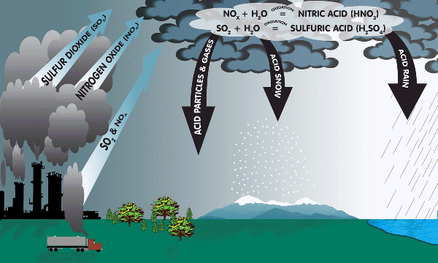
Acid Rain

Slide 14
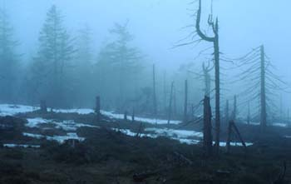
Effects of Acid Rain
Black Forest of Germany

Slide 15
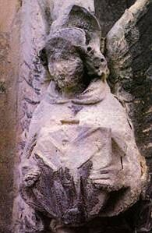
The Effects of Acid Rain of a Statue
From: http://eces.org/gallery/000465.php

Slide 16
IV. Photochemical smog
A. Photochemical smog is air pollution that contains nitrogen oxides (NOx) and hydrocarbons (HC), which react in the presence of sunlight to produce ozone (O₃) and peroxylacetyl nitrate (PAN)
B. Both NOx and hydrocarbons come from fossil fuel combustion, but additional hydrocarbons come from various other sources as well, including paint solvents and pesticides.
C. Breathing O₃ affects respiratory and nervous systems, results in respiratory distress, headache, and exhaustion.
D. Ozone is damaging to plants, resulting in leaf mottling and reduced growth.

Slide 17
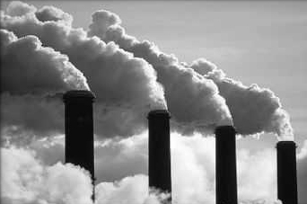
Causes of Smog
From: http://www.angiobon.net/arainneachd/smog.jpg

Slide 18
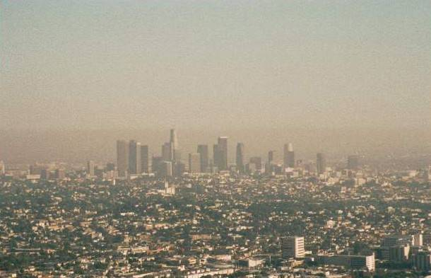
Effects of smog in Los Angeles, California
From:http://www.gps.caltech.edu/~fry/pictures/smog.jpg

Slide 19
E. Carbon monoxide
1. Carbon monoxide (CO) is a gas that comes from burning of fossil fuels in the industrial regions.
2. High levels of CO increase the formation of ozone (O₃).
3. CO combines preferentially with hemoglobin and prevents hemoglobin from carrying oxygen.

Slide 20
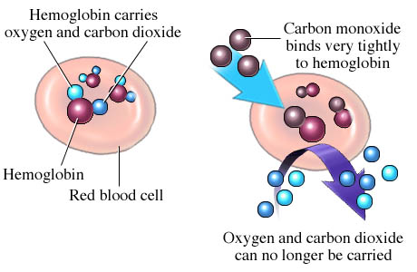
Red Blood Cells prefer to bond with carbon monoxide rather than oxygen. This results in headaches, nausea, and could lead to death.
From: http://health_info.nmh.org/hwdb/images/hwstd/medical/hematol/n5551241.jpg

Slide 21
F. Thermal inversion
1. Normally, warm air near the ground rises and dissipates into the upper atmosphere.
2. Air pollutants, including smog and soot, are sometimes trapped near earth due to a thermal inversion.
3. Thermal inversion occurs when a layer of dense cold air is trapped under a layer of warm air.
4. Areas around hills are susceptible because air stagnates, with little mixing.

Slide 22
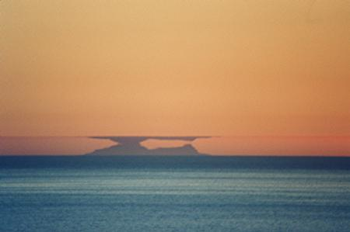
Thermal Inversion on Catalina Island, California
From: http://flzhgn.home.mindspring.com/jpg_files/catalina22.jpg

Slide 23
V. Ozone depletion
A. The ozone shield is a layer of ozone (O3) in the stratosphere, some 50 km above the earth's surface
B. It absorbs much of the ultraviolet (UV) radiation of the sun, preventing it from reaching the earth's surface
C. In the history of life, ozone shield permitted life on land to exist; aquatic organisms are shielded by water.
D. Hazards of UV radiation include increased mutation rate, which can lead to skin cancer and cataracts; depression of immune system; impaired crop and tree growth; and death of plankton.

Slide 24
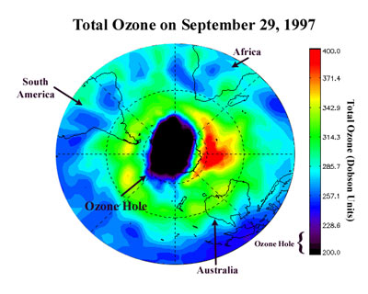
Ozone Layer Hole over Antarctica
From: http://www.met.sjsu.edu/~cordero/education/ozone_hole_where.jpg

Slide 25
E. It became apparent in the 1980s that some depletion of worldwide ozone had occurred.
F. By the 1990s, there was an annual loss of 40-50% of ozone above Antarctica
G. U.N. Environment Program predicts a 26 percent rise in cataracts and nonmelanoma skin cancers for every 10 percent drop in ozone; this is 1.75 million cases of cataracts and 300,000 more cases of skin cancer every year.

Slide 26
H. The cause of ozone depletion can be traced to the release of chlorine (Cl-) atoms in the stratosphere.
1. Chlorine atoms combine with ozone and strip away oxygen atoms one by one
2. One atom of chlorine destroys up to 100,000 molecules of ozone before settling to earth's surface
3. Chlorine atoms come from breakdown of CFCs, which were in heavy human use from 1950 to 1990.
4. Freon is a common CFC used in refrigerators and air conditioner.
5. Other CFCs occurred in cleaning agents, production of plastics, and as spray can propellants.
6. Most countries have agreed to stop use of CFCs by 2000; CFCs in atmosphere will remain for a century.

Slide 27
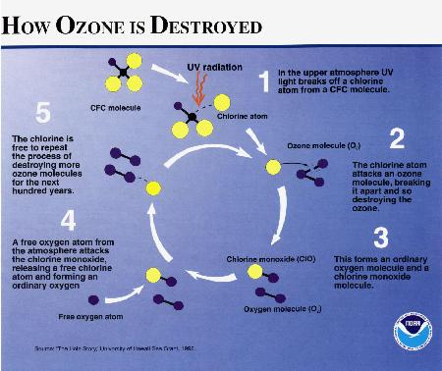
From: http://www.tamucc.edu/~whatley/padm5370/ozone/odes2.jpg

Slide 28
VI. Water
A. Pollution of Surface Waters
1. Pollution contributes to the shortage of fresh water
2. Solid wastes include household trash, sewage sludge, agricultural residue, mining refuse, and industrial waste
B. Sewage
1. Sewage treatment plants degrade organic wastes, which would otherwise cause oxygen depletion in lakes
2. Human feces contains pathogens that cause cholera, typhoid fever, and dysentery; these kill many children.

Slide 29
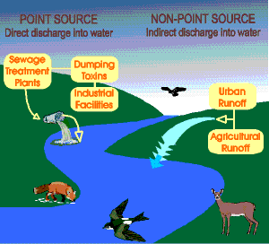
Sources of Water Pollution
From: http://www.deq.state.la.us/assistance/educate/liquid5b.gif

Slide 30
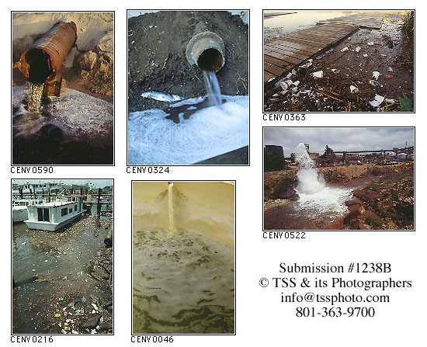
Water Pollution

Slide 31
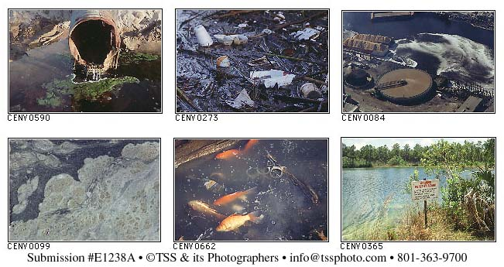
Water Pollution

Slide 32
C. Pollution of oceans
1. The oceans are the final recipients of wastes deposited in rivers and along the coasts.
2. Waste dumping occurs at sea, and ocean currents sometimes transport both trash and pollutants back to shore.
3. Solid pollutants cause death of birds, fish, and marine mammals that mistake them for food and get entangled.

Slide 33
4. Offshore mining and shipping add pollutants to the oceans
a. Five million metric tons of oil a year, over one gram per 100 square meters of ocean surface, ends up in oceans
b. Large oil spills kill plankton, fish larvae, and shellfishes, as well as birds and marine mammals
c. The Exxon Valdez oil spill in Alaska's Prince William Sound leaked 44 million liters of crude oil
d. In Gulf War, 120 million liters were released from damaged onshore storage tanks in the Persian Gulf
e. Petroleum is biodegradable; takes a long time because low-nutrient content does not support bacteria
5. Some species of fish are in dramatic decline from combined effects of pollution and overfishing.

Slide 34
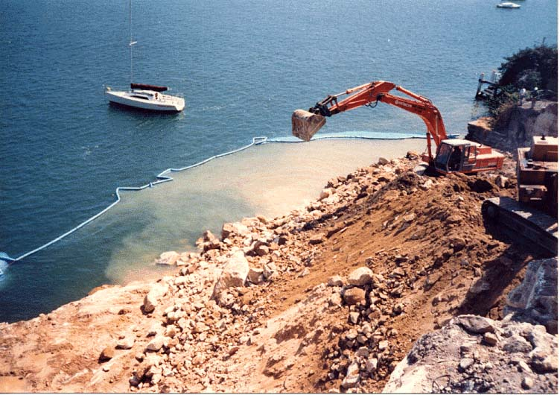
Water Pollution in Tropical Reef Ecosystem
From: http://www.pccd.com.au/Boom-jpg.jpg

Slide 35
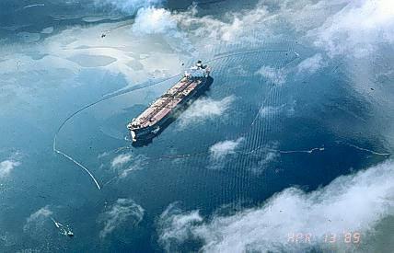
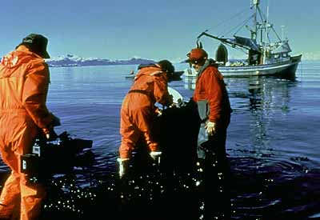
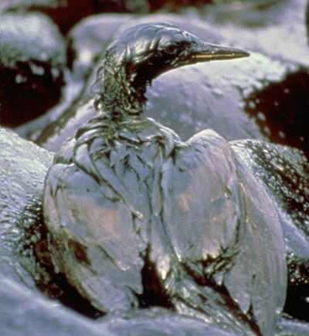
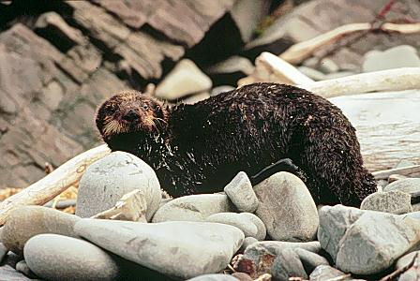
Exxon Valdez tanker circled with containment boom
Oil spill cleanup
Oiled cormorant on a rocky oil-covered shore
Oiled sea otter on shore

Slide 36
VII. Soil erosion, desertification, and deforestation
A. City populations increase
1. In 1950, 20 percent of the world population lived in cities; by 2000 it is predicted that 60 percent will live in cities.
2. As new housing is built around new cities, it takes over agricultural land.
B. Soil erosion and desertification
1. In agricultural areas, wind and rain carry away about 25 billion tons of top soil yearly, worldwide.
2. At such a rate, it is estimated that practically all top soil will be lost by the middle of the next century.

Slide 37
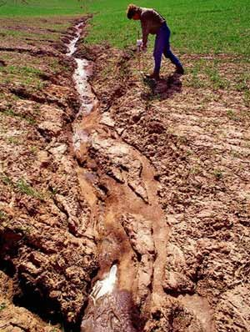
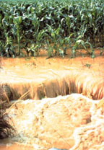
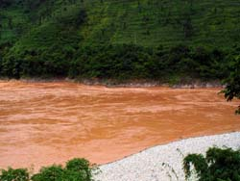
Soil Erosion
From: http://static.howstuffworks.com/gif/irrigation-soil-erosion.jpg

Slide 38
3. Soil erosion causes a loss of productivity; it is compensated for by fertilizers, pesticides, and fossil fuel energy.
4. Desertification is transformation of marginal lands to desert conditions due to overgrazing and overfarming.
a. This is most evident along the southern edge of the Sahara Desert in Africa.
b. Over 240,000 square miles of once-productive grazing land has become desert in the last fifty years.
c. A similar process can occur if U.S. rangeland is overgrazed.

Slide 39
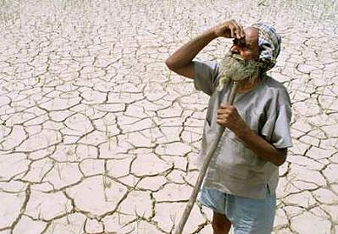
Desertification due to Improper Land Management

Slide 40
C. Deforestation
1. In Canada, vast stands of trees are scheduled to be felled for paper, wood products and particleboard.
2. Tropical rain forests are more biologically diverse than temperate forests.
3. One million species are in danger of disappearing in 20 years due to deforestation.
4. Lost species that have never been studied may have been sources of food or medicine.

Slide 41
5. Logging in tropical forests meets the demand for furniture and also the desire of local people to farm the land.
6. Slash-and-burn agriculture also contributes to the destruction of tropical rain forests.
a. The ashes provide temporary nutrients to raise crops.
b. After a few years, the fertility of the land is insufficient to raise crops and farmers move on.
c. Cattle ranching usually takes over from farming.

Slide 42
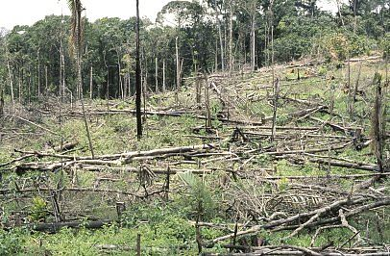
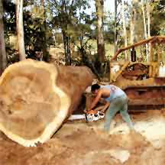
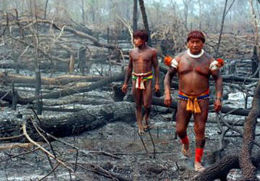
Deforestation

