Slide 1
Evolution
Descent with Modification

Slide 2
I. Evolution
a) Definition:
Evolution is a change in the genes of a population of organisms over time.
A gene is a unit of hereditary that can be passed on unchanged for many generations.
b) Biodiversity: A History of Explanation
1. Biodiversity refers to the great amounts of anatomical and physiological differences within and between species of organisms.
Species: A group of organisms capable of breeding and producing fertile offspring.

Slide 3
2. Creationism
The idea that a divine creator established the vast diversity of life on earth.
The ideas of creationism have existed for thousands of generations to help explain natural phenomenon.
The scientific revolution has brought into question the ideas of creationism due to its lack of evidence.

Slide 4
3. Evolution and biodiversity
The ideas of evolution contradicts the ideas of creationism.
However, the theory of evolution can be tested using the scientific method and thus evidence supporting (and also refuting) the ideas were obtainable.

Slide 5
c) Historical Development of Evolutionary Biology
1. The Greek philosophers Plato and Aristotle held opinions that were directly opposed to the ideas of evolution.
2. Carolus Linnaeus: (1707-1778)
founder of the modern system of taxonomy (naming and classification of organisms).
developed a system of binomial nomenclature (genus and species).
Linnaeus did not make the connection between his system of classification and evolution. However, a century later Darwin used Linnaeus’s system as evidence for his theory of Natural Selection.

Slide 6
3. Jean Baptiste de Lamarck (1744-1829)
Lamarck developed one of the first theories on how species changed.
Lamarck (1809) concluded that organisms of higher complexity had evolved from preexisting, less complex organisms.
He proposed the inheritance of acquired characteristics (length of the giraffe neck).
The idea of use and disuse indicated that the stretching of necks resulted in their development, which was somehow passed on to their progeny.
Although Lamarck’s mechanism for evolutionary change was wrong, it provoked the impetus for the development of the theory of

Slide 7
4. Charles Darwin
The Theory of Natural Selection
Darwin, former divinity student, former medical student, secured a position as ship's naturalist on the H.M.S. Beagle.
Darwin collected plant, animal and fossil specimens, as well as making extensive geological observations.
Darwin settled on four main points of the theory.
Adaptation: all organisms adapt to their environments.
Variation: all organisms are variable in their traits.
Over-reproduction: all organisms tend to reproduce beyond their environment's capacity to support them (based on the work of Thomas Malthus).
natural selection : the idea that not all organisms are equally well adapted to their environment. "survival of the fittest".

Slide 8
5. The Darwin Theory
Individuals in a population have variable levels of agility, size, ability to obtain food, and different successes in reproducing.
Left unchecked, populations tend to grow, leading to a scarcity of resources.
In the struggle for existence, some individuals are more successful than others, allowing them to survive and reproduce.
Those organisms best able to survive and reproduce will leave more offspring than those unsuccessful individuals.
Over time there will be heritable changes in phenotype and genotype of a species, resulting in a transformation of the original species into a new species similar to, but distinct from, its parent species.

Slide 9
d) Natural Selection and Genetics
1. Darwin could not adequately explain how evolution occurred because he did not know the source of variations within organisms.
2. The question that remained was, “How were these inheritable traits (variations) passed on to the next generation?”

Slide 10
II. Evidence for Evolution
Overview: How do we know that evolution has occurred?
The evidence for evolution has primarily come from four sources:
The fossil record of change in earlier species.
The chemical and anatomical similarities of related life forms.
The geographic distribution of related species.
The recorded genetic changes in living organisms over many generations.

Slide 11
a) Fossils: Types and Modes of Formation
1. Definition: the remains of a previously existing organism.
2. The formation of fossils is only possible if part or the whole organism is preserved after death (prevention of decomposition).
The difficulty in fossil formation is due to the relative ease in which soft tissue decomposes and the low probability of the optimal conditions for tissue preservation.

Slide 12
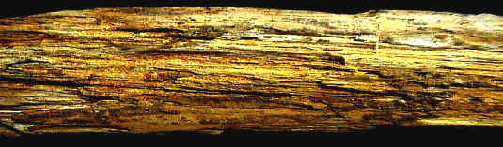
3. Fossil Formation:
Petrification occurs when the pores of the plant or animal remains are replaced by minerals.
The original shape of the object is not changed.
Petrified Wood

Slide 13
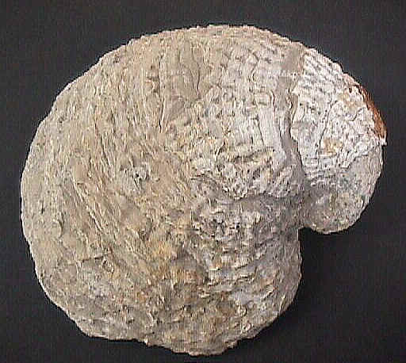
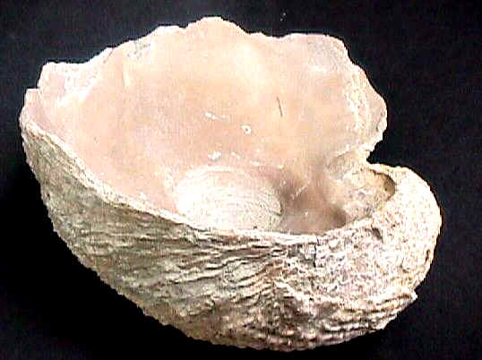
Molds and cast are types of fossils where the physical characteristics of organisms have been impressed onto rocks.
This happened when organisms became buried or trapped in mud, clay, or other materials which hardened around them. The bodies decayed, leaving molds of the organism.
Casts of the Shells of Mollusks (clams)

Slide 14
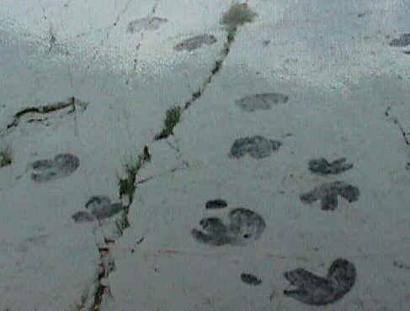
Impressions are two dimensional imprints of an organism which contain no organic matter.
Impressions may be of plants or animals, or of tracks or footprints left by organisms.
Most impressions are found in fine-grained sediment such as clay or silt.
Impressions are formed when the soft mud or sediment in which they are made hardens into stone.
Dinsasaur Ridge Photo by L.Arnold

Slide 15
Whole organism preservations are incredibly rare.
Most fossils consist of only parts of an organism, such as bones, shells, teeth, or footprints.
Some of the best-known whole fossils are eggs of dinosaurs, small reptiles, and birds.
The La Brea tar pits provide excellent examples of fossils which are of the whole organism. Bones, complete skeletons, insects, leaves, and flowers have been reclaimed from this site.
Wax and amber are excellent preservative. It preserves all parts of the organism, not just the hard parts.
Desiccation and Mummification occurs in areas void of moisture, such as the desert or in a dry cave. Dehydration occurs and the entire organism is preserved.

Slide 16
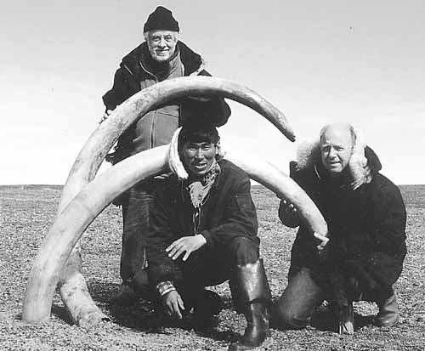
Freezing preserves a fossil of the highest quality.
It preserves the organism with little alteration to the chemical composition. The temperature prevents little, if any, change to the organism.

Slide 17
b) The Fossil Record
Geological strata containing an evolutionary sequence of fossils
1. Remains of organisms (fossils) found in sedimentary rock deposits give us an indisputable record of past changes through time.
2. This evidence attests to the fact that there has been a tremendous diversity of living things.
3. Some now extinct species had traits that were transitional between major groups of organisms. Their existence confirms that species are not fixed but can evolve into other species over time.
4. The evidence also shows that what have appeared to be gaps in the fossil record are due to incomplete data collection.
5. The more that we learn about the evolution of specific species lines, the more that these so-called gaps or "missing links in the chain of evolution" are filled with transitional fossil specimens.

Slide 18
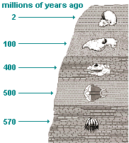
Geological Strata Indicating the Relative Age of Various Fossils

Slide 19
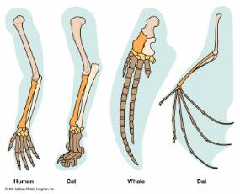
c) Comparative Anatomy
1. Many groups of species share the same types of body structures because they inherited them from a common ancestor that had them.
2. This is the case with the vertebrates, which are the animals that have internal skeletons.
Homologous Structures (structural similarity, different function).
The arms of humans, the forelegs of dogs and cats, the wings of birds, and the flippers of whales and seals all have the same types of bones (humerus, radius, and ulna) because they have retained these traits of their shared common ancient vertebrate ancestor.

Slide 20
Analogous Structures
Structures that they serve the same function in different species but they evolved independently.
An example of analogous structures would be the wings on butterflies, bats and birds.
Vestigial Structures
Structures found in an organism with little or no known function.
Such structures are thought to be remnants of a structure that at one time had a function in an ancestral species.
Examples include pelvic and leg bones of both whales and snakes that are left over from ancestral species that walked.

Slide 21
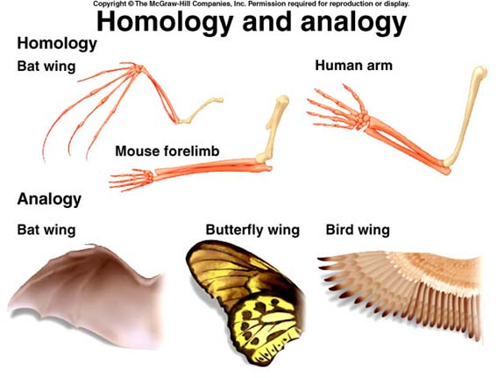

Slide 22
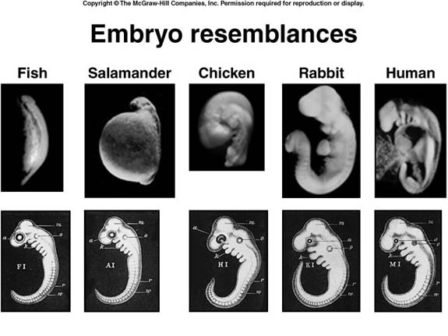
d) Comparative Embryology
Comparative embryology helps support the theory of evolution by comparing embryos of very different species of organisms.
Developing organisms look very similar to one another and often pass through developmental stages that resemble the organisms from which they evolved.

Slide 23
e) Comparative Biochemistry
Molecular evidence for evolution includes similarities at the gene, protein, chromosomal, and genome levels.
Gene sequence differences among species can be placed in a time frame derived from mutation rates.
By comparing the similarities and differences between the DNA and proteins of different species of organisms, scientists can hypothesize whether they share common evolutionary ancestors.

Slide 24
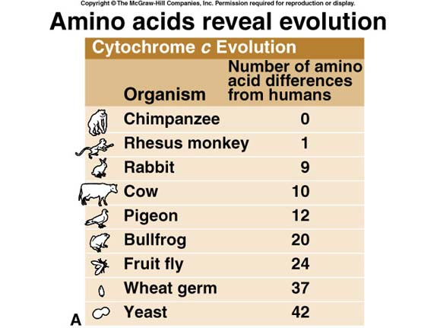

Slide 25
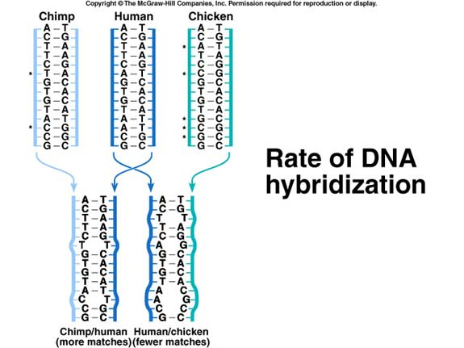

Slide 26
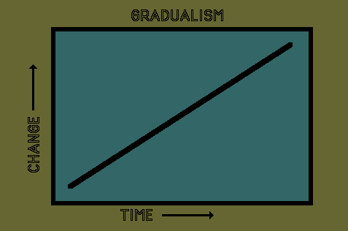
III. The Pace of Evolution
a) Gradualism: The pace of evolution is often slow, so slow that all of the stages in species formation cannot be observed.
The traditional, or Darwinian, view of evolution was that it was a very slow process, resulting from the gradual accumulation of small differences.

Slide 27
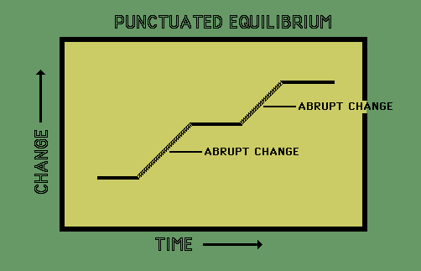
b) Punctuated Equilibrium: speciation occurs rapidly over a short time, followed by a long period of little or no change.

Slide 28
IV. EVOLUTIONARY TRENDS
a) An increase or decrease in size.
This may be for the whole body or certain parts (such as teeth, brain, horns, etc.).
b) A reduction or increase in the number of certain body parts, such as ribs, toes, fingers, teeth, etc.
c) An increase in the complexity of certain body parts, such as brain, armor (dinosaurs), etc.
NOTE: Some organisms did not change much over very long periods of time. Ones that are still living (extant) are called living fossils (examples: the brachipod Lingula, the opossum, the coelocanth (Latemeria).

Slide 29
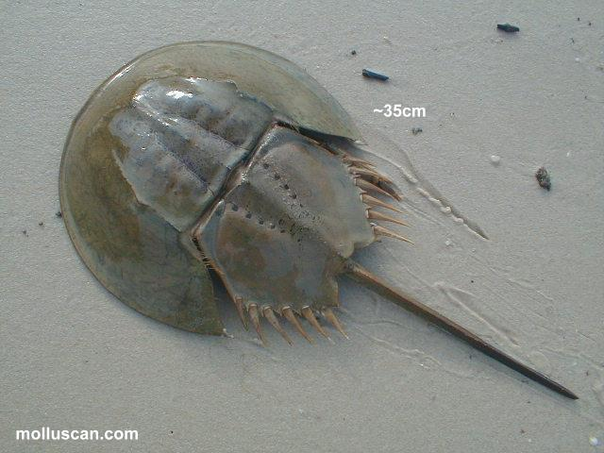
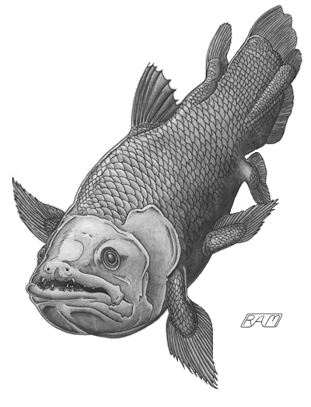
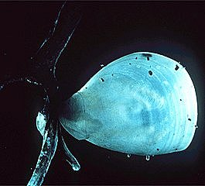
Horseshoe Crab
Coelocanth
Brachiopod
Living Fossils

