Slide 1
Heterotrophic Nutrition
The intake and use of organic molecules

Slide 2
Nutrition
a) Heterotrophic Nutrition: Simple versus Complex Organisms
1. Single-celled and simple multicellular organisms can directly take in nutrients from their outside environment.
Small, simple organic molecules can pass directly through the cell membrane via passive transport (diffusion).
Large, complex organic molecules can be actively obtained by cells via phagocytosis and pinocytosis.
2. Complex multicellular animals, with most of their cells removed from contact directly with the outside environment, have developed specialized structures for obtaining and breaking down their food.
Animals depend on two processes: feeding and digestion.

Slide 3
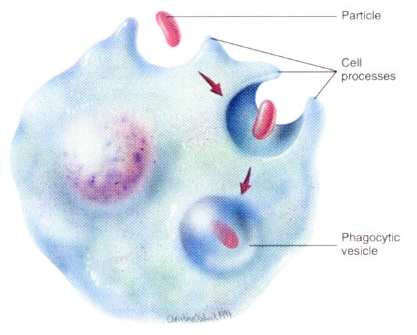
Phagocytosis

Slide 4
b) Plans and Locations
1. Types of Digestion: The digestive system uses mechanical and chemical methods to break food down into nutrient molecules that can be absorbed into the blood.
2. Types of Digestive Systems: Vertebrates (organisms with backbones) use an efficient tube-within-a-tube plan with food entering through one opening (the mouth) and wastes leaving through another (the anus).
3. Locations of Digestion
Intracellular digestion: food is taken into cells by phagocytosis with digestive enzymes being secreted into the phagocytic vesicles; occurs in very simple organisms.
Extracellular digestion: digestion occurs in the opening of the digestive system, with the nutrient molecules being transferred to the blood or body fluid; occurs in chordates.

Slide 5
c) Stages in the Digestive Process
1. movement: propels food through the digestive system
2. secretion: release of digestive juices in response to a specific stimulus
3. digestion: breakdown of food into molecular components small enough to cross the plasma membrane
4. absorption: passage of the molecules into the body's interior and their passage throughout the body
5. elimination: removal of undigested food and wastes

Slide 6
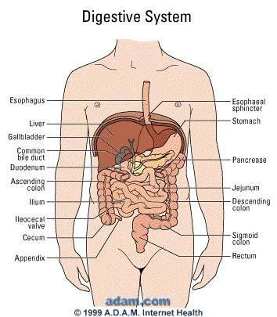

Slide 7
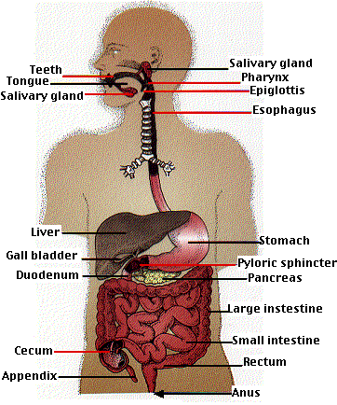

Slide 8
d) The Structures and Functions of the Human Digestive System
The human digestive system is a coiled, muscular tube (6-9 meters long when fully extended) extending from the mouth to the anus.
Several specialized compartments occur along this length: mouth, pharynx, esophagus, stomach, small intestine, large intestine, and anus.
Accessory digestive organs are connected to the main system by a series of ducts: salivary glands, parts of the pancreas, and the liver and gall bladder.
Digestive enzymes are secreted from cells lining the inner surfaces of various exocrine glands.
The enzymes hydrolyze the macromolecules in food into small, soluble molecules that can be absorbed into cells.

Slide 9
1. Mouth and Pharynx
Mechanical breakdown begins in the mouth by chewing (teeth) and actions of the tongue.
Chemical breakdown of starch (carbohydrate) by production of salivary amylase (a digestive enzyme) from the salivary glands.
This mixture of food and saliva is then pushed into the pharynx (the back of the throat) and esophagus (food tube).

Slide 10
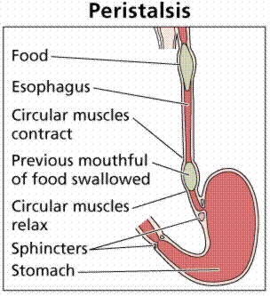
2. Esophagus
The esophagus is a muscular tube whose muscular contractions (peristalsis) moves food to the stomach.
The esophagus is located behind the windpipe (trachea) of the respiratory system.
Food is prevented from entering the “wrong pipe” (trachea) by a flap of skin called the epiglottis.
Peristalsis and the movement of food from the mouth to the stomach. Image from Purves et al., Life: The Science of Biology, 4th Edition, by Sinauer Associates (www.sinauer.com) and WH Freeman (www.whfreeman.com, used with permission.

Slide 11
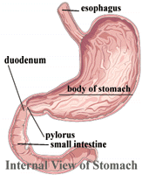
3. Stomach – the chemical digestion of protein.
The stomach produces hydrochloric acid and pepsin which is a protease (an enzyme that breaks down protein).
The stomach also mechanically churns the food.
Chyme, the mix of acid and food in the stomach, leaves the stomach and enters the small intestine.
Pyloric (mucous) and parietal (HCl) glands are found within the lining of the stomach.
Chief cells release pepsinogen (inactive protease).

Slide 12
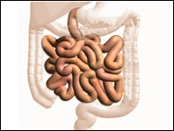
4. The Small Intestine
The small intestine, a long coiled tube over 3 meters, is where final digestion and absorption of digested food into the blood occur.
The digestion of lipids occur in the small intestines.
Final digestion of proteins and carbohydrates occurs in the small intestines.
The SI consists of three sections: the duodenum, jejunum, and the ileum.

Slide 13
Enzymes that are responsible for this process include:
- aminopeptidases attack the amino terminal (N-terminal) of peptides producing amino acids.
- disaccharidases which convert disaccharides into their monosaccharide subunits.
  - maltase hydrolyzes maltose into glucose.
  - sucrase hydrolyzes sucrose (common table sugar) into glucose and fructose.
  - lactase hydrolyzes lactose (milk sugar) into glucose and galactose.
- fatty acids and monoglycerides become resynthesized into fats as they enter the cells of the villus. The resulting small droplets of fat are then discharged by exocytosis into the lymph vessels, called lacteals, draining the villi.
The juices of the small intestines are alkaline.

Slide 14
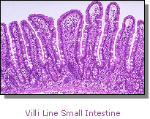
Villi (which are small finger-like structures) make up the small intestines and are surrounded by small blood vessels called capillaries. The villi increase the surface area of the intestines to maximize nutrient absorption into the blood.

Slide 15
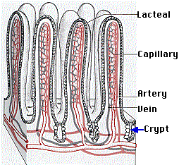
Microscopic Structure of the Villi of the Small Intestines
Lacteals, which are part of the lymphatic system, are responsible for the absorption of fat globules in the small intestines.
From: http://users.rcn.com/jkimball.ma.ultranet/BiologyPages/G/GITract.html

Slide 16
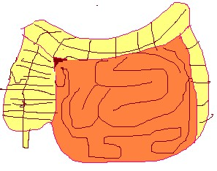
5. The Large Intestine
The large intestine is made up by the colon, cecum, appendix, and rectum.
Material in the large intestine is mostly indigestible food which is egested.
Water, salts, and vitamins are absorbed by the large intestines.
Mutualistic bacteria (E.coli) exist in large intestines; aids in releasing vitamins from undigested food and by synthesizing vitamin K (needed for the synthesis of blood clotting factors).
Large intestines

Slide 17
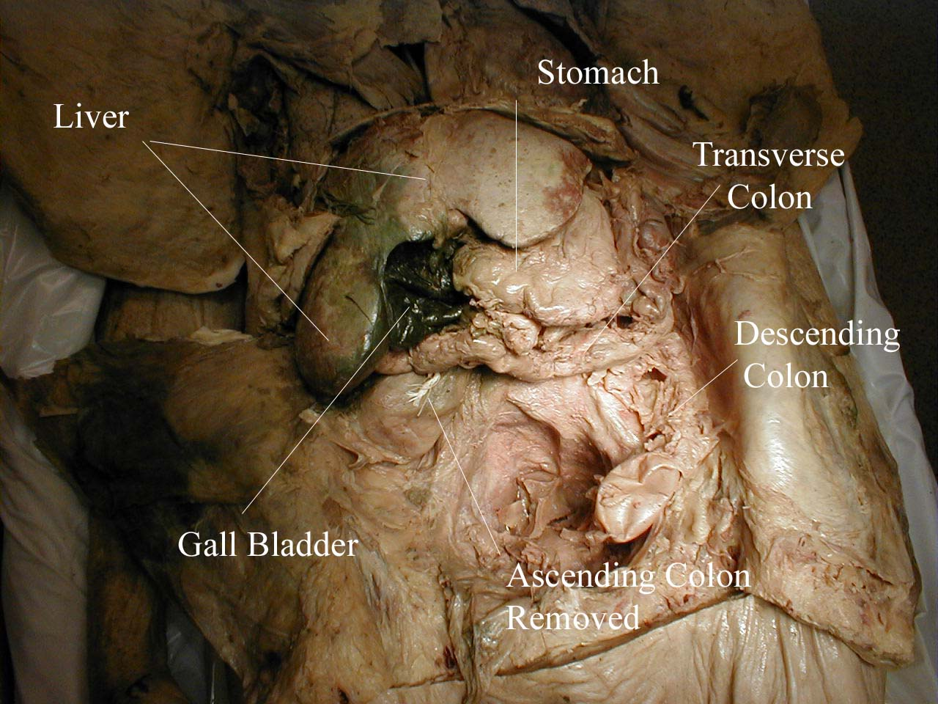

Slide 18
6. The Liver
The liver secretes bile that is stored in the gall bladder.
Bile helps in the physical digestion of lipids (fats and oils) by a process called emulsification
The liver breaks down old red blood cells releasing hemoglobin.
The liver deaminates amino acids to form the nitrogen-containing waste urea.
When food, especially when it contains fat, enters the duodenum, the release of the hormone cholecystokinin (CCK) stimulates the gall bladder to contract and discharge its bile into the duodenum.
converts excess glucose into glycogen for temporary storage (fight-or-flight responses.

Slide 19
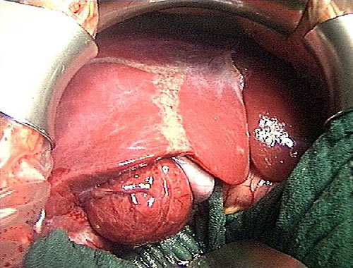
liver

Slide 20
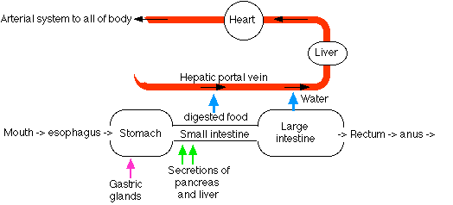
Hepatic Portal Circulation
From: http://users.rcn.com/jkimball.ma.ultranet/BiologyPages/G/GITract.html
The capillary beds of most tissues drain into veins that lead directly back to the heart.
But blood draining the intestines is an exception. The veins draining the intestine lead to a second set of capillary beds in the liver.
Here the liver removes many of the materials that were absorbed by the intestine.

Slide 21
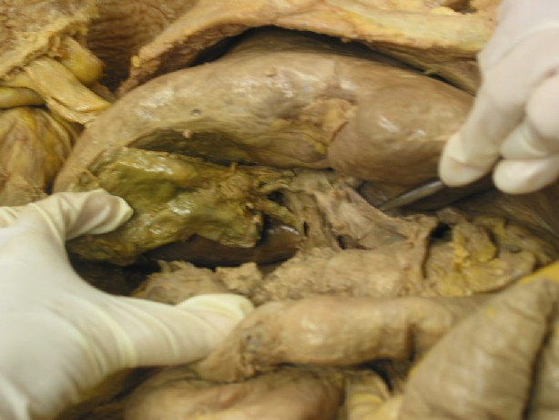
7. Gall Bladder
The gallbladder is a small pear-shaped organ that stores and concentrates bile.
liver
Gall Bladder

Slide 22
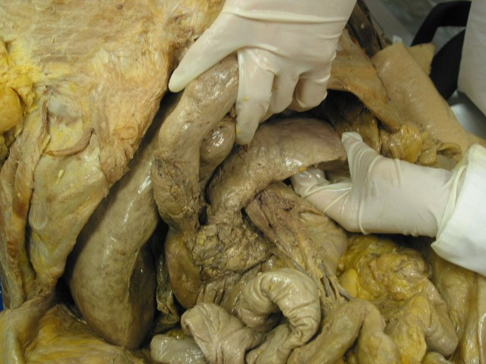
8. Pancreas
The pancreas consists of clusters if endocrine cells (The Islets of Langerhans) and exocrine cells whose secretions drain into the duodenum.
These secretions include proteases, lipases, and amylases.
pancreas

Slide 23
Pancreatic fluid contains:
- sodium bicarbonate (NaHCO₃). This neutralizes the acidity of the fluid arriving from the stomach raising its pH to about 8.
- pancreatic amylase which hydrolyzes starch into a mixture of maltose and glucose.
- pancreatic lipase which hydrolyzes ingested fats into a mixture of fatty acids and monoglycerides.
  - trypsin and chymotrypsin cleaves specific peptide bonds within proteins producing polypeptide fragments. (Inactive forms are known as trypsinogen and chymotrypsinogen respectively).
  - carboxypeptidase and aminopeptidases digests polypeptides into amino acids..
- nucleases hydrolyze ingested nucleic acids (RNA and DNA) into their component nucleotides.

Slide 24
"zymogens" proteins that are precursors to active proteases. These are converted into the active proteolytic enzymes. Examples include pepsinogen, trypsinogen, and chymotrypsinogen.
The secretion of pancreatic fluid is controlled by two hormones:
secretin, which mainly affects the release of sodium bicarbonate, and
cholecystokinin (CCK), which stimulates the release of the digestive enzymes.

Slide 25
II. Digestive Systems of the Hydra, Earthworm, and Grasshopper
Hydra:
  Characteristics
  Taxonomy:
    K: Animalia
    P: Cnidaria
2. Small, sessile.
3. Single opening (mouth) to the gastrovacular cavity.
4. Muscular, stinging tentacles with cnidocytes (nematocysts) aid in capturing and transferring prey into the mouth.
5. Digestive enzymes are secreted by the cells lining the gastrovascular cavity (extracellular digestion). Smaller food particles are absorbed by the cells where intracellular digestion occurs.

Slide 26
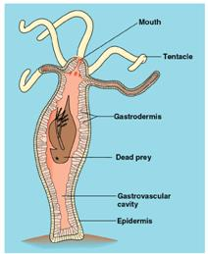
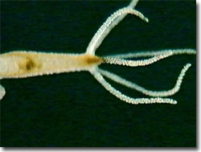
From: http://www.mic-d.com/gallery/moviegallery/images/pondscum/hydra.jpg
Hydra
From: http://biology.dbs.umt.edu/biol103/labs/Christian/4b_inverts_and_hydra_files/image016.jpg

Slide 27
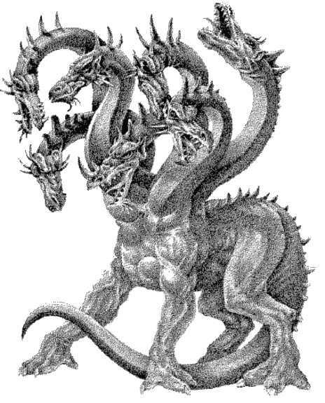

Slide 28
b) Grasshopper
Characteristics
Taxonomy:
    K: Animalia
    P: Arthropoda
“Tube-within-a tube” body plan.
Mouth (anterior) and anus (posterior).
Mouth (mandibles) with biting/chewing parts, esophagus, crop (food storage), gizzard (food grinding), stomach (chemical digestion), intestines (food absorption), and anus (egestion).
Herbivorous diet; feeding mainly on plant tissue and juices.
Gastric caeca secretes digestive enzymes into the stomach.

Slide 29
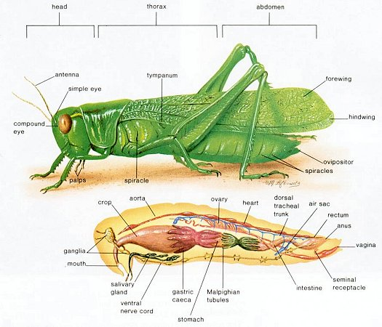
Grasshopper From: http://universe-review.ca/I10-82-grasshopper.jpg

Slide 30
c) Earthworm
Characteristics
1. Taxonomy:
    K: Animalia
    P: Annelida (segmented worms)
Tube-within-a tube” body plan.
3. Mouth (anterior) and anus (posterior).
4. Mouth, esophagus, crop (food storage), gizzard (food grinding), stomach (chemical digestion), intestines (food absorption), and anus (egestion).
5. Food consists mainly of decaying organic matter and bits of vegetation.

Slide 31
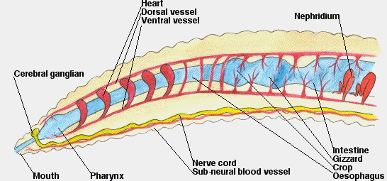
Earthworm: Digestive and nervous systems
From: http://www.nrwmg.vic.gov.au/images/ana1.gif

