Slide 1
Regulation
Controlling the Internal Environment

Slide 2
I. The Transport of Heat: Regulating Body Temperature
a) The circulatory system not only transports material, it is responsible for the distribution of heat throughout the body.
b) This is true both of:
1. Endotherms are animals that generate internally the heat needed to maintain their body temperature. Ex: Birds and mammals are "warm-blooded' or homeothermic, maintaining their body temperature within narrow limits, no matter what the ambient temperature.
2. Ectotherms are animals that secure their heat from their surroundings (e.g., by basking in the sun). Ex: Ectotherms are "cold-blooded" or poikilothermic.

Slide 3
c) The major source of heat for endotherms is the metabolism of their internal organs.
1. Over two-thirds of the heat generated in a resting human is created by the organs of the thoracic and abdominal cavities and the brain (which contributes 16% of the total - about the same as all our skeletal muscles when they are at rest).
d) Mechanisms of Thermoregulation
1. Vasodilation is the widening of the blood vessels that increases blood flow towards the skin. This effectively causes a loss in heat energy that is carried by the blood.
2. Vasoconstriction is the narrowing of the blood vessels that decreases blood flow towards the skin. This effectively prevents heat energy loss by the blood.

Slide 4
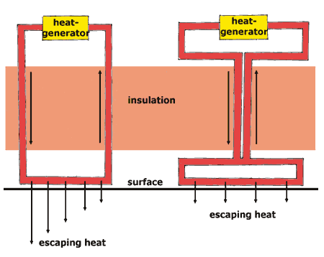
3. Countercurrent Blood Flow is a physiological adaptation in which the arteries and veins are in close contact with each other. This type of blood flow facilitates heat transfer from the arteries to the veins along the entire length of the blood vessel. Organisms such as large marine mammals and birds posses this adaptation which minimizes the amount of heat energy lost to the environment.
Evaporative heat loss in terrestrial endotherms and ectotherms allows for the effective loss of heat to lower body temperatures. Ex: sweating, panting.

Slide 5
II. Water Balance and Waste Disposal
a) Single-celled organisms have most of their wastes are transported out into the outside environment directly across cell membranes by diffusion. The medium of waste transport is water.
b) Multicellular organisms must have a specialized organ system to concentrate and remove wastes from the interstitial fluid into the blood capillaries and eventually deposit that material at a collection point for removal entirely from the body.

Slide 6
c) Waste Types
1. Cells produce water and carbon dioxide as by-products of metabolic breakdown of sugars, fats, and proteins.
2. Chemical groups such as nitrogen, sulfur, and phosphorous must be enzymatically cleaved, from the large molecules to which they were formerly attached, as part of preparing them for energy conversion.
The continuous production of metabolic wastes establishes a steep concentration gradient across the plasma membrane, causing wastes to diffuse out of cells and into the extracellular fluid.

Slide 7
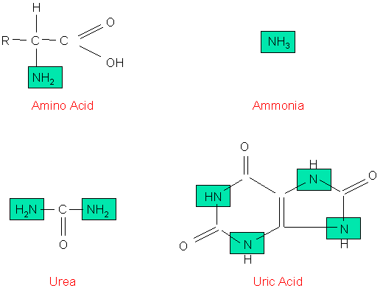
Nitrogenous Wastes
From: http://faculty.clintoncc.suny.edu/faculty/Michael.Gregory/files/Bio%20102/Bio%20102%20lectures/excretory%20system/excret1.gif

Slide 8
3. Nitrogen Wastes
Nitrogen wastes are a by product of protein metabolism.
Amino groups are removed from amino acids prior to energy conversion.
The NH2 (amino group) combines with a hydrogen ion (proton) to form ammonia (NH3).
Ammonia is very toxic and usually is excreted directly by marine animals.
Terrestrial animals usually need to conserve water. Ammonia is converted to urea, a compound the body can tolerate at higher concentrations than ammonia. Amphibians and mammals secrete urea that they form in their liver. Amino groups are turned into ammonia, which in turn is converted to urea, dumped into the blood and concentrated by the kidneys.
Birds and insects secrete uric acid that they make through large energy expenditure but little water loss.

Slide 9
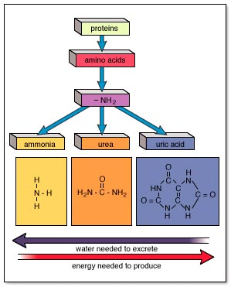
Nitrogenous Wastes and the Necessities of Water
From:http://www.mhhe.com/biosci/esp/2001_gbio/folder_structure/an/m9/s2/assets/images/anm9s2_1.jpg

Slide 10
III. Regulation of Extracellular Fluids
Excretory systems regulate the chemical composition of body fluids by removing metabolic wastes and retaining the proper amounts of water, salts, and nutrients.
Components of this system in vertebrates include the kidneys, liver, lungs, and skin.
Not all animals use the same routes or excrete their wastes the same way humans do. Excretion applies to metabolic waste products that cross a plasma membrane.
Elimination is the removal of feces.

Slide 11
Water and Salt Balance
The excretory system is responsible for regulating water balance in various body fluids.
1. Osmoregulation refers to the state aquatic animals are in: they are surrounded by freshwater and must constantly deal with the influx of water.
Osmoconformers have an internal salt concentration very similar to that of the surrounding ocean. Little water transport between the inside of the animal and the isotonic outside environment occurs.
Ex: crabs
Osmoregulators have internal concentrations of salt that are about one-third of the surrounding seawater. Osmoregulators face two problems: prevention of water loss from the body and prevention of salts diffusing into the body.
Ex: Marine vertebrates

Slide 12
2. Fish pass water out of their tissues through their gills by osmosis and salt through their gills by active transport.
Cartilaginous fish have a greater salt concentration than seawater, causing water to move into the shark by osmosis; this water is used for excretion.
Freshwater fish must prevent water gain and salt loss. They do not drink water, and have their skin covered by a thin mucus. Water enters and leaves through the gills and the fish excretory system produces large amounts of dilute urine.
Terrestrial animals use a variety of methods to reduce water loss: living in moist environments, developing impermeable body coverings, production of more concentrated urine. Water loss can be considerable: a person in a 100 degree F temperature loses 1 liter of water per hour.

Slide 13
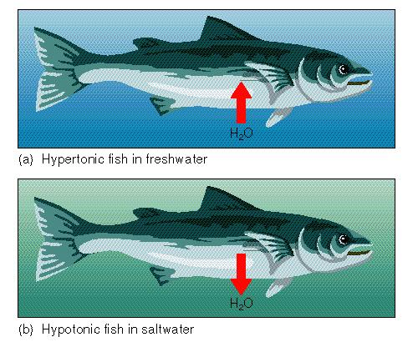
Osmoregulation in Fresh and Salt Water Fish
From:http://www.biosci.uga.edu/almanac/archive/spring_96/bio_104/images/42_4.jpg

Slide 14
IV. Excretory System Functions
Collect water and filter body fluids.
Remove and concentrate waste products from body fluids and return other substances to body fluids as necessary for homeostasis.
Eliminate excretory products from the body.
a) Invertebrate Excretory Organs
1. Many invertebrates such as flatworms use a nephridium as their excretory organ.
At the end of each blind tubule of the nephridium is a ciliated flame cell. As fluid passes down the tubule, solutes are reabsorbed and returned to the body fluids.
b) Vertebrates Excretory Organs
Vertebrates have paired kidneys which regulate body fluid levels as a primary duty, and remove wastes as a secondary one.

Slide 15
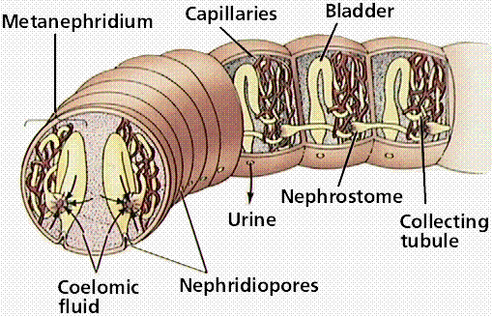
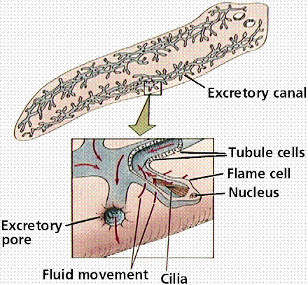
Flatworm and Segmented Worm Excretory Systems
From:http://www.emc.maricopa.edu/faculty/farabee/BIOBK/BioBookEXCRET.html

Slide 16
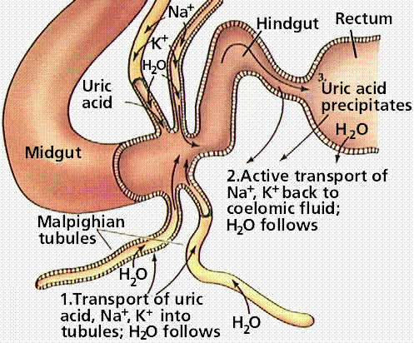
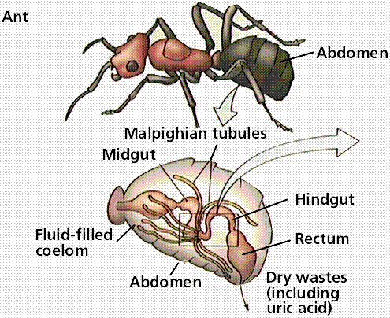
2. Body fluids are drawn into the Malphigian tubules by osmosis due to large concentrations of potassium inside the tubule.
Body fluids pass back into the body, nitrogenous wastes empty into the insect's gut.
Water is reabsorbed and waste is expelled from the insect.
Insect Excretion and Malphigan Tubules
http://www.emc.maricopa.edu/faculty/farabee/BIOBK/BioBookEXCRET.html

Slide 17
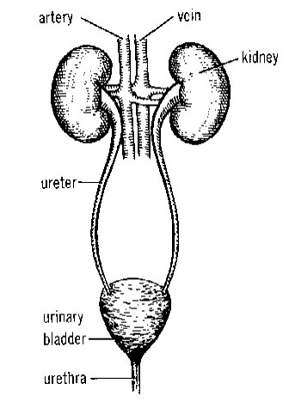
c) The Human Excretory System
1. The urinary system is made-up of the kidneys, ureters, bladder, and urethra.
2. Waste is filtered from the blood and collected as urine in each kidney.
3. Urine leaves the kidneys by ureters, and collects in the bladder. The bladder can distend to store urine that eventually leaves through the urethra.

Slide 18
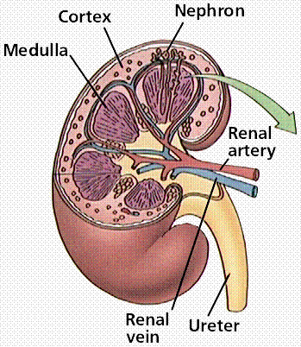
Structure of the Human Kidney
From:http://www.emc.maricopa.edu/faculty/farabee/BIOBK/BioBookEXCRET.html

Slide 19
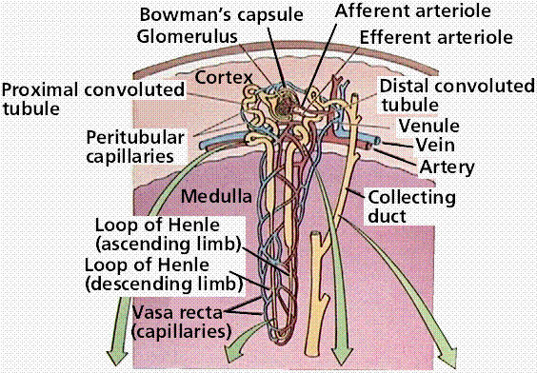
2. The nephron, an evolutionary modification of the nephridium, is the kidney's functional unit.
http://www.emc.maricopa.edu/faculty/farabee/BIOBK/BioBookEXCRET.html

Slide 20
The nephron consists of a cup-shaped capsule (Bowman’s Capsule) containing a network of capillaries (glomerulus), and a long renal tube.
Blood flows into the kidney through the renal artery, which branches into capillaries associated with the glomerulus.
Arterial pressure causes water and solutes from the blood to filter into the capsule.
Fluid flows through the proximal tubule, which include the loop of Henle, and then into the distal tubule.
The distal tubule empties into a collecting duct. Fluids and solutes are returned to the capillaries that surround the nephron tubule.

Slide 21
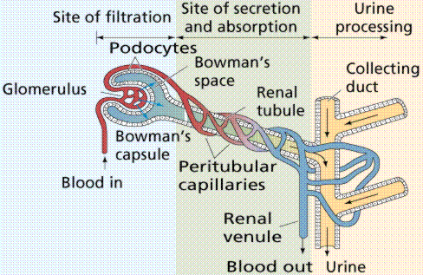
Filtration of the blood in the fine structure of the kidneys. Image from Purves et al., Life: The Science of Biology, 4th Edition, by Sinauer Associates (www.sinauer.com) and WH Freeman (www.whfreeman.com), used with permission.

Slide 22
d) Functions of the Nephron
1. Glomerular filtration of water, salts, urea, amino acids, and simple sugars from the blood.
2. Tubular reabsorption of water, amino acids, and simple sugars back into the blood.
3. Tubular secretion of ions and other waste products from surrounding capillaries into the distal tubule (concentration of urine).

Slide 23
e) Urine Production
Filtration in the glomerulus and nephron capsule.
Reabsorption in the proximal tubule.
Tubular secretion in the Loop of Henle.
f) Components of The Nephron
Glomerulus: mechanically filters blood
Bowman's Capsule: mechanically filters blood
Proximal Convoluted Tubule: Reabsorbs 75% of the water, salts, glucose, and amino acids
Loop of Henle: Countercurrent exchange, which maintains the concentration gradient
Distal Convoluted Tubule: Tubular secretion of H ions, potassium, and certain drugs.

Slide 24
V. Hormone Control of Water and Salt
a) Antidiuretic hormone (ADH)
1. Water reabsorption is controlled by the in negative feedback.
Released from the pituitary gland in the brain.
Dropping levels of fluid in the blood signal the hypothalamus to cause the pituitary to release ADH into the blood.
ADH acts to increase water absorption in the kidneys by putting more water back in the blood, increasing the concentration of the urine.
When too much fluid is present in the blood, sensors in the heart signal the hypothalamus to cause a reduction of the amounts of ADH in the blood. This increases the amount of water absorbed by the kidneys, producing large quantities of a more dilute urine.

Slide 25
b) Aldosterone, a hormone secreted by the kidneys, regulates the transfer of sodium from the nephron to the blood.
1. When sodium levels in the blood fall, aldosterone is released into the blood, causing more sodium to pass from the nephron to the blood. This causes water to flow into the blood by osmosis.
c) Renin is released into the blood to control aldosterone.

Slide 26
VI. Kidney Stones
a) Excess wastes crystallize as kidney stones. They grow and can become a painful irritant that may require surgery or ultrasound treatments. Some stones are small enough to be forced into the urethra.
Disruption of Kidney Function
a) Infection, environmental toxins such as mercury, and genetic disease can have devastating results by causing disruption of kidney function. Many kidney problems can be treated by dialysis, where a machine acts as a kidney. Kidney transplants are an alternative to dialysis.

