Slide 1
CELLULAR RESPIRATION
Harvesting Chemical Energy

Slide 2
I. Cellular Respiration: Overview
a) Definition: The series of enzyme-controlled chemical reactions that releases the chemical energy found within organic molecules for the metabolic reactions that aid in maintaining homeostasis.
b) The overall metabolic pathway of cellular respiration is catabolic and exergonic (releasing energy (-686 kcal/glucose) by breaking material down).
c) Examples include anaerobic (alcohol and lactic acid fermentation) and aerobic respiration.

Slide 3
d) Although organisms absorb a vast array of organic compounds (i.e: lipids, proteins) each are eventually led to the same metabolic pathway as glucose.
e) Respiration is “controlled combustion”. The reactants are organic compounds and oxygen (aerobic) while the products are water, carbon dioxide, and energy.

Slide 4
II. ATP and Cellular Metabolism
a) Characteristics of ATP:
1. ATP (adenosine triphosphate) is the molecule in living systems that provides energy for metabolism.
2. ATP provides energy to chemical reactions when an enzyme removes the terminal phosphate group and transfers it to the given substrate molecule (which is then considered to be phosphorylated).

Slide 5
3. The phosphate group causes the substrate to become unstable resulting in a chemical change or rearrangement.
4. In the process, the phosphorylated substrate loses its phosphate group.
5. ATP is converted into ADP (adenosine diphosphate) and an inorganic phosphate group.
6. To carry out metabolism, the cell must regenerate its supply of ATP.
7. An understanding of the processes of oxidation and reduction are necessary to explain the regeneration of ATP.

Slide 6
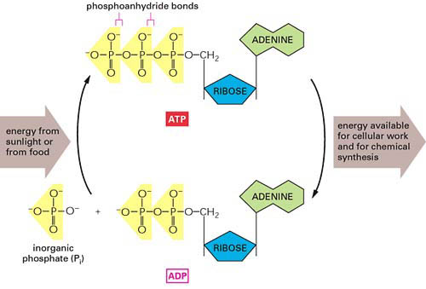
The conversion of ATP to ADP

Slide 7
III. Reduction and Oxidation
a) The decomposition of organic compounds to produce useable energy involves the transfer of electrons between chemicals.
b) Oxidation: the loss of electrons resulting in the production of cations.
c. Reduction: the gain of electrons resulting in the formation of anions.
NOTE: The reducing agent in the chemical that is oxidized. The oxidizing agent is the chemical that is reduced.

Slide 8


Na (s) + Cl₂ (g) Na⁺ + 2Cl⁻
Sodium is oxidized and is thus the reducing agent.
Chlorine is reduced and is thus the oxidizing agent.
d) Reduction and oxidation reactions are always coupled.

Slide 9
e) Organic molecules that have an abundance of hydrogen are excellent fuels.
C₆H₁₂O₆ + 6O₂ 6CO₂ + 6H₂O
NOTE: By viewing the overall equation for cellular respiration, it is easy to see that oxygen accepts hydrogen from the organic molecule being oxidized. What is most important to note is the transfer of high energy electrons to oxygen. It is this process that enables cells to produce a useable form of energy in ATP molecules.

Slide 10
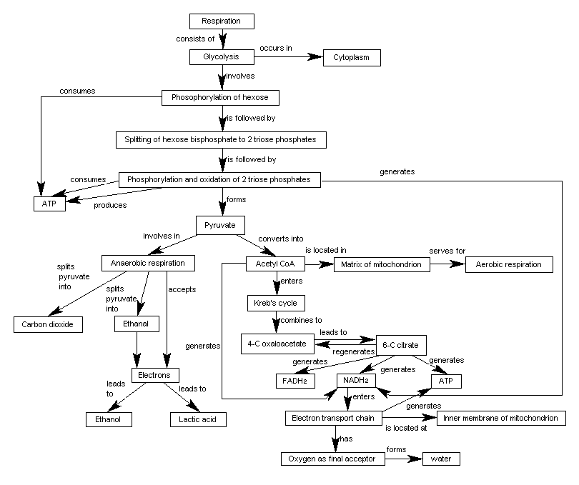

Concept Map on Cellular Respiration
Source : Yu Woon Kwan
All rights reserved
Return to home page

Slide 11
f) The major difference between the combustion of a hydrocarbon and the oxidation of organic compounds as a result of cellular respiration is the rate of the reactions.
g) In cellular respiration, the high energy electrons are transferred not directly to oxygen, but to electron carrier molecules known as coenzymes.
h) Such coenzymes include NAD+ and FAD (nicotinamide adenine dinucleotide and flavin adenine dinucleotide).

Slide 12
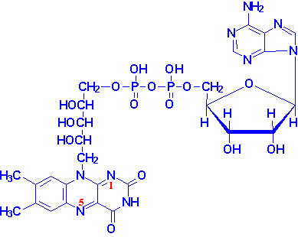
Flavin Adenine Dinucleotide

Slide 13
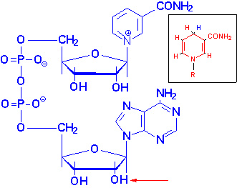
Nicotinamide Adenine Dinucleotide

Slide 14
i) The transfer of the high energy electrons is regulated by enzymes called dehydrogenases.
j) The high energy electrons are passed through a series of enzyme systems that are embedded in the cristae of the mitochondria.
k) The controlled transfer of electrons from the organic compound to the coenzymes and finally to oxygen allows for the controlled release of energy.
l) These controlled processes allows cells to effectively and efficiently release energy from organic compounds and produce ATP.

Slide 15
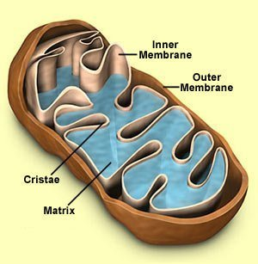
Mitochondria Structure

Slide 16
IV. Cellular Respiration: Overview
Stages:
1. Glycolysis
occurs within the cytosol (cytoplasm).
is a series catabolic reactions that degrades glucose (6C) to two pyruvate (3C) molecules.
involves ten enzyme cataylzed reactions.

Slide 17
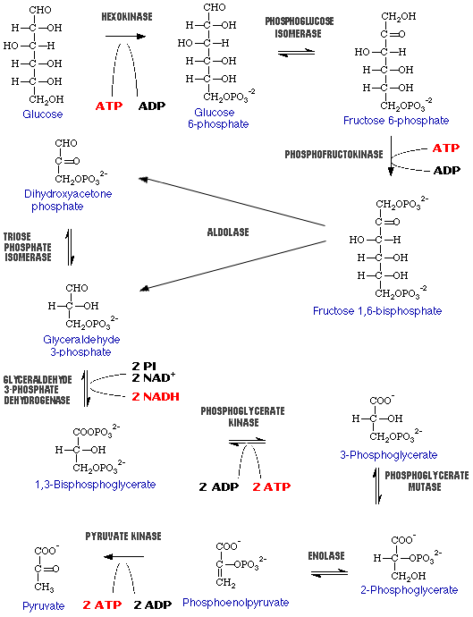
[BioTech Home | Glycolysis Home | Reactions | Pathway | Practicals | Exam ]
Last updated: July 18, 1998
URL: http://biotech.icmb.utexas.edu/glycolysis/pathway.html
Questions or Comments: feedback@biotech.icmb.utexas.edu
BioTech Resources Web Project_x000b_Indiana Institute for Molecular and Cellular Biology _x000b_©, 1995-1998 The Trustees of Indiana University

Slide 18
The reactions in glycolysis can be divided into two phases:
  Energy Investment: Two ATP molecules are used to destabilize glucose so that it is able to be metabolized.
  Energy Payoff: Four ATP molecules are produced by substrate-level phosphorylation while two NADH molecules are produced by the oxidation of the organic molecules.
Net reaction:
Glucose + 2Pi + 2ADP + 2NAD⁺ 2 pyruvate + 4ATP + 2NADH + 2H⁺ + 2H₂O

Slide 19
2. The Krebs Cycle (The Citric Acid Cycle)
In aerobic respiration, the end products of glycolysis must enter the mitochondria.
This is accomplished when a membrane protein in the cristae translocates the pyruvate (3C) molecules into the mitochondrial matrix. This is an active (energy requiring) process.
Once in the matrix, each pyruvate (3C) is decarboxylated (broken down or catabolized) releasing CO₂ .
Each pyruvate is oxidized by NAD⁺ and FAD (forming NADH and FADH₂) while ATP is formed.

Slide 20
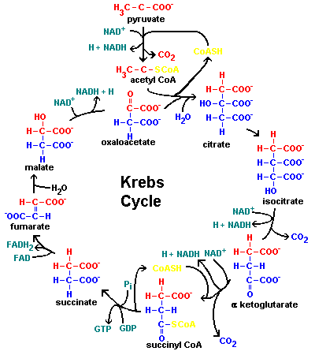
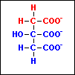


Slide 21
Krebs Cycle Overview
Reactants
2 pyruvate
Products
6 CO₂
2 ATP
8 NADH
2 FADH₂
The energy of ATP can be used directly for metabolism. The energy of the high energy electrons of NADH and FADH₂ are released during the reactions of the electron transport chain.

Slide 22
3. Electron Transport Chain
The ETC consists of a collection of molecules embedded in the inner membrane of the mitochondria.
The highly convoluted (folded) inner membrane allows for the efficient production of ATP due to its high surface area.
The cristae has a thousands of protein complexes that are alternatively oxidized and reduced. These complexes receive the high energy electrons from NADH and FADH₂.
The generation of ATP is derived not from the oxidation and reduction of the protein complexes, but from a process known as chemiosmosis.

Slide 23
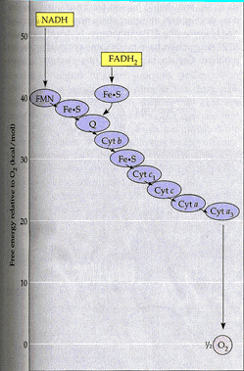
http://www.sirinet.net/~jgjohnso/respiration.html

Slide 24
Chemiosmosis: an energy-coupling mechanism that uses energy stored in the form of an H⁺ gradient to drive cellular work.
As NADH and FADH₂ pass high energy electrons from electron carrier to electron carrier, energy is released. This energy is used to pump H⁺ from the matrix across the inner membrane (cristae) into the intermembrane compartment.
Result: An increase in the concentration of H⁺ in the intermembrane space, a decrease in the concentration of H⁺ in the matrix, and the establishment of a concentration gradient.
The H⁺ diffuse passively back into the matrix through specific channel proteins in the cristae. These channel proteins are coupled with an enzyme complex called ATP synthase.

Slide 25
The H⁺ gradient that is created by this process is referred to as a proton-motive force due to the fact that it has the capacity to do work.
As the H⁺ diffuse through the channel proteins in the cristae, ATP synthase attaches an inorganic phosphate to a molecule of ADP generating ATP.
Finally, the H⁺ and high energy electrons are accepted by oxygen to from water.

Slide 26
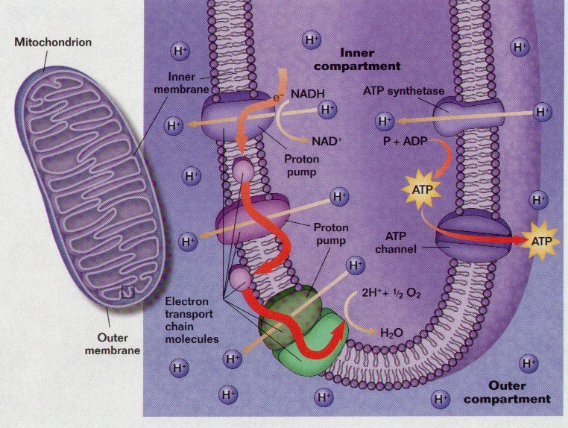
ETC and ATP Production
FMN
Q
Cyt

Slide 27
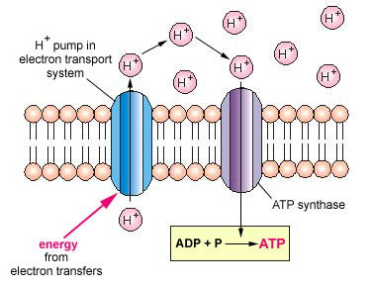
CHEMIOSMOSIS AND ATP SYNTHASE

Slide 28
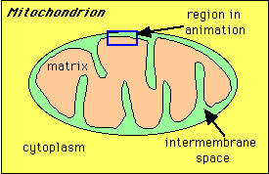
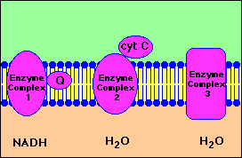
Intermembrane Space
Matrix

Slide 29
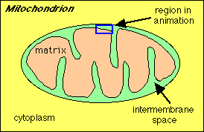
Step 1: Proton gradient is built up as a result of NADH (produced from oxidation reactions) feeding electrons into electron transport system.

Slide 30
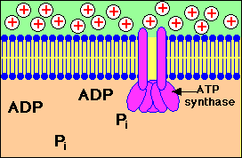
Step 2: Protons (indicated by + charge) enter back into the mitochondrial matrix through channels in ATP synthase enzyme complex. This entry is coupled to ATP synthesis from ADP and phosphate (Pi)

Slide 31
Key points:
Protons are translocated across the membrane, from the matrix to the intermembrane space, as a result of electron transport resulting from the formation of NADH by oxidation reactions.
The continued buildup of these protons creates a proton gradient.
ATP synthase is a large protein complex with a proton channel that allows re-entry of protons.
ATP synthesis is driven by the resulting current of protons flowing through the membrane:
ADP + Pi ---> ATP
From: http://www.sp.uconn.edu/~terry/images/anim/ATPmito.html

Slide 32
NADH from glycolysis yields 2 ATP (due to the fact that the cristae is impermeable to the NADH in the cytosol).
NADH from the reactions of the Krebs Cycle generates 3 ATP molecules.
FADH₂ from the Krebs Cycle generates 2 ATP molecules.

Slide 33
IV. Accounting for ATP Synthesis (per glucose molecule)
Glycolysis: ATP’s
- 2ATP - 2ATP
+ 4ATP + 4ATP
2 NADH + 4ATP
b) Production of Acetyl CoA
2 NADH + 6ATP
c) Krebs Cycle
6NADH + 18 ATP
2 FADH₂ + 4 ATP
Totals: + 34 ATP net

Slide 34
V. Anaerobic Respration: Alcohol and Lactic Acid Fermentation
a) Anaerobic Respiration: type of respiration that lacks oxygen atom as a final acceptor of electrons.
1. Much less efficient than aerobic respiration (i.e. : less ATP produced from a single molecule of glucose).
2. Alcohol Fermentation:
glucose undergoes glycolysis.
pyruvate (3C) is decarboxylated to acetylaldehyde (2C).
acetylaldehyde is reduced by NADH to ethanol.
NAD⁺ is recycled for glycolysis.

Slide 35
3. Lactic Acid Fermentation
pyruvate is reduced directly by NADH to form lactate.
4. Products of Fermentation
Alcohol Fermentation: - 2ATP
+ 4ATP
CO₂
ethanol
Lactic Acid Fermentation - 2ATP
+ 4ATP
lactic acid

Slide 36
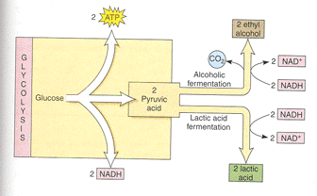
Anaerobic Respiration

