Slide 1
Taxonomy
The Naming and Classification of Life

Slide 2
I. Taxonomy: the branch of biology that deals with the naming and classification (grouping) of living and extinct organisms.
Taxon = group
  a) Methods of Classification
    Organisms (living things) are classified based upon physical (anatomical) and genetic (DNA) similarities.
    Organisms that are placed into groups can be said to closely related in terms of evolution.
Evolution: the theory that organisms today have come from more primitive organisms from the past. The theory states that organisms have changed over long periods of time.

Slide 3
  b) Reason for Classification
    The classification of life is necessary to enable biologists to more easily study living things.
  c) Father of Modern Classification System
    Carolus Linnaeus
  d) Organization of Taxonomy
    Organisms are grouped into seven major taxons:
KINGDOM (large, broad, most organisms, least similarities)
PHYLUM
CLASS
ORDER
FAMILY
GENUS
SPECIES (small, specific, least organisms, most similarities)

Slide 4
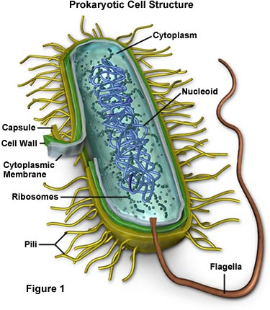
e) Five Kingdom System:
  1. Monera – unicellular; simple; microscopic; no membrane-bound organelles; no nucleus; some are autotrophic while others are heterotrophic; prokaryotes.
Ex: bacteria, archaebacteria, blue-green algae
Bacteria

Slide 5
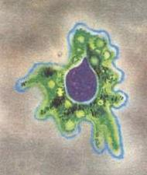
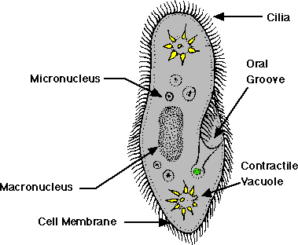
2. Protist – unicellular; simple (but more complex than monera); microscopic; have organelles; have a nucleus; some are autotrophic while others are heterotrophic; eukaryotes.
Ex: Ameba, Paramecium, Algae
Ameba
Paramecium

Slide 6
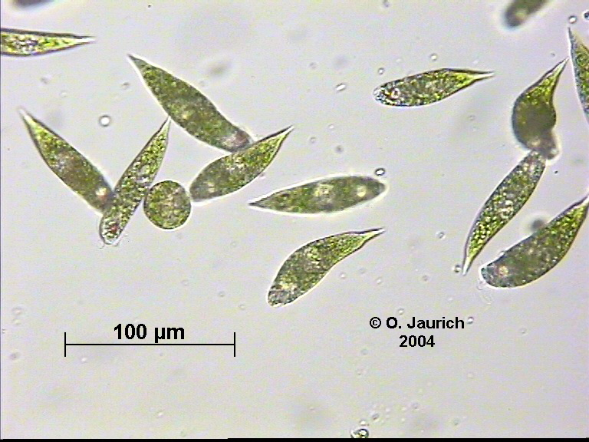
Euglena

Slide 7
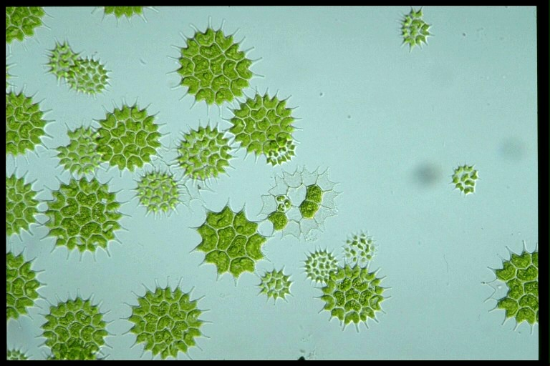
Algae
From: http://www.fcps.k12.va.us/StratfordLandingES/Ecology/Plants/Green%20Algae/07.jpg

Slide 8
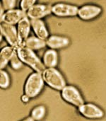
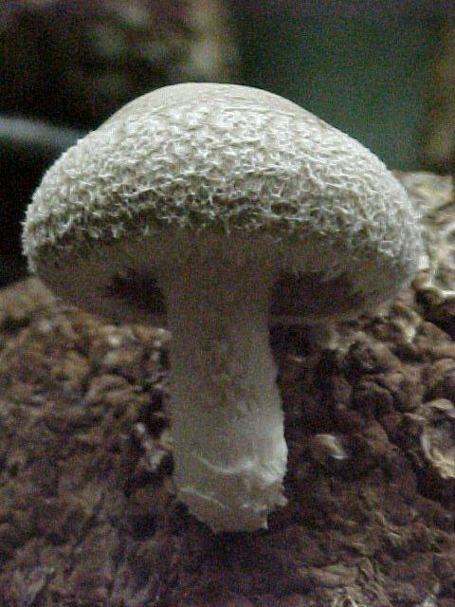
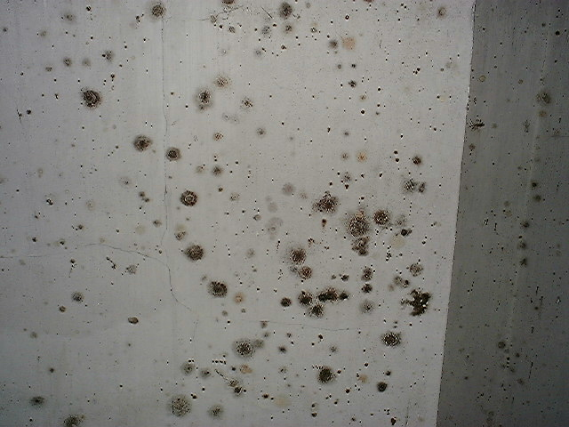
3. Fungus: multicellular; complex, macroscopic; heterotrophic; consume dead plant material (saprophytes).
Ex: mushrooms, yeast, mold
Yeast
Mushroom
Mold

Slide 9
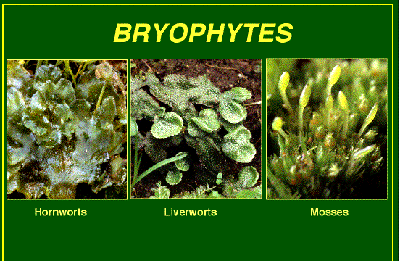
4. Plants:
multicellular; complex; autotrophic (photosynthesis); macroscopic.
Ex: grass, shrubs, bushes, trees, moss
Bryophyta – lacks vascular tissue such as xylem and phloem.
Ex: moss, liverworts, and hornworts.

Slide 10
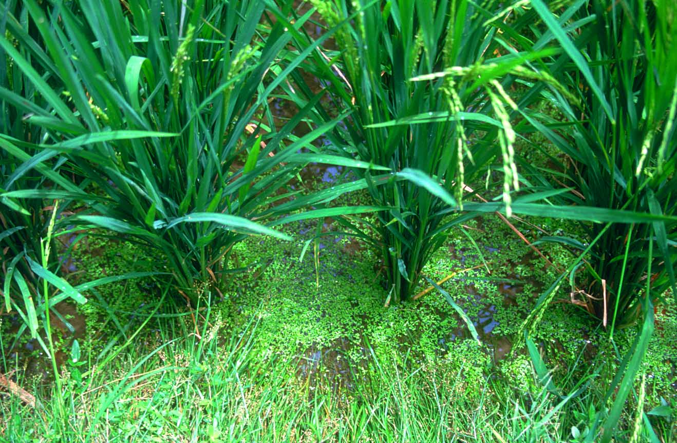
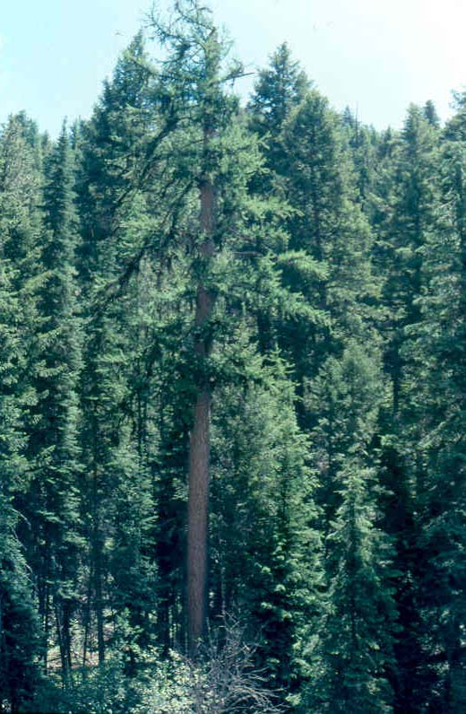

Tracheophyta -are plants with roots, stems and leaves. Some tracheophytes reproduce with seeds and some reproduce with spores.
Tracheophytes have vascular tissue: xylem and phloem.

Slide 11
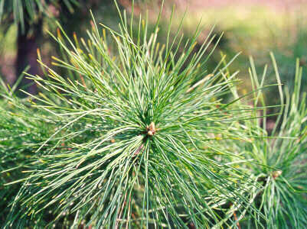
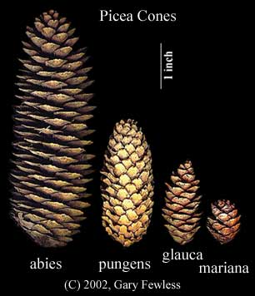
Gymnosperms: a group of vascular plants whose seeds are not enclosed by a ripened ovary (fruit). The seeds of many gymnosperms (literally, "naked seed") are borne in cones and are not visible.

Slide 12
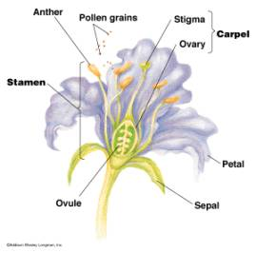
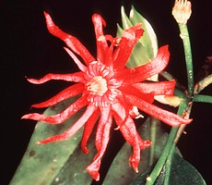
Angiosperms:
Angiosperms are flowering plants. Angiosperms are the biggest group in the plant kingdom. They have true roots, stems, leaves and flowers. They also have seeds. The seeds are formed when an egg or ovule is fertilized by pollen in the ovary. The ovary is within a flower. The flower contains the male and/or female parts of the plant. Fruits are frequently produced from these ripened ovaries.

Slide 13
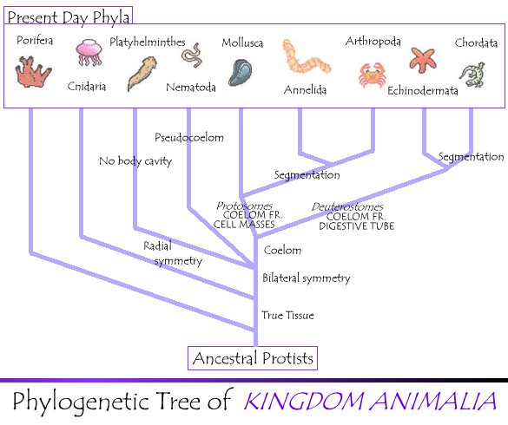
5. Kingdom Animalia:

Slide 14
Characteristics: Eukaryotic, multicellular, heterotrophic, lack of cell walls, interior digestion of food, possession of a digestive tract where hydrolytic enzymes are secreted and digestion takes place, and special cell junctions in their tissues.
Kingdom Animalia is thought to have arose in the sea, from colonial protists.
The most well known phyla of kingdom Animalia are the Mollusca, Porifera, Cnidaria, Platyhelminthes, Nematoda, Annelida, Arthropoda, Echinodermata, and Chordata. There are more than 35 phyla in all, but these nine generally comprise the bulk of the kingdom.

