Slide 1
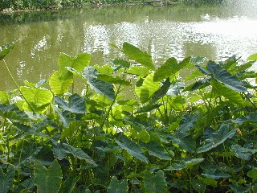
PHOTOSYNTHESIS

Slide 2
I. Photosynthesis:
a) The mode of nutrition in which organisms synthesize their own food.
b) Organisms that have the this unique ability are known as autotrophs or producers.
c) Examples of producers include photoautotrophs and chemoautotrophs.
d) Photoaututrophs, which use CO₂, H₂O, minerals, and light energy to synthesize organic compounds, include plants, protists (algae and euglenoids), and monerans (cyannobacteria).
e) Chemoautotrophs include certain prokaryotes (thermophiles) that synthesize organic compounds by the oxidation of inorganic substances.

Slide 3
II. Adaptations for Photosynthesis
a) Plants have specific structures whose function is to maximize the rate of photosynthesis.
1. Leaves:
major site of photosynthesis.
absorbs the greatest intensity and duration of sunlight due to their position and great surface area.
have various layers which facilitate the processes of photosynthesis.

Slide 4
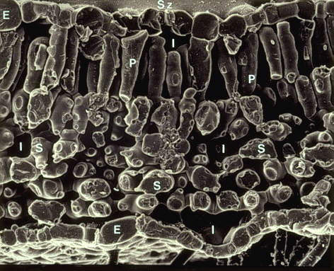
SEM: Cross-section of a bean leaf
Pallisades
Layer
Spongy Layer

Slide 5
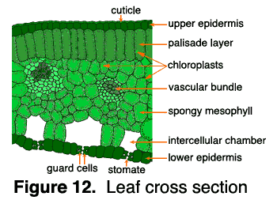

Slide 6
The mesophyll of the leaf is specialized tissue that includes the spongy and pallisades layers. The pallisades layer consists of tightly packed column like cells that have a high concentration of chloroplasts. The spongy layer is characterized by large air spaces which are responsible for holding the photosynthetic gases.
The leaf’s upper and lower epidermis consists of transparent, flattened, and protective cells that are covered by a thick waxy cuticle.
Interspersed within the epidermis (mainly the lower epidermis) are guard cells that control the opening and closing of stomates (pores in the leaf) based upon the rate of evapotranspiration.

Slide 7
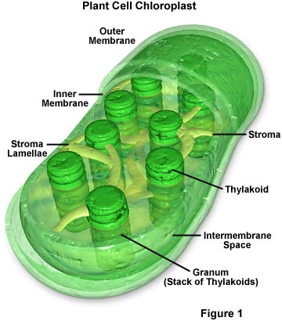
Chloroplast
contains the light capturing pigment chlorophyll.
Chlorophyll contains the element magnesium.
Organelles found in certain photosynthetic organisms.
Consists of stacks of thylakoids (grana) that are responsible for the capturing the light energy for photolysis and the watery stroma that fixes carbon for the synthesis of glucose.

Slide 8
III. The Chemistry of Photosynthesis
a) Overall Reaction:
light
6CO₂ + 6H₂O C₆H₁₂O₆ + 6O₂
The overall equation of photosynthesis is the reverse of aerobic respiration. However, plants do not simply synthesize glucose by reversing respiration.
b) Source of Oxygen
The source of oxygen in photosynthesis has been determined to be water, not carbon dioxide.
Evidence to help support this theory came from C.B. van Neil’s work at Stanford University (1930) with bacteria that use H₂S instead of H₂O.

Slide 9
One significant group of such organism are bacteria which use hydrogen sulfide instead of water in their photosynthetic pathway.
light
  12 H₂S + 6CO₂ C₆H₁₂O₆ + 12S _{(g)} + 6H₂O
Some of these produce globules of sulfur as a waste product instead of oxygen, while others further oxidize it, producing sulfates.

Slide 10
Further evidence came with the use radioisotopes as biochemical tracers such as heavy oxygen (O^{18).}
light
6 H₂O¹⁸ + 6CO₂ C₆H₁₂O₆ + 6O₂¹⁸
light
6 H₂O + 6CO₂¹⁸ C₆H₁₂O₆¹⁸ + 6O₂

Slide 11
c) Photosynthesis as a Redox Process
The reactions of photosynthesis involve the reduction and the oxidation of specific molecules.
Reduction is a process in which an atom gains electrons.
Oxidation is the process in which an atom loses electrons.
Water is split (oxidized) and high energy electrons are passed (along with H⁺) to CO₂ to form glucose.
The electrons that are passed from water to sugar increase in potential energy.
The required energy boost is supplied by sunlight.

Slide 12
d) The Reactions of Photosynthesis (conversion of solar energy (radiant) to chemical energy in glucose)
The two stages of photosynthesis are known as the light reactions and the dark reactions (the Calvin cycle) respectively.
The heart of photosynthesis as it occurs in most autotrophs consists of two key processes:
1. the removal of hydrogen (H) atoms from water molecules
2. the reduction of carbon dioxide (CO₂) by these hydrogen atoms to form organic molecules (glucose).

Slide 13
1. Light Reactions (light-dependent reactions)
Occurs in the grana (specifically in the membrane of the thylakoid).
Light energy that is absorbed by chlorophyll causes the splitting of water into 2H⁺ and O₂ (photolysis).
As water is split, high energy electrons and a H+ are transferred to electron carrier molecules called NADP+ to form NADPH.
NOTE: NADP⁺ is the phosphorylated version of NAD⁺ from respiration. It plays the same role. NADPH can be used as a source of reductive power for biosynthesis.
The energy that is absorbed is also used to synthesize ATP from ADP and Pi in a process called photophosphorylation.

Slide 14
Nicotinamide Adenine Dinucleotide Phosphate (NADP⁺)
Nicotinamide adenine dinucleotide phosphate (NADP⁺) is one of the most important coenzymes in the cell.
Coenzymes are classified any one of a group of relatively small organic molecules required for the catalytic function of certain enzymes.
A coenzyme may either be attached by covalent bonds to a particular enzyme or exist freely in solution.
Those coenzymes that have been found to be necessary in the diet are vitamins such as biotin (B complex), cobalamin (B12), coenzyme A, flavin coenzymes, nicotinamide nucleotides, etc.

Slide 15
In cells, most oxidations are accomplished by the loss of electrons and the removal of hydrogen atoms. NADP⁺ plays a crucial role in this process.
Each molecule of NADP⁺ can acquire two electrons; that is, be reduced by two electrons. One proton accompanies the reduction.
The other proton produced as two hydrogen atoms are removed from the molecule being oxidized is liberated into the surrounding medium.
Ex: NADP⁺ + 2H⁺ NADPH + H⁺
NADP⁺ ‘s role in photosynthesis is to act as a transporter of high energy electrons and hydrogen ions.

Slide 16
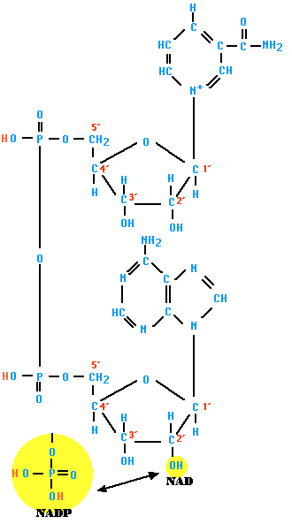
NADP

Slide 17
ATP (Adenosine triphosphate)
ATP is a nucleotide that performs many essential roles in the cell.
It is the major energy currency of the cell, providing the energy for most of the energy-consuming activities of the cell.
It regulates many biochemical pathways.
Energy
When the third phosphate group of ATP is removed by hydrolysis, a substantial amount of free energy is released (7.3 kcal per mole).
The bonds between the second and third phosphate groups are known as "high-energy" bonds.

Slide 18
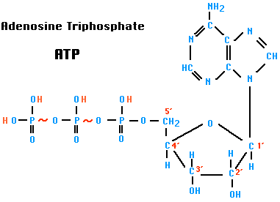
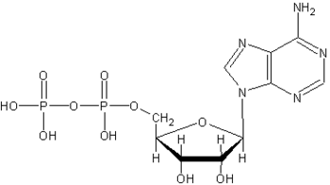
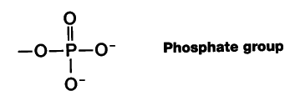
ATP + H₂O ADP + Pi
Adenosine Diphosphate
ADP
+ H₂O
+
Pi – Inorganic Phosphate Group

Slide 19
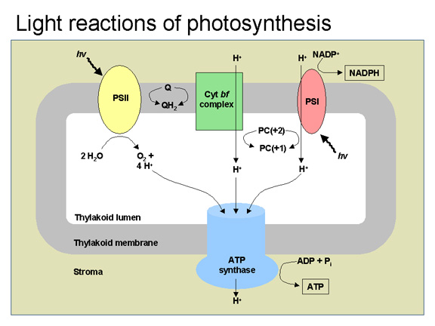

Slide 20
2. The Dark Reactions (Calvin Cycle, light-independent reactions, carbon fixation)
occur with the stroma of the chloroplast.
This pathway produces organic compounds (glucose) from CO₂, using the energy stored in ATP and NADPH during the light reactions.
CO₂ + NADPH 2PGAL C₆H₁₂O₆
PGAL (phosphoglyceraldehyde) is a three carbon compound. The dehydration synthesis of two molecules of PGAL produces a single glucose molecule.
RuBisCO (ribulose bisphosphate carboxylase/oxidase) is the primary enzyme responsible for catalyzing the dark reactions.
The Calvin Cycle is named after Melvin Calvin (1911-1997), the American scientist who worked out the details of the pathway.

Slide 21
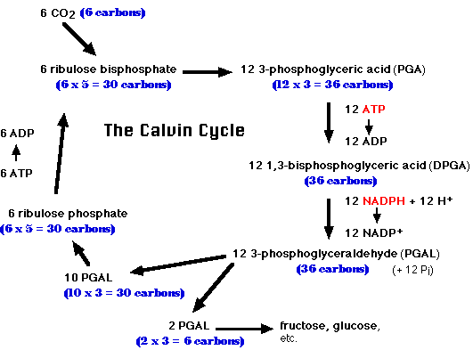

Slide 22
e) The Structure and Function of Photosystems I and II
Photosystems are membrane protein complexes found in photosynthetic organisms (higher plants, green algae and cyanobacteria), which harnesses light energy to split H₂O into O₂, protons and electrons.
2H₂O ⁻> 4e− + 4H+ + O₂
Photosystems are arrangements of chlorophyll and other pigments packed into thylakoids.
Photosynthetic pigments come in a huge variety: there are many different types of chlorophyll, carotenoids, and phycobilins, differing from each other in their precise chemical structure

Slide 23
Photosystem II breaks down water into hydrogen ions, free, high energy electrons, and free oxygen.
Photosystem II also generates ATP for the dark reactions.
Characteristics of ATP
ATP (adenosine triphosphate) is the molecule in living systems that provides energy for metabolism.
ATP provides energy to chemical reactions when an enzyme removes the terminal phosphate group and transfers it to the given substrate molecule (which is then considered to be phosphorylated).

Slide 24
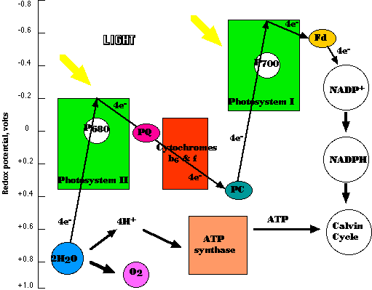
PHOTOSYSTEMS OF PHOTOSYNTHESIS

Slide 25
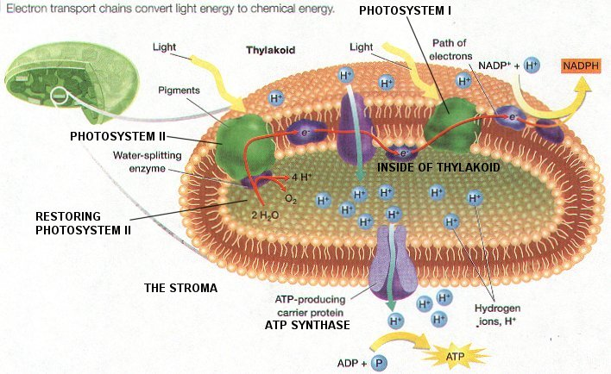

Slide 26
VI. The Nature of Light
a) Light behaves both as a wave phenomenon and as discrete particles of energy called photons.
b) If we look at light as a wave phenomenon, we can assign it a wavelength (the distance from one peak of the wave to the next) and an amplitude (the distance the wave oscillates from its centerline).
c) Different wavelengths of light have different characteristic energies and properties.

Slide 27
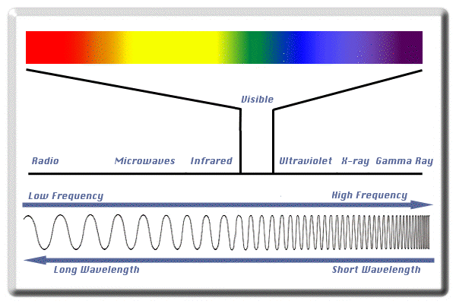
Electromagnetic Spectrum

Slide 28
d) Light can also travel at various speeds in different media, producing a frequency at which the wave travels.
e) The energy contained in a wave of light is related to its frequency.
E=hf
Or
E=hc
^{λ}
Where E is energy, h is Planck's constant Energy = (6.626196 * 10^-34 Joule-seconds), c is the speed of light, f is the frequency of light, and λ is the wavelength.

Slide 29
f) Pigments
1. Molecules, when struck by a wave or photon of light, reflect some of its energy back out, or it can absorb the energy, and thus enter into a higher energy or excited state.
2. Each molecule absorbs or reflects its own characteristic wavelengths of light. Molecules that have evolved to absorb wavelengths in the visible region of the spectrum very well are called pigments.

Slide 30
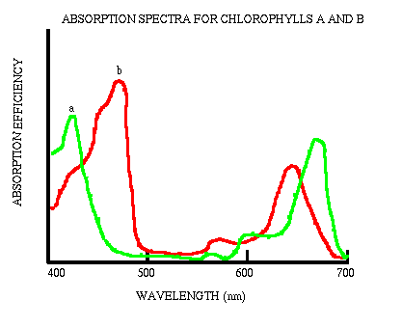
g) Absorption and Action Spectra
1. An absorption spectrum for a particular pigment describes the wavelengths at which it can absorb light and enter into an excited state.

Slide 31
2. An action spectrum describes the efficiency of a particular molecule at acieiving its purpose in absorbing light.
3. This measurement shows what wavelengths of light the molecule can trap to conduct photosynthesis.
h) Classes of Pigments
1. Chlorophylls are greenish pigments which contain a porphyrin ring.
There are several kinds of chlorophyll, including chlorophyll a (most prevalent form), chlorophyll b, and chlorophyll c.

Slide 32
2. Carotenoids are usually red, orange, or yellow pigments, and include the familiar compound carotene, which gives carrots their color.
They are attached to membranes within the cell due to their nonpolar nature.
3. Phycobilins are water-soluble pigments, and are therefore found in the cytoplasm, or in the stroma of the chloroplast.

Slide 33
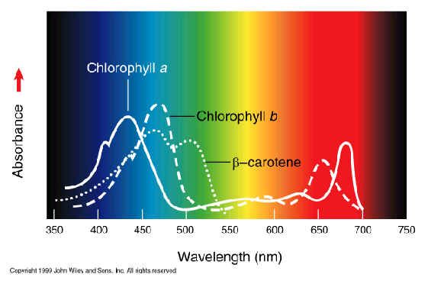
Photosynthetic Pigments and Absorption Spectrum

Slide 34
VII. Alternative Forms of Carbon Fixation
a) C-4 Photosynthesis
Mode of photosynthesis that occurs in sugar cane, corn, and members of the grass family.
1. The initial CO2 fixation reaction involves the enzyme ribulose-1,5-bisphosphate carboxylase/oxygenase (RuBisCO)..
2. RuBisCO can react with either oxygen (leading to a process named photorespiration and not resulting in carbon fixation) or with CO2.

Slide 35
3. If the concentration of CO₂ is too low, RuBisCO will react with O₂ and photorespiration will take place.
A decrease in the concentration of CO₂ will occur when guard cells close stomates during the hot, arid conditions to avoid excess water loss.
When RuBisCO reacts with O₂, it prevents it from fixing CO₂ to Ribulose BisPhosphate (effectively preventing the Calvin Cycle and preventing the synthesis of glucose.
4. To increase the concentration CO₂ some plants (referred to as C4 plants) have set aside some cells within a leaf (named bundle-sheath cells) to be involved primarily in CO₂ fixation and others (named mesophyll cells) to specialize in the light reactions.

Slide 36
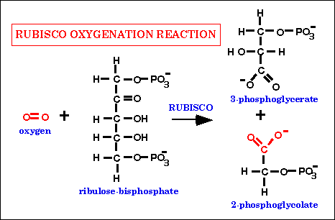

Slide 37
5. Bundle-Sheath cells are closely packed cells surrounding the veins (fibrovascular bundles) of the leaf.
6. Mesophyll cells are loosely packed cells found between the bundle sheath and the leaf surface.
7. CO₂ cannot penetrate the Bundle Sheath cells.
8. In C4 plants, the Calvin Cycle is confined to the chloroplasts of the Bundle Sheath cells.

Slide 38
9. For CO₂ to enter the Bundle Sheath cells (site of Calvin Cycle), they must first be fixed to the three carbon compound phosphoenolpyruvate(PEP) to form oxaloacetate. Oxaloacetate is then converted to malate. Malate diffuses into the Bundle Sheath Cells.
10. This process is catalyzed by the enzyme phosphoenolpyruvate carboxylase which has a much higher affinity for CO₂ than RuBisCO.
11. When oxaloacetate is formed in the mesophyll cells, it is then transported to the Bundle Sheath Cells via plasmodesmata.
12. In the Bundle Sheath cells the oxaloacetate is decarboxlated releasing CO₂ which is then assimilated into the Calvin Cycle by RuBisCO.

Slide 39
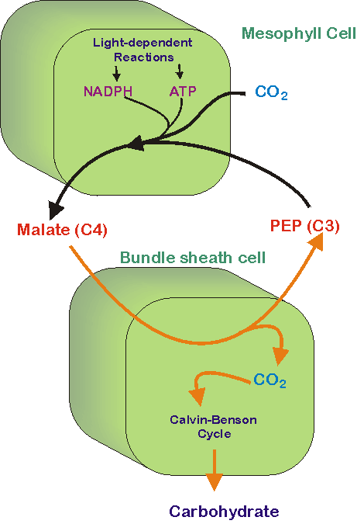

Slide 40
b) CAM Photosynthesis (Crassulacean Acid Metabolism)
Mode of photosynthesis used by succulent plants including cacti and pineapples.
1. These plants open their stomates at night and close them during the day to aid in the conservation of water.
2. The CO₂ is that is absorbed at night is incorporated into various organic acids.
3. The organic acids are decarboxylated and then can enter the Calvin Cycle.

Slide 41
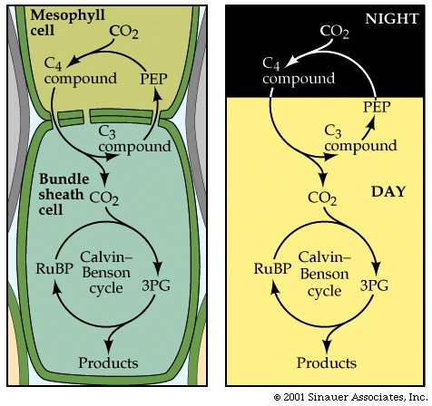
C4 versus CAM Photosynthesis

Slide 42
Plant Tissues
Mature vascular plant contains several differentiated cell types. These are grouped together in tissues. Some tissues contain only one type of cell. Some consist of several.
a) Meristematic
The main function of meristematic tissue is mitosis.
The cells are small, thin-walled, with no central vacuole and no specialized features.
Meristematic tissue is located in the
1. apical meristems at the growing points of roots and stems.
2. secondary meristems (lateral buds) at the nodes of stems (where branching occurs). 3. cambium that is found within the mature stem.
The cells produced in the meristems soon become differentiated (specialize) into one or another of several types.

Slide 43
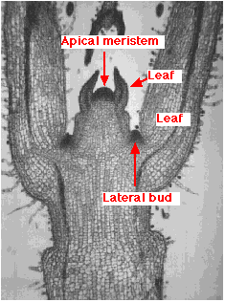
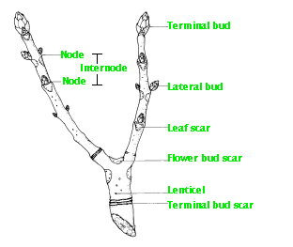
Plant Anatomy: Meristematic Tissue
From: http://users.rcn.com/jkimball.ma.ultranet/BiologyPages/F/Flowering.html

Slide 44
b) Protective Tissue: Epidermal Tissue
Protective tissue covers the surface of leaves and the living cells of roots and stems. Its cells are flattened with their top and bottom surfaces parallel. The upper and lower epidermis of the leaf are examples of protective tissue.
c. Ground Tissue
1. Parenchyma
large, thin-walled, and usually have a large central vacuole.
often partially separated from each other.
usually stuffed with plastids (i.e.: chloroplasts) .
In areas not exposed to light, colorless plastids predominate and food storage is the main function.
The cells of the white potato are parenchyma cells.
Where light is present, e.g., in leaves, chloroplasts predominate and photosynthesis is the main function.

Slide 45
2. Sclerenchyma
The walls of these cells are very thick and built up in a uniform layer around the entire margin of the cell.
Often, the protoplasts die after the cell wall is fully formed.
Sclerenchyma cells are usually found associated with other cells types and give them mechanical support.
Sclerenchyma is found in stems and also in leaf veins.
Sclerenchyma also makes up the hard outer covering of seeds and nuts.

Slide 46
3. Collenchyma
Collenchyma cells have thick walls that are especially thick at their corners.
These cells provide mechanical support for the plant.
They are most often found in areas that are growing rapidly and need to be strengthened.
The petiole ("stalk") of leaves is usually reinforced with collenchyma.

Slide 47
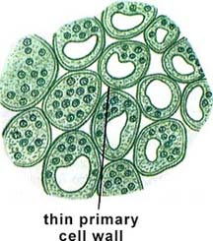
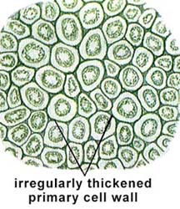
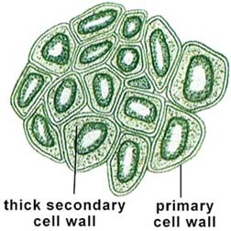
Parenchyma cells Collenchyma cells Sclerenchyma cells

Slide 48
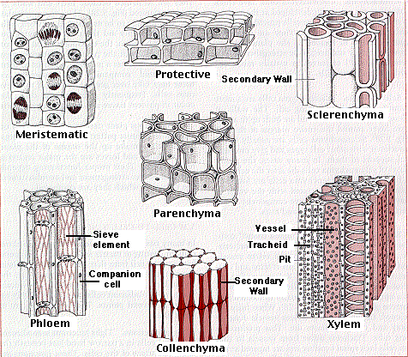
Plant Tissues From: http://users.rcn.com/jkimball.ma.ultranet/BiologyPages/P/PlantTissues.html

Slide 49
c) Xylem
Xylem conducts water and dissolved minerals from the roots to all the other parts of the plant.
In angiosperms, most of the water travels in the xylem vessels.
These are thick-walled tubes that can extend vertically through several feet of xylem tissue. Their diameter may be as large as 0.7 mm.
Their walls are thickened with secondary deposits of cellulose and are usually further strengthened by impregnation with lignin.
The secondary walls of the xylem vessels are deposited in spirals and rings and are usually perforated by pits.

Slide 50
Xylem vessels arise from individual cylindrical cells oriented end to end. At maturity the end walls of these cells dissolve away and the cytoplasmic contents die. The result is the xylem vessel, a continuous nonliving duct. The vessels carry water and some dissolved solutes, such as inorganic ions, up the plant.
Xylem also contains tracheids which are individual cells tapered at each end so the tapered end of one cell overlaps that of the adjacent cell.
Like xylem vessels, they have thick, lignified walls and, at maturity, no cytoplasm. Their walls are perforated so that water can flow from one tracheid to the next. The xylem of ferns and conifers contains only tracheids.
In woody plants, the older xylem ceases to participate in water transport and simply serves to give strength to the trunk. Wood is xylem. When counting the annual rings of a tree, one is counting rings of xylem.

Slide 51
d) Phloem
The main components of phloem are
sieve elements and companion cells.
1. Sieve elements: have end walls that are perforated allowing cytoplasmic connections between vertically-stacked cells. The result is a sieve tube that conducts the products of photosynthesis - sugars and amino acids - from the place where they are manufactured (a "source"), e.g., leaves, to the places ("sinks") where they are consumed or stored; such as
roots
growing tips of stems and leaves
flowers
fruits, tubers, corms, etc.
Sieve elements have no nucleus and only a sparse collection of other organelles. They depend on the adjacent companion cells for many functions.

Slide 52
2. Companion cells move sugars and amino acids into and out of the sieve elements.
In "source" tissue, such as a leaf, the companion cells use transmembrane proteins to take up - by active transport - sugars and amino acids from the cells manufacturing them.
Water follows by osmosis.
These materials then move into adjacent sieve elements by diffusion through plasmodesmata.
The pressure created by osmosis drives the flow of materials through the sieve tubes.

Slide 53
In "sink" tissue, the sugars and amino acids leave the sieve tubes by diffusion through plasmodesmata connecting the sieve elements to the cells of their destination.
Again, water follows by osmosis where it may leave the plant by transpiration or increase the volume of the cells or move into the xylem for recycling through the plant.

Slide 54
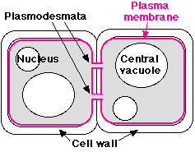
Plasmodesmata
Fine strands of cytoplasm, called plasmodesmata, extend through pores in the cell wall connecting the cytoplasm of each cell with that of its neighbors.
Plasmodesmata provide an easy route for the movement of ions, small molecules like sugars and amino acids, and even macromolecules like RNA and proteins, between cells.
The larger molecules pass through with the aid of actin filaments.
Plasmodesmata are sheathed by a plasma membrane that is simply an extension of the plasma membrane of the adjoining cells. This raises the intriguing question of whether a plant tissue is really made up of separate cells or is, instead, a syncytium: a single, multinucleated cell distributed throughout hundreds of tiny compartments.

Slide 55
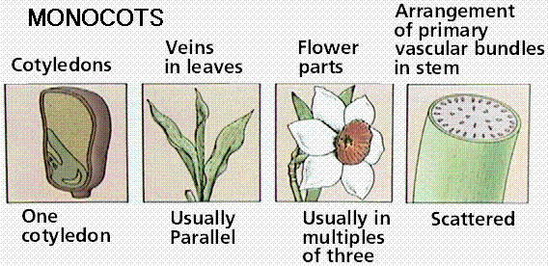
Monocots and Dicots
Angiosperms, flowering plants, are divided into two groups: monocots and dicots.
a) Monocot Characteristics

Slide 56
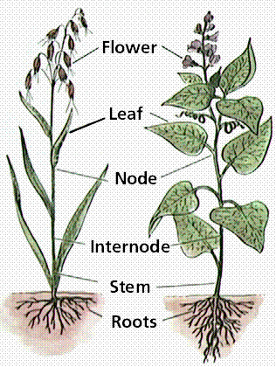
1. Monocot seeds have one "seed leaf" termed a cotyledon (in fact monocot is a shortening of monocotyledon). Dicots have two cotyledons.
Both groups, however, have the same basic architecture of nodes, internodes, etc.
Comparison of monocot (left, oat) and dicot (right, bean) gross anatomy. Image from Purves et al., Life: The Science of Biology, 4th Edition, by Sinauer Associates (www.sinauer.com) and WH Freeman (www.whfreeman.com), used with permission.

Slide 57
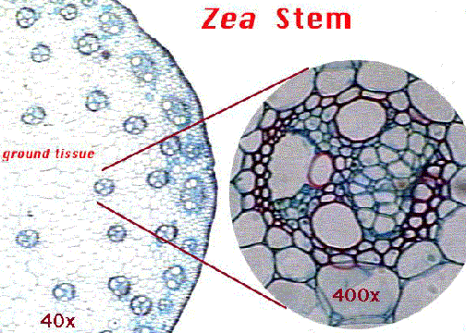
2. Monocot stems have scattered vascular bundles that are located near the outside edge of the stem.
The bundles are surrounded by large parenchyma in the cortex region.
There is no pith region in monocots.
Note the scattered vascular bundles of the corn stem.
The above images is from gopher://wiscinfo.wisc.edu:2070/I9/.image/.bot/.130/Stem/Zea_cross_section/Stem_composite.

Slide 58
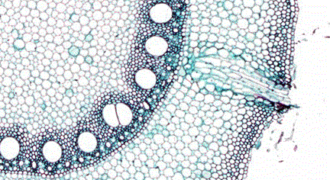
3. Monocot roots have their vascular bundles arranged in a ring.
Vascular Bundle
Cross-section of a root of corn. Note the ringed array of vascular bundles in this Zea (monocot) root cross section.
The above image is cropped and reduced from gopher://wiscinfo.wisc.edu:2070/I9/.image/.bot/.130/Root/Monocot_Roots/Zea_Monocot_Root/Zea_xs

Slide 59
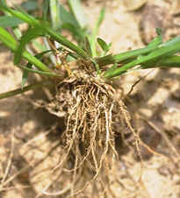
4. Monocots have a fibrous root system.

Slide 60
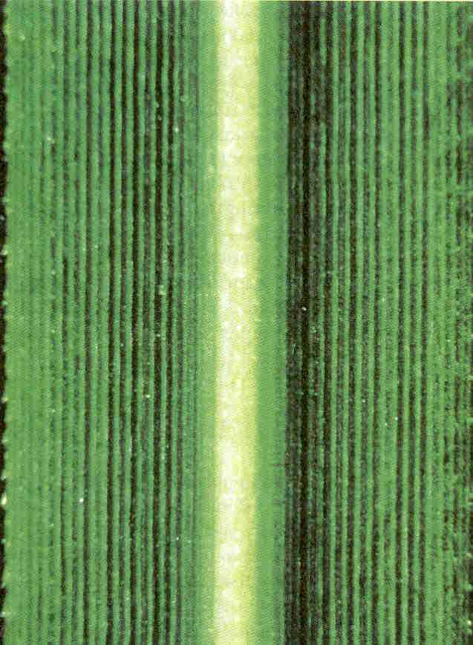
5. Monocot leaves have their leaf veins arranged parallel to each other and the long axis of the leaf (parallel vennation).
A common example of this is the husk of corn or a blade of grass.

Slide 61
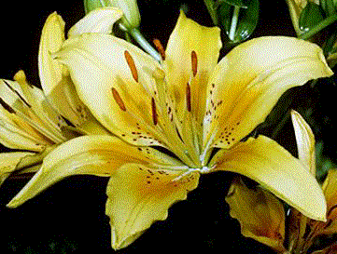
6. Monocots have their flower parts in threes or multiples of three. Examples include the tulip and lily (Lilium ).
Monocot flowers. Note the typical monocot arrangement of flower parts in 3's or multiples of 3. Lilium flower.
The above image is cropped from gopher://wiscinfo.wisc.edu:2070/I9/.image/.bot/.130/Angiosperm/Lilium/Flower_dissection/Flowers.

Slide 62
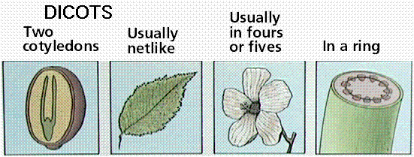
Features of monocot and dicot plants. Images from Purves et al., Life: The Science of Biology, 4th Edition, by Sinauer Associates (www.sinauer.com) and WH Freeman (www.whfreeman.com), used with permission.

Slide 63
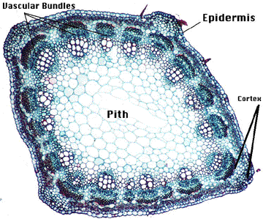
b) Dicot Characteristics
1. Dicot stems have their vascular bundles in a ring arrangement surrounding parenchyma cells in a pith region.
Between the bundles and the epidermis are smaller (as compared to the pith) parenchyma cells making up the cortex region.
Note the ringed array of vascular bundles in this dicot stem (Medicago).
The above image is from gopher://wiscinfo.wisc.edu:2070/I9/.image/.bot/.130/Stem/Medicago_cross_section/Labeled.

Slide 64
Cork cambium : meristematic tissue that exists between the cork and cortex which produces more cork by mitosis.
Cambium
During the growing season, mitosis in this band of meristematic tissue produces new phloem to the outside and new xylem to the inside.
Xylem
Xylem makes up the wood region.
Xylem serves two functions:
transport of water and minerals up the stem support.
support the weight of the tree.
Pith
In young stems, the pith, which is made of parenchyma, stores food. The pith disappears in older stems.

Slide 65
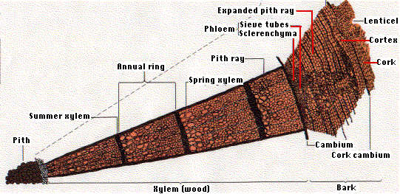
The Woody Dicot Stem

Slide 66
3. Dicot Roots
General Functions: Roots anchor the plant in soil and absorb and transport water and mineral nutrients. The storage of water and organic compounds is provided by roots.
Types: Dicots have an enlarged primary root which is called a taproot (THE LARGEST ROOT).
Taproots can grow deep, reaching water far below the surface of the ground.
Ex: Beets and Carrots

Slide 67
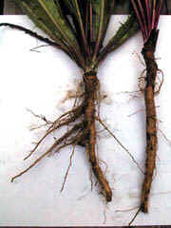
Dicots have a taproot system.

Slide 68
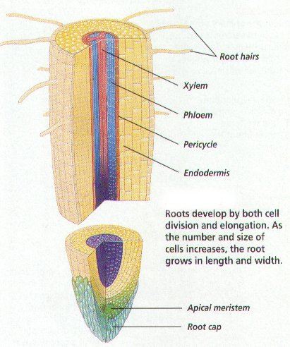
Root Anatomy
The root tip is covered by a protective root cap, which covers the apical meristem (primary growth – elongation).

Slide 69
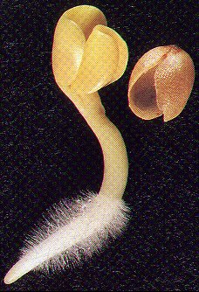
Root Hairs: tiny, hairlike projections on the epidermis that absorb water and dissolved minerals from the soil.
Root hairs increase the surface area of the plant roots to maximize water and mineral absorption.

Slide 70
Vascular Cylinder: the core of a root that contains xylem and phloem.
Surrounding the vascular cylinder is a band of ground tissue called the cortex that is covered the epidermis.
In dicots, the vascular tissue forms a solid core at the center of the root.

Slide 71
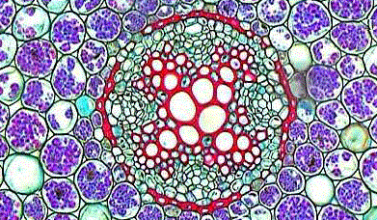
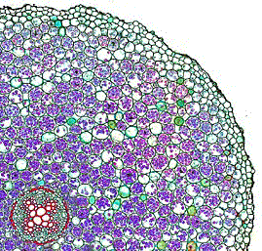
Dicot roots have their xylem in the center of the root and phloem outside the xylem.
xylem
phloem
Cross-section of a dicot root. Note the X-shaped xylem (in the lower left corner of the picture) of the root of Ranunculus (dicot).
The above image (left) is cropped from gopher://wiscinfo.wisc.edu:2070/I9/.image/.bot/.130/Root/Ranunculus_root_cross_sections/Mature/Whole_cross_section. The above image (right [lower if your browser window is narrow]) is cropped from gopher://wiscinfo.wisc.edu:2070/I9/.image/.bot/.130/Root/Ranunculus_root_cross_sections/Mature/Vascular_bundle.

Slide 72
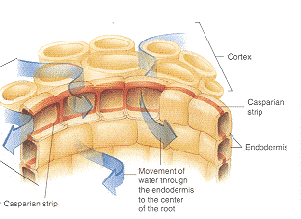
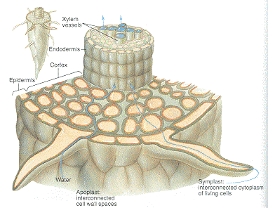
Endodermis (cell layer like a row of bricks).
The layer of cells that separates the cortex from the vascular cylinder.
The cells of the endodermis are coated with a waxy layer called the casparian strip which blocks the movement of water between adjacent cells of the endodermis.
This causes the water and dissolved minerals that enter a root to be channeled through the cytoplasm of the cells of the endodermis into the vascular tissue.

Slide 73
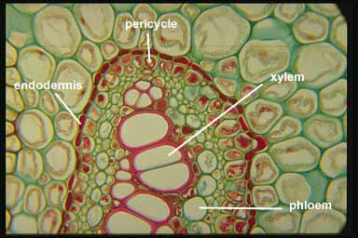
Pericycle: the outermost layer or layers of the central vascular tissue.
The pericycle cells form the vascular cambium which produces secondary xylem toward the inside of the root and secondary phloem toward the outside.
Lateral roots are formed by the division of pericycle cells.
Dicots and gymnosperms roots often experience secondary growth which begins when the vascular cambium forms between xylem and phloem.
Dicot Root Anatomy
From: http://www.puc.edu/Faculty/Gilbert_Muth/phot0167.jpg

Slide 74
Dicot Root Physiology : selectively absorbs aqueous solutions of minerals (as ions).
There are 13 Minerals that are essential for all plants.
Macronutrients, such as nitrogen and potassium, are minerals absorbed in large amounts.
Micronutrients are minerals absorbed in smaller amounts.
Plants with deficiencies show characteristic symptoms and reduced growth.
Carbohydrates are stored in roots these excess as the polysaccharide starch in parenchyma cells.
Large amounts of water are stored by the roots of some plants which helps the plant to survive during dry periods.

Slide 75
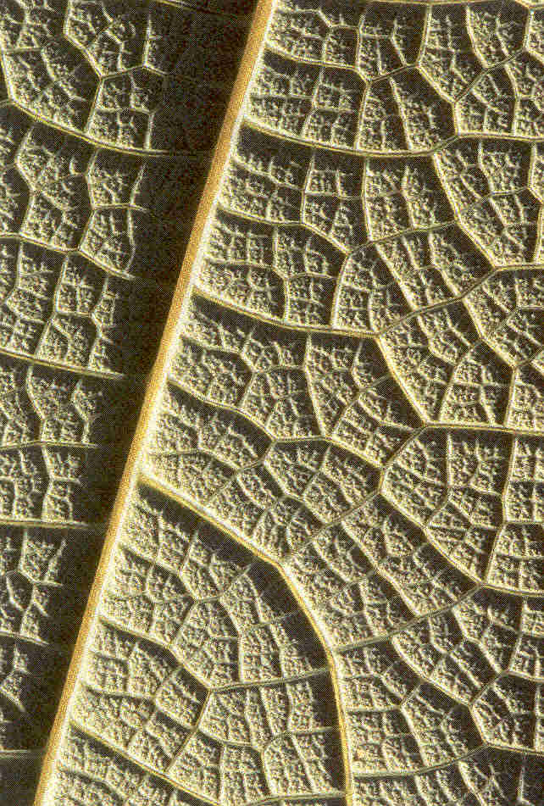
4. Dicot leaves have a network of veins arising from a mid-vein termed net vennation.
Examples of dicot leaves include maples, oaks, geraniums, and dandelions.

Slide 76
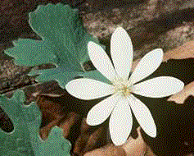
5. Dicots have flower parts arranged in fours (or multiples) or fives (or multiples). Examples of some common dicot flowers include the geranium, snapdragon, and citrus.
Dicot flowers. Note the dicot florap part array of flower parts in four or multiples of four on this flower of Sanguinaria canadensis.
The above image (right, or lower if your browser window is small) is cropped from gopher://wiscinfo.wisc.edu:2070/I9/.image/.bot/.130/Angiosperm/Various_flowers/Dicots/Popavaraceae/Sanguinaria_canadensis_KS.

Slide 77
