Slide 1

Predicting NYC Airbnb Prices
Daniel Hyun
Salih Tuzen

Slide 2
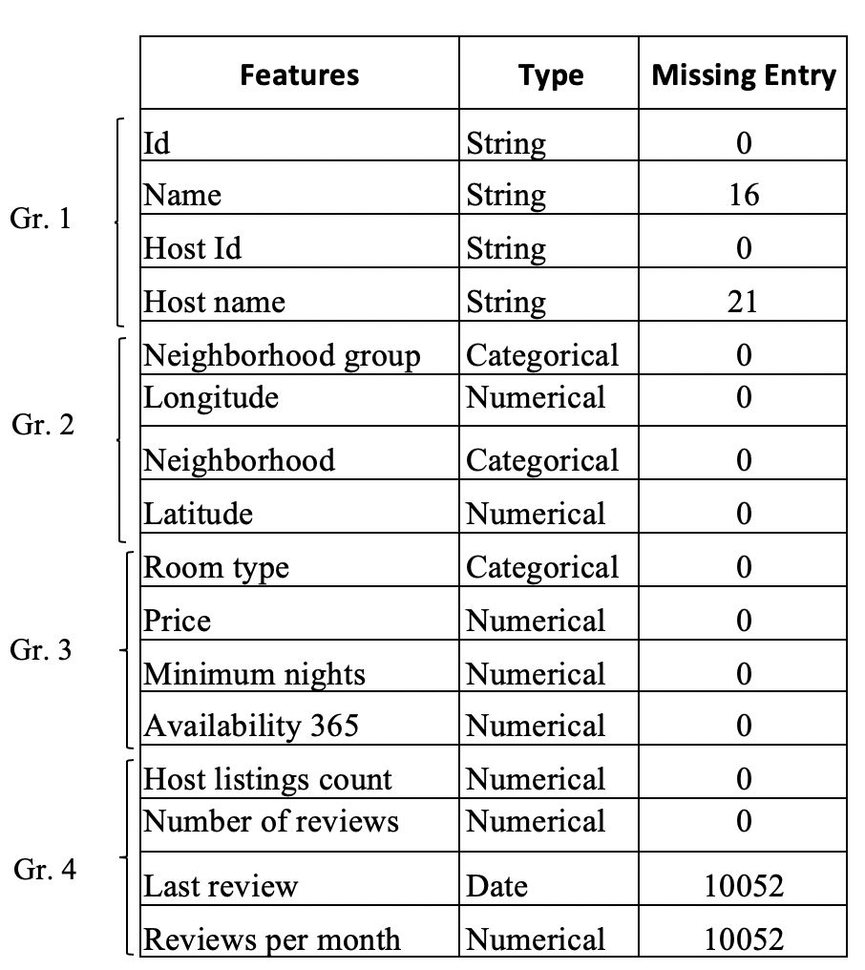
Dataset Description
Data source: Kaggle
Airbnb listing in NYC
Public dataset that can also be found on the Airbnb website
Number of features: 16
Features can be grouped into 4 general descriptions
4 string features
3 categorical features
1 date feature
8 quantitative features
Number of observations: ~49,000

Slide 3
Objective & Methodology
Predict the prices of Airbnb
Models that we will use:
Ordinary least squares regression
Ridge regression
Lasso regression
KNN regression
K-Fold cross-validation
Scoring metrics used:
R-squared
RMSE

Slide 4
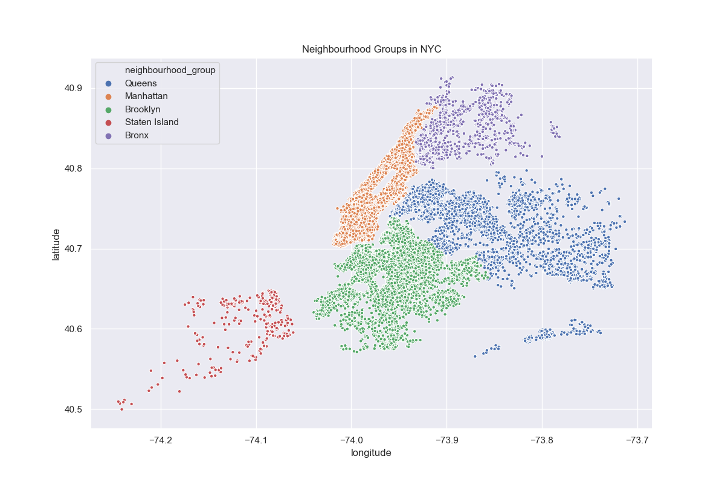
Data Exploration
NYC Neighborhood Groups (Boroughs)

Slide 5
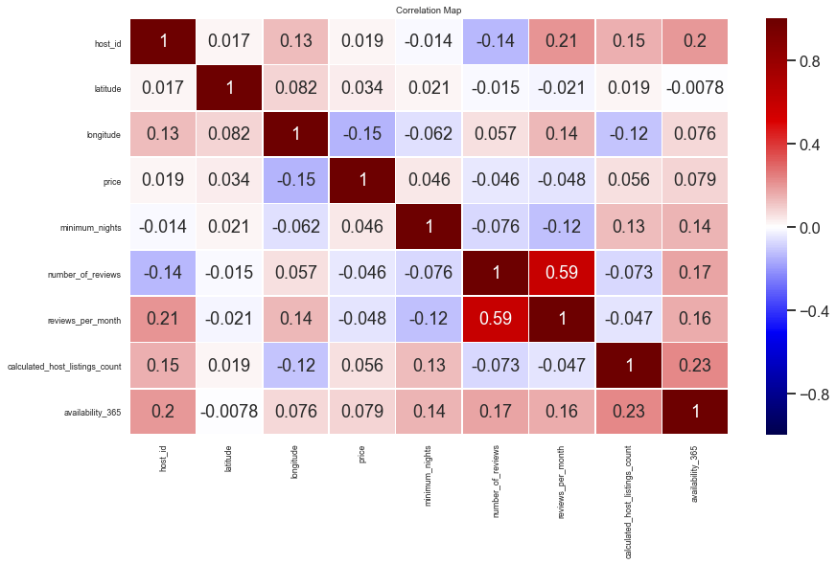
Data Exploration
Correlation Matrix Heatmap

Slide 6
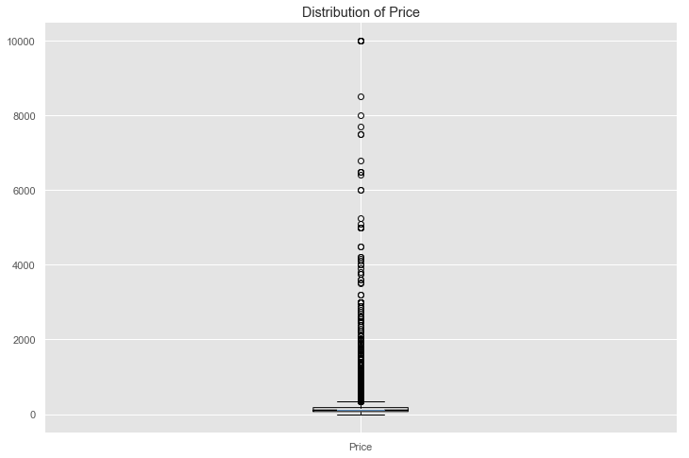
Data Exploration
Box plot of Price

Slide 7
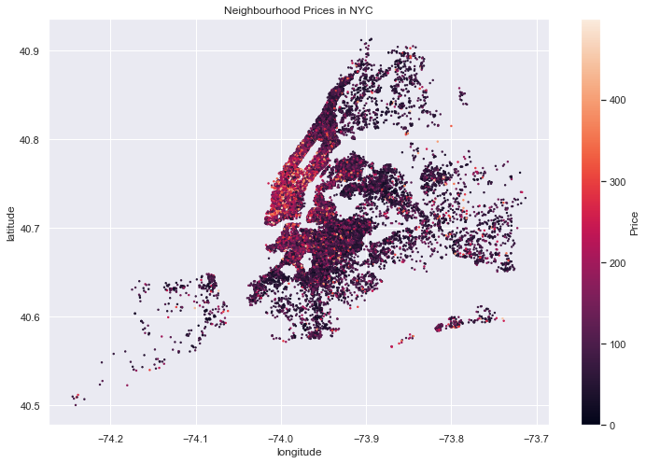
Data Exploration
Price Heat Map

Slide 8
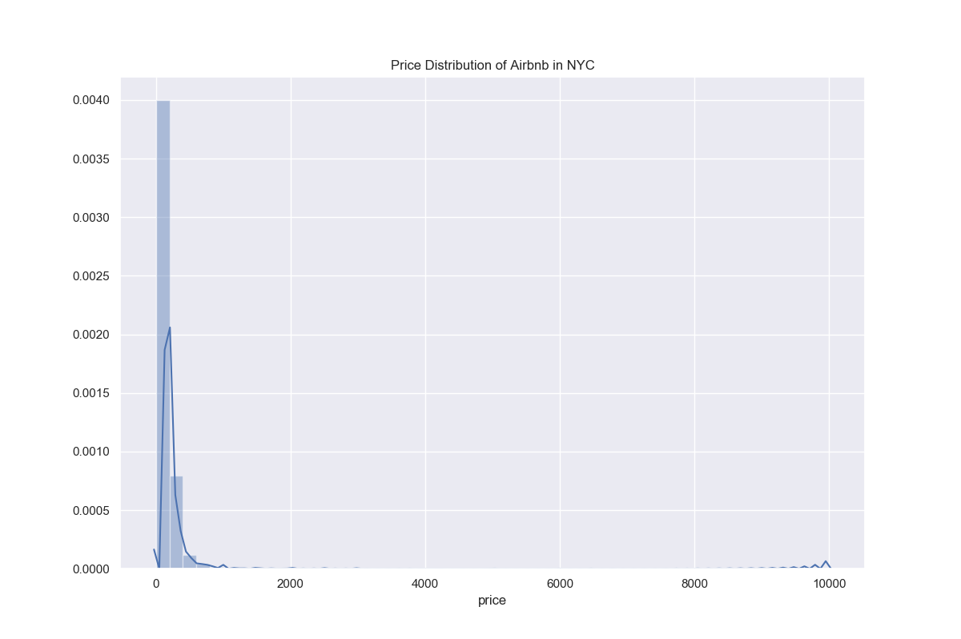
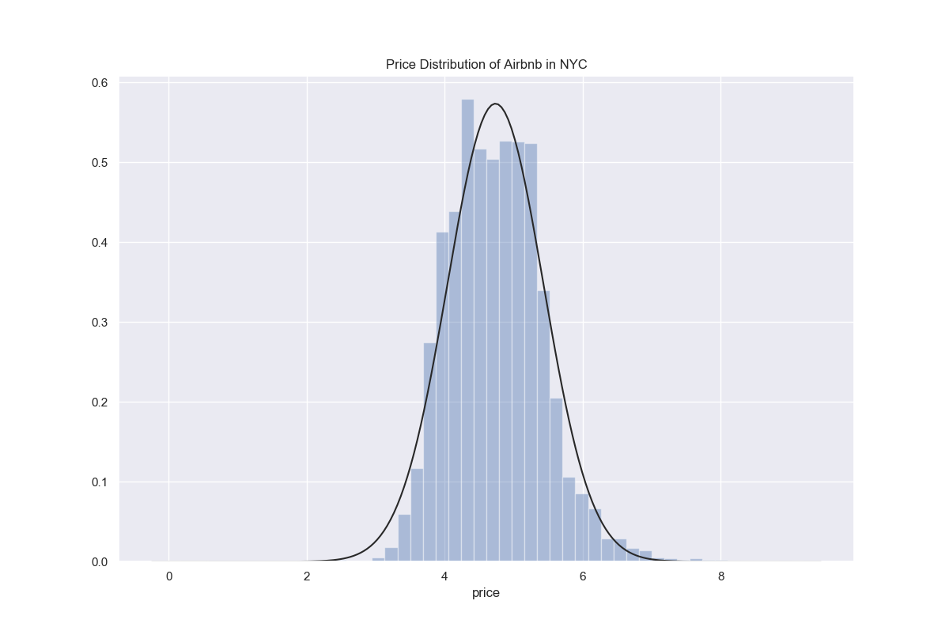
Data Preprocessing
Original Price Distribution:
Log-transformation Price Distribution:

Slide 9
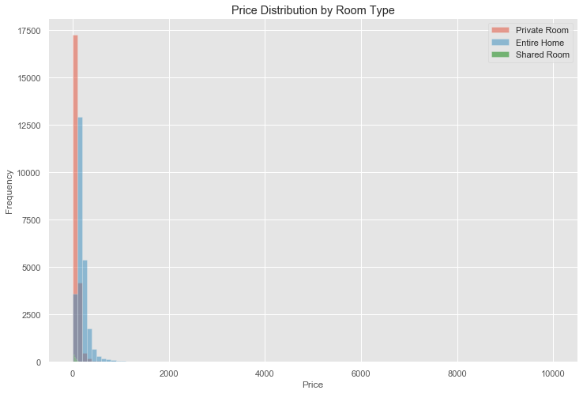
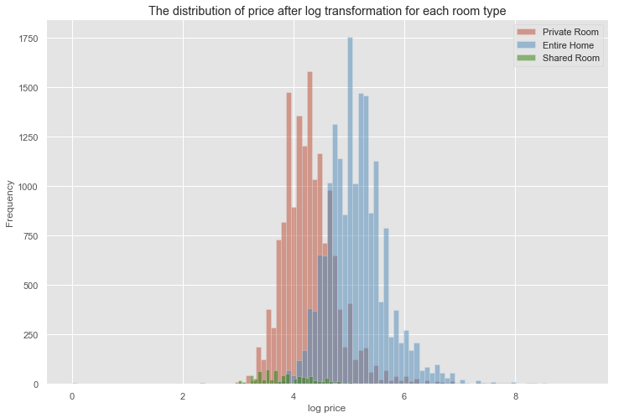
Data Preprocessing
Original Price Distribution:
Log-transformation Price Distribution:

Slide 10
Data Preprocessing
Removing unnecessary features
Name
Host name
Listing Id
Host Ids
Neighborhood: 221 unique values, redundant because of neighborhood_group
Taking care of missing values
number_of_reviews: Either impute using mean or zeros
Partitioning data
70% training 30% test with cross-validation
Standardize features
KNN uses Euclidean distance
Larger magnitudes will have more weight
Dummy variables for machine learning models
Handle nominal features: room_type & neighborhood_group

Slide 11
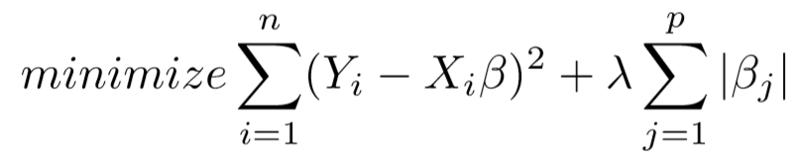

Lasso Regression
Regularization using L1 penalty term
Sum of the absolute values of the coefficient
$λ$ is the tuning parameter
Controls amount of regularization
Cost function:
Use GridSearchCV to find the optimal $λ$
10-fold cross-validation
R-squared metric

Slide 12
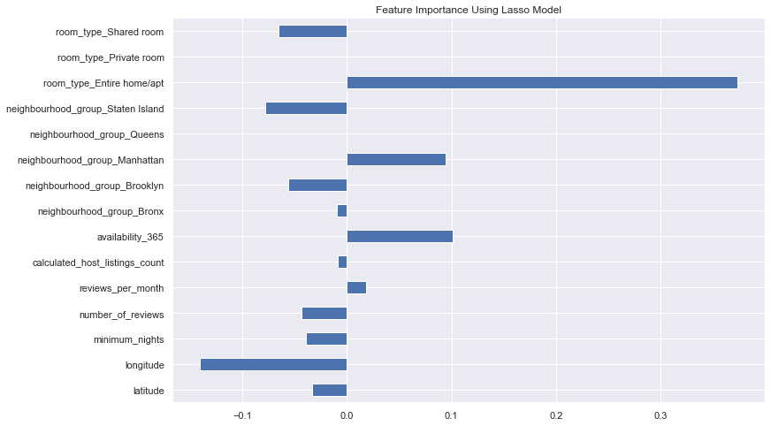
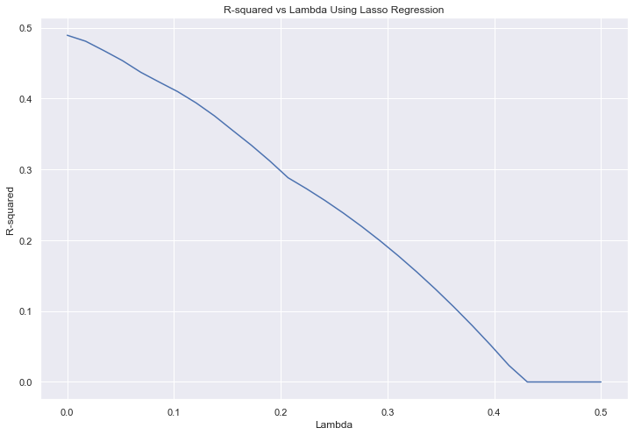
Lasso Regression
Feature Importance
GridSearchCV

Slide 13
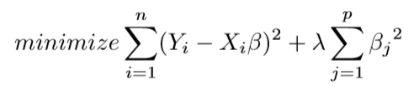

Ridge Regression
Regularization using L2 penalty term
Sum of the squared values of coefficients
$λ$ is the tuning parameter
Controls amount of regularization
Cost function:
Use GridSearchCV to find the optimal $λ$
10-fold cross-validation
R-squared metric

Slide 14
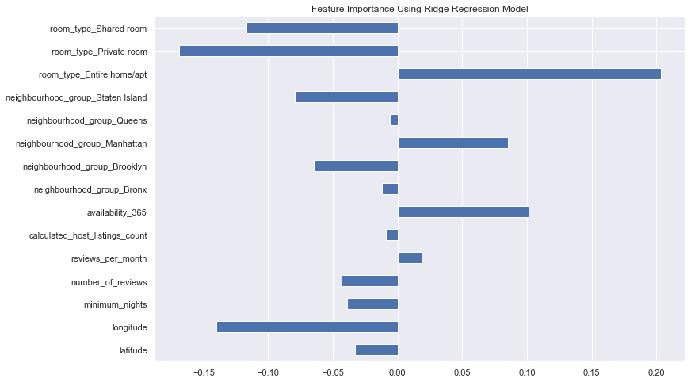
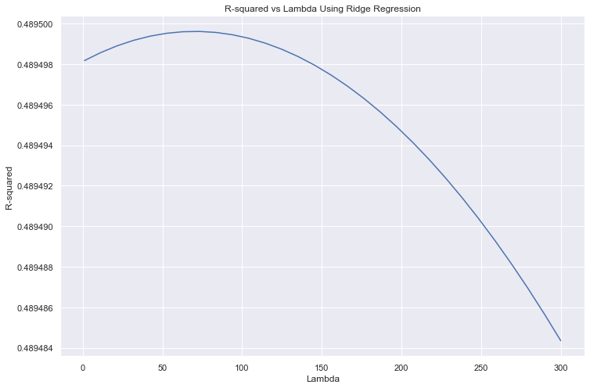
Ridge Regression
Feature Importance
GridSearchCV

Slide 15
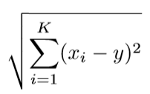

KNN Regression
Uses the K nearest neighbors to predict continuous outcome
Nonparametric method
Calculates the Euclidean distance between each training point xi & the new data y:
Use GridSearchCV to find the optimal $K$
3-fold cross-validation for faster computation
R-squared metric

Slide 16
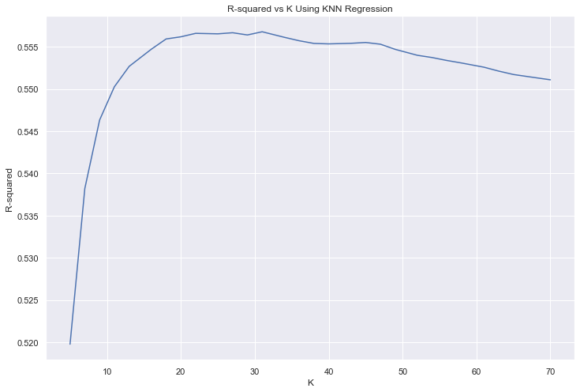
KNN Regression
Optimal K Value Using GridSearchCV

Slide 17
Model Summary
Performance for Lasso and Ridge were the same
Regularization was not necessary
OLS performed the same
Very low penalty parameter for Lasso
KNN performed the best
Much more computationally intensive
Higher explained variation in price resulted in lower RMSE
Model | Optimum Parameter | R2 | RMSE
Lasso Regression | 0.0001 | 0.48 | 0.5
Ridge Regression | 73 | 0.49 | 0.5
Linear Regression | N/A | 0.49 | 0.5
KNN | 31 | 0.56 | 0.46

Slide 18
Conclusion
At best, we were able to explain 56% of the variation in price with our best model KNN regression.
RMSE of 0.5 in log-transformed price.
Based on our results, we can conclude that:
Entire Home & Apartments Manhattan Higher Availability
Shared & Private Rooms Brooklyn Moving East (Away from downtown Manhattan)

