Slide 1
Stable Homes Grant — Annual Outcome Report
Stable Homes Grant
July 01, 2024 – June 30, 2025 · Prepared by Program Data & Evaluation Team
Synthetic demonstration data — contains no real client information.

Slide 2
At a glance
260
472
145
Households served
Individuals
Exits
64.1%
46.8%
97.2%
Permanent housing rate
Income increased
Follow-up completion

Slide 3
Executive summary
During the reporting period (July 2024–June 2025), Stable Homes Grant programs enrolled 260 clients across 260 households (472 individuals). Of 145 exits, 93 (64.1%) were successful and 93 (64.1%) went to permanent housing. Median household income change at exit was $0, with 46.8% of households increasing income. 5 of 5 performance measures met their targets. Headline: 64.1% of the 145 exits this period were successful, against 5 tracked measures (5 met, 0 missed).

Slide 4
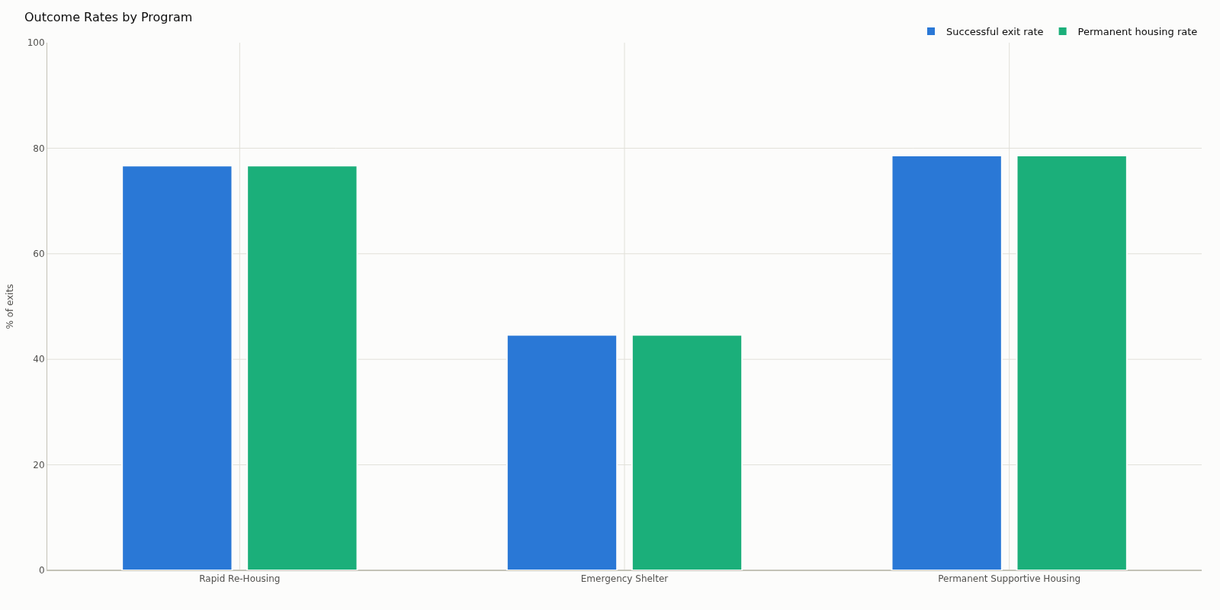
Outcomes by program

Slide 5
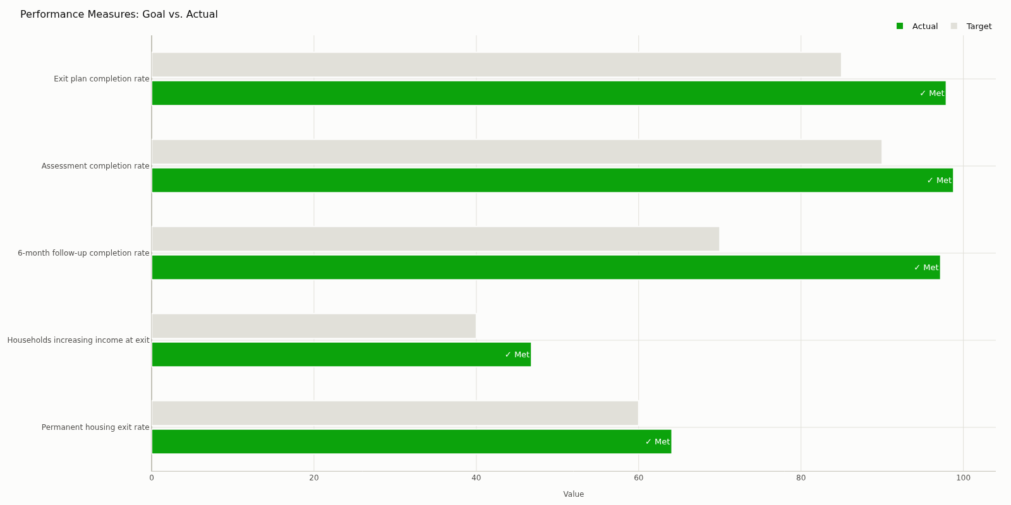
Performance against target

Slide 6
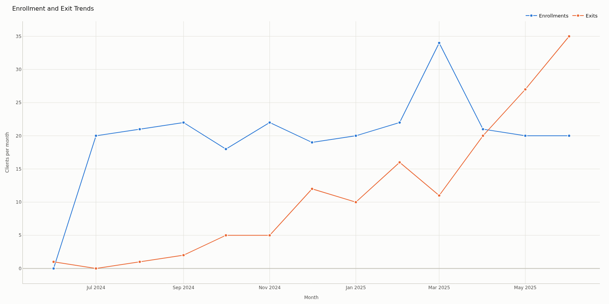
Enrollment and exit trend

Slide 7
Performance measures
Measure | Target | Actual | Status
Permanent housing exit rate | 60.0% | 64.1% | Met
Households increasing income at exit | 40.0% | 46.8% | Met
6-month follow-up completion rate | 70.0% | 97.2% | Met
Assessment completion rate | 90.0% | 98.8% | Met
Exit plan completion rate | 85.0% | 97.9% | Met

Slide 8
Data quality
85.1
Blocking issues to resolve before submission:
Missing required fields — 4 record(s)
Missing exit destination — 3 record(s)
Exit before enrollment — 3 record(s)
Duplicate client enrollment — 6 record(s)
Unknown program — 2 record(s)
Grade B · 263 records

Slide 9
Key findings
260 enrollments across 3 program(s) served 260 households (472 individuals: 327 adults, 164 children).
145 clients exited (55.8% of enrollments); 93 were successful exits (64.1%) and 93 went to permanent housing (64.1%).
Among 139 exits with complete income data, median income change was $0 and 46.8% of households increased income.
5 of 5 performance measures met their targets.
Enrollments are up 0.0% month-over-month in the most recent month.
Enrollment peaked in 2025-03 (34) and was lowest in 2024-10 (18).

Slide 10
Recommended actions
Complete the 12 overdue follow-up(s); follow-up completion is a funder performance measure.
Fix duplicate client enrollment (6 record(s)): Keep one record per client per enrollment; merge or delete the duplicates.
Fix exit before enrollment (3 record(s)): Check both dates against case notes and correct whichever was mis-entered.
Fix missing required fields (4 record(s)): Fill in the missing values from case files or the source system, then re-upload.
Fix overdue 3-month follow-up (4 record(s)): Contact the flagged clients to complete the 3-month follow-up, and record the completion date.
Fix overdue 6-month follow-up (4 record(s)): Contact the flagged clients to complete the 6-month follow-up, and record the completion date.

Slide 11
Methodology and limitations
Every figure in this deck is calculated by the application; the AI layer only narrates.
Deterministic narrative (non-AI mode).
3 duplicate enrollment record(s) were excluded from analytics.
3 household(s) had missing or implausible household size and were excluded from individual counts.
Income change is based on 139 of 145 exits; the rest were missing or had invalid entry/exit income.
Blocking data quality issues were present at generation time; affected metrics may be understated (see the Data Quality section).
3 exit(s) lack a destination and are counted as non-successful, which understates outcome rates.

