Slide 1
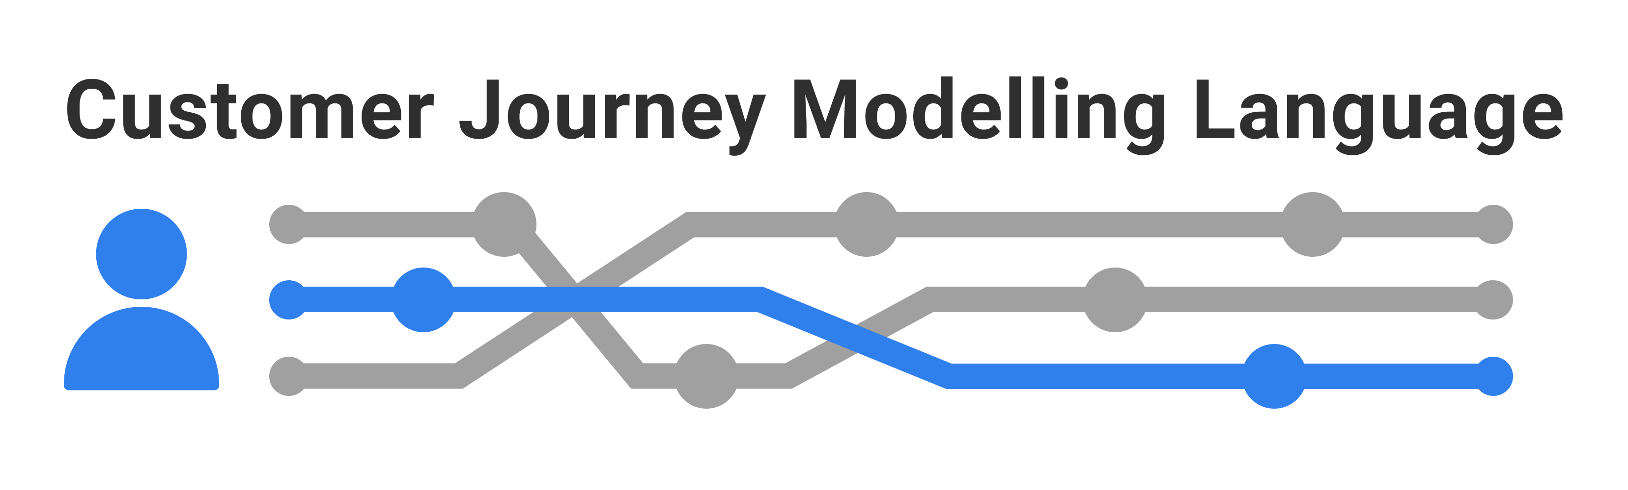

Diagram generator Templates for creating journey diagrams
HORM: Human and organisational risk modelling
Part of HORM (Human and organisational risk modelling)
Based on CJML version 1.1
SINTEF Digital | Sustainable communication technologies
Copyright © 2022 SINTEF

Slide 2
Contents
Overview and diagram types
How to make a diagram
Symbol gallery
Templates – swimlane diagram
Templates – journey diagram
Example
Man-in-the-middle attack
See more examples in Deliverable 4.1

Slide 3
Overview and diagram types
The CJML language
Diagram types and comparison

Slide 4
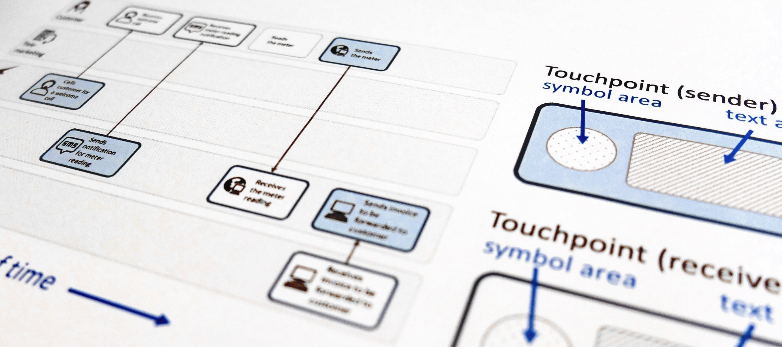
CJML - Customer Journey Modelling Language
CJML is a visual language dedicated to modelling of customer journeys, human behaviour and digital service processes
Customer journey
User journey
Employee journey
Patient journey
Citizen journey

Slide 5

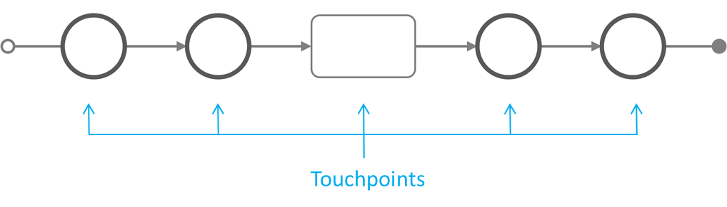
The CJML language
CJML is a formal language for specification and visualization of customer journeys and service processes.
CJML is centred around humans and human activities, regardless of their role being a customer, user, citizen, consumer, patient, or employee.
Customer journeys are modelled as sequences or constellations of touchpoints for a customer to achieve a specific goal or outcome.
CJML consists of terminology, diagrams, methods and tools.
Communication points are instances of communication or interaction between a user and a service provider
Actions are non-communicative events or activities conducted by an actor as part of a customer journey
The scope of a journey should be defined in relation to the purpose of the study.
Customer journey

Slide 6

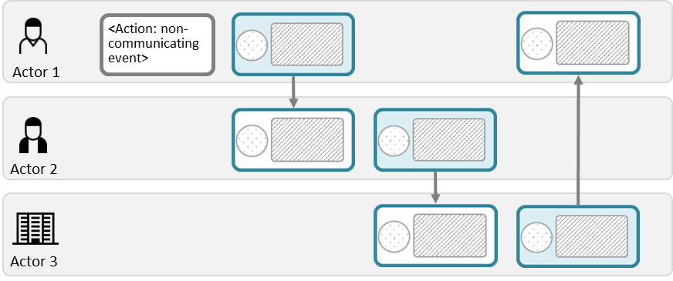
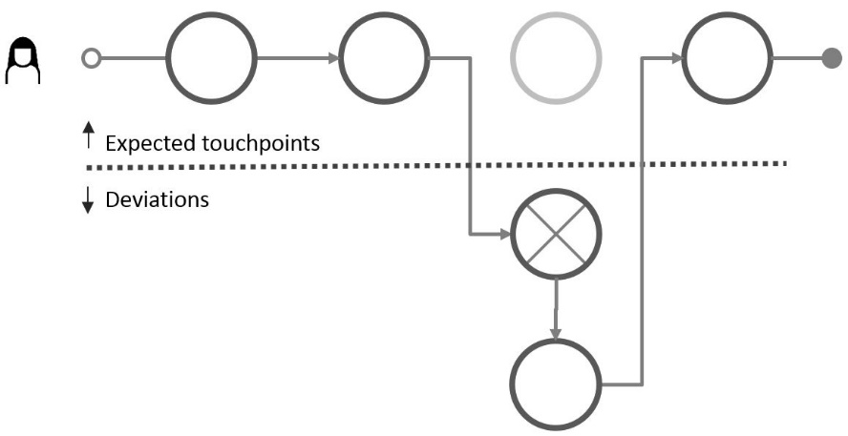
Diagram types
This overview shows only the main principles. Please refer to the documentation for further details.
Journey diagram
Suitable for planned and actual journeys with few actors involved
Suitable for actual journeys when emphasizing deviations from the planned journey
Swimlane diagram
Suitable when several actors are involved
Suitable for service delivery networks (see reference)
Reveals both the sender and the receiver of each communication point
Note the difference in how a communication point is represented in the two diagrams.
The swimlane diagram shows both the sender and the receiver.

Slide 7











Comparison of diagram types
Meets for an appointment with the GP
Receives information about the appointment
Receives an SMS reminder about the appointment
Consultation with specialist at the out-patient clinic
Journey diagram (patient's journey)
Note that this journey corresponds to the elements in the patient's swimlane below.
Swimlane diagram
Meets for an appointment with GP
Receives information about the appointment
Receives an SMS reminder about the appointment
Consultation with specialist at the out-patient clinic
Patient
Medical examination => need to consult a specialist
Sending an electronic referral to the specialist
Note that this touchpoint is invisible for the patient (and thus not part of the patient's journey above)
GP
Receives the referral and decide to call in the patient
Schedules and issues a letter with information
Sends notification about the appointment
Examines the patient, decides for an operation
Specialist
Simplification: this stage involves several actors and steps which is not shown here.
Simplification: this is normally taken care of by a medical coordinator at the specialist's clinic
Comment

Slide 8
How to make a diagram?
CJML diagrams are process diagrams (with a time dimension)
CJML diagrams have two or more actors are involved
There should be at least one human involved
The starting point is always a scenario.
Please refer to the slide “Diagram types” in the introduction for choice of diagram type.

Slide 9
Describe the scenario
Examples:
Threat scenario
Unwanted incident
Best practice ("happy path")
Deviation from best practice
Cyber security procedures
Start by describing a scenario (textual) and how it develops over time
Who (which actors) are involved?
How do they communicate?
What important steps are involved?
Identify the communication points among the actors and their essential attributes
Who is the initiator/sender of a message?
Who is the receiver?
Which communication channel is used?
When do the communication take place?
Identify important actions (non-communicating events).
Which actions are essential for the scenario?
Who are responsible for these actions
Describe chronologically what happens over time.

Slide 10
Symbol gallery
General: Actors and communication channels
Additional symbols for cyber security
Additional symbols for health care

Slide 11
















































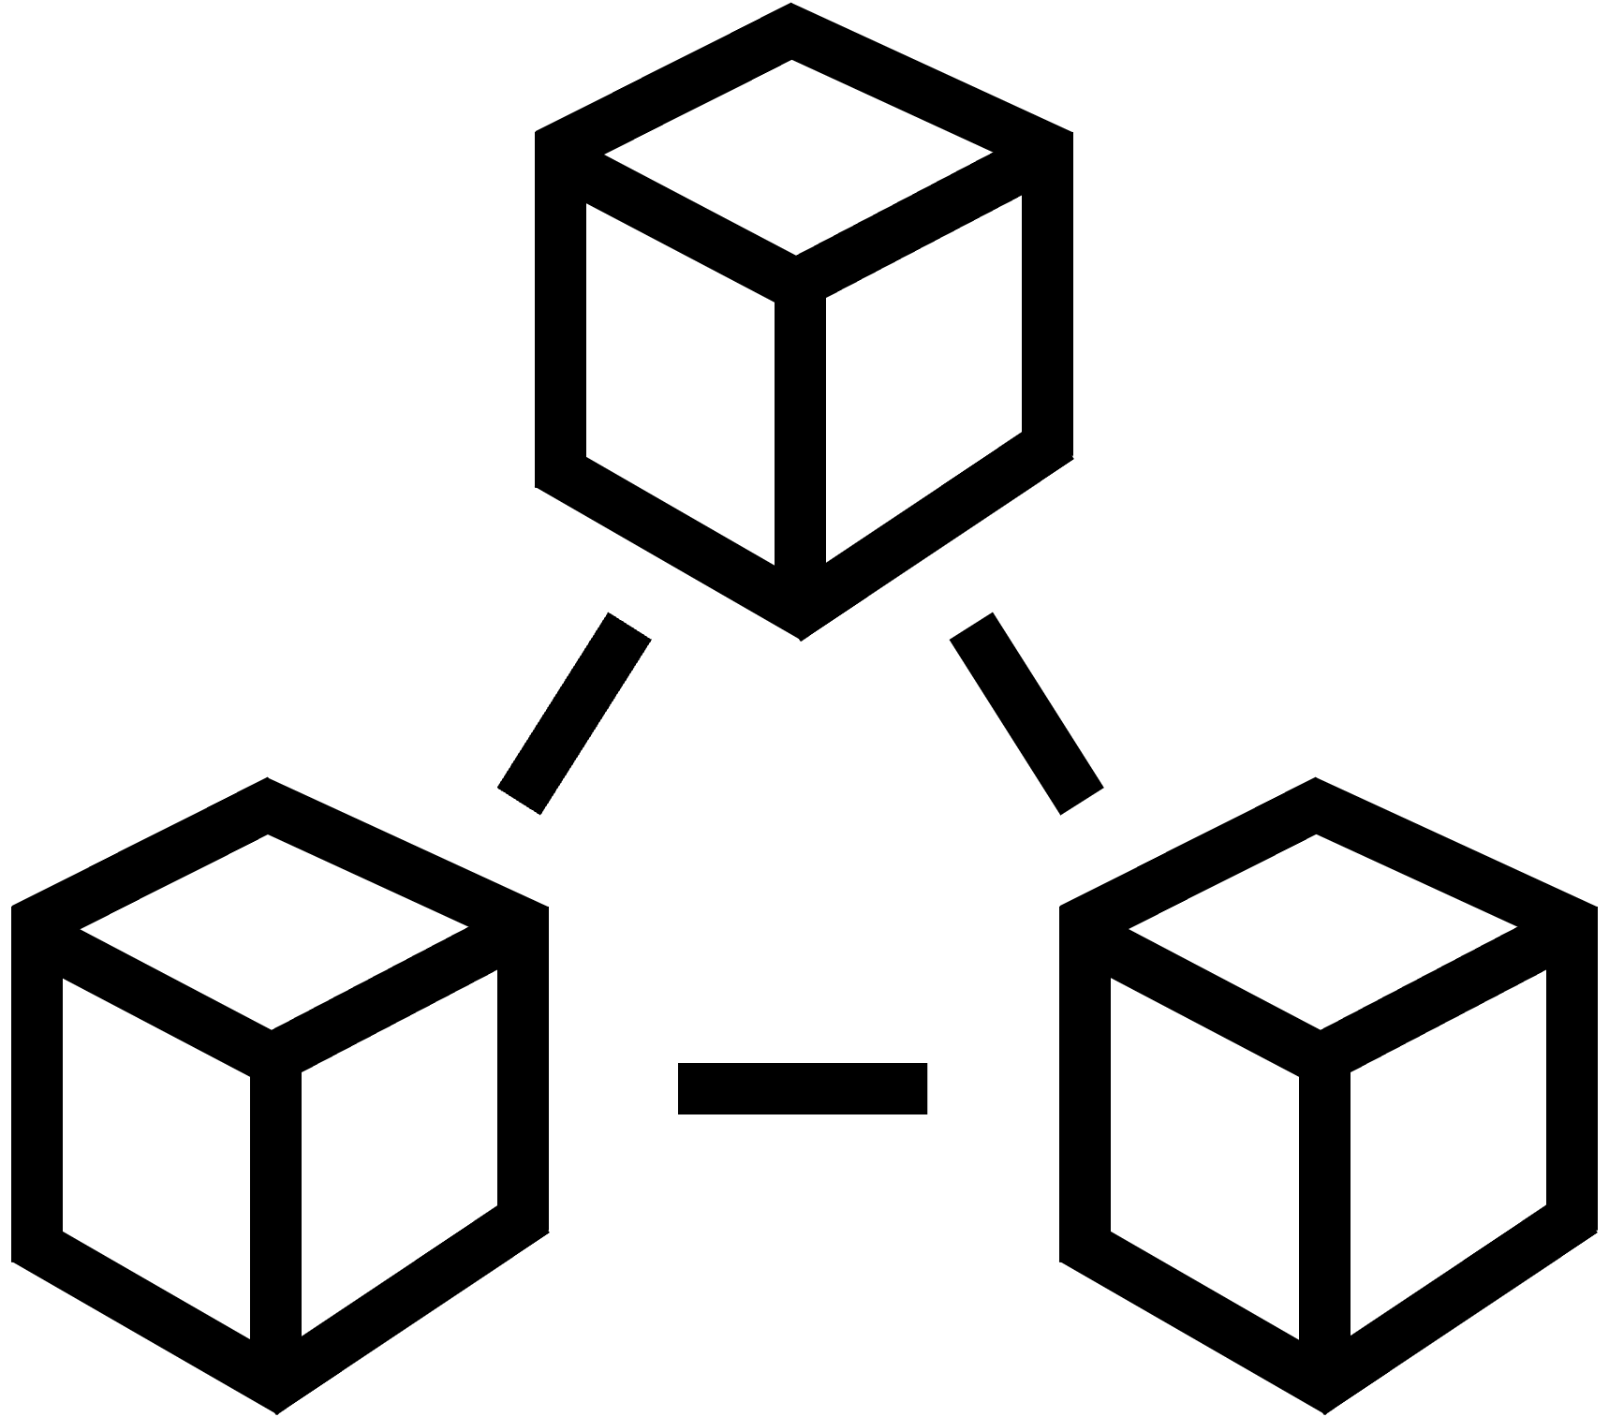

Actors and user experience
General symbols
Users and customers
user1
user2
user3
user4
user5
user6
user7
user8
user9
user10
user11
user12
user13
user14
user15
user16
user17
user18
user19
user20
Service providers
service provider1
service provider2
service provider3
service provider4
service provider5
store1
store2
store3
store4
bank1 online
bank2 online
bank3
bank4
bank5
bank6
Employee - general
employee1
employee2
employee3
employee4
employee5
employee6
employee7
employee8
employee9
employee10
employee11
employee12
employee13
employee14
employee15
employee16
IT staff and technicians
User/customer experience
staff IT1
staff IT2
staff3 IT3
staff tech1
staff tech2
staff tech3
Platforms and systems
1 very unsatisfied
2 unsatisfied
3 neutral
4 satisfied
5 very satisfied
tech1 database
tech2 database
tech3 server
tech4 virtual machine
tech5 cloud
tech6 network
tech7 system
tech8 system cloud

Slide 12




































Communication channels
General symbols
telephone conversation
letter
SMS
internet via PC
e-mail
internet via tablet
social media message or inbox message
internet via smartphone
chat
payment or bank transaction
face-to-face interaction
payment or bank transaction

Slide 13























Communication channels
General symbols
call centre
self-service machine
globe/internet
online shopping
app on PC
shopping
app on tablet
shop counter
app on smartphone
service desk
Package delivery and logistics
fax message
unknown channel/device

Slide 14




















Cyber security symbols
Cyber security symbols
Cyber security experts
cyber security expert 1
cyber security expert 2
cyber security expert 3
cyber security expert 4
cyber security expert 5
cyber security expert 6
cyber security expert 7
cyber security expert 8
cyber security expert 9
Attackers / cyber criminals
attacker
attacker network
attacker physical
attacker software
attacker social engineering
Special symbols
threat
unwanted incident
vulnerability lock
vulnerability unlock
firewall
danger2

Slide 15





















Healthcare symbols
Healthcare symbols
Patients
patient-1
patient-2
patient-3
Doctors and surgeons
Health secretaries
doctor-1
doctor-2
doctor-3
doctor-4
health-secretary-1
health-secretary-2
secretary-receptionist-1
secretary-receptionist-2
Nurses
Health systems
nurse-1
nurse-2
nurse-3
nurse-4
chief-nurse
hospital-computer-system
hospital-post-office
patient-medical-record-1
patient-medical-record-2
patient-medical-record-3
Hospitals and health systems
hospital-1
hospital-2
hospital-3
hospital-4

Slide 16
Templates – Swimlane diagrams
Suitable when more than two actors are involved.
Reveals both the sender and the receiver of each communication point.
Basic elements
Template – 3 actors
Template – 4 actors
Special elements

Slide 17
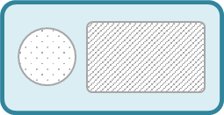



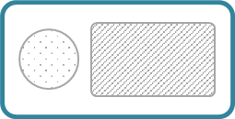


Swimlane diagram – basic elements
A communication point has a sender and a receiver that must be positioned in the corresponding swimlanes of the actors.
Action
Communication point
Communication point
Communication point
All the actors involved in the journey has a separate swimlane.
Sender
text area
Communication channel
direction
text area
Actor 1
Receiver
Actor 2
An action element is used for non-communicating events
Actor 3
Text area
Comment
Add an extra swimlane for comments if explanations are needed.

Slide 18
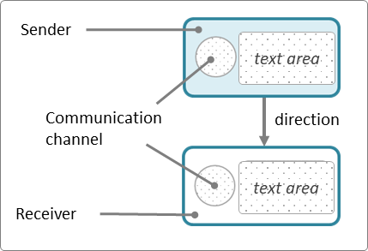

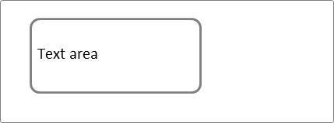

Swimlane – 3 actors
Position each part of the communication point in the correct lane, insert text and symbol
Use an action element for non-communicating events
Each actor should have a swimlane. Find a suitable icon for each actor.
Insert the touchpoints. Start with an action, describing the point-of-departure.
Each communication point should span two swimlanes (sender and receiver). Choose a suitable icon for the communication channel.
<Actor 1>
<Actor 2>
<Actor 3>
Choose symbols from the symbol gallery and place them here
<Short text explaining the sending side>
Text
Text
Text
<describe the action>
<describe the action>
<Short text explaining the receiving side>
Text
Text
Text

Slide 19




Swimlane – 3 actors
Text
Text
Text
<describe the action>
Text
Text
Text
Text
Text
Text
Text
Text
Text

Slide 20
Swimlane - 4 actors
Actor 1
Actor 2
Actor 3
Actor 4
Text
Text
Text
Text
<describe the action>
<describe the action>
Text
Text
Text
Text

Slide 21
Special elements for deviations
Sender Receiver
A swimlane diagram can also be used to represent actual customer journeys with deviations from the planned journey.
The shape's boundary style carries information about its status, as illustrated to the right.
When it is important to outline deviations in relation to a planned journey, a customer journey deviation diagram may be more suitable.
Completed
Missing
Failing
Ad-hoc

Slide 22
Templates – Journey diagrams
Suitable if you have few actors.
Especially suitable to express deviations - compare an actual journey with the planned journey
Basic elements
Templates - journey diagram
Templates - deviation diagram
Templates – 4, 5, 6, and 7 touchpoints

Slide 23


Journey diagram – basic elements
Choose colours for the various actors. A tradition in CJML is to use orange colour to represent a customer
Communication point boundary
Communication points are represented as a circle
The circle's boundary style carries information about
the actor initiating the touchpoint
the status of the touchpoint
The symbol in the middle represents the communication channel or the device being used
symbol area
The symbols are presented in a separate slide
Examples
Actor
The colour indicates the actor who initiates the communication point. Conventions
Orange is often reserved for a customer
Choice of colour should be consistent
If many actors are involved, a swimlane diagram may be more suitable
Customer
Service provider
Additional actor
Customer calls the service company
Service company sends an e-mail
Patient
Doctor
Patient meets for a medical consultation
Hospital sends a SMS reminder
Status
The boundary style indicates the status of the communication point
solid boundary: completed
dashed boundary: missing
crossed touchpoint: failing
Completed
Missing
only used for actual journeys
Failing
only used for actual journeys
Customer fails to buy a train ticket
Customer did not receive a call from the service company

Slide 24
Journey diagram
Customer journey
User journey
Employee journey
Patient journey
Citizen journey
Identify the actor in focus, and choose a colour associated with the communication points initiated by the actor in focus. Also, choose a colour for the other actor(s).
Insert the actions and communication points and connect them. Insert appropriate symbols from the symbol gallery.
Alternatively, pick touchpoints with already-inserted symbols.
For actual journeys, insert the actor symbol in front
Communication point boundary
symbol area
<Description of the communication point>
<Description of the communication point>
<Description of the communication point>
<Description of the action>
Action
Planned journey
<describe the action>
<Description of the communication point>
<Description of the communication point>
<Description of the communication point>
<Description of the action>
Actual journey

Slide 25
Journey diagram - deviation
Planned journey
Actual journey
Expected touchpoints
Deviations
This is an unexpected touchpoint, or a failing or missing touchpoint.

Slide 26






Journey diagram
Insert communication points based on the scenario text, and connect them.
Choose one colour for the customer-initiated elements, and one for the company-initiated elements.
Insert appropriate symbols
Remember to provide a short description
Start of journey
Continue here to build the planned journey by connecting more elements
<Description>
<Description>
Additional touchpoints
End of journey
<Description>
<Description>
<Description>
You may add actions too, but please prioritize the communication points
Frequently used symbols (see symbol gallery)
<describe the action>

Slide 27
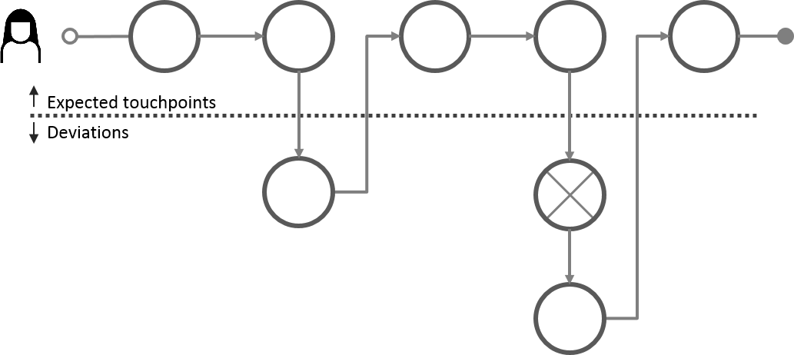

Journey diagram with deviations
Example of a deviation diagram
Continue here to build the planned journey by connecting more elements
<Description>
<Description>
<Description>
<Description>
<Description>
Expected touchpoints
Deviations
<Unexpected touchpoints will appear under the line>
Missing touchpoints
Failing touchpoint
Connectors
<Description>
<Description>
The symbols you will need

Slide 28
Journey diagram
<Description>
<Description>
<Description>
<Description>
4 touchpoints
<Description>
<Description>
<Description>
<Description>
<Description>
5 touchpoints
<Description>
<Description>
<Description>
<Description>
<Description>
<Description>
6 touchpoints
<Description>
<Description>
<Description>
<Description>
<Description>
<Description>
<Description>
7 touchpoints

Slide 29
Example – Swimlane diagram
Man-in-the-middle attack

Slide 30
Scenario: Man-in-the-middle attack
Eric works for HealthRec, a company specialised in software for patient administrative systems and electronic health records (EHR) for municipal doctors’ offices. Eric works as a customer consultant, and his main tasks are answering customer inquiries and developing training material.
After the COVID-19 outbreak, Eric works mostly from home. From time to time, he brings his laptop down to the local coffee shop to have a change in working environment. As a regular guest, Eric’s laptop automatically connects to the shop’s WiFi network.
While working on the new user manuals he receives a call from Cindy, a general practitioner in one of their customer sites. She cannot synchronise patient journals that contain new lab results, that are imported from another system. Eric asks her to send the system log and error messages and promises to prioritise her problem. Five minutes later he receives the e-mail from Cindy. He immediately understands the reason for the error messages, which have to do with Cindy not being assigned the correct editing privileges. He quickly upgrades her user account to the correct level and confirms through an e-mail that the problem is fixed.
In the same coffee shop, Eve, a cybercriminal guest has set up a WiFi access point duplicating the coffee shop’s SSID and password. When Eric arrived in the coffee shop, he unknowingly used the cybercriminal’s WiFi access point. Eve can now monitor Eric’s online activity, intercept his login credentials to the EHR system, and other data being transmitted and received over the network. The consequences may be severe, now that Eve has Eric’s login credentials, as a system administrator in platforms used in municipal doctors’ offices.

Slide 31


Scenario: Man-in-the-middle attack
Eric works in a SME developing e-health systems as a customer consultant. Cindy, a general practitioner, has problems when uploading patient health records. Eric has brought his laptop to a coffee shop and unknowingly connects via a fraudster WiFi-connection. Eric's login credentials to the e-health system is intercepted by the attacker.
E
Eric visits the local coffee shop to do some work on his PC.
Eric unknowingly connects his laptop via the fraudster WiFi network.
He receives the call and asks for system logs and error messages.
He receives the system logs and error messages.
He logs into the EHR system to reconfigure Cindy's user account.
Eric explains the error and confirms that it is solved.
Eric (consultant)
The user account is now configured correctly.
EHR system
Cindy has problems when synchronising new patient information in the EHR system.
She calls Eric, her regular consultant, to solve the problem.
She sends system logs and error messages.
Cindy receives a confirmation that the problem is solved.
Cindy (customer)
In a coffee shop, Eve has set up a fraudster WiFi connection with a legitimate sounding SSID
Eve intercepts the message received by Eric.
Eve intercepts Eric's login credentials.
Eve (attacker)

