Slide 1
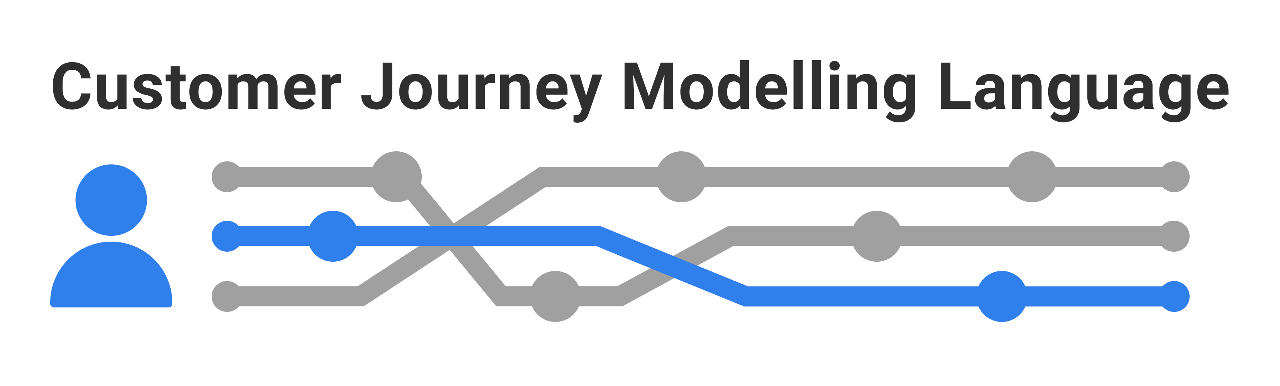

Introduction CJML - Customer Journey Modelling Language
HORM: Human and organisational risk modelling
Part of HORM (Human and organisational risk modelling)
Based on CJML version 1.1
SINTEF Digital | Sustainable communication technologies
Copyright © 2022 SINTEF

Slide 2




Overview of CJML resources
All the general CJML resources can be found here: www.sintef.no/cjml
www.cjml.no
Introduction
Overview, purpose and target group
Modelling approach
Visual notation
Diagrams, elements, and symbols
Features and examples
Terminology
Definitions, attributes, and class diagrams
CJML meta-model
The CJML material consists of several documents that are to be seen in connection to each other. The material can be used separately, but we recommend to start with Introduction and overview.
Diagram generator
Templates for easy diagramming
Examples
Graphical elements
Symbol collection
Bitmap and vector format

Slide 3
Content
Introducing CJML
Key facts
Target group
Development process and origin
Theoretical foundation and modelling approach
Planned and actual journeys
Journey types and examples
Touchpoint typology
Delineation of steps
A quick tour of CJML
Diagram types and examples
Comparison of diagram types
Customer/User experience

Slide 4
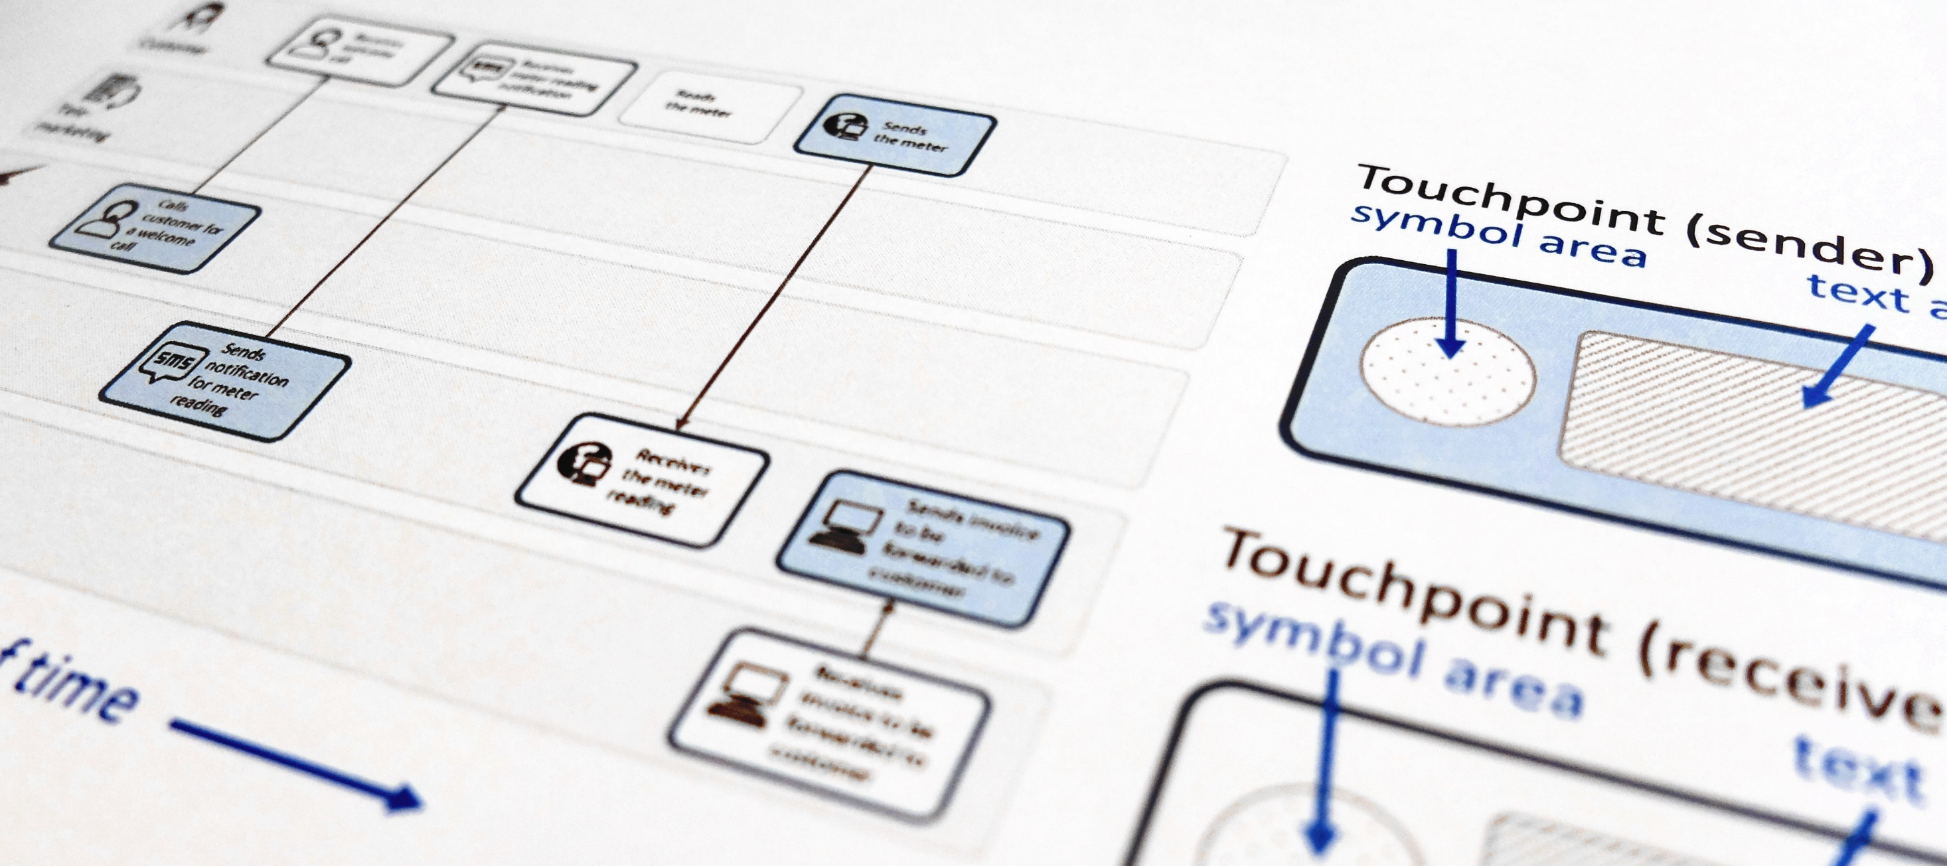
CJML - Customer Journey Modelling Language
CJML is a visual language dedicated to modelling of customer journeys, human behaviour and digital service processes
Customer journey
User journey
Employee journey
Patient journey
Citizen journey

Slide 5
Introducing CJML
Key facts
Target group
Development process and origin

Slide 6
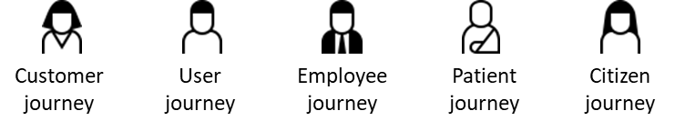
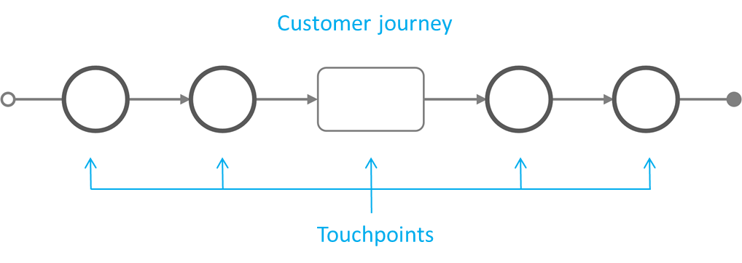
Key facts I
CJML is a formal language for specification and visualization of customer journeys
CJML is centred around humans and human activities, regardless of their role being a customer, user, citizen, consumer, patient, or employee.
The basic concepts of the language are customer journeys and touchpoints.
CJML consists of terminology, diagrams, methods and tools.
Customer journeys are modelled as sequences of touchpoints to achieve a specific goal or outcome.
CJML distinguished between touchpoints that communicate a message (circle) and not (square).
Introducing CJML
Theoretical foundation and modelling approach
A quick tour of CJML

Slide 7
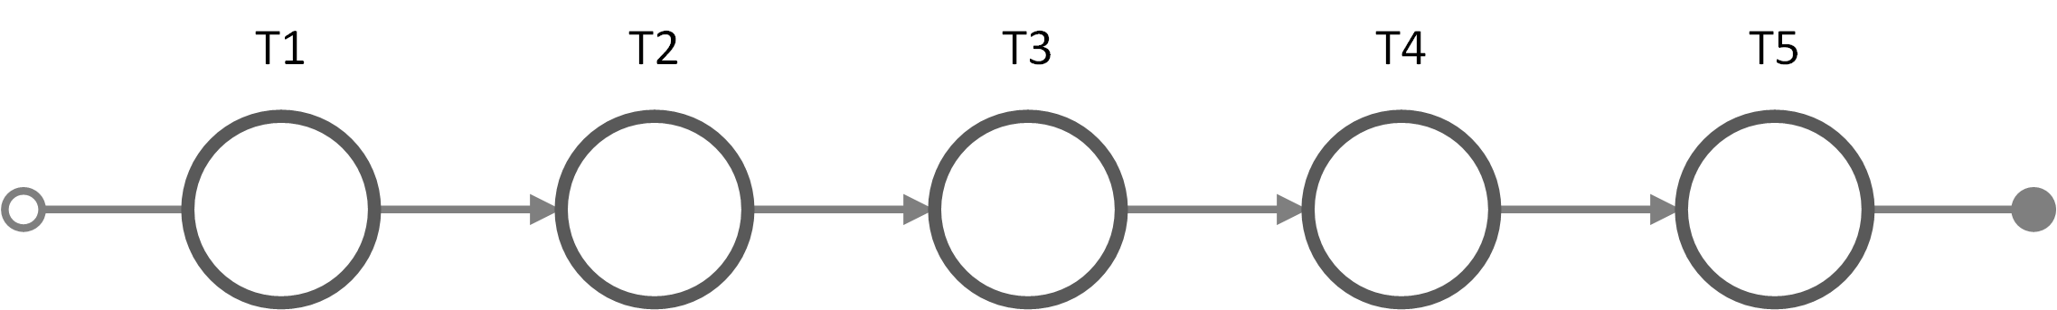
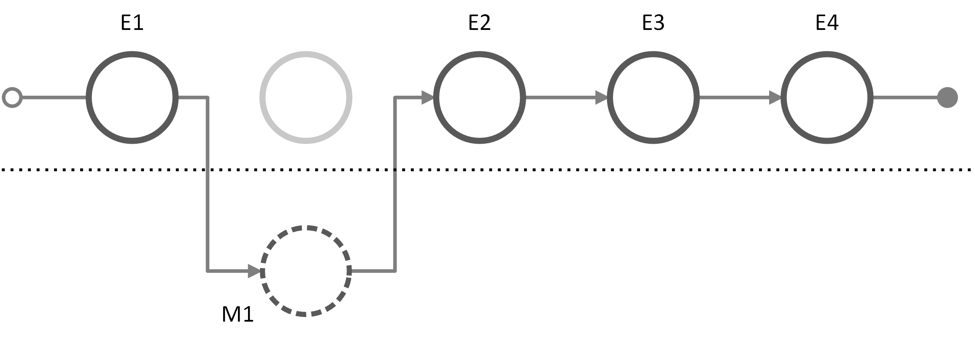

Key facts II
CJML addresses the detailed interactions between
A human and one or more service providers (B2C)
A human and a network of users and/or service providers (C2C, B2B2C etc.)
CJML describes journeys in two states:
The hypothetical state (planned journey)
The real state – with an individual user (actual journey).
Planned journey
Actual journey
Introducing CJML
Theoretical foundation and modelling approach
A quick tour of CJML

Slide 8
Key facts III
CJML differs from other diagrammatic languages in two principal ways:
CJML models the service process from the customer's point of view
CJML aims at being intuitive for a wide user group – no technical background recquired
CJML is well suited for service processes that extends over time, being mediated by various communication channels.
CJML is particularly targeting service processes that are technology-driven and repeated in high volumes
Introducing CJML
Theoretical foundation and modelling approach
A quick tour of CJML

Slide 9
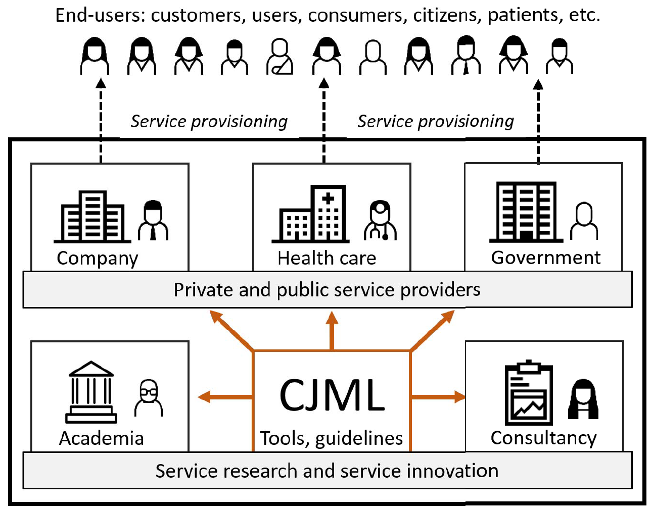
Target group
CJML is relevant to anyone who works with service provisioning, whether you are engaged in service design, business development or customer support.
The core elements of CJML targets a wide user group, in principle "everyone" in a service providing organization.
CJML does not require a technical background.
The more advanced features of CJML targets analysts, system developers, and researchers.
Systematic evaluations have shown that new users can easily adopt CJML and make customer journey diagrams with a high level of precision.
Halvorsrud, R., Haugstveit, I. M., & Pultier, A. (2016). Evaluation of a modelling language for customer journeys. Proceedings from the IEEE Symposium on Visual Languages and Human-Centric Computing, pp. 40-48. IEEE Xplore. doi:10.1109/VLHCC.2016.7739662
Introducing CJML
Theoretical foundation and modelling approach
A quick tour of CJML

Slide 10
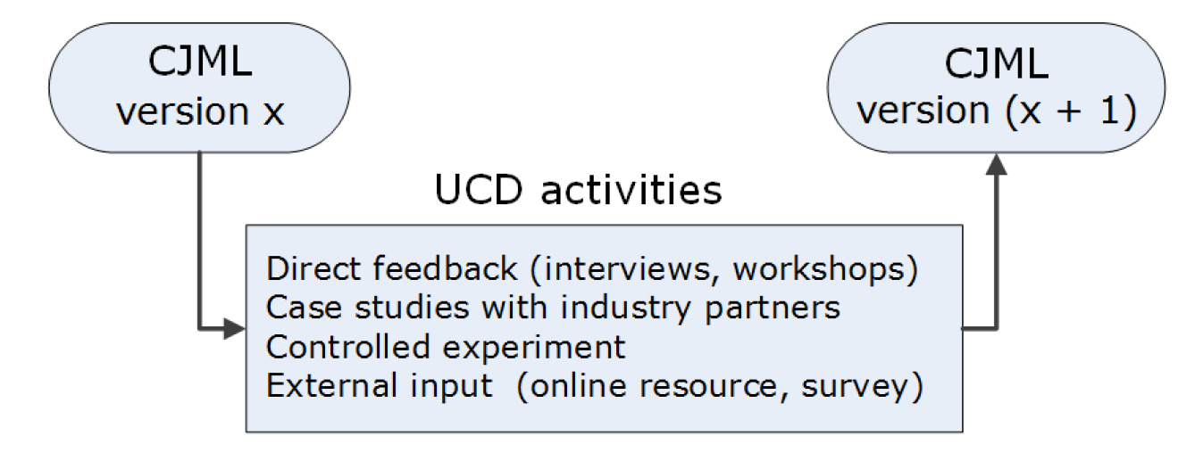
Development process and origin
The development of CJML is based on user-centred design and an extensive involvement of users from various business sectors.
CJML has been developed in iterations, based on operational experience and case studies with industry partners, literature studies and systematic evaluations.
CJML is continuously being developed through several SINTEF-led innovation and research projects. In all, 11 public and private service providers, 4 research institutions, and 2 consultancies have been involved up to now.
The early versions of CJML was called VISUAL, named after an innovation project (2013-2016) funded by the Research council of Norway.
Halvorsrud, R., Boletsis, C., & Garcia-Ceja, E. (2021). Designing a Modeling Language for Customer Journeys: Lessons Learned from User Involvement. Proceedings from the ACM/IEEE 24th International Conference on Model Driven Engineering Languages and Systems (MODELS’21) (pp. 239-249).
Introducing CJML
Theoretical foundation and modelling approach
A quick tour of CJML

Slide 11
Theoretical foundation and modelling approach
Planned and actual journeys
Journey types and examples
Touchpoint typology
Delineation of steps

Slide 12
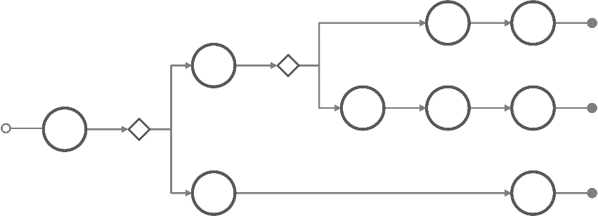
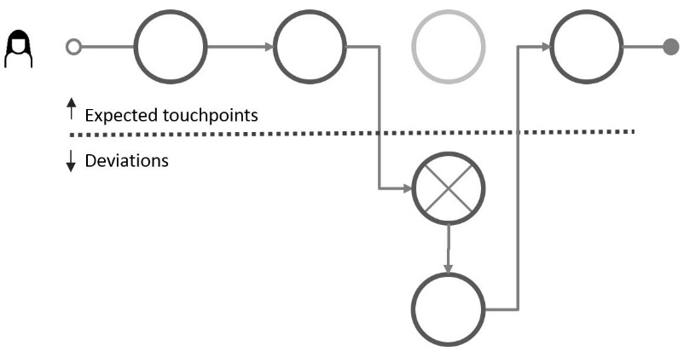
Two states of a journey
User experience is considered only for actual journeys. In this regard, CJML differs from most other approaches.
The planned journey
The actual journey
reflects how the service process is implemented by the service provider - regardless of whether it was deliberately designed or resulted from ad-hoc development
often branch into alternative paths as a result of decisions made by the user (e.g. preferred channel) or the service provider (e.g. business dependencies)
always involve an individual user
is associated with a subjective user experience which is subjective, context dependent, and may change over time
often deviate from the planned journey
plan
deviation
Theory
Reality
Introducing CJML
Theoretical foundation and modelling approach
A quick tour of CJML

Slide 13
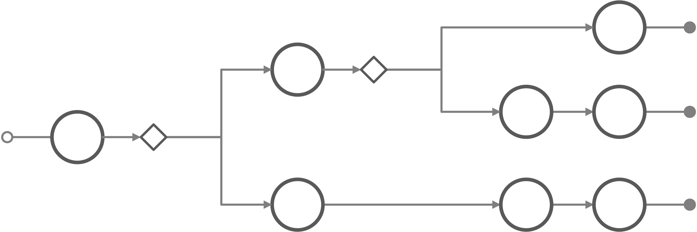
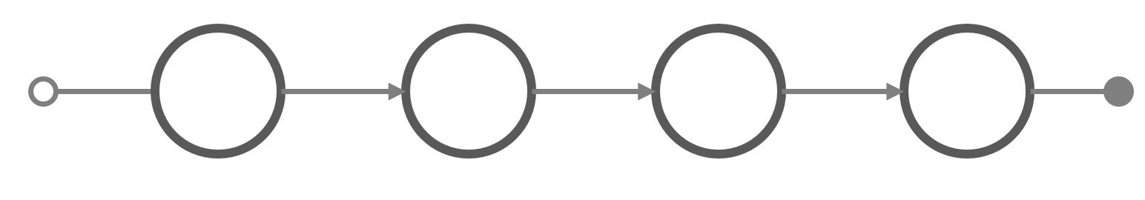

Naming of customer journeys
For a given service process, there is often a group of closely related planned journey. These are called a journey group. The group represents all the alternative (allowed) paths through the service process.
Planned journey group A set of related customer journeys that represents alternative ways to achieve a common user goal. Due to digitalization there may be several channels available. Also, alternatives may result from configurations and dependencies in the business case.
Planned journey One specific customer journey, as implemented (or planned for the future) by the service provider, given the service conditions
Actual journey A real journey, as it unfolds for an individual customer during execution of a service process. (Alternatively, an anticipated execution of a service process for a persona or fictional customer). An actual journey may comply with the planned journey, or it may contain deviations.
An actor’s symbol at the beginning of a journey indicates an actual journey.
Introducing CJML
Theoretical foundation and modelling approach
A quick tour of CJML

Slide 14
Customer journey
Note that CJML can be used for all types of journeys: user journeys, patient journeys, employee journeys etc.
A journey is modelled as a sequence of touchpoints involved for a human user to achieve a specific goal.
The scope of a journey should be defined in relation to the purpose of the study
Communication points are instances of communication or interaction between a user and a service provider
Actions are non-communicative events or activities conducted by an actor as part of a customer journey
Introducing CJML
Theoretical foundation and modelling approach
A quick tour of CJML

Slide 15
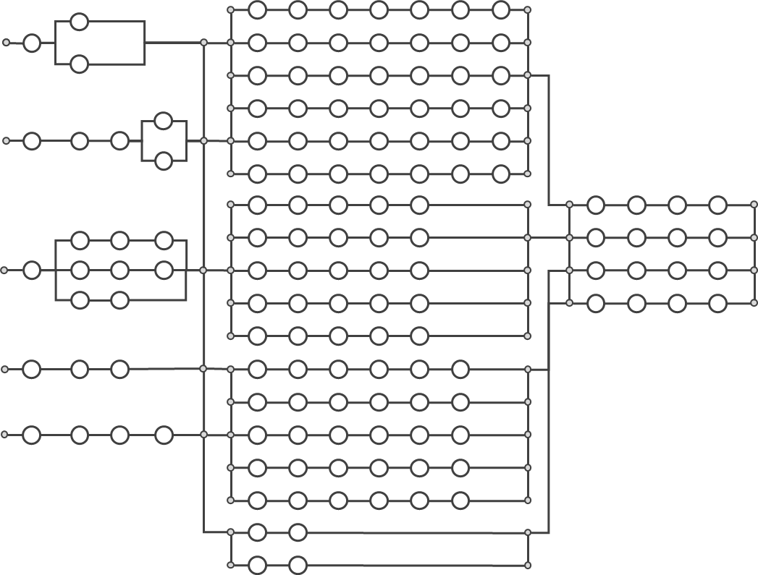
Example: Planned journey group for on-boarding new customers
A utility company offers five different ways to initiate the on-boarding of new customers.
The numerous choices of communication channels and messages results in as many as N = 648 unique, alternative paths (generic journeys)
Each circle represents a touchpoint (in this case a communication point) where the company and customer communicate through e.g. e-mail, SMS, or an app.
1
2
3
4
All the digital touchpoints leave traces and involves internal systems and work processes.
5
Number of journeys =
9 x 18 x 4 = 648

Slide 16
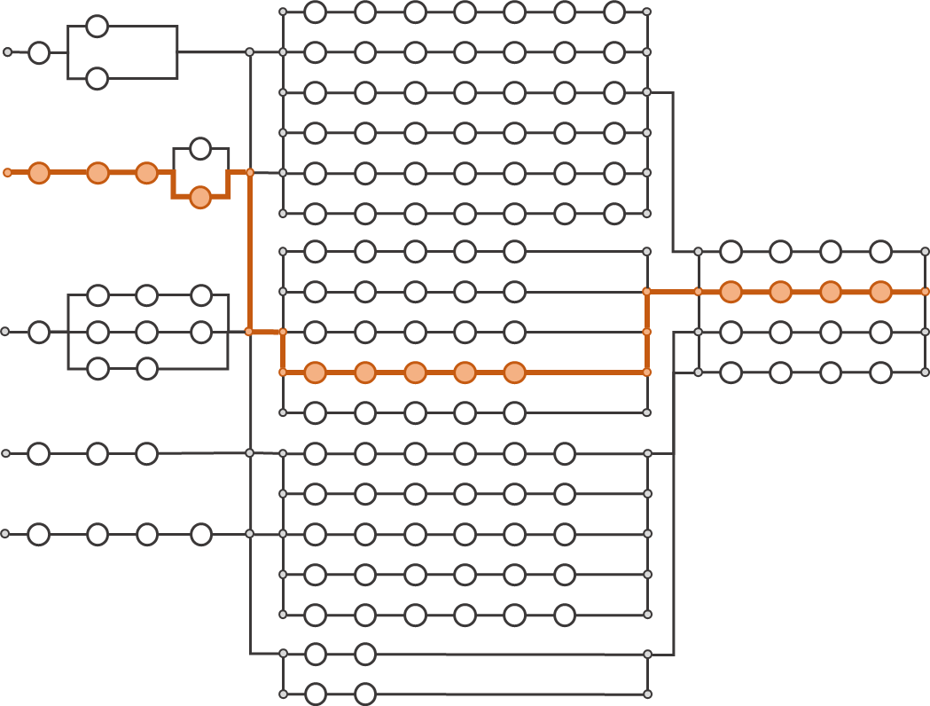

Example – actual journey
Peter is a new customer who choose to sign up through the company web page. His journey is outlined in orange colour.
1
Peter has a unique experience throughout the actual journey
2
I prefer to contact them through their web site.
This was definitely not that easy…
3
4
The customer has completed one of the 648 possible paths.
The journey consisted of 13 touchpoints.
In reality, there are often deviations from the planned journey.
5
Number of journeys =
9 x 18 x 4 = 648

Slide 17

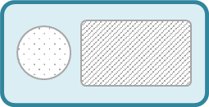

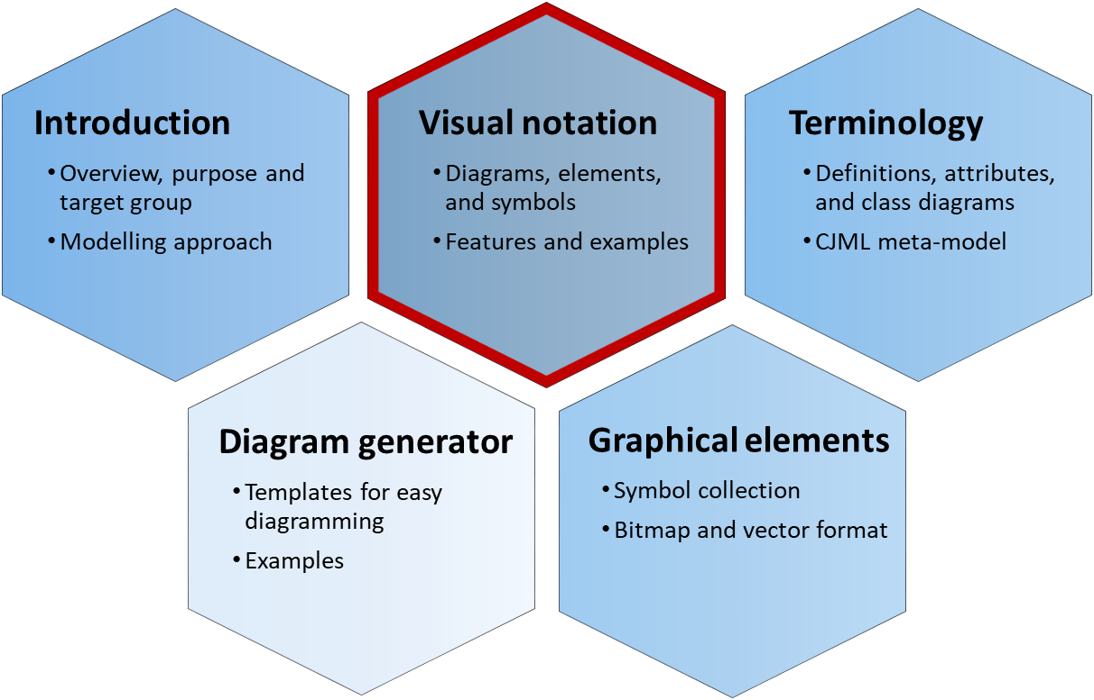
Modelling of communication points
Message
Communication in CJML is defined through the Shannon- Weaver model of linear communication, where a sender transmits a message to a receiver through a communication channel.
This model is pertinent for technology-mediated communication, but clearly has its limitation, e.g. in case of human conversation.
Communication channel
Actor 1
(initiator)
Actor 2
(receiver)
Visual representation of a touchpoint
Shannon, C. E., & Weaver, W. (1963). Mathematical theory of communication. Urbana, IL: University Illinois Press.
Journey diagram
Swimlane/network diagram
Communication channel
Communication channel
There are two ways to visualize a communication point, reflecting the two diagram types in CJML, see the Visual notation document.
text area
Actor 1
(initiator)
Actor 1
(initiator)
direction
Actor2
(receiver)
text area
Useful for simple journeys and for showing deviations from the planned journey.
Useful for journeys with several actors, and for showing both initiator and receiver.
Introducing CJML
Theoretical foundation and modelling approach
A quick tour of CJML

Slide 18
What is a customer journey?
Customer journey
A customer journey is defined as a sequence or constellation of touchpoints involved for a customer to achieve a specific goal or a desired outcome. The start and end of the journey must be seen in context with the purpose of the analysis.
As a common method in service design, customer journey mapping is practiced in various ways. However, there are some common factors that can be identified across all approaches:
The journey is based on the customer's point of view
The journey has a time dimension – or a process nature
The journey is divided into steps
Note that a customer journey might involve both voluntary and/or mandatory aspects, and the outcome might or might not be desirable for the customer (e.g. tax reporting resulting in an additional tax payment is an example of a user journey that is mandatory and with an undesirable outcome).
About customer journeys
The term customer journey is generally used as metaphor for taking a customer's (or a user's, consumer's, citizen's) perspective.
Customer journeys or customer journey mapping also denote a method in service design. The method is often used to express a service user's experience.
Although the method is commonly used in the service industry, it lacks a theoretical foundation and a formalization.
A customer journey is often divided into "before", "during" and "after" the service. Sometimes, the borders between these stages are not can be hard to define.
Examples of journeys
Hospitality service: Going to the cinema to watch a movie. The service process comprises ordering and payment of the ticket, retrieval of the ticket, procedures at the movie theatre, and the movie itself.
Health service: Having a knee surgery. The journey starts with a visit to the general practitioner, and continues with a MR scanning, a consultation with a specialist, and finally the surgery. The patient has a relation to more than one service actor throughout the patient journey.
Introducing CJML
Theoretical foundation and modelling approach
A quick tour of CJML

Slide 19





Who are involved in a customer journey?
Directly involved actors The actors on the left side are directly involved in delivering the service to the customer. They are responsible for (parts of) the customer's journey.
External actors The actors on the right side may influence the customer's journey, although they are not responsible for any part of the service delivery.
Example: In the case of a visit to the cinema, a directly involved actor would be the cinema company and the supply chain partner responsible for delivering systems for online booking.
Service provider
Friend
Example: In the case of a visit to the cinema, an external actor could be the newspaper that made the customer aware of the film, or a friend who recommended the film.
Customer
Sub-contractor(s)
Newspaper
Note that a customer often see the set of service providers as one entity, and does not distinguish (or care) about their interrelation.
Introducing CJML
Theoretical foundation and modelling approach
A quick tour of CJML

Slide 20
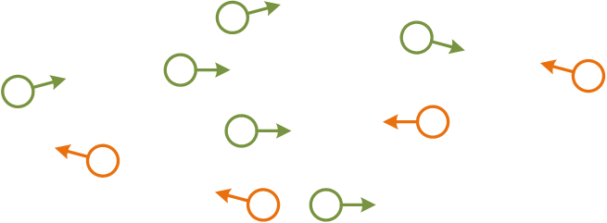


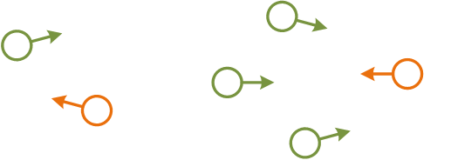
Touchpoints are the "atoms" of a journey
Touchpoint
A customer journey is modelled as sequences of steps that we refer to as touchpoints. Communication points are a sub-class of touchpoints that represents instances of communication or interaction between the customer and other actors. The other sub-class of touchpoints are actions, which do not involve directed communication. Actions are not part of the illustration, but will be further described.
Service provider
Friend
Customer
Sub-contractor
Newspaper
Communication points
Communication points are instances of communication or interaction between the customer and other actors. Communication points forms "the backbone" of a customer journey, and they are associated with
a sender
a receiver
a communication channel
Introducing CJML
Theoretical foundation and modelling approach
A quick tour of CJML

Slide 21


Communication points
The Visual notation document contains all the details on how to visualise touchpoints.
Communication points constitutes the backbone of a journey.
The most important attributes are codified in the visual notation.
Both the direction of the communication, and the communication channel itself are visually emphasized.
Communication points initiated by the customer have a different colour than the ones initiated by other actors
Service provider
Friend
Customer
Sub-contractor
Newspaper
The customer sends an e-mail to the service provider
The customer receives an e-mail from the service provider
A friend calls and recommends the movie
Introducing CJML
Theoretical foundation and modelling approach
A quick tour of CJML

Slide 22
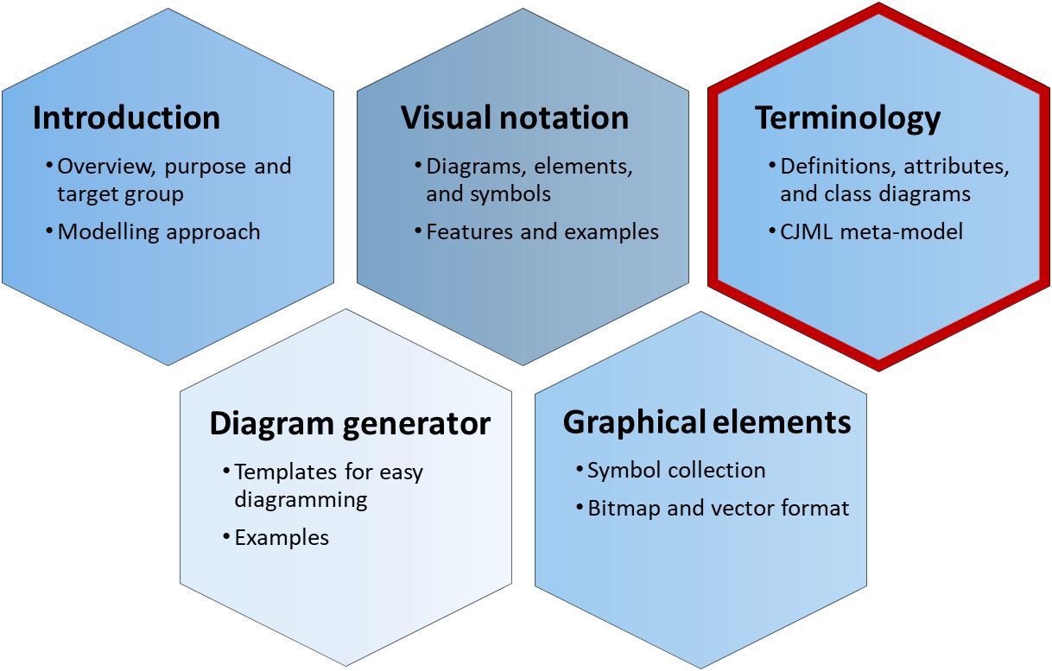
Touchpoint typology
CJML distinguishes four categories of touchpoints
Communication or interaction between the customer and the service provider
Communication or interaction between the customer and an external actor
An action or activity involving the service system
An action or activity not involving the service system.
Touchpoint metamodel
UserJourneyElement
Touchpoint
description: Text
status: TouchpointStatus
arbitrarilyOccuring: Boolean
timeOriginated: Time [0..1]
timeAvailable: Time [0..1]
timeConsumed: Time [0..1]
experienceDescr.: Text [0..1] experienceRating: Note [0..1]
objects
Object
*
backendSyst
ITSystem
0..1
Action
CommunicationPoint
The document describing the terminology provides more information about the attributes of touchpoints.
Introducing CJML
Theoretical foundation and modelling approach
A quick tour of CJML

Slide 23

Touchpoint typology
Directly involved actors The actors on the left side are directly involved in delivering the service to the customer. They are responsible for (parts of) the customer's journey.
External actors The actors on the right side may influence the customer's journey, although they are not responsible for any part of the service delivery.
Communication point
External communication point
Direct communication Steps involving a "sender" and a "receiver" in the context of the customer's journey.
A communication channel is always involved.
Communication with the service provider or the service system. Often part of the planned journey.
Communication with an external actor who is not involved in the service provisioning
Action
External action
No communication Steps without communication are called actions. They may or may not involve interaction with the service system.
Non-communicated observations and cognition is included here.
Action involving the service system.
Lisa grabs a shopping cart at the mall
Action not involving the service system.
Lisa writes a shopping list at home
These touchpoints involve the service system, and can be controlled (to some extent) by the service provider.
These touchpoints occur outside the service system, and cannot be controlled by the service provider
Introducing CJML
Theoretical foundation and modelling approach
A quick tour of CJML

Slide 24
Extra: Delineation of steps
CJML allows abstraction through journey phases, see the terminology document. Example: before the flight, during the flight, after the flight.
Service processes often involve a number of activities and steps, and it can sometimes be challenging to divide the process into logical units.
The general rule is that the process should be divided into touchpoints carrying "the smallest unit of meaningful content" considering the purpose of the mapping.
When the communication channel changes, a new step begins.
When a new service provider is introduced, a new step begins
E.g. online shopping, when products are chosen and payment starts
For human encounters, when a new person approach the user
E.g. air travel, when moving from check-in desk to security check
Modelling always involve some kind of simplification. To illustrate this, when making a pone call there is a number of steps that are not necessary to describe, e.g. "holding the phone to the ear".
Delineation of steps must always be seen in relation to relevance. The steps "dialling the telephone number" is usually not important. However for an emergency service this step may be essential.
Example: Online shopping can be divided as follows:
Browse the products and add items to the virtal shopping cart
Look through the order and pay
Example of delineation: A visit to the doctor includes many actions.
Steps that are essential:
The doctor's examination of patient
The doctor’s diagnosis and any decision about further follow-up or referral
Steps that may be important:
Check-in at the reception (some might have systems that notifies the doctor about arrival)
The time spent in the waiting room
Payment and check-out
Steps that are not important:
The bus ride to the medical centre
Leaving the jacket in the wardrobe in the waiting room
Introducing CJML
Theoretical foundation and modelling approach
A quick tour of CJML

Slide 25
Extra: Communication point or action?
Distinguishing communication points and actions can sometimes be difficult if one doesn't have definitions and guidelines to relate to.
Communication, as defined in CJML, requires that an actor sends a message directed to another actor. In addition, the message must be sent in context of the journey. As a consequence, a radio broadcast or advertisement on the bus is not considered a communication point but an action.
Note that acquisition of information (perception and cognition) is not defined as communication in CJML unless the information is communicated actively to an intended receiver and in the context of a journey.
Example 1: John is reading the electricity meter and writes down the number on a piece of paper.
This step is an action, as John has not yet communicated the number to anyone.
Example 2: John sends the meter reading to the utility company through an SMS.
This step is definitely a communication point, as the message is actively sent to an intended receiver.
Example of touchpoints that involve direct communication:
A patient has a telephone conversation with the doctor.
The doctor receives an epicrisis from the specialist.
A patient receives a SMS reminder about the upcoming appointment with the doctor.
Example of touchpoints that are not defined as direct communication:
Writing down questions before a visit to the doctor.
Reading an information brochure at the doctor's waiting room.
Looking at the map of the hospital area to find the right building.
Introducing CJML
Theoretical foundation and modelling approach
A quick tour of CJML

Slide 26
A quick tour of CJML
Only a small selection of the diagrams and visual features in CJML is shown here.
The full specification can be found in the Visual notation document.
Diagram types and examples
Comparison of diagram types
Customer/User experience

Slide 27

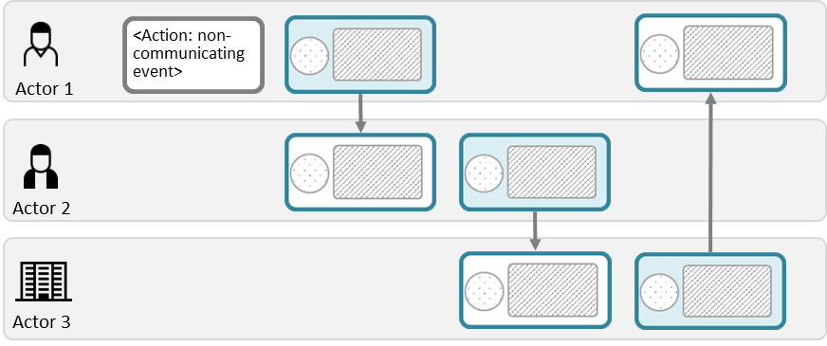

Overview - diagram types
The journey diagram has many visual features, however the swimlane diagram enables a better overview of the service delivery network.
Journey diagram
Suitable for planned and actual journeys with few actors involved
Suitable for actual journeys when emphasizing deviations from the planned journey
Swimlane diagram
Suitable when several actors are involved
Suitable for service delivery networks (see reference)
Reveals both the sender and the receiver of each communication point
Tax et al. (2013). The Service Delivery Network (SDN): A Customer-Centric Perspective of the Customer Journey. Journal of Service Research, 16(4), 454-470.
Note the difference in how a communication point is represented in the two diagrams.
Introducing CJML
Theoretical foundation and modelling approach
A quick tour of CJML

Slide 28
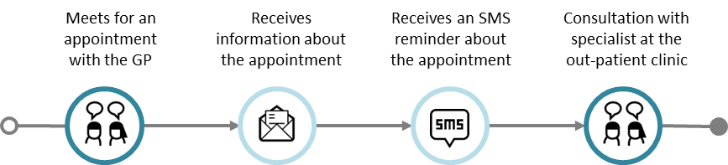
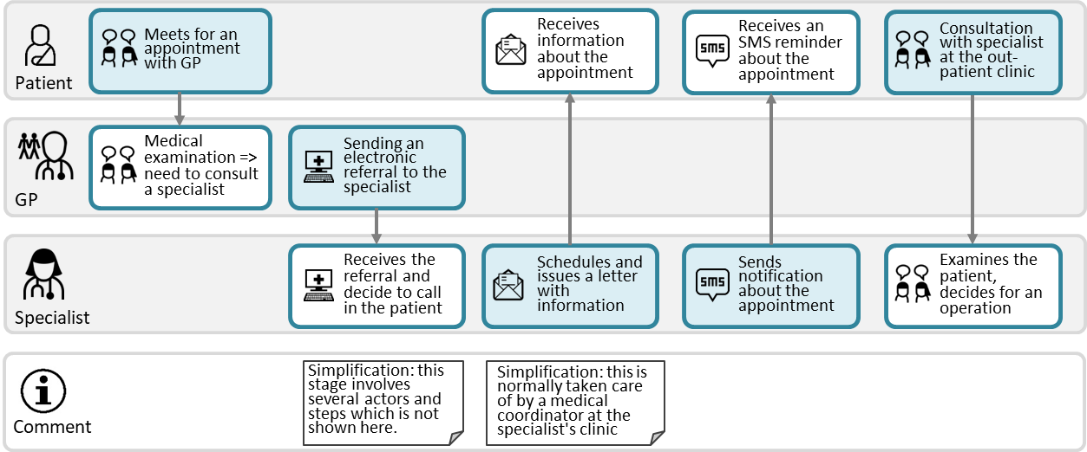
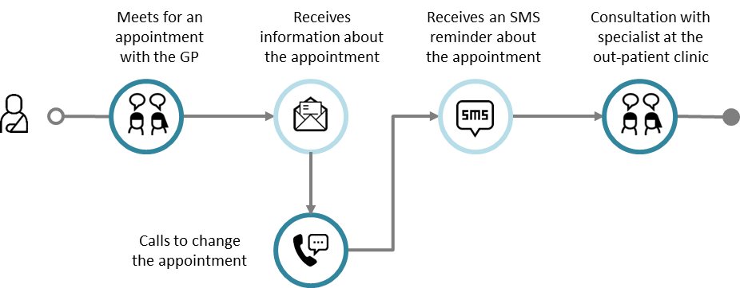
Example: Referral to a specialist
Journey diagram
Example of planned journey
Example of actual journey with a deviation
Swimlane diagram
The patient journey in the upper swimlane corresponds to the planned patient journey to the left
The swimlane diagrams shows all the individual journeys at once, and it also reveals the exchange between the GP and the Specialist, which is not part of the patient journey
Planned journey
Actual journey
This is an example of a deviation from the planned journey
Introducing CJML
Theoretical foundation and modelling approach
A quick tour of CJML

Slide 29











Comparison of diagram types
Note the correspondence with the upper swimlane
Meets for an appointment with the GP
Receives information about the appointment
Receives an SMS reminder about the appointment
Consultation with specialist at the out-patient clinic
Journey diagram (the patient's journey only)
Swimlane diagram
(all journeys)
Meets for an appointment with GP
Receives information about the appointment
Receives an SMS reminder about the appointment
Consultation with specialist at the out-patient clinic
Patient
Medical examination => need to consult a specialist
Sending an electronic referral to the specialist
GP
Receives the referral and decide to call in the patient
Schedules and issues a letter with information
Sends notification about the appointment
Examines the patient, decides for an operation
Specialist
Simplification: this stage involves several actors and steps which is not shown here.
Simplification: this is normally taken care of by a medical coordinator at the specialist's clinic
Comment
Introducing CJML
Theoretical foundation and modelling approach
A quick tour of CJML

Slide 30
Comparison of diagram types
Meets for an appointment with the GP
Receives information about the appointment
Receives an SMS reminder about the appointment
Consultation with specialist at the out-patient clinic
Journey diagram (the patient's journey only)
Swimlane diagram
(all journeys)
Meets for an appointment with GP
Receives information about the appointment
Receives an SMS reminder about the appointment
Consultation with specialist at the out-patient clinic
Patient
Medical examination => need to consult a specialist
Sending an electronic referral to the specialist
Note that this touchpoint is not visible to the patient, and thus not part of the patient's journey.
GP
Receives the referral and decide to call in the patient
Schedules and issues a letter with information
Sends notification about the appointment
Examines the patient, decides for an operation
Specialist
Simplification: this stage involves several actors and steps which is not shown here.
Simplification: this is normally taken care of by a medical coordinator at the specialist's clinic
Comment
Introducing CJML
Theoretical foundation and modelling approach
A quick tour of CJML

Slide 31
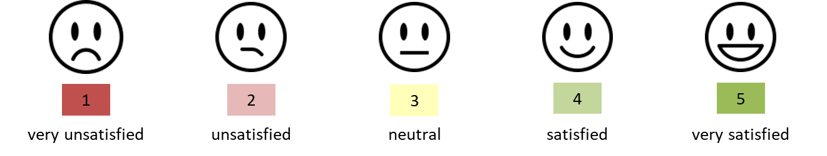
Customer/User experience
Introducing CJML
Theoretical foundation and modelling approach
A quick tour of CJML

Slide 32
Customer/User experience
CJML insists that a user's experience is individual and thus cannot be assigned to a journey on a general level. In this way, CJML differs from the majority of other customer journey approaches.
When representing user experience (UX), CJML adheres to principles from HCI research;
UX is subjective
UX is dynamic
UX is context dependent
UX is thus associated with actual journeys only.
UX is based on a user's self-reported input.
Otherwise it must be flagged as "anticipated user experience"
UX can be expressed in various ways, depending on the diagram type.
Swimlane diagram: in a separate swimlane
Journey diagram: as call-outs from a communication point
See for example Law, E. et al. (2009). Understanding, scoping and defining user experience: a survey approach. Proceedings of 27th SIGCHI conference on Human factors in computing systems (pp. 719-728).
Introducing CJML
Theoretical foundation and modelling approach
A quick tour of CJML

Slide 33
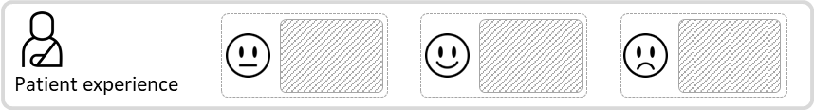
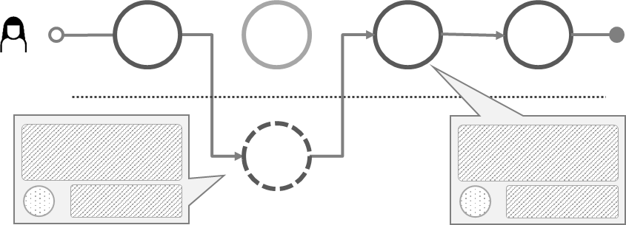
Customer/User experience
CJML insists that a user's experience is individual and thus cannot be assigned to a journey on a general level. In this way, CJML differs from the majority of other customer journey approaches.
Emoticon based on rating
Text based on user's self-reported input
Swimlane diagram
Journey diagram
Text based on user's self-reported input
Emoticon based on rating
Introducing CJML
Theoretical foundation and modelling approach
A quick tour of CJML

