Slide 1
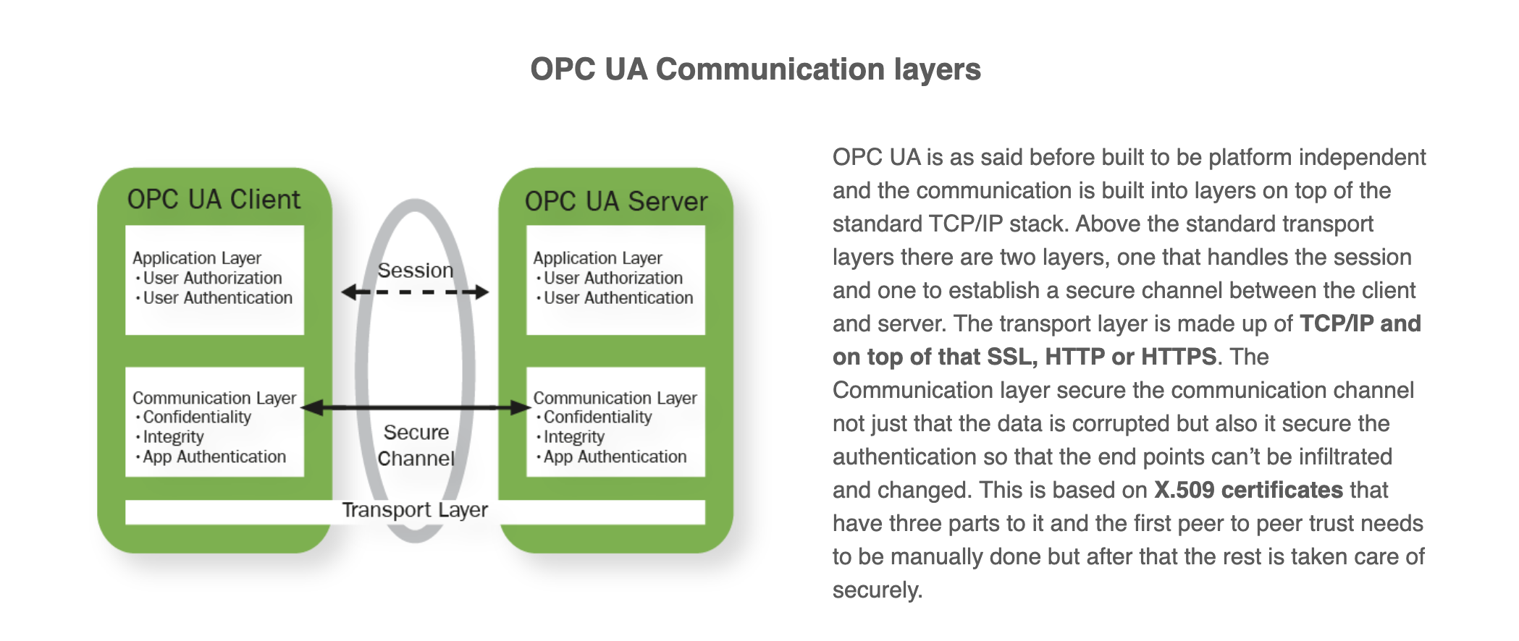
OPC UA
OPC Unified Architecture (UA)

Slide 2
OPC UA Client
server = Server()
url = "opc.tcp://127.0.0.1:4840"
server.set_endpoint(url)
name = "OPC_SIMULATION_SERVER"
addspace = server.register_namespace(name)
node = server.get_objects_node()
Param = node.add_object(addspace, "Parameters")
Temp = Param.add_variable(addspace, "Temperature", 0)
Press = Param.add_variable(addspace, "Pressure", 0)
Time = Param.add_variable(addspace, "Time", 0)

Slide 3
Temp.set_writable()
Press.set_writable()
Time.set_writable()
if __name__ == '__main__':
server.start()
print("Server started at {}".format(url))
while True:
temperature = randint(-10,50)
pressure = 1000 + randint(0, 100)
time = datetime.datetime.now()
print(temperature, pressure, time)
Temp.set_value(temperature)
Press.set_value(pressure)
Time.set_value(time)
sleep(1)

Slide 4
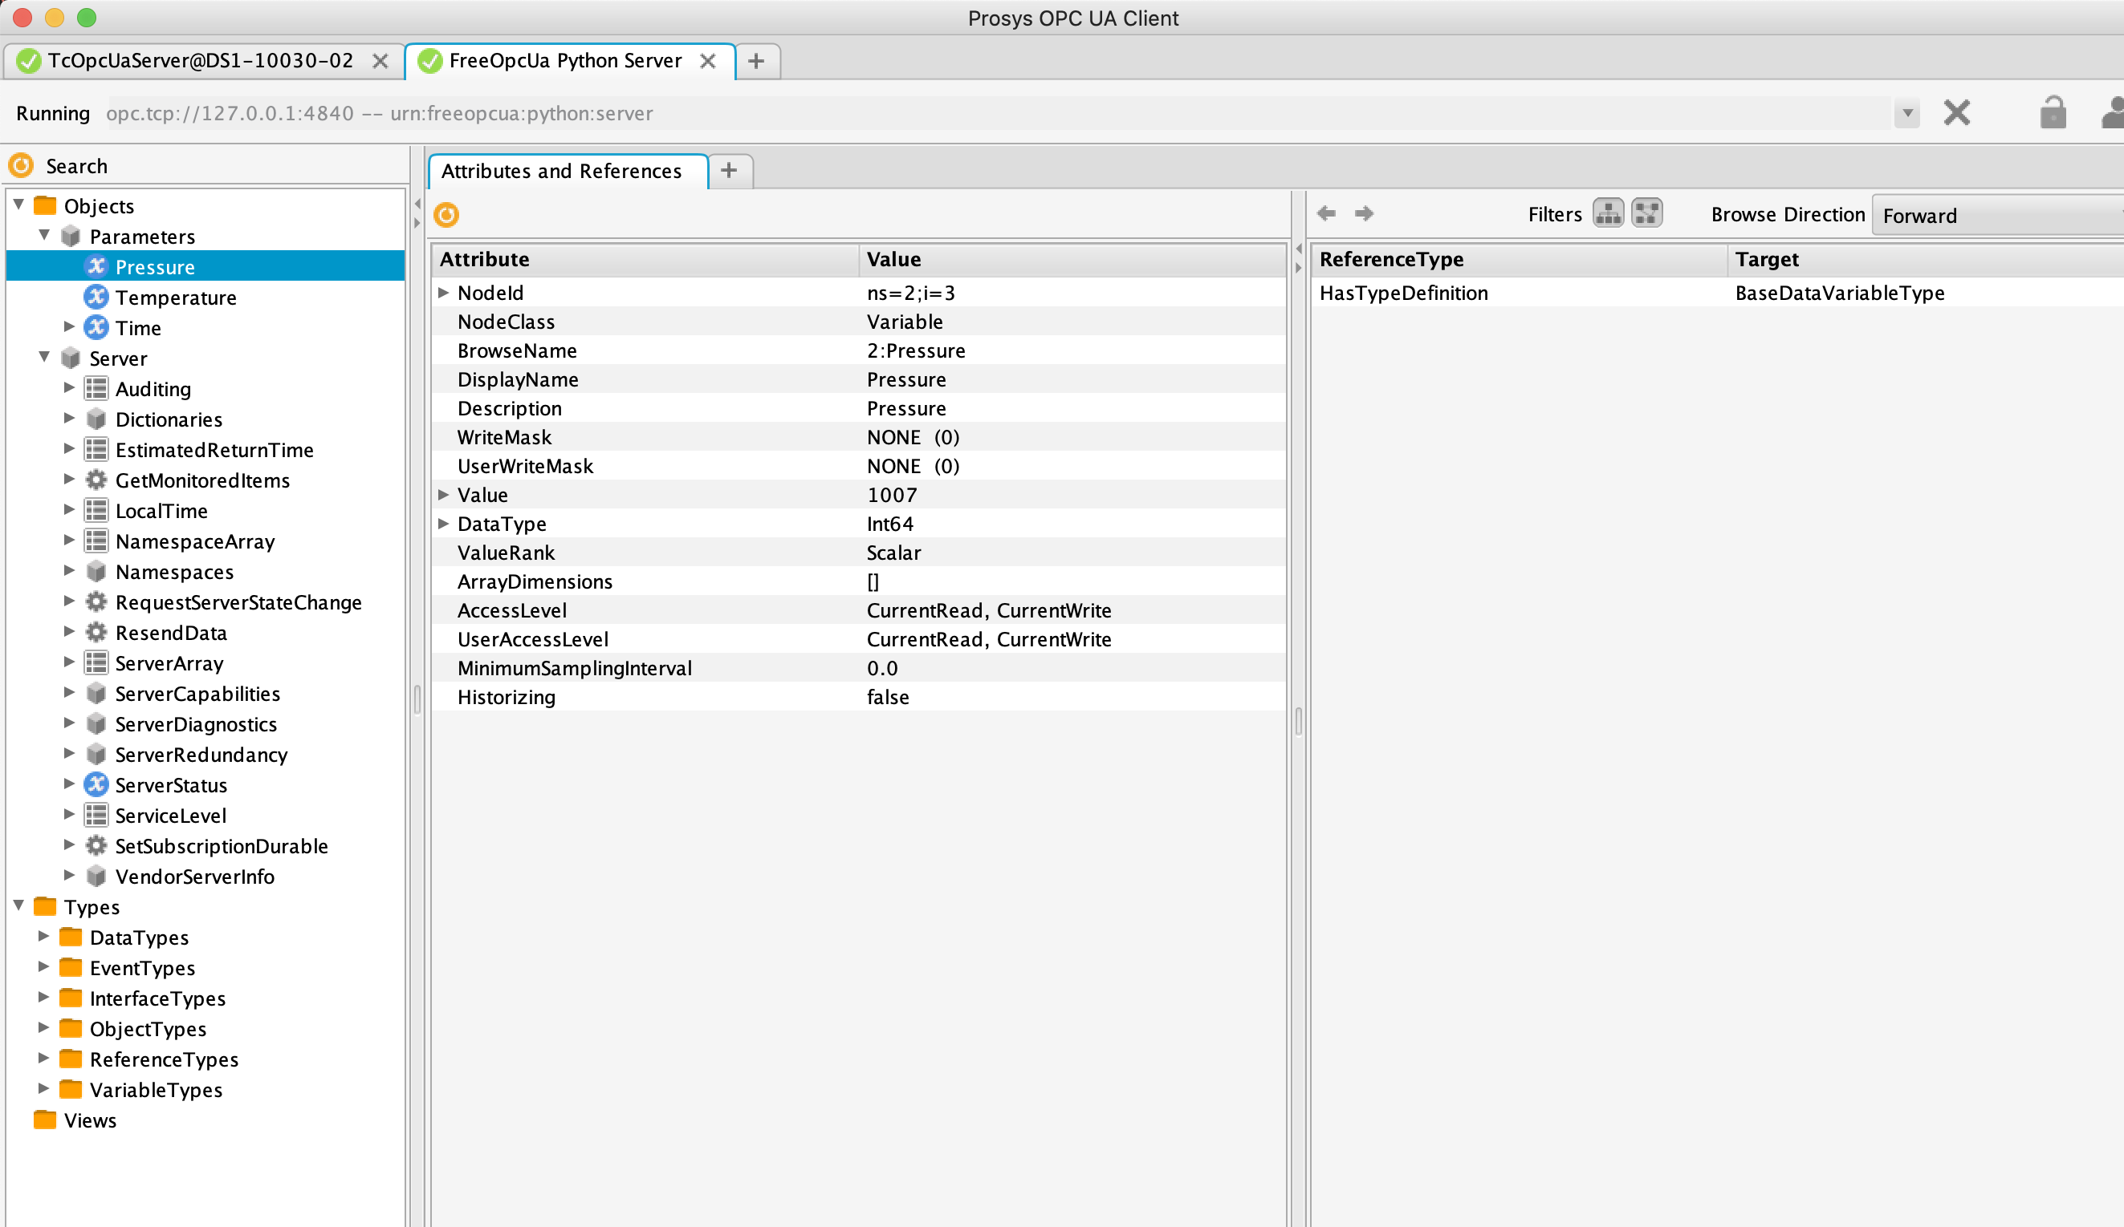
nodeID
Prosys OPC UA Client

Slide 5
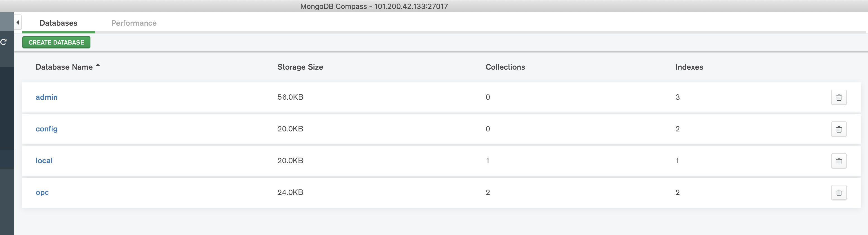
Mongodb

Slide 6
