Slide 1
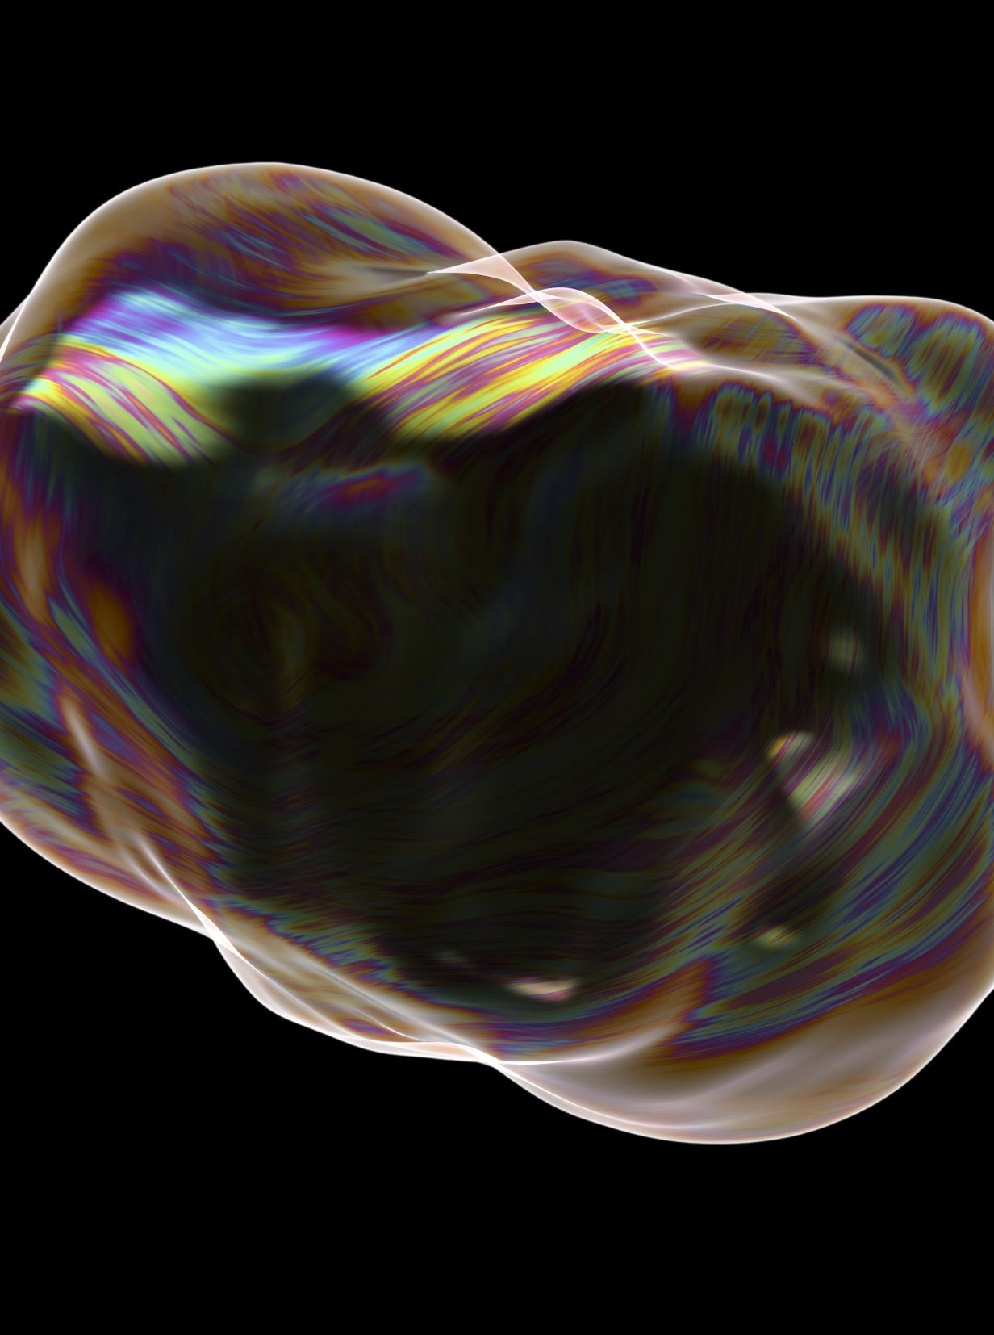
Meteorite Simulation
Steven Viola

Slide 2
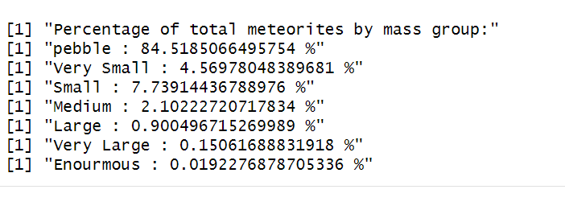
Process
My simulation uses rates that were obtained using R studio. A dataset of meteorite landings was used to obtain these rates.

Slide 3
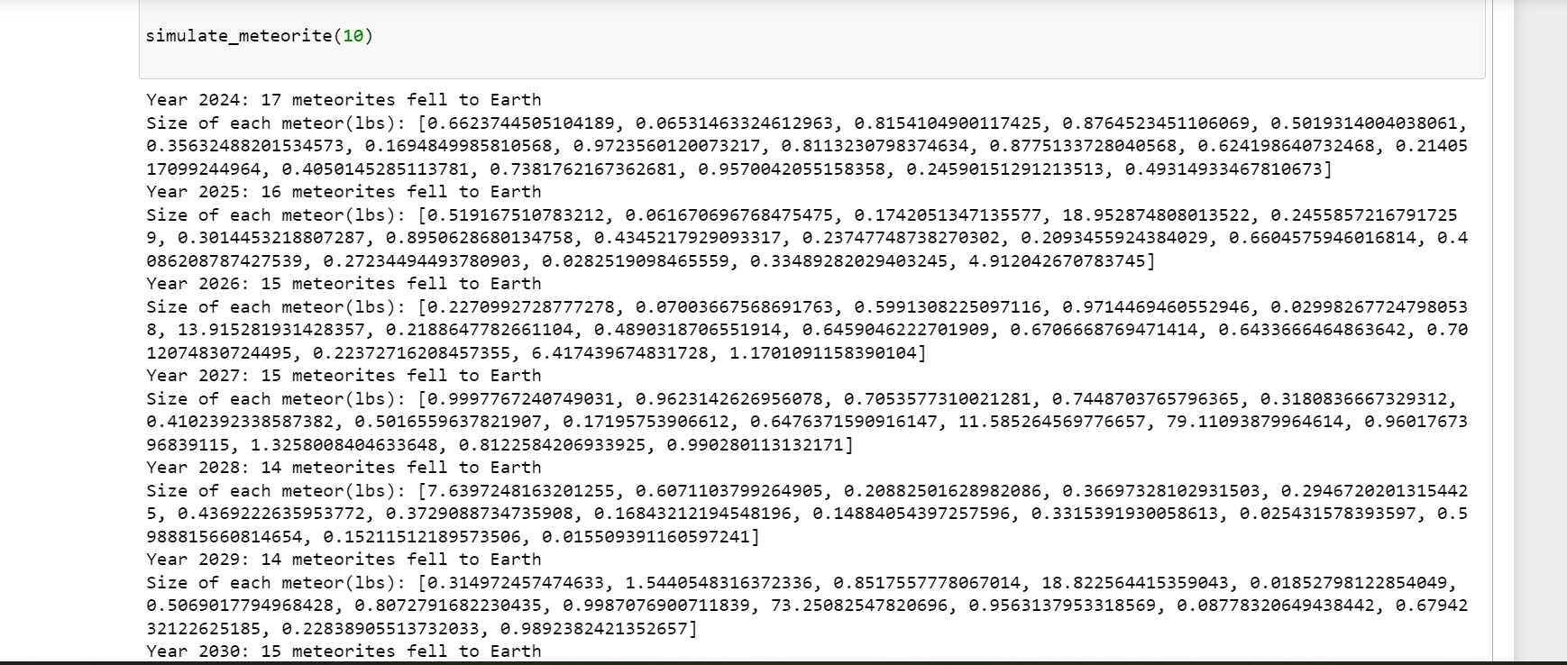
The simulation results
My simulation as of right now tells the user what year it simulated for, how many meteorites fell in that year, and the mass of each meteorite.

