Slide 1
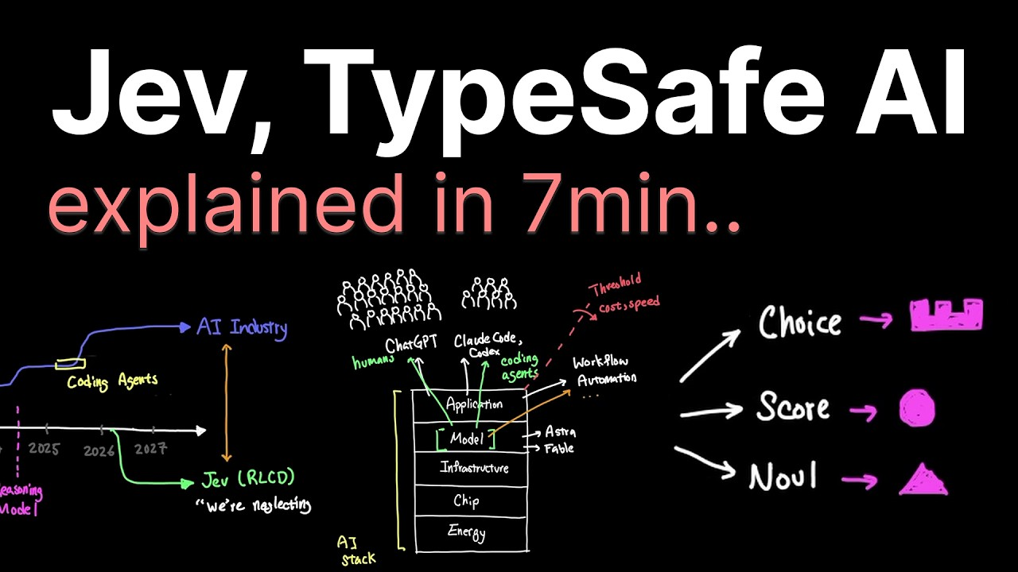
JEV · TEAM BRIEFING · 1 / 4
Jev: AI that decides,
not chats
TypeSafe AI's first “System One” model: fast, typed, calibrated decisions that software can use directly.
▸ What it is. Input = a state (text or JSON) + typed questions. Output = typed answers with calibrated probabilities. It never generates text, so there is nothing to parse and no broken schema.
▸ Why it exists. LLMs were optimised for chat (RLHF) and coding agents (RLVR). Workflow automation needs thousands of quick decisions under uncertainty: the neglected use case.
▸ How it is trained. RLCD = reinforcement learning for calibrated decisions. Rewards come from proper scoring rules, so honest probabilities score best.
▸ Speed and cost. All questions in one parallel pass: 70–500 ms, 20–200× faster and 40–400× cheaper than LLMs on classification-style tasks. $0.042 per 1M input tokens, output is free.
▸ Not an LLM replacement. It cannot write, explain or plan. Jev is System 1 (fast intuition); LLMs stay System 2 (slow reasoning). Use both.
Video: “Jev explained in 7min..” – Caleb Writes Code
Same question, two models: “Is there PII in this text?”
LLM
≈ 5 s
prompt
›
token · token · token …
›
text → parse
Jev
≈ 0.1 s
state + question
›
1 parallel pass
›
noul = 0.98
Demo from “Building a Harness with Jev” – LangChain
Notes:
WHAT: Jev (TypeSafe AI, early access since Sept 2026) is the first "System One" model. You send a state and typed questions (choice / score / noul) to POST /v1/systemone and get typed answers with probabilities back. No text generation.
WHY (Caleb Writes Code, "Jev explained in 7min"): the AI stack's application layer pushed models toward chat (RLHF) and coding agents (RLVR). Workflow automation never crossed the cost/speed threshold, even with very capable models. TypeSafe argues that forcing chat/agent-optimised models into automation is the wrong approach and trains for calibrated decisions instead (RLCD). Most community demos show off speed (sorting email, RAG, games, model routing) rather than depth - LLMs can do these functionally, but not at 70-500 ms, because they generate tokens one after another.
HOW FAST/CHEAP: vendor-reported 40-200x faster; LangChain quotes 20-200x faster and 40-400x cheaper on classification-style tasks. Price $0.042 per 1M input tokens, output free (~$0.0004 per decision).
NAME: System 1 / System 2 from Kahneman, "Thinking, Fast and Slow".
LANGCHAIN DEMO: "Is there PII in this text?" - LLM writes an answer + structured output in ~5 s; Jev returns 0.98 almost instantly.
Takeaway from video 1: this is less about Jev's novelty and more about the use-case space growing horizontally - narrow, specialised models next to general LLMs.

Slide 2
HOW IT WORKS · 2 / 4
Three primitives, one parallel call
Like logic gates and registers: your code owns the control flow, Jev answers narrow typed questions.
Choice
Score
Noul
Pick one option from a set you define (up to 255).
Rate on ordered levels you describe (2–10).
Yes/no question → probability of “yes”.
Which team should handle this ticket?
How frustrated is the customer?
calm · frustrated · very angry
Does the message convey urgency?
choice: "billing"
p = .84 · confidence = .60
score: 1.04
(frustrated, not very angry)
noul: 0.999
One request, three answers (support-ticket example from the docs)
Where it fits: around the LLM in the agent loop (LangChain)
POST /v1/systemone
{ "state": "My Stripe connection has failed for 3 days.
I'm losing sales. Please help ASAP.",
"questions": {
"team": {"type": "choice", "criteria": {"billing": …}},
"mood": {"type": "score", "criteria": ["calm", …]},
"urgent": {"type": "noul", "instructions": "Urgent?"} } }
→ team = billing (.84) · mood = 1.04 · urgent = 0.999
▸ Model routing. Pick the cheapest LLM that can handle each request, almost instantly.
▸ Auto mode. Classify every tool call (delete DB, mass send) and block risky ones before they run - fast enough to keep it switched on.
▸ Jev-as-a-judge. Score agent answers against a rubric (correct? grounded? cited?) for online evals: cheaper, faster and more consistent than LLM-as-judge.
Video: “Building a Harness with Jev” – LangChain · pip install langchain-typesafe
Notes:
PRIMITIVES (all three videos + docs.typesafe.ai/api):
- Choice: map of option -> rubric (or null). Returns choice, probabilities per option, confidence. Max 255 options.
- Score: ordered array of level descriptions (2-10). Returns a probability-weighted score that can land between levels (1.04 = frustrated, not very angry), plus legend/probabilities/confidence.
- Noul: yes/no; returns P(yes). Optional criteria for what true/false mean.
- Many questions about one state are answered in ONE parallel pass - adding questions barely changes latency (unlike LLMs, which reason sequentially).
- Instructions and criteria can be structured JSON; refer to state fields in backticks.
Caleb's framing: "It almost feels like we're back to logic gates and registers" - you build abstractions on top. On the Pareto frontier Jev competes with Flash/Nano-class models, but only on workflow-specific tasks.
DOCS PATTERNS: confidence-gated routing (the answer tells you WHAT, confidence tells you WHETHER to act), composite scoring (atomic scores, weights in code), speculative fan-out (ask everything in one call, code decides what is relevant), intent routing.
LANGCHAIN ("Building a Harness with Jev"): langchain-typesafe exposes TypeSafeClassifier plus experimental middleware: ModelRouterMiddleware (fast vs powerful model per request) and AutoModeMiddleware (tool-risk gating). Jev-as-a-judge for LangSmith online evals: rubric criteria scored by Jev - reported as cheaper, faster and more consistent than LLM judges. Sample 06 in our repo implements all three ideas.

Slide 3
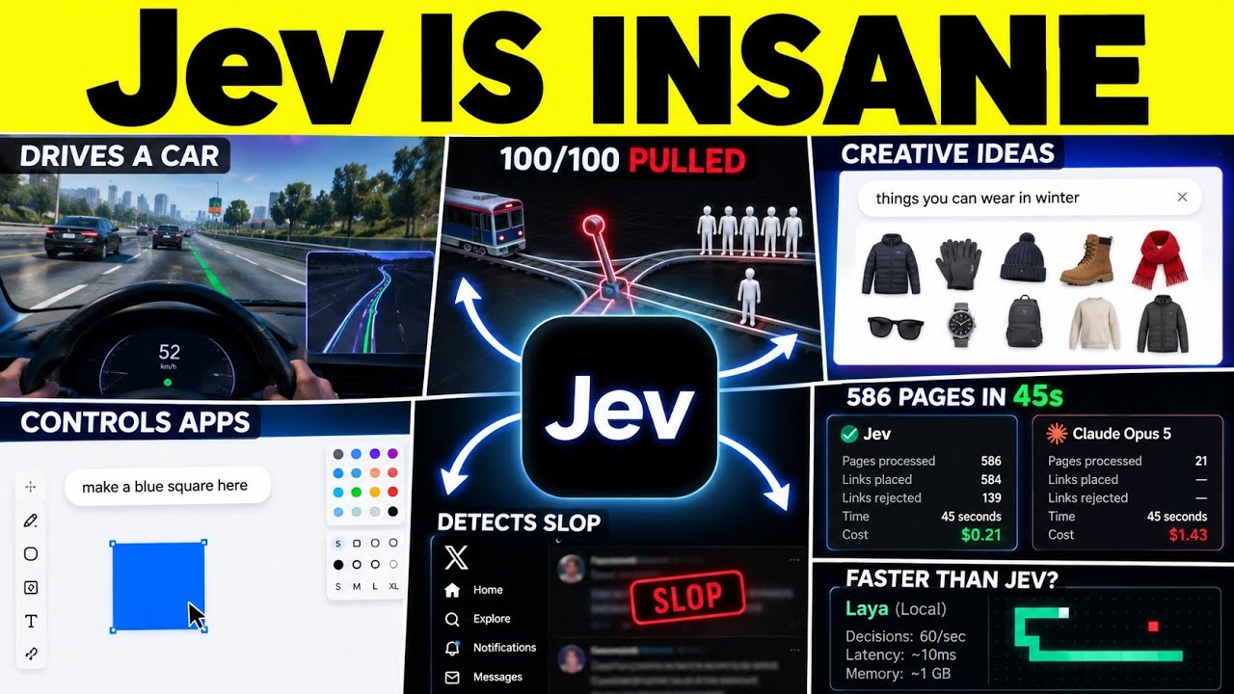
FOR MARKETING SOFTWARE · 3 / 4
Thousands of tiny marketing decisions, in milliseconds
Use case | Question Jev answers | Primitive
Lead scoring & routing | How well does the lead fit our ICP? How ready to buy? Who owns it? | Score + Choice
Campaign reply triage | Meeting, not now, unsubscribe, out of office, wrong person? | Choice + Noul
Search terms & negatives | Buyer, researcher, job seeker, competitor or junk? | Choice
Ad creative tagging | Hook, format, offer, awareness stage? (724 ads in 40 s ≈ $0.09) | Choice ×4
SEO internal linking | Is there an honest reason to link page A to page B? | Noul
Social listening | Engagement bait? Sentiment? Complaint, question or churn? | Noul + Score
Content QA gate | Does this draft meet each of the 20 checklist points? | Noul ×20
AI assistant harness | Fast or powerful LLM? Is this tool call risky? Is the claim grounded? | Choice + Noul
Video: “Jev Is WAY More Powerful Than We Thought” – Pursuing AI
SEO: 586 pages in 45 s, 584 links placed, 139 rejected, $0.21 (Claude Opus 5: 21 pages, $1.43)
Also: driving sim, trolley problem 100/100, voice-controlled drawing app, live slop detector, Laya playing Snake at ~60 decisions/s
The decide-then-act loop · same architecture for every row above
Collect
rows via API / code
Shortlist
rules or embeddings
Ask Jev
Choice · Score · Noul
Threshold
auto · review · drop
LLM writes
only what passed
Verify
Jev checks the output
Limits: no rationale (a number, not a reason) · closed answer sets only · triage-grade accuracy (vendor benchmark ~68% vs ~73% for frontier LLMs) · early access, price may change. If the answer must be written, it belongs to an LLM.
Notes:
MARKETING USE CASES (TypeSafe use-case map: lead generation, advertising, customer support, moderation; Ryze AI "Jev for Marketing: 8 use cases and the limits"):
- Lead scoring and routing: score each lead against the ICP and pick the owner - two questions, one call. Sales gets the top band, the rest goes to nurture. (A 700-lead demo on X did exactly this.)
- Search terms & negatives (paid search): buyer / researcher / job seeker / competitor / junk -> auto-negative, queue or drop by confidence.
- Ad creative tagging: Matthew Berman ran Jev on 724 live ads from 37 brands in 40 s (~9 cents) - hook, format, offer, CTA, awareness stage, landing-page mismatch.
- SEO internal links: the 586-page Distribb demo from video 2.
- AI citation / GEO checks: "Is our brand recommended in this AI answer?" (Noul).
- Review & survey themes: classify every response instead of sampling 200.
- Content QA gate: 20 Nouls per draft; only passing drafts reach an editor.
- Model routing: frontier vs small vs no model.
Cost at list price is cents per job -> jobs that ran monthly on a frontier LLM can run nightly.
DECIDE-THEN-ACT LOOP (Ryze): collect with code -> shortlist to 10-15 candidates -> one bounded question per row -> threshold (high confidence auto, middle band to approval queue, low dropped) -> LLM writes only where text is needed -> verify the LLM output with Jev before it ships.
VIDEO 2 (Pursuing AI): AI that watches, decides and acts. Driving simulator (real-time control), trolley problem 100 trials (99% pull, consistent), designer visual exploration (hundreds of tiny decisions what to show), voice + gesture control of a drawing app, live slop detector on X, SEO 586 pages, Laya (local, M3 Max) playing Snake at ~60 decisions/s with 10-18 ms latency and ~1 GB memory.
LIMITS: no explanation; bounded answers only; vendor-reported benchmarks measure agreement with frontier models (Jev 67.8% vs Claude Opus 5 73.1%, GPT-5.6 Sol 74.1% on TypeSafe's 4-workflow benchmark); "cannot hallucinate" means it cannot break the schema - it can still pick the wrong option. Label 500 rows of your own data before trusting a threshold. Waitlist access, price may move.

Slide 4
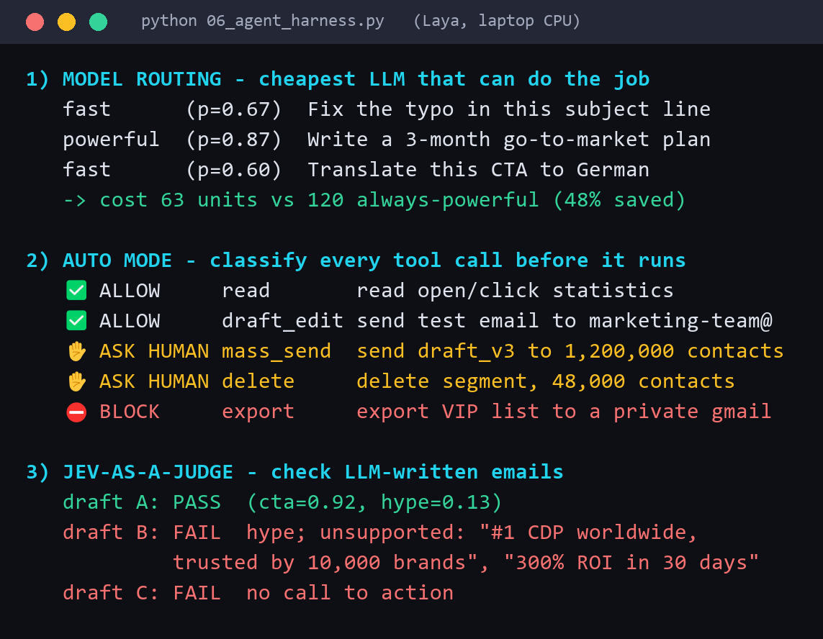
HANDS-ON · 4 / 4
We built it: 6 samples running locally on Laya
Laya: open-source (Apache-2.0), Jev-compatible, 421M params, same /v1/systemone shape. Runs on a laptop CPU.
# | Sample | Primitives | What happened on our laptop
01 | Lead scoring | Choice + Score + Noul | VP with budget → 86/100, enterprise AE; student & agency dropped; possible competitor → human check
02 | Reply triage (EN/DE/CZ) | Choice + Noul | 10/10 correct labels; 7 automated, 1 review, 2 escalated; opt-outs always suppressed
03 | SEO internal linking | Noul + Choice | 36 page pairs → 18 links + anchor texts; party page gets none
04 | Social feed monitor | Noul + Score + Choice | 3/3 slop posts hidden; complaint → support, cancellation → retention
05 | Command bar | Choice | “cut meta prospecting in half” → change_budget(…, 50%); vague → “did you mean…?”
06 | Agent harness | Choice + Noul | 48% LLM cost saved by routing; 6/6 tool calls gated; fake claims caught
Real output of samples/06_agent_harness.py (excerpt)
What we learned (zero-shot, no fine-tuning)
Next steps
▸ Atomic questions win: one persona Choice beat four disqualifier Nouls.
▸ Data and business rules stay in code; the model only judges language.
▸ Wording matters: test 3–5 phrasings on a small labelled set before you trust a threshold.
▸ Gate on confidence, fail safe: uncertain → human or “did you mean…?”. CPU ≈ 0.3 s/question, GPU ≈ 33 ms.
1. Pick one pilot: reply triage or lead scoring
2. Label 300–500 real examples, set thresholds
3. Compare Laya (fine-tuned) vs Jev API on it
4. Ship behind a confidence gate + human review
Notes:
REPO: samples/ - six runnable Python samples + jev_client.py (local Laya backend or any Jev-compatible HTTP endpoint via JEV_BASE_URL / JEV_API_KEY). Run: python -m venv .venv; .venv\Scripts\pip install -r samples\requirements.txt; cd samples; ..\.venv\Scripts\python 01_lead_scoring.py
LAYA (huggingface.co/convaiinnovations/laya): ModernBERT-large backbone (395M) + a decision head trained from scratch, 421M total; multilingual checkpoint on mmBERT-base for 100+ languages; trained with RLCD-style proper scoring rules. laya-serve exposes the same POST /v1/systemone request/response shape as TypeSafe Jev. Author-reported vs Jev (third-party numbers, different setups): 7.8x faster on a T4 GPU (32.8 ms vs 236-276 ms p50), better calibration after temperature fitting, but Jev is better with >20 options (Banking77: 0.87 vs 0.43). The base checkpoint scores 0.36 on the typed-decisions benchmark; the fine-tuned typed-decisions checkpoint 0.77 - fine-tuning matters.
OUR MEASUREMENTS (Intel Core Ultra 7 268V, CPU only): ~250-350 ms for one short question, ~1-2 s for 4-5 questions about one item, model load ~10 s from cache. Fine for batch/demo; use a GPU or the Jev API for real-time.
LESSONS: we tested 3-5 phrasings per question on small labelled sets. Examples: "Do both pages cover the same marketing topic?" (AUC 1.0) beat "Are the pages closely related?"; short option labels beat long descriptions for the command bar; plain-text tool-call descriptions + a "kind of action" Choice beat risk Nouls on JSON. Giving the model fewer CRM fields improved persona detection.
NEXT STEPS: one pilot use case, label data, measure Laya vs Jev, ship behind confidence gating with human review for the middle band.

