Slide 1
let’s get staRted
Steven Tseng
28 February 2018

Slide 2
What is R?
Two faces:
One of many statistical software programs
Programming language

Slide 3
Why R? ^{Lite}
Free software
Open source
Versatile: Can technically accomplish any statistical task you need

Slide 4
R vs. Other Statistical Programs
The best tool is whatever gets the job done
Other programs may do the same, but lack functions here and there
R packages
If a package does not exist, you can write your own code for it!

Slide 5
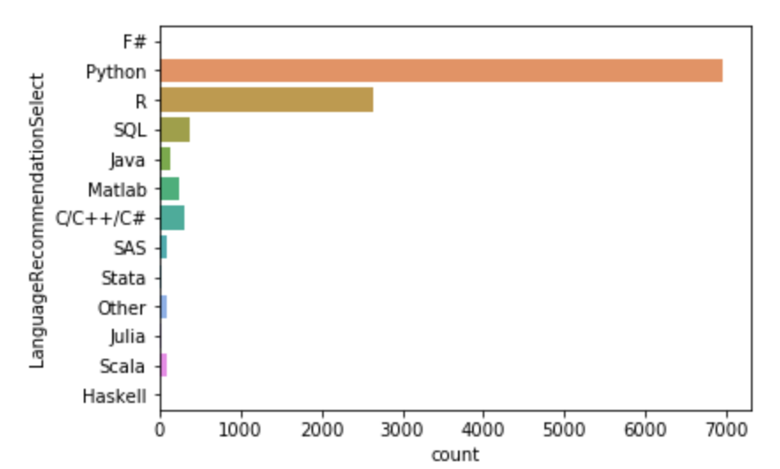
R vs Python

Slide 6
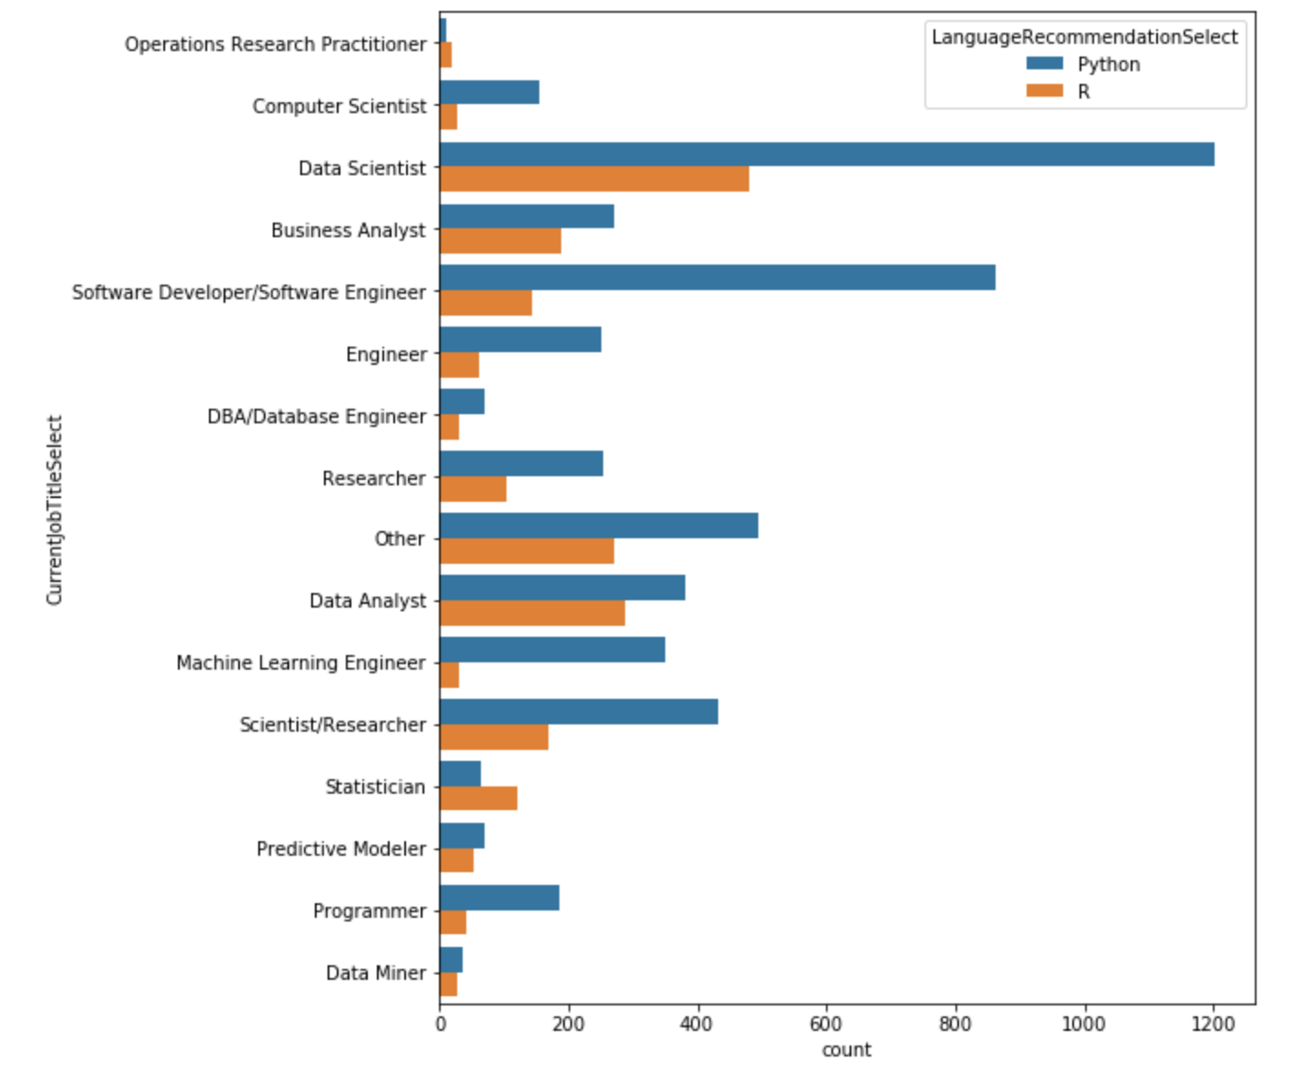
R vs Python

Slide 7
Why R? ⁺
Mode of communication with statisticians, computer scientists, and data scientists
Support open science
Easy start to programming
Great support network
Fun

