Slide 1
BIDS Projekt - G3
Constanze Leichtweiß Ivanna Marchesini Christoph Kovacs Enrico Wondra

Slide 2
In the morning

Slide 3
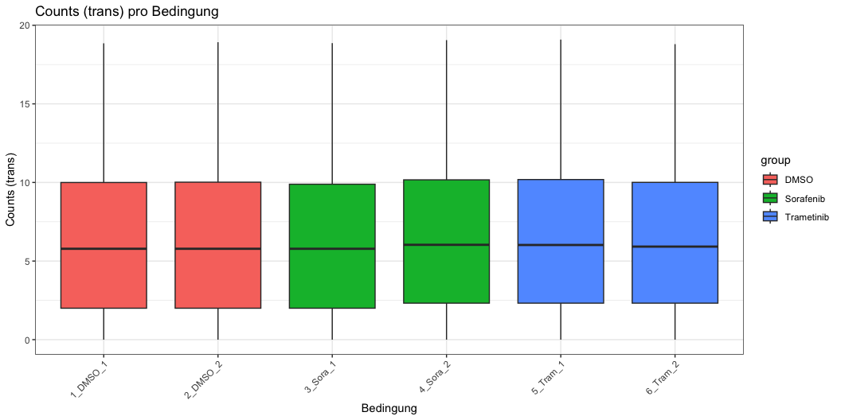
Getting up
Turn off alarm
Get out of bed

Slide 4
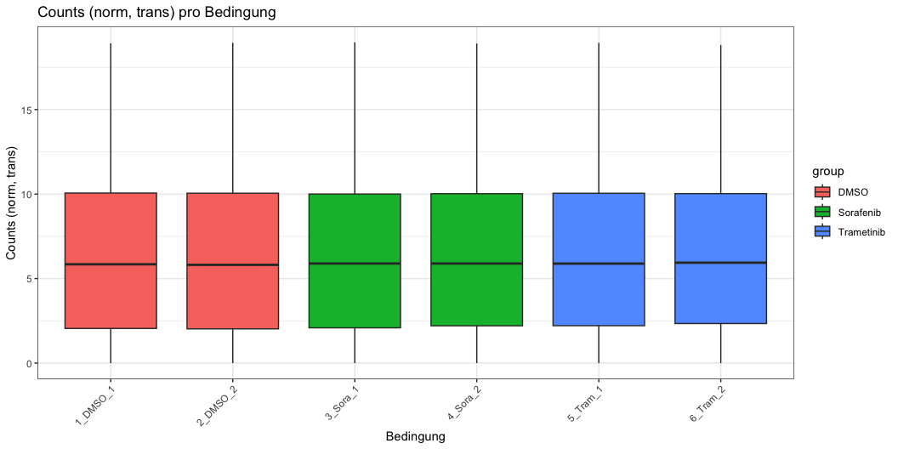

Slide 5
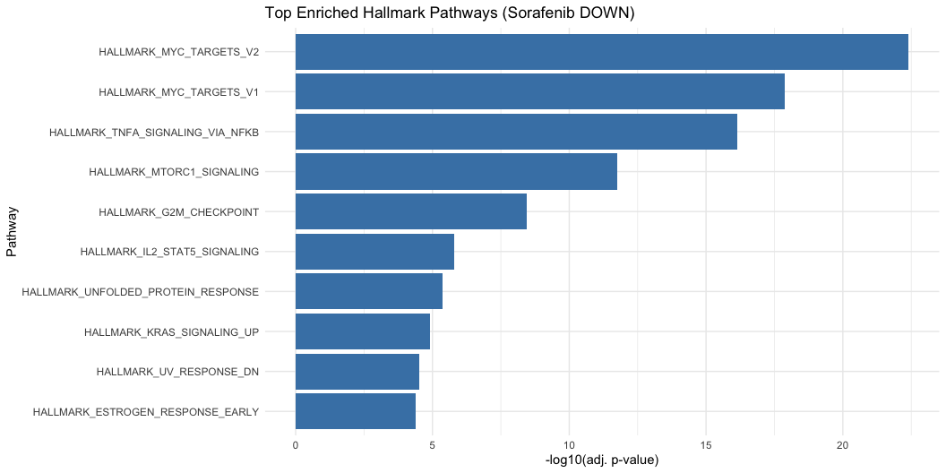
Breakfast

Slide 6
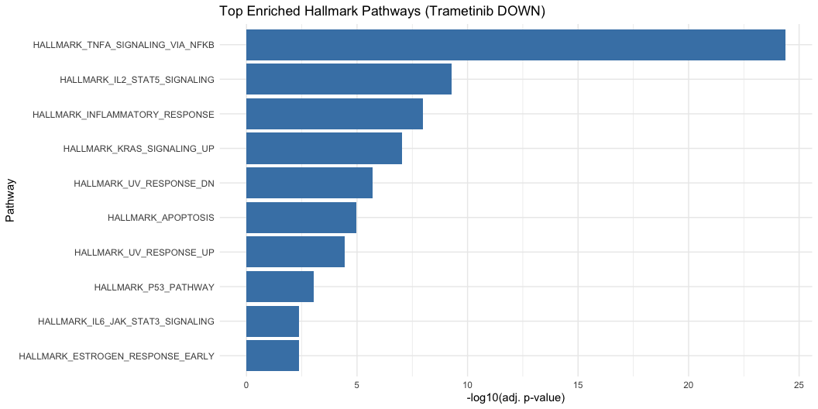

Slide 7
Eat eggs
Drink coffee

Slide 8
In the evening

Slide 9
Dinner
Eat spaghetti
Drink wine

Slide 10
Going to sleep
Get in bed
Count sheep

