Slide 1
Curation and Cheminformatic Characterization of a Clinical-Stage GPCR Ligand Dataset for Machine-Learning-Based Binding Prediction
Dagmawi Tarekegn Fikadu MSc Molecular & Medical Biotechnology
Principal Investigator: Prof. Alejandro Giorgetti · Supervisor: Filippo Baldessari · University of Verona
Notes:
Good morning. I'm Dagmawi Tarekegn Fikadu, and this is my thesis, supervised by Professor Giorgetti and Filippo Baldessari. It asks whether we can predict how strongly clinical-stage drugs bind their receptors, and whether that prediction can be trusted. That second half is the thread through the whole talk.

Slide 2
ROADMAP
A two-part thesis
PART ONE
PART TWO
Curate & characterise
Model binding affinity
Build a clean clinical-stage GPCR ligand dataset
Measure 15 descriptors on every molecule.
Perform Exploratory Data analysis
Use that dataset to predict pKi from structure
Leakage-controlled validation
Regression, virtual screening, and interpretation
→
→
→
→
01
02
03
04
Dataset
Models
Validation
Results
MSc Molecular & Medical Biotechnology · University of Verona
1
Notes:
The thesis starts from a repurposing question. Drugs that reached clinical trials have already cleared early safety testing in humans. So if one of them binds a receptor nobody tested it on, that is the cheapest route to a new therapy. Propranolol, a heart drug, now treats infant haemangiomas exactly that way.
Finding those cases needs two things. A clean record of what these drugs bind: that is Part One. And a model that predicts binding where nobody has measured it. Part Two asks whether that prediction can be trusted.

Slide 3
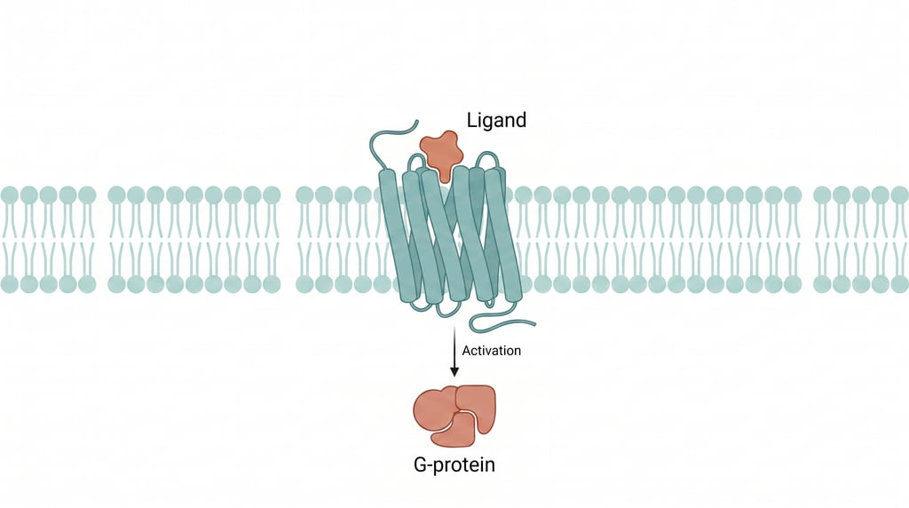
BACKGROUND
GPCRs and binding affinity
G-protein-coupled receptors are the most productive drug-target class: about a third of approved drugs act through them.
The aminergic subfamily (serotonin, dopamine, adrenergic, muscarinic) is especially drug-rich, with pockets that fit small drug-like molecules.
Binding affinity is measured as Ki and reported as pKi = 9 − log10(Ki[nM]); higher pKi means tighter binding.
A GPCR in the membrane: a small-molecule ligand binds the extracellular pocket and triggers intracellular G-protein signalling.
MSc Molecular & Medical Biotechnology · University of Verona
2
Notes:
First, the targets. G-protein-coupled receptors are the most productive drug-target class we have: about a third of approved drugs act through them. The aminergic family, serotonin, dopamine, adrenergic and muscarinic receptors, is especially rich in drugs. What I measure is binding affinity, Ki, on a log scale as pKi. Only one thing to remember: higher pKi means tighter binding.

Slide 4
PART ONE · THE DATASET
What was curated, and how
719
3,011
47
18
unique molecules
compound–target records
targets
receptor families
The curation pipeline
Human Ki binding data from ChEMBL for compounds in clinical Phases I–IV and below 700 Da, with salt removal, peptide exclusion, a rotatable-bond flexibility filter, and highest-pKi deduplication per molecule.
MSc Molecular & Medical Biotechnology · University of Verona
3
Notes:
Part One. From ChEMBL I took human binding data for every compound that reached clinical phases one to four. Under 700 daltons, salts removed, peptides excluded, very flexible molecules filtered out, duplicates collapsed to the highest affinity. That gives 3,011 records: 719 unique molecules against 47 targets, in 18 receptor families. I curated by clinical stage, not by potency, on purpose. This is chemistry that has already survived selection.
And it's diverse: those 719 molecules sit on 511 different scaffolds, and 83 per cent of the scaffolds appear only once. So this is a broad sample of aminergic chemistry, not a few analogue series, and that is why, in Part Two, the models are tested on whole scaffolds they have never seen.
HOLD — only if asked:
a scaffold is the ring system plus the links between rings (Bemis–Murcko), side chains stripped off. · Clinical set: about 1.4 molecules per scaffold. The Part Two sets are less diverse — 1,936 scaffolds for 4,620 compounds and 2,607 for 5,488, about 2.4 and 2.1 per scaffold — because preclinical chemistry comes in analogue series: see question 3b.

Slide 5
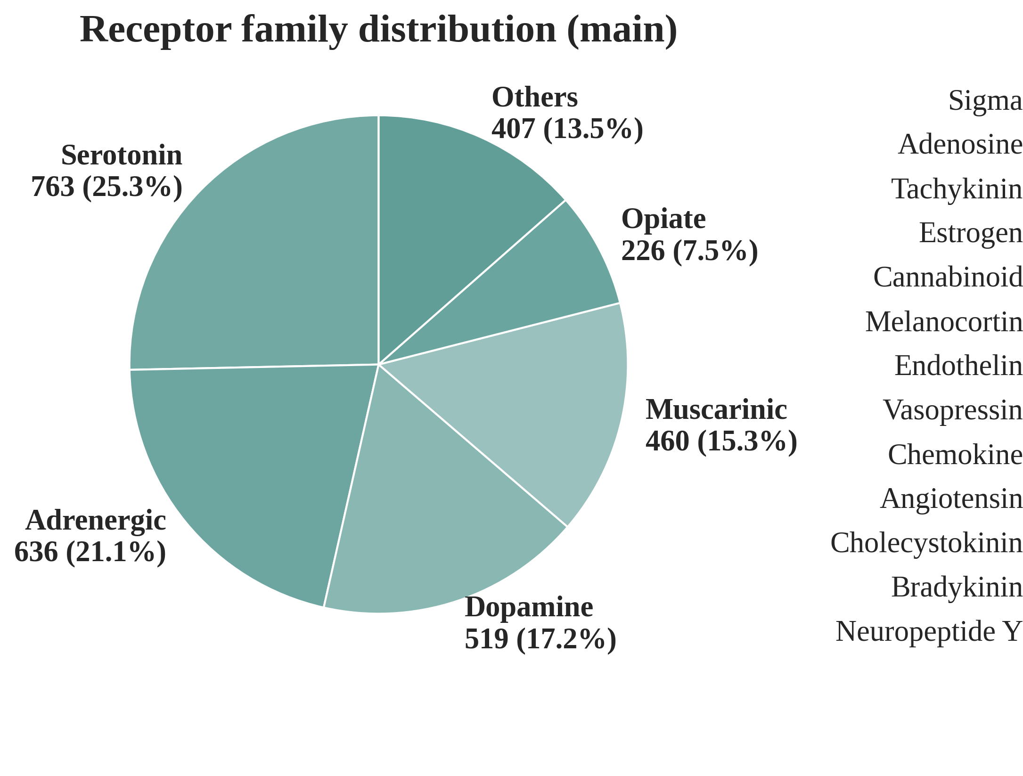
PART ONE · COMPOSITION
MSc Molecular & Medical Biotechnology · University of Verona
4
Notes:
The set is strongly aminergic. Serotonin, adrenergic, dopamine, muscarinic and opioid receptors make up about 86 per cent of the records. And just over half of the drugs, 52 per cent, are approved. The rest reached phases one to three of clinical trials.
HOLD — only if asked:
if someone quotes 70% from the thesis table, that is counted per row: approved drugs have more rows because they've been measured against more receptors. Per drug, it is 52%.

Slide 6
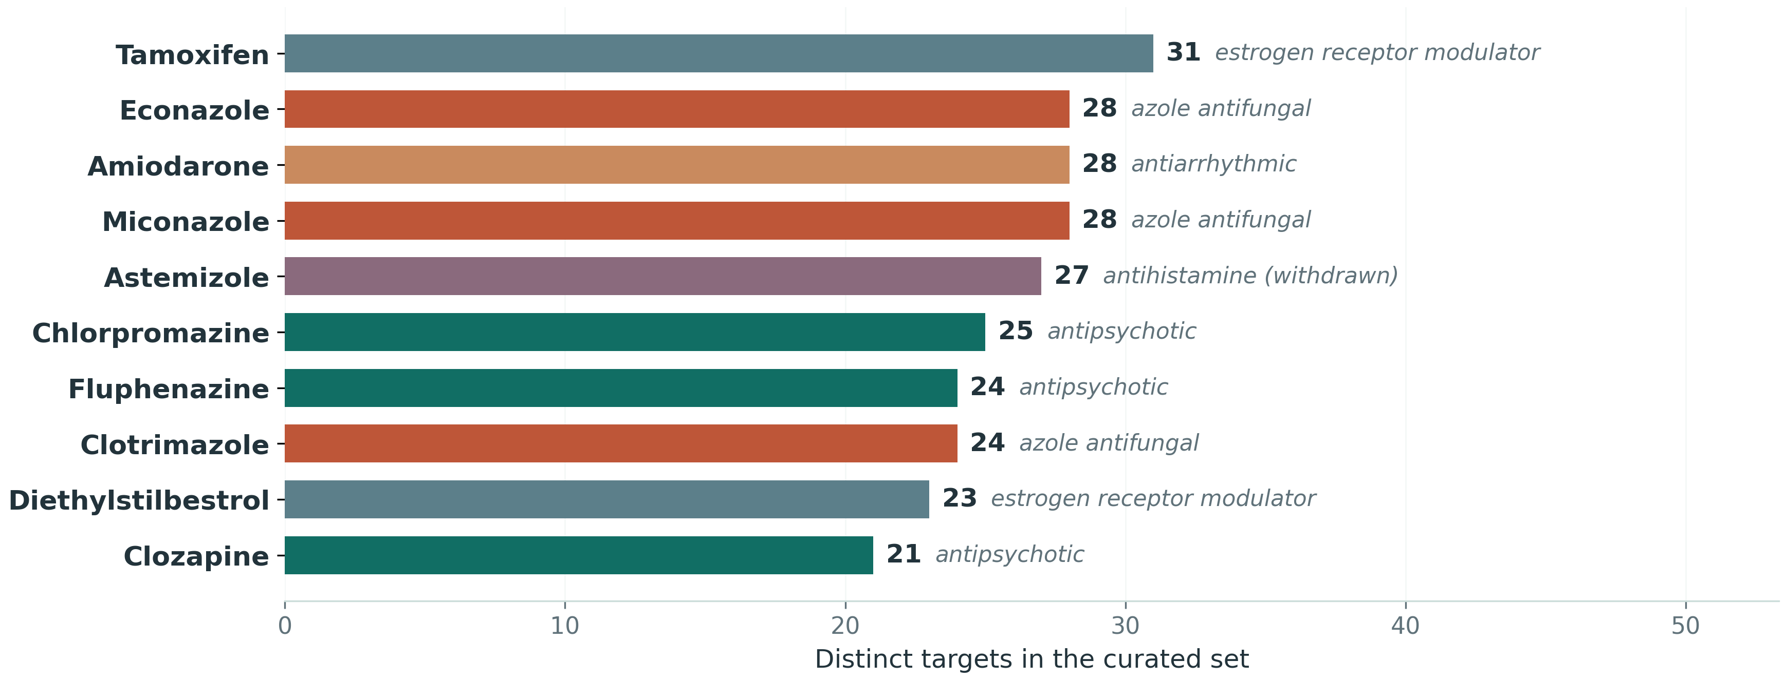
PART ONE · POLYPHARMACOLOGY
Clinical-stage ligands engage many targets
4.19 targets per molecule
64.7% act on more than one target
Promiscuity crosses family boundaries: 1.89 families per molecule on average (max 11), and 38.0% act on more than one. This is the basis for the repurposing motivation, and the reason for the later robustness check that removes multi-target compounds and retrains.
MSc Molecular & Medical Biotechnology · University of Verona
5
Notes:
And this is the property that matters most for repurposing. These drugs are promiscuous. On average each molecule acts on 4.19 different targets, and 64.7 per cent act on more than one. Tamoxifen alone hits 31. It crosses families too: 38 per cent act on more than one receptor family.
That matters twice. It is the opportunity repurposing exploits. And it is why, later, I remove the most promiscuous drugs and retrain, to check the models do not depend on them.

Slide 7
PART ONE · DESCRIPTORS
Physicochemical and structural (11)
MW · LogP · LogS · TPSA · HBA · HBD · RotB · HAC · RingCount · Fsp³ · HalogenCount
Size, lipophilicity, solubility, polarity, flexibility and shape: the properties that govern whether a molecule is orally bioavailable and CNS-penetrant.
Efficiency metrics (4)
LE · LLE · LELP ·QED
Derived from the descriptors above together with the measured pKi, so potency is judged relative to size and lipophilicity rather than on its own.
15 descriptors → ~200 for the models
MSc Molecular & Medical Biotechnology · University of Verona
6
Notes:
To characterise this chemistry I computed fifteen descriptors for every compound. Eleven describe the molecule itself: size, lipophilicity, solubility, polarity, flexibility and shape, the properties that decide whether a drug can be taken orally and reach the brain.
The other four are composite scores. QED rolls eight properties into one drug-likeness score, from zero to one. The other three set potency against what it cost. Ligand efficiency is potency per heavy atom. Lipophilic ligand efficiency is potency minus LogP: the binding you get beyond what greasiness alone would give. And LELP is LogP divided by ligand efficiency, where lower is better.
Together they tell a clear story. The set is drug-like, median QED 0.69, and size-efficient: three quarters clear the usual ligand-efficiency threshold of 0.3. But only 23 per cent reach the lipophilic-efficiency target of five. Many of these compounds lean heavily on lipophilicity to bind, a known weakness of aminergic drugs.
Hold on to the number fifteen: in Part Two it scales to about two hundred.
HOLD — only if asked:
QED is computed from structure alone; only LE, LLE and LELP use the measured pKi (the slide's subtitle groups all four loosely). · Formulas: LE = 1.37 × pKi ÷ heavy atoms; LLE = pKi − LogP; LELP = LogP ÷ LE. · Thresholds and sources: QED ≥ 0.67 high (Bickerton 2012); LE ≥ 0.3 (Hopkins 2004); LLE ≥ 5 (Leeson & Springthorpe 2007); LELP ≤ 7.5 optimal, > 10 poor (Keserű & Makara 2009). · 46.9% of records have poor LELP above 10. · The 1.37 converts pKi into kcal/mol of binding energy at room temperature.

Slide 8
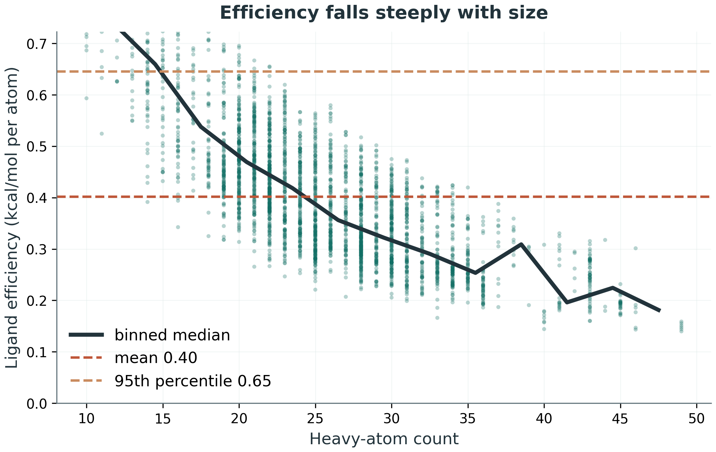
PART ONE · PROPERTIES
Is the potency earned, or bought with size?
0.52 → 0.24
ligand efficiency, smallest compounds vs largest
6.66 → 6.51
median pKᵢ across the very same range
MSc Molecular & Medical Biotechnology · University of Verona
7
Notes:
That was lipophilicity. The other way to buy potency is size: add atoms, and affinity goes up. So is the potency in this dataset earned, or bought with size?
Ligand efficiency answers that. On the right, efficiency falls steeply with size, Spearman minus 0.77. And the number that makes it concrete: compare the smallest compounds, twenty heavy atoms or fewer, with the largest, thirty-five or more. Median efficiency halves, from 0.52 to 0.24. Median affinity barely moves: 6.66 against 6.51. The extra size bought almost no potency. That is why efficiency, not raw potency, is the thing to optimise.
HOLD — only if asked:
"≤20 heavy atoms" is roughly the smallest fifth (627 records), "≥35" the largest tenth (265). · Not cherry-picked: at ≤18/≥38, ≤22/≥33 or quartiles, LE always roughly halves and median pKi stays 6.5–7.0. · "LE has size in the denominator, so it must fall" — see question 7d. · These medians are per record; per molecule see question 7. · The efficiency axis is clipped at the 95th percentile, 0.65; every compound is still in the analysis.

Slide 9
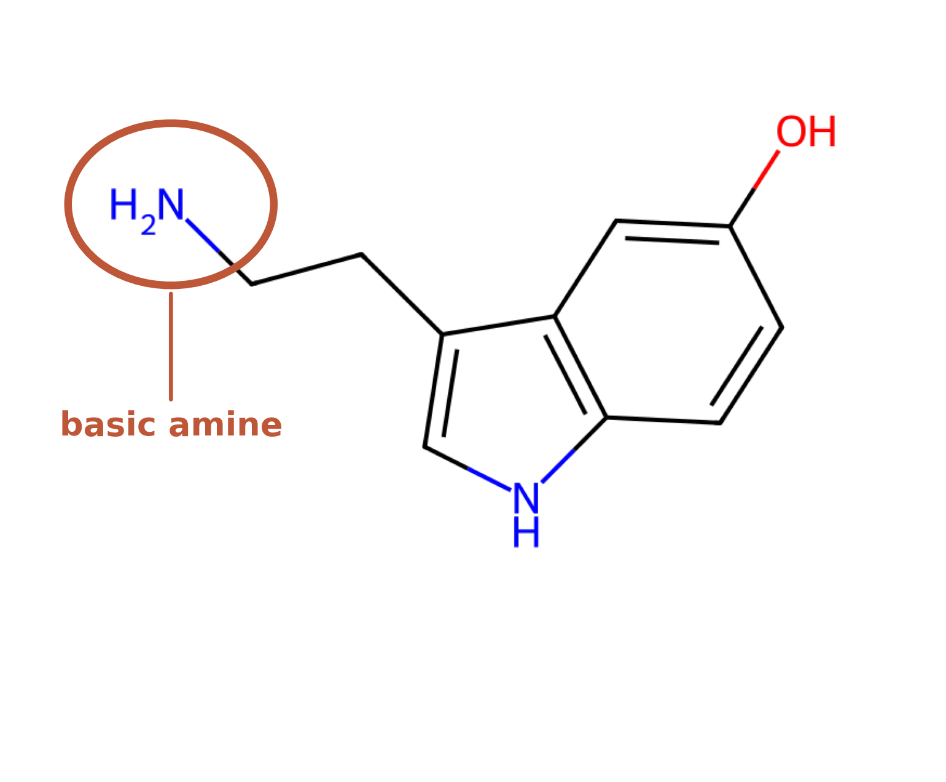
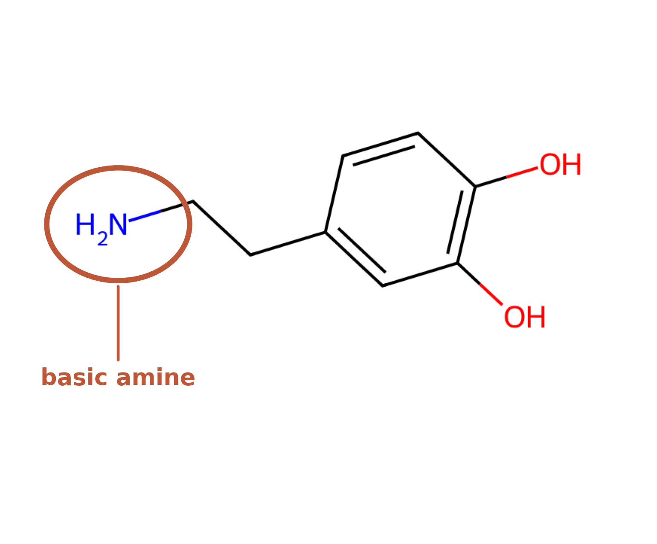
PART TWO · THE TARGETS
Two data-rich receptors, and how they reached modelling scale
Serotonin 5-HT₂A
Dopamine D₃
172 → 4,620 ligands
173 → 5,488 ligands
endogenous ligand: serotonin
endogenous ligand: dopamine
Only 172 and 173 clinical compounds per target: too few to train on and validate. Preclinical ChEMBL compounds were added under the same curation.
MSc Molecular & Medical Biotechnology · University of Verona
9
Notes:
So Part One leaves me with an opportunity, a choice, and an obstacle.
The opportunity: nearly two-thirds of these drugs act on more than one receptor, exactly what repurposing exploits. To use it, I need to predict binding where nobody has measured it.
The choice: how to predict it. One route is docking: fit each molecule into a 3D structure of the receptor and score the fit. Docking is very good at showing how a molecule sits in the pocket, but its scores are a weak guide to how strongly it binds. The other route is to learn from measured affinities, and I had just curated thousands of them. For a question about binding strength, learning was the better fit. The two are complementary, and combining them is a natural next step.
The obstacle: learning needs data. My first model, on the clinical compounds alone, reached an R-squared of only about 0.35. Was that the method, my curation, or simply too few compounds? To test it, I took the two richest receptors, serotonin 5-HT2A and dopamine D3, shown here with their natural ligands, and extended each with preclinical ChEMBL compounds under the same curation rules: from 172 and 173 compounds to 4,620 and 5,488.
Adding data raises an obvious worry about leakage. Answering it is the heart of this work.
HOLD — only if asked:
why not docking — see question 1b. · The initial ~0.35 is in the thesis Discussion, opening of the modelling section. · Roughly 27-fold and 32-fold expansion.

Slide 10
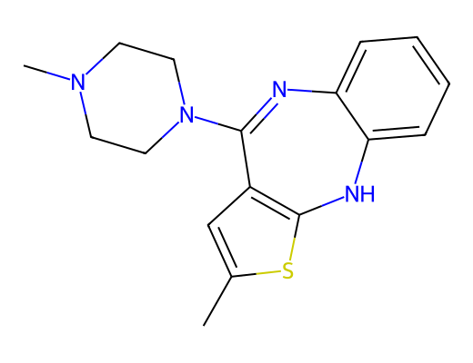
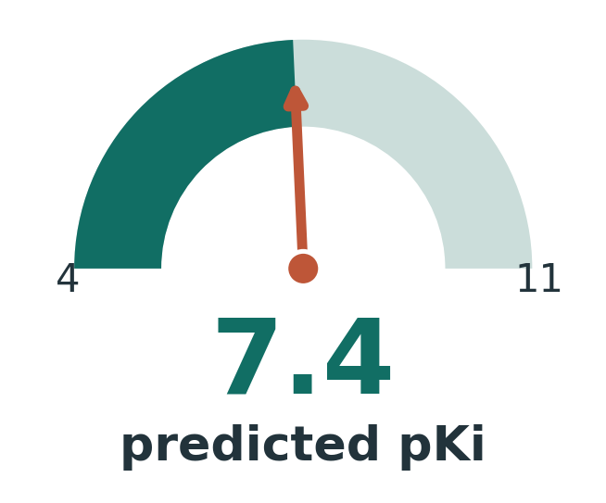
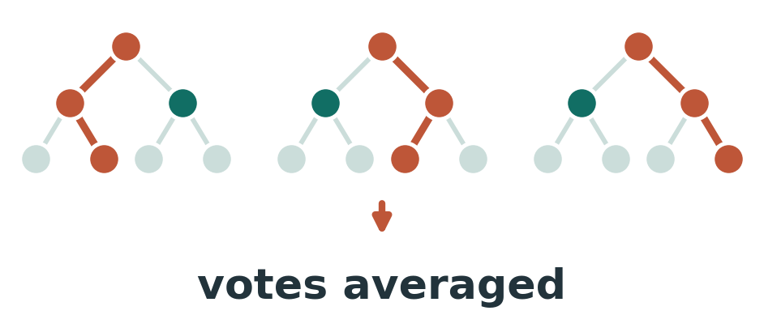
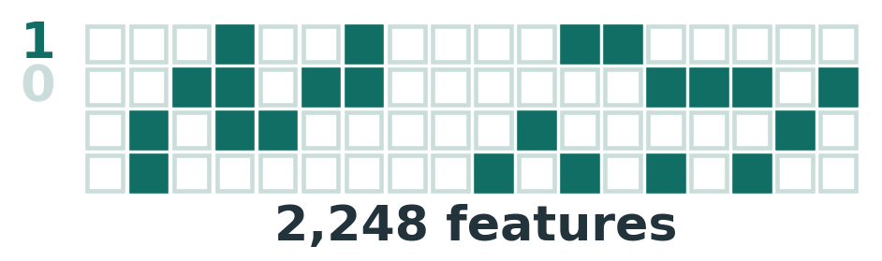
THE TASK
From a molecule to a predicted affinity
Molecule
Features
Model
Predicted pKi
→
→
→
A model is a mathematical function: it takes numbers in and returns a number. So the molecule must first be translated into numbers.
MSc Molecular & Medical Biotechnology · University of Verona
10
Notes:
Part Two. The task in one line: a molecule goes in, a predicted pKi comes out. But a model is just a mathematical function. It takes numbers in and gives a number out. It cannot read a chemical drawing. So the first real step is translating each molecule into numbers, in two ways.

Slide 11
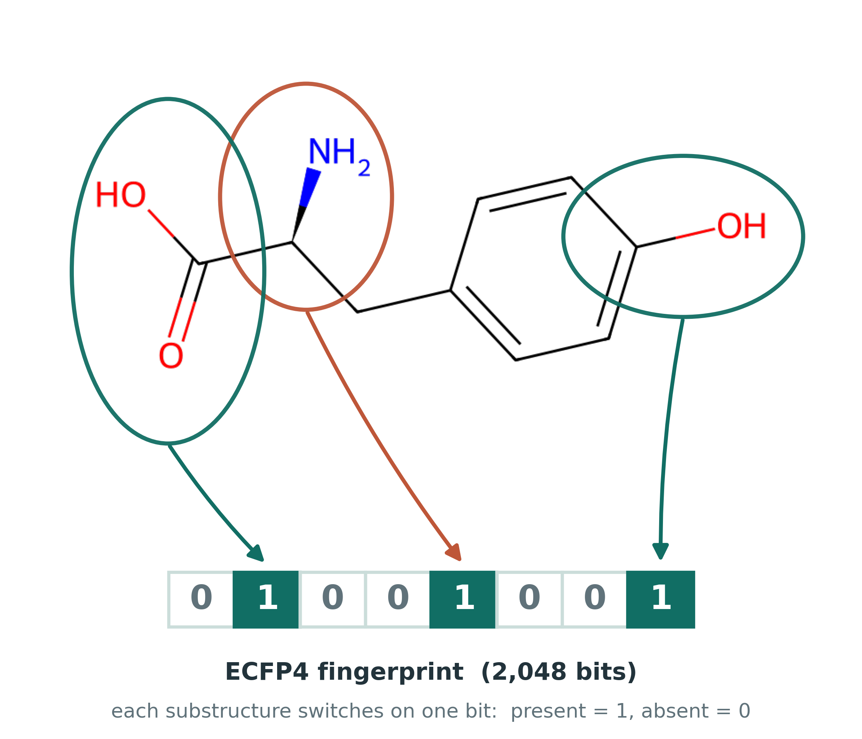
FEATURES I
ECFP4 fingerprints
Each atom local neighbourhood (out to two bonds) is a small substructure.
Every substructure is hashed into one of 2,048 slots: a fixed-length on/off barcode.
Each bit answers: is this fragment present? Similar molecules give similar barcodes.
Length is always 2,048 bits, whatever the molecule size.
MSc Molecular & Medical Biotechnology · University of Verona
11
Notes:
The first is a fingerprint, ECFP4, shown here on tyrosine, the natural precursor of dopamine. Take each atom and look at its neighbourhood out to two bonds. On the left, that captures the carboxylic acid. In the middle, the carbon carrying the amine. On the right, the phenol: the OH on the ring. Each fragment is hashed into one of 2,048 slots and switches it on: present is one, absent is zero. The picture shows three, but every atom is read at three sizes, so tyrosine actually switches on 24 bits. Two things matter. The length is always 2,048, whatever the size of the molecule. And molecules that share fragments share bits.
HOLD — only if asked:
13 heavy atoms → 24 bits. Each atom is read at radius 0 (itself), 1 (plus neighbours) and 2 (plus neighbours' neighbours); the "4" in ECFP4 is the diameter, four bonds. · Occasionally two different fragments land in the same slot, a collision: the price of a fixed length. · Similarity, by Tanimoto: tyrosine vs L-DOPA (one extra ring OH) 0.65; vs phenylalanine (one fewer OH) 0.70; vs dopamine only 0.25, because dopamine has lost the acid and gained an OH, and in a molecule this small two changes rewrite most local environments. · The fingerprint is stereo-blind: see question 7e.

Slide 12
FEATURES II
Descriptors, and the fused vector
The 15 become ~200
Fused representation
The same idea as the Part One panel, scaled up: weight, lipophilicity, polar surface area, charge and much else, from DescriptaStorus (RDKit2D, normalised). Part One used 15 interpretable descriptors; the model gets the full panel.
The 2048-bit fingerprint and ~200 descriptors are concatenated into a single 2,248-dimensional vector: the only view of each molecule the model ever sees.
2048 + 200 = 2,248
MSc Molecular & Medical Biotechnology · University of Verona
12
Notes:
The second is descriptors: the fifteen from Part One, scaled up to about two hundred whole-molecule properties, like weight, lipophilicity, polar surface and charge. I join fingerprint and descriptors into one vector of 2,248 numbers. That is the only view of each molecule the model ever sees. Whether joining them actually helps, I tested rather than assumed.
HOLD — only if asked:
DescriptaStorus is an open-source library built on RDKit (by Brian Kelley) that computes a standard panel of exactly 200 2D descriptors in one call; it is the same panel the Chemprop deep-learning package uses. · "Normalised" means each value is replaced by its percentile against a large reference set of molecules, so everything sits between 0 and 1. Tyrosine's molecular weight, 181, becomes 0.01: lighter than 99% of the reference. · Those reference distributions ship with the library, so normalisation uses nothing from my data and cannot leak test-set information. · Why normalise for trees: question 7g.

Slide 13
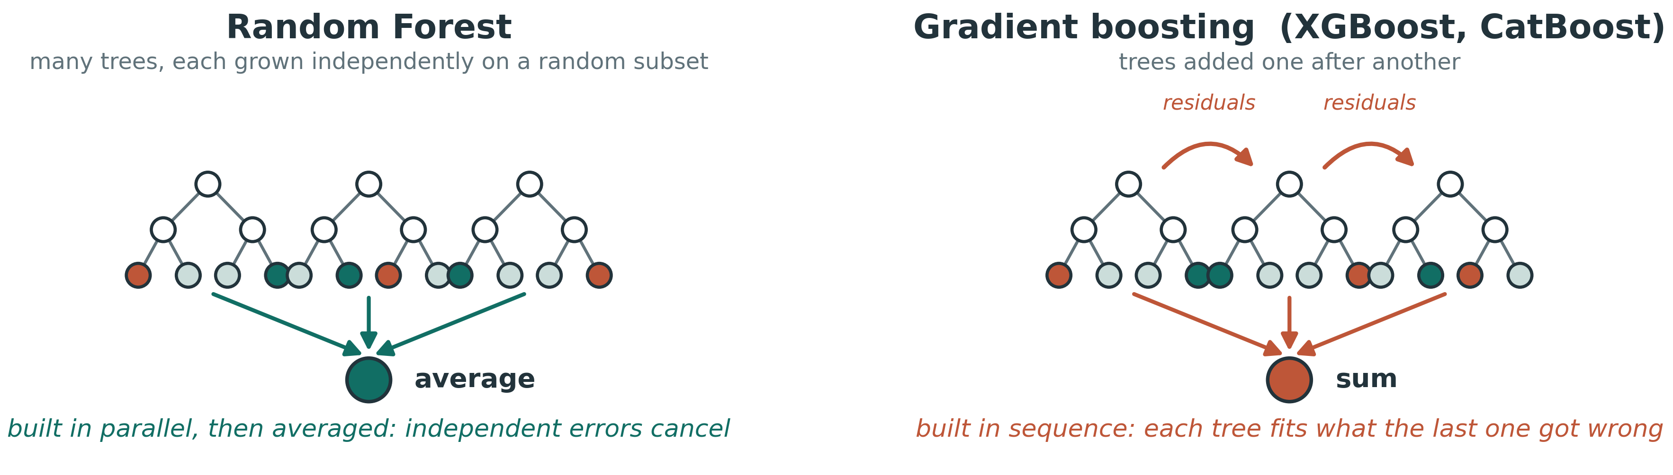
THE MODELS
Tree ensembles
Random Forest
XGBoost
Hundreds of decision trees trained on random data and feature subsets, then averaged, so diverse errors cancel out.
Gradient boosting: trees added in sequence, each correcting the errors of the last.
MSc Molecular & Medical Biotechnology · University of Verona
13
Notes:
The models are tree ensembles. Random Forest builds hundreds of decision trees on random subsets and averages them, so their errors cancel. XGBoost adds trees one after another, each correcting the mistakes of the last. I also ran a third, CatBoost, only to check the result does not depend on one method. At this data size, tree ensembles are competitive, robust, and much easier to interpret than deep learning.

Slide 14
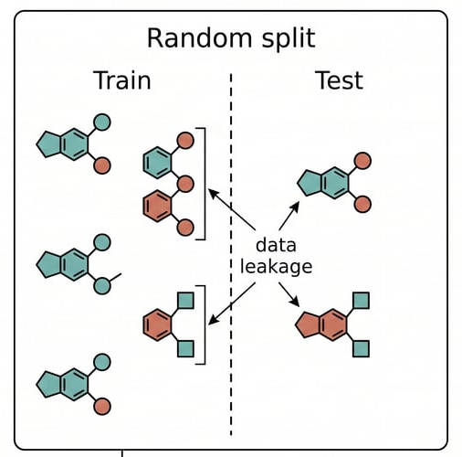
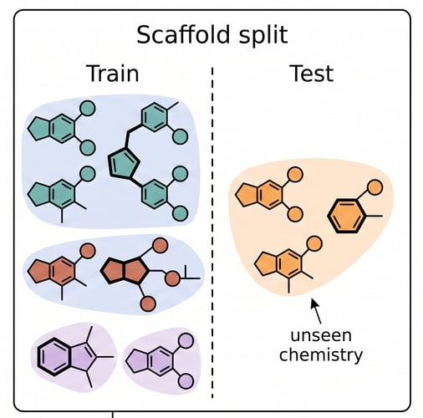
VALIDATION
The honest test: a scaffold split
1
Random split
2
Scaffold split
Near-identical analogs land on both sides, so the model "predicts" what it has already seen.
Whole scaffold families are held out, so every test compound is structurally novel.
MSc Molecular & Medical Biotechnology · University of Verona
14
Notes:
This is the part I care most about, so I will slow down.
The obvious test is a random split: hide twenty per cent of the compounds and train on the rest. On this kind of data it is misleading. Medicinal chemistry is full of analogue series, dozens of small variations on one core. A random split puts near-identical analogues on both sides, so the model just recognises what it has already seen. The score looks excellent, and it is inflated.
The fix is to split by family. A scaffold is the core skeleton of a molecule: strip off the side chains, keep the rings and the links between them. Whole scaffold families go to one side together, so every test compound is chemistry the model has genuinely never seen. I repeat this twelve times with different random splits and report the mean.
The score drops. And that drop is the point. It is the honest number.
HOLD — only if asked:
grouping is by the exact Bemis–Murcko scaffold, not by similarity. For the stricter similarity-based split, see question 2 below. This is the most likely technical question of the day.

Slide 15
RESULTS
Regression performance
MSc Molecular & Medical Biotechnology · University of Verona
15
Notes:
So, the results. With fused features and XGBoost, the scaffold-split R-squared is 0.56 for 5-HT2A and 0.64 for D3, up from about 0.35 on the clinical compounds alone. So most of that ceiling was the data, and the learning curve in a moment shows exactly how.
The other bars are the test I promised: was fusing worth it? For 5-HT2A, yes, modestly: together beats either part alone. For D3 the fingerprint already carries nearly everything, so fusion ties. The error is 0.81 and 0.76 log units, about one and a half times the disagreement between laboratories. And Random Forest and CatBoost land in the same place, so performance is set by the data, not by the learner.
HOLD — only if asked:
bar values: fingerprint alone 0.544 and 0.639, descriptors alone 0.521 and 0.598, fused 0.562 and 0.644. Descriptors alone are weakest on both targets: whole-molecule properties matter, but substructure matters more. · Inter-laboratory noise is about 0.5 log units, so 0.81 and 0.76 are 1.6 and 1.5 times that floor.

Slide 16
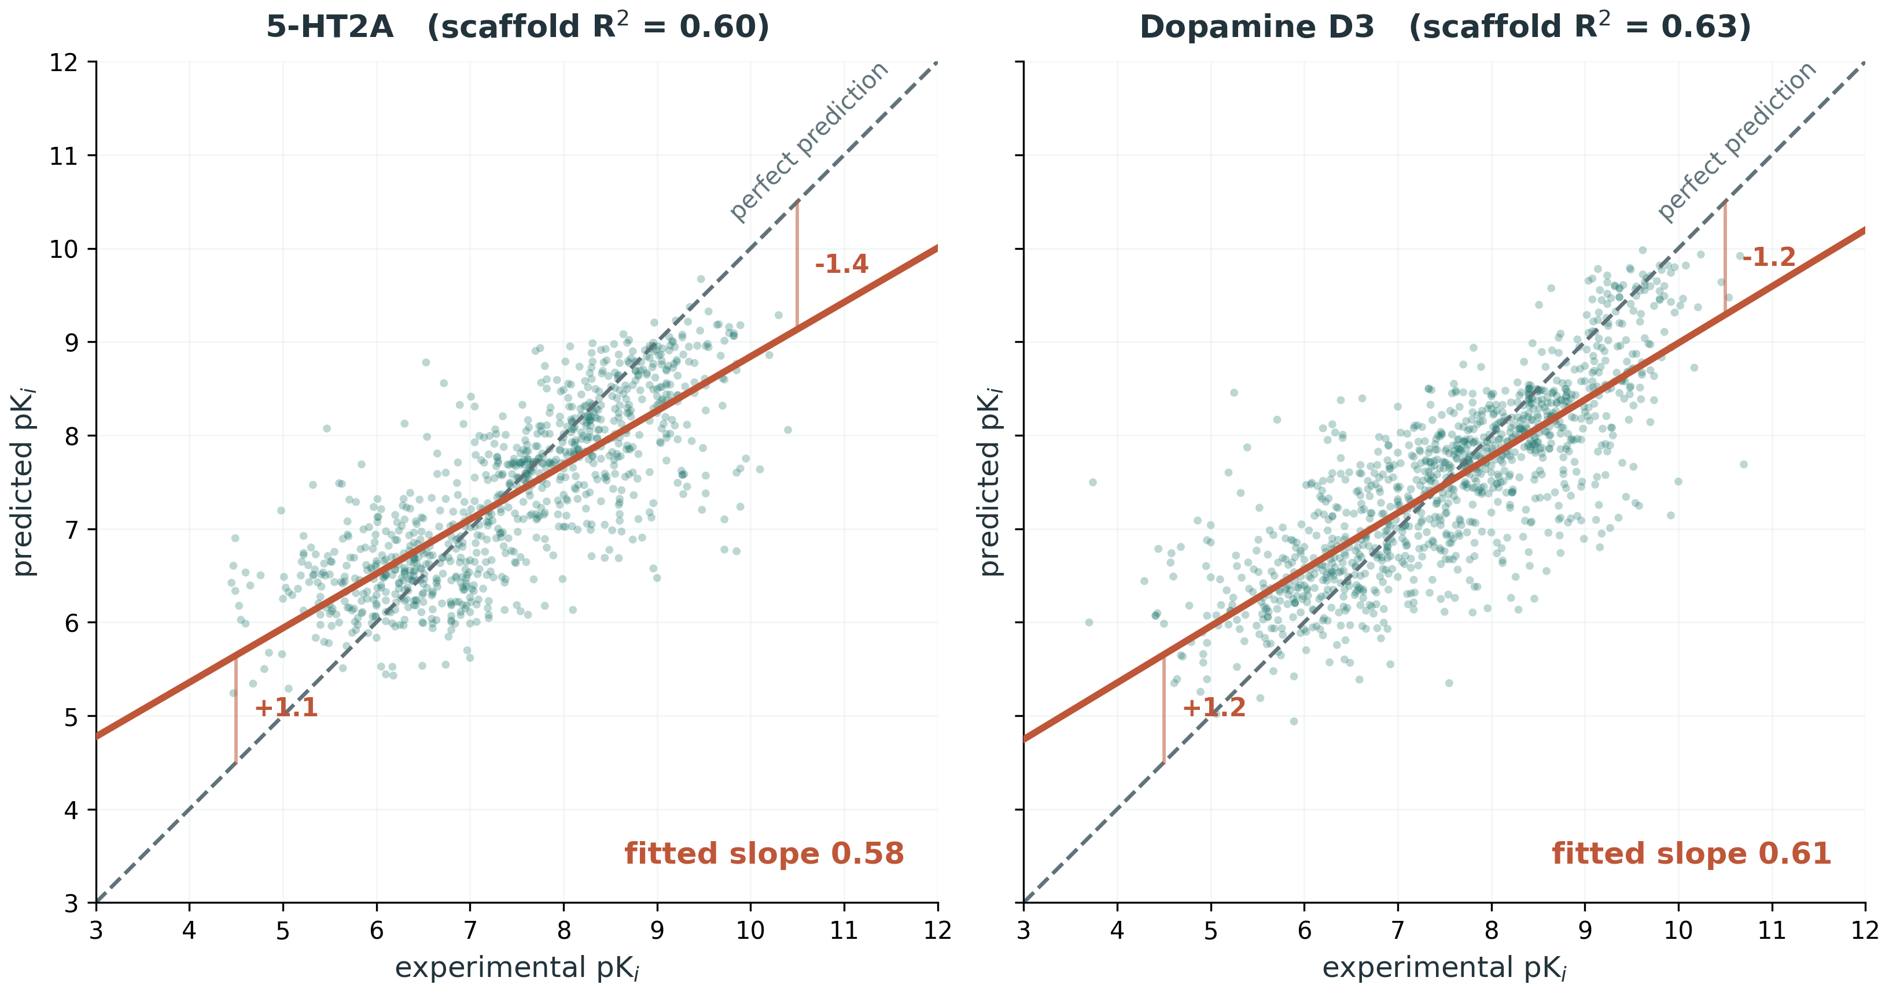
RESULTS
Predicted versus experimental
Held-out predictions, scaffold split, both targets on identical axes.
The fitted line has slope 0.58 and 0.61, not 1. Weak binders are over-predicted by about a log unit, strong binders under-predicted by the same. Ranking is reliable; absolute values are conservative at the potent end.
MSc Molecular & Medical Biotechnology · University of Verona
16
Notes:
Here are the actual predictions on held-out compounds, both targets on the same axes. One thing first: the R-squared in the titles, 0.60 and 0.63, is for this single split. The twelve-split means are the 0.56 and 0.64 you just saw.
The message is the slope: 0.58 and 0.61, not one. Look at the red bars. At the weak end the model over-predicts by about one log unit; at the potent end it under-predicts by one to one and a half. It pulls the extremes toward the middle, which is what a model minimising average error does. So the ranking is reliable, but absolute values are conservative at the potent end.
HOLD — only if asked:
the predicted spread is about three quarters of the measured spread (SD 0.92 vs 1.24, and 0.98 vs 1.28).

Slide 17
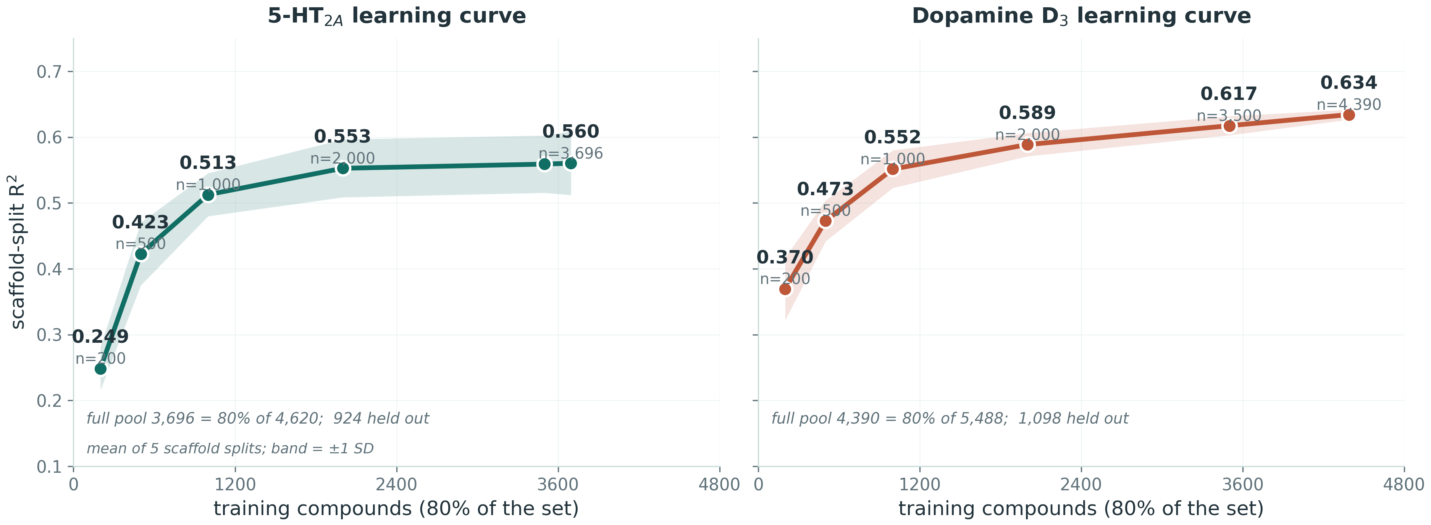
THE GAIN IS REAL
Learning curve
Both panels on identical scales. R² climbs steeply, then flattens against the single-target ceiling; the gain is data-driven.
MSc Molecular & Medical Biotechnology · University of Verona
18
Notes:
This is how we know the gain came from data. I trained on growing subsets and measured R-squared on held-out compounds each time, five scaffold splits per point.
R-squared climbs steeply, then flattens. For 5-HT2A it goes from 0.25 with 200 training compounds to 0.56 with the full set. But the first thousand compounds deliver most of that; the last seventeen hundred add less than 0.01.
That flat tail is the important part. The model is near the ceiling you can reach from one target's data with this representation. More of the same data will not help. To go further you have to share information across targets, and that is where this thesis ends up.
HOLD — only if asked:
the x-axis stops at 3,696 and 4,390 because that is the 80% training pool; the other 924 and 1,098 compounds are the test set. · D3 sits above 5-HT2A at every matched training size, so its relationship is easier to learn, not just better supplied.

Slide 18
VALIDATION
What random folds would have claimed
Random folds: 0.68 and 0.72
Ten-fold cross-validation lets close analogues fall on both sides of a split, so the model partly recognises what it has seen.
Scaffold split: 0.56 and 0.64
Whole scaffold families are held out, so the gap of about 0.1 is the inflation this removes.
MSc Molecular & Medical Biotechnology · University of Verona
19
Notes:
One more look at what the scaffold split costs. Standard ten-fold cross-validation lets close analogues fall on both sides of every split. It would report 0.68 and 0.72. The scaffold split reports 0.56 and 0.64. That gap of about 0.1 is exactly the inflation the scaffold split removes. Both numbers are in the thesis so the gap is explicit, and the lower one is the number I stand behind.
HOLD — only if asked:
cross-validation RMSE is 0.70 and 0.69, against 0.81 and 0.76 on the scaffold split.

Slide 19
CONTROL
Is it more than a similarity lookup?
The most deflating explanation for a good QSAR score is that the model has simply memorised which training compound each test compound resembles. So the models were made to beat that strategy explicitly.
The baseline: 1-NN read-across
Why it is the right baseline
Assign each test compound the pKi of its single most Tanimoto-similar training compound. No learning, pure nearest-neighbour lookup.
It is exactly what a fingerprint model could degenerate into. Beating it by a clear margin shows aggregate structure-activity is being learned.
0.35 → 0.56
0.44 → 0.64
5-HT₂A: read-across → model (R²)
D₃: read-across → model (R²)
Read-across reaches R² 0.347 and 0.435; the models beat it by roughly 0.2 R², a 48 to 62 per cent gain on both targets.
MSc Molecular & Medical Biotechnology · University of Verona
21
Notes:
Two controls stand behind these numbers.
First, chance. I shuffled the affinity labels and retrained a hundred times. R-squared collapsed every time, and no shuffled model reached the real one: p equals 0.0099, the floor for a hundred permutations.
Second, the harder one. The most deflating explanation for a good score is that the model has simply memorised which training compound each test compound looks like. So I built exactly that as a baseline: give each test compound the affinity of its most similar training compound. No learning at all. That reaches 0.35 and 0.44. The models reach 0.56 and 0.64, about 0.2 higher. They are learning structure-activity relationships, not doing a disguised lookup.
HOLD — only if asked:
the permutation test has its own section, 3.5.4, and figure in the thesis. Read-across exact values: 0.347 and 0.435.

Slide 20
ROBUSTNESS
Not leaning on a few promiscuous drugs
A natural worry is that performance depends on a handful of well-known multi-target drugs. Removing every compound that engages five or more distinct targets and retraining leaves performance intact, indeed marginally higher. The metric below is R² from the regression models, not MCC.
R² 0.56 → 0.58
R² 0.64 → 0.67
5-HT₂A · scaffold split, regression
D₃ · scaffold split, regression
136 of 4,620 compounds for 5-HT₂A and 117 of 5,488 for D₃: every molecule recorded against five or more distinct targets.
A molecule optimised to hit many targets sits where the structure–activity relationship for any single target is weaker, so it is harder to fit. Removing them leaves a slightly cleaner signal.
MSc Molecular & Medical Biotechnology · University of Verona
22
Notes:
Remember the promiscuous drugs from Part One. A fair worry is that the models lean on a handful of famous multi-target compounds. So I removed every compound hitting five or more targets, 136 for 5-HT2A and 117 for D3, and retrained. R-squared did not drop. It rose slightly: 0.56 to 0.58, and 0.64 to 0.67. If anything, those compounds are harder to fit.
HOLD — only if asked:
why removal helps: a molecule built to hit many targets sits where any single target's structure-activity relationship is weaker. · Classifier version: see question 11.

Slide 21
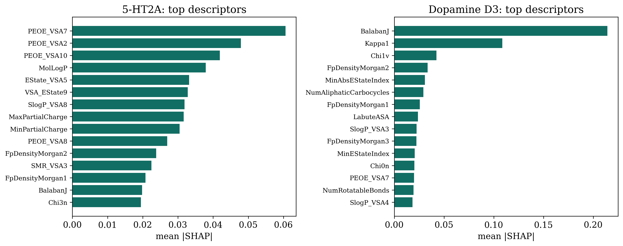
INTERPRETATION
What drives the predictions (SHAP)
The two targets rely on different property families: 5-HT₂A on charge and electrostatics, dopamine D₃ on molecular shape and topology.
MSc Molecular & Medical Biotechnology · University of Verona
23
Notes:
Last question for the regression: what is the model actually using? SHAP traces each prediction back to the input features. The two receptors rely on different chemistry. 5-HT2A is driven mostly by charge and electrostatic descriptors. D3 leans on shape and branching, topological indices like Balaban J. That split is chemically sensible, and it means the models are not black boxes.

Slide 22
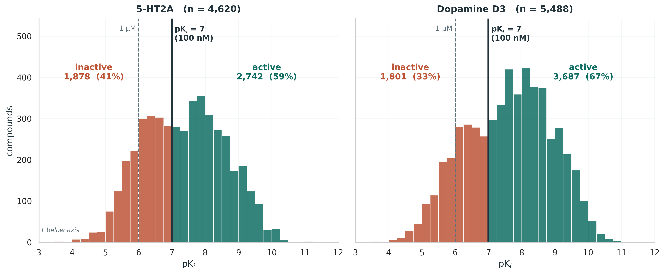
VIRTUAL SCREENING
The task: where the active/inactive line falls
100 nM splits the library 59/41 and 67/33. At 1 µM it would be 85 and 87 per cent active, and MCC falls from 0.63 to 0.35 and 0.43 — too few inactives left to learn a boundary from. The threshold is a modelling decision, and this is the evidence for it.
MSc Molecular & Medical Biotechnology · University of Verona
24
Notes:
Now the same models as a screening tool, which is closer to how they would actually be used, and back toward repurposing. First, the task itself. Every compound here is a measured binder, so I am not separating binders from non-binders. I am separating potent from weak. The cut is 100 nanomolar, the solid line. That splits the libraries 59 to 41 and 67 to 33: two real classes.
Why not 1 micromolar, the usual screening cut-off? That is the dashed line. Almost everything here binds at least that well, so 85 and 87 per cent would be called active, and MCC, which I will define in a moment, falls from 0.63 to 0.35 and 0.43. The threshold is not tuned to flatter the result. It is where this library actually has two classes.

Slide 23
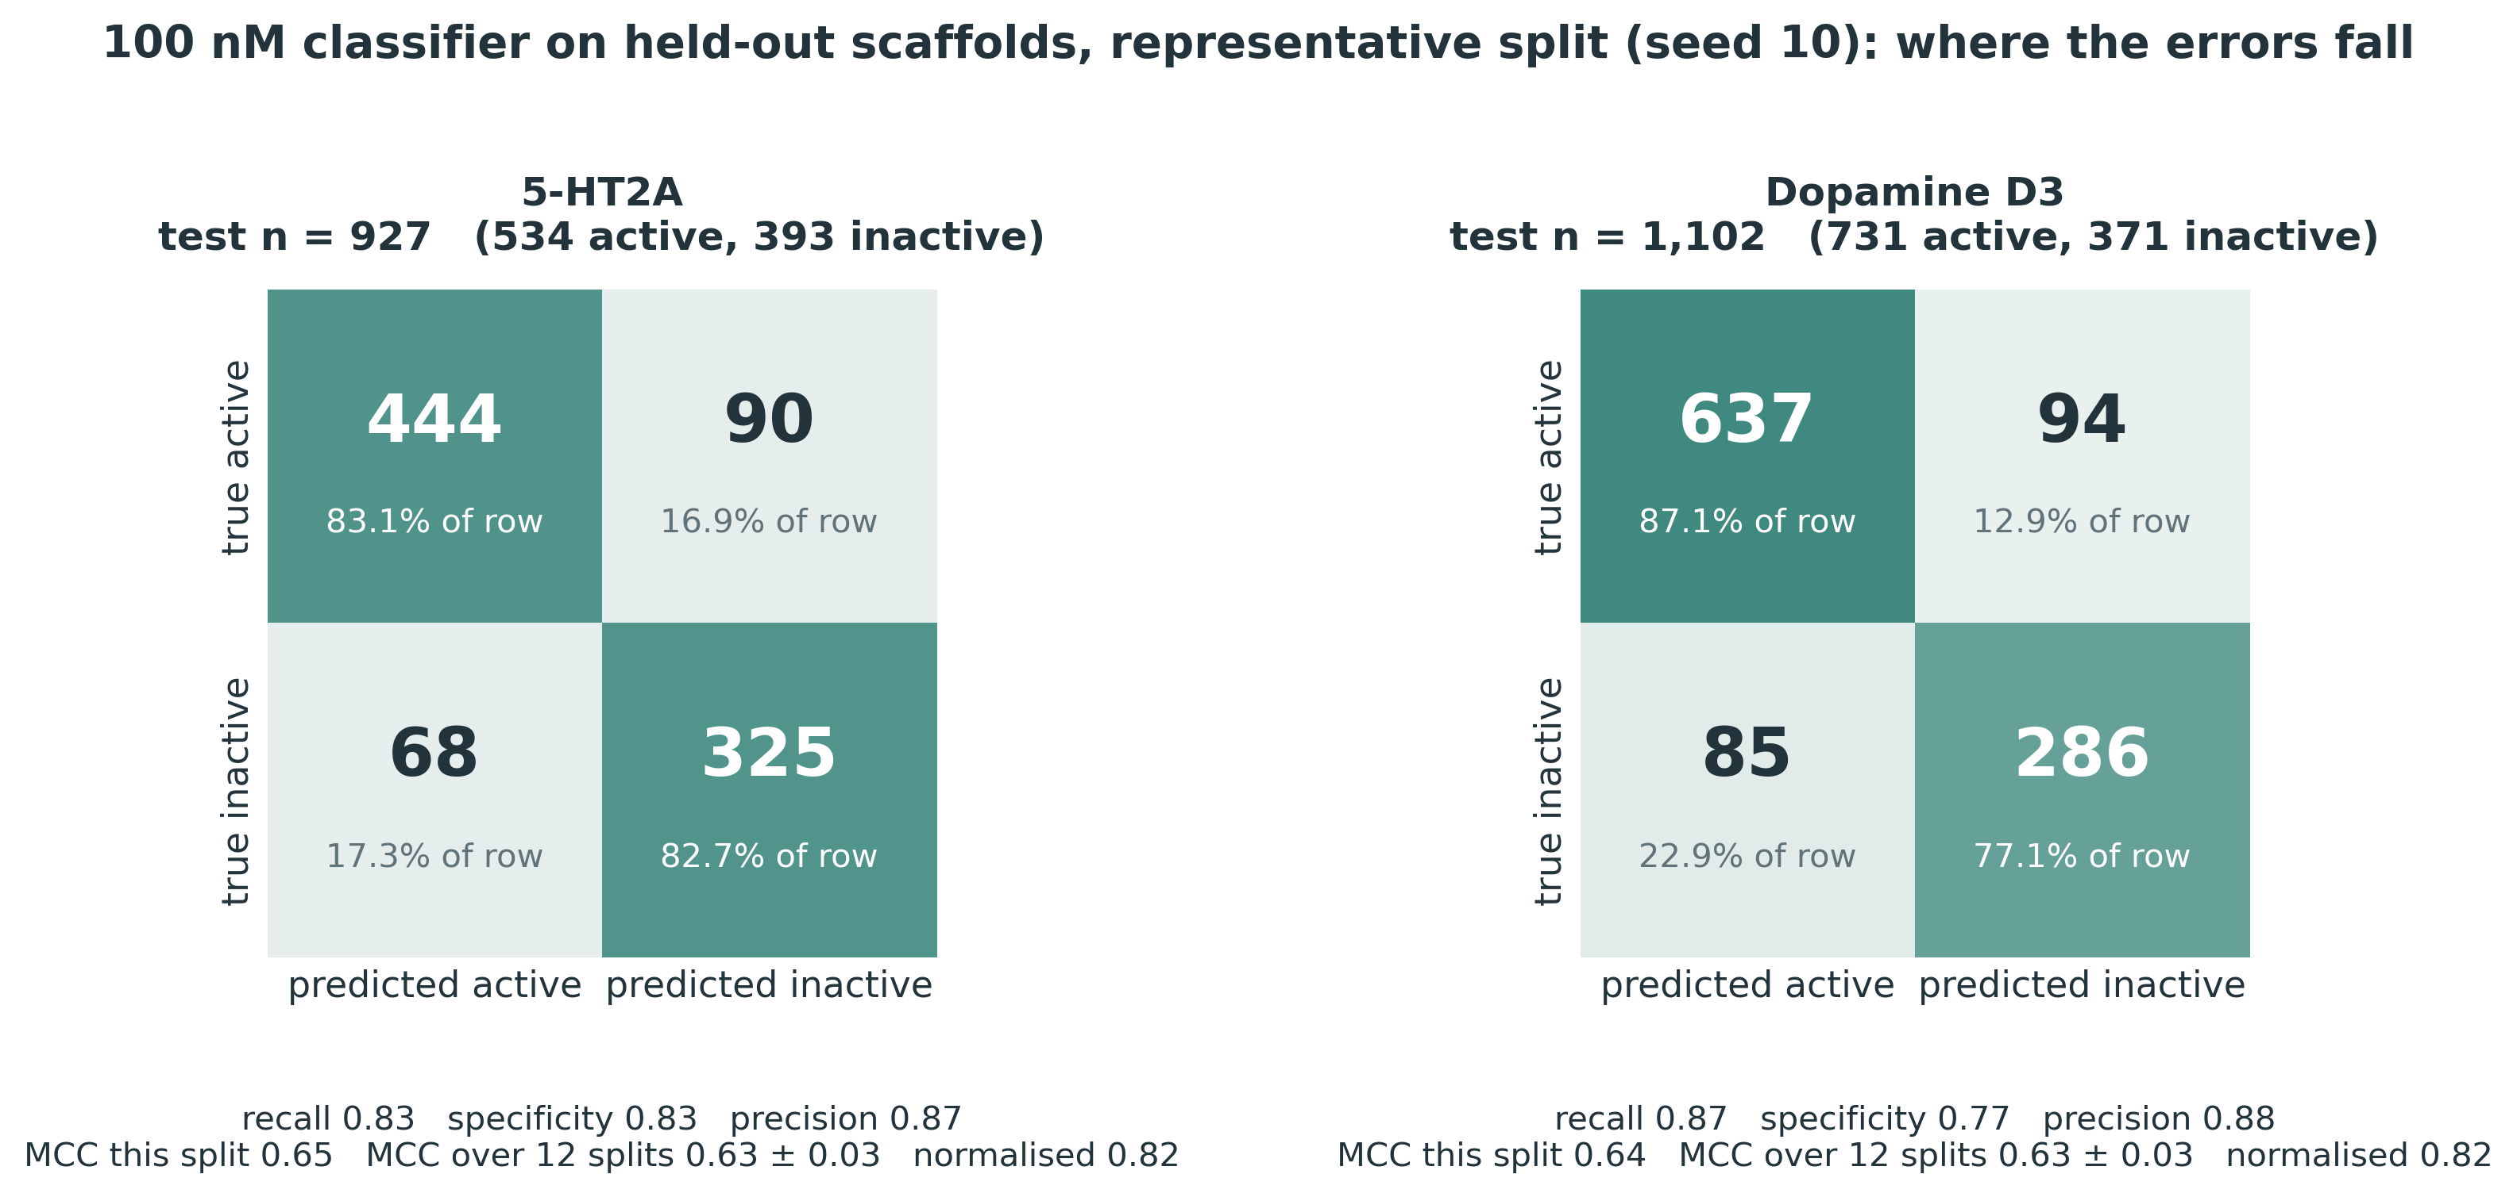
VIRTUAL SCREENING
The classifier
MSc Molecular & Medical Biotechnology · University of Verona
25
Notes:
Here is the classifier itself, on one representative split: the one closest to the median, not the best. Read the top-left of each panel. For 5-HT2A, 444 of 534 true actives found, and 325 of 393 inactives correctly rejected: 68 false alarms, 90 misses. For D3, 637 of 731 actives found. Notice the balance: it is not just calling everything active. Every metric on the next slide can be recomputed from these four numbers.
HOLD — only if asked:
this split is seed 10; its MCC is 0.654 and 0.639 against twelve-split means of 0.635 and 0.632. · Recall and specificity are both 0.83 for 5-HT2A; for D3, 0.87 and 0.77.

Slide 24
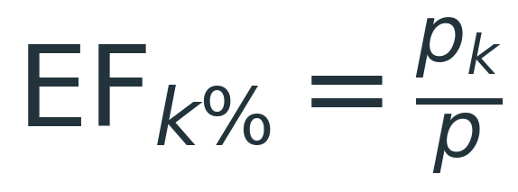
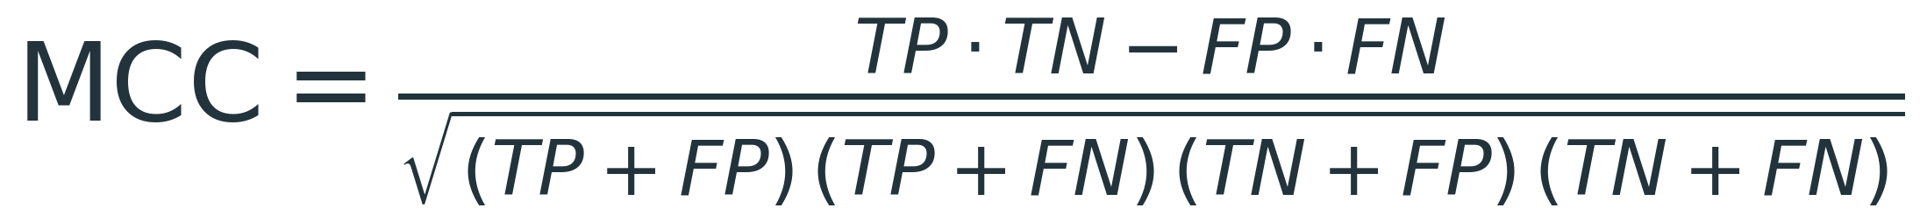
VIRTUAL SCREENING
What the screening metrics measure
MCC · 0.635 and 0.632
Enrichment factor · 1.67 and 1.46
Accuracy lies when one class dominates: this library is 59% and 67% active, so always answering "active" scores 59% and is useless. MCC uses all four cells of the confusion matrix, so it only rises when both classes are called correctly. It runs −1 to +1, where 0 is chance.
Rank the library by predicted affinity, take the top 1%, and ask how much richer in true actives it is than the library overall. 1.0 is random ranking. The ceiling is 1 over the active fraction: 1.69 and 1.49 here, so this sits at 98% of the maximum achievable.
MSc Molecular & Medical Biotechnology · University of Verona
26
Notes:
Two metrics, and what they mean, because a number alone means nothing.
MCC first. Accuracy lies when one class dominates. This library is 59 and 67 per cent active, so a model that always says "active" scores 59 per cent and is useless. The Matthews correlation coefficient uses all four cells you just saw, so it only rises when both classes are called correctly. Plus one is perfect, zero is chance. Ours is 0.635 and 0.632, across twelve scaffold splits.
Enrichment second. Rank the library by prediction, take the top one per cent, and ask how much richer in actives it is than the library overall. One means random. Ours is 1.67 and 1.46, which sounds modest until you know the ceiling. Because the library is mostly active, the maximum possible is 1.69 and 1.49. We are at 98 per cent of the maximum.
HOLD — only if asked:
ROC-AUC is about 0.90 for 5-HT2A and 0.92 for D3: see question 6. · All three learners give MCC 0.61–0.64. · If anyone asks you to compare MCC with R²: see question 6b. · The top 1% is about nine compounds per split, averaged over twelve splits: see question 6c.

Slide 25
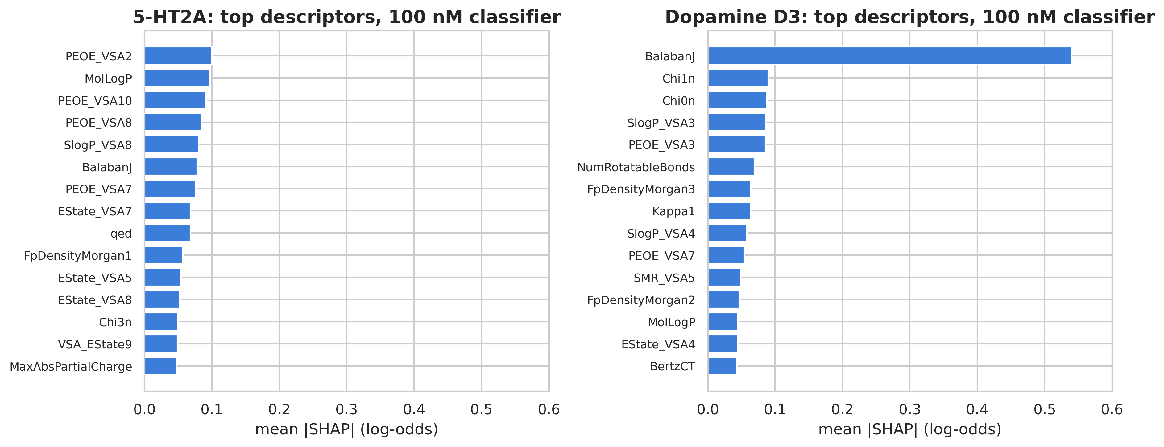
INTERPRETATION
What the classifier keys on
Rank correlation with the regression SHAP: 0.90 and 0.87. The same chemistry drives the category call and the continuous prediction, so the interpretation is a property of the data rather than of the loss function. Charge-binned surface areas lead for 5-HT₂A; for D₃, Balaban J alone carries 18 per cent of the attribution. Values are in log-odds, so ranks are comparable to the regression figure but magnitudes are not.
MSc Molecular & Medical Biotechnology · University of Verona
28
Notes:
Last result. Does the classifier rely on the same chemistry as the regression? I ran SHAP again. The rank agreement between the two is 0.90 for 5-HT2A and 0.87 for D3. Ask the model a different question, and it leans on the same features. Charge-related surface areas still lead for 5-HT2A; for D3, Balaban J alone carries 18 per cent of the attribution. So the interpretation is a property of the data, not of how I set up the model.
HOLD — only if asked:
the axis is in log-odds, so ranks compare with the regression figure but magnitudes do not. · Salt bridge: see question 10.

Slide 26
LIMITATIONS
What this work does not establish
Two targets only 5-HT₂A and D₃ were chosen for data density. The pipeline is general, but the numbers are not yet shown to transfer across the receptor panel.
2D representationECFP4 and 2D descriptors carry no explicit conformation or protein structure, so binding-mode effects are invisible to the model.
Scope of tuning and ablation Hyperparameters are fixed sensible defaults, not per-fold tuned; nested CV would be the rigorous protocol. The promiscuity ablation covers the regression models only, not the classifiers.
No external test set Validation is internal, albeit leakage-controlled and repeated. A prospective or external set would be the stronger claim.
MSc Molecular & Medical Biotechnology · University of Verona
30
Notes:
What this work does not establish. The labels are pooled from many laboratories, and laboratories agree only to about half a log unit, which puts a floor under the error. Only two targets, chosen because they had enough data. The representation is two-dimensional: no 3D shape, no protein structure, which is exactly what docking would add. Validation is internal: careful and repeated, but there is no external or prospective test set. And hyperparameters are sensible defaults rather than fully tuned. Each of these is a concrete next step, not something I am hiding.

Slide 27
CONCLUSIONS
Contributions and next steps
A curated clinical-stage GPCR ligand dataset that did not exist in this form: 719 molecules, 3,011 records, characterised across fifteen descriptors.
As a virtual screen, the strongest result: MCC 0.63 on both receptors, with top-1% enrichment at 98% of its achievable ceiling.
Underneath it, a leakage-controlled affinity model at scaffold R² 0.56–0.64, with chance, baseline and robustness controls behind every number.
SHAP shows the two receptors are driven by different property families: charge for 5-HT₂A, molecular topology for D₃.
MSc Molecular & Medical Biotechnology · University of Verona
31
Notes:
To close the loop.
Part One produced a curated dataset of clinical-stage GPCR drugs that did not exist in this form: 719 molecules and 3,011 records, with their chemistry and their promiscuity mapped.
Part Two answered the question repurposing depends on. On these two receptors, binding can be predicted on chemistry the model has never seen: R-squared 0.56 to 0.64, and as a screen, MCC 0.63 with enrichment at 98 per cent of its ceiling. Those numbers survive a scaffold split, a permutation test, a similarity baseline and a promiscuity check.
And the learning curve tells me where the next gain has to come from: not more single-target data, but sharing information across targets. A multitask model over the whole panel could score all 719 clinical molecules against receptors they were never tested on. That is the repurposing screen this work makes possible.
Thank you to Professor Giorgetti, to Filippo, to the professors of the programme, and to my family. I am happy to take questions.

