Slide 1
MSc THESIS DEFENCE
Curation and Cheminformatic Characterization of a Clinical-Stage GPCR Ligand Dataset for Machine-Learning-Based Binding Prediction
Part One: curation and chemical characterisation · Part Two: machine-learning prediction of binding affinity
Dagmawi Tarekegn Fikadu MSc Molecular & Medical Biotechnology
Principal Investigator: Prof. Alejandro Giorgetti · Supervisor: Filippo Baldessari · University of Verona
Notes:
Good morning. I am Dagmawi Tarekegn Fikadu and I will present the machine-learning part of my thesis: predicting GPCR binding affinity directly from molecular structure. Supervised by Prof. Giorgetti and Filippo Baldessari. The thread running through the talk is not just building a model that predicts well, but validating it carefully enough that we can trust the number.

Slide 2
ROADMAP
A two-part thesis, and what today covers
PART ONE
→
PART TWO · TODAY
Curate & characterise
Model binding affinity
Build a clean clinical-stage GPCR ligand dataset
Measure 15 descriptors on every molecule
Drug-likeness and ligand efficiency
Use that dataset to predict pKi from structure
Rigorous, leakage-controlled validation
Regression, virtual screening, and interpretation
01
02
03
04
The dataset
The models
The discipline
The results
719 clinical-stage GPCR ligands, curated and characterised.
Turn molecules into numbers, then learn with tree ensembles.
Validation built to resist over-optimism: the core of the work.
Regression, a virtual-screening view, and what drives predictions.
Today focuses on Part Two, but it rests entirely on the curated dataset from Part One.
MSc Molecular & Medical Biotechnology · University of Verona
1
Notes:
One slide on how the project fits together. Part One was curation and characterisation: a clean clinical-stage GPCR ligand dataset, and mapping its chemistry. Part Two, today, uses that dataset to predict binding affinity with careful validation. Then the four parts of the talk: the task, the models, the validation discipline which is the heart of the work, and the results.

Slide 3
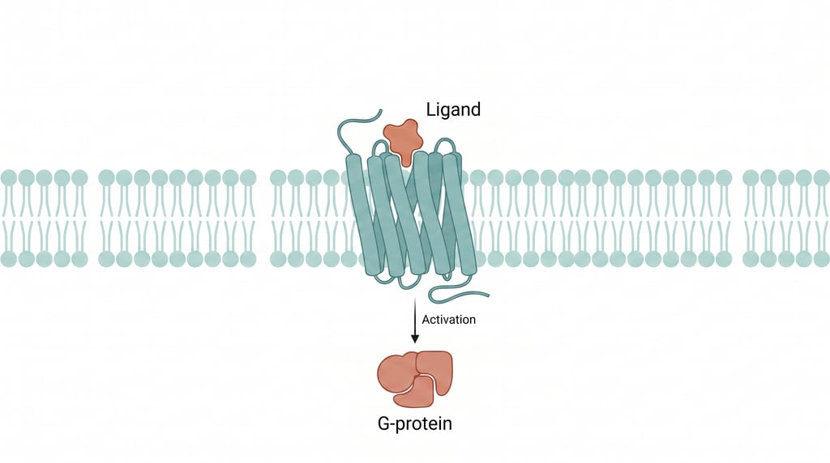
BACKGROUND
GPCRs and binding affinity
G-protein-coupled receptors are the most productive drug-target class: about a third of approved drugs act through them.
The aminergic subfamily (serotonin, dopamine, adrenergic, muscarinic) is especially drug-rich, with pockets that fit small drug-like molecules.
Binding affinity is measured as Ki and reported as pKi = 9 − log10(Ki[nM]); higher pKi means tighter binding.
Predicting pKi from structure is the task of this work.
A GPCR in the membrane: a small-molecule ligand binds the extracellular pocket and triggers intracellular G-protein signalling.
MSc Molecular & Medical Biotechnology · University of Verona
2
Notes:
GPCRs are the most productive drug-target class we have, about a third of approved drugs. The aminergic subfamily is especially rich in drugs because its pockets fit small drug-like molecules. What we predict is binding affinity, Ki, on a log scale as pKi. The only thing to remember: higher pKi means tighter binding.

Slide 4
PART ONE · THE DATASET
What was curated, and how
719
3,011
47
18
unique molecules
compound–target records
targets
receptor families
The curation pipeline
Why curate by clinical stage
Human Ki binding data from ChEMBL for compounds in clinical Phases I–IV and below 700 Da, with salt removal, peptide exclusion, a rotatable-bond flexibility filter, and highest-pKi deduplication per molecule.
Selecting on clinical status rather than single-target potency gives chemistry that has already survived safety and developability selection, and it is what makes the set informative for repurposing.
MSc Molecular & Medical Biotechnology · University of Verona
3
Notes:
Part One. The curation pipeline: human Ki binding data from ChEMBL, compounds in clinical Phases I to IV, below 700 daltons, with salt removal, peptides excluded, a rotatable-bond flexibility filter, and deduplication keeping the highest pKi per molecule. That yields 3,011 compound-target records spanning 719 unique molecules, 47 targets and 18 receptor families. The reason to curate by clinical stage rather than by potency is that this chemistry has already cleared safety and developability selection.

Slide 5
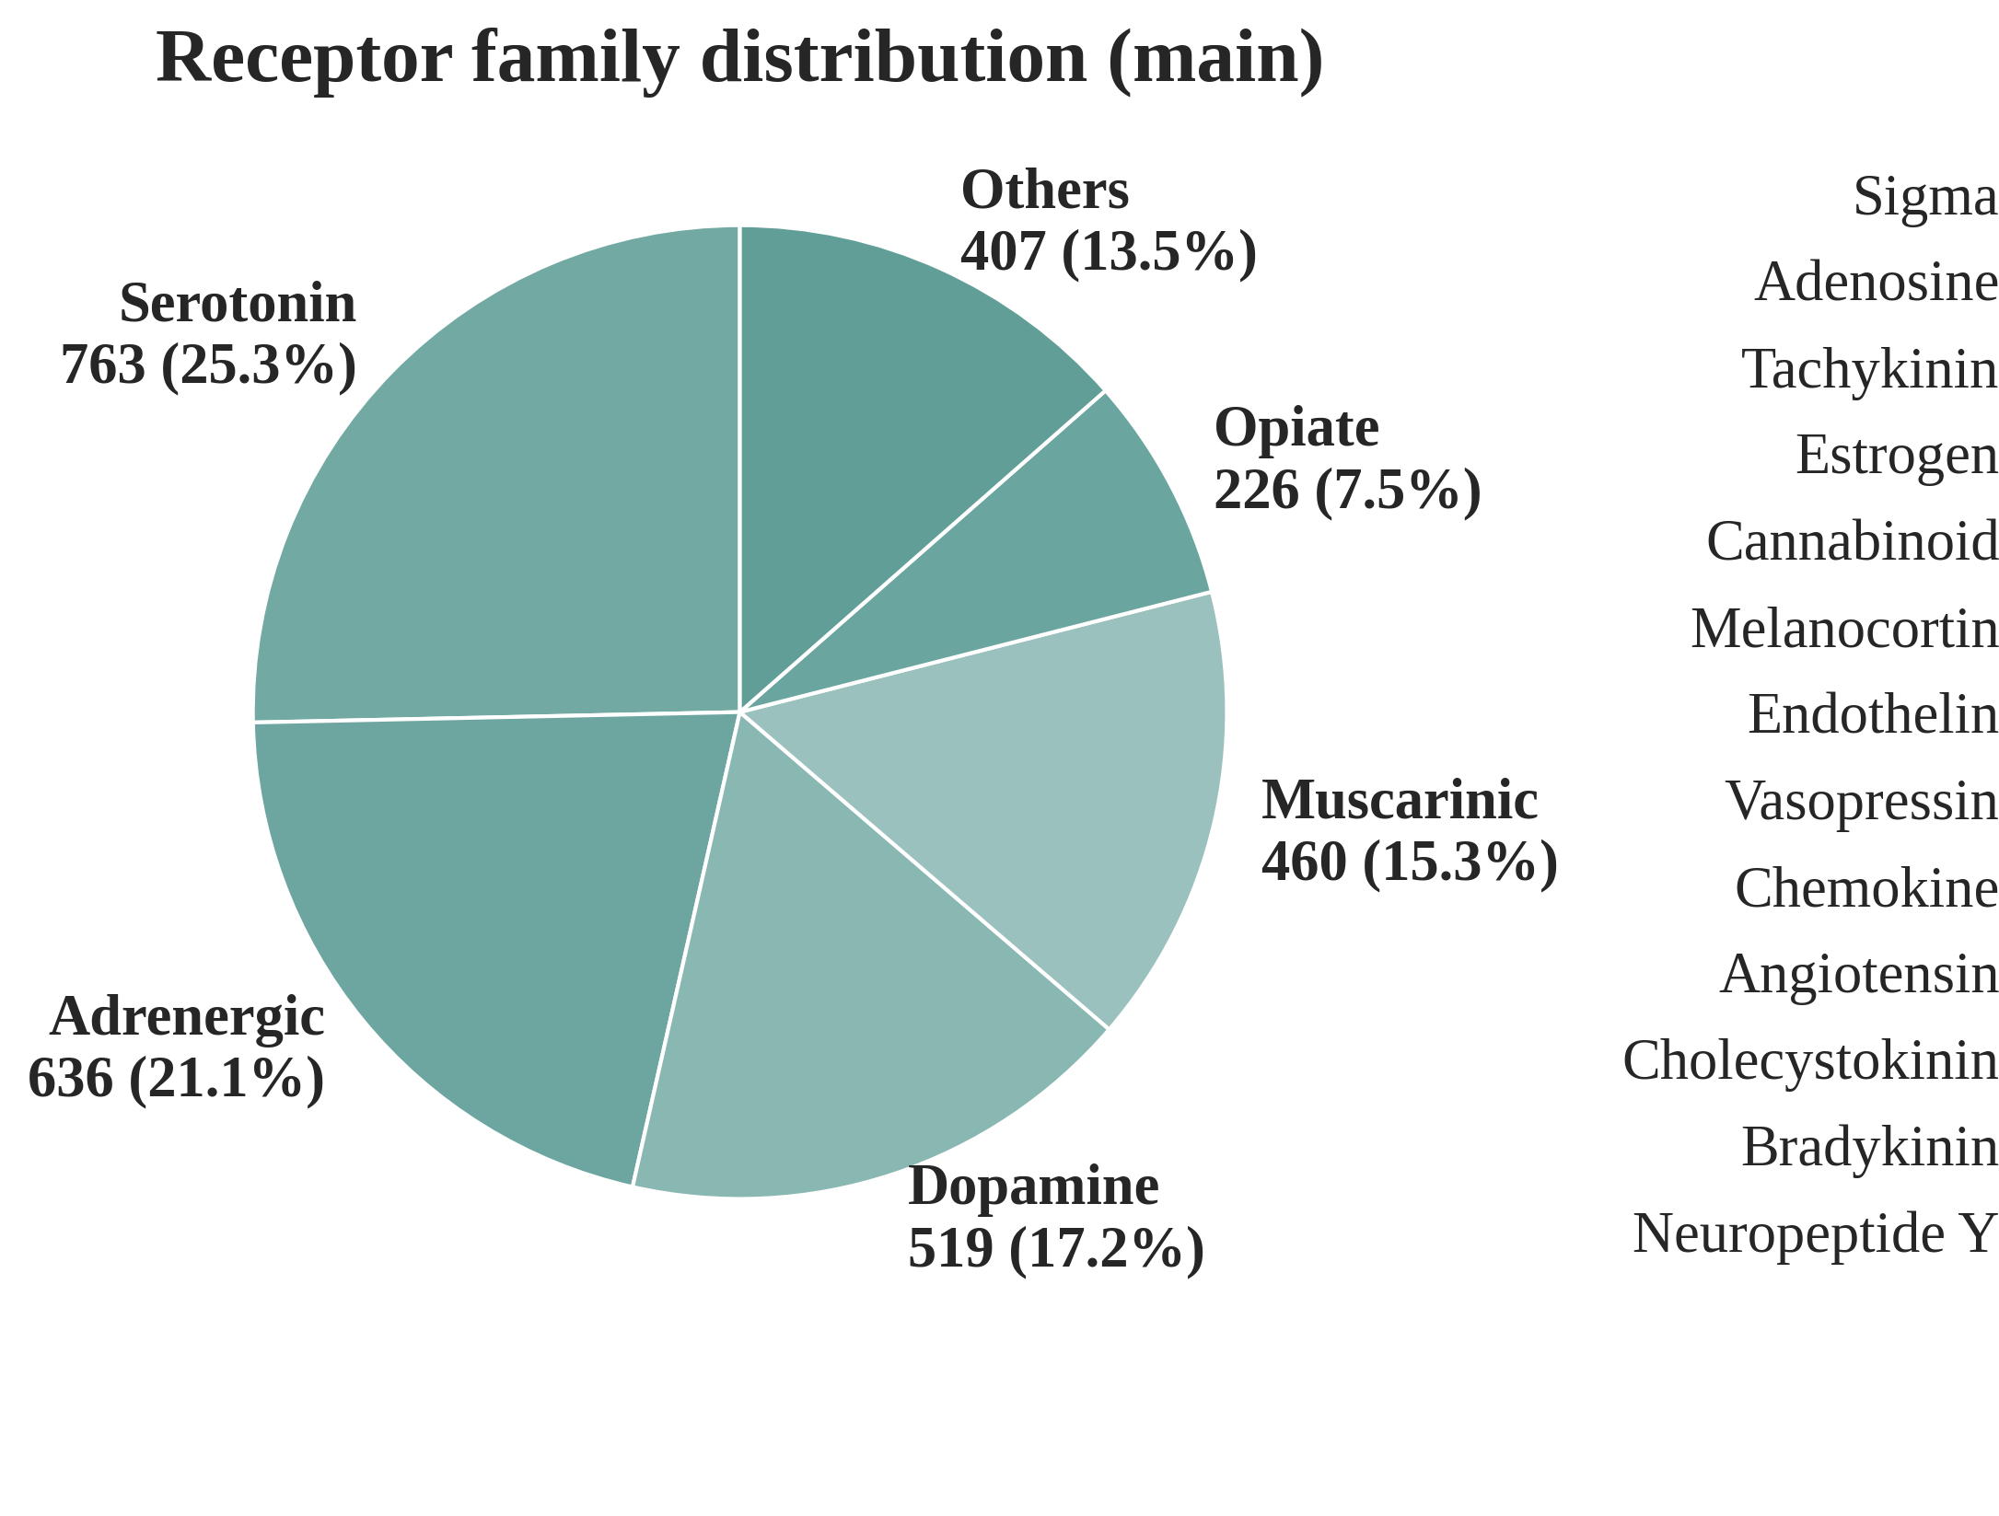
PART ONE · COMPOSITION
Receptor families and clinical phase
3,011
719
compound-target records
unique molecules
52.4%
of molecules reached Phase IV, counted per unique molecule
Records or molecules? It matters
At record level 69.8% are Phase IV, but approved drugs are promiscuous and assayed against many targets, so they are over-counted. Per unique molecule: 52.4% Phase IV, 31.4% Phase II, 12.4% Phase III, 3.8% Phase I. This class imbalance is carried through every later analysis.
MSc Molecular & Medical Biotechnology · University of Verona
4
Notes:
The chemical space is strongly aminergic: serotonin 25.3%, adrenergic 21.1%, dopamine 17.2%, muscarinic 15.3%, opiate 7.5%, together about 86% of records. On clinical phase, an important subtlety: at record level 69.8% are Phase IV, but approved drugs are promiscuous and get assayed against many targets, so they are over-counted. Counted per unique molecule it is 52.4% Phase IV, 31.4% Phase II, 12.4% Phase III, 3.8% Phase I. That class imbalance is a defining feature and it is carried through every later analysis.

Slide 6
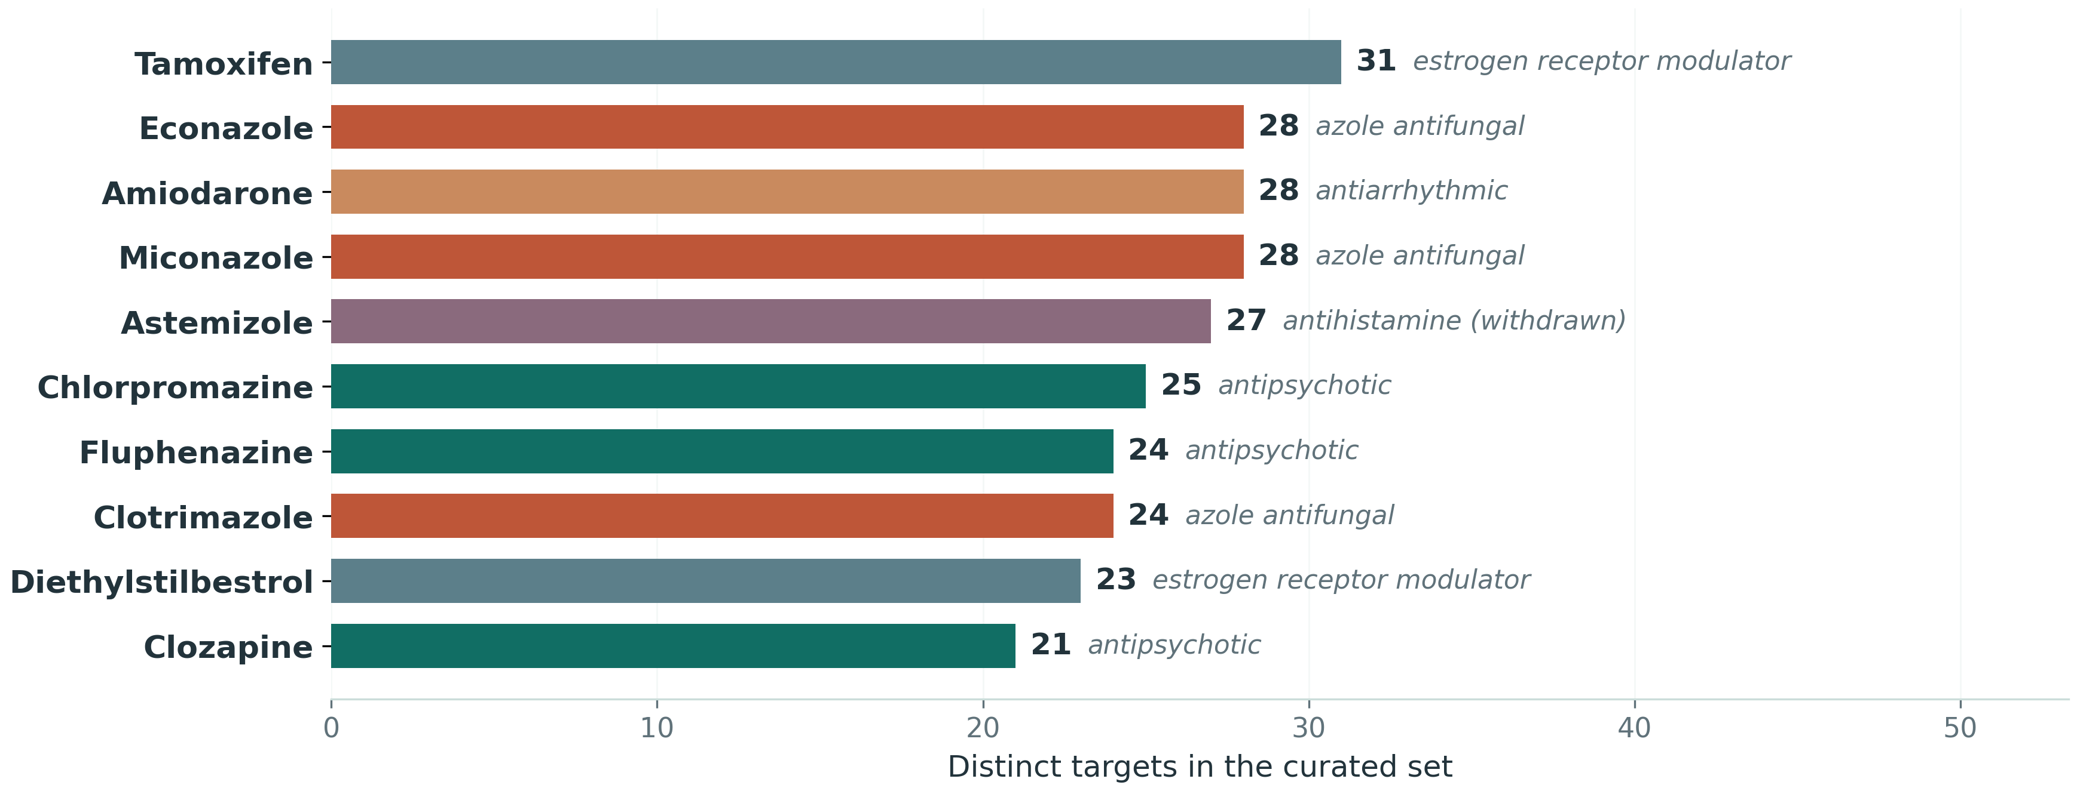
PART ONE · POLYPHARMACOLOGY
Clinical-stage ligands engage many targets
4.19
targets per molecule (median 2, max 31)
64.7%
act on more than one target
Why this matters twice
Promiscuity crosses family boundaries: 1.89 families per molecule on average (max 11), and 38.0% act on more than one. This is the basis for the repurposing motivation, and the reason for the later robustness check that removes multi-target compounds and retrains.
MSc Molecular & Medical Biotechnology · University of Verona
5
Notes:
A defining property of a clinically curated set is that its compounds are extensively polypharmacological, which follows directly from selecting on clinical status rather than single-target potency. Across the 719 molecules the mean is 4.19 distinct targets, median 2, maximum 31, and 64.7% hit more than one target. Promiscuity crosses family boundaries too: 1.89 families on average, and 38% act on more than one family. This matters twice: it is the basis for repurposing, and it is why I later remove promiscuous compounds and retrain as a robustness check.

Slide 7
PART ONE · DESCRIPTORS
What we measured on every molecule
Fifteen descriptors were computed for every curated compound with RDKit: eleven physicochemical and structural properties, plus four composite efficiency metrics derived from them and the measured affinity.
Physicochemical and structural (11)
Efficiency metrics (4)
MW · LogP · LogS · TPSA · HBA · HBD · RotB · HAC · RingCount · Fsp³ · HalogenCount
Size, lipophilicity, solubility, polarity, flexibility and shape: the properties that govern whether a molecule is orally bioavailable and CNS-penetrant.
QED · LE · LLE · LELP
Derived from the descriptors above together with the measured pKi, so potency is judged relative to size and lipophilicity rather than on its own.
These fifteen are interpretable, and they are what Part One analyses. For modelling, the same idea is scaled up: ~200 normalised descriptors, plus a structural fingerprint.
15 descriptors → ~200 for the models
MSc Molecular & Medical Biotechnology · University of Verona
6
Notes:
Everything in Part One rests on this panel. Fifteen descriptors computed with RDKit for every curated compound. Eleven are physicochemical and structural: molecular weight, LogP, LogS, polar surface area, hydrogen-bond acceptors and donors, rotatable bonds, heavy-atom count, ring count, fraction of sp3 carbons, and halogen count. Four are composite efficiency metrics built from those plus the measured affinity: QED, ligand efficiency, lipophilic ligand efficiency, and LELP. These are the interpretable ones, and they are what the next two slides analyse. Hold on to this number, fifteen, because in Part Two the same idea is scaled to about 200 normalised descriptors plus a 2,048-bit fingerprint. That is the bridge between the two halves of the thesis.

Slide 8
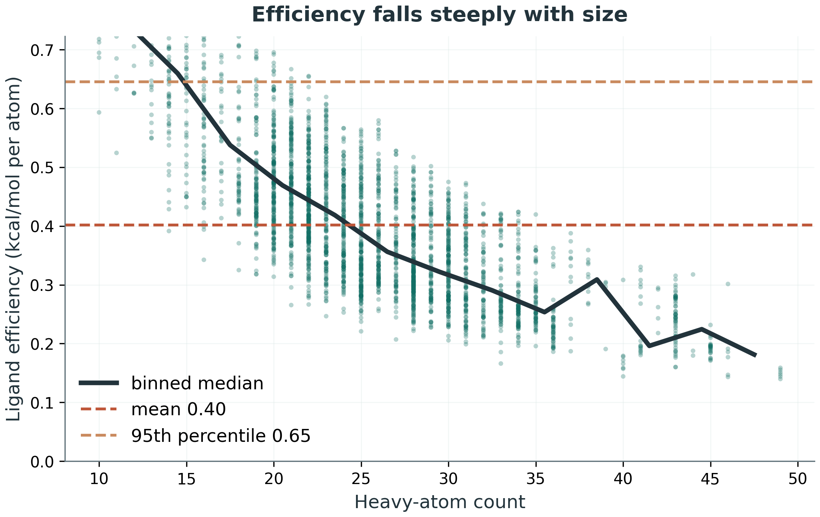
PART ONE · PROPERTIES
Is the potency earned, or bought with size?
Raw potency is easy to buy: add atoms, add grease, affinity rises. Ligand efficiency asks the harder question, binding energy per heavy atom.
0.52 → 0.24
ligand efficiency, smallest compounds vs largest
6.66 → 6.51
median pKᵢ across the very same range
Fifteen extra heavy atoms bought nothing. Spearman rho -0.77.
MSc Molecular & Medical Biotechnology · University of Verona
7
Notes:
This slide has to earn its place, so I start with the question rather than the plot. Raw potency is easy to buy: add atoms, add grease, and affinity goes up. So the first thing to ask of any potency dataset is whether the potency was earned or purchased. Ligand efficiency answers that, because it is binding energy per heavy atom, 1.37 times pKi divided by heavy-atom count. On the left, affinity against size, and the dashed diagonals are iso-efficiency contours: every compound on one line has the same efficiency whatever its size. Most of the set sits between 0.2 and 0.5, which is the normal band for optimised drugs. On the right, efficiency falls steeply with size, Spearman rho minus 0.77. And here is the number that makes it concrete. Compare compounds with twenty or fewer heavy atoms against those with thirty-five or more: median ligand efficiency drops from 0.52 to 0.24, less than half, while median potency is 6.66 against 6.51, essentially identical. Those extra fifteen heavy atoms bought nothing. That is why efficiency rather than raw potency is the right optimisation target. If asked about the clipped axis: the axis is clipped at the 95th percentile, 0.645, not the data. Every compound is still in the analysis and in the correlation.

Slide 9
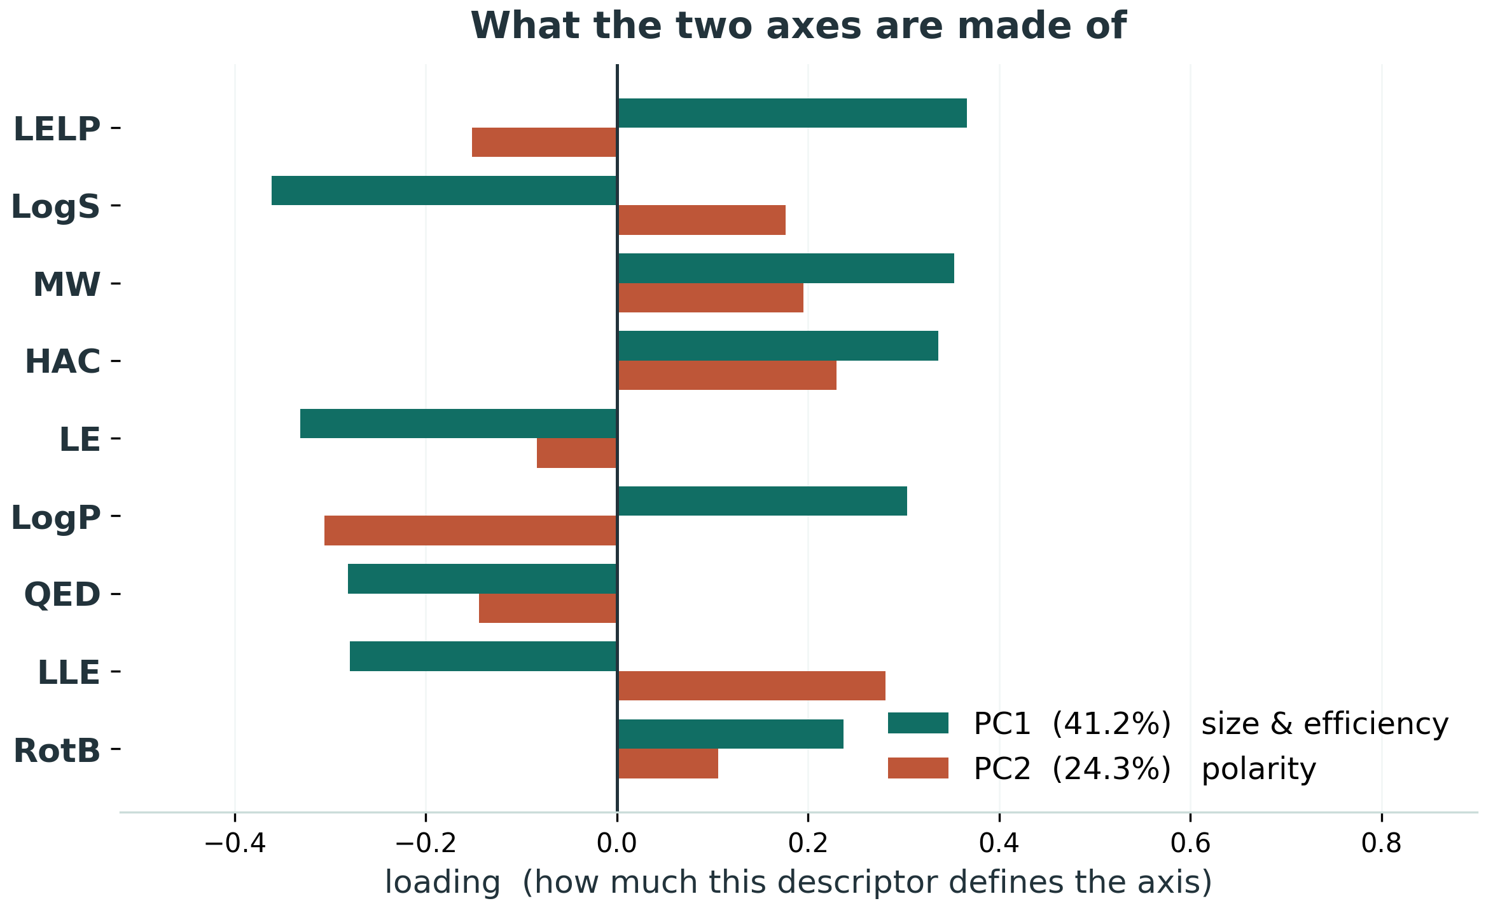
PART ONE · DESCRIPTOR SPACE
What the descriptor space actually looks like
65.5%
of all descriptor variance sits in just two components; four reach 80%
And no phase signal
Clinical phase does not meaningfully separate: effect sizes 0.005 and 0.02, where 0.06 would only count as small.
PC1 is the same size-efficiency trade-off as the previous slide, found without being asked for. Positive on LELP, molecular weight and heavy atoms; negative on solubility, ligand efficiency and QED.
MSc Molecular & Medical Biotechnology · University of Verona
8
Notes:
A PCA on the standardized descriptors, at record level. Two components carry 65.5 per cent of the variance and four reach eighty, so the descriptor space is low-dimensional. PC1, 41.2 per cent, is a size and efficiency axis; PC2, 24.3 per cent, is polarity. Now the caveat I would raise myself rather than wait for it. Three of the fifteen descriptors, ligand efficiency, LLE and LELP, are computed from pKi, so this is not purely a chemical space: PC1 correlates with affinity at minus 0.27. I therefore repeated the analysis on the eleven purely structural descriptors, where that correlation falls to minus 0.02, and the conclusion is unchanged. Clinical phase does not meaningfully separate. It is statistically detectable at this sample size, but the effect sizes are negligible, epsilon-squared 0.005 on PC1 and 0.02 on PC2 against 0.06 for what would count as a small effect, and between 94 and 100 per cent of Phase I compounds sit inside the Phase IV range. So the honest statement is no useful discrimination rather than no separation at all, and that is exactly why the modelling moves to fingerprints instead of bulk properties.

Slide 10
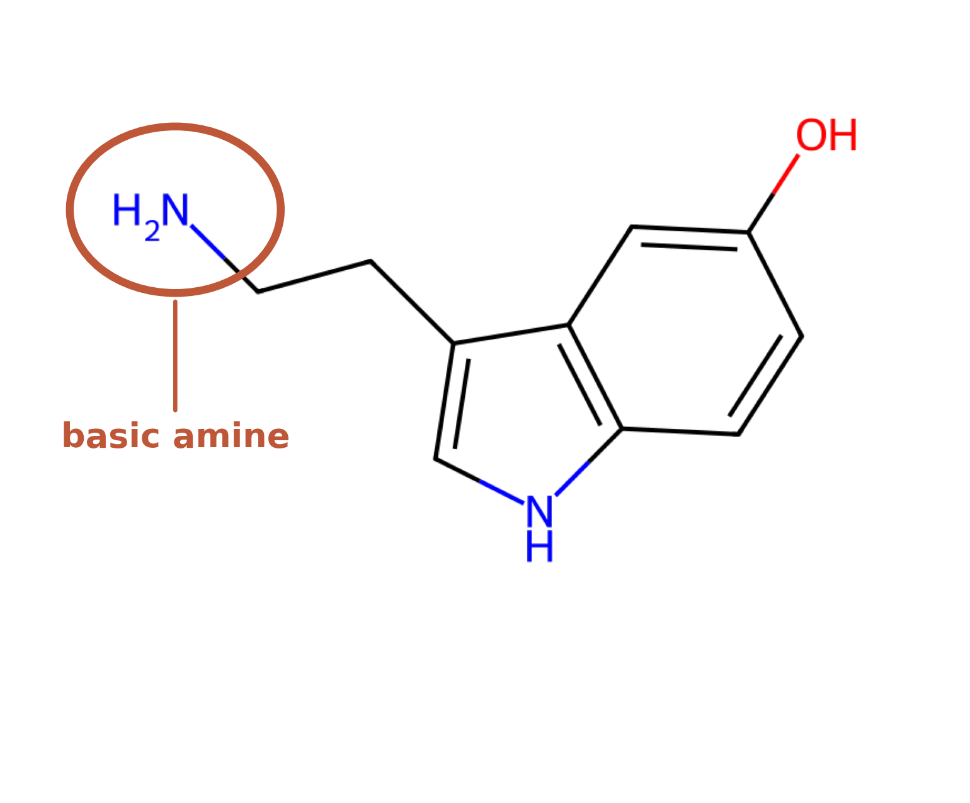
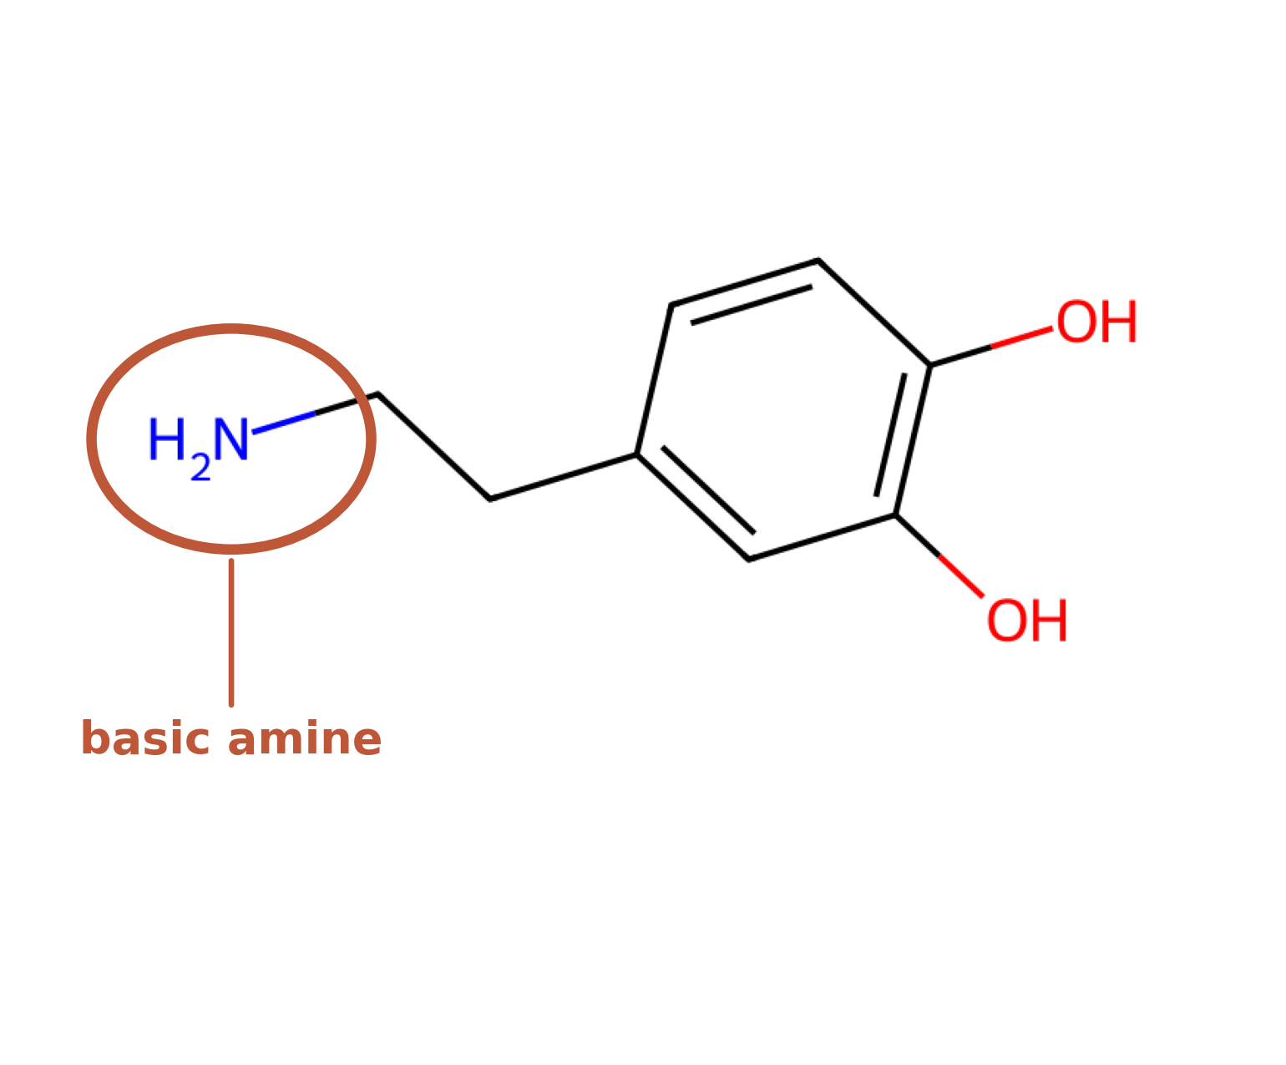
PART TWO · THE TARGETS
Two data-rich receptors, and how they reached modelling scale
Serotonin 5-HT₂A
Dopamine D₃
172 → 4,620 ligands
173 → 5,488 ligands
endogenous ligand: serotonin
endogenous ligand: dopamine
Both carry the same basic amine
Why the ~27x and ~32x expansion is fair
The circled protonatable amine forms a salt bridge to a conserved aspartate in transmembrane helix 3. That is the anchor point every ligand in the set competes for, and it is why 5-HT₂A later turns out to be charge-driven.
Only 172 and 173 clinical compounds per target: too few to train on and validate honestly. Preclinical ChEMBL compounds were added under the same curation, and whole scaffold families are still held out, so every test compound stays structurally novel.
MSc Molecular & Medical Biotechnology · University of Verona
9
Notes:
Two slides folded into one, and I will talk through most of it. These are the two receptors: serotonin 5-HT2A and dopamine D3, both data-rich aminergic GPCRs. I am showing the endogenous ligands rather than an arbitrary drug, because the receptors are named after them and because they make the word aminergic concrete. Both carry a protonatable amine, circled, which forms a salt bridge to a conserved aspartate in transmembrane helix three. That is the anchor point every ligand in my dataset competes for, and it is worth holding on to, because when we reach the interpretation slides 5-HT2A turns out to be driven by charge and electrostatics. Now the arrows, and I want to be upfront about this because my title says clinical-stage. The curated clinical set gives only 172 and 173 compounds for these two targets, too few to train on and validate honestly at the same time. So each was extended with preclinical ChEMBL compounds under the same metadata-based curation rules, roughly 27-fold for 5-HT2A and 32-fold for D3, reaching 4,620 and 5,488. The critical point is that the scaffold split still holds out whole scaffold families, so every test compound remains structurally novel to the model. A fair expansion, not a shortcut, and it is what took R-squared from about 0.3 to about 0.6. If asked whether the preclinical set occupies the same chemical space: 84 and 87 per cent of the added compounds fall inside the clinical region, median nearest-clinical Tanimoto 0.33, so related but not redundant. There is a real offset of 0.7 and 1.1 standard deviations, and it is coherent, because everything that shifts is size, polarity or three-dimensionality while LogP does not move at all.

Slide 11
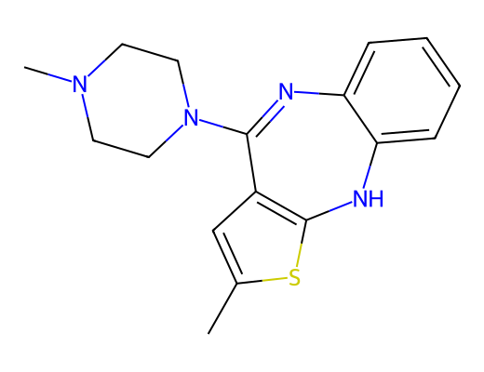
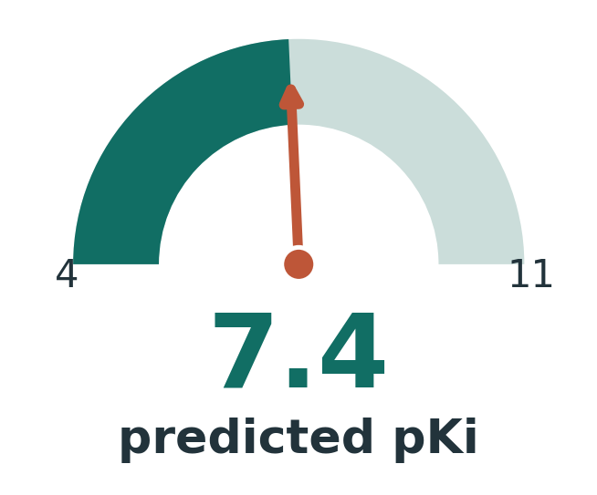
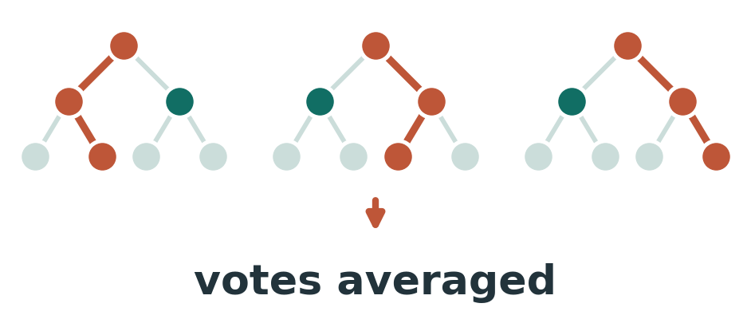
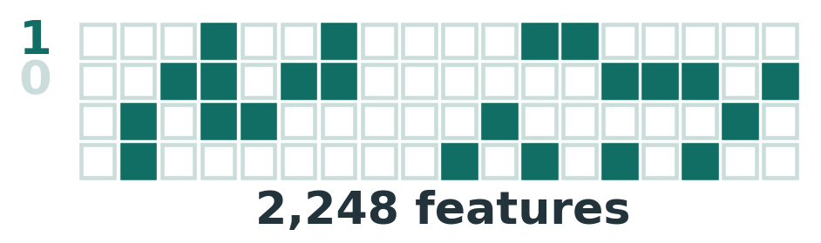
THE TASK
From a molecule to a predicted affinity
Molecule
Features
Model
Predicted pKi
→
→
→
A model is a mathematical function: it takes numbers in and returns a number. So the molecule must first be translated into numbers.
MSc Molecular & Medical Biotechnology · University of Verona
10
Notes:
BUILD: three clicks. The whole pipeline in one line. A molecule goes in as a structure, is turned into a fixed set of numbers, those go into a model, and out comes a predicted pKi. The key point, and the reason the next two slides exist: a model is just a mathematical function. It only works on numbers, it cannot read a chemical drawing. So the first real step is translating the molecule into numbers.

Slide 12
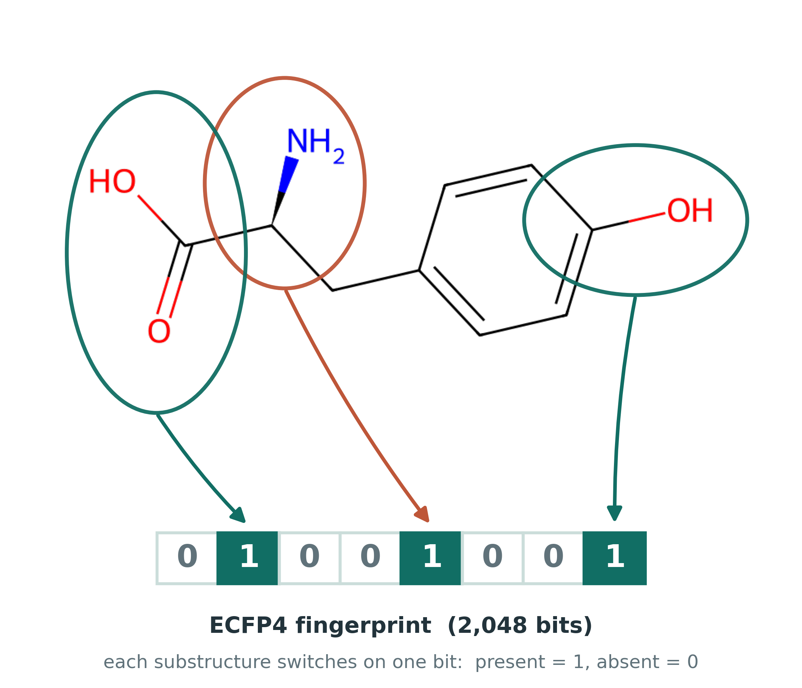
FEATURES I
ECFP4 fingerprints
Each atom local neighbourhood (out to two bonds) is a small substructure.
Every substructure is hashed into one of 2,048 slots: a fixed-length on/off barcode.
Each bit answers: is this fragment present? Similar molecules give similar barcodes.
Length is always 2,048 bits, whatever the molecule size.
Why a fingerprint at all
It turns any molecule, of any size, into the same fixed-length vector, which is the one thing a model requires.
Tyrosine: three substructures, three bits switched on. Tyrosine is also the biosynthetic precursor of dopamine.
MSc Molecular & Medical Biotechnology · University of Verona
11
Notes:
The translation has two parts. First, a fingerprint. For every atom I look at its local neighbourhood out to two bonds, a small substructure, and hash it into one of 2,048 slots. The figure shows the idea on tyrosine: circle a substructure, and it switches on one bit. Present is 1, absent is 0. Two things matter: the vector is always 2,048 bits whatever the molecule size, which is exactly what a model needs, and similar structures give similar barcodes. I use tyrosine here because it is simple enough to read at a glance, and it happens to be the biosynthetic precursor of dopamine, so it is not an arbitrary example for this target class.

Slide 13
FEATURES II
Descriptors, and the fused vector
The 15 become ~200
Fused representation
The same idea as the Part One panel, scaled up: weight, lipophilicity, polar surface area, charge and much else, from DescriptaStorus (RDKit2D, normalised). Part One used 15 interpretable descriptors; the model gets the full panel.
The 2048-bit fingerprint and ~200 descriptors are concatenated into a single 2,248-dimensional vector: the only view of each molecule the model ever sees.
2048 + 200 = 2,248
Fusion was measured, not assumed: fused beat either representation alone on 5-HT₂A (0.562 vs 0.544 fingerprint, 0.521 descriptors) and tied on D₃.
MSc Molecular & Medical Biotechnology · University of Verona
12
Notes:
The second part is about 200 physicochemical descriptors: whole-molecule properties like weight, lipophilicity, polar surface area, charge. I concatenate fingerprint and descriptors into a single 2,248-dimensional vector, and that fused vector is the only thing the model ever sees. I did compare the three options rather than assume: fusion helped modestly on 5-HT2A and tied on D3, so it was adopted as best-or-tied on both.

Slide 14
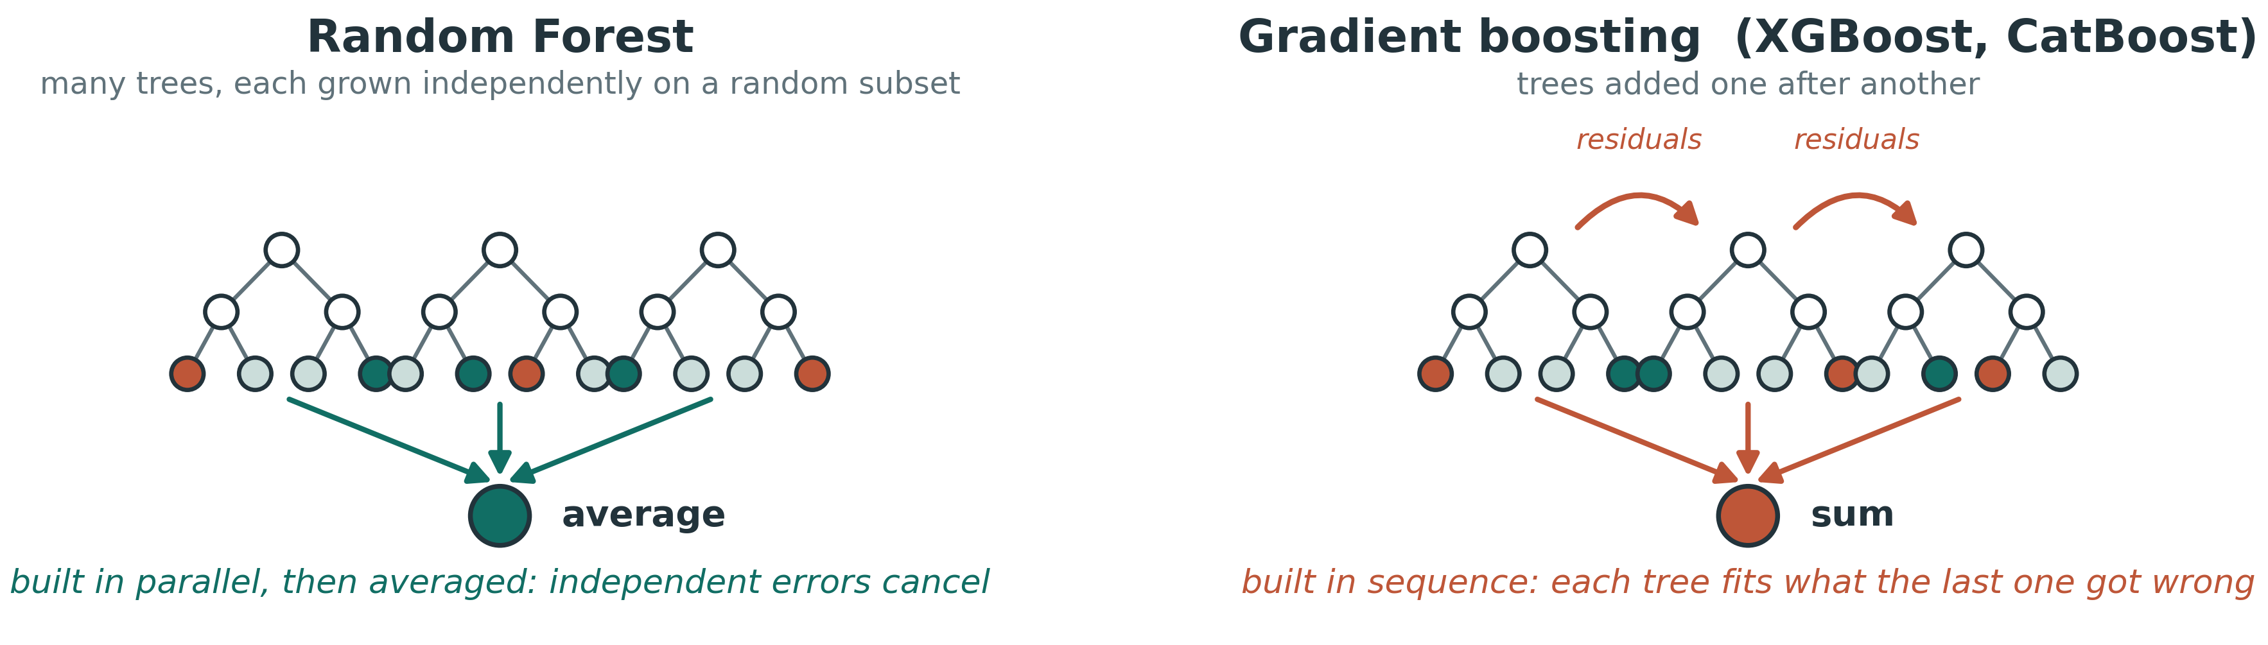
THE MODELS
Three tree ensembles
Random Forest
XGBoost
CatBoost
Hundreds of decision trees trained on random data and feature subsets, then averaged, so diverse errors cancel out.
Gradient boosting: trees added in sequence, each correcting the errors of the last.
A third gradient-boosting method, added to check the result is not specific to one learner.
MSc Molecular & Medical Biotechnology · University of Verona
13
Notes:
BUILD: four clicks, three cards then the diagram. Three tree ensembles. Random Forest builds hundreds of trees on random subsets and averages them so individual errors cancel. XGBoost and CatBoost are boosting: trees added one after another, each correcting the last one mistakes. CatBoost was added mainly to check the result is not specific to one method. I chose tree ensembles over deep learning because at this data scale they are competitive, robust and interpretable.

Slide 15
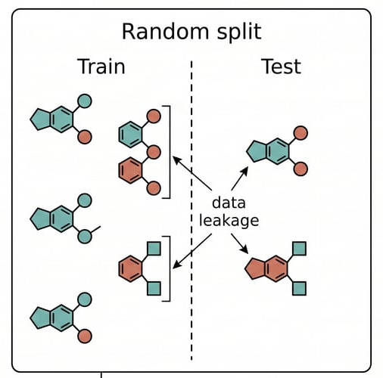
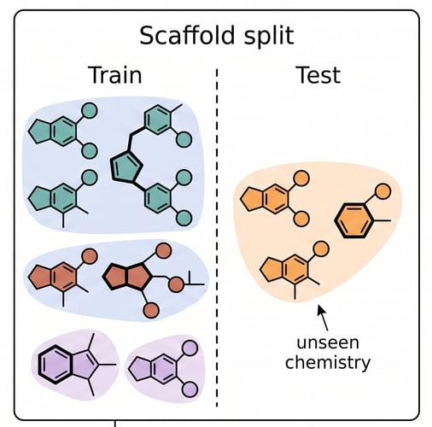
VALIDATION
The honest test: a scaffold split
1
The trap: a random split
2
The fix: a scaffold split
Near-identical analogs land on both sides, so the model "predicts" what it has already seen.
Whole scaffold families are held out, so every test compound is structurally novel.
Grouped by exact Murcko scaffold, not by similarity clustering. Whole groups are shuffled onto one side, repeated over 12 partitions: no scaffold appears on both.
MSc Molecular & Medical Biotechnology · University of Verona
14
Notes:
The part I care most about, so I slow down here. The obvious test is a random train-test split, but it is misleading on this kind of data. Medicinal chemistry datasets are full of analogue series, dozens of variations on one core, so a random split scatters near-identical analogues across both sides and the model recognises what it has effectively already seen. The score looks excellent and it is inflated. The fix is to split by family. A scaffold is the core skeleton: strip every side chain and keep the ring system and the linkers between rings. Whole scaffold families are held out together, so every test compound is chemistry the model has genuinely never seen. The score drops, and that drop is the entire point. Concretely: grouping is by exact Bemis-Murcko scaffold, whole groups assigned to one side, repeated over 12 randomised 80/20 partitions, mean reported with a confidence interval. IF ASKED WHETHER THIS IS A SIMILARITY-BASED SPLIT, and it is the most likely technical question of the talk, the answer is no and I should be precise. Molecules are grouped by their exact Murcko scaffold string and whole groups go to one side. It is not Butina or Tanimoto clustering. The honest consequence is that two chemically similar but formally different scaffolds could in principle sit on opposite sides. That is exactly why I also report the nearest-neighbour read-across baseline: copying the affinity of the single most Tanimoto-similar training compound is precisely the strategy that would exploit any residual similarity, and the models beat it by about 0.2 R-squared, 0.347 to 0.562 and 0.435 to 0.644. So whatever leftover similarity exists, it is not what drives the result. AND I DID RUN THE STRICTER SPLIT, so I should not offer it as future work. I repeated the classification task with compounds grouped into single-linkage connected components at 0.60 Tanimoto, which guarantees the separation by construction; I used connected components rather than Butina because Butina clusters are not transitively closed, so two compounds above the threshold can land in different clusters and the split does not actually enforce what it promises. Under that harsher partition MCC roughly halves, 0.632 to 0.328 and 0.633 to 0.296. For D3 the model still beats read-across, 0.296 against 0.234, winning 11 of 12 splits, p equals 0.016. For 5-HT2A it does not, 0.328 against 0.331, p equals 0.73. That is in the thesis, section 3.5.9, and I would rather state it than be asked for it.

Slide 16
RESULTS
Regression performance
R² 0.56 / 0.64
5-HT₂A 0.56 · D₃ 0.64. The share of the spread in affinity the model explains. 1 = perfect, 0 = guessing the average.
RMSE 0.81 / 0.76
5-HT₂A 0.81 · D₃ 0.76 pKᵢ units — the typical miss. About 1.6× and 1.5× the 0.5-unit lab-to-lab noise floor.
Random Forest (5-HT₂A 0.53, D₃ 0.63) and CatBoost (0.56, 0.64) land in the same place: performance is set by the data and representation, not the learner.
MSc Molecular & Medical Biotechnology · University of Verona
15
Notes:
The headline results. The best model, fused features with XGBoost, reaches a scaffold-split R-squared of 0.56 for 5-HT2A and 0.64 for D3, with a scaffold-split RMSE of 0.81 and 0.76 log units, about 1.6 and 1.5 times the experimental noise floor of the data itself. Note this is the scaffold RMSE, measured over the same 12 splits; the 0.68 to 0.70 figures elsewhere are the ten-fold cross-validation RMSE and are not comparable. The bars show the honest scaffold score against the more optimistic cross-validation score. Random Forest and CatBoost land in the same place, so performance here is set by the data and the representation, not by which learner I pick.

Slide 17
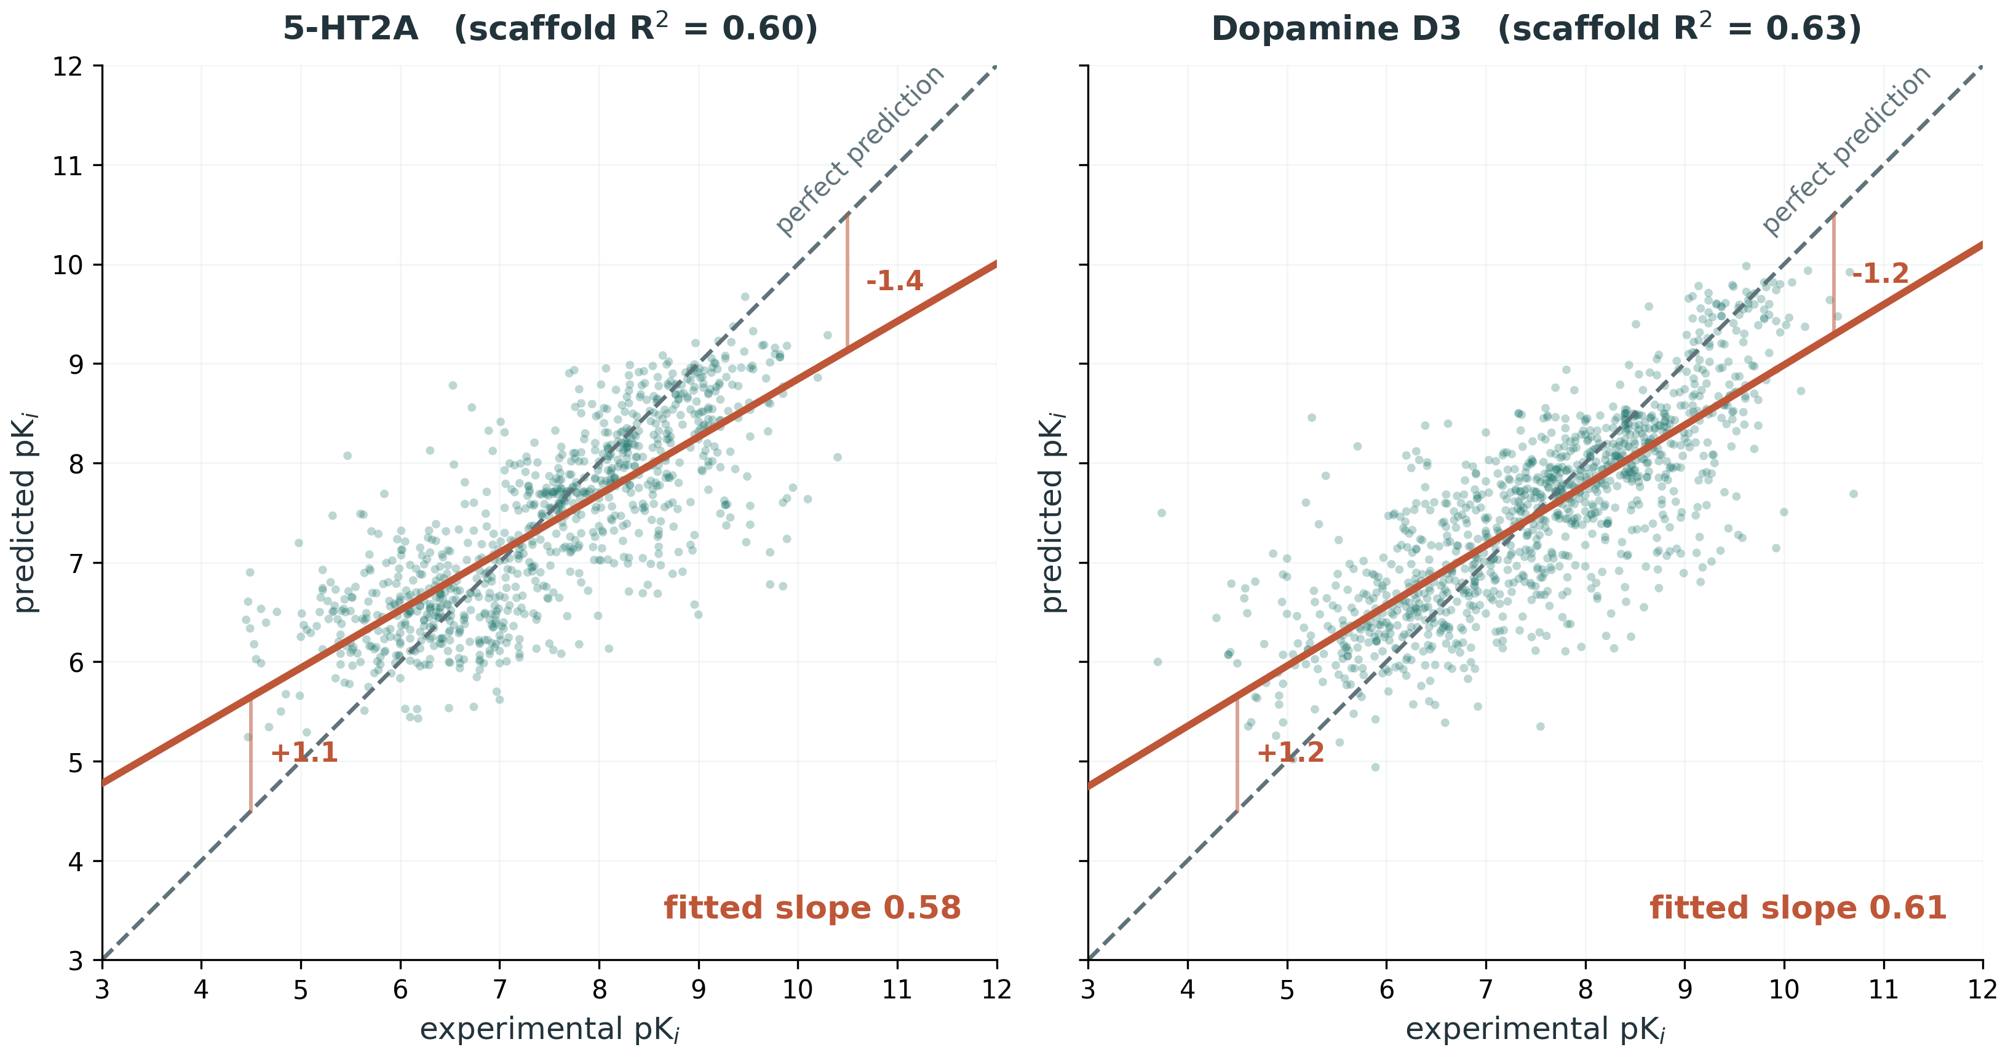
RESULTS
Predicted versus experimental
Held-out predictions, scaffold split, both targets on identical axes.
The fitted line has slope 0.58 and 0.61, not 1. Weak binders are over-predicted by about a log unit, strong binders under-predicted by the same. Ranking is reliable; absolute values are conservative at the potent end.
MSc Molecular & Medical Biotechnology · University of Verona
16
Notes:
Predicted against measured pKi on held-out compounds, both targets on identical axes. The grey dashed line is perfect prediction. The solid line is the actual fit through the points, and the gap between them is the whole message. That fitted slope is 0.58 for 5-HT2A and 0.61 for D3, not 1. What that means concretely: a compound whose real pKi is 5 gets predicted at about 6, over-predicted by roughly a log unit, and a compound whose real pKi is 9.5 gets predicted at about 8.5, under-predicted by roughly the same. The predicted spread is 74 and 76 per cent of the measured spread. This is regression to the mean under a leakage-controlled split rather than a defect: predicting near the average is the safest way to minimise average error, so the model is deliberately cautious at the extremes. The practical consequence, and I would volunteer it: the ranking is reliable, which is what the enrichment result shows, but absolute predicted values are conservative at the potent end. Held-out n is 949 and 1,131.

Slide 18
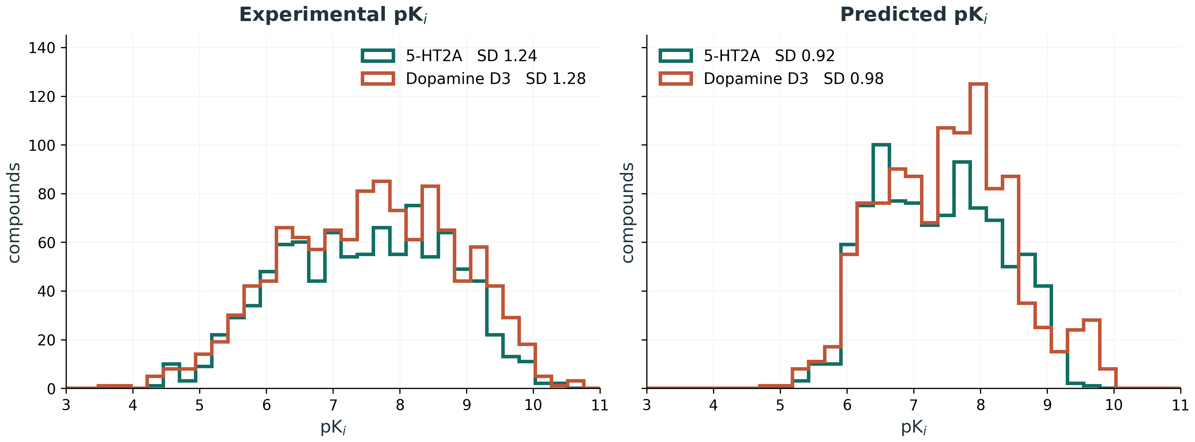
RESULTS
The predicted spread is narrower than the data
Held-out compounds, scaffold split, identical bins and axes on both panels.
SD 1.24 and 1.28 measured, 0.92 and 0.98 predicted. About three quarters of the real spread is retained. For screening this matters in one direction: the ranking is reliable, but the top of the list is less extreme than reality, so absolute predictions are conservative at the potent end.
MSc Molecular & Medical Biotechnology · University of Verona
17
Notes:
Two histograms on identical bins and axes, so the comparison is direct rather than asserted. On the left, the experimental pKi of the held-out compounds. On the right, what the model predicted for those same compounds. The measured distribution runs from about 3.5 to 11; the predicted one is squeezed into roughly 5 to 10. Numerically, standard deviation 1.24 and 1.28 measured against 0.92 and 0.98 predicted, so about 74 and 76 per cent of the real spread survives. This is regression to the mean under a leakage-controlled split, and it is expected: predicting near the average is the safest way to minimise average error, so the model is deliberately cautious at the extremes. It is the same finding as the parity slope, seen a second way: the slope said the line is too flat, this says the histogram is too narrow. The consequence carries into the screening section later, where the model will rarely commit to a very high predicted affinity, so absolute values at the potent end should be read as conservative. If asked why there is no enrichment curve in the deck, the enrichment number and its ceiling are quantified later on the screening metrics slide, and this comparison says more.

Slide 19
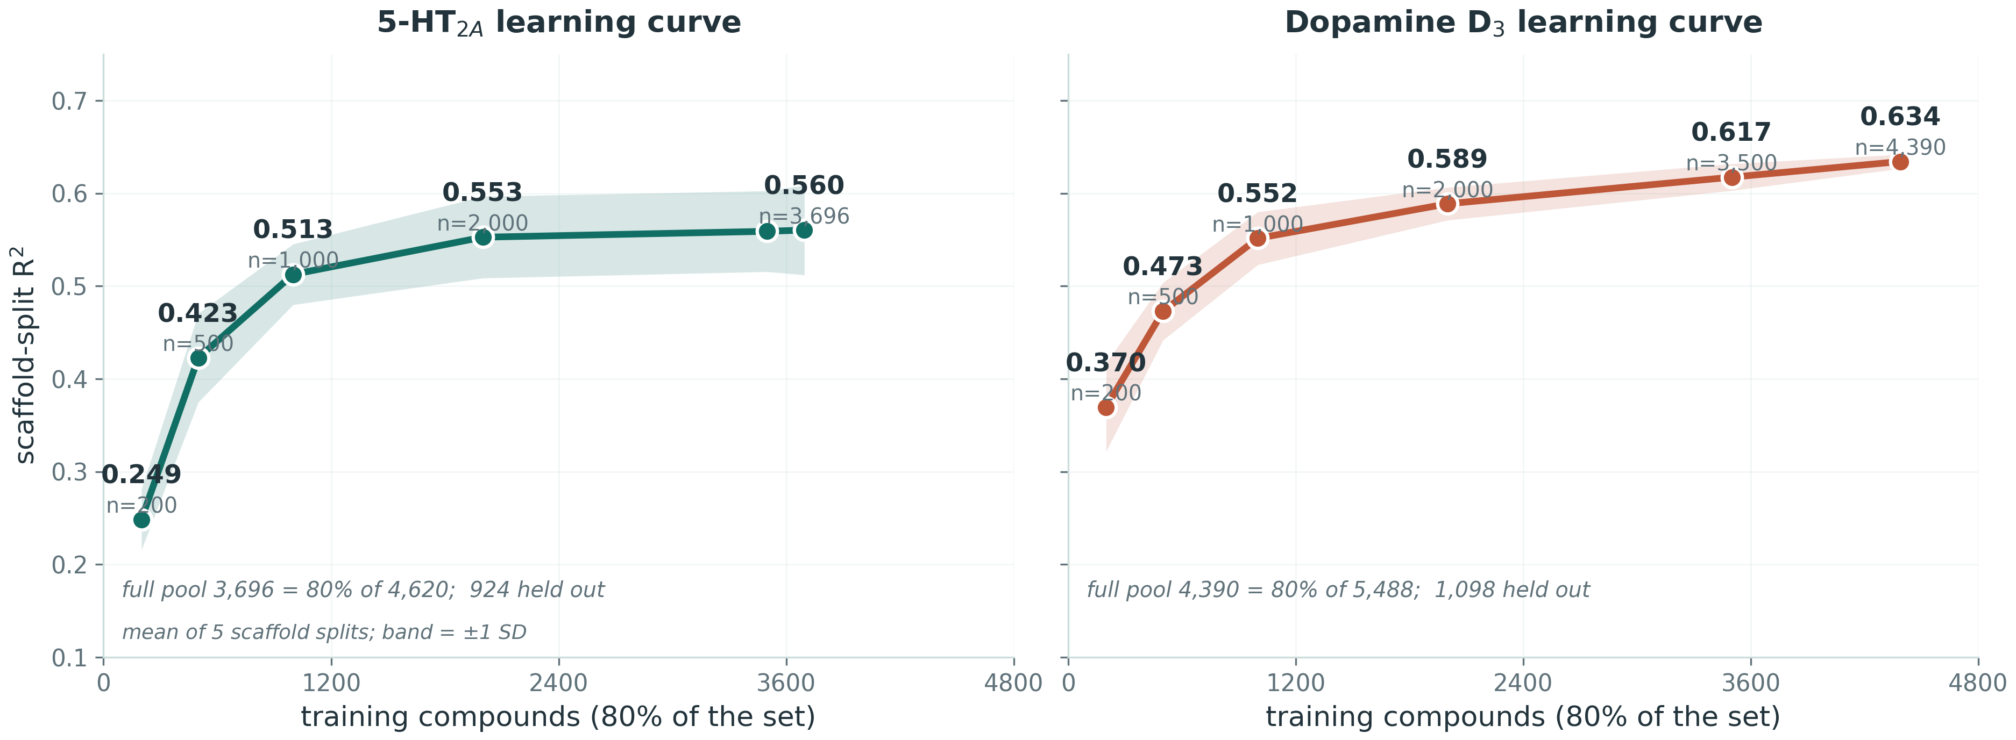
THE GAIN IS REAL
Learning curve
Both panels on identical scales. R² climbs steeply, then flattens against the single-target ceiling; the gain is data-driven.
MSc Molecular & Medical Biotechnology · University of Verona
18
Notes:
The evidence that the gain is genuinely data-driven. The two panels are on identical scales, x to 4,800 and y from 0.10 to 0.75 on both, so the curves can be compared directly. Every point carries its R-squared and its actual training-set size, so nothing has to be read off the axis. IF ASKED WHY THE CURVE STOPS AT 3,696 AND 4,390 WHEN THE SETS ARE 4,620 AND 5,488: the x axis is the training pool, which is 80 per cent of each set. The other 20 per cent, 924 and 1,098 compounds, is the held-out test set that every R-squared on this figure is measured on. It is noted on the figure itself. As the training set grows, R-squared climbs from 0.249 at 200 training compounds to 0.560 at the full 3,696 for 5-HT2A, and from 0.370 to 0.634 at 4,390 for D3, with sharply diminishing returns. Each point is a mean over five scaffold splits and the shaded band is one standard deviation, so the scatter is visible rather than hidden. Two things to draw out. First, D3 sits above 5-HT2A at every matched training size, not just at the end, which says the D3 structure-activity relationship is easier to learn rather than that it merely had more data. Second, the plateau is the model approaching the ceiling reachable from single-target data at this representation, so adding more of the same data would not help much from here; exceeding it needs multitask learning or structural information. The flat tail is the useful part: for 5-HT2A the first thousand compounds buy 0.264 of the total 0.311 gain and the last 1,696 add 0.007, so more of the same data would not help. D3 is still climbing slightly at the full pool, which fits its larger and smoother set.

Slide 20
REPRESENTATION
Was fusing the two worth it?
The three representations were compared directly, so the value of combining them was measured rather than assumed. Scaffold-split R², XGBoost.
5-HT₂A: fusion helps
Fingerprint and descriptors carry partly independent signal, so combining them adds a little: 0.544 and 0.521 alone, 0.562 fused.
D₃: fingerprint is enough
The fingerprint alone already captures almost everything (0.639); fusion adds essentially nothing (0.644).
Fused was adopted throughout as the best-or-tied choice on both targets.
MSc Molecular & Medical Biotechnology · University of Verona
19
Notes:
A question worth answering rather than assuming: was fusing the two representations worth it? For 5-HT2A the fused representation is best at 0.562, just ahead of the fingerprint alone at 0.544 and the descriptor panel alone at 0.521, so the two feature types carry partly independent signal and combining them helps modestly. For dopamine D3 the fingerprint alone already captures almost everything at 0.639, and fusion adds essentially nothing, 0.644. So fused was adopted throughout as the best-or-tied choice on both targets. Note the descriptor panel alone is the weakest of the three on both targets: whole-molecule properties matter, but substructure matters more.

Slide 21
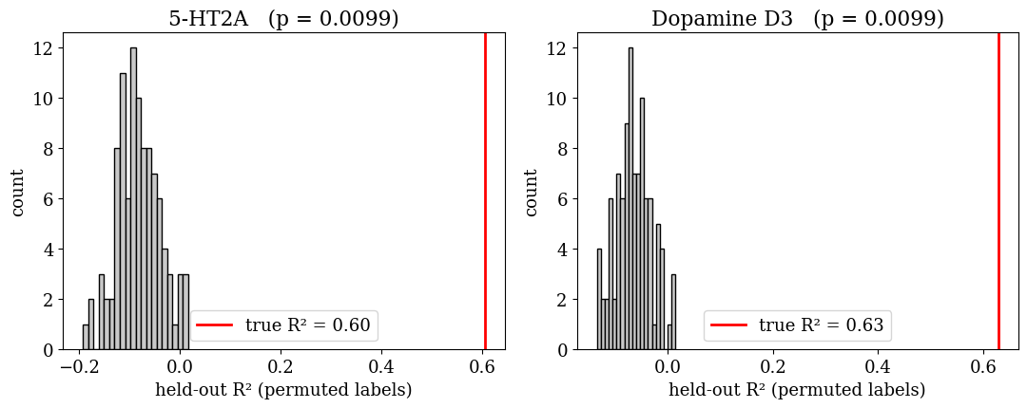
CONTROL I
Is the signal real, or chance fitting?
p = 0.0099
What this rules out
If the models were fitting noise, shuffling the labels would leave performance roughly unchanged. Instead R² collapses to a null centred below zero (mean -0.08 and -0.07, best case 0.02), far from the true 0.60 and 0.63 on this split. No permutation ever reaches it.
over 100 permutations, both targets
MSc Molecular & Medical Biotechnology · University of Verona
20
Notes:
The first control asks whether the performance reflects real structure-activity signal or chance fitting. I permuted the training labels 100 times and refitted, for each target. If the model were fitting noise, shuffling the labels would leave it roughly unchanged. Instead the held-out R-squared collapses to a null distribution centered well below zero, mean minus 0.08 and minus 0.07, with a maximum of 0.02, far below the true values of 0.60 and 0.63 on this split. No permutation reaches the true value, giving a permutation p of 0.0099 for both targets. So the models are capturing signal, not fitting noise.

Slide 22
CONTROL II
Is it more than a similarity lookup?
The most deflating explanation for a good QSAR score is that the model has simply memorised which training compound each test compound resembles. So the models were made to beat that strategy explicitly.
The baseline: 1-NN read-across
Why it is the right baseline
Assign each test compound the pKi of its single most Tanimoto-similar training compound. No learning, pure nearest-neighbour lookup.
It is exactly what a fingerprint model could degenerate into. Beating it by a clear margin shows aggregate structure-activity is being learned.
0.35 → 0.56
0.44 → 0.64
5-HT₂A: read-across → model (R²)
D₃: read-across → model (R²)
Read-across reaches R² 0.347 and 0.435; the models beat it by roughly 0.2 R², a 48 to 62 per cent gain on both targets.
MSc Molecular & Medical Biotechnology · University of Verona
21
Notes:
The second control. The most deflating explanation for a good QSAR score is that the model has just memorised which training compound each test compound looks like. So I benchmarked against exactly that: a one-nearest-neighbour read-across, where each test compound is assigned the pKi of its most Tanimoto-similar training compound. No learning at all. That reaches R-squared of only 0.347 for 5-HT2A and 0.435 for D3. The models reach 0.562 and 0.644, so they beat the lookup by roughly 0.2 R-squared on both targets. That is the evidence that they learn aggregate structure-activity relationships rather than performing a disguised similarity search.

Slide 23
ROBUSTNESS
Not leaning on a few promiscuous drugs
A natural worry is that performance depends on a handful of well-known multi-target drugs. Removing every compound that engages five or more distinct targets and retraining leaves performance intact, indeed marginally higher. The metric below is R² from the regression models, not MCC.
R² 0.56 → 0.58
R² 0.64 → 0.67
5-HT₂A · scaffold split, regression
D₃ · scaffold split, regression
What was removed
Why it can rise
136 of 4,620 compounds for 5-HT₂A and 117 of 5,488 for D₃: every molecule recorded against five or more distinct targets.
A molecule optimised to hit many targets sits where the structure–activity relationship for any single target is weaker, so it is harder to fit. Removing them leaves a slightly cleaner signal.
Read as: the regression signal is broad-based, not carried by polypharmacological drugs. If anything they are harder to fit, so removing them leaves a slightly cleaner structure–activity signal.
MSc Molecular & Medical Biotechnology · University of Verona
22
Notes:
A natural worry is whether performance rests on a handful of promiscuous multi-target drugs, the tamoxifens and amiodarones from the polypharmacology slide. So I removed every compound hitting five or more distinct targets, 136 of 4,620 for 5-HT2A and 117 of 5,488 for D3, and retrained. R-squared did not drop; it rose slightly, 0.56 to 0.58 and 0.64 to 0.67. The regression result therefore does not depend on those compounds. If asked why removal helps rather than hurts: a molecule optimised to hit many targets sits in a region where the structure-activity relationship for any one target is weaker, so those compounds are harder to fit and removing them leaves a marginally cleaner signal. I repeated the same ablation on the classifier and it gives the same answer in MCC, 0.632 to 0.662 and 0.633 to 0.635; that is on the classification controls slide later.

Slide 24
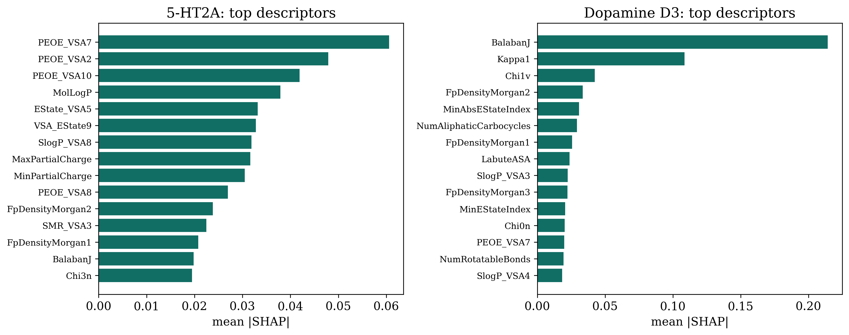
INTERPRETATION
What drives the predictions (SHAP, regression)
The two targets rely on different property families: 5-HT₂A on charge and electrostatics, dopamine D₃ on molecular shape and topology.
MSc Molecular & Medical Biotechnology · University of Verona
23
Notes:
To see what the models actually use I computed SHAP values, which attribute each prediction back to the input features. The interesting result: the two targets rely on different chemistry. 5-HT2A is driven mostly by partial-charge and electrostatic descriptors, while D3 leans on shape and topology, Balaban J, Kappa1, Chi indices. That is chemically sensible and mirrors the different binding pockets, so the models are not black boxes.

Slide 25
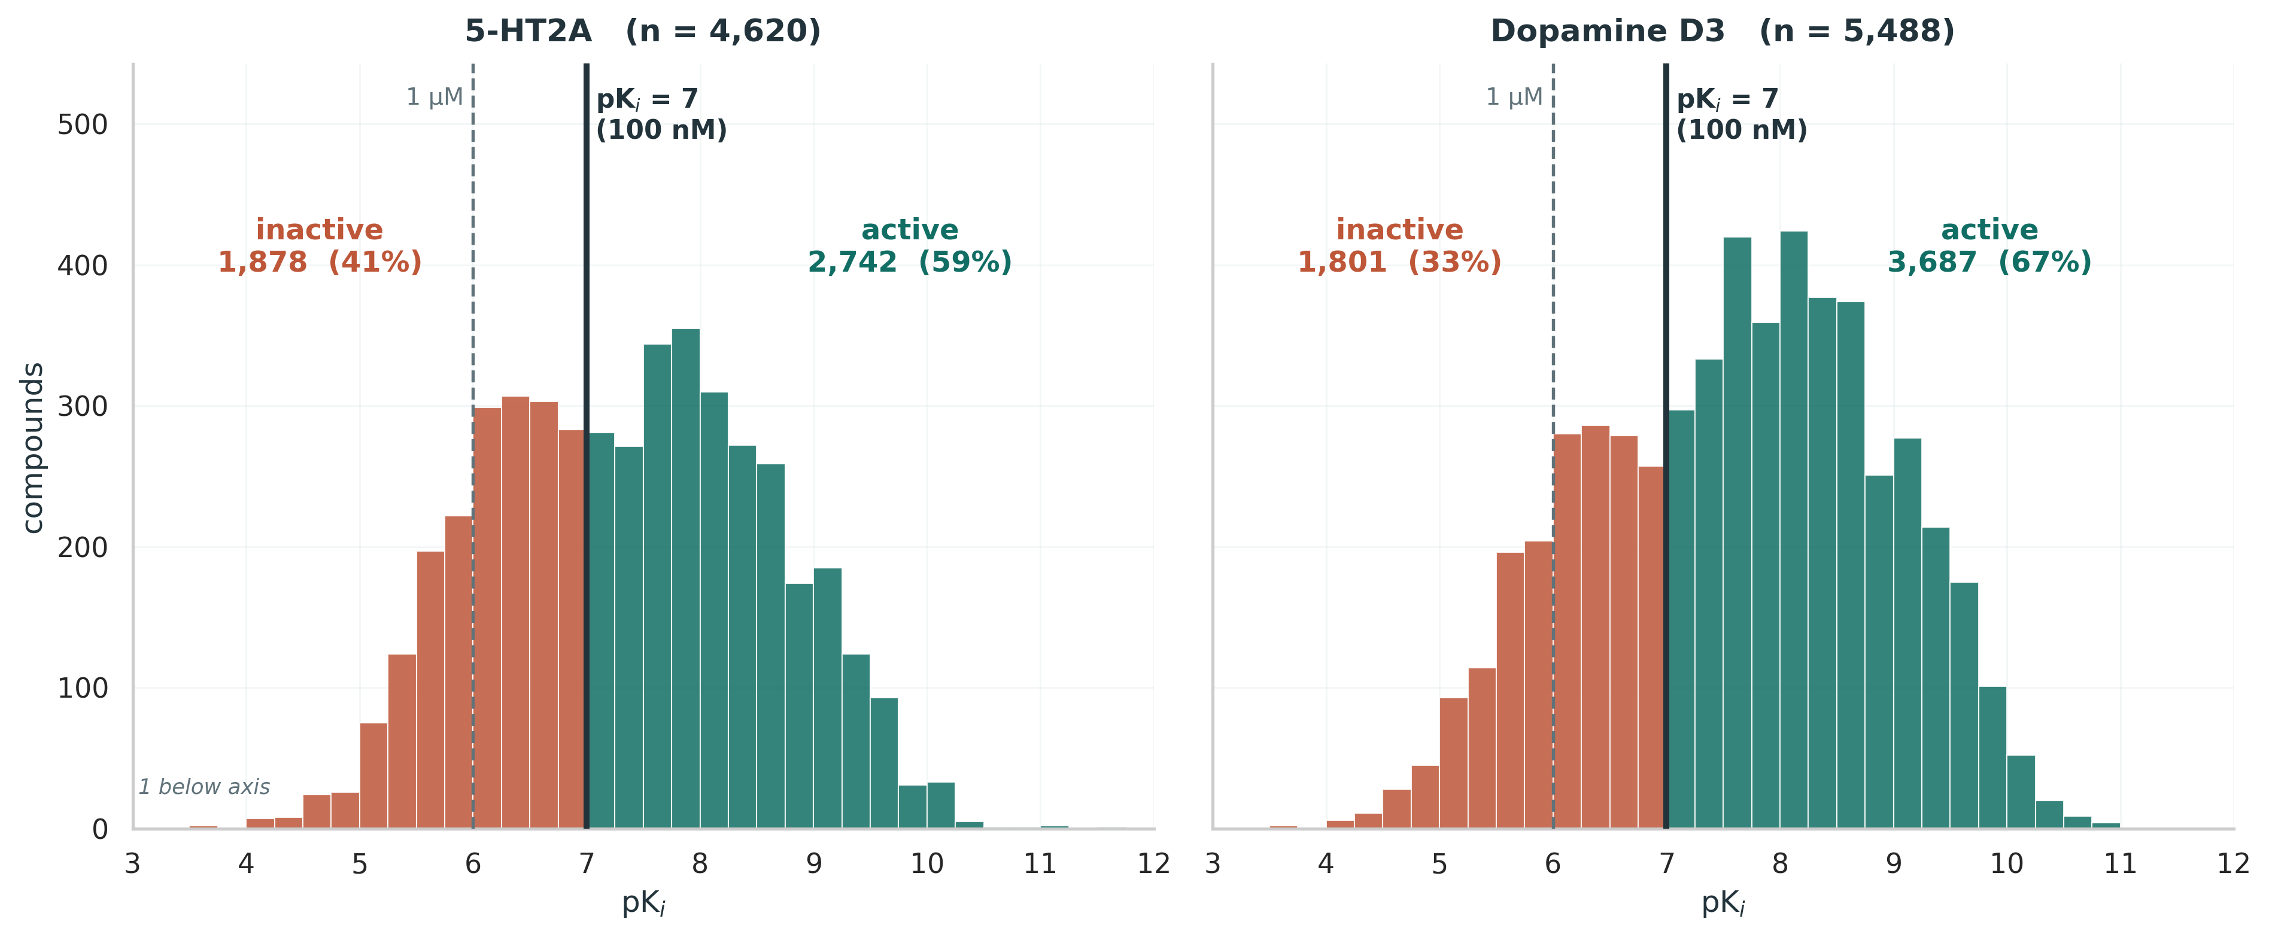
VIRTUAL SCREENING
The task: where the active/inactive line falls
Measured pKᵢ for both modelling sets, identical bins and axes. Solid line: the 100 nM cut-off used for the labels. Dashed: the 1 µM alternative.
100 nM splits the library 59/41 and 67/33. At 1 µM it would be 85 and 87 per cent active, and MCC falls from 0.63 to 0.35 and 0.43 — too few inactives left to learn a boundary from. The threshold is a modelling decision, and this is the evidence for it.
MSc Molecular & Medical Biotechnology · University of Verona
24
Notes:
This is the slide that defines the task, and it should come before any score. Every compound in the set is a measured binder, so I am not separating binders from non-binders; I am separating potent from weak. The cut is at 100 nanomolar, a pKi of 7, drawn as the solid line. That gives 2,742 active against 1,878 inactive for 5-HT2A, 59 to 41 per cent, and 3,687 against 1,801 for D3, 67 to 33. Near-balanced, which is what makes MCC a meaningful number rather than a formality. Now the obvious question, and I would rather answer it before it is asked: why 100 nanomolar and not 1 micromolar, which is the more common screening cut-off. The dashed line is 1 micromolar. On this library it leaves 85 and 87 per cent of compounds on the active side, because almost everything here is at least a micromolar binder, and the measured consequence is that MCC drops from 0.635 to 0.346 for 5-HT2A and from 0.632 to 0.426 for D3. So the threshold is not arbitrary and it is not tuned to flatter the result. It is the cut-off at which this library actually contains two classes.

Slide 26
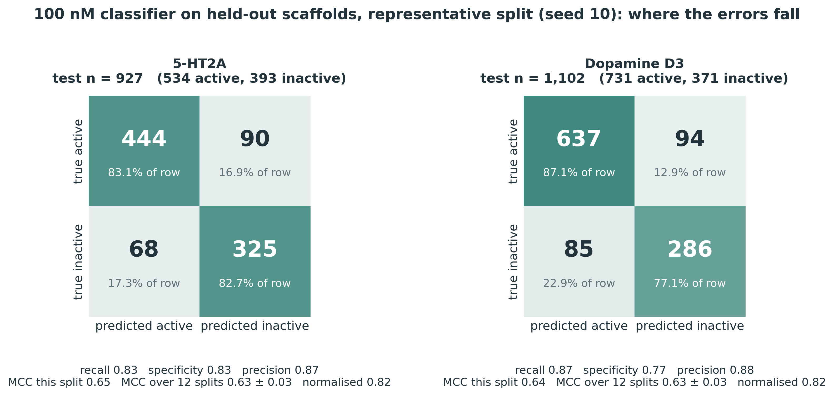
VIRTUAL SCREENING
The classifier itself, not a summary of it
Held-out scaffolds, representative split (seed 10, the split closest to the 12-split median). Probability threshold 0.5.
Errors are balanced, not one-sided. 5-HT₂A recall 0.83 and specificity 0.83; D₃ recall 0.87 and specificity 0.77. The model is not buying its score by calling everything active — which is exactly what MCC on the next slide is designed to detect.
MSc Molecular & Medical Biotechnology · University of Verona
25
Notes:
Here is the classifier itself rather than a summary of it. Read the top-left cell of each panel: for 5-HT2A, 444 of the 534 true actives were found, and 325 of the 393 true inactives correctly rejected, with 68 false alarms and 90 missed. For D3, 637 of 731 actives found, 286 of 371 inactives rejected. This is one representative split, and I want to be precise about what representative means: the seed was chosen as the one minimising distance to the twelve-split median MCC, not the best of twelve. Its MCC is 0.65 and 0.64, against twelve-split means of 0.63 and 0.63, so it is a fair picture rather than a flattering one. The thing to point at is the balance. Recall and specificity are both about 0.83 for 5-HT2A. For D3 recall is 0.87 and specificity 0.77, so it is slightly more willing to call something active, which follows from D3 being 67 per cent active to begin with. Every metric on the next slide is computed from these four numbers, so if anyone doubts a metric they can recompute it from this table.

Slide 27
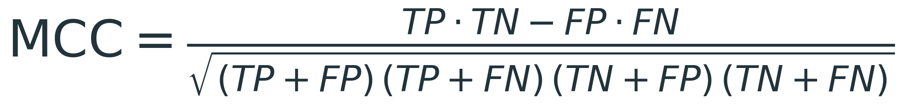
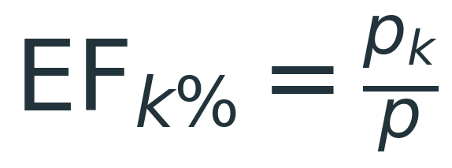
VIRTUAL SCREENING
What the screening metrics actually measure
At a 100 nM cut-off the models predict a category rather than a number. Two metrics, and both need their definition to mean anything.
MCC · 0.635 and 0.632 (normalised 0.82)
Enrichment factor · 1.67 and 1.46
Accuracy lies when one class dominates: this library is 59% and 67% active, so always answering "active" scores 59% and is useless. MCC uses all four cells of the confusion matrix, so it only rises when both classes are called correctly. It runs −1 to +1; rescaled to 0–1 the value is 0.82, which is the fair comparison against an R².
Rank the library by predicted affinity, take the top 1%, and ask how much richer in true actives it is than the library overall. 1.0 is random ranking. The ceiling is 1 over the active fraction: 1.69 and 1.49 here, so this sits at 98% of the maximum achievable.
Said plainly, and unprompted: every compound here is a measured binder, so this separates potent binders from weaker binders, not binders from non-binders. A true screen needs inactive data the dataset does not contain. ROC-AUC is 0.92, but on a majority-active library it flatters any model, so I do not lead with it.
MSc Molecular & Medical Biotechnology · University of Verona
26
Notes:
Having finished the regression results, I now recast the same models as a classifier, because that is closer to how they would actually be used. Filippo asked me to say what the metrics are rather than put numbers on a screen, so this slide leads with definitions. MCC first. Accuracy is misleading when one class dominates, and my library is 59 and 67 per cent active at the 100 nanomolar cut-off, so a model answering active every single time scores 59 per cent accurate and is completely useless. The Matthews correlation coefficient uses all four cells of the confusion matrix, so it only goes high when both classes are called correctly. Plus one perfect, zero chance, minus one perfectly wrong. Ours is 0.635 and 0.632 over twelve scaffold splits, and all three learners agree within about 0.03. Enrichment factor second. Rank the library by predicted affinity, take the top one per cent, and ask how much richer in true actives that slice is than the library as a whole. One means random ranking. Ours is 1.67 and 1.46, and this is the number people misread, so give the ceiling immediately: the maximum achievable is one divided by the active fraction, 1.69 and 1.49 here, so we are at about 98 per cent of the theoretical maximum, not at a mediocre 1.67. Then the caveat, volunteered: every compound in this set is a measured binder, so this separates potent binders from weaker binders, not binders from non-binders. A genuine binder-versus-decoy screen would need inactive data my dataset does not contain. ROC-AUC is 0.92 for both targets and it is in my results, but I do not lead with it because on a majority-active library it flatters any model. If asked for the confusion matrix, it is on the previous slide: for 5-HT2A, 444 true positives, 68 false positives, 90 false negatives, 325 true negatives.

Slide 28
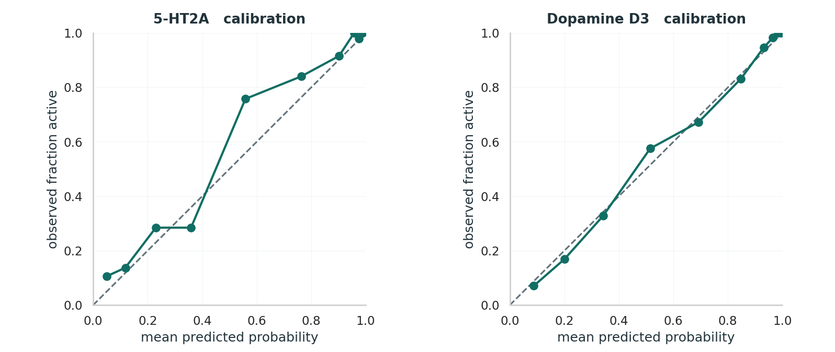
VIRTUAL SCREENING
Are the predicted probabilities honest?
Scaffold split at the 100 nM cut-off. Mean predicted probability against the observed fraction active, with the identity line.
On the line means the number is trustworthy. When the model says 80% active, about 80% are. D₃ tracks the diagonal almost exactly. This is the one property neither MCC (0.635 / 0.632) nor enrichment can test: both are threshold or ranking metrics.
MSc Molecular & Medical Biotechnology · University of Verona
27
Notes:
Filippo asked for the classification equivalent of the regression diagnostics, and calibration is the right one because it is the direct counterpart of the predicted-versus-experimental plot: mean predicted probability on the x-axis, observed fraction active on the y-axis, and the identity line. Points on the line mean the probabilities are trustworthy numbers, so when the model says eighty per cent active, about eighty per cent really are. Dopamine D3 tracks the diagonal almost exactly; 5-HT2A shows mild under-confidence in the middle of the range, between roughly 0.4 and 0.6, involving relatively few compounds. Why this matters: it is the one property that neither MCC nor enrichment factor can test. MCC is a threshold metric and enrichment is a ranking metric, and a model can score well on both while producing probabilities that mean nothing. If asked about separation of the two classes, that is what the MCC of 0.635 and 0.632 and the confusion matrix on the previous slide already establish, so I do not repeat it here.

Slide 29
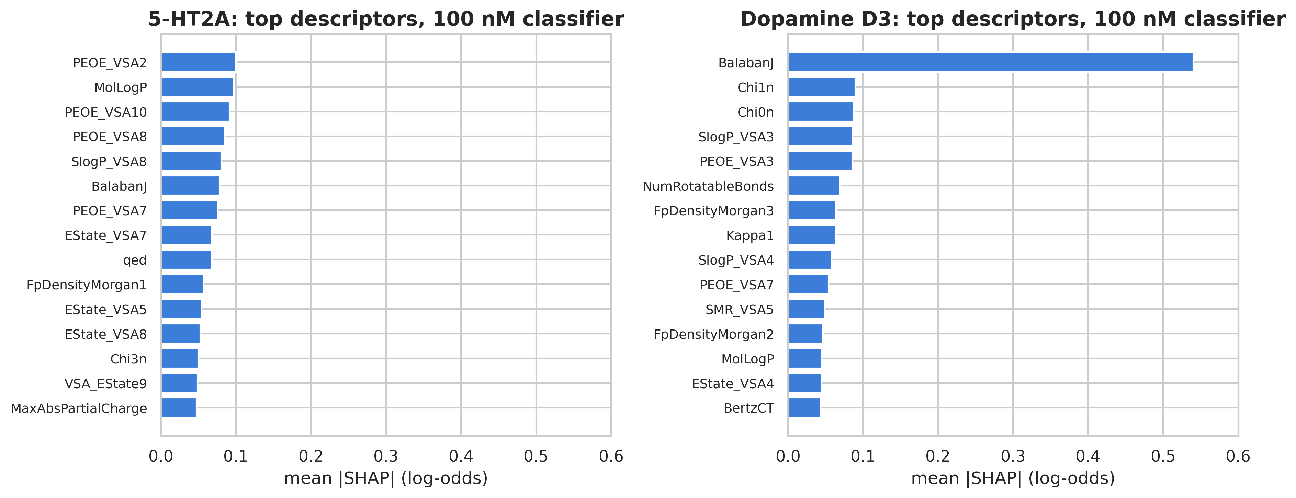
INTERPRETATION
What the classifier keys on
Rank correlation with the regression SHAP: 0.90 and 0.87. The same chemistry drives the category call and the continuous prediction, so the interpretation is a property of the data rather than of the loss function. Charge-binned surface areas lead for 5-HT₂A; for D₃, Balaban J alone carries 18 per cent of the attribution. Values are in log-odds, so ranks are comparable to the regression figure but magnitudes are not.
MSc Molecular & Medical Biotechnology · University of Verona
28
Notes:
SHAP applied to the classifier. First, what the axis is: for a classifier the tree contributions sum to the margin in log-odds, not to a probability, because the sigmoid comes afterwards and is not additive. So the ranking is comparable to my regression SHAP figure but the magnitudes are not, and I have labelled the axis accordingly. The headline is agreement. Across all 200 named descriptors the Spearman rank correlation between the regression and classification attributions is 0.90 for 5-HT2A and 0.87 for D3, and ten out of ten of the regression top-ten remain in the classifier top-twenty for 5-HT2A. That matters because it means the interpretation is not an artefact of choosing squared error: ask the model a different question and it leans on the same chemistry. The receptor contrast survives too. 5-HT2A is dominated by PEOE_VSA terms, which are surface areas binned by partial charge, with lipophilicity behind them. D3 is dominated by Balaban J, a topological branching index, which alone carries 18 per cent of the total attribution and is six times the next descriptor. If asked whether the charge terms recover the salt bridge: the two largest do run in the expected direction, negative-charge surface pushing toward inactive and positive toward active, but I checked all fourteen charge bins and there is no monotonic trend, so I would not claim the model recovered the mechanism. It has learned something more specific than cations bind better.

Slide 30
VIRTUAL SCREENING
The same controls, on the classifier
Everything the regression models were put through was repeated for the 100 nM classifier, so this section is held to the same standard as the rest of the work.
Representation
Chance fitting ruled out
Read-across baseline
Same ordering as regression: fused best or tied. ECFP4 0.629 / 0.629, descriptors 0.604 / 0.585, fused 0.632 / 0.633.
MCC collapses to a null centred on zero (mean +0.02 and −0.00 over 100 permutations, best case 0.17 and 0.14) against 0.68 and 0.67 for the true labels on the same split. p = 0.0099; no permutation came close.
MCC 0.574 and 0.551 against the models 0.632 and 0.633. A real but modest margin of 0.06 and 0.08.
And a fourth check: removing the promiscuous compounds leaves MCC at 0.66 and 0.63. The same ablation run on the regression models gives R² 0.58 and 0.67, so both tasks agree. On the read-across margin, the models beat nearest-neighbour lookup by 0.06 and 0.08 MCC. That margin is narrower than on regression, and expectedly so: a compound and its closest structural neighbour usually fall on the same side of a 100 nM threshold, so lookup is already strong there. The classifier still beats it, on every one of the four checks.
Same scaffold split, same 12 partitions, same 100 permutations as the regression controls.
MSc Molecular & Medical Biotechnology · University of Verona
29
Notes:
This closes the classification section, and the point of the slide is that this section was held to the same standard as the main one. All three controls from the regression section were repeated. Representation: the same ordering, fused best or tied, ECFP4 0.629 and 0.629, descriptors 0.604 and 0.585, fused 0.632 and 0.633. Y-randomisation: MCC collapses to a null centred at zero: mean plus 0.02 and minus 0.00 over 100 permutations, best case 0.17 and 0.14, against 0.68 and 0.67 for the true labels on that same split, giving p equals 0.0099. These are single-split values from one scaffold partition, which is what a permutation test needs; the twelve-split means are 0.635 and 0.632. Note that the MCC null sits at zero rather than below it, because MCC is defined so chance equals zero, whereas R-squared can go negative. Read-across: MCC 0.574 and 0.551 against the models 0.632 and 0.633. And that last one is the number I would volunteer rather than wait to be asked. On regression the models beat nearest-neighbour lookup by about 0.2 R-squared, a 48 to 62 per cent gain. As a classifier the margin narrows to 0.06 and 0.08 MCC, only 10 to 15 per cent. The reason is that thresholded classification is an easier task: a compound and its closest structural neighbour usually fall on the same side of a 100 nanomolar cut-off, so lookup is already strong. Predicting the actual affinity value is where the model earns its keep, and that is precisely why I lead with regression and treat this whole section as a screening view rather than the headline.

Slide 31
LIMITATIONS
What this work does not establish
Pooled Ki labels
Two targets only
2D representation
Ki values come from many assays and laboratories. Inter-laboratory reproducibility is only ~0.5 log units, which sets a floor on achievable error.
5-HT₂A and D₃ were chosen for data density. The pipeline is general, but the numbers are not yet shown to transfer across the receptor panel.
ECFP4 and 2D descriptors carry no explicit conformation or protein structure, so binding-mode effects are invisible to the model.
No external test set
Binder-only library
Scope of tuning and ablation
Validation is internal, albeit leakage-controlled and repeated. A prospective or external set would be the stronger claim.
Potency ranking within binders, not binder versus non-binder discrimination.
Hyperparameters are fixed sensible defaults, not per-fold tuned; nested CV would be the rigorous protocol. The promiscuity ablation covers the regression models only, not the classifiers.
MSc Molecular & Medical Biotechnology · University of Verona
30
Notes:
I want to own the limitations rather than be caught on them. Ki labels are pooled across assays and laboratories, and inter-lab reproducibility is only about half a log unit, which floors the achievable error. Only two targets, chosen for data density. The representation is 2D, so no conformation or protein structure. Validation is internal and leakage-controlled but there is no external or prospective test set. The library is binder-only. And hyperparameters are sensible defaults rather than nested-CV tuned. Each of these is a concrete next step rather than a flaw I am hiding.

Slide 32
CONCLUSIONS
Contributions and next steps
A curated clinical-stage GPCR ligand dataset that did not exist in this form: 719 molecules, 3,011 records, characterised across fifteen descriptors.
As a virtual screen, the strongest result: MCC 0.63 on both receptors, with top-1% enrichment at 98% of its achievable ceiling and honest probabilities.
Underneath it, a leakage-controlled affinity model at scaffold R² 0.56–0.64, with chance, baseline and robustness controls behind every number.
SHAP shows the two receptors are driven by different property families: charge for 5-HT₂A, molecular topology for D₃.
The contribution is not a record score. It is a number that survives a scaffold split, a permutation test, a nearest-neighbour baseline and a promiscuity ablation. Most single-target QSAR results are reported without any of the four. An MCC above 0.6 under those conditions is worth more than a higher figure obtained without them.
Where this goes next
Extend across the receptor panel; move to three-dimensional or structure-aware representations; add inactive data so a genuine binder-versus-decoy screen becomes possible. The most direct next experiment: train on preclinical only, test on the held-out clinical set.
MSc Molecular & Medical Biotechnology · University of Verona
31
Notes:
To conclude. The headline result is the screening view: MCC of 0.63 on both receptors at the 100 nanomolar cut-off, with top-one-per-cent enrichment at about 98 per cent of its achievable ceiling and probabilities that are calibrated rather than merely ranked. An MCC above 0.6 is a good classifier by any standard, and it survives four separate controls: a scaffold split, a permutation test, a nearest-neighbour baseline and a promiscuity ablation. Underneath it sits the affinity model at R-squared 0.56 to 0.64, which is the honest number for predicting a continuous value on unseen chemotypes, and the SHAP analysis showing the two targets are driven by different property families. Going forward, the way past the single-target ceiling is multitask learning across the receptor panel and bringing in three-dimensional structural information. Thank you to Prof. Giorgetti, to Filippo Baldessari, to the professors of the programme, and to my family. Happy to take questions.

