Slide 1
Final Project Demo
Group1:陳維仁、曾靖渝、袁維澤

Slide 2
Outline
‧Implementation of classifier
‧Implementation of GAN

Slide 3
Implementation of classifier

Slide 4
Methodology & Evaluation
．Basically based on sample code
．Modify some parameters to improve performance
．We focus on what we’ve tried to increase accuracy

Slide 5
Methodology & Evaluation
First try:
increase the number of hidden layers
Result:
Little improvement(still not good enough , with accuracy 0.7~0.8)

Slide 6
Methodology & Evaluation
Second try:
increase training epochs from 20 to 25 , and increase the initial learning rate of Adam optimizer(to speed up)
Result:
At around 22nd training epoch , early stopping terminates the training process

Slide 7
Remove Early stopping
Purpose of Early stopping:
avoid overfitting
But what if …...
Notes:
There might be the case

Slide 8
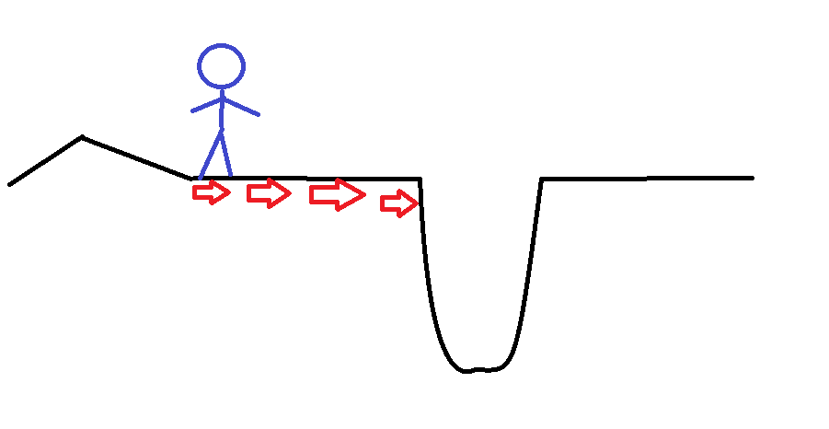
Remove Early stopping
loss
early stopping occurs
small learning rate-->small step
a better optimum

Slide 9

Remove Early stopping
After removing the Early stopping , and increasing the initial learning rate of Adam optimizer(we change the default setting)……
Result:
With accuracy 0.79~0.85

Slide 10
Can the classifier be better?
Yes!
The total number of images per class is over 60000 , we only take 2000!
Result:
With accuracy 0.95~0.97

Slide 11
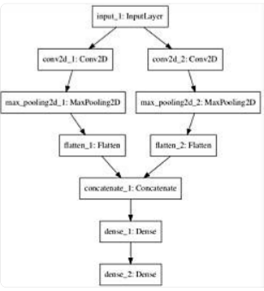
Can the classifier be better?
change the sequential model to non-linear mode
Result:
With accuracy only 0.56~0.6
-->We use the classifier of previous page as our final classifier

Slide 12
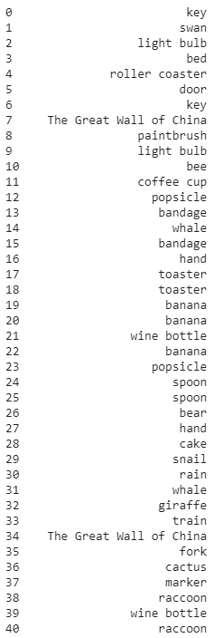
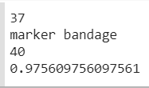
Test result

Slide 13
Demo result
Accuracy : 36/40

Slide 14
Implementation of GAN

Slide 15
Methodology
．Use DCGAN , one GAN for each class label
．Using some tips to better the performance of DCGAN

Slide 16
Methodology
1. Use Strided Convolutions
It is common to use pooling layers such as max-pooling layers for downsampling in convolutional neural networks.
In GANs, the recommendation is not to use pooling layers, and instead use the stride in convolutional layers to perform downsampling in the discriminator model.

Slide 17
Methodology
2. Remove Fully-Connected Layers
It is common to use fully-connected layers after feature extraction layers in convolutional layers as an interpretation of the extracted features prior to the output layers of the model.

Slide 18
Methodology
2. Remove Fully-Connected Layers
Instead, in GANs, fully-connected layers are not used, in the discriminator and the convolutional layers are flattened and passed directly to the output layer.

Slide 19
Methodology
3. Use Batch Normalization
Batch normalization standardizes the activations from a prior layer to have a zero mean and unit variance. This has the effect of stabilizing the training process.
Batch normalization has become a staple when training deep convolutional neural networks, and GANs are no different.

Slide 20
Methodology
4. Use ReLU, Leaky ReLU, and Tanh
Activation functions such as RELU are used to address the vanishing gradient problem in deep convolutional neural networks and promote sparse activations (e.g. lots of zero values).

Slide 21
Methodology
4. Use ReLU, Leaky ReLU, and Tanh
ReLU is recommended for the generator, but not for the discriminator model. Instead, a variation of ReLU that allows values less than zero, called Leaky ReLU, is preferred in the discriminator.

Slide 22
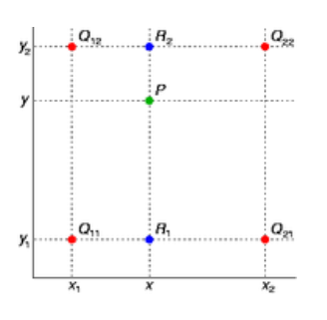
Image.BILINEAR
Can use the red points to get the green points
-->increase the resolution of the image

Slide 23
Methodology
Increase/Decrease the training data size based on class label
- 100000 for some labels
-200000 for others
-The reason will be given in the Discussion & Conclusion

Slide 24
Evaluation & Test result
-During training process of GAN , we save the generator every 1 ~ 3 epochs , and feed the generator into the classifier to perceive how many epochs the GAN has the best performance.

Slide 25
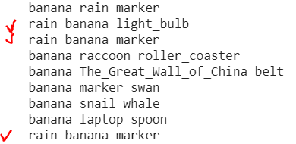
Evaluation & Test result
-Our classifier will list three most likely labels , we will use this to determine whether further training does better.
-Red pen represents further training may be better

Slide 26
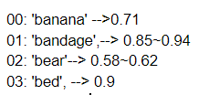
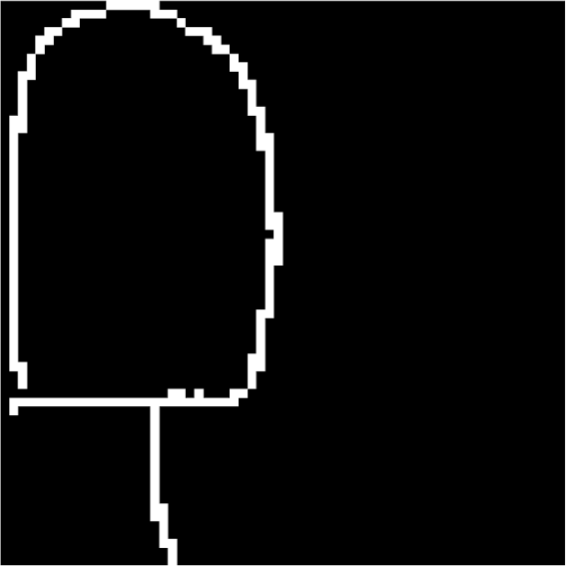
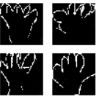
Evaluation & Test result
Accuracy returned by oue classifier

Slide 27
Demo result
Accuracy : 100/100 (0 subjective)

Slide 28
Discussion & Conclusion
-Easy image label(e.g. hand) → Every doodle drawing game players can draw perfectly(high quality data)
-->increase data size to 200000
-Difficult label(e.g. raccoon) →Many low quality drawings
-->decrease data size to 100000

