Slide 1
EasyMagpieTTS PyTorch Architecture
Conceptual model internals and inference pipeline Codex

Slide 2
Scope
This deck explains the EasyMagpieTTS model as it runs in PyTorch.
It intentionally does not focus on vLLM, Triton, TensorRT, or serving infrastructure.
The useful code anchors are:
nemo/collections/tts/models/easy_magpietts_inference.py
nemo/collections/tts/models/easy_magpietts.py
nemo/collections/tts/modules/magpietts_modules.py

Slide 3
One-Slide Mental Model
EasyMagpieTTS is a decoder-only TTS model.
It does not directly predict waveform samples.
It predicts discrete audio codec tokens across multiple codebooks.
A neural codec decoder turns those predicted codes back into waveform.
Context audio and context text provide speaker/style conditioning.
Text, phoneme, and audio streams are delayed and aligned so generation can run incrementally.

Slide 4
Class Split
EasyMagpieTTSInferenceModel
Owns the runtime architecture.
Contains codec, embeddings, decoder backbone, prediction heads, streaming state, and do_tts / infer_batch.
EasyMagpieTTSModel
Subclasses the inference model for training.
Adds process_batch, dataloaders, losses, validation inference, and logging.

Slide 5
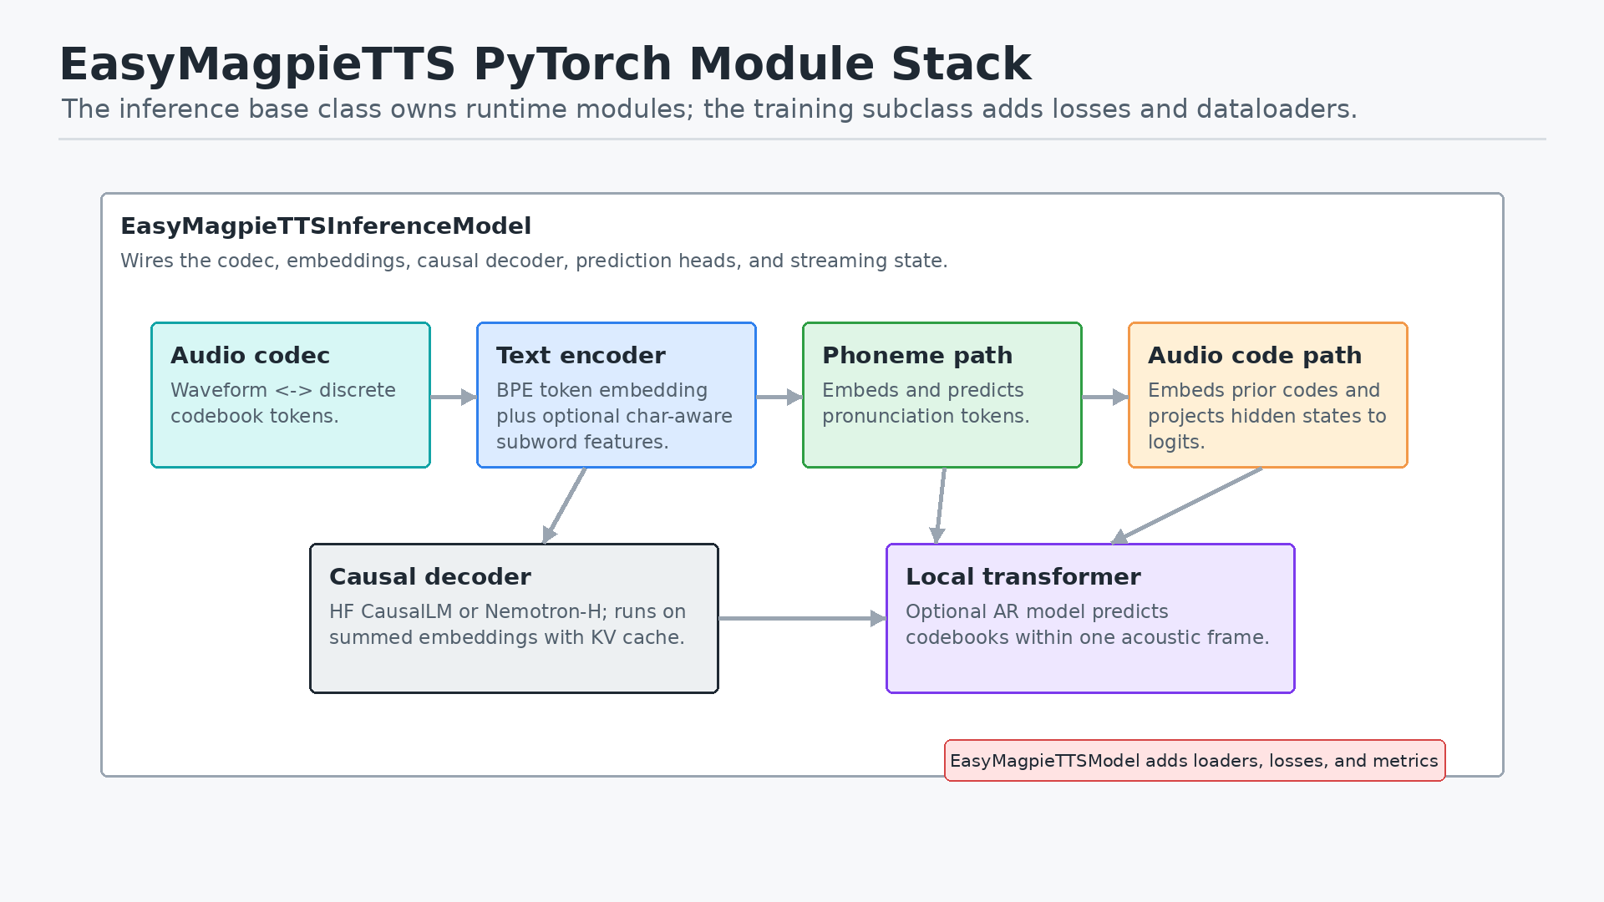
Module Stack

Slide 6
Core Idea: Audio as Tokens
The codec encoder maps waveform into codebook token sequences.
EasyMagpie predicts those token IDs, including BOS/EOS-style special tokens.
The codec decoder maps generated token sequences back to audio.
This makes TTS look like language modeling over acoustic tokens.

Slide 7
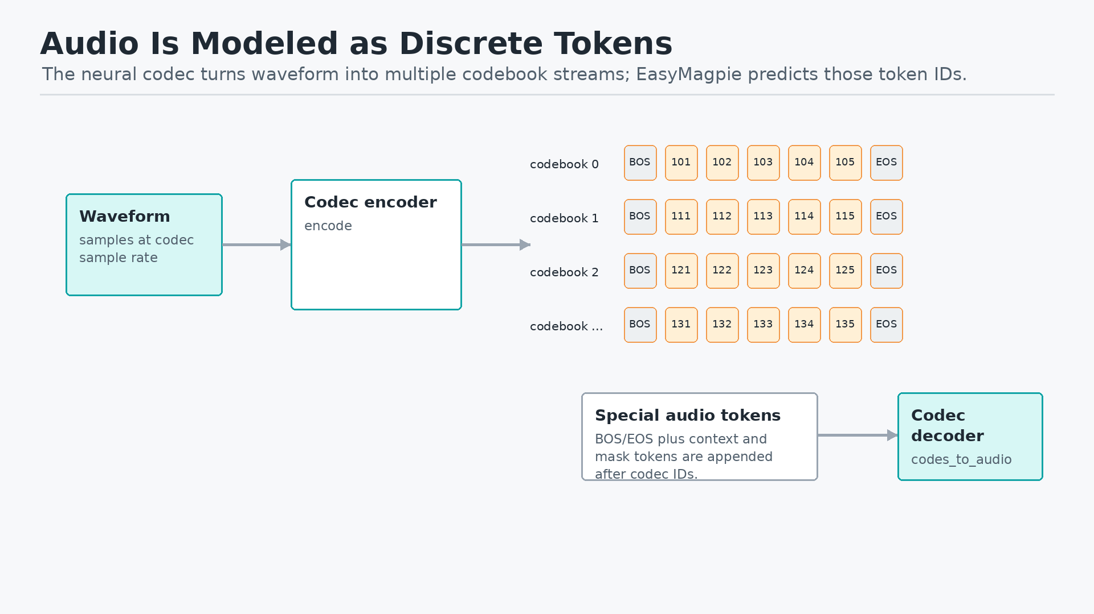
Audio Token Diagram

Slide 8
Inputs at Inference
Main text transcript becomes text tokens plus EOS.
Context text becomes a conditioning token sequence.
Context audio becomes discrete codec codes.
Optional ground-truth phoneme text can force the phoneme stream.
The model builds a batch and delegates to the same streaming machinery used for batched inference.

Slide 9
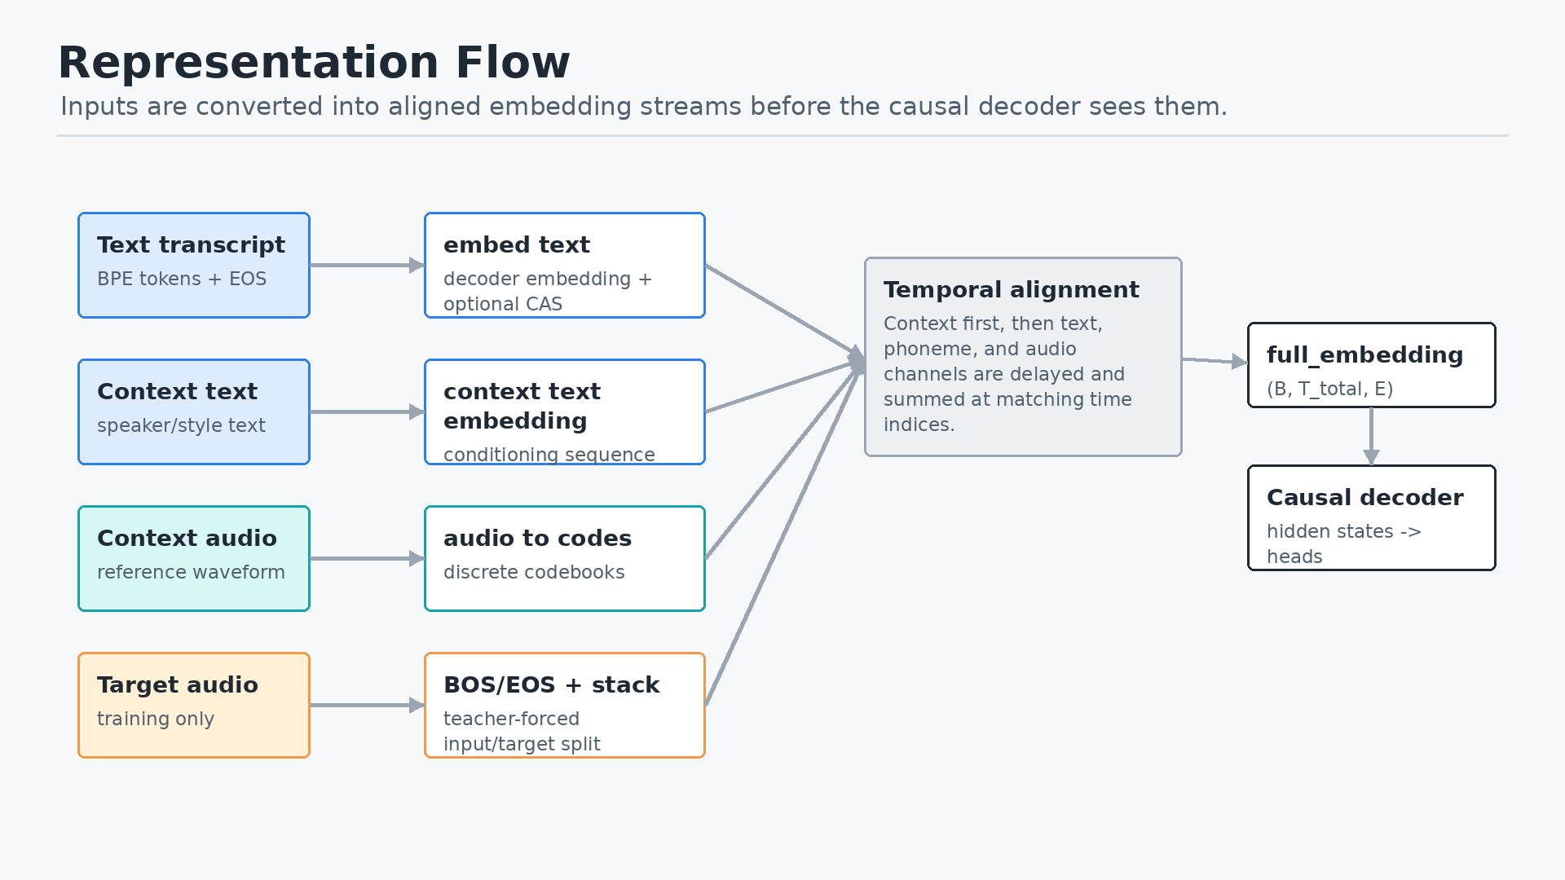
Representation Flow

Slide 10
Embedding Streams
Text tokens use the decoder token embedding table.
If configured, the char-aware subword encoder adds character-level subword information.
Audio tokens use per-codebook embeddings that are averaged and projected.
Phoneme tokens use their own embedding tables.
The model sums aligned stream embeddings instead of concatenating separate modalities at each step.

Slide 11
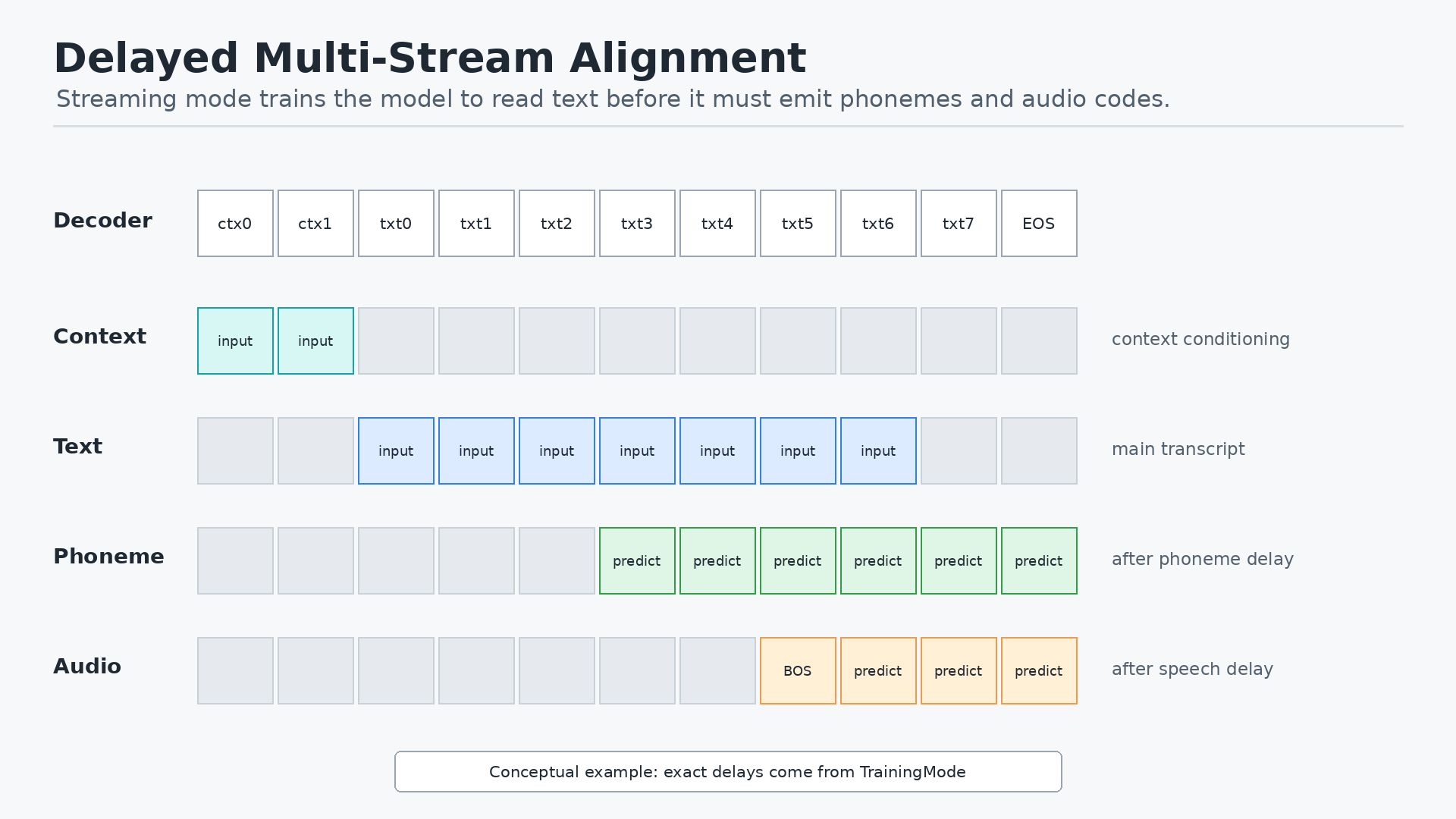
Delayed Stream Alignment

Slide 12
What the Delays Mean
TrainingMode defines whether text is full or streaming.
In streaming mode, text arrives first.
Phoneme prediction starts after streaming_phonemes_delay.
Audio prediction starts after streaming_speech_delay.
The delay creates a lookahead buffer so audio generation has enough text/phoneme context.

Slide 13
Decoder Backbone
The backbone is selected by config:
Hugging Face causal LM backend.
Nemotron-H backend.
The model calls the decoder with inputs_embeds, not just token IDs.
Streaming inference uses KV cache through past_key_values.
The backbone emits hidden states used by phoneme and audio-code heads.

Slide 14
Prediction Heads
Phoneme head
phoneme_final_proj maps decoder hidden states to phoneme-token logits.
In predicted mode, low-confidence phoneme steps can be replaced with UNK.
Audio-code head
audio_out_projection adapts decoder hidden size to audio embedding size.
final_proj maps to logits for all codebooks and special audio tokens.

Slide 15
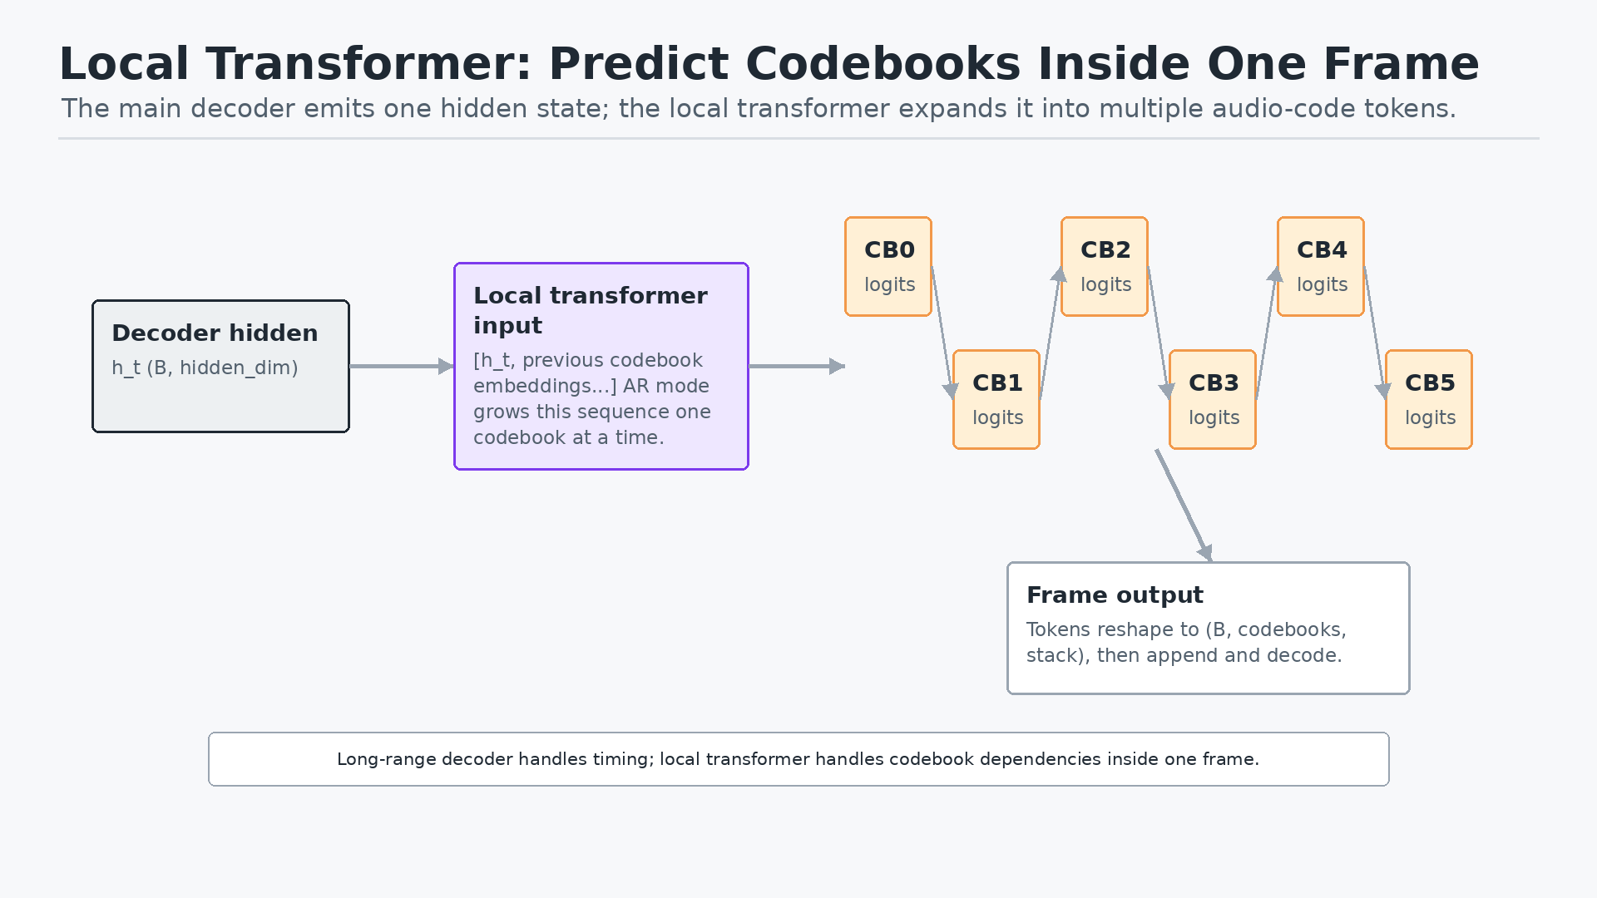
Local Transformer

Slide 16
Why the Local Transformer Exists
The main decoder models long-range text, phoneme, and acoustic timing.
One audio frame contains several codebook tokens.
Those codebooks are not independent.
The local autoregressive transformer predicts codebooks within a frame sequentially.
This lets the global decoder advance one frame at a time while still modeling codebook dependencies.

Slide 17
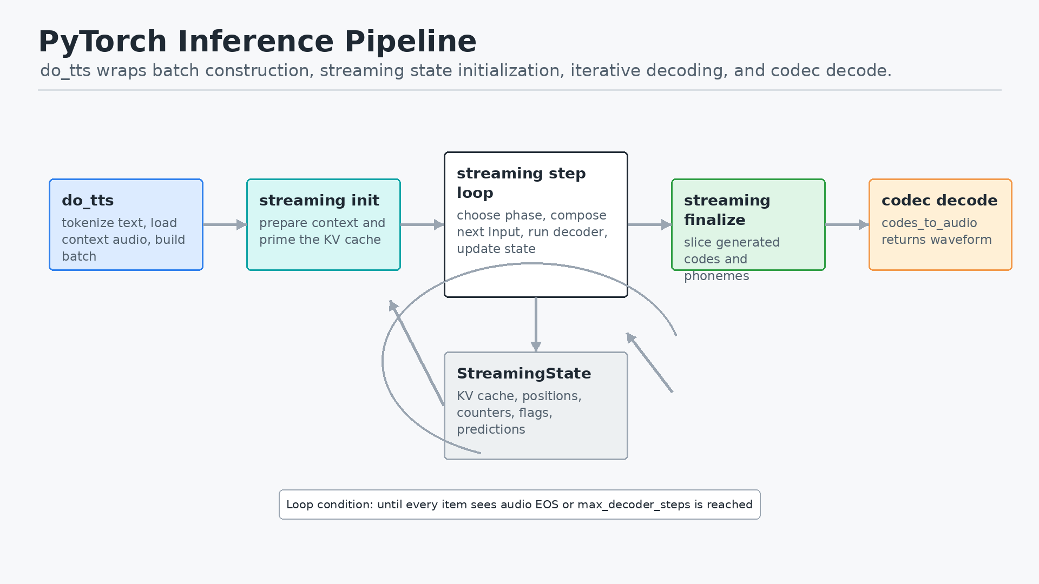
PyTorch Inference Pipeline

Slide 18
Streaming State Machine
Context phase: consume remaining context embeddings.
Prompt phase: consume early text before any predictions are emitted.
Phoneme-only phase: predict phonemes before audio starts.
Audio phase: predict phonemes and audio codes until audio EOS or max_decoder_steps.
Finalize: slice valid codes, unstack if needed, and decode with the codec.

Slide 19
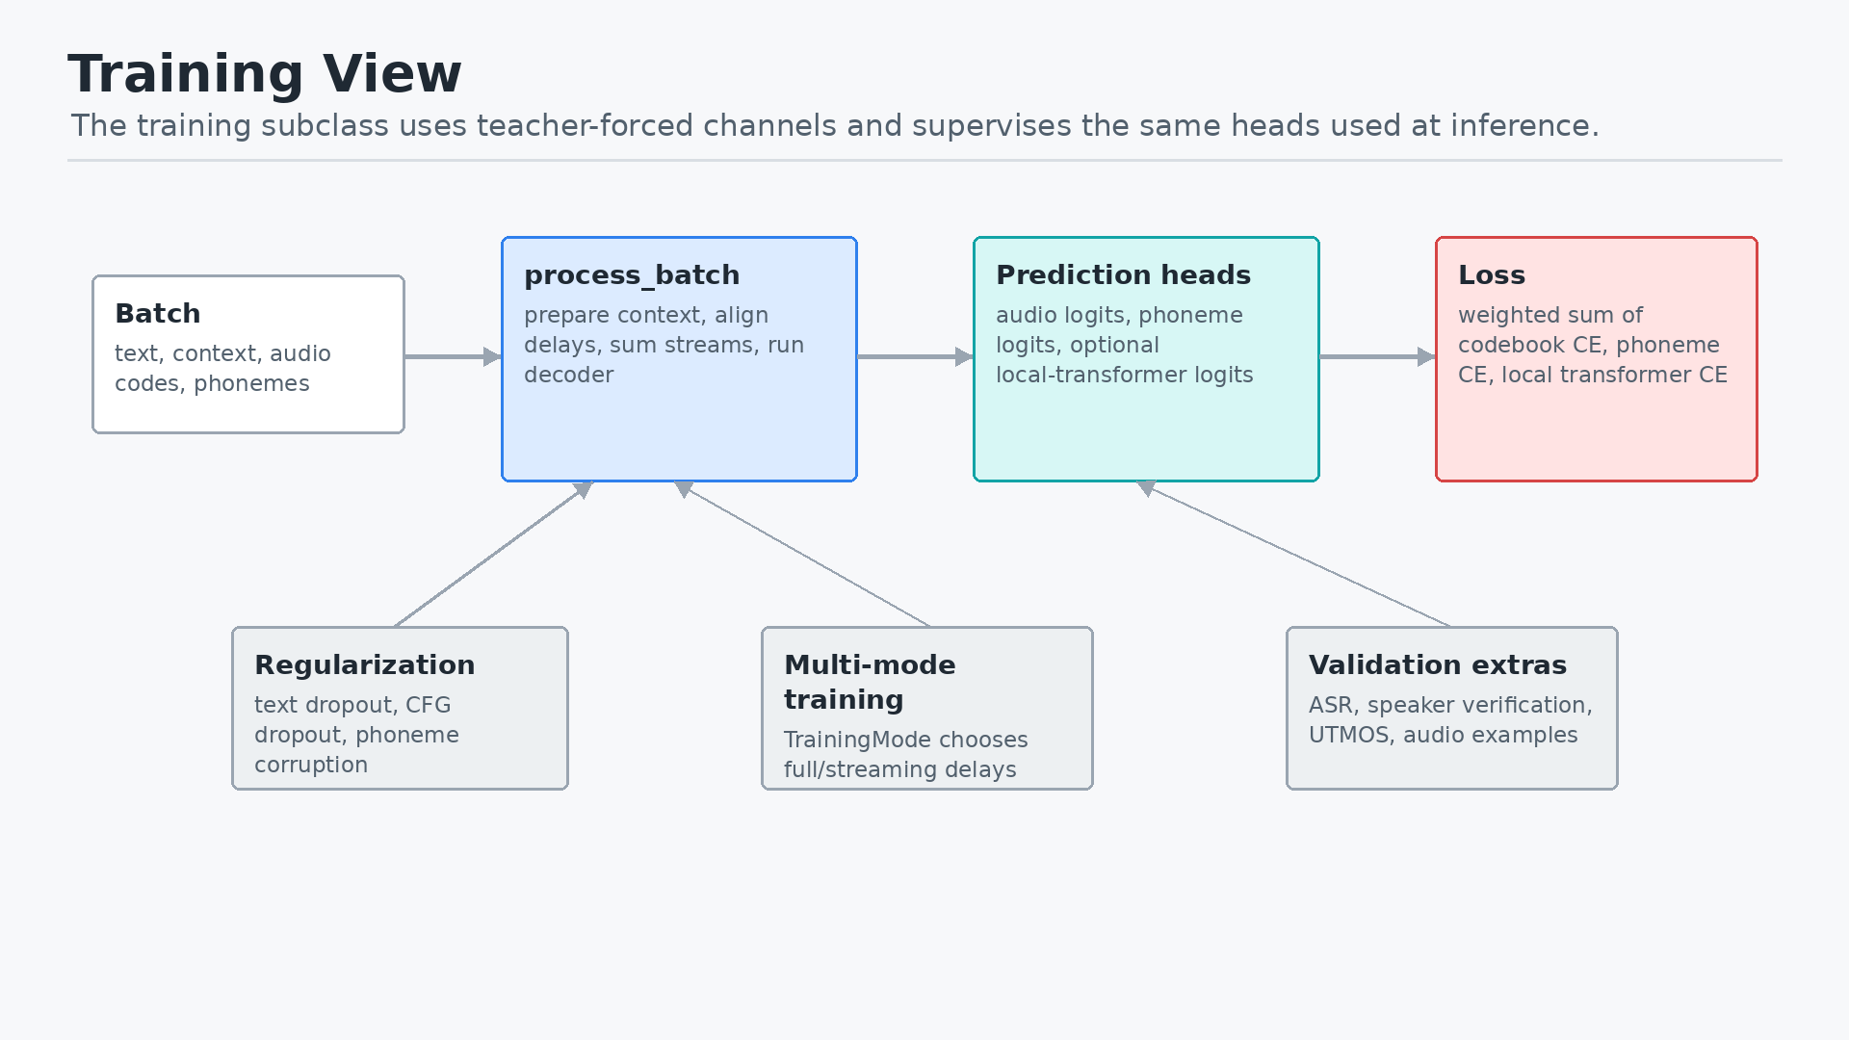
Training View

Slide 20
Losses
Audio codebook CE supervises the main audio-code projection head.
Phoneme CE supervises the phoneme prediction head when phoneme tokens exist.
Local transformer CE supervises the per-frame codebook predictor when enabled.
Total loss is a weighted sum controlled by config:
parallel_codebook_loss_scale
phoneme_loss_weight
local_transformer_loss_scale

Slide 21
Training Regularization
Text dropout makes the model less brittle to transcript conditioning.
CFG conditioning dropout trains unconditional context behavior.
Phoneme corruption makes audio generation robust to imperfect predicted phonemes.
Multi-mode training lets the same model learn different text/delay regimes.

Slide 22
Shape Cheat Sheet
Text tokens: (B, T_text)
Context audio codes: (B, C, T_context)
Embedded sequence: (B, T_total, E)
Decoder hidden states: (B, T_total, hidden_dim)
Audio logits: (B, T_audio, C * vocab_per_codebook)
Generated audio codes: (B, C, T_audio_frames)
Decoded waveform: (B, num_samples)

Slide 23
Presenter Narrative
Start with the codec: “The model speaks by predicting codec tokens, not waveform.”
Then explain conditioning: “Reference audio and context text anchor voice and style.”
Then explain alignment: “Text, phoneme, and audio are delayed streams summed into one decoder input.”
Then explain inference: “A streaming state object feeds one embedding step at a time through a causal decoder.”
Then explain quality/control: “The phoneme path and local transformer make token generation more structured.”
Close with training: “The same heads are teacher-forced and supervised with cross-entropy.”

Slide 24
Takeaways
EasyMagpieTTS is best understood as codec-token language modeling for speech.
The PyTorch model is a multimodal embedding composer plus a causal decoder.
Streaming works because the model maintains explicit phase counters and KV cache.
The local transformer handles short-range dependencies among codebooks inside each frame.
The codec decoder is the final waveform renderer.

