Slide 1
EasyMagpieTTS on vLLM-Omni + Triton
Architecture, artifact preparation, and inference pipeline Codex

Slide 2
What We Built
Ported EasyMagpieTTS from NeMo artifacts into a vLLM-Omni runtime.
Served the autoregressive TTS model and codec decoder through Triton.
Built the missing TensorRT codec engine.
Baked a default English speaker embedding.
Validated an end-to-end gRPC request returning 22.05 kHz audio.

Slide 3
Starting Inputs and Final Outputs
Inputs
EasyMagpieTTS .nemo checkpoint
Spectral codec .nemo
Phoneme tokenizer
English context audio sample
Outputs
easymp_vllm_model/
codec.onnx
model_repository/codec/1/model.plan
speaker_embeddings/eng.pt
Triton model repository serving easymp + codec

Slide 4
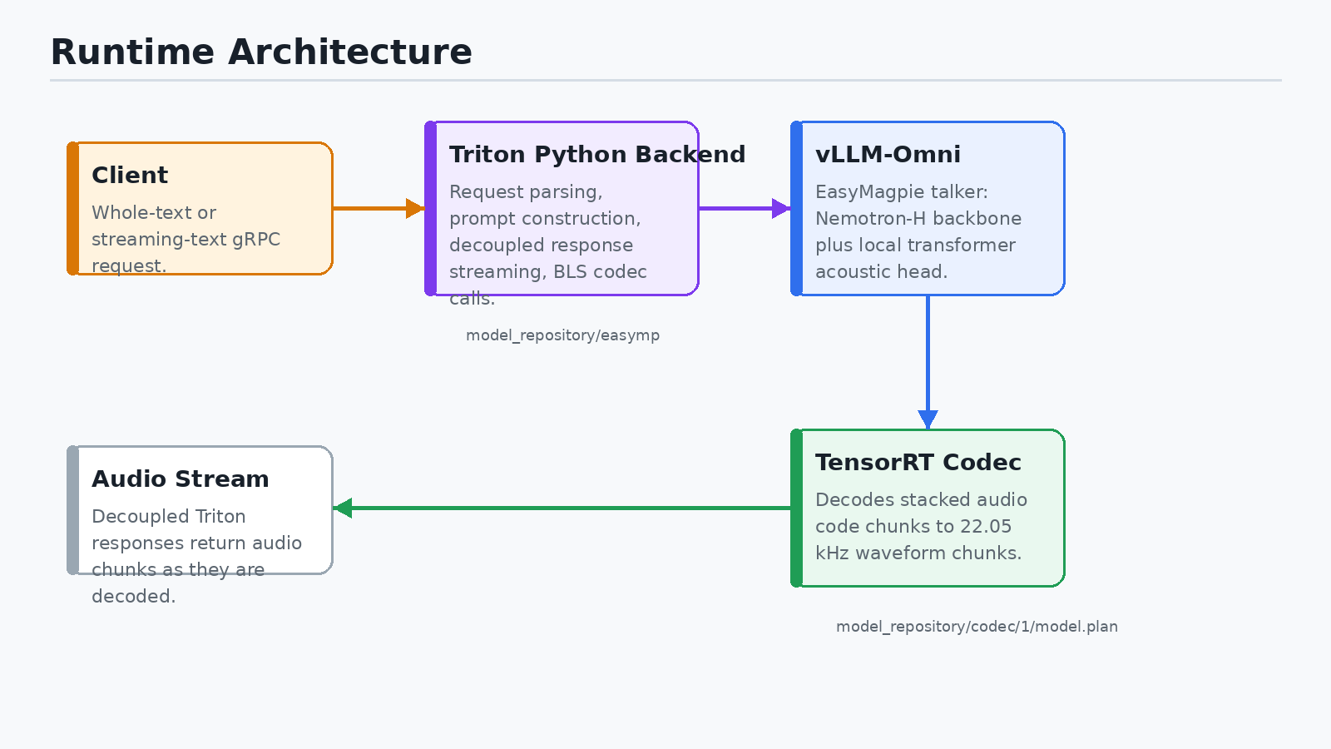
Runtime Architecture

Slide 5
Runtime Architecture: Key Ideas
Triton owns the service boundary and response streaming.
The Python backend is the orchestration layer.
vLLM-Omni runs the EasyMagpie autoregressive acoustic-code generator.
TensorRT runs codec decoding as a separate Triton model.
Triton BLS calls connect generated code chunks to codec decode calls.

Slide 6
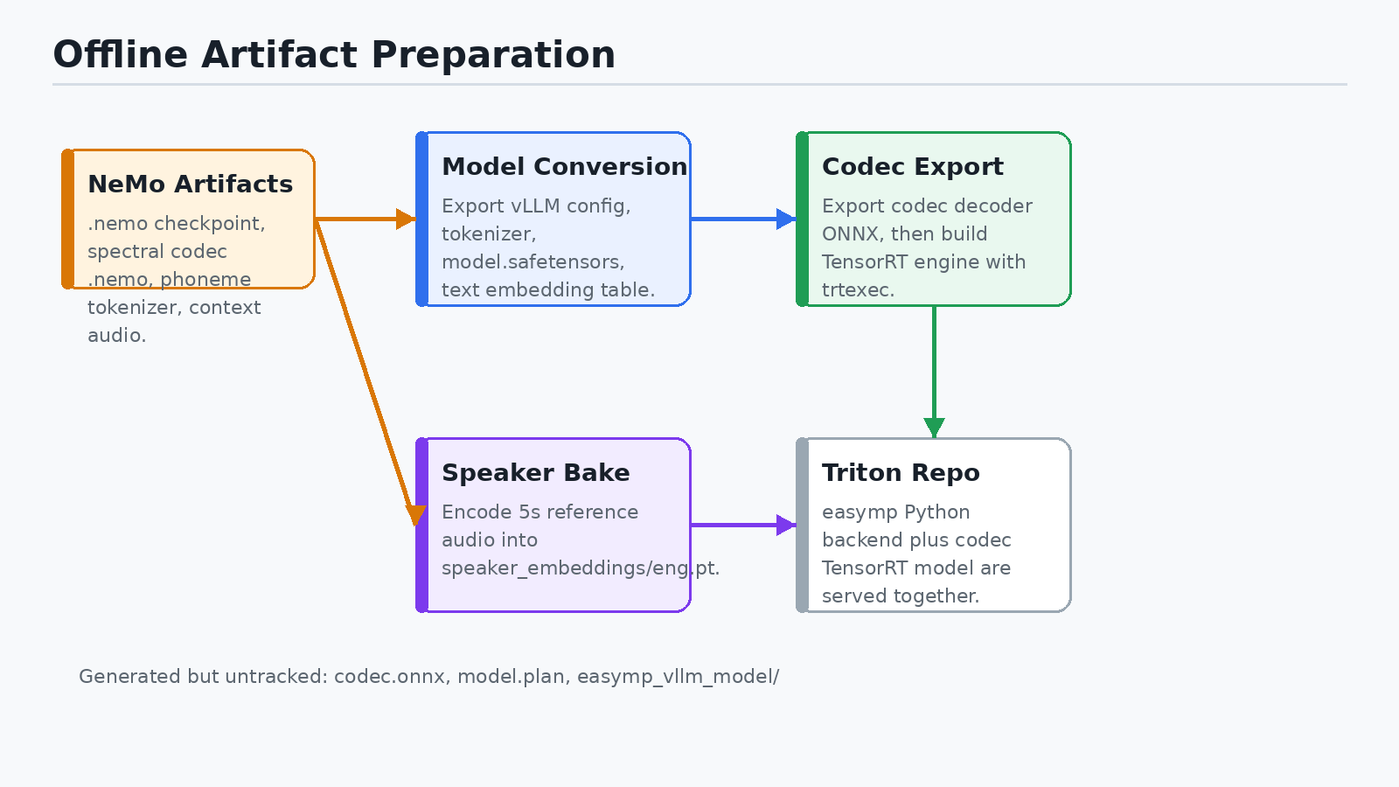
Offline Artifact Preparation

Slide 7
Artifact Preparation: What Changed
Conversion scripts were patched to run from the local checkout.
Heavy NeMo imports were made lazy so --help and test collection stay light.
CPU restore was made viable through map_location.
The .nemo checkpoint was converted into a Hugging Face/vLLM-style model directory.
The codec decoder was exported to ONNX, then compiled to TensorRT.

Slide 8
EasyMagpie Model Inside vLLM-Omni
Backbone
Nemotron-H decoder
Mamba/attention hybrid layers
Runs through vLLM’s compiled model executor
TTS-specific heads
Local autoregressive transformer
Multi-codebook acoustic token generation
Phoneme/text/audio stream delay semantics
Conditioning
Text tokenizer and baked text embedding lookup
Known speaker embedding loaded from speaker_embeddings/eng.pt
Context text defaults to [EN]

Slide 9
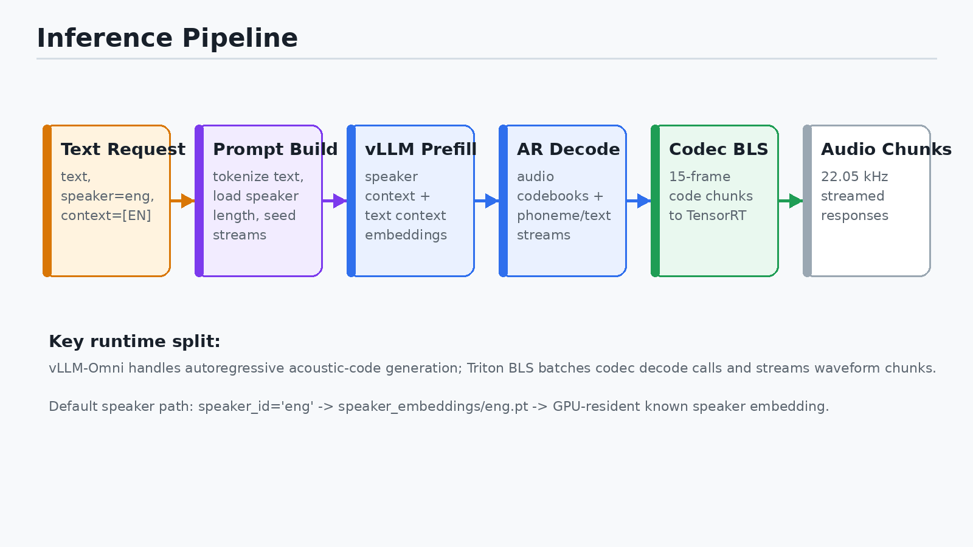
Inference Pipeline

Slide 10
Whole-Text Request Flow
Client sends text to Triton gRPC.
Python backend selects speaker id eng and context text [EN].
Backend builds prompt length and sampling metadata.
vLLM-Omni generates stacked audio-code tokens.
Backend chunks codes into 15-frame codec windows.
TensorRT codec model decodes codes into waveform chunks.
Triton decoupled responses stream audio back to the client.

Slide 11
Speaker Embedding Path
Problem
The Triton config defaulted to speaker=eng.
The converted model had no speaker_embeddings/eng.pt.
First request reached the model, then failed at speaker resolution.
Fix
Used context_audios/audio_context_samples/english_audio_context_samples/Emma_Additional.flac.
Loaded the NeMo EasyMagpie model in a disposable NeMo/Riva container.
Called the existing extract_speaker_embedding() helper directly.
Saved speaker_embeddings/eng.pt with shape (64, 1536).

Slide 12
Codec Path
ONNX stage
Codec decoder exported as codec.onnx.
Graph input: stacked model codes.
Clamp, unstack, index conversion, and decode are baked into the graph.
TensorRT stage
Built model.plan from codec.onnx.
Static frame profile: 15 model frames.
Batch profile: 1 / 8 / 32.
FP32 engine was used for the working serving path.

Slide 13
Triton Model Repository
model_repository/ easymp/ config.pbtxt 1/model.py codec/ config.pbtxt 1/model.plan
easymp
Python backend.
Starts vLLM-Omni.
Streams responses in decoupled mode.
codec
TensorRT plan backend.
Dynamically batches codec decode calls.

Slide 14
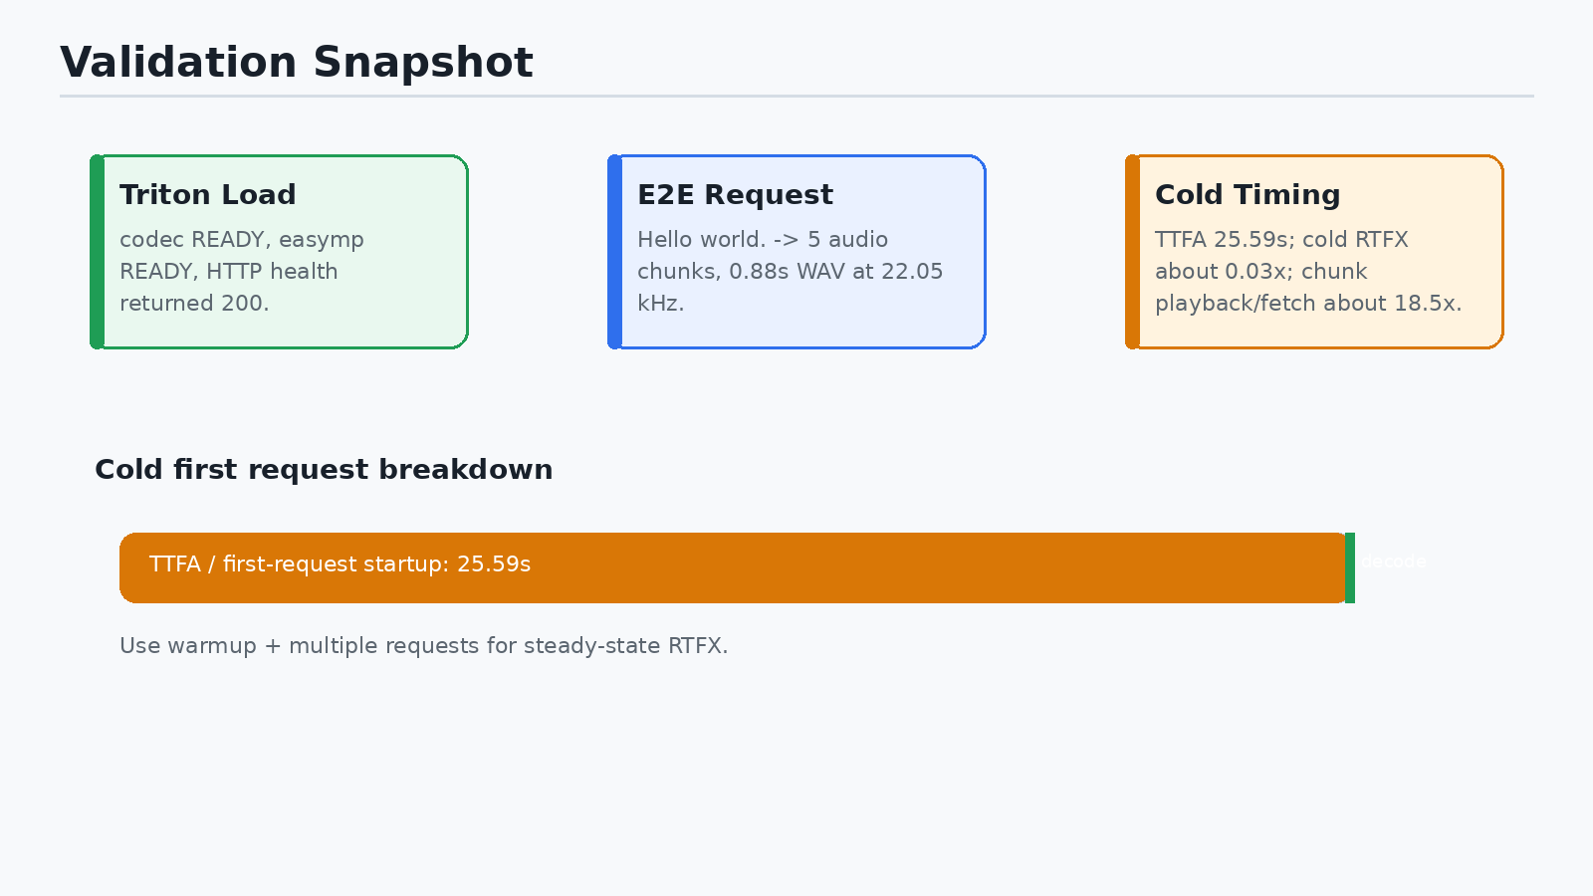
Validation Snapshot

Slide 15
Validation Details
Triton health endpoint returned HTTP 200.
codec reached READY.
easymp reached READY.
End-to-end request:
utt1 Hello world.
Result: 1 ok / 0 failed.
Output: /tmp/easymp_e2e_out/utt1.wav.
WAV: mono, 22.05 kHz, 16-bit PCM, 0.88 seconds.

Slide 16
Performance Interpretation
Cold first request
Audio duration: 0.88 seconds.
Wall time: 25.65 seconds.
TTFA: 25.59 seconds.
Cold RTFX: about 0.03x.
Why cold RTFX is misleading
First request includes vLLM/Triton JIT behavior and startup path costs.
Chunk fetch/playback factor after first audio was about 18.5x realtime.
Use warmup plus multiple requests for steady-state RTFX.

Slide 17
Operational Guardrails
Keep vLLM/vLLM-Omni isolated from the active NeMo development environment.
Do not kill unknown GPU processes.
Treat generated artifacts as large, untracked outputs unless explicitly approved.
Rebuild TensorRT plans when changing TensorRT/CUDA/runtime version.
Re-bake speaker embeddings when changing the default voice or reference audio.

Slide 18
Final Status
Completed
Docker runtime image built.
TensorRT codec plan built.
English speaker embedding baked.
Triton service validated.
End-to-end request returned audio.
Remaining useful work
Run warm steady-state benchmarks.
Add a clean embedding-only helper script.
Decide whether generated artifacts should be stored, uploaded, or ignored.
Test streaming-text mode separately from whole-text mode.

